Slide 1
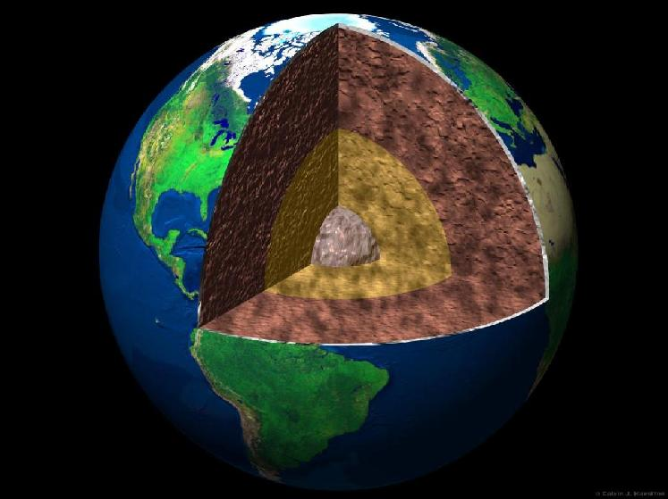
Earth Quiz

Slide 2
Which type of wave won’t travel through liquids?
compression waves
raptor waves
shear waves
circularly polarized waves

Slide 3
Certain types of seismic waves will not propagate through the outer core. This is convincing evidence that the outer core is
Molten or liquid
Metallic
Composed primarily of oxides, silicates, and other minerals
Exactly located at the center of the earth
Very dense

Slide 4
Seismic wave speeds generally increase with depth, but at a specific depth called the Mohorovicic discontinuity there is a sharp drop in speed. This is evidence that:
The chemical composition of the crust changes at this depth
The density of the crust changes sharply at this depth
The pressure changes sharply at this depth
The temperature and pressure at this depth allows partial melting of the minerals

Slide 5
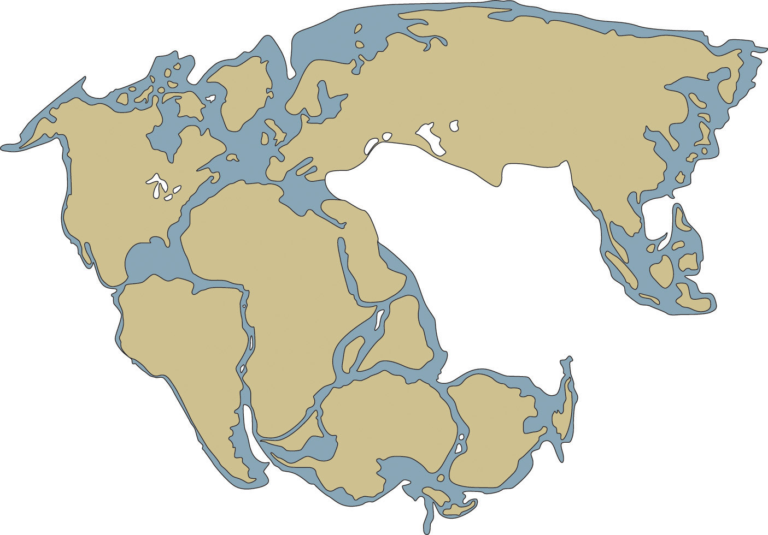
State 3 other pieces of evidence for Pangaea/plate tectonics
The puzzle piece evidence

Slide 6
The interior structure of Earth has been determined mostly from
Drilling
Exploration
X-Rays
Earthquake waves
Chemical analysis

Slide 7
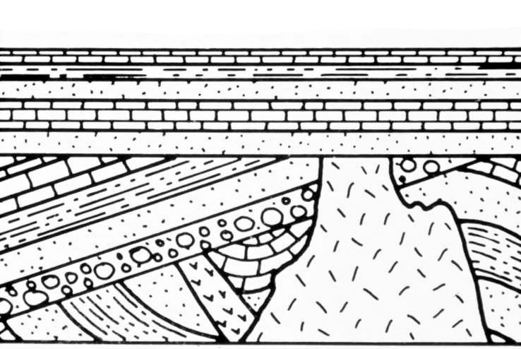
Which feature is the oldest?
A
C
B
D

Slide 8
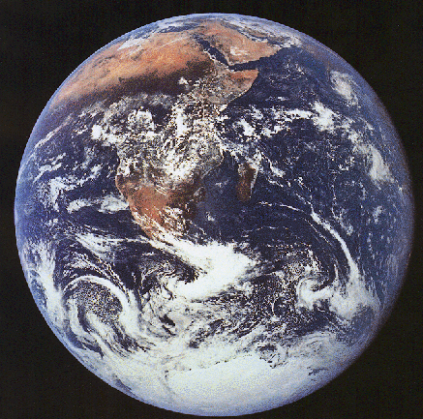
What is the estimated age earth and how do we postulate it?
13.7 billion yrs, Uranium-Lead dating
4.5 billion yrs, Various radiometric dating methods
4.5 million yrs, Carbon dating
6,000 yrs, Archbishop James Usher

Slide 9
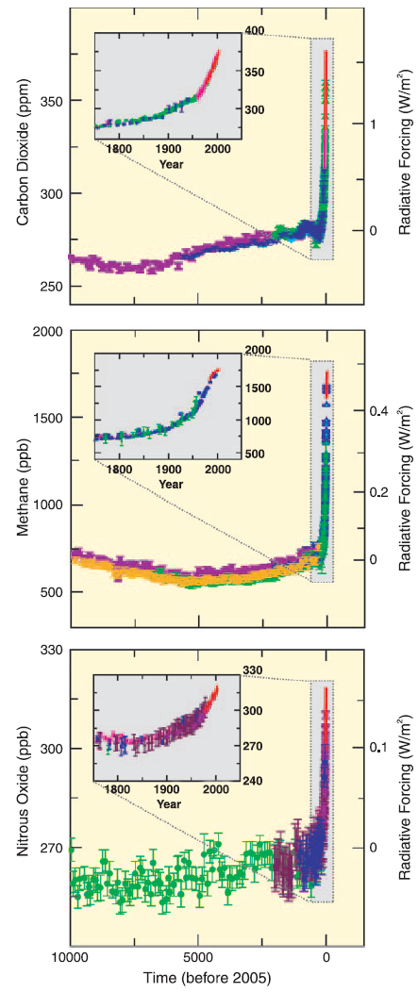
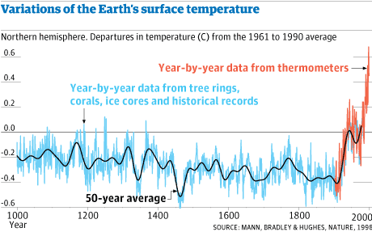
What are these famous graphs called?

