Slide 1
Rest of the semester
March 24 – Chapters 24 and 25
March 31 – Earth
April 7 – Astronomy
April 14 – Cosmology and final review
April 21 – Final, same format as midterm

Slide 2
Today - Earth
Next week - Astronomy
In 2 weeks - Cosmology
and review for final
April 21 - Final
in PS005 from 9am-11am

Slide 3
The final is…
Same format as midterm
  Half the questions from the midterm
  The other half from the last sections

Slide 4
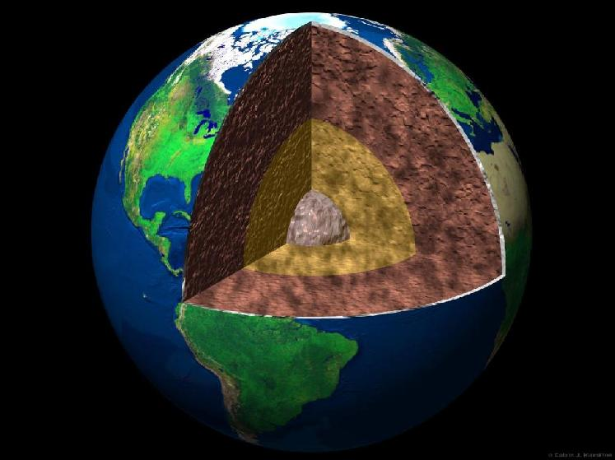
Earth

Slide 5
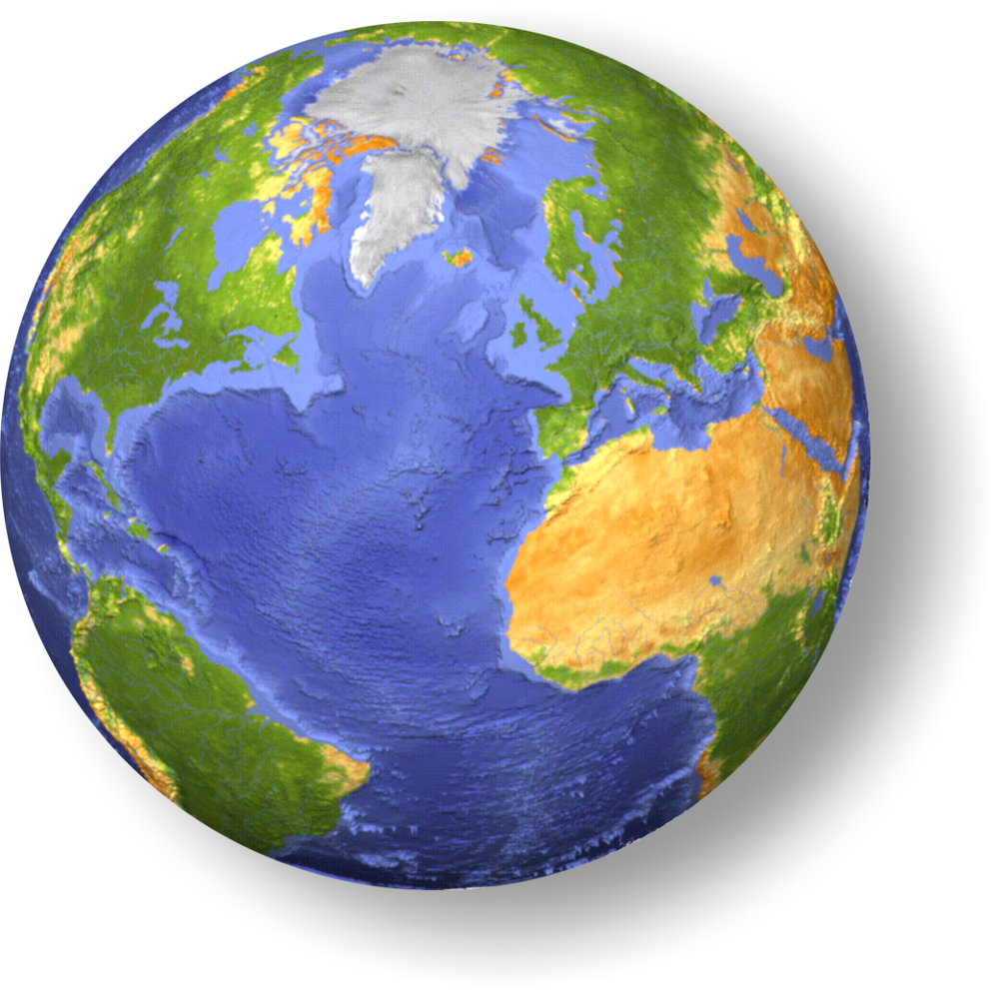
The size
8,000 Miles
Notes:
deepest hole I know about: 8 miles
weigh the earth--how mass is distributed
magnetic field: see strength and directions
earthquakes the best: waves diffract, reflect, and get absorbed

Slide 6

Perception of Earth’s size
Let’s say you cut a rope that goes around the world.
Notes:
deepest hole I know about: 8 miles
weigh the earth--how mass is distributed
magnetic field: see strength and directions
earthquakes the best: waves diffract, reflect, and get absorbed

Slide 7
Perception of Earth’s size
How far apart would the ends be?
Not to scale
Then lift the rope one foot above the surface around the whole earth
Notes:
deepest hole I know about: 8 miles
weigh the earth--how mass is distributed
magnetic field: see strength and directions
earthquakes the best: waves diffract, reflect, and get absorbed

Slide 8
Perception of Earth’s size
Before
After
~6.28ft
Notes:
deepest hole I know about: 8 miles
weigh the earth--how mass is distributed
magnetic field: see strength and directions
earthquakes the best: waves diffract, reflect, and get absorbed

Slide 9
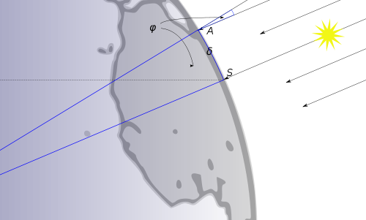
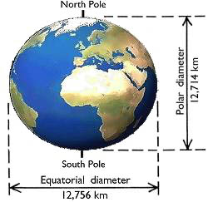
7 orders of magnitude different!
6.28319 ft << 20,925,700 ft
Eratosthenes' measurement of the Earth's circumference
However!
Notes:
deepest hole I know about: 8 miles
weigh the earth--how mass is distributed
magnetic field: see strength and directions
earthquakes the best: waves diffract, reflect, and get absorbed

Slide 10
Time Dependent Mass
Everyday the Earth collects ~100 tons of falling debris from space
The Earth is ~5,972,000,000,000,000,000,000 metric tons
5 sextillion, 9 hundred and seventy two quintillion metric tons
How much more massive will the Earth be after one million years?

Slide 11
Time Dependent Mass
How much more massive will the Earth be after one million years?
36,500,000,000 metric tons more massive
In one million years the Earth will be ~5,972,000,000,036,500,000,000 metric tons
7 orders of magnitude away from making a difference!

Slide 12
How do we know anything about the Earth’s Interior?
Direct Observations
Inferences from Meteorites
Evidences from Earth’s Mass & Density
Evidences from Seismology
Evidences from Earth’s Magnetic Field

Slide 13
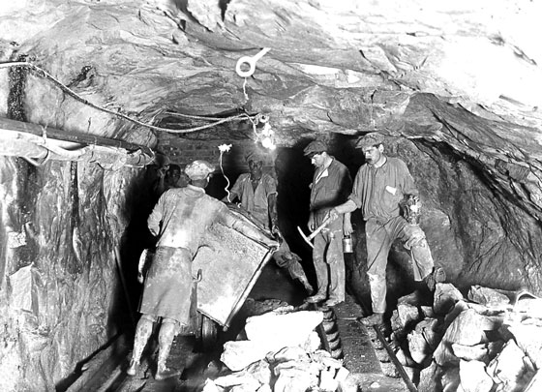
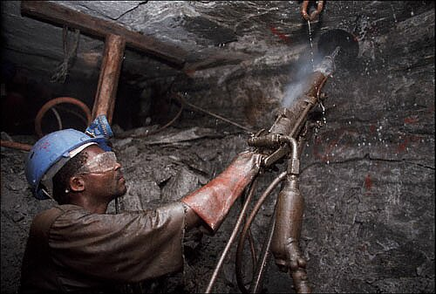
Digging a hole where people can go: a mine
World's deepest mine, 3585m (2.2 miles) below surface
1933, ½ mile
2005, ~2 miles

Slide 14
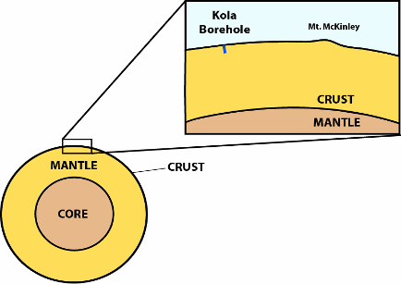
Drilling a hole
The deepest hole drilled = 12.26 km.
50km

Slide 15
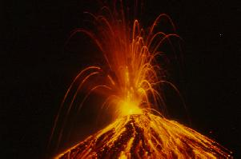
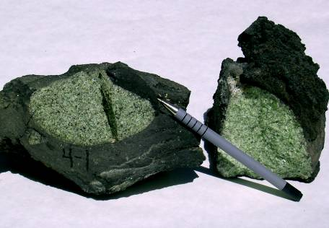
Direct Observations
  rock brought up in magma to the surface

Slide 16
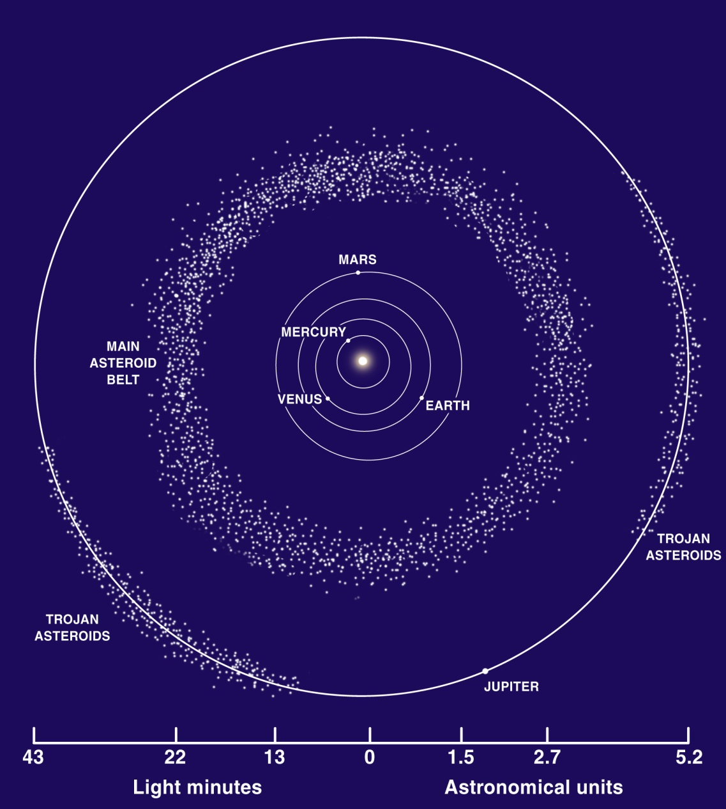
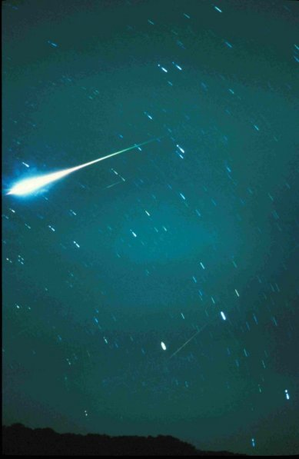
What is a Meteorite?
Meteorite: - chunk of rock from space that lands on earth. (“shooting star”)

Slide 17
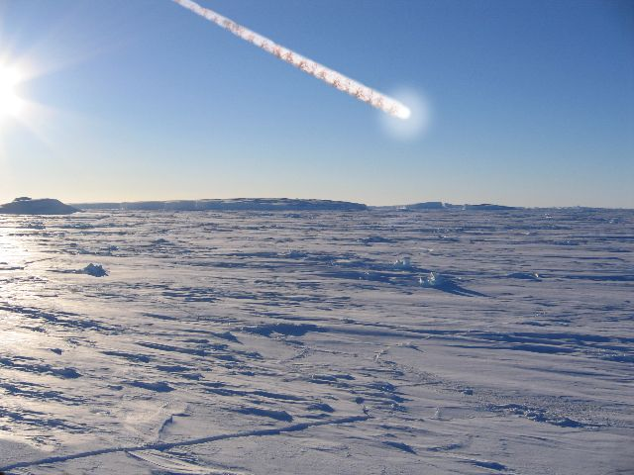
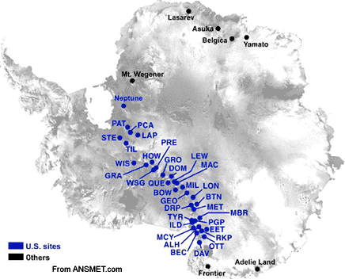
Where do you go to find meteorite?
Antarctica
Notes:
Well, meteorites fall on Antarctica as they do anywhere else. Unsurprisingly, most of the ones that fall there end up imbedded in ice. Ice flows, slowly. Most of it eventually ends up melting into the ocean, which is not very useful. However, there are a few areas in Antarctica which are "sinks" for ice, where flowing ice runs up against rock, is pushed upward, and gets steadily eroded by wind. Anything tough imbedded in that ice ends up sitting on the surface. The result is that meteorites collect on the surface there. Not only that, but Antarctica's near-total lack of liquid water and life means that they are in very nearly their original condition. This provides a very convenient way to collect large numbers of well-preserved meteorites.

Slide 18
Evidences from Earth’s Mass & Density
The mass of the earth is 6x10²⁴ kg
The volume of the earth is 1.1x10²¹ m³
Density of overall Earth is 5.5 g/cm³
  Granite has a density of ~2.7 g/cm³
    Continental Crust
  Basalt has a density of ~3.0 g/cm³
    Oceanic Crust
  Peridotite has a density of ~3.3 g/cm³
    This represents the rocks from the Upper Mantle
So, what does this tell us about the Earth’s Interior?

Slide 19
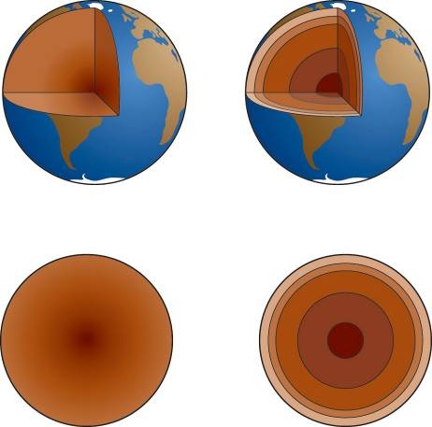
From density alone can we tell which of the models below is correct?
Gradually increasing density model
Layered density model

Slide 20
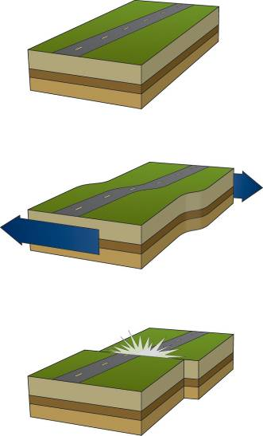
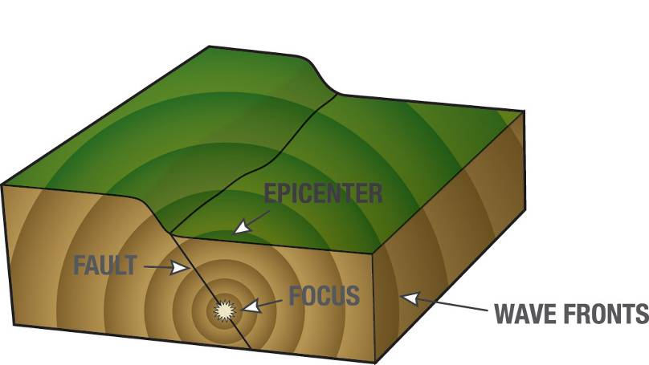
Evidences from Seismology
Elastic Rebound
Earthquakes produce waves, called seismic waves

Slide 21
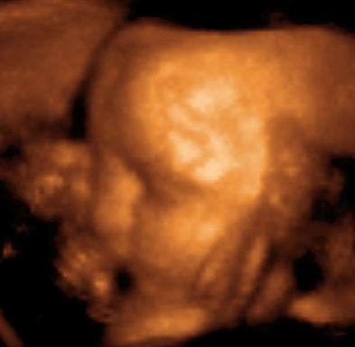

How can listening to vibrations tell us about interior of an object?

Slide 22
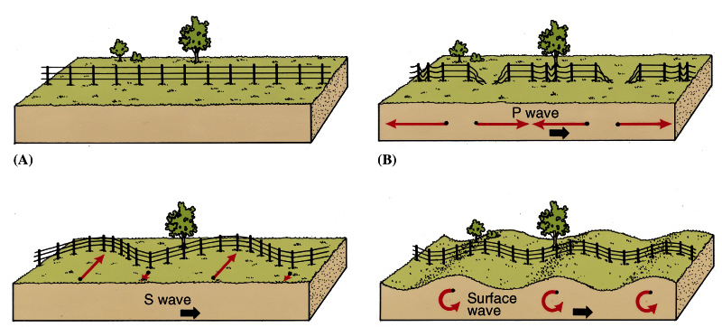
Types of Waves
Surface waves
  cause most of the damage and destruction
Volume waves
  compression waves
    primary (P) waves, arrive first
    travel through solids and liquids
  shear waves
    secondary (S) waves, arrive second
    will not travel through liquids

Slide 23
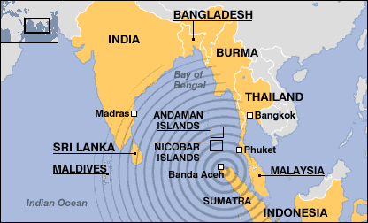
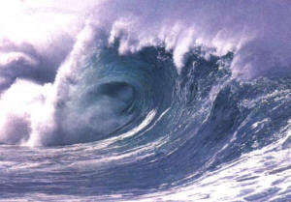
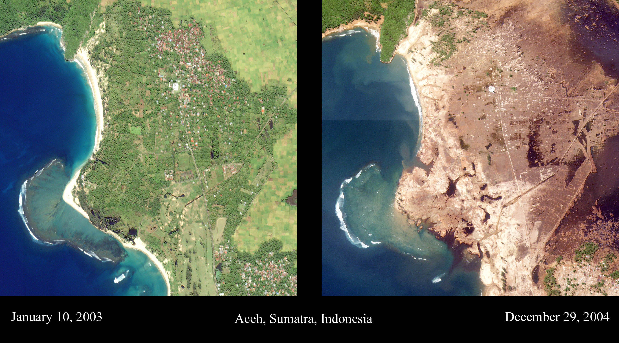
Surface waves can cause Tsunamis
Notes:
Evidence shows that the wave was about 10 meters tall.

Slide 24
Speed of Seismic Waves
P faster than S

Slide 25
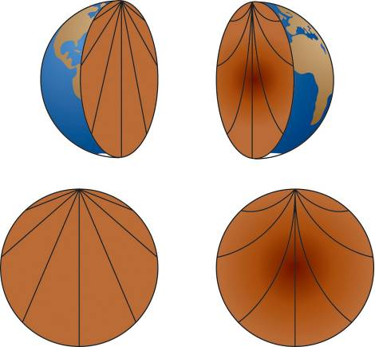
How would seismic waves travel through the different Earth density models?
Uniform density model
Gradually increasing density model

Slide 26
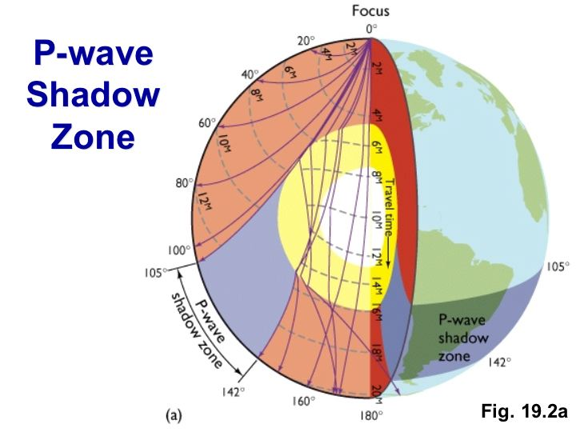
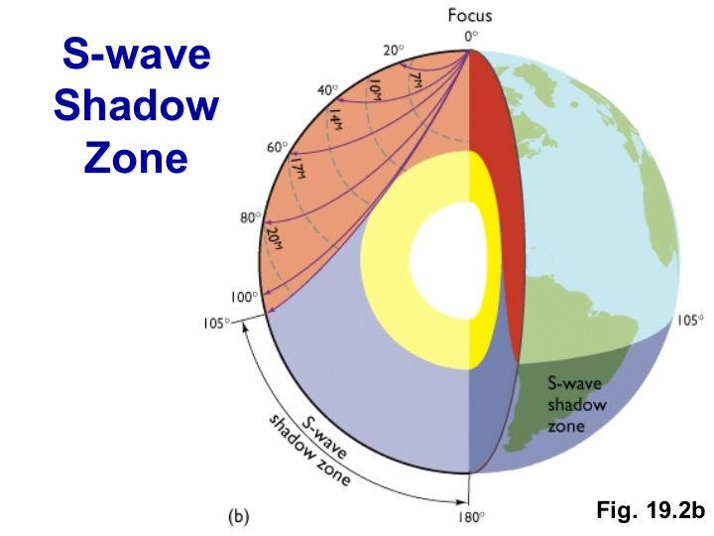
Shadow Zones
P Waves
  Waves change speed abruptly when they transition from solid to liquid
  This causes bending (refraction)
  Refraction makes it impossible for waves to arrive in the shadow zone
  Resulting shadow zone is doughnut-shaped
S Waves
  S waves cannot travel through the core
  Resulting shadow zone is bowl-shaped
  Implies core is liquid

Slide 27
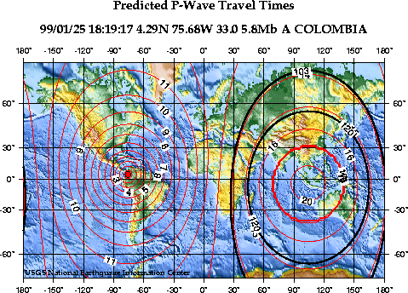
A Real Shadow Zone
Shadow zone between the dark ovals

Slide 28
So what do we conclude?
Earth is Layered
  Compositional Layers
    Core – made of Iron
    Mantle – made of Peridotite
    Crust – made of granite & basalt
  Mechanical Layers
    Inner Core – Solid
    Outer Core – Liquid
    Mesosphere – Solid, but plastic
    Asthenosphere – Mostly solid, plastic, 1-6% liquid
    Lithosphere – Solid, brittle

Slide 29
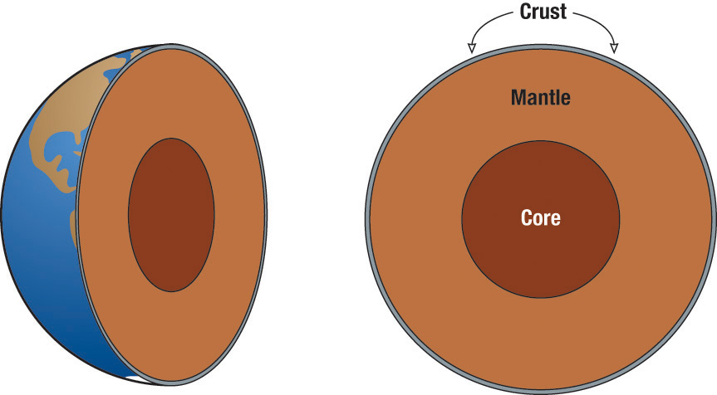
Compositional Layers
Granite/Basalt
Peridotite
Dense Oxides
Iron

Slide 30
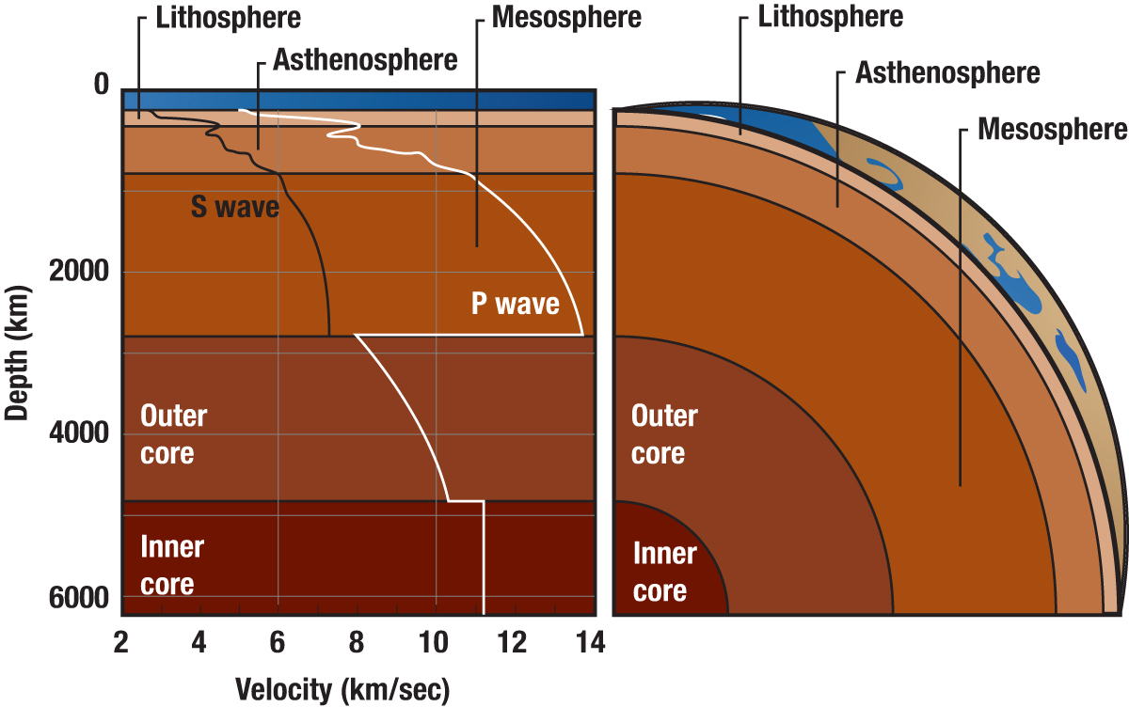
Mechanical Layers
Solid and brittle
Mostly solid, plastic,
partially molten
Solid
(but plastic)
liquid
solid

Slide 31
Secondary (shear) seismic waves will not propagate through the outer core. This is convincing evidence that the outer core is
Molten or liquid
Metallic
Composed primarily of oxides, silicates, and other minerals
Exactly located at the center of the earth
Very dense

Slide 32
Seismic wave speeds generally increase with depth, but at a specific depth called the Mohorovicic discontinuity there is a sharp drop in speed. This is evidence that:
The chemical composition of the crust changes at this depth
The density of the crust changes sharply at this depth
The pressure changes sharply at this depth
The temperature and pressure at this depth allows partial melting of the minerals

Slide 33
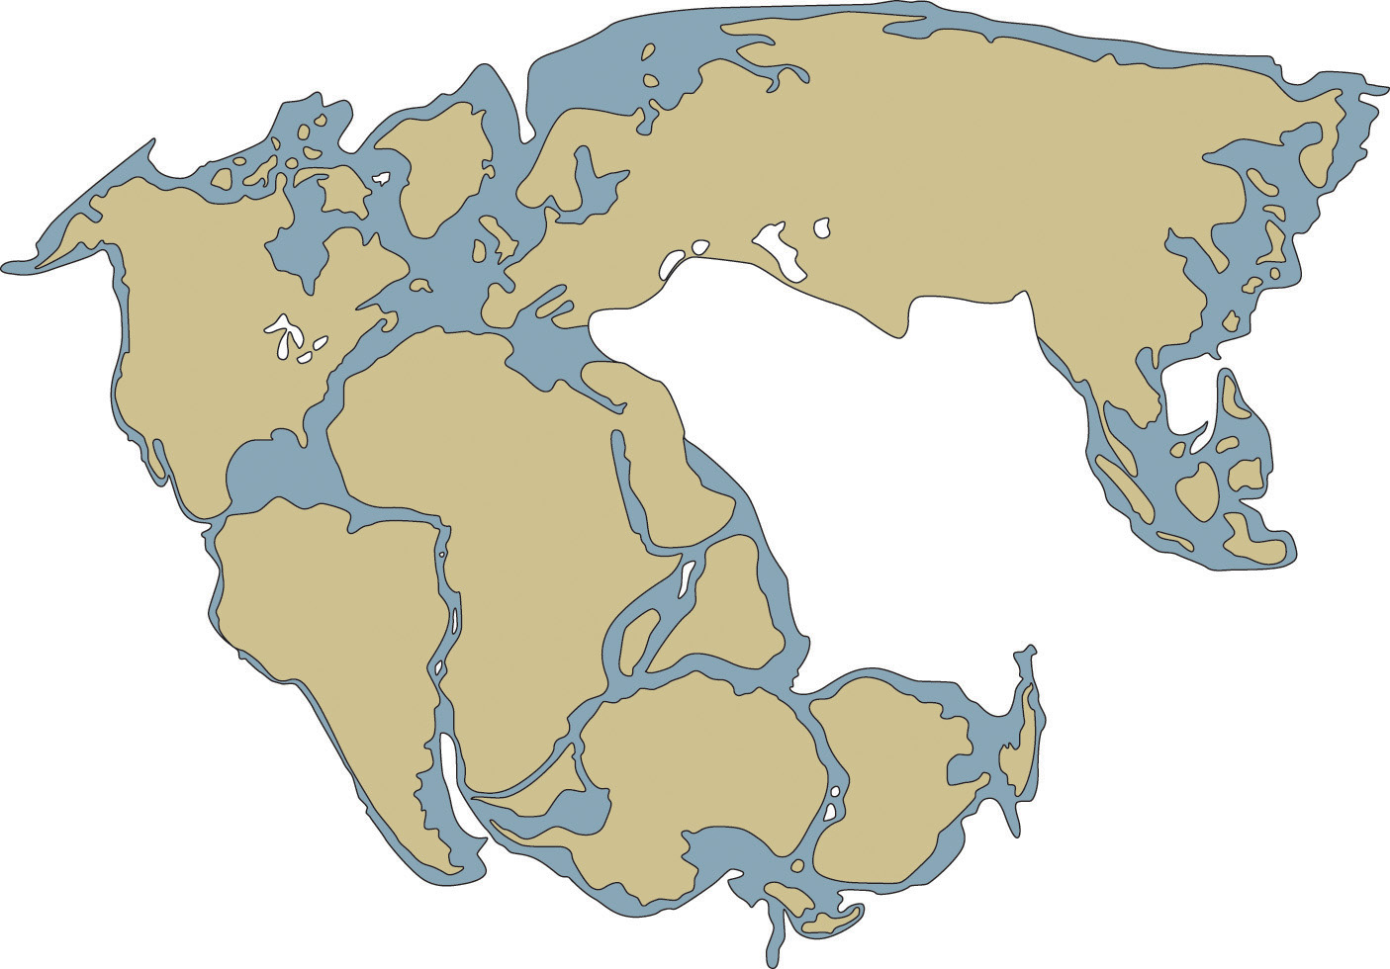
Earth surface history – Pangaea
Alfred Wegner’s ideas

Slide 34
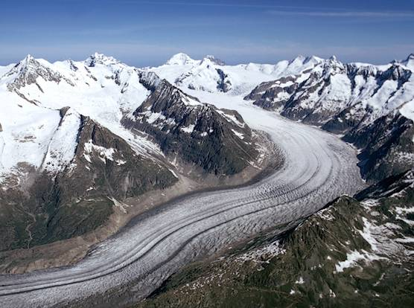
Glaciers erode the earths surface as they flow

Slide 35
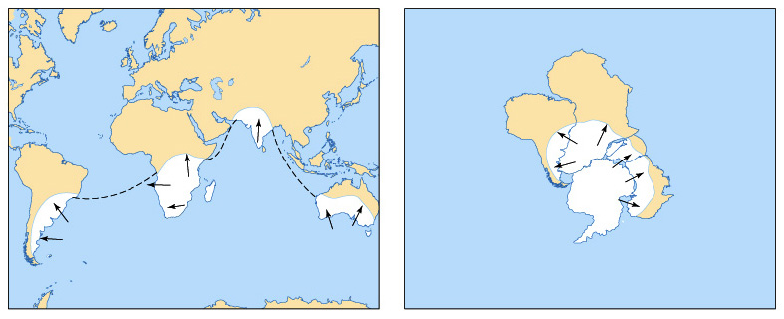
Patterns of Ancient Glaciation

Slide 36
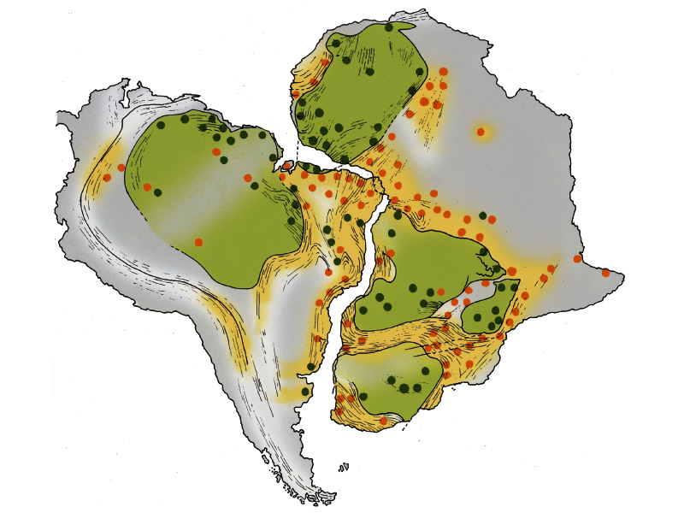
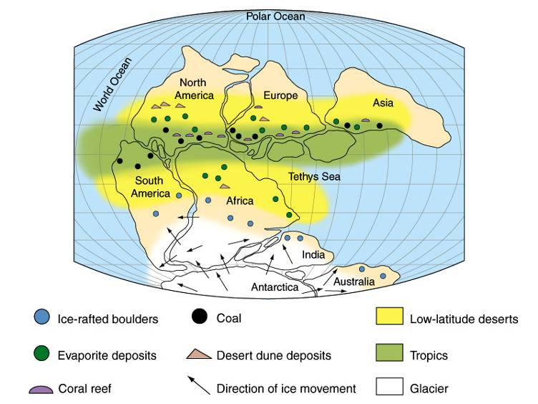
Paleoclimate Indicators and structural trends

Slide 37
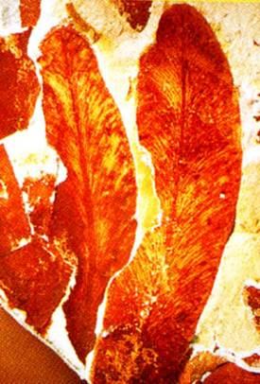
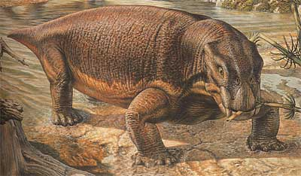
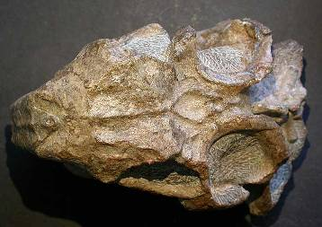
Patterns of Fossil Occurrence
Glossopteris
Lystrosaurus

Slide 38
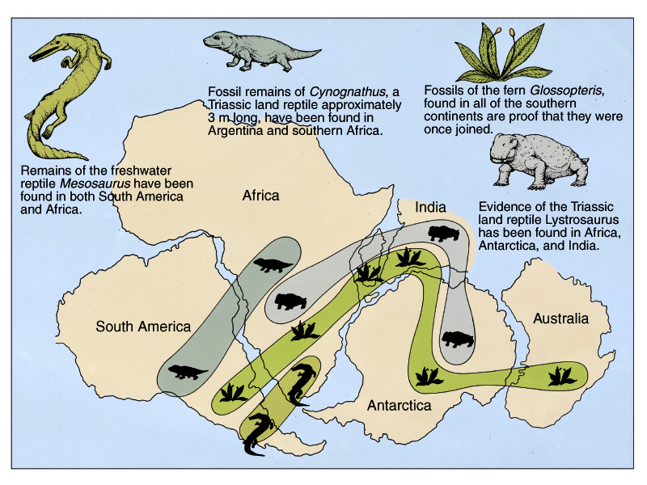
Patterns of Fossil Occurrence

Slide 39
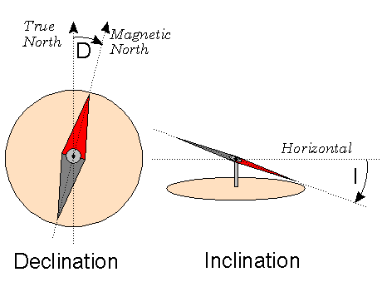
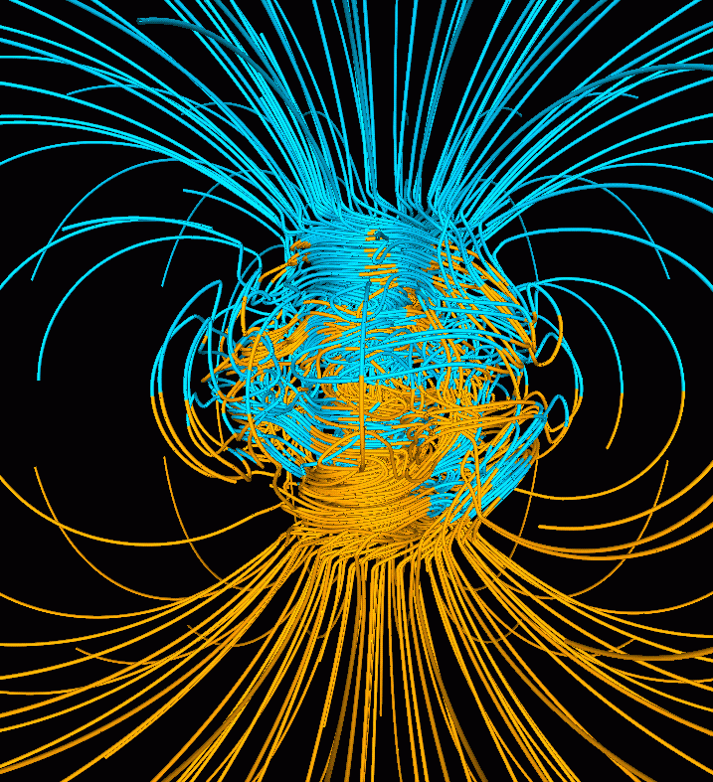
Earth’s Magnetic Field

Slide 40
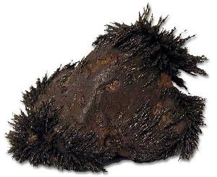
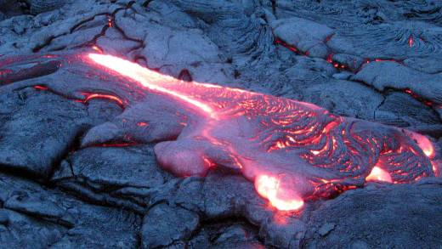
Rocks (magnetite) can record the orientation of Earth’s magnetic field

Slide 41
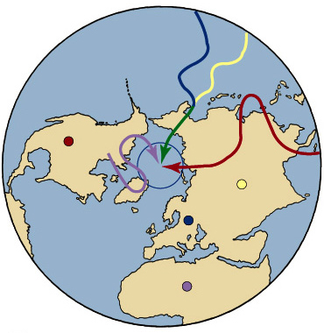
What do we actually find?

Slide 42
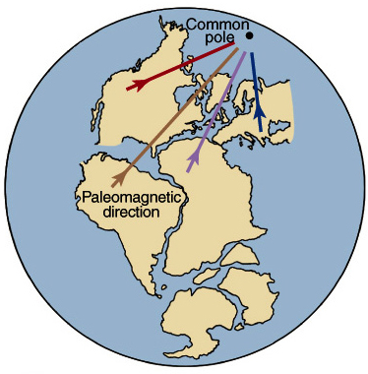
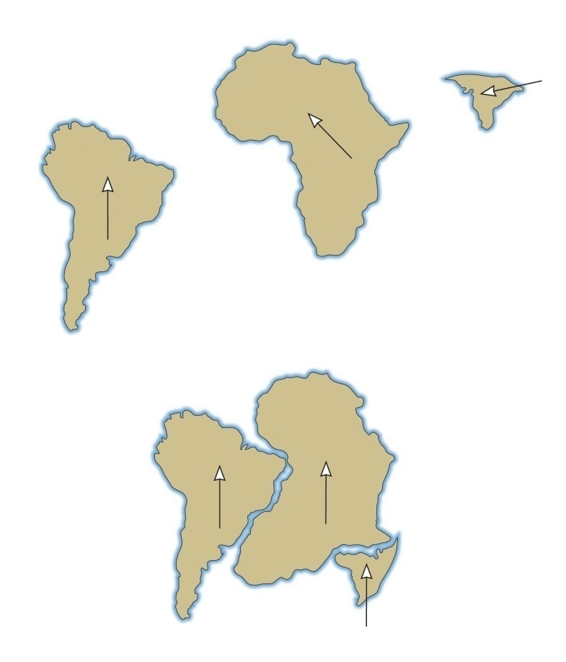
If the continents were together, then they do give a single location for the magnetic pole!

Slide 43
How was Wegener’s Theory received?
Rollin T. Chamberlin (U of Chicago,1928)
  “Wegener’s hypothesis in general is of the foot-loose type, in that it takes considerable liberty with our globe, and is less bound by restrictions or tied down by awkward, ugly facts than most of its rival theories. Its appeal seems to lie in the fact that it plays a game in which there are few restrictive rules and no sharply drawn code of conduct.”

Slide 44
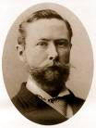
How was Wegener’s Theory received?
Bailey Willis (Stanford Univ.,1928)
  “When we consider the manner in which the theory is presented, we find that the author offers no direct proof of its verity; that the indirect proofs assembled from geology, paleontology, and geophysics prove nothing in regard to drift…; that the fields of related sciences have been searched for arguments that would lend color to the adopted theory, whereas facts and principles opposed to it have been ignored. Thus the book leaves the impression that it has been written by an advocate rather than by an impartial investigator.”

Slide 45
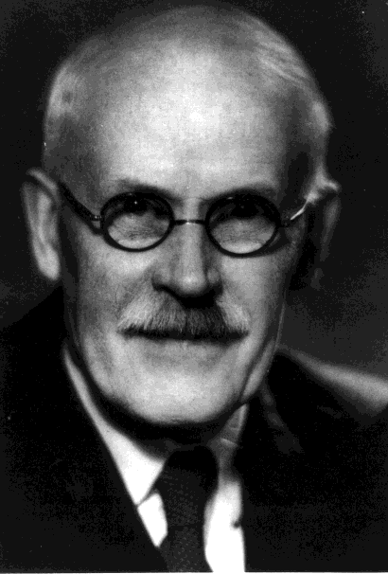
How was Wegener’s Theory received?
Harold Jeffreys (Cambridge U., 1924)
  “It is an impossible hypothesis! How can a small force not only produce indefinitely great movement, but overcome a force many times greater acting in the opposite direction at the same time?”

Slide 46
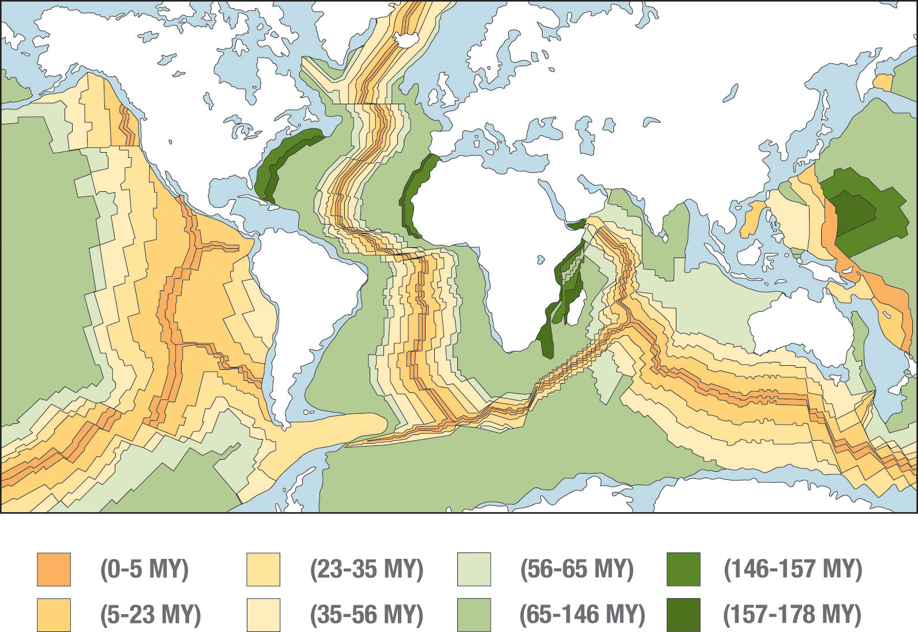
More evidence: The ocean crust is youngest near the ridges

Slide 47
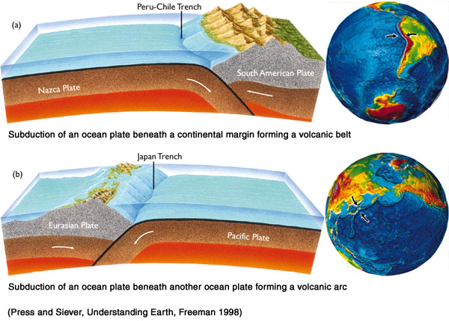
Since the surface area isn’t getting any bigger, we know that ocean crust is destroyed at trenches

Slide 48
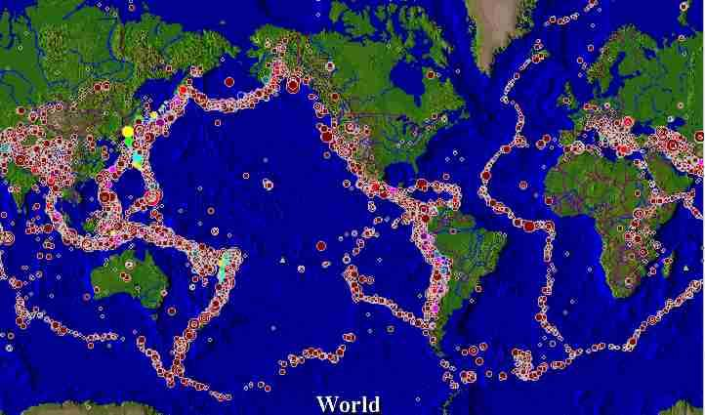
Patterns Earthquakes & Volcanoes

Slide 49
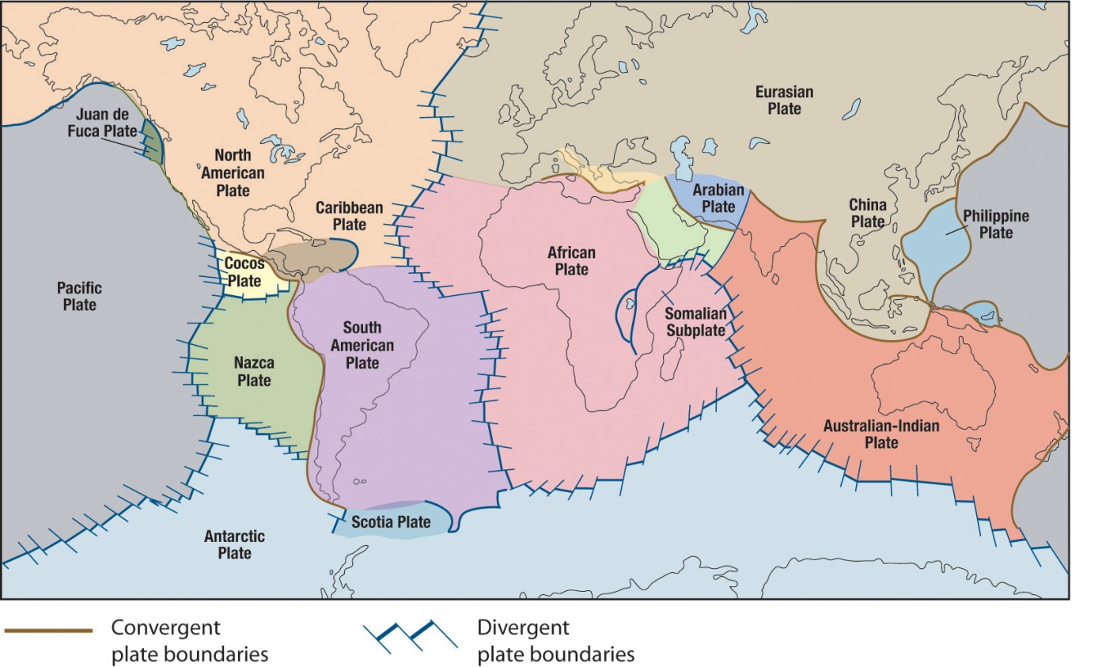
Plate Boundaries
The action in plate tectonics is almost always at the plate boundaries.
Two plates moving towards each other form a convergent boundary
  Ocean crust meets ocean crust
  Ocean crust meets continental crust
  Continental Crust meets continental crust
Two plates moving away from each other form a divergent boundary

Slide 50
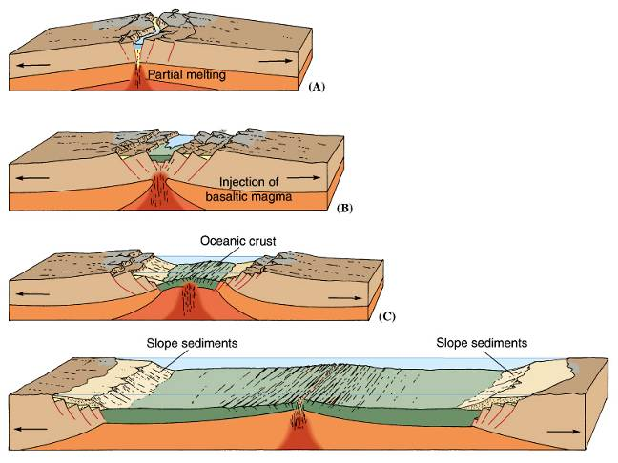
Divergent Plate Boundaries under continents
Extensional Stresses stretching
Eventually creates New Seafloor
Volcanoes
  Basalt and granite (Bimodal composition)
Earthquakes
  Shallow foci
  Modest magnitudes -- larger than oceanic rifts.

Slide 51




The rift valley in Africa is one of the most clear examples of continental rifting
Oldoinyo Lengai
Erta Ale
Killimanjaro

Slide 52
Convergent Plate Boundaries
Compressional Stresses
Old Seafloor Destroyed (Subduction)
Volcanoes
  Explosive and Very Dangerous (lots of gas)
Earthquakes
  Shallow to Deep foci
  Large magnitudes
Mountain Belts/High Deformation
Accretion – Building of the Continents

Slide 53

Ocean-Ocean Collision

Slide 54


Island arcs: Indonesia, Japan, Taiwan, Philippines, Kamchatka Peninsula, Aleutian Islands.

Slide 55

Ocean-Continent Collision

Slide 56



The Andes mountains are the result of a ocean-continent collision

Slide 57

Deep, severe earthquakes and explosive volcanoes occur as oceanic crust subducts

Slide 58

Continent-Continent Collision
Why are there no volcanoes when continents collide?
No plate is sinking into the mantle and melting!

Slide 59

The Indian subcontinent slammed into Asia several million years ago

Slide 60


India is now a part of Asia. The Asian continent has grown.

Slide 61


Transform faults are evident in the ocean ridges

Slide 62


The San Andreas fault is a transform boundary

Slide 63


transform boundary examples

Slide 64

Island Chains
Created by plates drifting over hot spots.

Slide 65


Major plate boundaries today

Slide 66
The interior structure of Earth has been determined mostly from
Drilling
Exploration
X-Rays
Earthquake waves
Chemical analysis

Slide 67



The surface of Earth can been determined by black lights – Fluorescent rocks
Calcite(CaCO₃) emits a red/orange color
Willemite(Zn2SiO4) emits a green color
Fluorite(CaF₂) emits a blue color
Pure calcite crystal, phosphorescence ~ 2.5 seconds.

Slide 68


Geological laws - Original Horizontality
Horizontal
Tilted

Slide 69


Geological laws - Superposition
youngest layers are on the top
oldest layers are on the bottom.

Slide 70


Geological laws - Cross-cutting
the youngest rock is the one cutting across.
Hydrocarbon dike
cutting sandstone
Granite dikes
cutting darker rock

Slide 71


Geological laws - Inclusions
included rocks must be older than the rocks around them
Dark inclusions in granite,
Yosemite National Park.
(Lens cap & student for scale)

Slide 72

Geological laws - Faunal Succession

Slide 73

What is the Sequence of Events?
E, G, L, C deposited
fault H
erosion, unconformity
M, D, J deposited
A intruded
erosion, unconformity
N, K, B deposited
tilting, erosion, unconformity
F deposited
erosion of current surface

Slide 74

Which feature is the oldest?
A
C
B
D

Slide 75

How old is the earth?
Ancient Hindus: 1,977,949,048 yrs
Ancient Egyptians: 2,555,000,000 yrs
Archbishop James Usher: 6,000 yrs
  Refined by Archbishop of Ireland in 1645: the earth was formed on “the night preceding the twenty-third day of October in the year of the Julian Calendar, 710 (4004 BC)”
Why do we care?
  It has implications for helping us understand how the earth works

Slide 76

Getting an absolute (numeric) age. Radioactive dating
Need long-lived radioactive isotopes to date Earth events.
Half life ~1.2B years

Slide 77

The relative percentage of parent to daughter isotope allows us to tell age

Slide 78
What are we dating with these radioactive isotopes?
The age of the elements?
  NO!
We are determining the age of events
  Usually the last time the rock or mineral was heated above its “Closure Temperature”
  Below the closure temperature the system is closed and the isotopes can accumulate
  Above the closure temperature the system is open and the isotopes may escape, resetting the clock
  Each mineral and isotope system has a different closure temperature

Slide 79
Requirements for accurate radioactive dating
A known half life
A sample of rock (igneous) representative of the geologic layer to be dated.
No end products present when the rock cooled (or corrections must be made)
No loss or gain of either the isotope or the product since the rock cooled.
Then. . . the ratio of the original isotope to the product gives the absolute date the rock formed.

Slide 80
How old is the earth?
It is not infinite in age. because radioactive elements with long half-lives still exist in the crust.
It is younger than the universe--less than 20 billion years.
It is older than a few million years because radioactive elements of such “short” lifetimes have all disappeared.
It is older than the oldest dated rock--older than 3.8 billion years.
It is about the same age as the sun, moon meteorites, etc. They are about 4.6 billion years.
Best estimate: ~ 4.6 billion years

Slide 81
Secondary (shear) seismic waves will not propagate through the outer core. This is convincing evidence that the outer core is
Molten or liquid
Metallic
Composed primarily of oxides, silicates, and other minerals
Exactly located at the center of the earth
Very dense

Slide 82
Seismic wave speeds generally increase with depth, but at a specific depth called the Mohorovicic discontinuity there is a sharp drop in speed. This is evidence that:
The chemical composition of the crust changes at this depth
The density of the crust changes sharply at this depth
The pressure changes sharply at this depth
The temperature and pressure at this depth allows partial melting of the minerals

Slide 83
Weather vs. Climate
Weather describes fluctuations in temperature, rainfall, etc. over short time scales, and is highly variable (day to day and by season)
Climate describes the average temperature, rainfall, etc. over long periods of time (many years at least).
Earth’s climate changes naturally over long time scales.
The current concern relates to climate change thought to be due to human activity.

Slide 84
Which best describes your opinion on global warming?
This is just political hype. No action is needed.
We should wait until the models are better before we do anything.
I’d like beachfront property in Utah. Do nothing and party on!
We should invest the $billions needed to find ways to reduce greenhouse gas emissions.
We are already in danger. We should immediately stop driving cars!
0

Slide 85


The global average temperature of the earth
The average temperature of the earth depends primarily on
  The amount of Solar radiation that reaches the Earth
  The fraction of Solar Radiation that gets trapped in the atmosphere
At times in the past the Earth has been much cooler and at other times much warmer

Slide 86



Solar Radiation Reaching the Earth
Milankovitch Cycles
  “Ellipticity” of Earth’s orbit around the Sun (100,000 yr cycle)
  Tilt of Earth on its axis (41,000 yr cycle)
  Precession of Earth on its axis (23,000 yr cycle)
Tilt and Precession
  Don’t change overall radiation, but can change seasonal extremes in weather.
  The arrangement of continents is not symmetric. Most of the land is in the northern hemisphere
  Land and ocean respond differently to seasons (glaciers vs. sea ice)

Slide 87

What does the past teach us?
The orbital cycles are reasonably good predictors of glaciations
  Orbital eccentricity: 100ky
  Axial inclination: 41ky
  Axial precession: 23ky
According to these cycles, we would predict that we would enter a new ice age sometime “soon” (on the thousands of years time scale)

Slide 88



Trapping solar radiation in the atmosphere increases the fraction of solar radiation that is retained
If you treat the earth and sun as “black” bodies, you underestimate the earth’s temperature.
The (unfortunately named) greenhouse effect is the reason.
  Infrared light emitted by the earth is absorbed by greenhouse gases (Carbon Dioxide, Methane, Water Vapor)
  The absorbed energy heats the gases, that then re-radiate—half up and half down
  The net effect is that energy is trapped in the atmosphere longer, and the planet is warmer than it would be without this effect

Slide 89

Historical correlation between temperature and greenhouse gas levels
So does temperature drive CO₂ or does CO₂ drive temperature?
Yes.

Slide 90

So what has been happening recently?
We have had good thermometers for a while now.
People on the coast keep good track of the sea level
Since the early 1900s we have good measurements of snow cover

Slide 91

Current warming is generally greater over continents

Slide 92

Larsen Ice Sheet Breakup
More glaciers are receding than advancing today.

Slide 93


Pasterze Glacier, Austria
1875
2004

Slide 94


Continental Glaciers seem to be receding
Example: Greenland

Slide 95


Why do we care?
What happens to water levels when an ice berg melts?
What happens when a continental glacier melts?

Slide 96


So are we causing the recent warming?
How can we tell?

Slide 97


The hockey stick graph!
“The hockey stick controversy”

Slide 98

What do the current climate models tell us?

Slide 99

Should we do anything?

Slide 100
Risk, Cost, & Benefit
Cost of reducing greenhouse emissions will certainly be many billions of dollars (more like trillions if we avoid nuclear).
Certainty of controlling global warming is not 100%
  Current predictions depend on imperfect models
Environmental and economic consequences could be truly catastrophic
  Some say global warming could cause the end of technological civilization
As voters and consumers, these are your issues

Slide 101
Which best describes your opinion on global warming?
This is just political hype. No action is needed.
We should wait until the models are better before we do anything.
I’d like beachfront property in Utah. Do nothing and party on!
We should invest the $billions needed to find ways to reduce greenhouse gas emissions.
We are already in danger. We should immediately stop driving cars!
0

