Slide 1
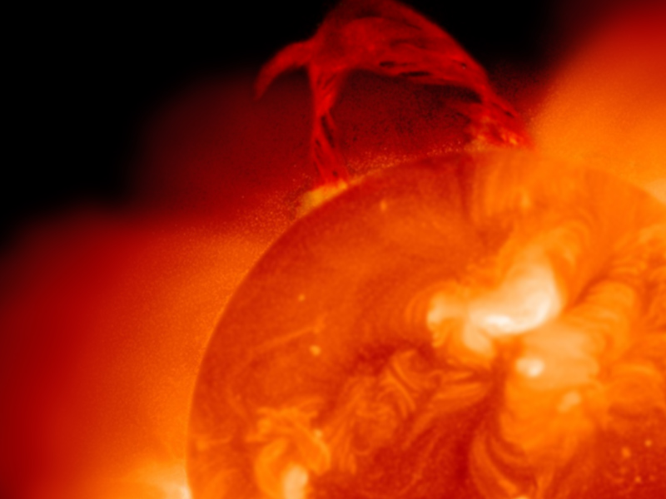
Chapter 24 and 25: Quiz
The discovery of nuclear chain reactions need not bring about the destruction of mankind any more than did the discovery of matches. We only must do everything in our power to safeguard against its abuse.
~ Albert Einstein

Slide 2
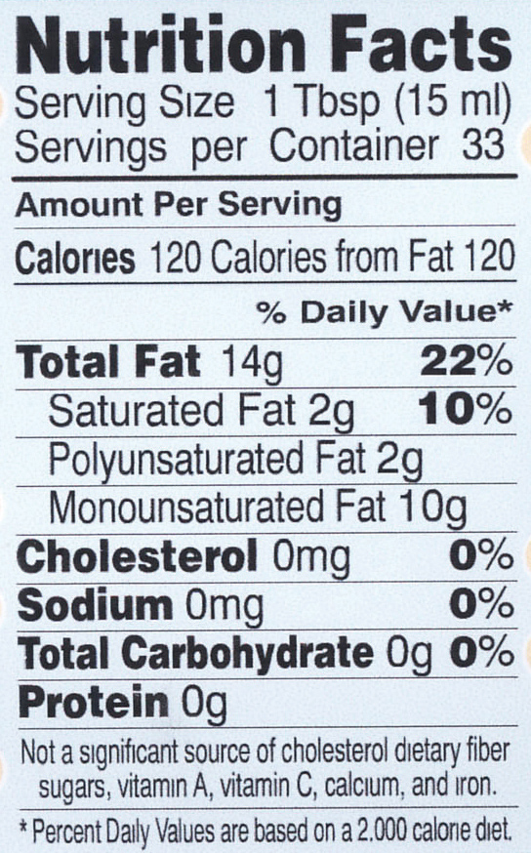
How to read a nutrition label
How many servings of this food product contains enough energy to raise 240,000 g of water by 1 °C?

Slide 3
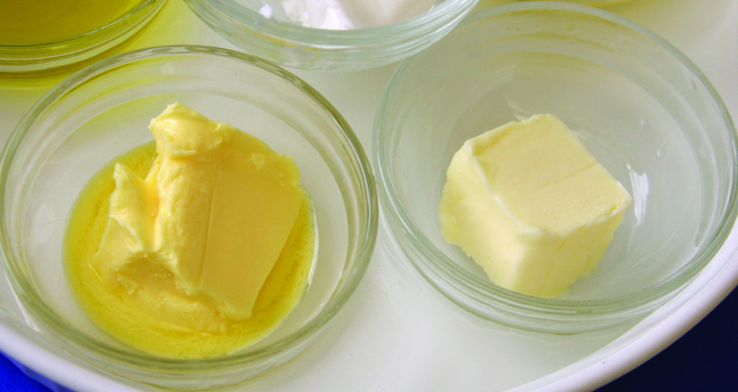
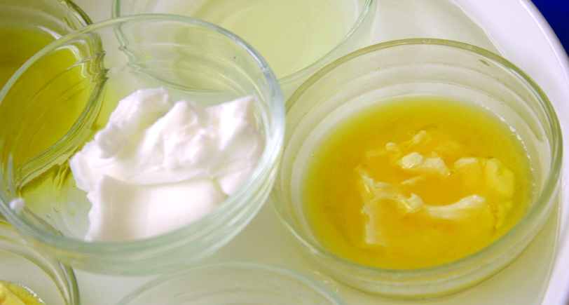
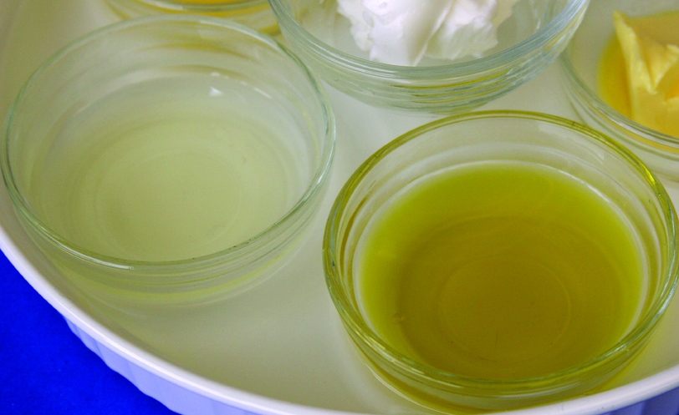
What is a major molecular difference between saturated and unsaturated fatty acids?

Slide 4
Fish that swim in the cold north Atlantic would have what type of fatty acid in their blood?
Saturated fatty acids
Unsaturated fatty acids
Triglycerides
Salty Fatty acids

Slide 5
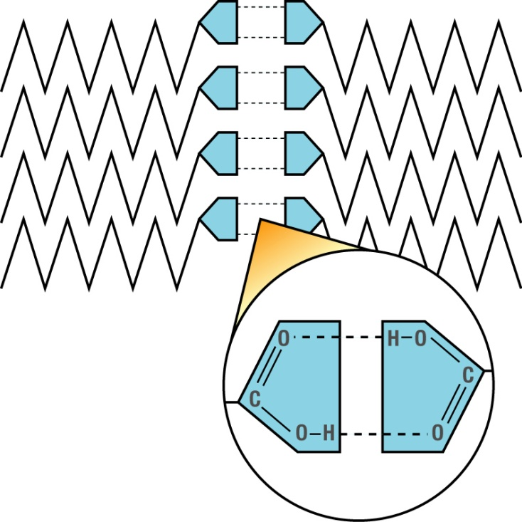
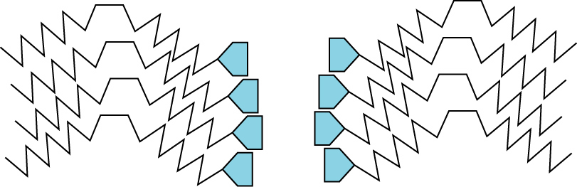
Which group of fatty acids has the most hydrogen?
A
B

Slide 6
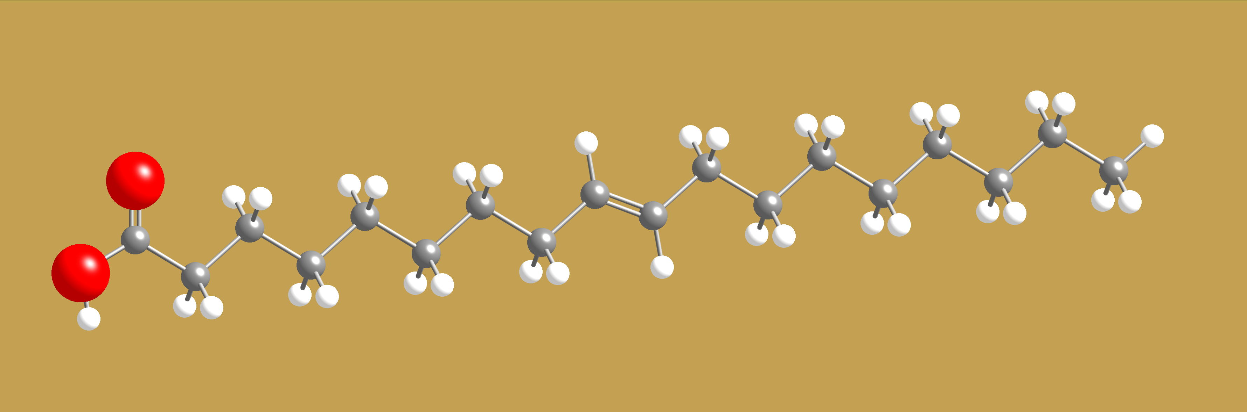
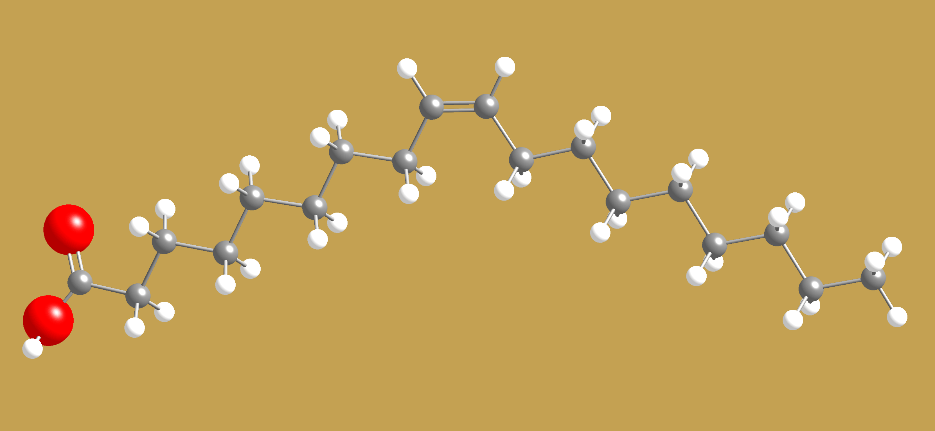
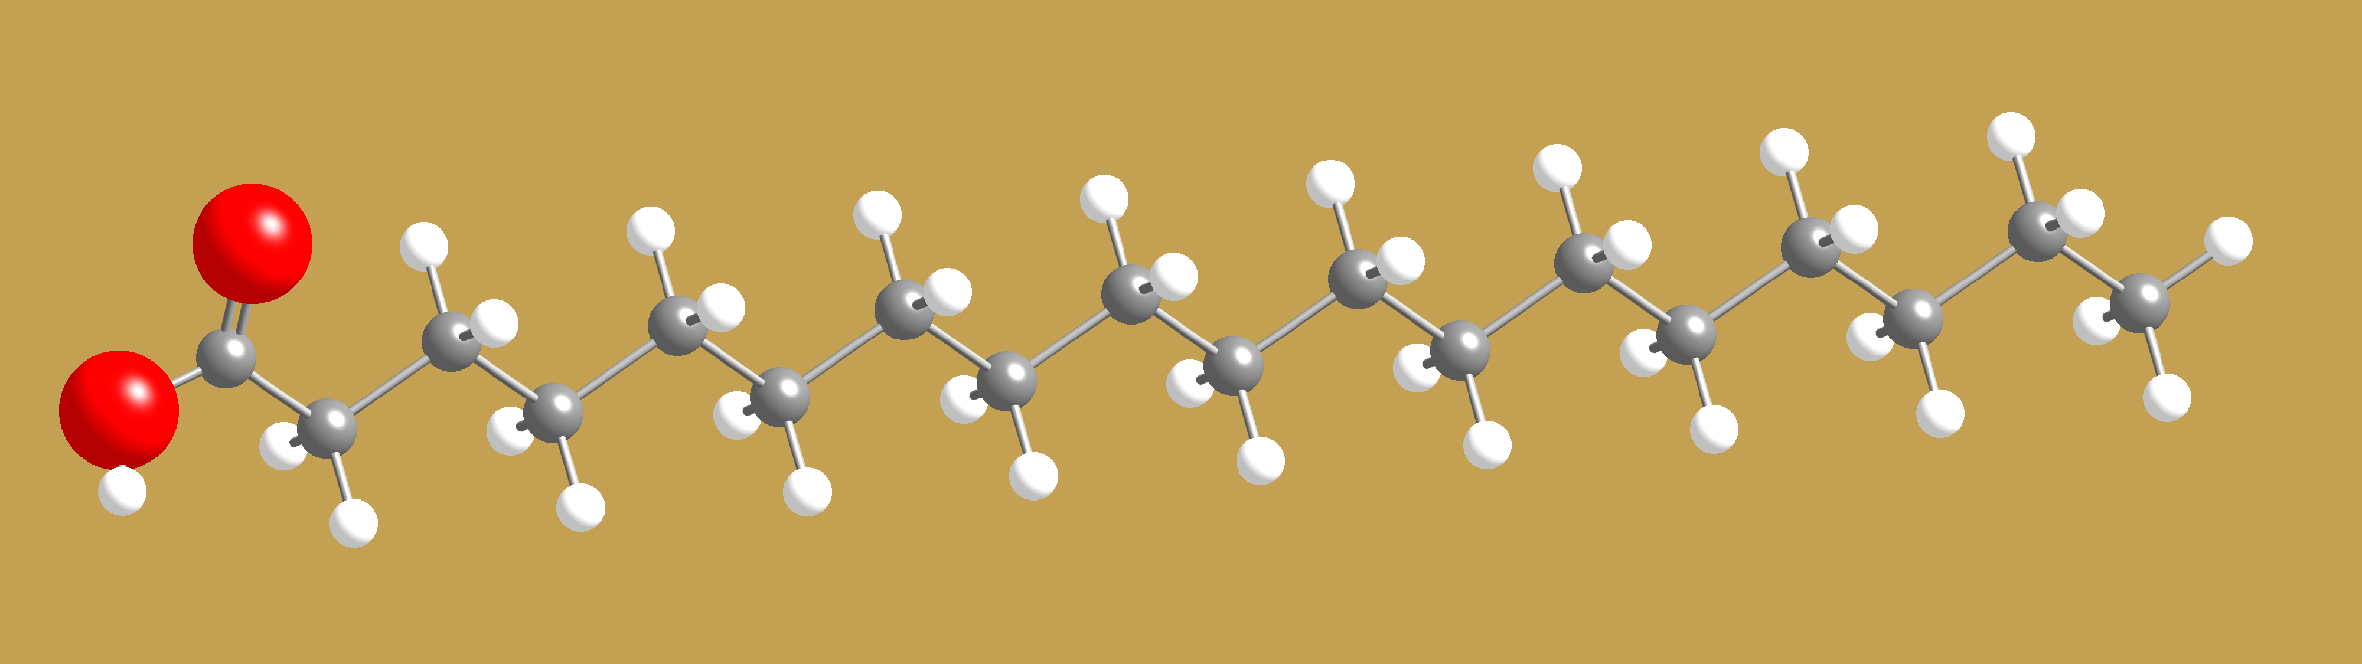
Which one is a Trans-Fatty Acid?
A
B
C

Slide 7
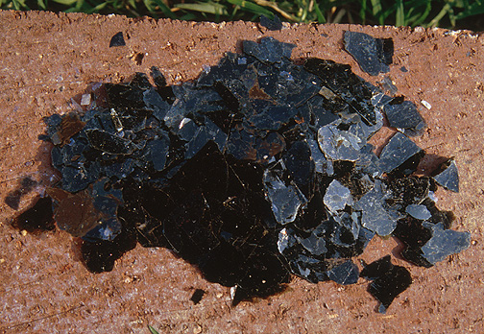
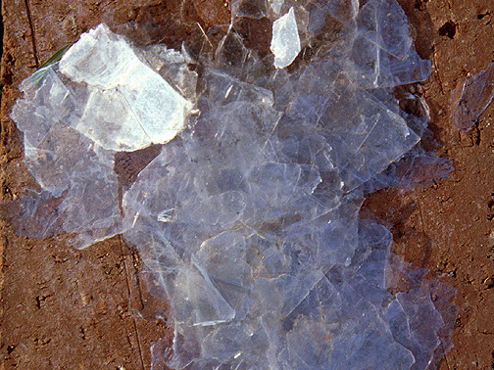
Which of these minerals do you think contains a transition metal?
Muscovite mica
Biotite mica

Slide 8
What two fundamental forces combine to make this shape for nuclei formation?
Energy
Distance between nucleons

Slide 9
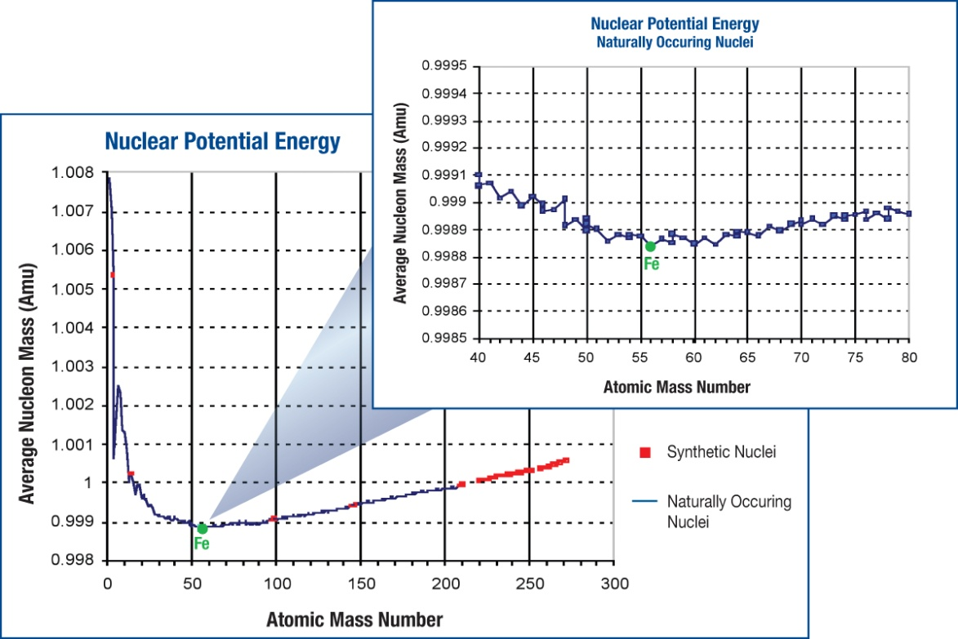
Nuclear energy. Mass
Which has more mass?
A proton by itself
A proton in an Iron nucleus
A proton in a Helium nucleus
An electron in a hydrogen atom

Slide 10
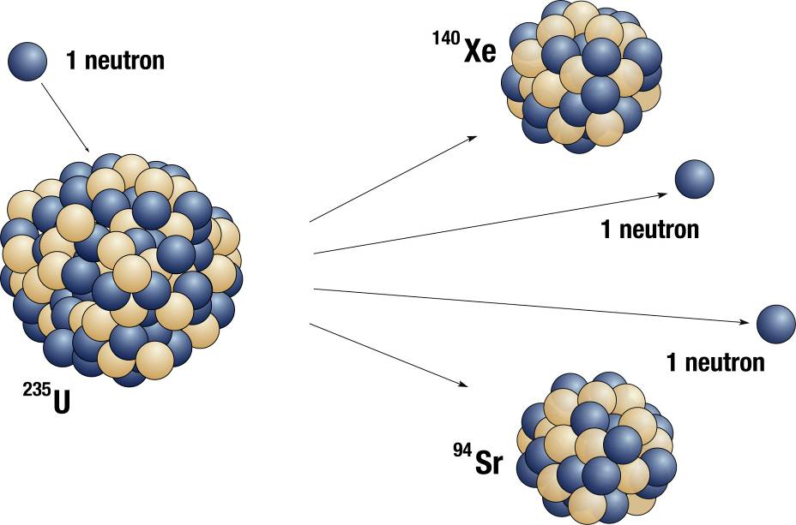
What nuclear process is this?

Slide 11
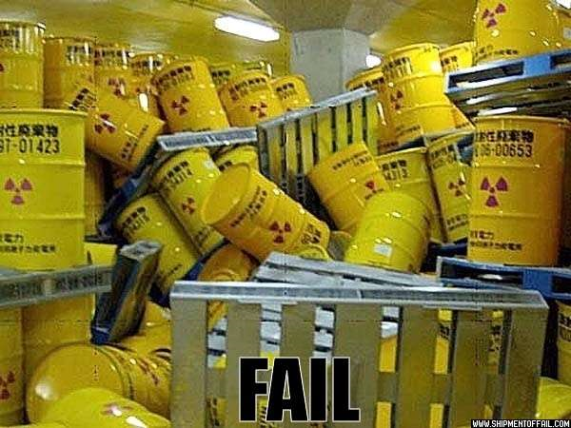
What are the three types of radioactive decay?
Don’t
me

Slide 12
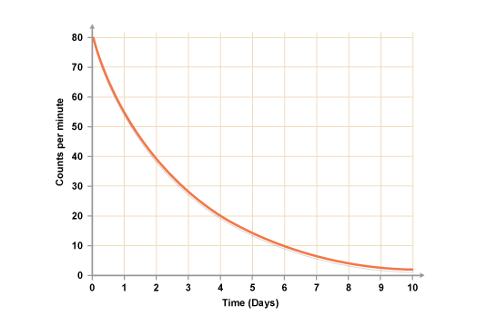
Half Life
What is the Half Life of this radioactive sample?

