Slide 1
Rest of the semester
March 24 – Chapters 24 and 25
March 31 – Geology
April 7 – Astronomy
April 14 – Cosmology and final review
April 21 – Final, same format as midterm

Slide 2
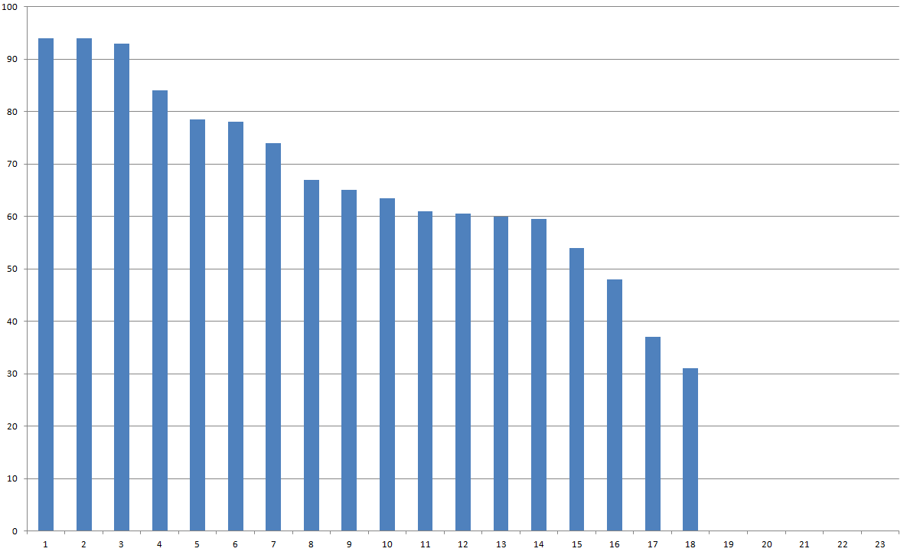
Grades
Midterm – let’s have a look see here

Slide 3
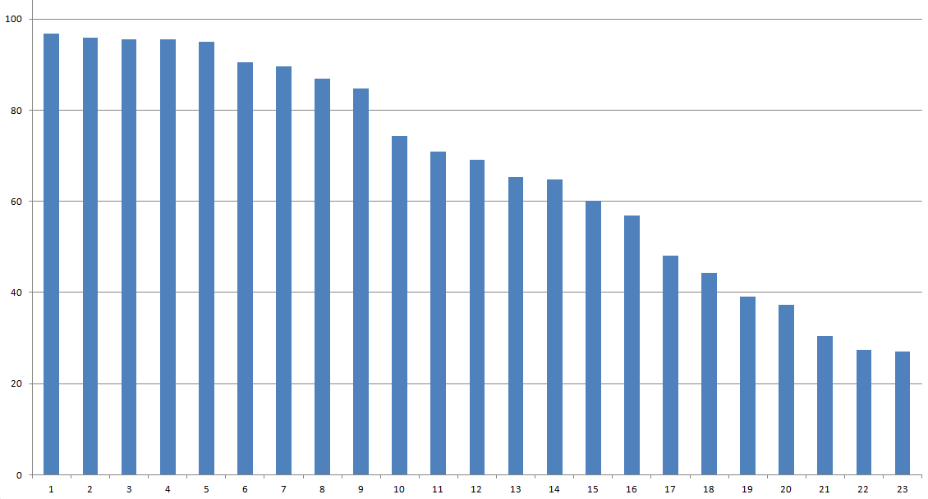
Grades
Rough current total

Slide 4
“Tis’ but a flesh wound”
The only way to fail this course is to not…
Communicate with instructor
Miss class
Take final

Slide 5
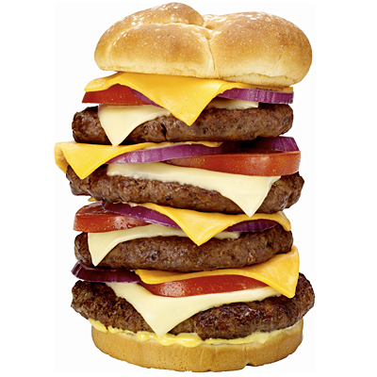
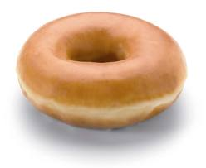
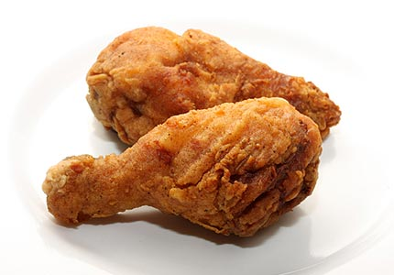
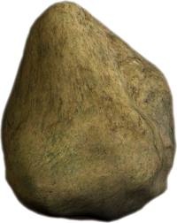
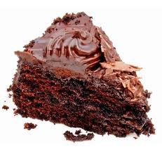
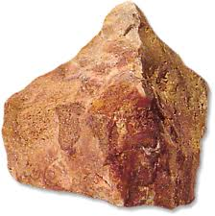
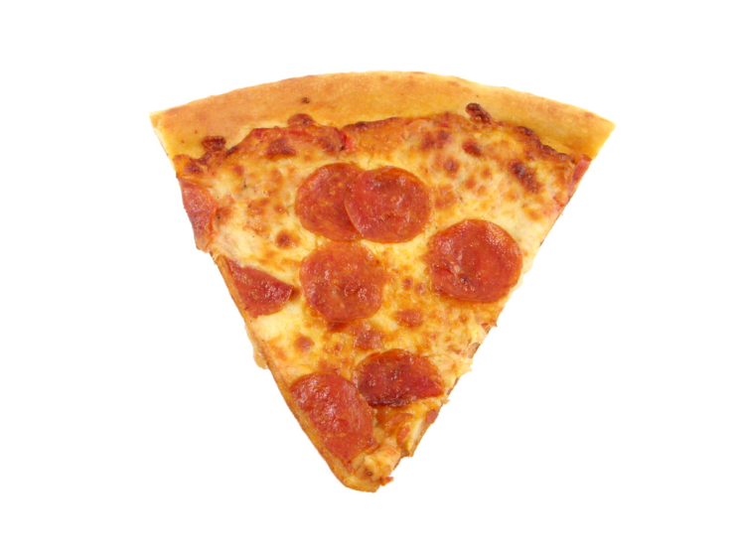
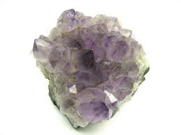
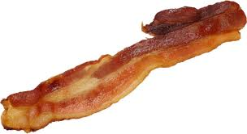
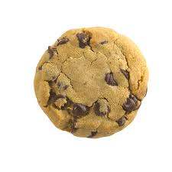
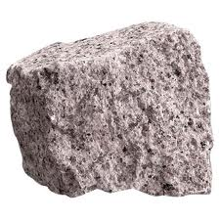
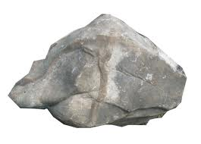
Chapters 24 and 25

Slide 6
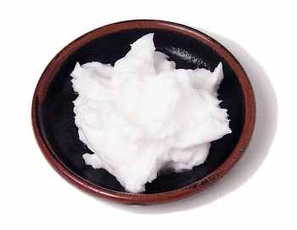
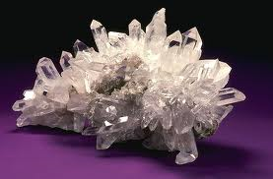
Atomic-Level Structure of Complex Materials Determines Properties
Animals & Vegetables
Lipids
Fats (obtained from animals)
Oils (usually obtained from vegetables)
Covalent molecules whose melting points are related to behavior in our bodies
Earth
Minerals
Silicate Mineral Family
Primarily Ionic Material
Different Arrangements of SiO₄⁴⁻ units leads to stringy, sheet-like
and chunky minerals

Slide 7
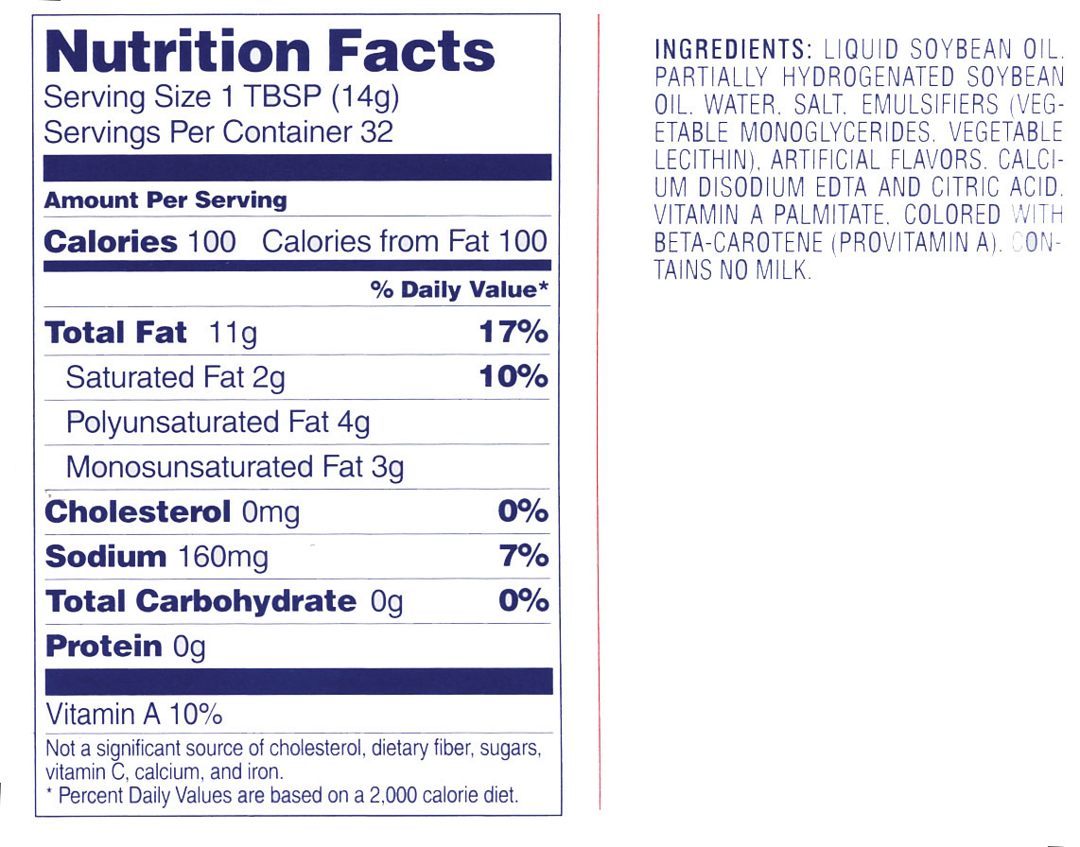
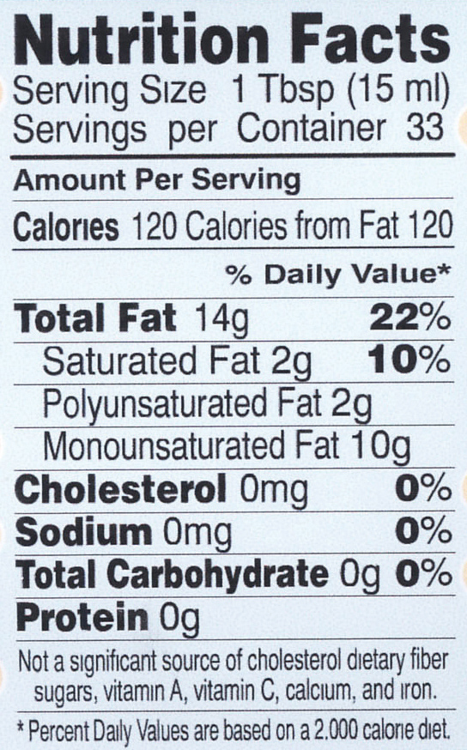
How to read a nutrition label: Margarine and Olive oil
What approximates the energy needed to increase the temperature of 1 gram of water by 1 °C

Slide 8
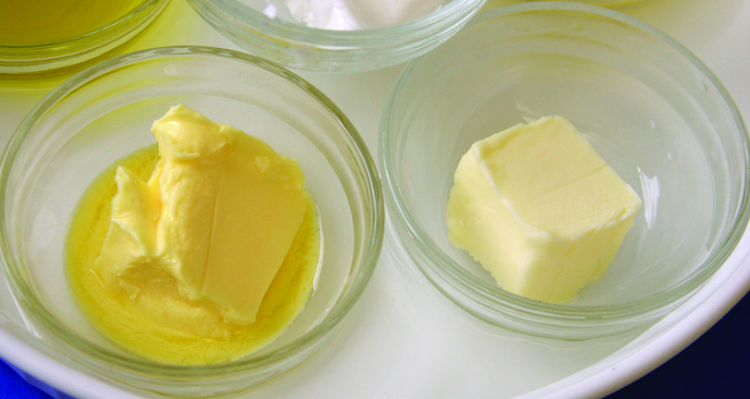
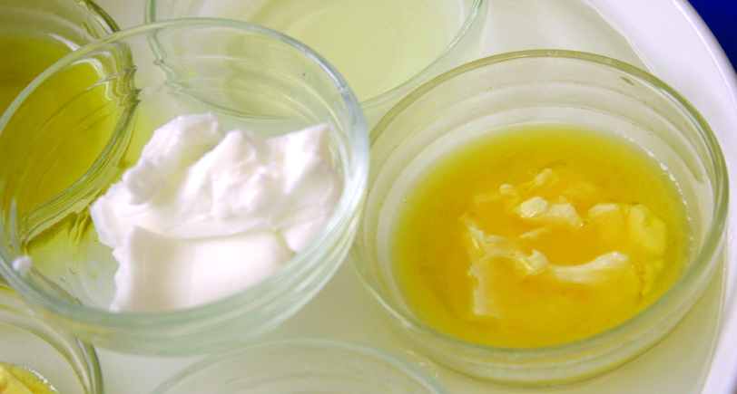
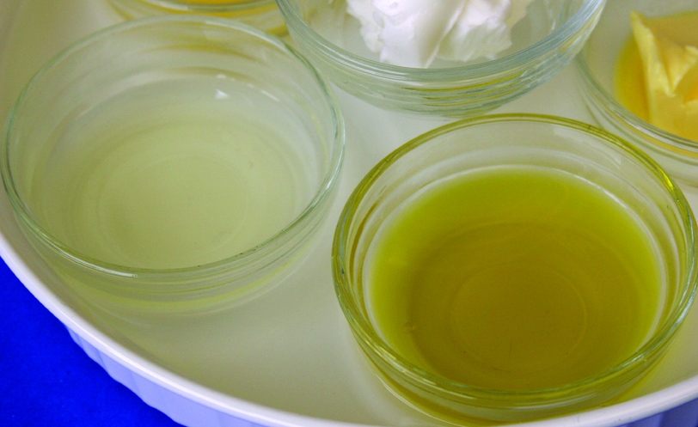
Fats and oils at room temperature – What observations can we make?
Butter
Easy Spread
Margarine
Stick
Margarine
Shortening
Canola Oil
Which are solids? Liquids?
Which are close to their melting temperature?
Olive Oil

Slide 9
Fats and Oils differ in Their Physical State at Room Temperature
Chicken Fat & Marbling in Meat | Solid | Fat
Shortening (Crisco) | Solid | Fat
Butter | Solid | Fat
Margarine | Liquid-Solid mix
“Promise” or “Benacol” | Liquid-Solid mix
Olive Oil | Liquid | Oil
Canola Oil | Liquid | Oil
Fish Oil | Liquid | Oil

Slide 10
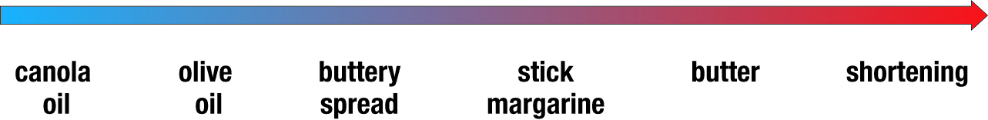
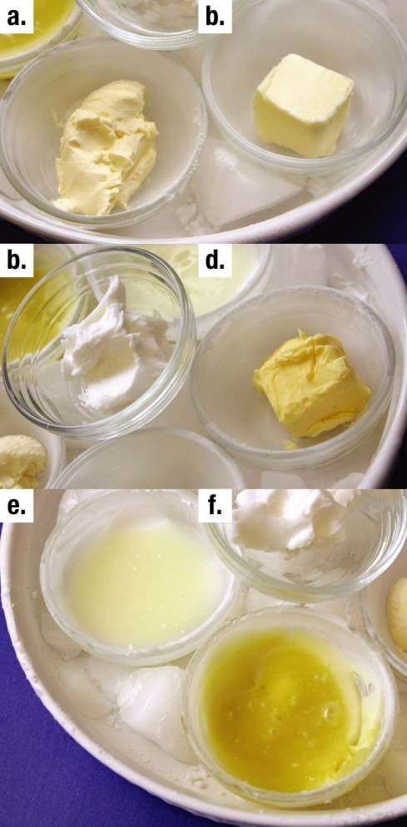
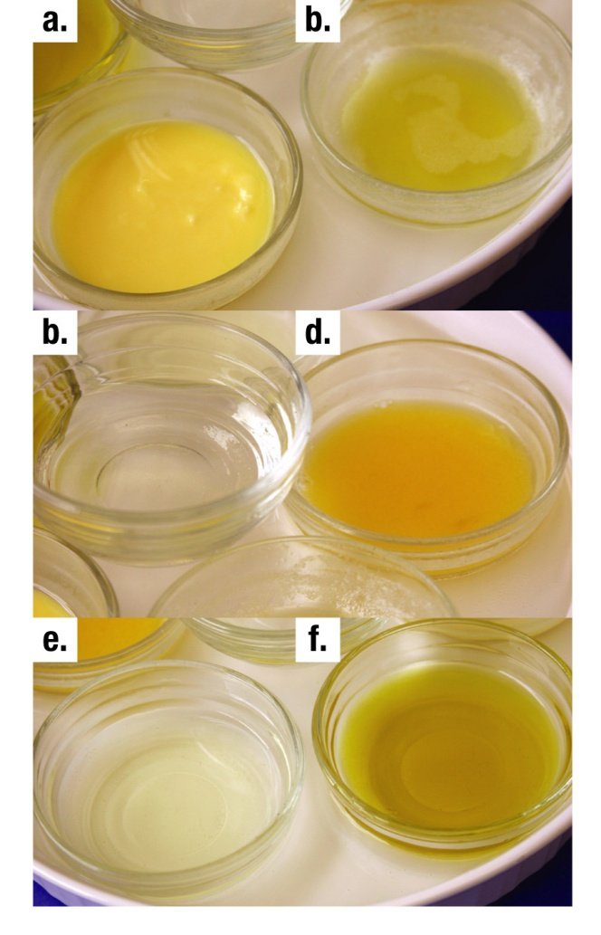
Sequence of melting temperatures
Pg. 289

Slide 11
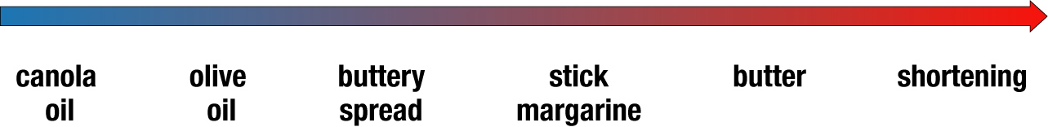
Sequence of Melting Temperatures
WHY THIS SEQUENCE? UNDERLYING MOLECULAR STRUCTURES
Heart Healthy Sequence (approximately)
maybe the best for you

Slide 12
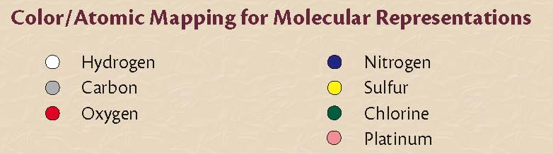
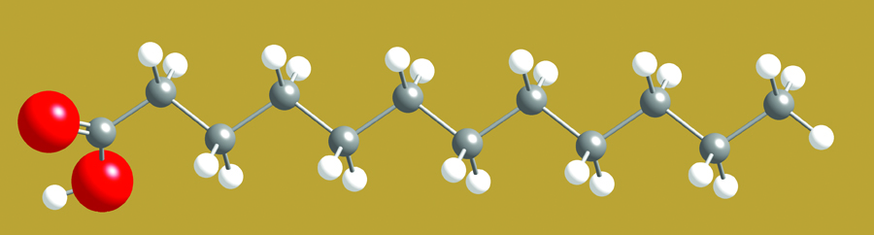
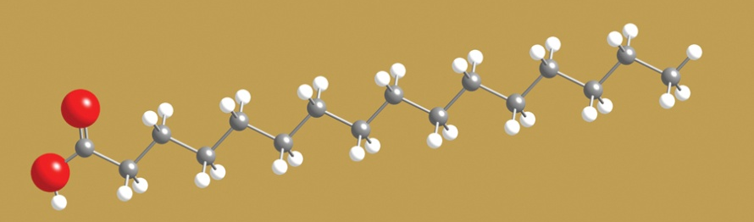
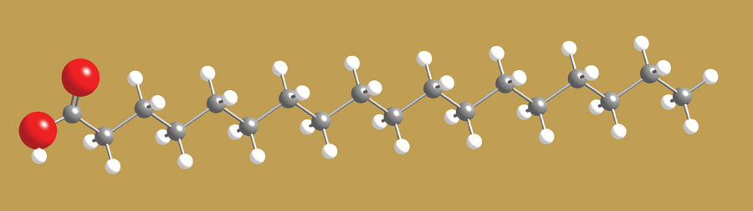
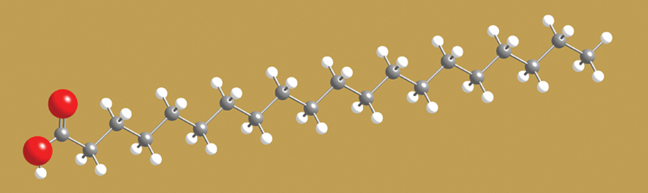
Fatty Acids – major component of fats and oils
Describe the structures:
What molecular groupings
do they have in common?
How do they differ?

Slide 13
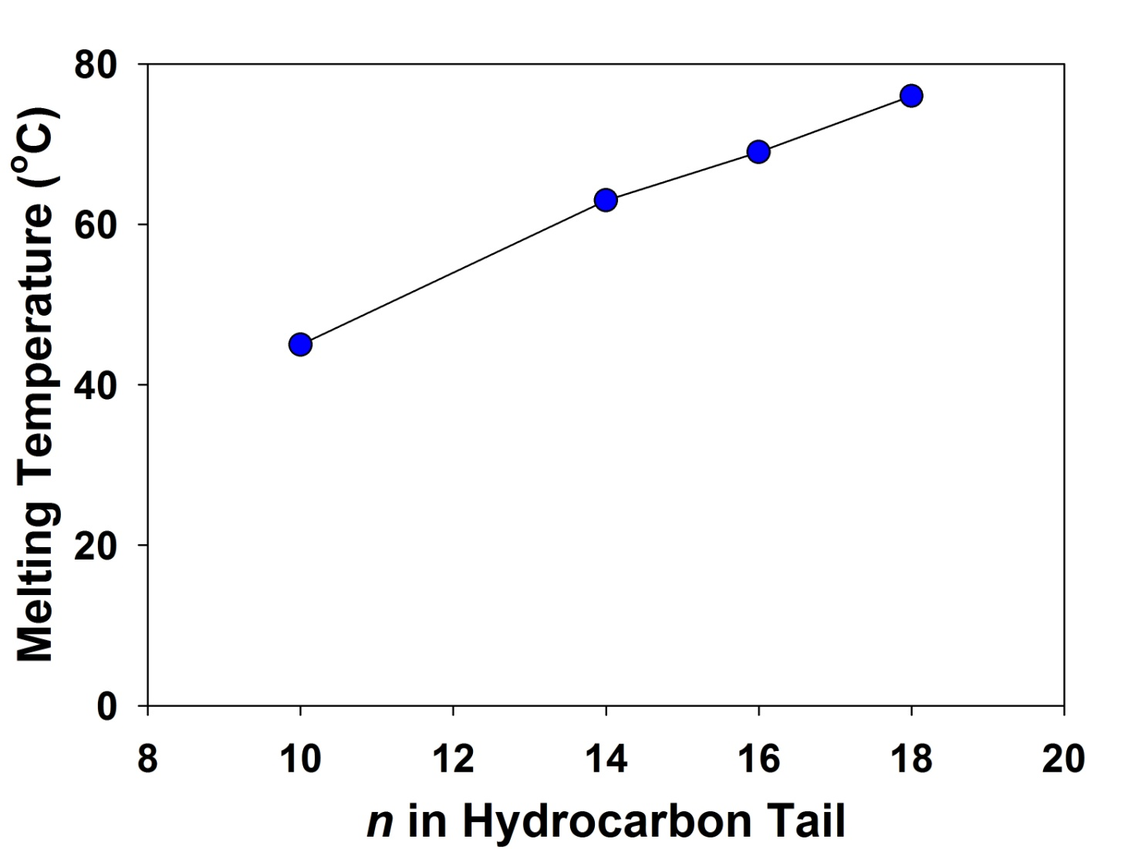
What difference does a tail make?
Fats containing
these fatty acids
are solids at
room temperature
Room temperature

Slide 14
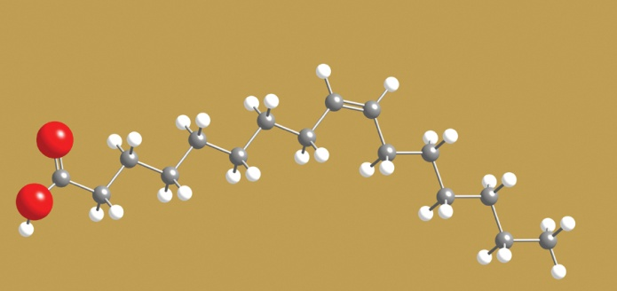
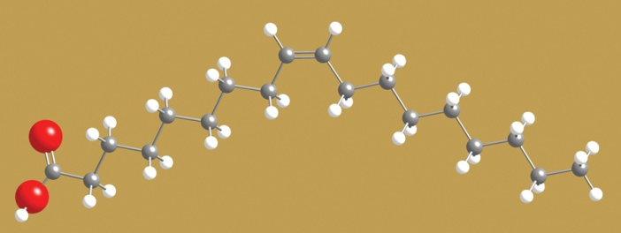
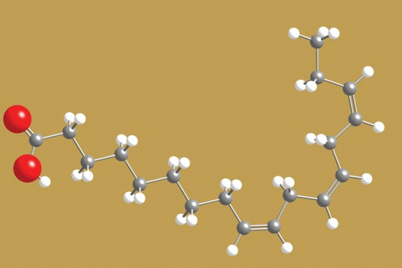
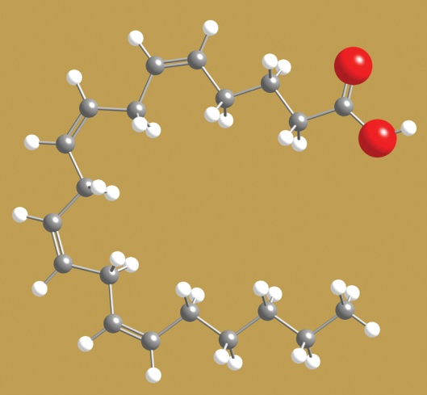
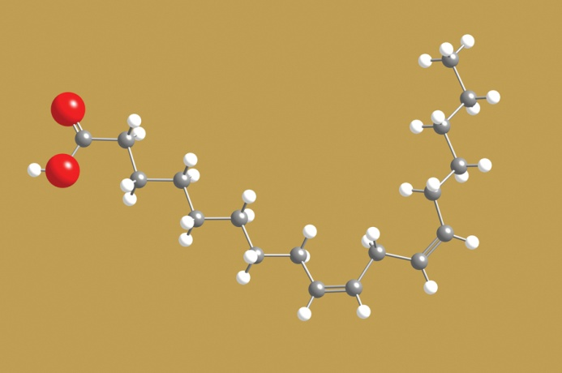
How do we get oils? (lower melting temperatures) A new family of fatty acids

Slide 15
How do we get oils? (lower melting temperatures) A new family of fatty acids
They have the
hydrocarbon tail.
So What’s Different?
THE TAILS
HAVE KINKS!

Slide 16
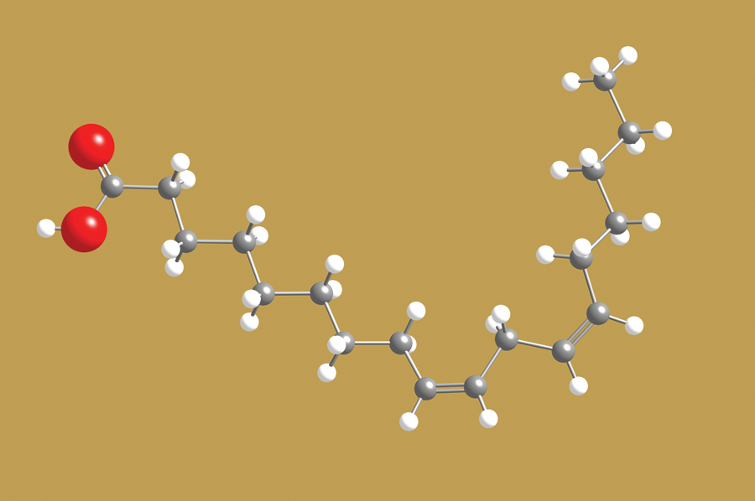
What causes the kinks? Differences in the Tails
Saturated fatty acids
No kinks
Unsaturated fatty acids
One kink (mono)
More than 1 kink (poly)
each C has 2 H atoms
C▬ C ▬ C ▬ C
(carbon-carbon single bonds)
Some C have only 1 H atom
C▬ C = C ▬ C
(carbon-carbon double bonds)
Kinks occur at double bonds.
(True of Unsaturated Fatty Acids that are found in Nature.)

Slide 17
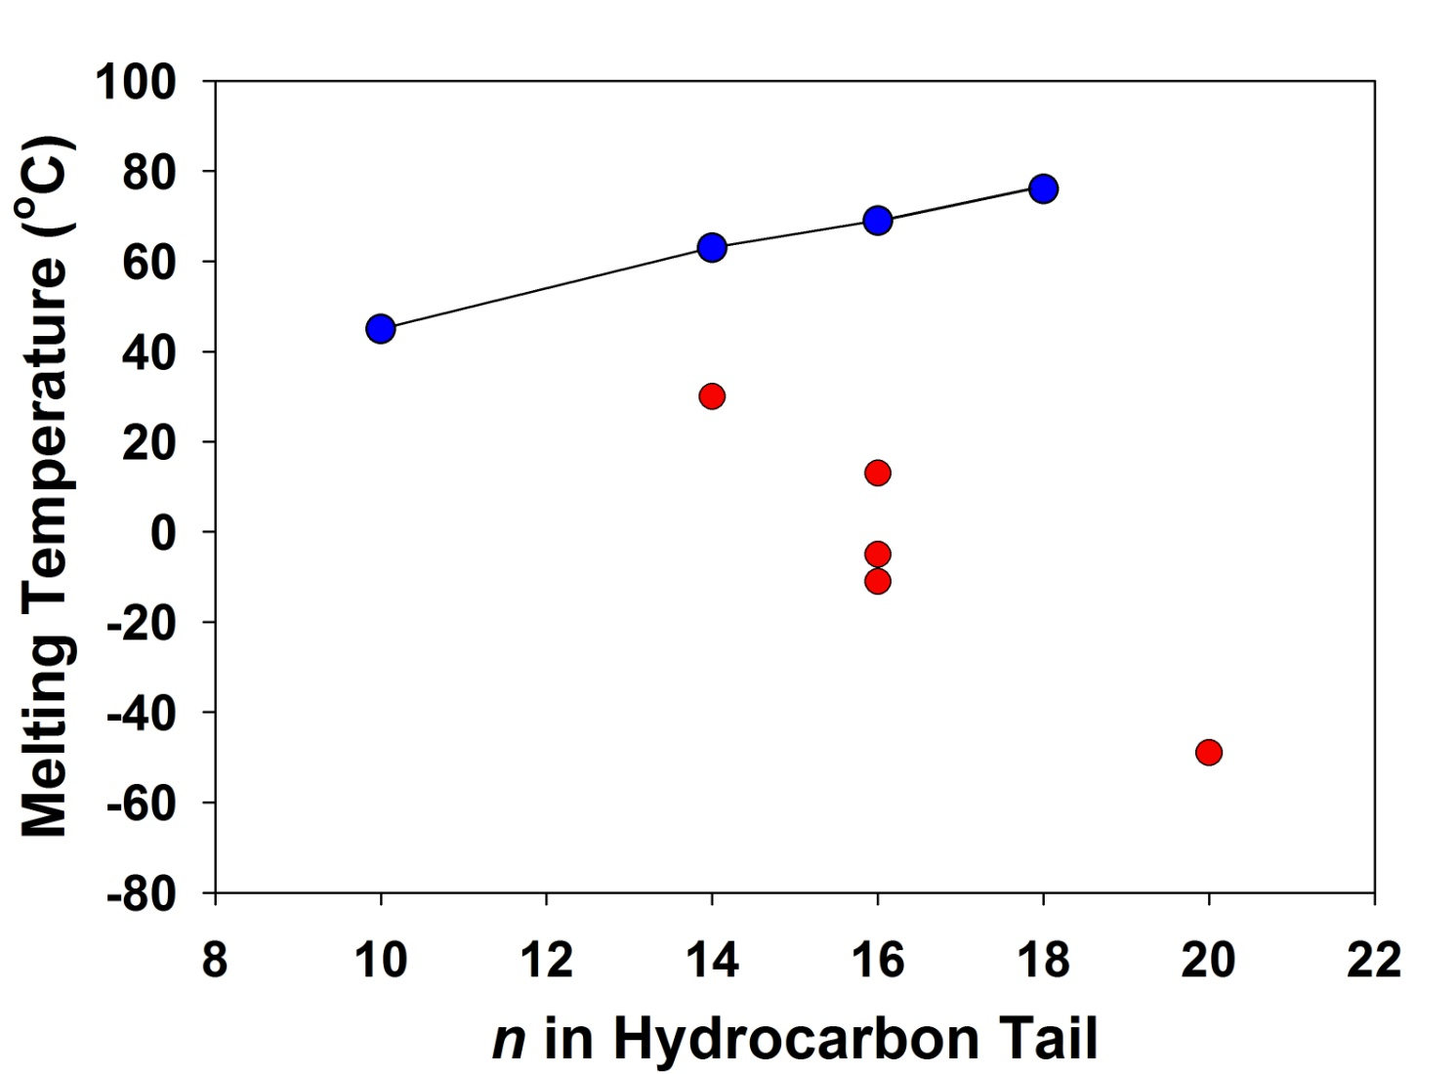
What difference does a kink make?
Fats containing
these fatty acids
are solids at
room temperature
Room temperature
1 kink
2 kinks
3 kinks
Oils containing
these fatty acids
are liquid at
room temperature
4 kinks

Slide 18
Fish that swim in the cold north Atlantic would have what type of fatty acid in their blood?
Saturated fatty acids with short tails
Saturated acids with long tails
Unsaturated acids with lots of double bonds

Slide 19
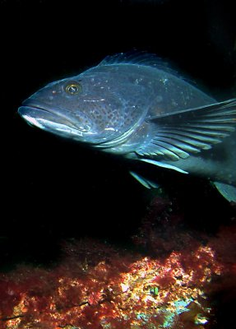
If you were a fish, swimming in the cold North Atlantic, what would you want flowing through your veins?
1 kink
2 kinks
3 kinks
4 kinks
Cod

Slide 20
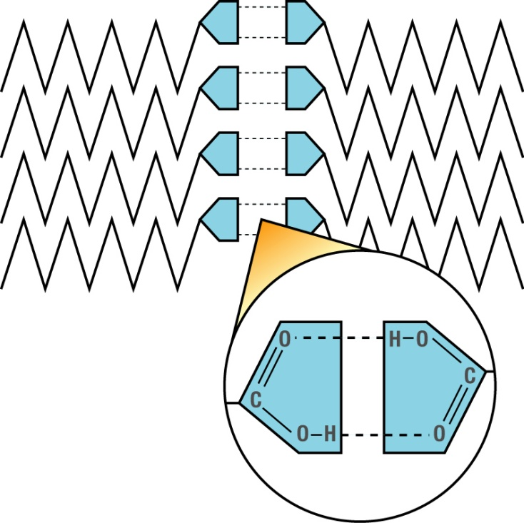
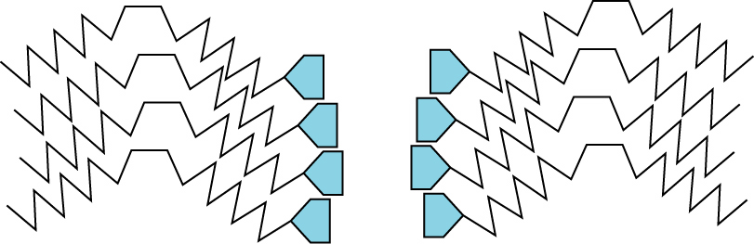
Why do kinks make a difference?
Molecules without kinks can
pack closer together.
RESULT:
more & stronger van der Waals forces between tails
stronger hydrogen bonding between CO₂H groups on different molecules
Strong forces mean high melting temperatures

Slide 21
What to look for?

Slide 22
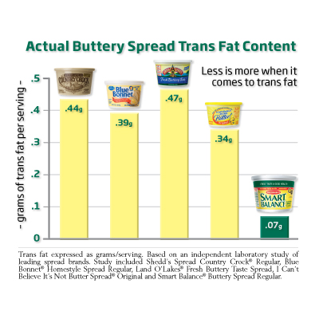
When rounding, one can be misled…
FDA guidelines allow food producers to round to the nearest gram per serving.
By fiddling with the serving size, you can claim 0 grams per serving!
5 spreads with “0 g” per serving.

Slide 23
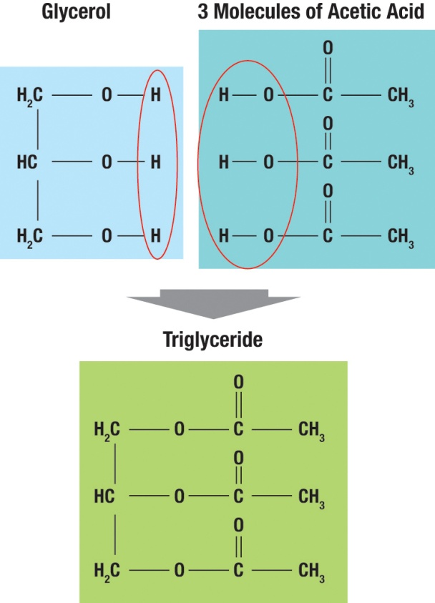
Chemical composition: Triglycerides
Three fatty acids combine with glycerol to form a triglyceride
If the fatty acids are saturated, this is saturated fat
Saturated fats are believed to cause heart and artery disease, increased cholesterol, and other health troubles
This is what we used to make biodiesel!
Notes:
Acetic acid, also known as ethanoic acid, is an organic chemical compound best recognized for giving vinegar its sour taste and pungent smell. Its structural formula is represented as CH3COOH. Pure, water-free acetic acid (glacial acetic acid) is a colourless liquid that attracts water from the environment (hygroscopy), and freezes below 16.7°C (62°F) to a colourless crystalline solid. Acetic acid is corrosive, and its vapour causes irritation to the eyes, a dry and burning nose, sore throat and congestion to the lungs. It is considered a weak acid due to the fact that at standard temperature and pressure the dissociated acid exists in equilibrium with the undissociated form in aqueous solutions, in contrast to strong acids, which are fully dissociated.

Slide 24
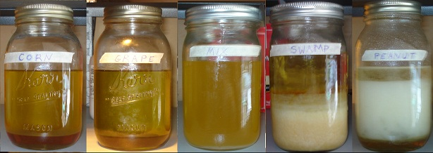
Biodiesel - Differing gel points
corn
grape
peanut
Related to choice of triglyceride source

Slide 25
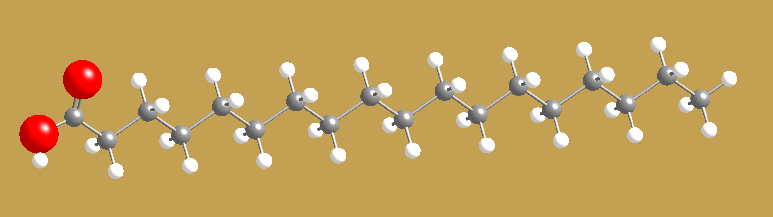
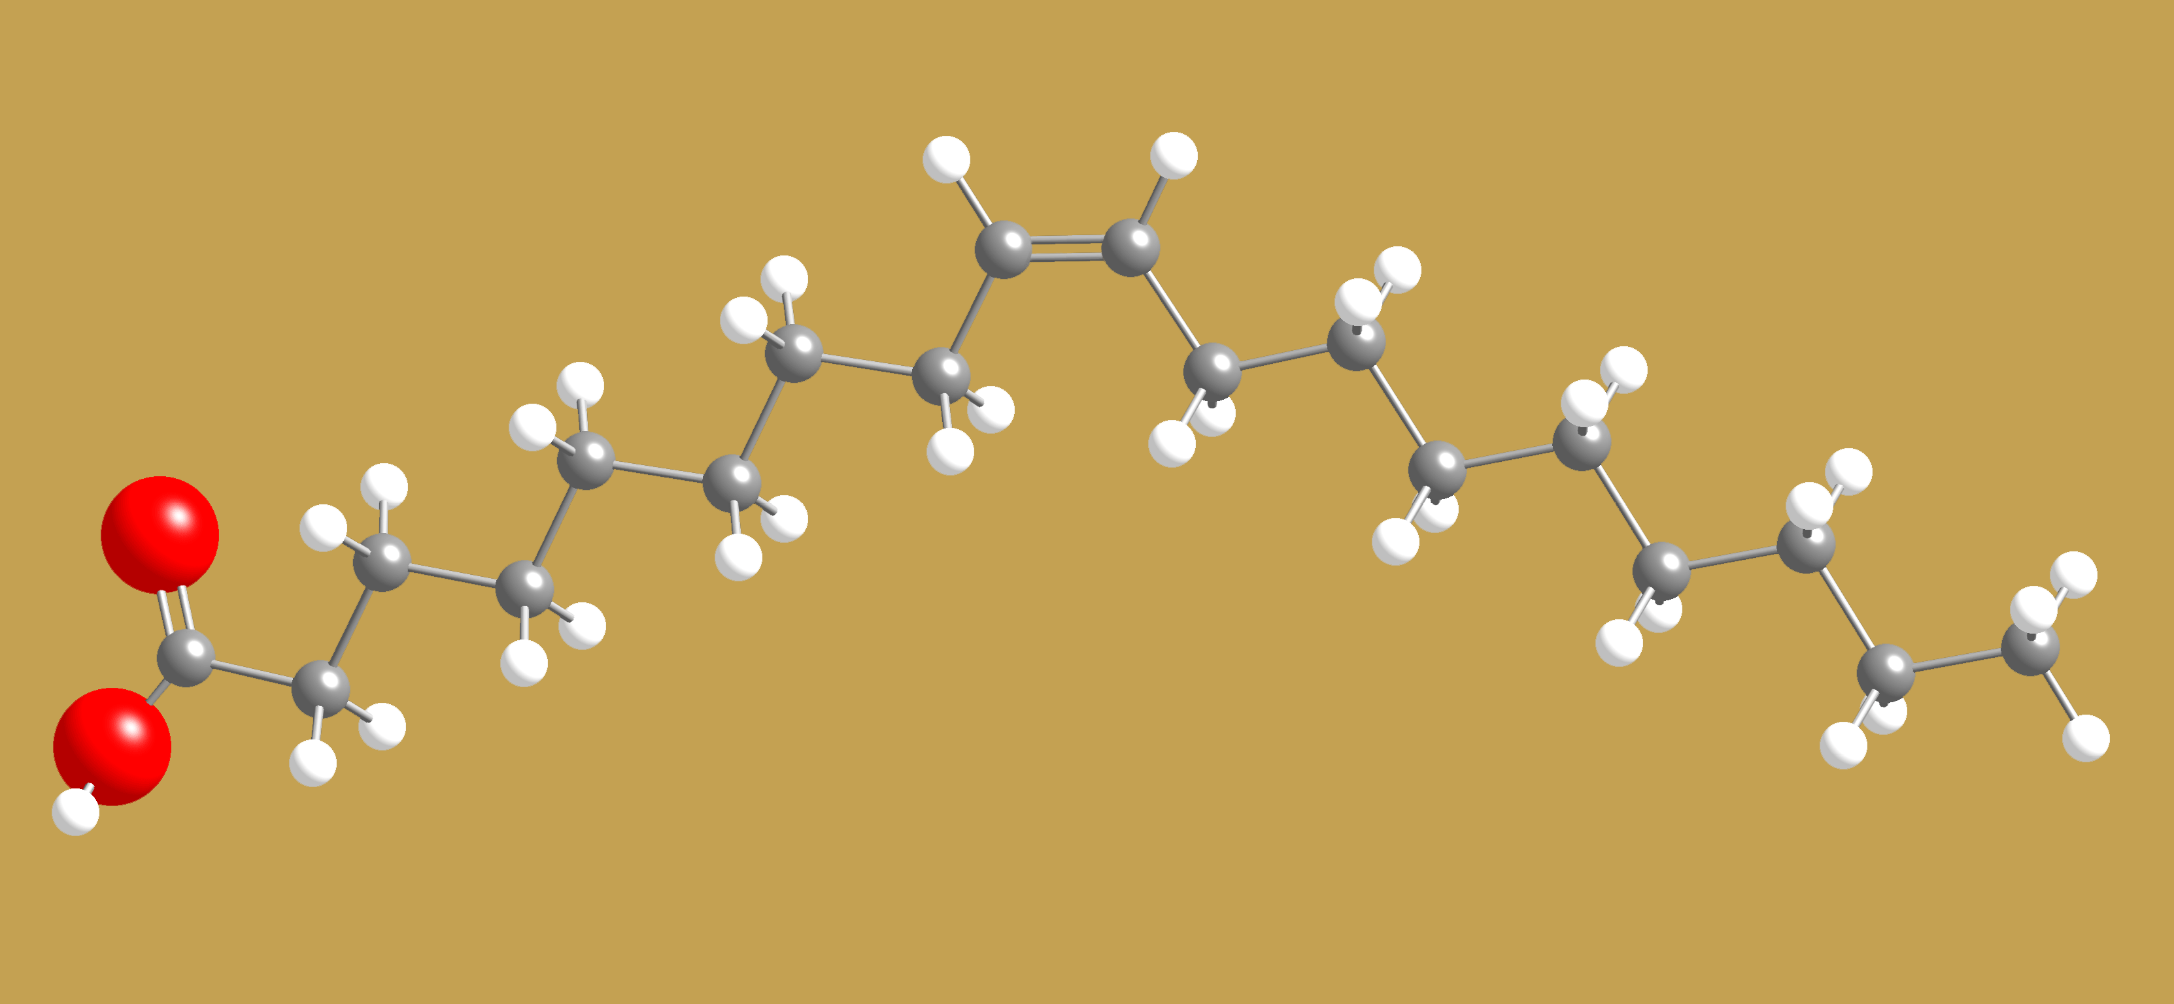
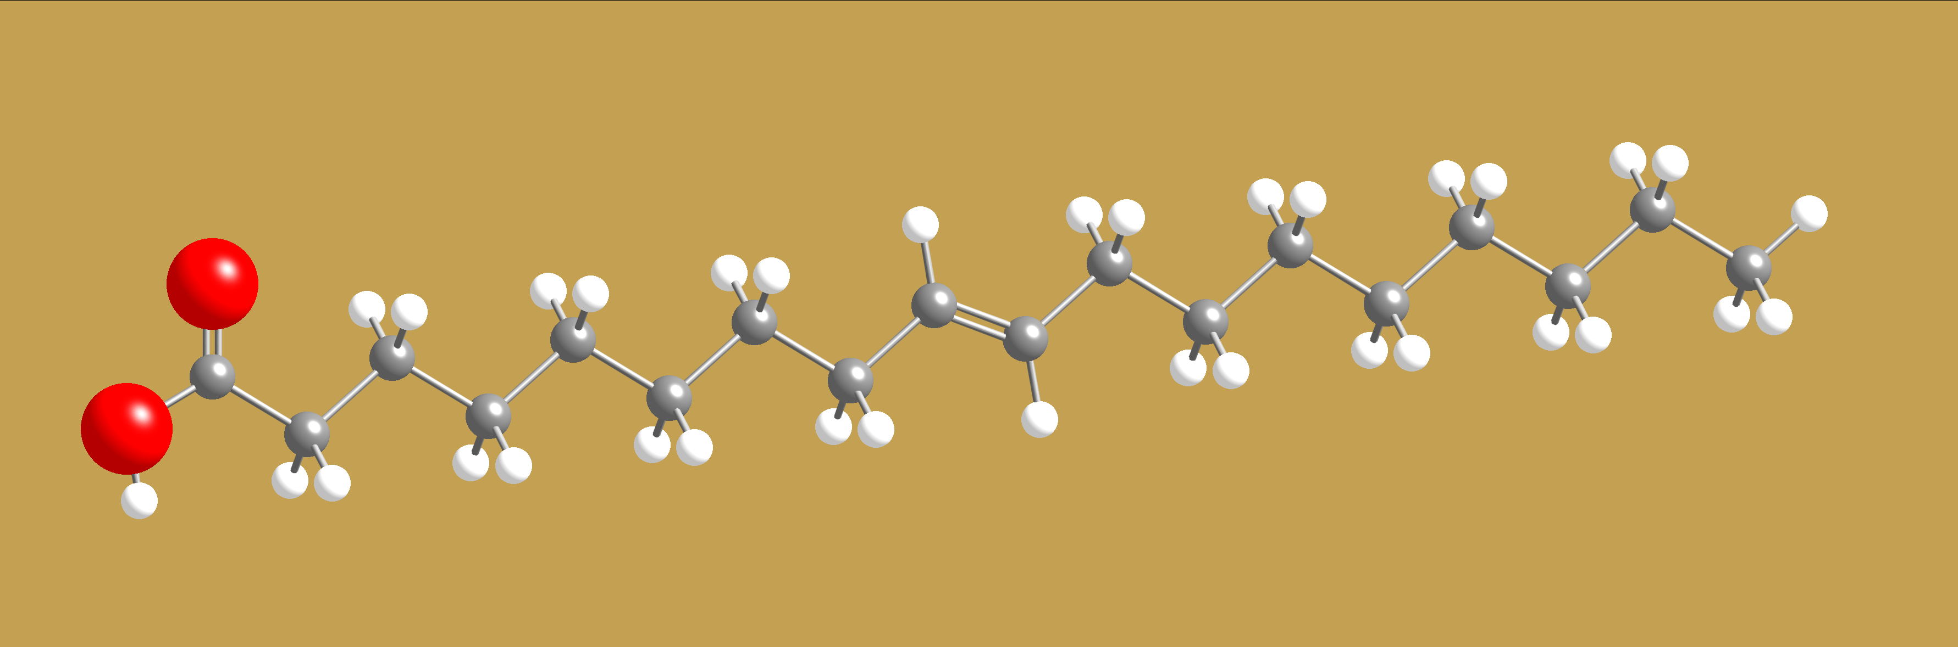
Trans-Fatty Acids – doing away with the kinks
Saturated Fatty Acid
No Kinks
Unsaturated Fatty Acid
Kink at
Double Bond
Unsaturated Fatty Acid
But no Kink at
Double Bond

Slide 26
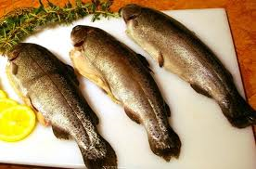
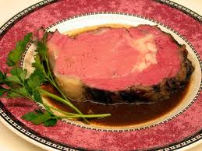
Fats
unsaturated fats with kinks
low melting points
don’t clog your arteries
good for your brain
fats without kinks
saturated & trans-fats
high melting points
solidify and block blood flow
olive oil
cold water fish
lard
shortening
prime rib

Slide 27
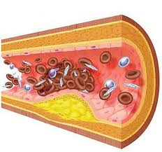
Mechanism for cardiac arrest
intima
Plaque
Fatty acid build-up
media
90% LAD?
- Fluid viscosity
Notes:
Left anterior descending coranary artery, entima ruptures
90% LAD

Slide 28

90% of a major artery is blocked!
LAD
Canvas announcement
“Pathology and pathogenesis of the vulnerable plaque”

Slide 29


Moving on to minerals…

Slide 30
What are rocks made of?
MINERALS!
Most rock forming mineral belong to a family of minerals called “SILICATES”
They all utilize the SiO₄⁻⁴ covalently bonded molecular ion.
This molecular ion may be put together in many different ways (just like the C and H molecules of organic matter)
Chains
Rings
Sheets
Isolated SiO₄ groups

Slide 31

The basis of Silicate Minerals: The Silicate ion, SiO₄⁴⁻
Tetrahedral arrangement
of oxygen atoms
around a central silicon
atom

Slide 32
What else do we need to make silicate minerals?
The SiO₄⁻⁴ group is negatively charged, so...
We need some positive charge to make the mineral electrically neutral
K⁺ and Na⁺
Fe²⁺, Ca²⁺, and Mg²⁺
Al³⁺
Ti⁴⁺
Or we need to arrange the SiO₄⁻⁴ groups so that the mineral is neutral

Slide 33


SiO₄⁴⁻ - a versatile connector
It is found in minerals
Two tetrahedra
share an oxygen
atom at the connection
as isolated units
Two tetrahedra
share an
oxygen atom
at the
connection
as chains or double chains
or as flat sheets of connected chains

Slide 34






Quartz
Asbestos
Mica
Clay
● Chains
● Sheets
● Framework
Which structures do these minerals have?
How can you tell?

Slide 35


Minerals with Isolated Silica Tetrahedra
Olivine – (Mg,Fe)₂SiO₄
This is the main mineral component in the Earth’s mantle
How does this mineral achieve neutral charge?
How are the SiO₄⁴⁻ groups arranged in the mineral?
Why do most olivine crystals contain both Mg and Fe?

Slide 36


Formation of Fibers
Asbestos
Positively Charged
Ions (Ca²⁺, Mg²⁺)
Double Chain
Weaker interactions
between units
Strongly-bound unit:
“Submarine sandwich”
You can pull apart fibers with your fingers

Slide 37




Formation of Sheets
silicate sheets
with negative charges
Small Al³⁺ Ions
Strongly-bound unit
You can pull
apart sheets
with your fingers
Positively Charged Ions, K⁺ and/or Na⁺

Slide 38



Which of these minerals do you think contains a transition metal?
Muscovite mica
Biotite mica

Slide 39



Formation of Irregular Chunks
Tetrahedron-tetrahedron
connections extend
in 3 directions.
Interactions are
equally strong in all
directions.
You need a hammer
to break crystal
into smaller chunks

Slide 40


Chapter 25 Nuclear Physics
Rutherford discovered
Contains positively charged protons.
Held together by the Nuclear Strong Force.
Very tiny

Slide 41
Modeling the nucleus
All of the previously discovered rules still apply.
Electric force law – protons will repel each other.
Wave-particle duality – protons and neutrons will behave as waves of probability.
Pauli exclusion principle – only one proton (or neutron) can occupy each possible state.

Slide 42

Where does the mass go? Why does the graph go down so steeply at low atomic mass?
E = mc²

Slide 43
Why would the graph increase at large atomic mass?
E = mc²

Slide 44
The graph abruptly ends. What does this tell us about the range of the nuclear strong force?
E = mc²

Slide 45
What two fundamental forces combine to make this shape for nuclei formation?
Energy
Nuclear strong and electromagnetic
Electromagnetic force
Strong force
He
Fe
Lv
Size of nucleus

Slide 46



Energy Released or Absorbed for nuclear process involving element “A”?
Mass | A < Iron | A > Iron
Fusion | Released | Absorbed
Fission | Absorbed | Released
Notes:
During World War I and after, young women at the U. S. Radium Corporation in Orange were employed painting luminous dial watches with a radium material. Apparently, the women were directed to point up their brushes with their tongues, imbibing radioactive paint. After the war, it was discovered that these women were dying of anemia and a disease called radium necrosis (radium poisoning) which ate away their jawbones. The initial investigation was made by Katherine Wiley of the Consumers League of New Jersey, who was called in by the family of one of the women in 1924. The League campaigned successfully to have radium necrosis recognized as an occupational disease by the State Workmen's Compensation Board in 1926, too late, however, to benefit women who had suffered from radium poisoning before the law was passed. The League aided them with their lawsuits until 1935, when all proceedings for damages against U. S. Radium were stopped. The universal horror caused by this case contributed to the passage in 1949 of a bill making all industrial diseases compensable and extending the time during which workers could discover illness.

Slide 47

Fusion
Combining two small nuclei to make a larger one gives off energy.
Abundant fuel (in sea water) and large energy gain make this a very exciting possibility.
The catch: Because nuclei are positively charged, you need either extremely hot reactants or large confining forces.
What forces do you have available for confinement?

Slide 48

Gravitational confinement

Slide 49

Confinement using magnetic fields: Tocamak

Slide 50



Fission
Breaking one extremely large nucleus into two smaller ones gives off energy.
Free neutrons from one fission can trigger another fission, creating a chain reaction.

Slide 51


Fission Process
Notes:
mass of fragments vary, but usually 2 fragments and 2-4 neutrons come out. The extra neutrons can trigger other reactions. This process is much more probable with slow neutrons (they spend more time near the nucleus and have more time to react).

Slide 52

A chain reaction

Slide 53

Fission Reactor
Fissile material (fuel rods)
²³⁵U, ²³⁹Pu
Moderator
Slow neutrons down
Control rods
Absorb extra neutrons
Problems
radioactive waste
fuel is rare
fuel can be misappropriated for weapons
mistakes are costly
Notes:
²³⁹Pu can be produced in a breeder reaction
fuel rods, ²³⁵U and ²³⁹Pu
good control rod: cadmium
good moderator: graphite, water
wastes have a long half life. Yucca Mountain--repository in Nevada: a place to put this (Nevada residents do not want to be the nuclear dumping ground of the nation). Nearby states (including Utah) don’t want fuel going through their state on the way there.

Slide 54



Current applications for fission reactors

Slide 55
Radioactive decay
Alpha decay
A nucleus emits 2 protons and 2 neutrons
Beta decay
A nucleus emits 1 electron
Gamma decay
A nucleus emits a high-energy photon

Slide 56
Ionizing Radiation
The particles released in decay carry a lot of energy
often a million times typical molecular binding energies
danger to living cells
damage RNA or DNA causing death of cells or mutations
disrupt metabolic processes
cells with high activity seem more prone to damage than others (cancer therapy)
Notes:
damage could be direct (damage RNA directly) or disrupt other molecules that then damage DNA or RNA
cal also be used to control cancer

Slide 57




The nuclear truth
Highly radioactive isotopes are dangerous if…
there are many of them highly concentrated
they have high R.B.E.
a number that expresses the relative amount of damage that a fixed amount of ionizing radiation of a given type can inflict on biological tissues
alpha particles
beta particles
Gamma rays

Slide 58



Potassium Iodide pills prevent concentration of I-131 in the thyroid
I-131
I-127

Slide 59


Radium watches
During World War I and after, young women at the U. S. Radium Corporation in Orange were employed painting luminous dial watches with a radium material. Apparently, the women were directed to point up their brushes with their tongues, imbibing radioactive paint. After the war, it was discovered that these women were dying of anemia and a disease called radium necrosis (radium poisoning) which ate away their jawbones.
Notes:
During World War I and after, young women at the U. S. Radium Corporation in Orange were employed painting luminous dial watches with a radium material. Apparently, the women were directed to point up their brushes with their tongues, imbibing radioactive paint. After the war, it was discovered that these women were dying of anemia and a disease called radium necrosis (radium poisoning) which ate away their jawbones. The initial investigation was made by Katherine Wiley of the Consumers League of New Jersey, who was called in by the family of one of the women in 1924. The League campaigned successfully to have radium necrosis recognized as an occupational disease by the State Workmen's Compensation Board in 1926, too late, however, to benefit women who had suffered from radium poisoning before the law was passed. The League aided them with their lawsuits until 1935, when all proceedings for damages against U. S. Radium were stopped. The universal horror caused by this case contributed to the passage in 1949 of a bill making all industrial diseases compensable and extending the time during which workers could discover illness.

Slide 60

Half Life
The half life is the time it takes half a sample of radioactive nuclei to decay
Importance examples
¹⁴C --> ¹⁴N + e + neutrino (half life of 5730 years)
⁴⁰K + e --> ⁴⁰Ar + neutrino (half life of 1.3 billion years)
is applicable only to matter which was once living and presumed to be in equilibrium with the atmosphere, taking in carbon dioxide from the air for photosynthesis.
Carbon-14 decays with a halflife of about 5730 years by the emission of an electron of energy 0.016 MeV. This changes the atomic number of the nucleus to 7, producing a nucleus of nitrogen-14. At equilibrium with the atmosphere, a gram of carbon shows an activity of about 15 decays per minute.

Slide 61

Half Life

Slide 62
Radioactive Dating
Each half-life, half of the remaining atoms are left undecayed.
One half-life--> ½
Two half-lives--> ½ x ½ = 1/4
Three half-lives--> ½ x ½ x ½ = 1/8
If the original number of atoms is known, the age of the sample can be determined by the fraction of atoms left.
This process is known as radioactive dating

Slide 63
A sample of radioactive gas is produced. After 20 minutes, only ¼ of the original gas remains. What is the half life of the gas?
5 minute
10 minutes
15 minutes
20 minutes

Slide 64
A sample of radioactive material with a half-life of 6 hours sits for a day (24 hrs). How much of the original material remains?
A half
A quarter
An eighth
A sixteenth

Slide 65

Procedure

Slide 66

Half Life
What is the Half Life of this radioactive sample?

Slide 67


Radioactive decay - Chart of the nuclides

