Slide 1
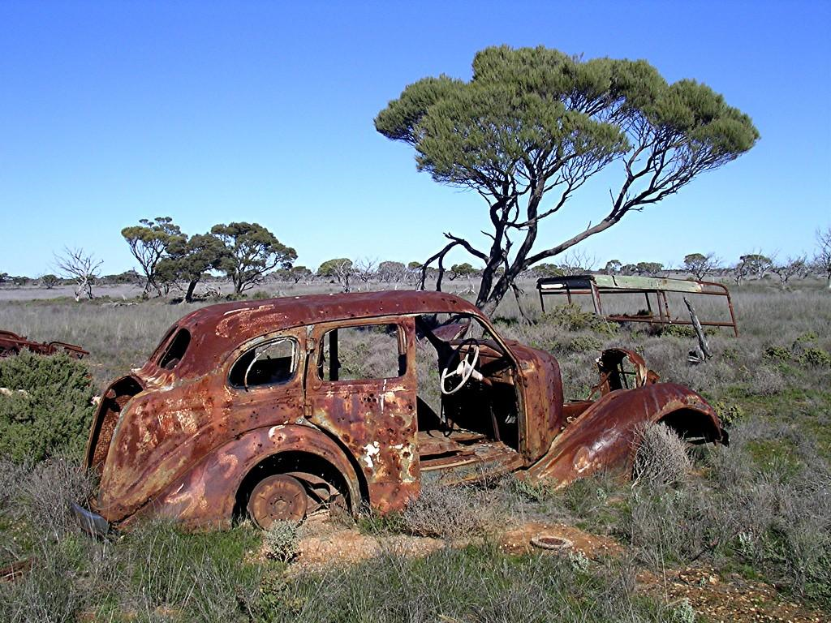
Chapter 18,19 and 20 Quiz

Slide 2
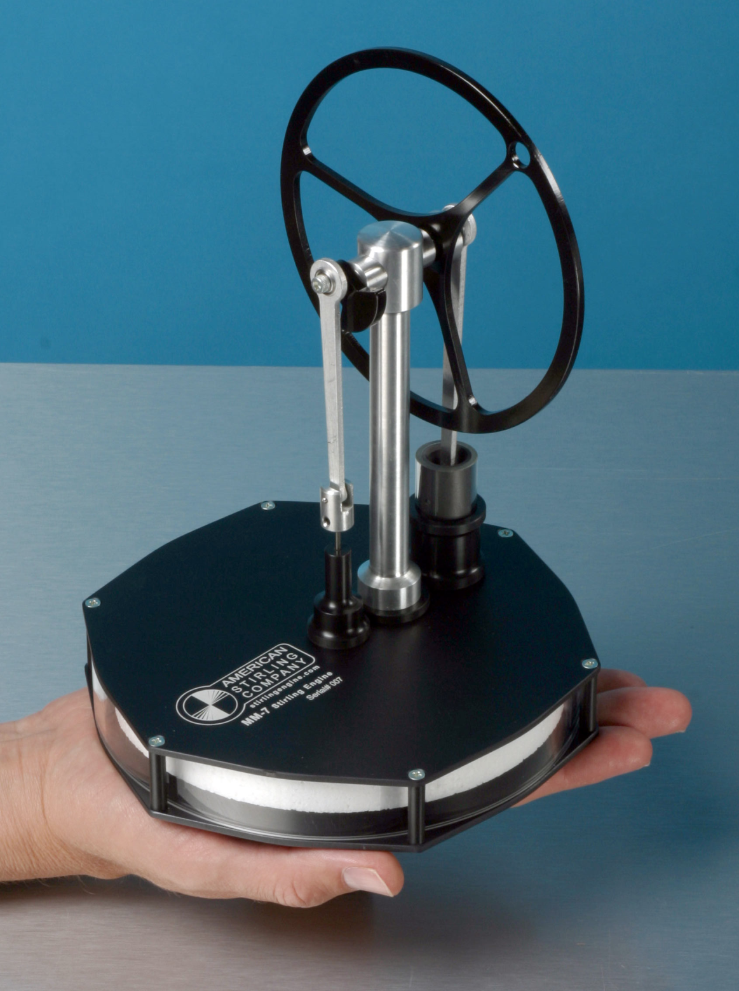
Stirling Engine
1
What is required to run the Stirling engine?

Slide 3
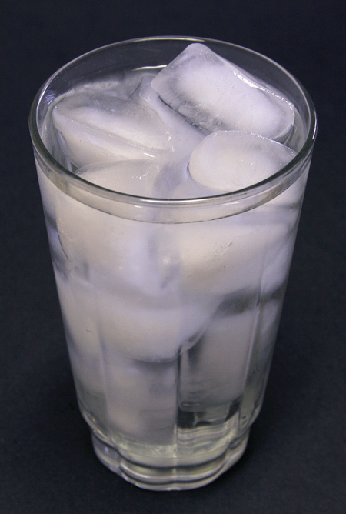
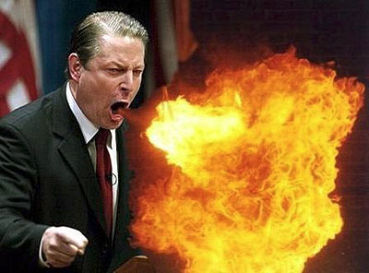
What is the difference between temperature and heat?
2

Slide 4
What is the temperature of this system?
3
33 Degrees Fahrenheit
0 Degrees Celsius
300 Joules Kelvin
90 lbs. Coal
e.-1 Degrees Celsius

Slide 5
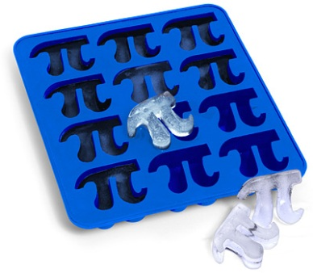
When water freezes into ice
4
The entropy of the universe decreases.
The entropy of the water/ice system increases
The water/ice system loses all its entropy
None of the above

Slide 6
What law states:
5
Changes occurring in natural systems always proceed in such a way that the total amount of “disorder” in the universe either is unchanged or increased.

Slide 7
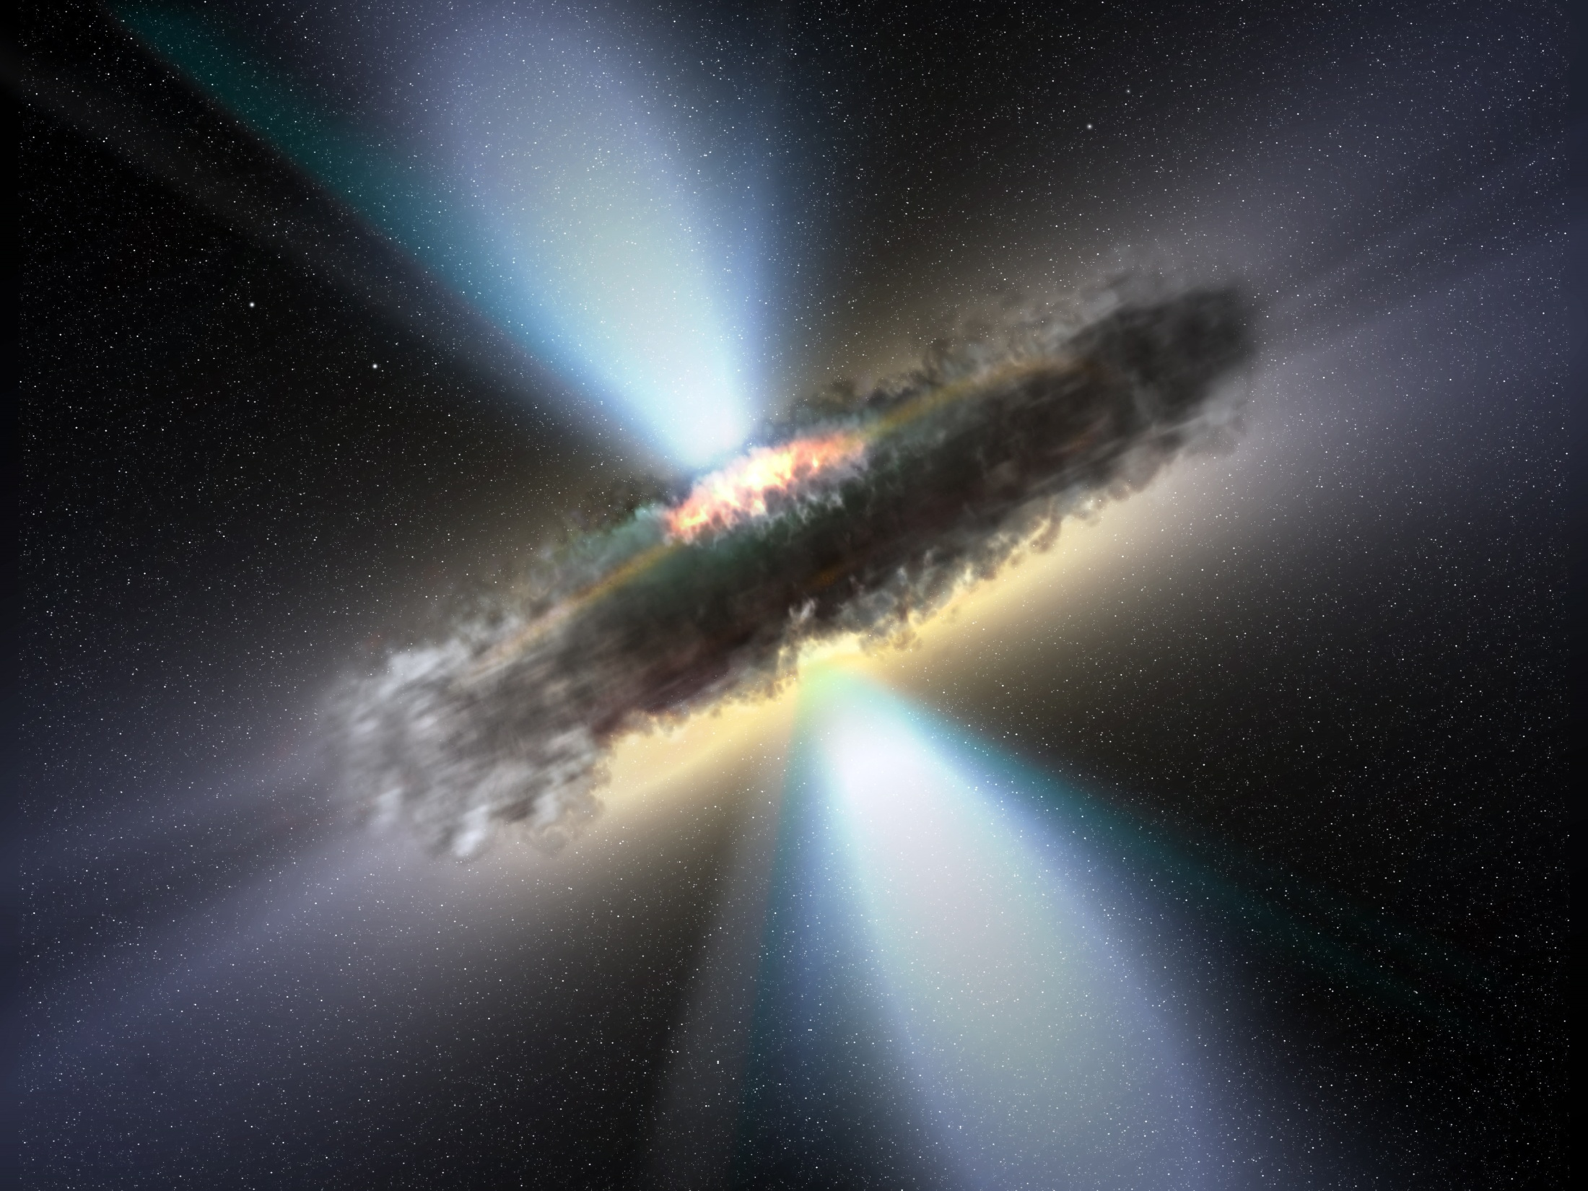
Give an example of an irreversible process.
6

Slide 8
Which is true concerning the limits to efficiency?
7
Energy can only partially be converted into heat.
Chemical potential energy can never change form.
Heat cannot be completely converted into kinetic energy.
You cannot get Macroscopic Kinetic Energy from a lower ordered form energy from.

Slide 9
Street jive theory
8
Which statement is incorrect and why?
How many atoms are in a molecule of aspirin?
My brothers truck has a carbon fiber frame.
Quit inhaling all the helium molecules from those balloons sir.
The nitrogen in this room is mostly diatomic.

Slide 10
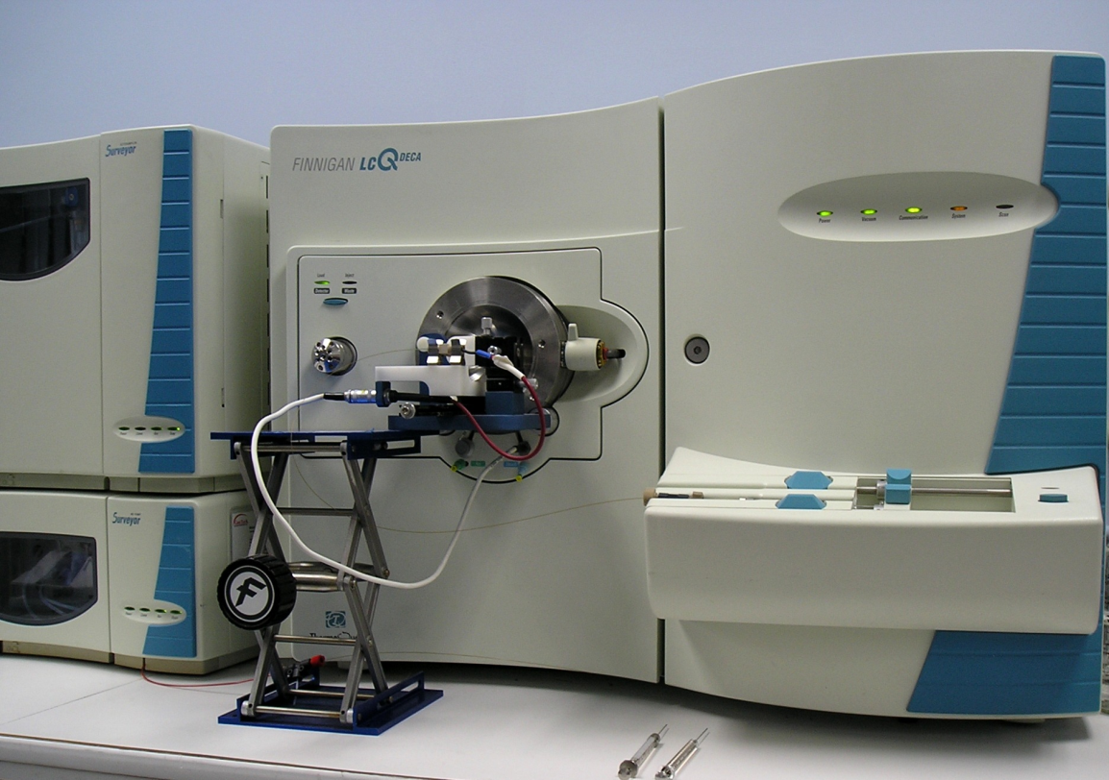
Time-of-Flight Mass Spectrometer
9
kinetic energy = ½(mass)(speed)²
CO₂ H₂O₂ PbO₂ CH₄
If the above fragments are each ionized and given the same kinetic energy, which one gets to the detector last?

Slide 11
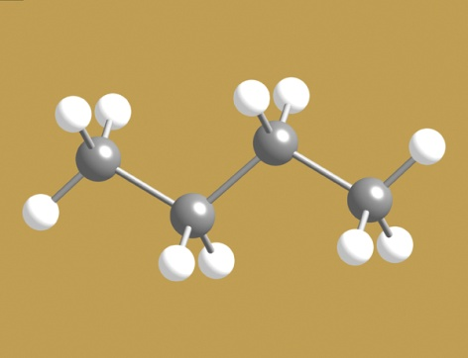
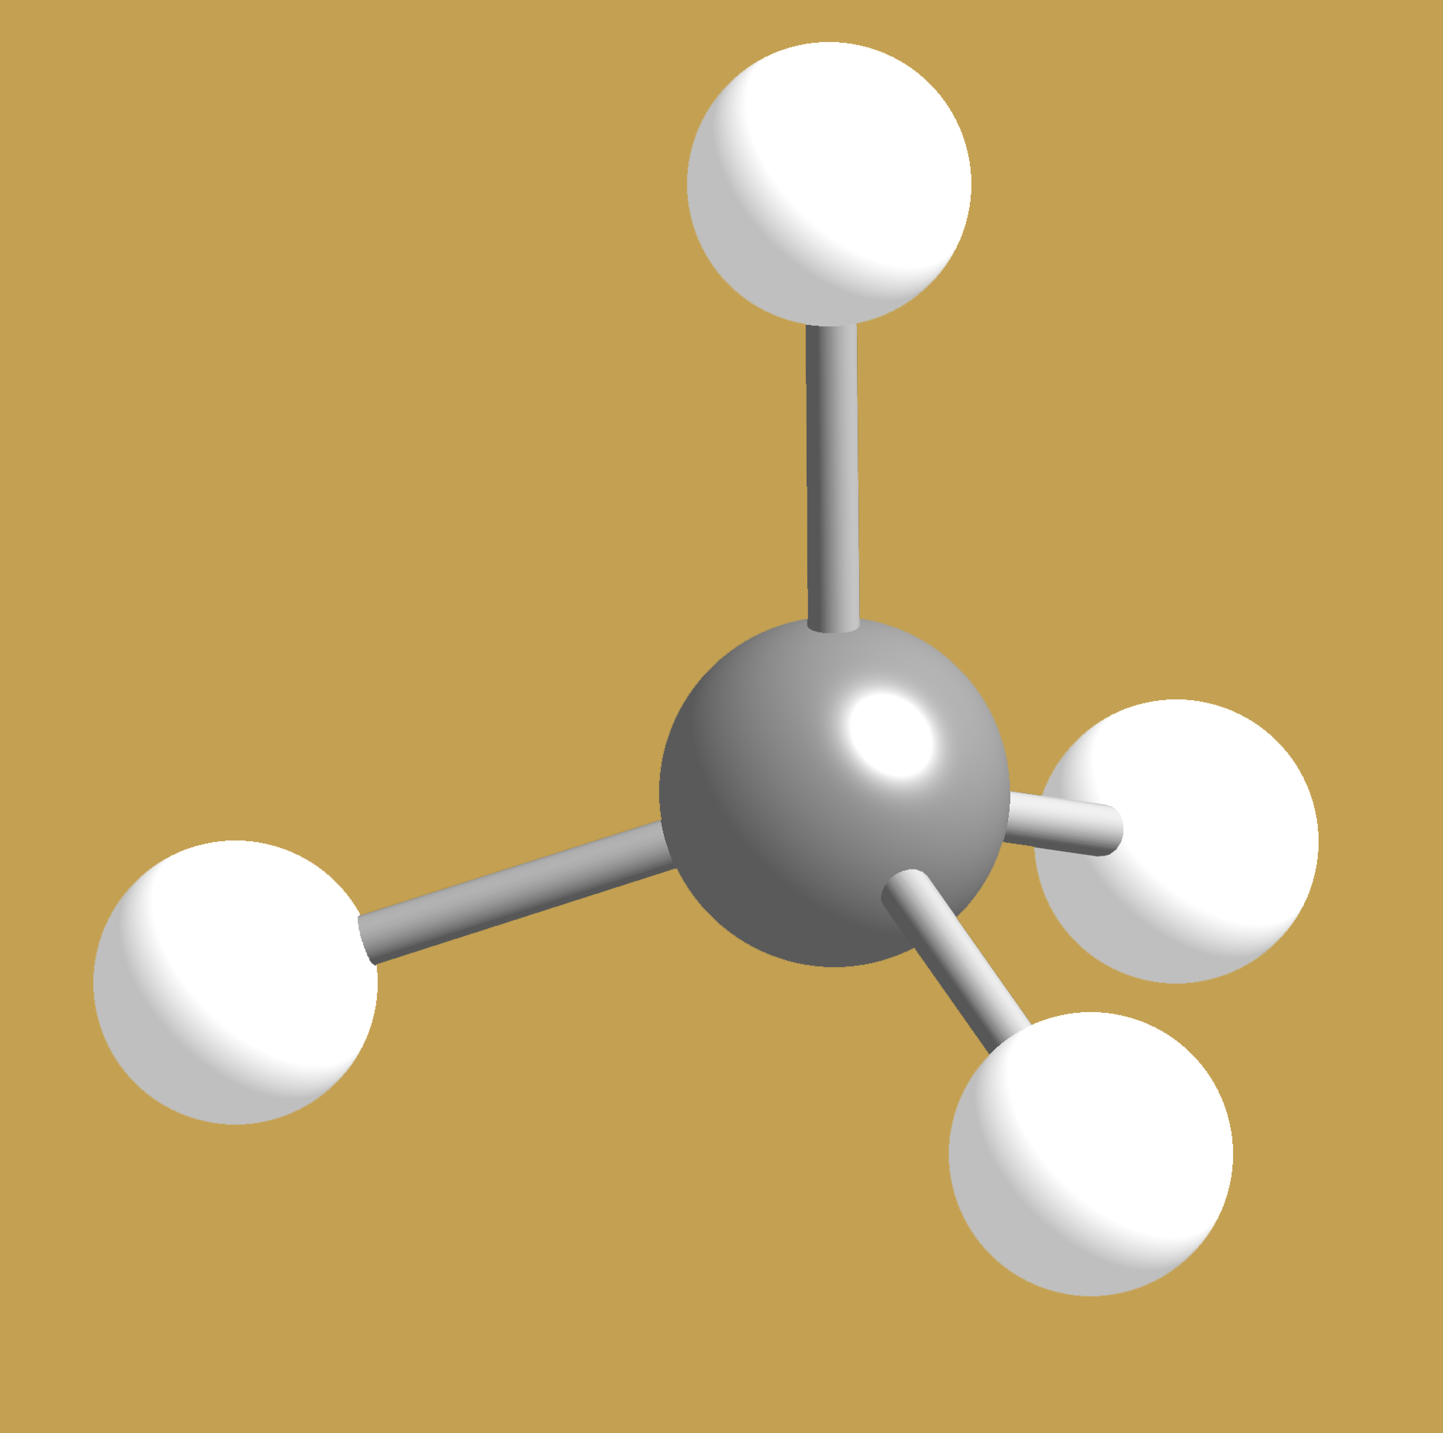
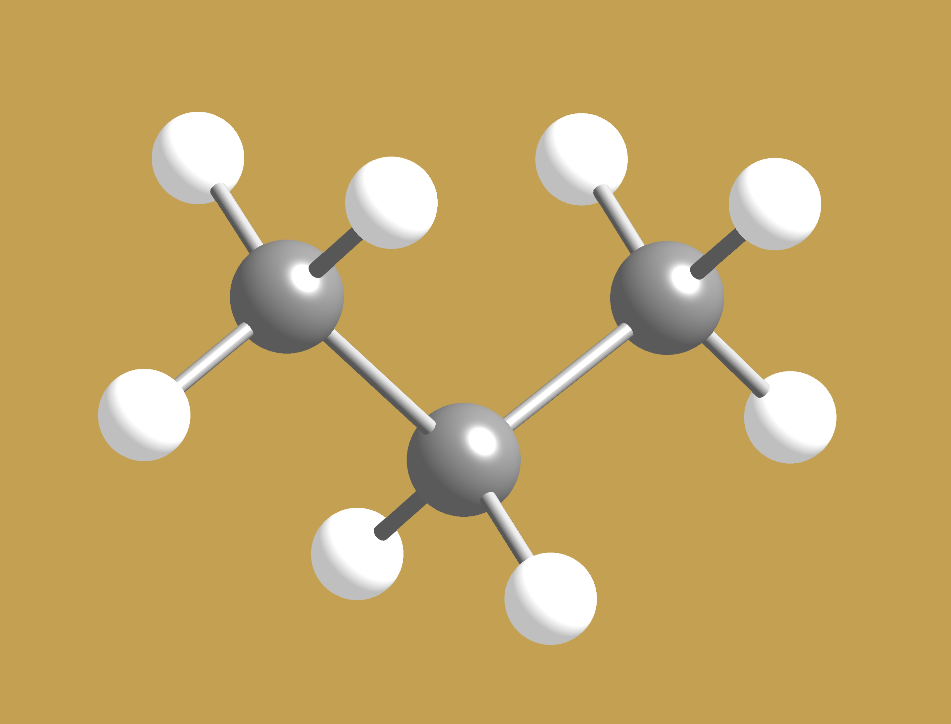
What formula represents this family of molecules?
10
(CH₂)_{n}
C_{n+3}H_{n+9}
C_{n}H_{2n+2}
C_{n}H_{n+2}
C_{2n}H_{5n}
C₄H₁₀
0
of
5
where n is an integer starting with 1
CH₄
0
C₃H₈
Answer Now

Slide 12
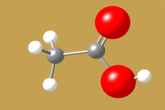

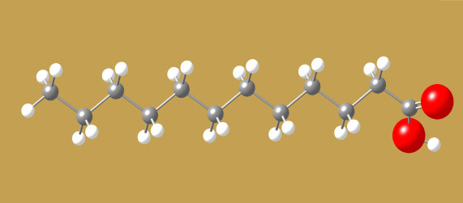
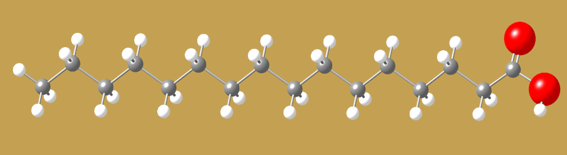
What 2 groups of atoms are common to all three molecules?
11
CH₃CO₂H -- Acetic acid (gives vinegar its taste)
CH₃(CH₂)₁₀CO₂H
Lauric acid – in coconut milk
CH₃(CH₂)₁₄CO₂H -- Palmitic acid (palm oils, and animals)

Slide 13
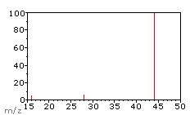
What molecule does this mass spectrum represent?
12
CO₂
CO
H₂0
NO
CH₄
m/z is mass per charge

Slide 14
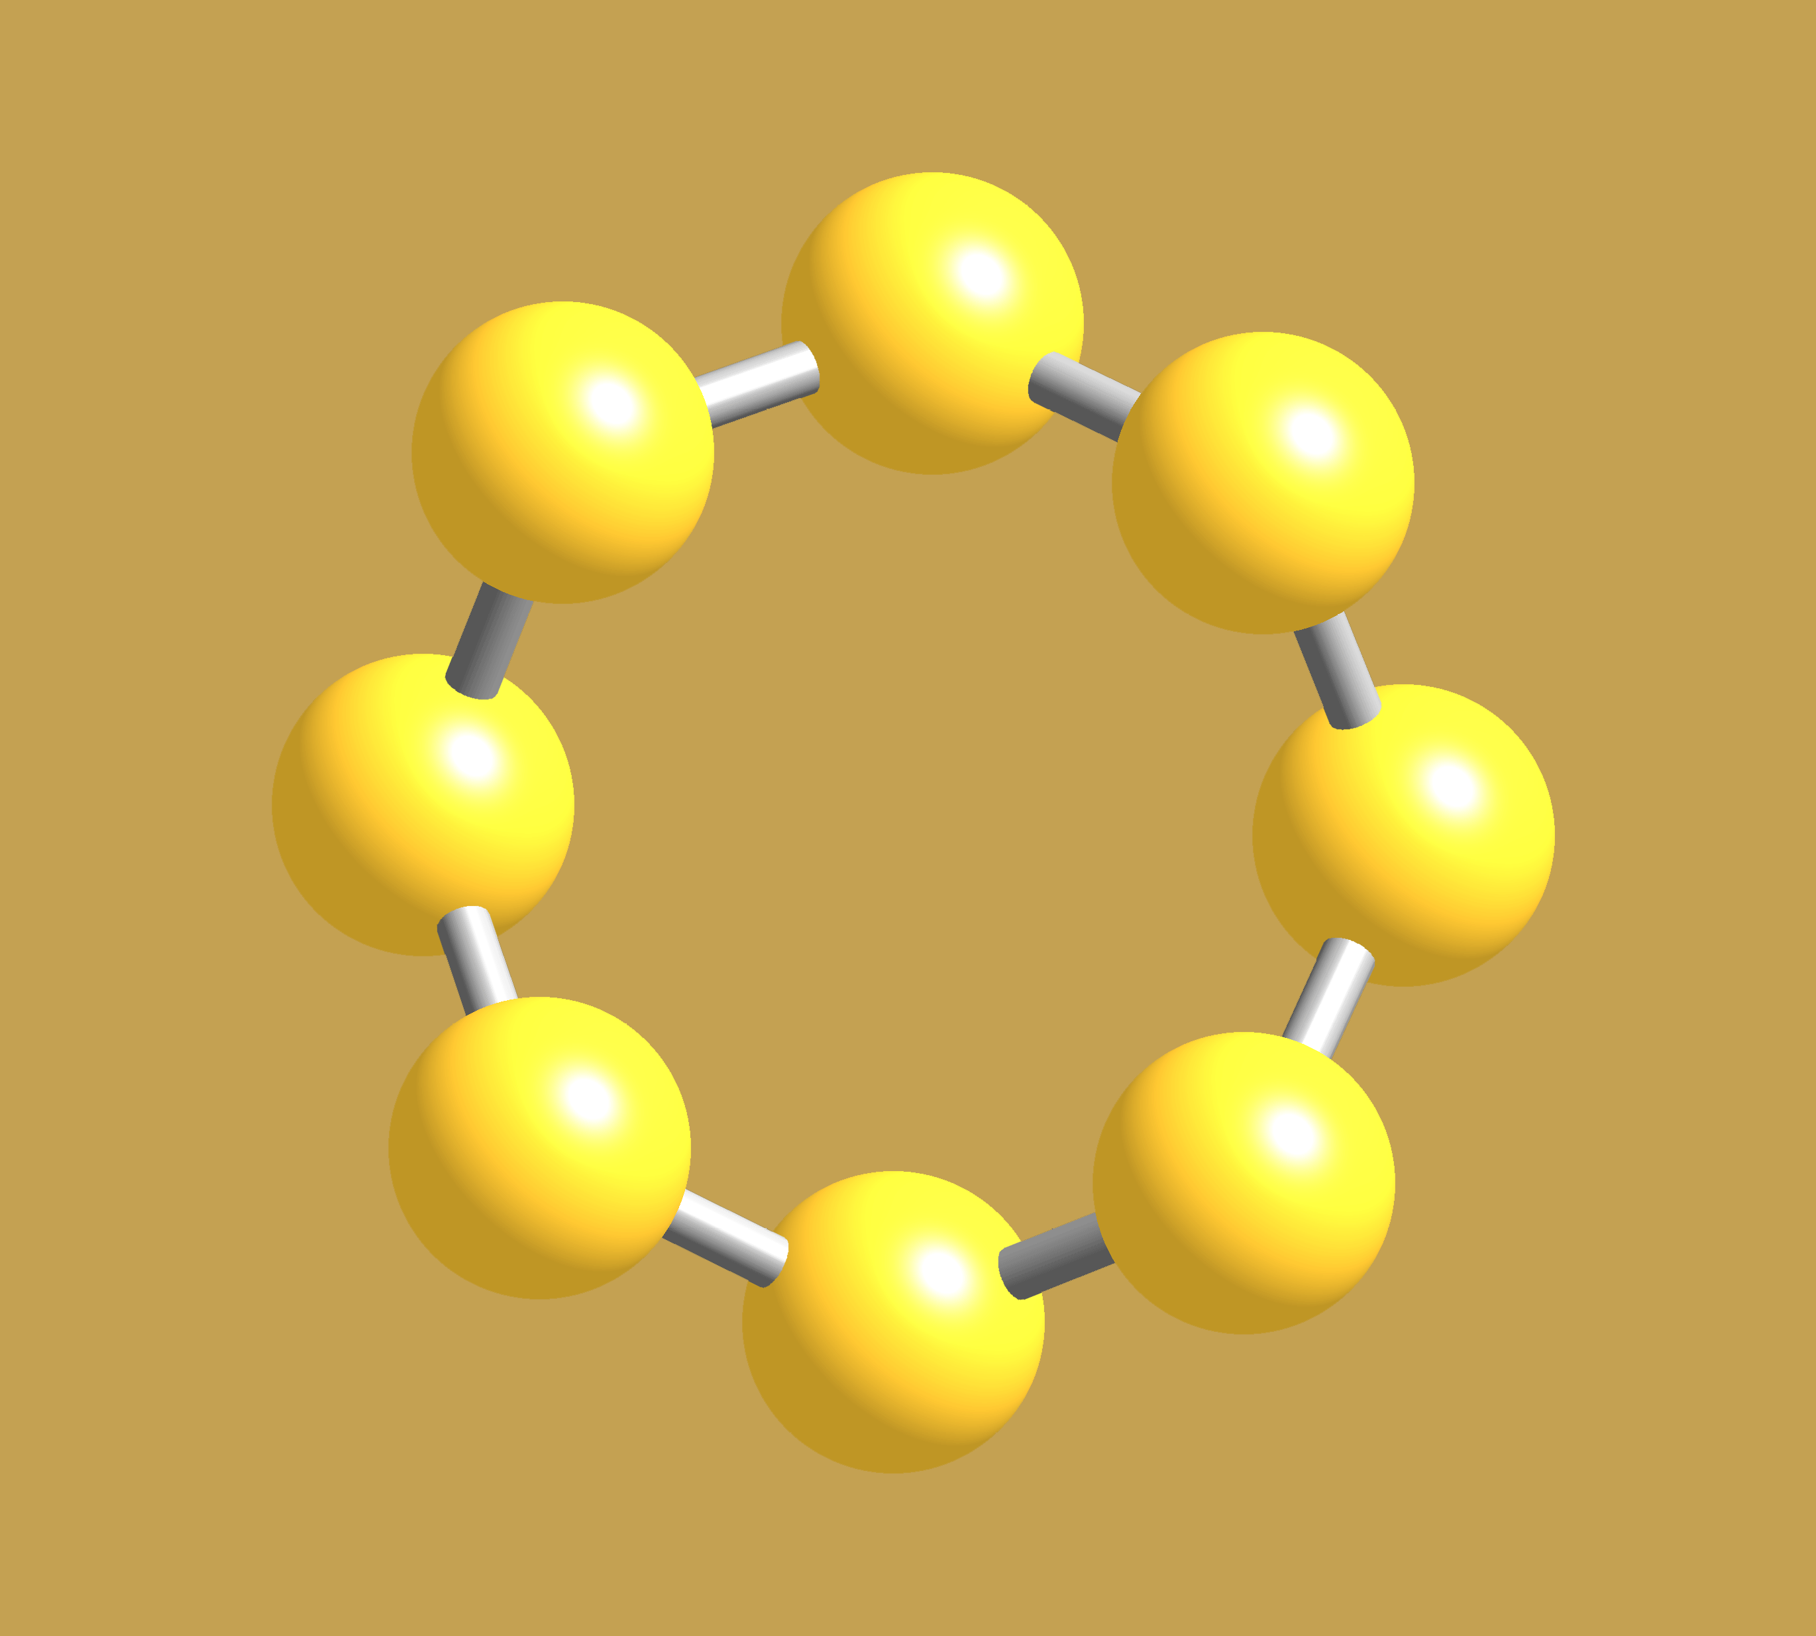
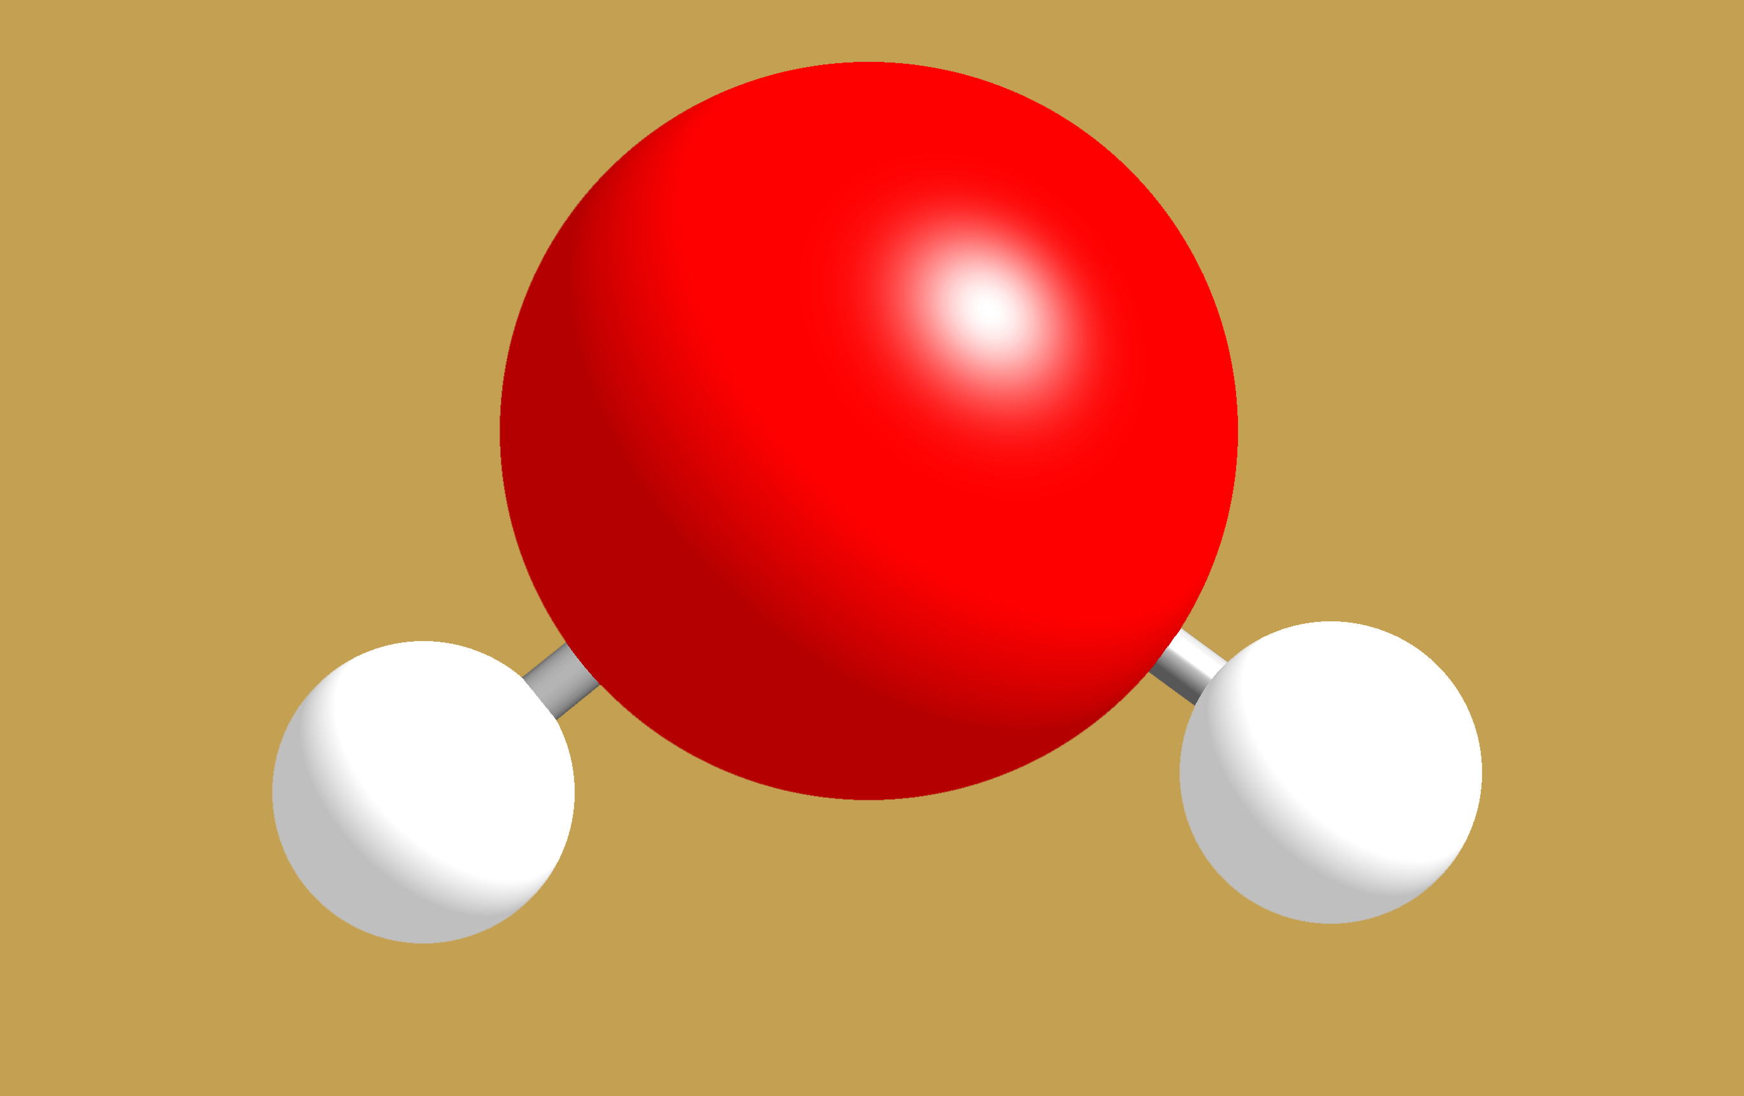
Write the chemical formulae for these molecules
13

Slide 15
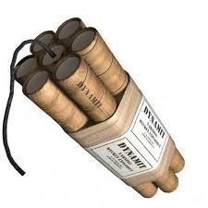
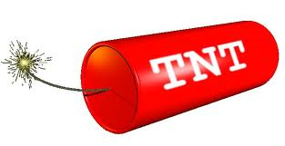
T.N.T. vs. Dynamite
14
T.N.T. is just a fancy acronym for trinitrotoluene, the chemical name for dynamite.
They are not the same. They do not even have the same molecules in them.
They are not the same. They have different proportions of the same elements though.
A stick of T.N.T. is the same thing as a stick of dynamite.

Slide 16
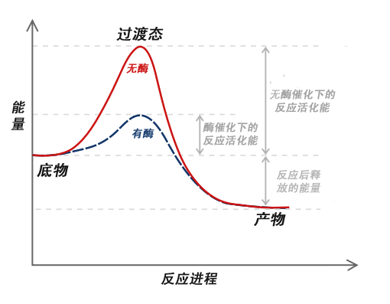
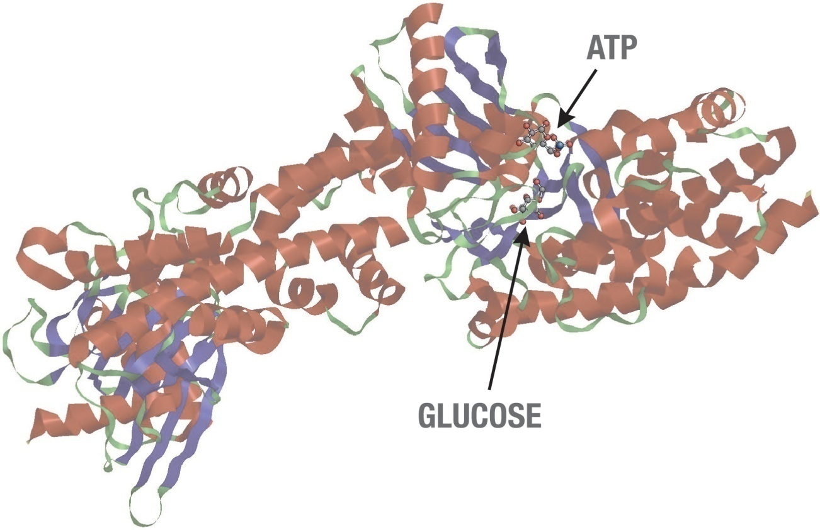
Kick the tires and light the fires.
15
What do you add to a mixture of chemicals to initialize a reaction? What does it do?

Slide 17
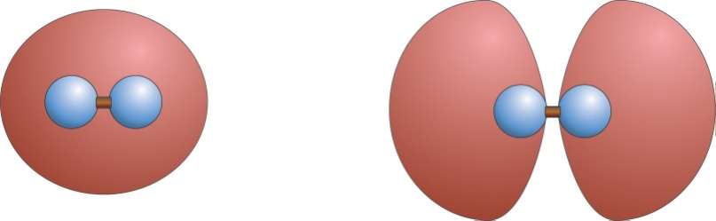
Molecular Orbitals and Bonding
16
↓↑
H–H or H₂
When two hydrogen atoms combine they either bond or anti-bond. Which orbital has more energy?

Slide 18
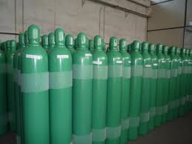
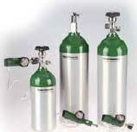
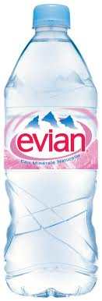
Which way of writing the reaction of hydrogen with oxygen to make water complies with conservation of matter?
17
2H₂ + O₂ → 3H₂O
H₂ + O₂ → H₂O₂
H₂ + O₂ → H₂O
H + O₂ → H2O
2H₂ + O₂ → 2H₂O
+

Slide 19
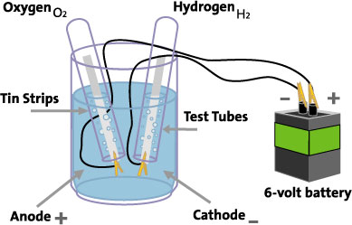
What is the process of separating Hydrogen and Oxygen from water called?
18
2H₂O + energy → 2H₂ + O₂

Slide 20
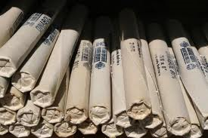
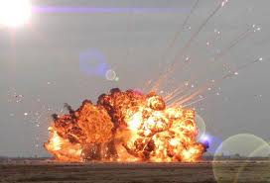
Reactions Go at Different Speeds- Fill in the Blank
19
2 C₇H₅N₃O₆ → __ N₂ + 5 H₂O + 7 CO + 7C

Slide 21
Reactions are more likely to occur if
20
There are more collisions between atoms and the collisions are more vigorous, this happens when you
Increase the ______________
2. The energy of the system will decrease
3. The ______ of the system will increase
(more than one answer)

