Slide 1
Last Chapters Vote
Chapter 21- Bonding in Metals, Alloys, and Semiconductors
Chapter 22- Bonding in Ionic Compounds
Chapter 23- Covalent Bonding molecular Interactions
Chapter 24- Animal, Vegetable, Mineral
Chapter 25- Radioactivity, Nuclear Processes
Chapter 26- Earth's Interior
Chapter 27- Plate Tectonics: A Working Model for Earth
Chapter 28- Geologic Time
Chapter 29- Plate Tectonics: The Evidence
Chapter 30- Surface Processes
Chapter 31- Earth’s Climate
Chapter 32- Beyond Earth
Chapter 33- The History of a Star
Chapter 34- Cosmology: The History of the Universe
Chapter 35- Looking Backward, Looking Forward

Slide 2
Midterm exam in 2 weeks
March 10
Starts at 10:45am in this room
Should take about an hour
Multiple choice and short answer
Covers chapters 1-20
Study guide on canvas
10% of your grade
I will not be here, a substitute will

Slide 3
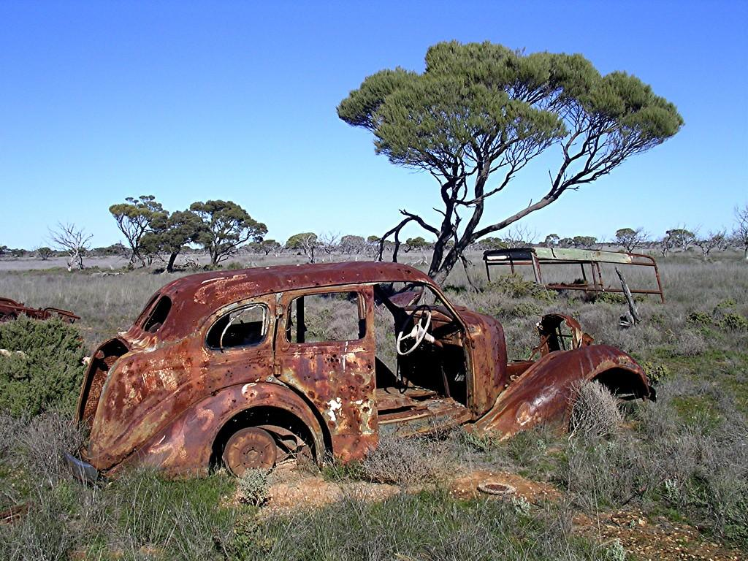
Chapter 18: The law of increasing disorder

Slide 4
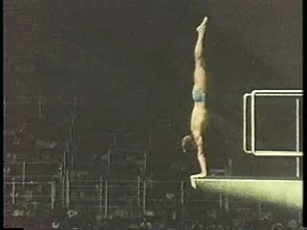
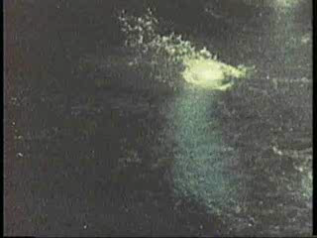
The arrow of time
Which movie shows the natural order of events?
Klaus Dibiasi – final dive in 10m platform on the way to gold in the 1976 Olympics

Slide 5
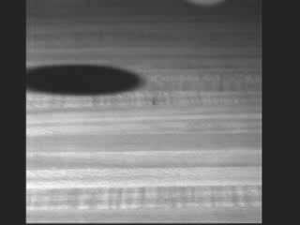
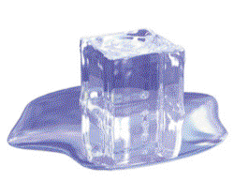
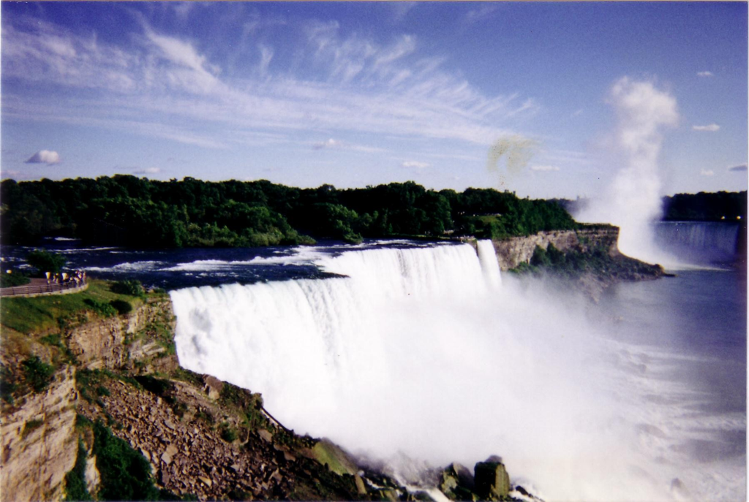
Irreversible processes are all around us
An irreversible process is one that occurs spontaneously in one way, but never in exactly the reverse way (i.e. the movie doesn’t make sense when played backwards).
Examples: an ice cube melting on the counter, water flowing over Niagara falls, balloon popping, getting older.

Slide 6
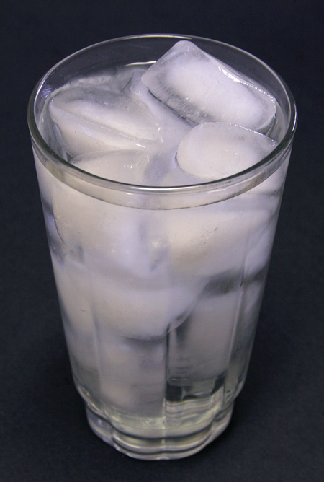
Reversible processes can occur with equal ease in the forward and backward direction
If a glass of ice water is held at exactly zero degrees Celsius and placed in an environment of the same temperature, the total amount of ice and water will remain constant. However, the shape of the ice cubes will change as water molecules become ice, and ice molecules become water.
If the water or the environment is at a different temperature the process becomes irreversible
Reversible processes occur under special circumstances, are almost always just approximately reversible, and do not usually occur in nature.
0 degrees Celsius!

Slide 7
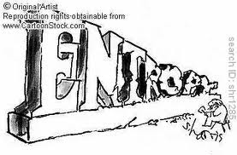
The second law of Thermodynamics
Changes occurring in natural systems always proceed in such a way that the total amount of “disorder” in the universe either is unchanged or increased. If total “disorder” is increased, the process is irreversible.

Slide 8
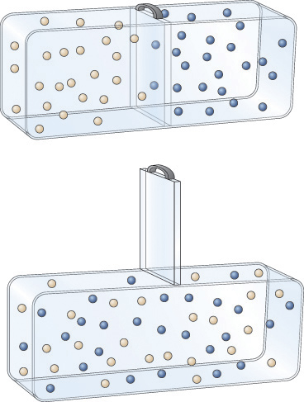
Getting a feel for entropy by example
Allowing gas molecules to mix
A
B

Slide 9
Example: Ice in water
Temperature difference destroyed
Ice molecules mixed throughout the water
We can refreeze the glass, but nature by itself will never recreate the blue cube separate from the frozen water.
To recover the original “system” we must grab each original ice molecule, return it to the ice cube tray, and refreeze it.

Slide 10
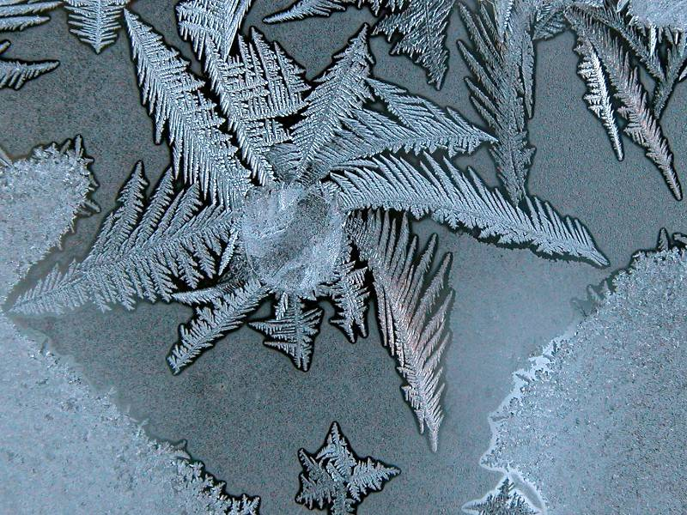
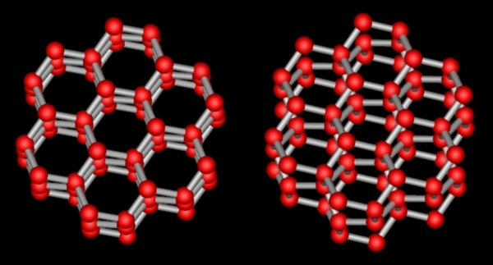

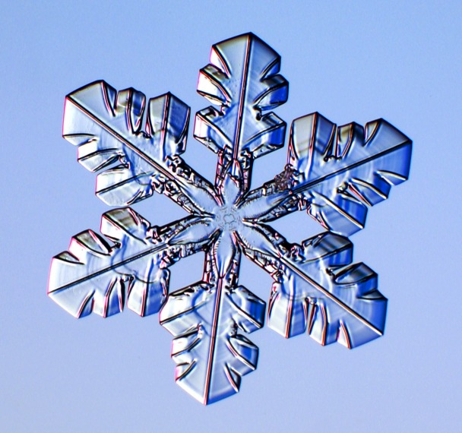
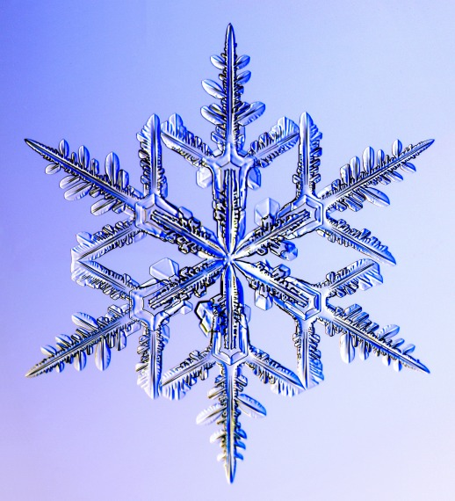
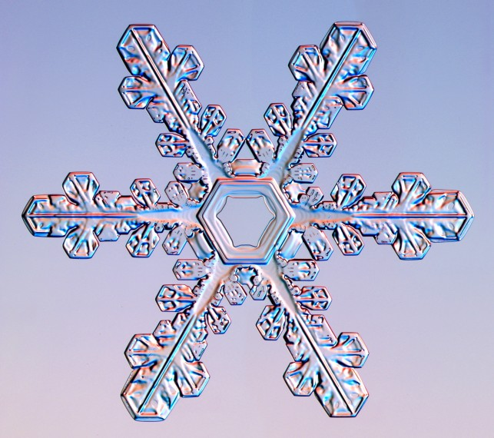
Molecules arranged in crystals have “order” Example: Ice crystals
= Oxygen
= Hydrogen
Notes:
Pictures from snowcrystals.com

Slide 11
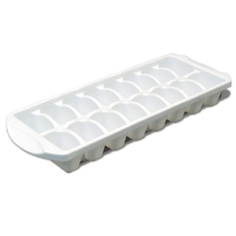
When water freezes into ice
The entropy of the universe goes down.
The entropy of the water/ice system goes down
The entropy of the water/ice system goes up
None of the above

Slide 12
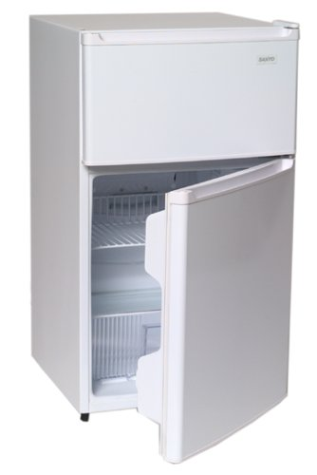
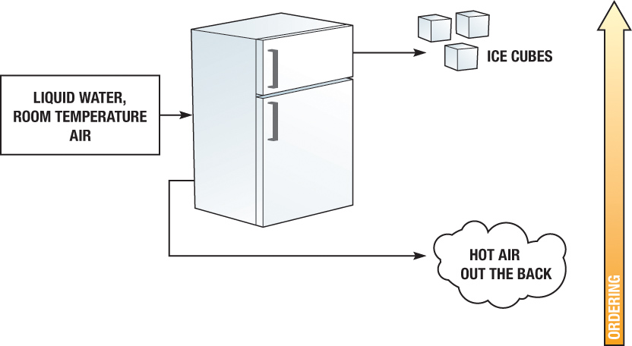
Getting a feel for entropy by example
A freezer performs the ordering process in making ice cubes
Extra energy (electricity) is needed to perform this ordering.

Slide 13
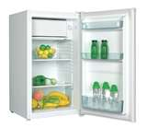
Take home lessons from the fridge
The second law of thermodynamics says you have to plug in the refrigerator for it to work.
The second law does not say that you can’t create order. It says that when you do create order, you have to create a corresponding amount of disorder
So what happens when you try to cool off in the summer by leaving your fridge open?

Slide 14
What is the difference between temperature and heat?
Temperature is a measurement of energy
Heat is a measurement of energy transfer

Slide 15
So what does it mean to increase entropy?
Increasing disorder (entropy)
An increase in random motion.
A greater physical mixing of types.
A reduction of temperature differences.
Conversion of energy to a lower order
Distinct Temperature Regions
Heat Flow
Heat Death

Slide 16

So what does it mean to decrease entropy?

Slide 17
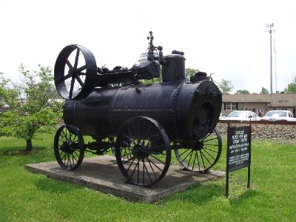
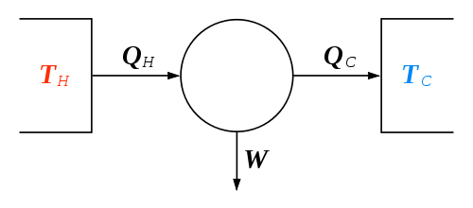
Transforming Energy
The Industrial Revolution was driven by the invention of the steam engine.
It changed chemical potential energy to kinetic with heat (thermal energy) as an intermediate form.
But how efficient could this process be?
http://www.bpreid.com/carnot.php

Slide 18
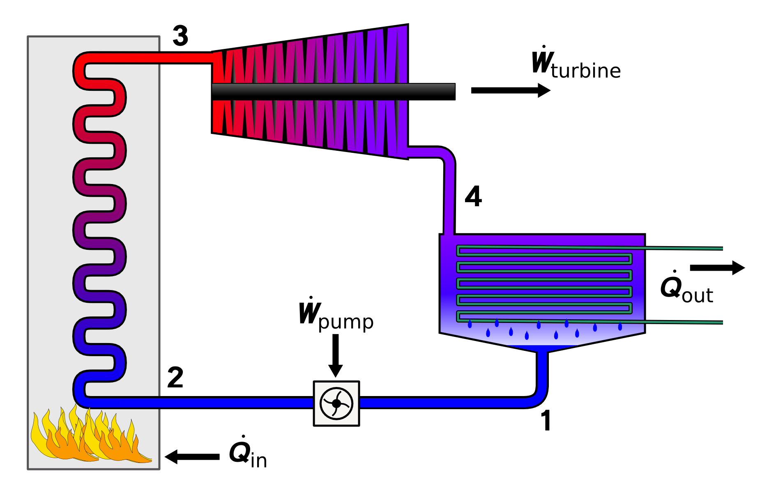
The steam engine

Slide 19
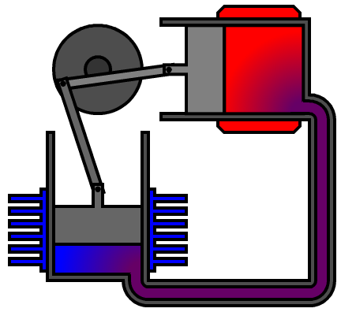
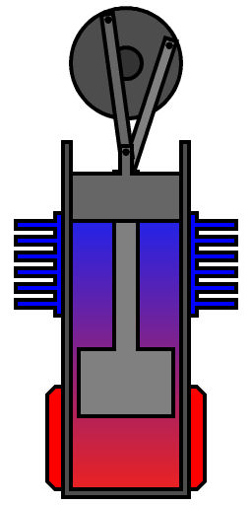
Stirling Engines -
Powergrid
http://www.youtube.com/watch?v=5pdqDQwehlk&NR=1

Slide 20
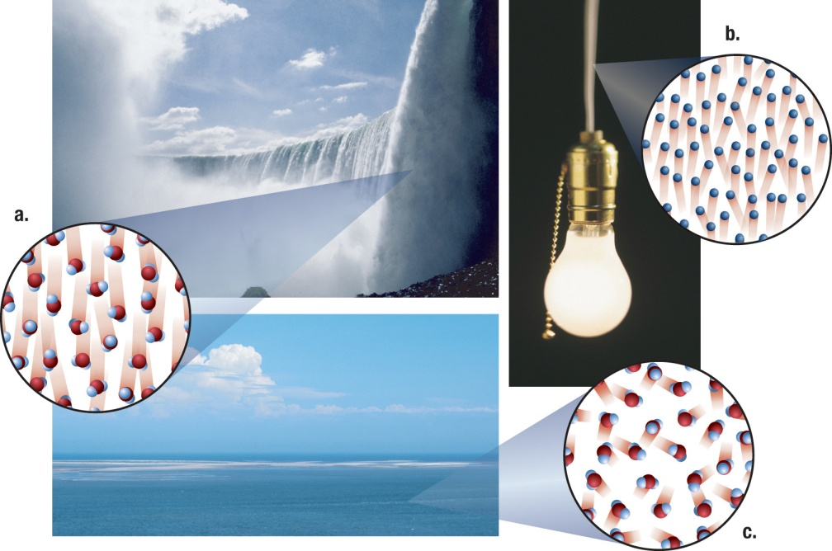
Classification of the “order” of a form of energy
Macroscopic Kinetic / Gravitational
Nuclear Potential
Electrical Potential
Chemical Potential
Ambient thermal (temperature)
Decreasing Order

Slide 21
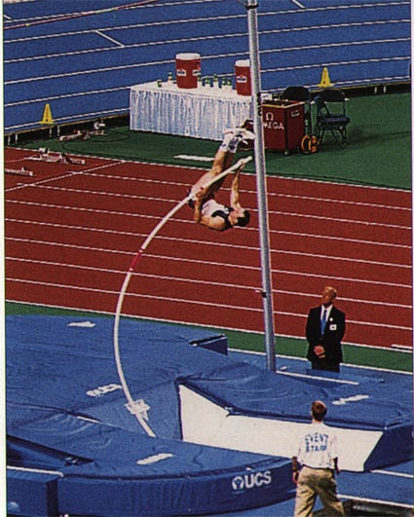
Limits to efficiency
Energy can be completely converted into heat (random thermal/kinetic energy)
Most kinetic energy eventually ends up as heat (random kinetic).
But heat cannot be completely converted into kinetic energy. Some will always remain as heat.

Slide 22
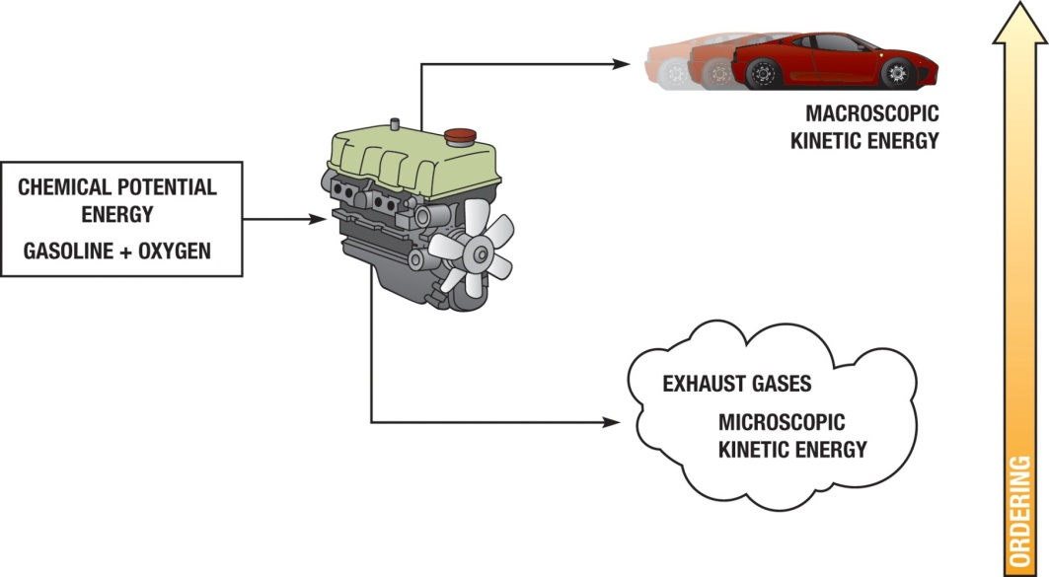
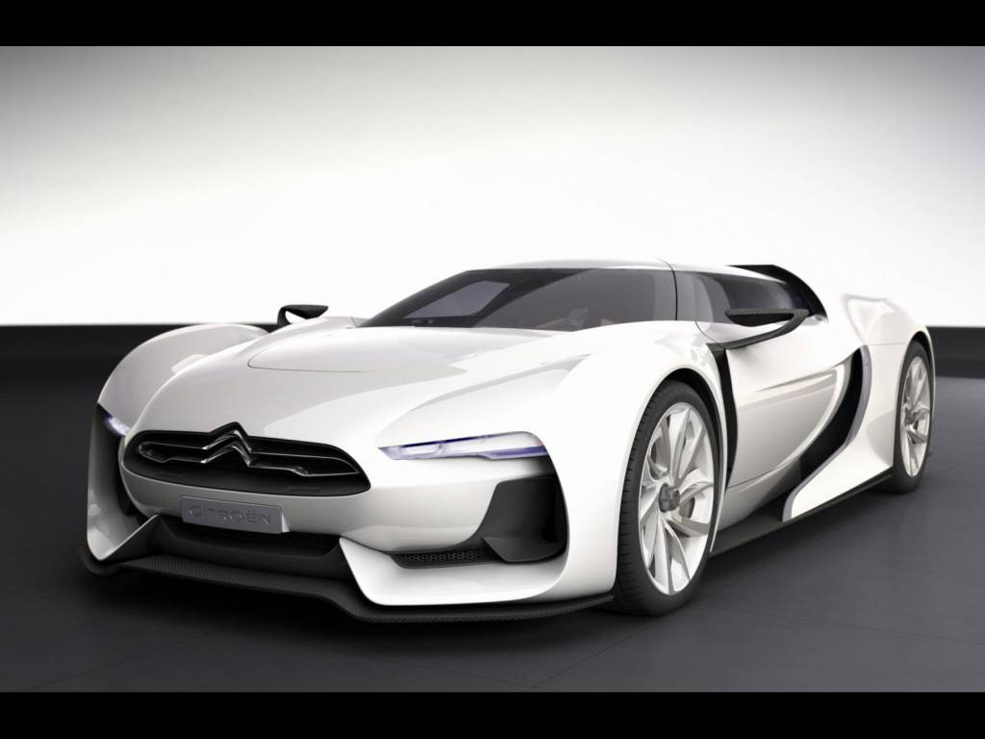
Car Engine
http://homepages.ius.edu/kforinas/physlets/thermo/Otto.html

Slide 23
Trace the Order
A car accelerates to 60 mph then coasts to a stop.
A refrigerator freezes a ice cube.
The sun warms the earth causing living things to grow.

Slide 24
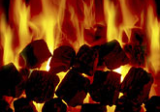




Why should you care about thermodynamics? We like to do things that take energy.
Per person U.S. daily energy use
90 lbs. Coal
125 lbs. Wood
8 gal Gasoline
10 Therms Natural Gas
1/6 Barrel of Crude Oil

Slide 25
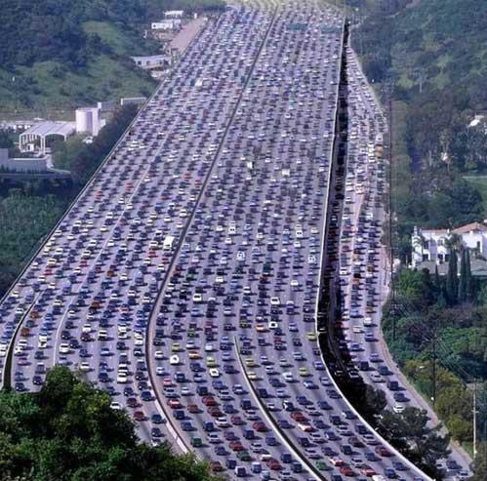
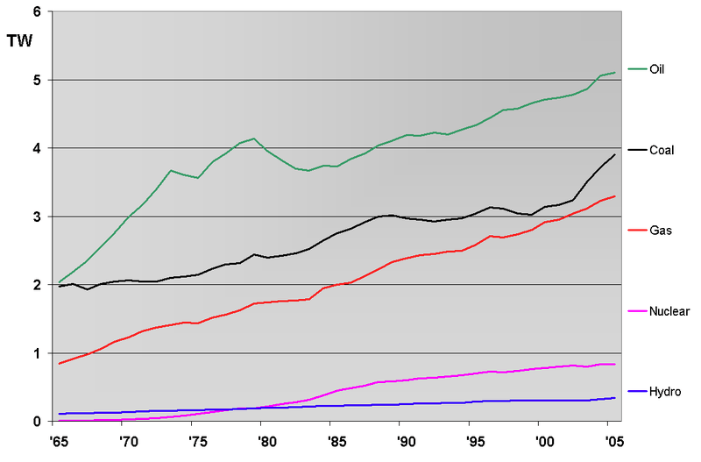
Energy and thermodynamics
1. Is there a “total” energy crisis?
NO! - total mass-energy is always conserved
2. Is there a limitation on the “useful” available to us?
YES! - burning fossil fuels loses order irreversibly
- resulting thermal energy is not very accessible

Slide 26
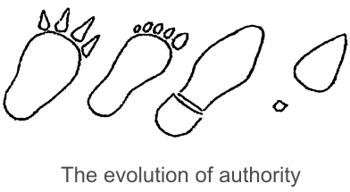
The second law of thermodynamics
Tells us that organic evolution is impossible, since nature cannot create order.
Tells us that the creation of life is impossible
Tells us that the ordering process involved with creating life must have created a larger amount of disorder elsewhere
Cannot be applied to the theory of evolution

Slide 27
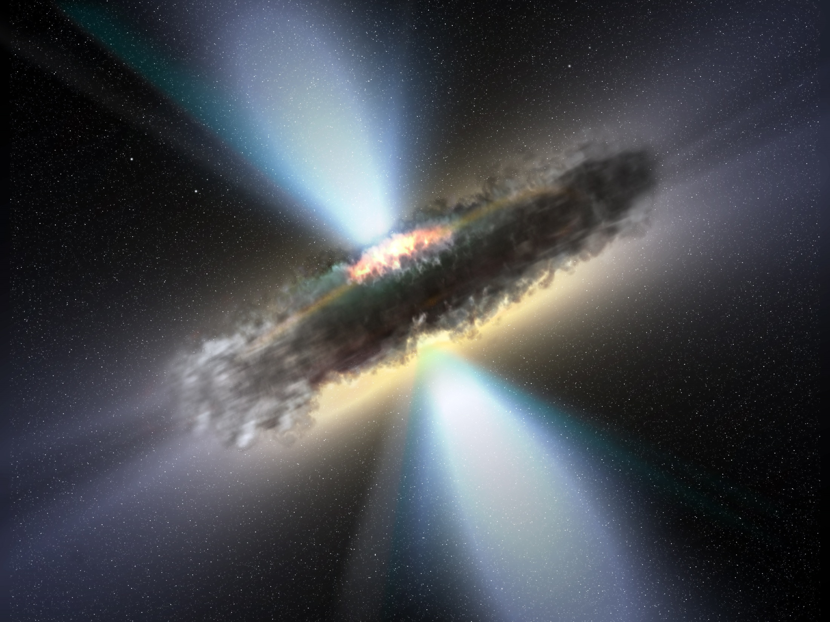
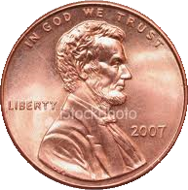

Play the reversible process game!
Option 1: Choose n pennies and shake for all heads. If you get all heads you get 10*n plus extra credit points. If you don’t, you lose nothing.
Option 2: Choose n pennies and shake for all heads. If you get all heads you get 100*n plus extra credit points. If you don’t, you lose 100*n points.

Slide 28
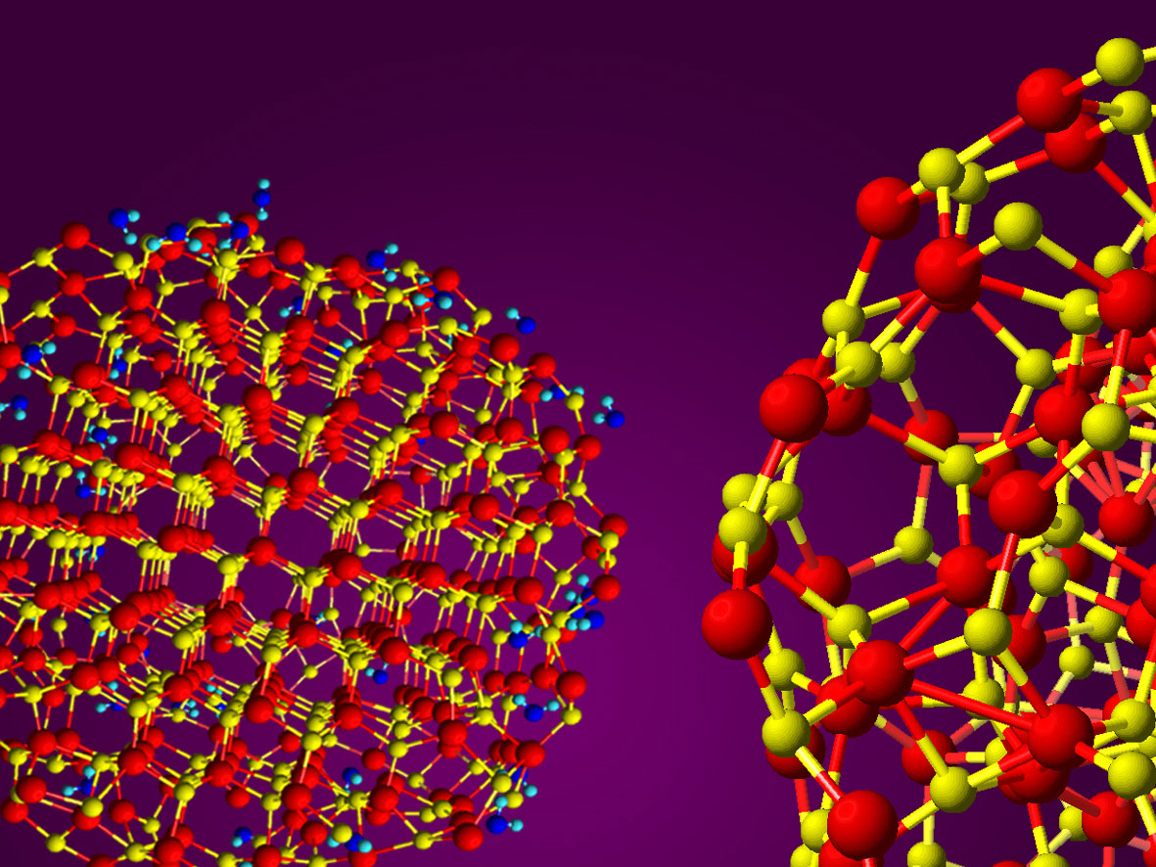
Chapter 19: Atoms, Molecules, and Extended-Bonding Substances

Slide 29
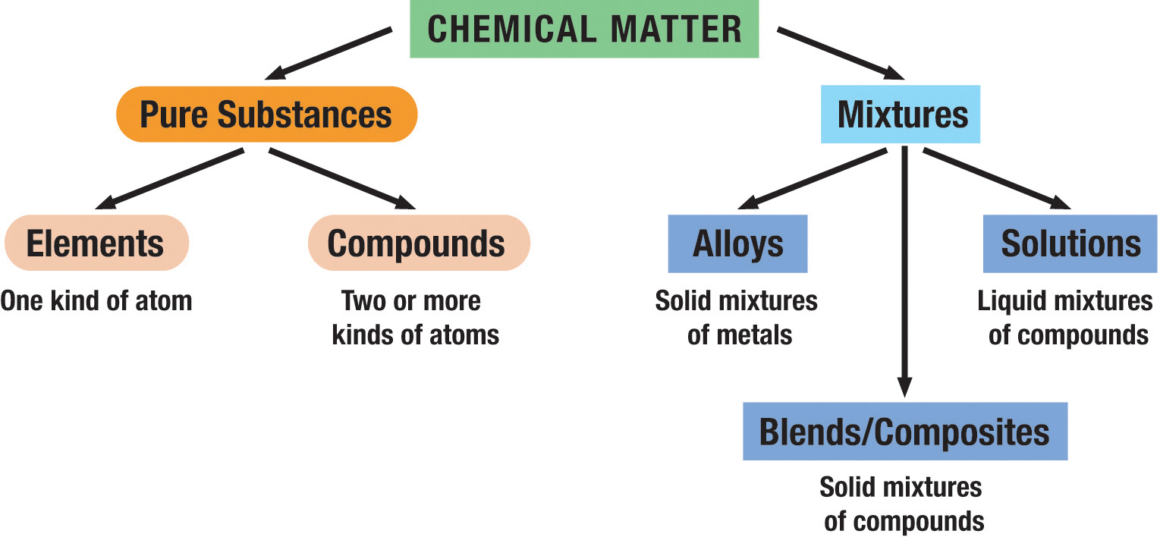
Chemical matter is classified into a number of types

Slide 30
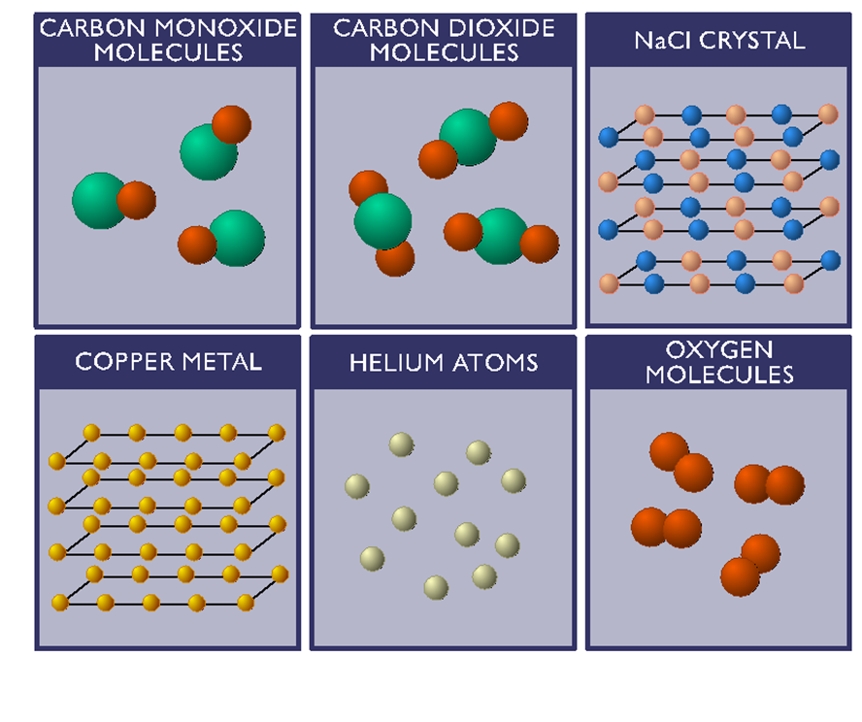
Elements vs Compounds
Elements: only one kind of atom
Compounds: two or more kinds of atoms strongly bonded internally but weakly bonded to the other molecules
Which are elements?
Which are compounds?

Slide 31
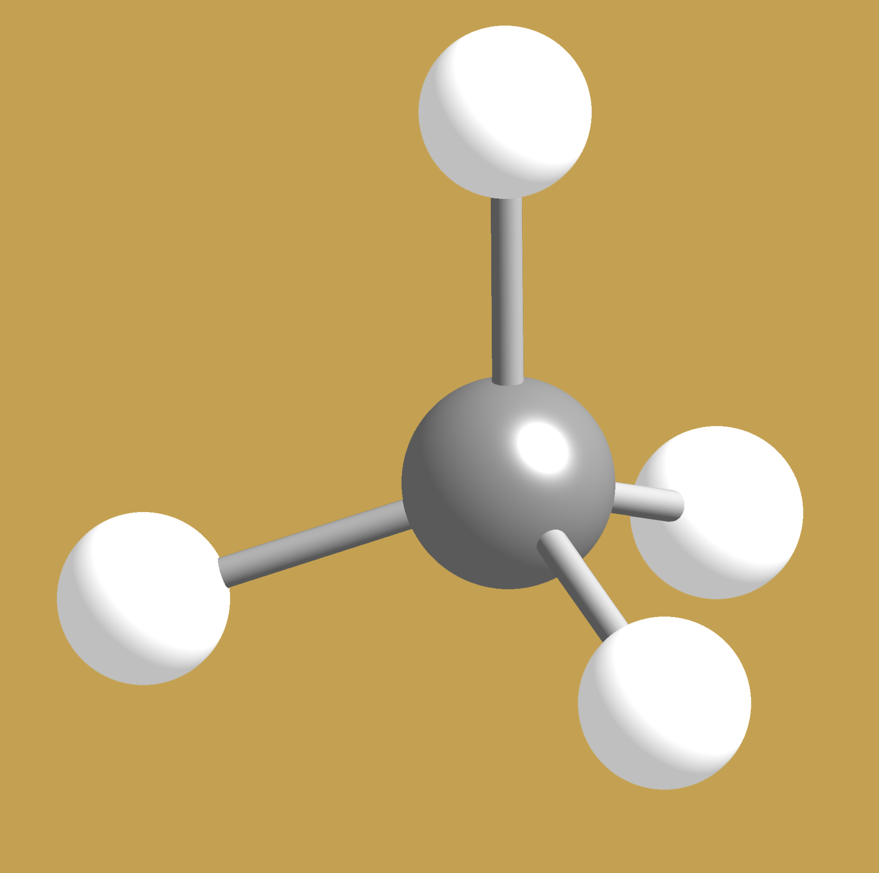
Chemical Bonds
The constituent atoms in molecules are held together by “bonds”. A bond is usually a pair of electrons.
Strong Bonds: Metallic, Ionic, Covalent
Weak Bonds: van der Waals, Hydrogen
The quantum model explains them all
Chapters 20-23 will feature each of the bonding types
In our visual models we often use sticks to represent bonds, and balls to represent atoms

Slide 32
How does bonding work?
Atoms give up, obtain, or share electrons and in the process combine to form the substances around us.
Bonding involves only the electrons in the outermost, unfilled orbitals: the valence electrons. All other inner electrons don’t matter as far as bonding is concerned.
All bonding involves atoms sharing or exchanging electrons in a “stable” way. Stability means:
To fall to a lower energy state and thus be more tightly bound.
To completely fill an orbital set.

Slide 33

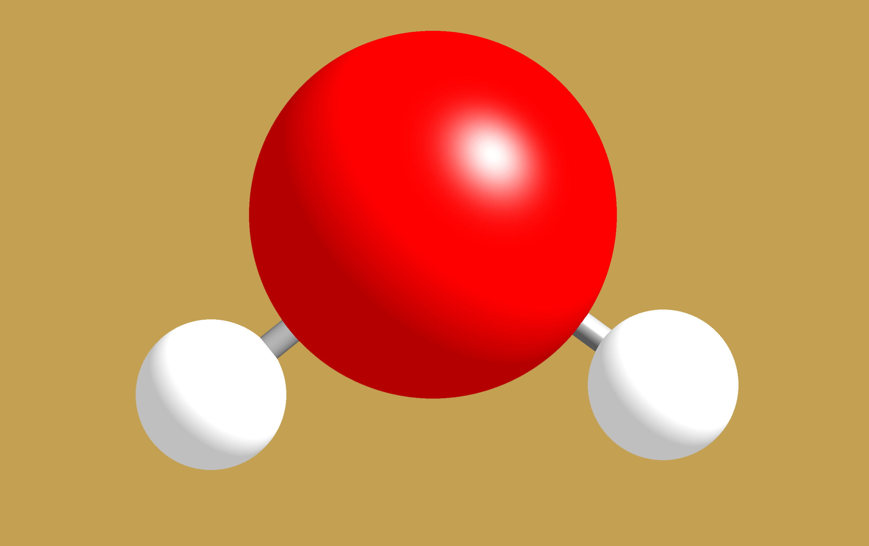
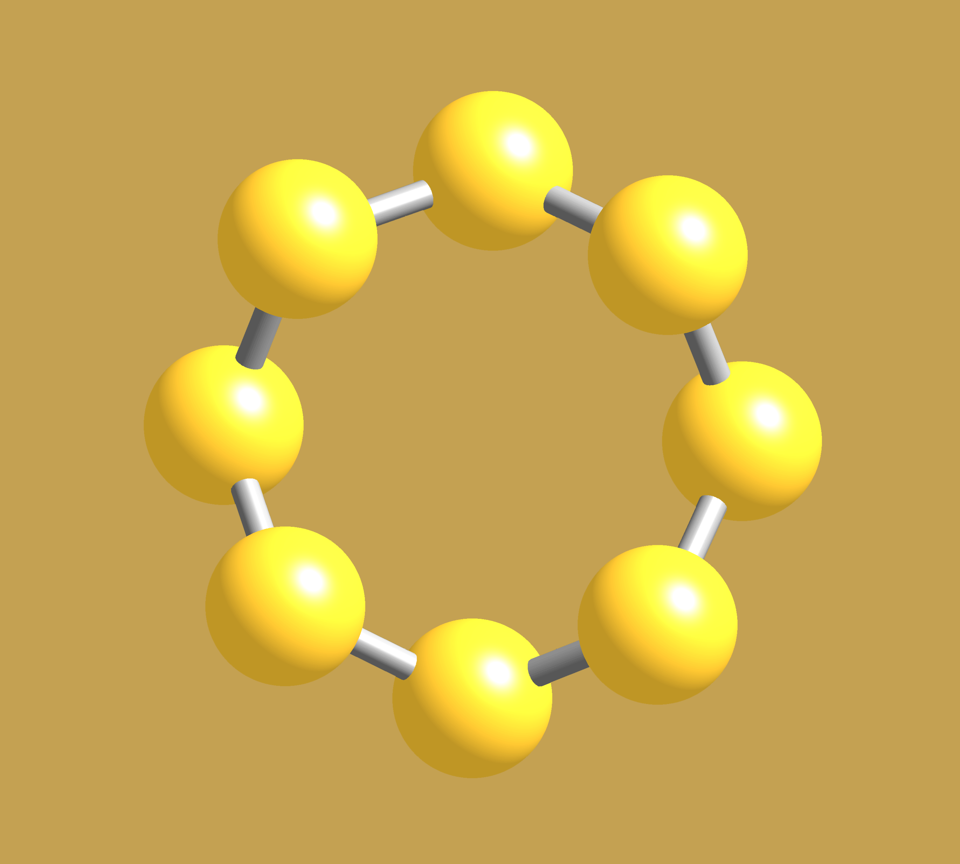
Writing chemical formulas for molecular matter
Identify atoms in a molecule
Give the number of each atom type
Examples
H₂O
S₈
CH₄

Slide 34
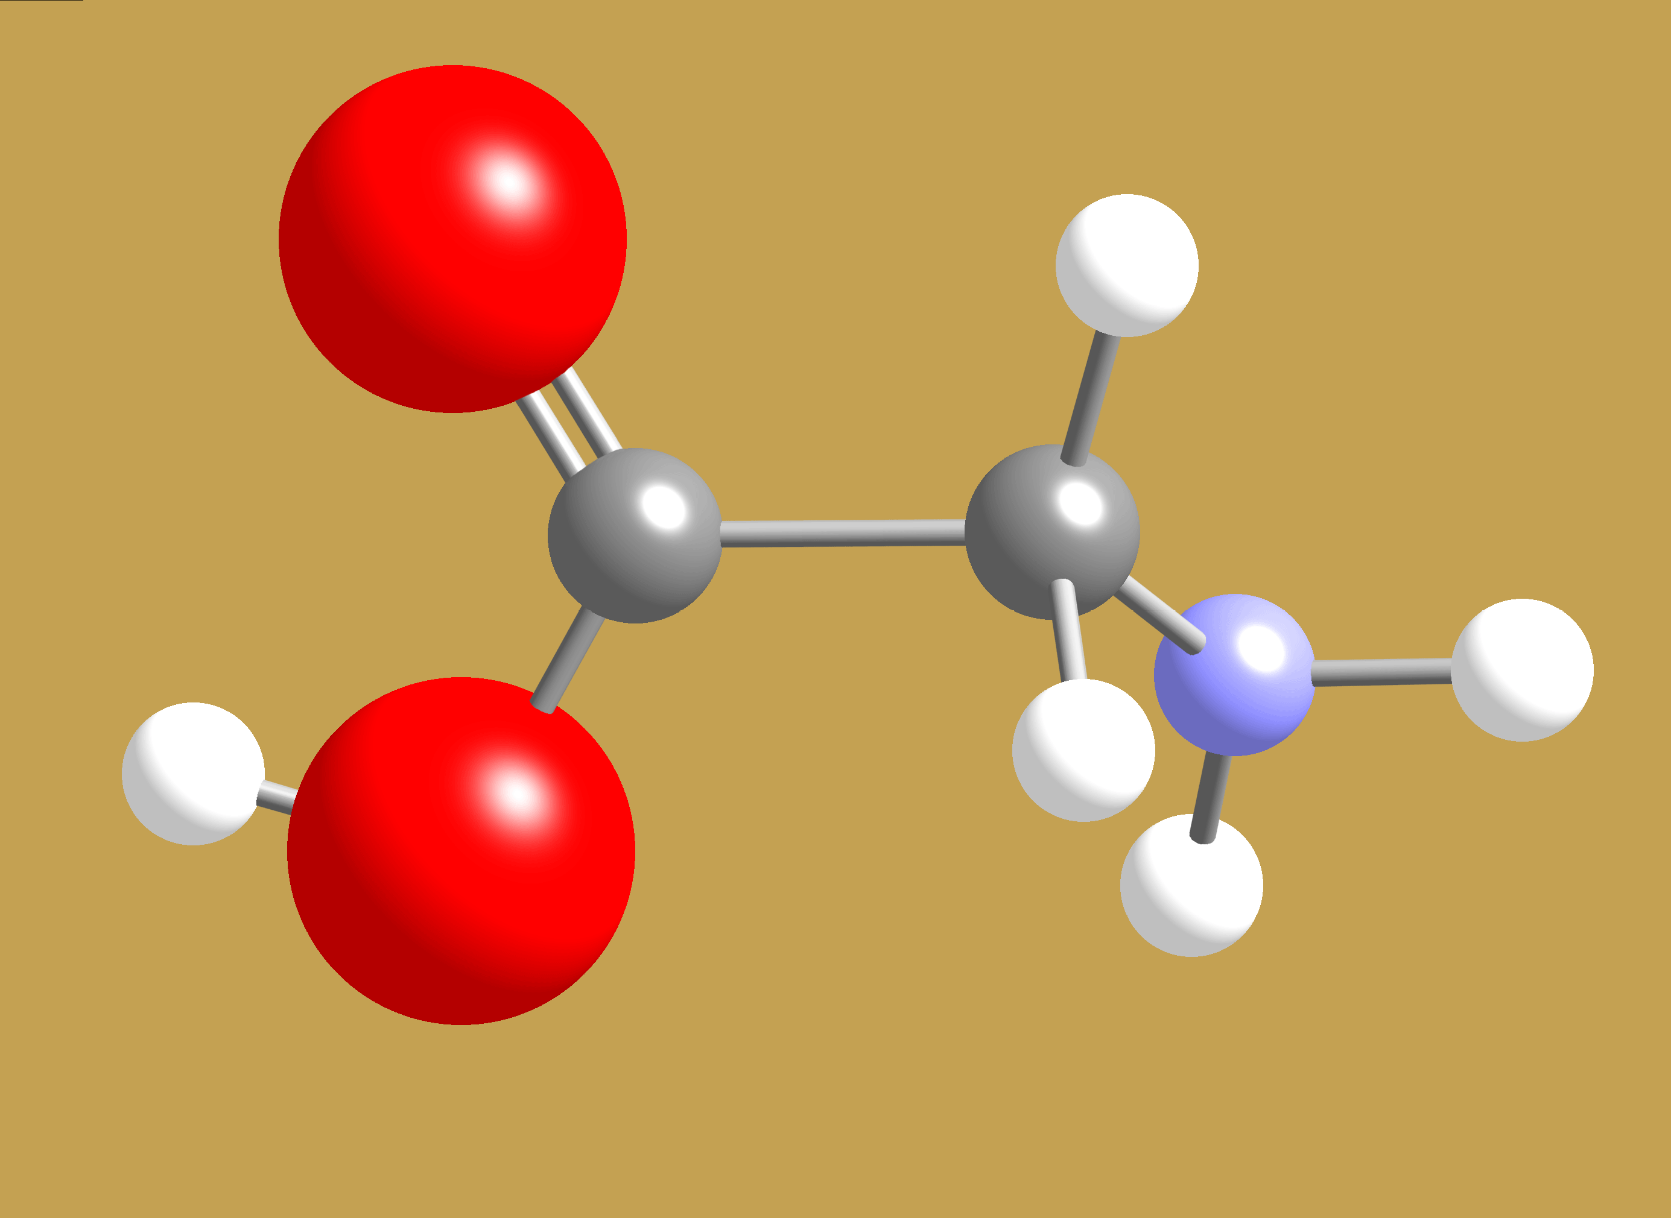
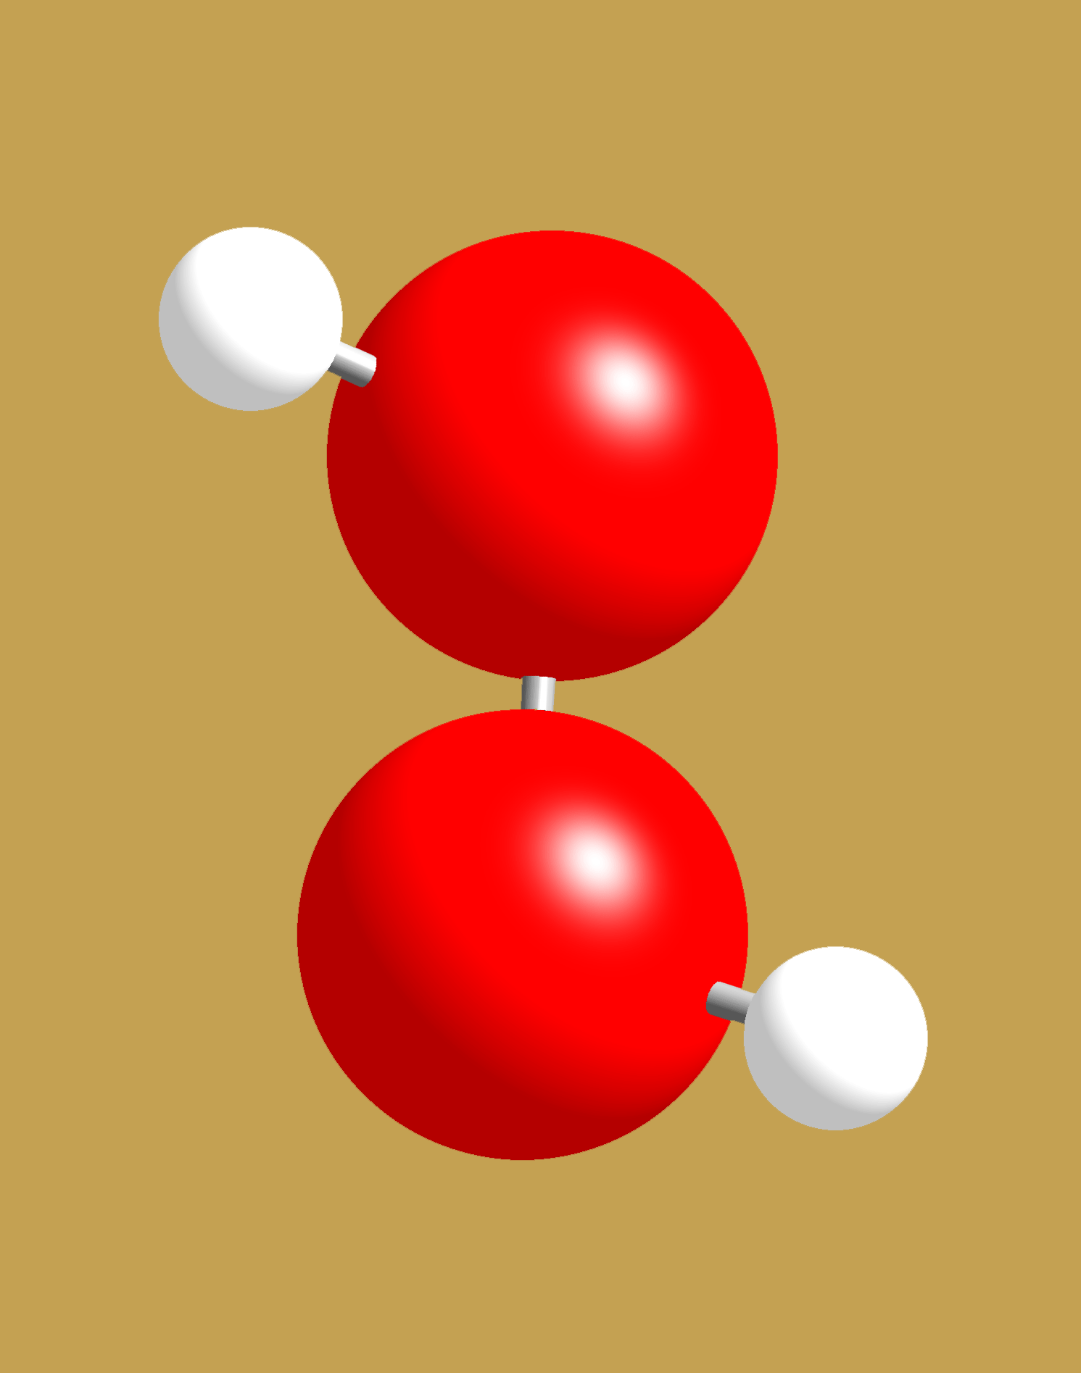
Write down the chemical formula for these two molecules
Glycine One of the 23 essential Amino acids
Hydrogen peroxide
Bleach and disinfectant
NH₂CH₂COOH

Slide 35
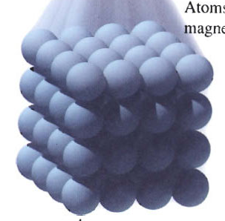
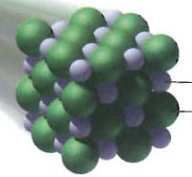
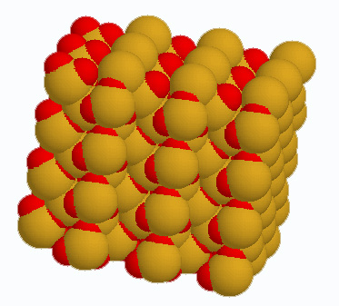
Chemical Formulas for Network/Extended Matter
Atoms of
metallic Mg
Identify kinds of atoms
Give the relative number of each atom type
Sodium chloride
NaCl
Quartz
SiO₂
O
Na
Cl
Si

Slide 36
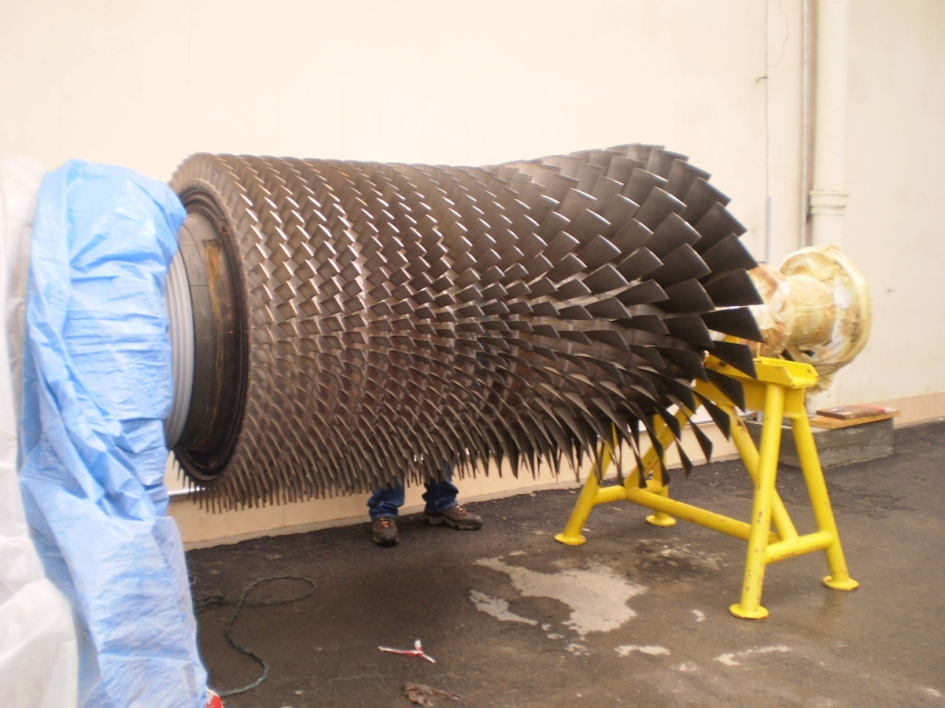
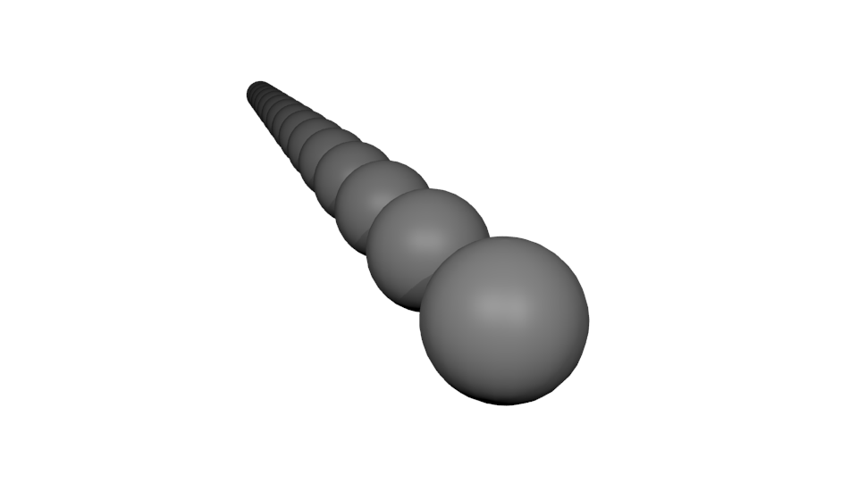
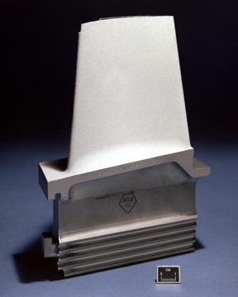
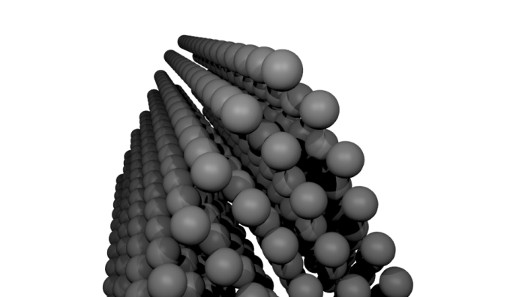
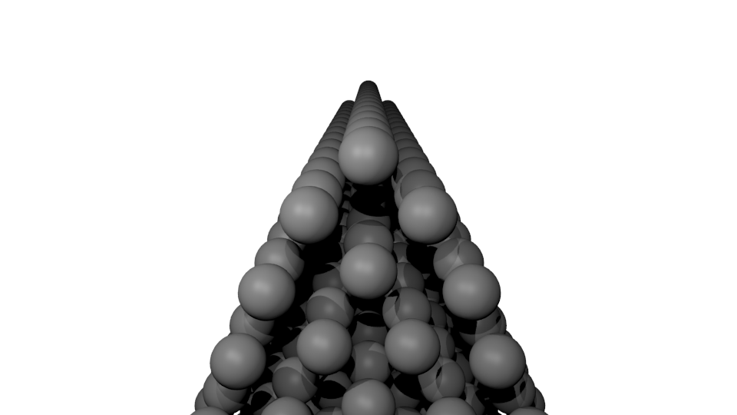
Directional crystal growth

Slide 37
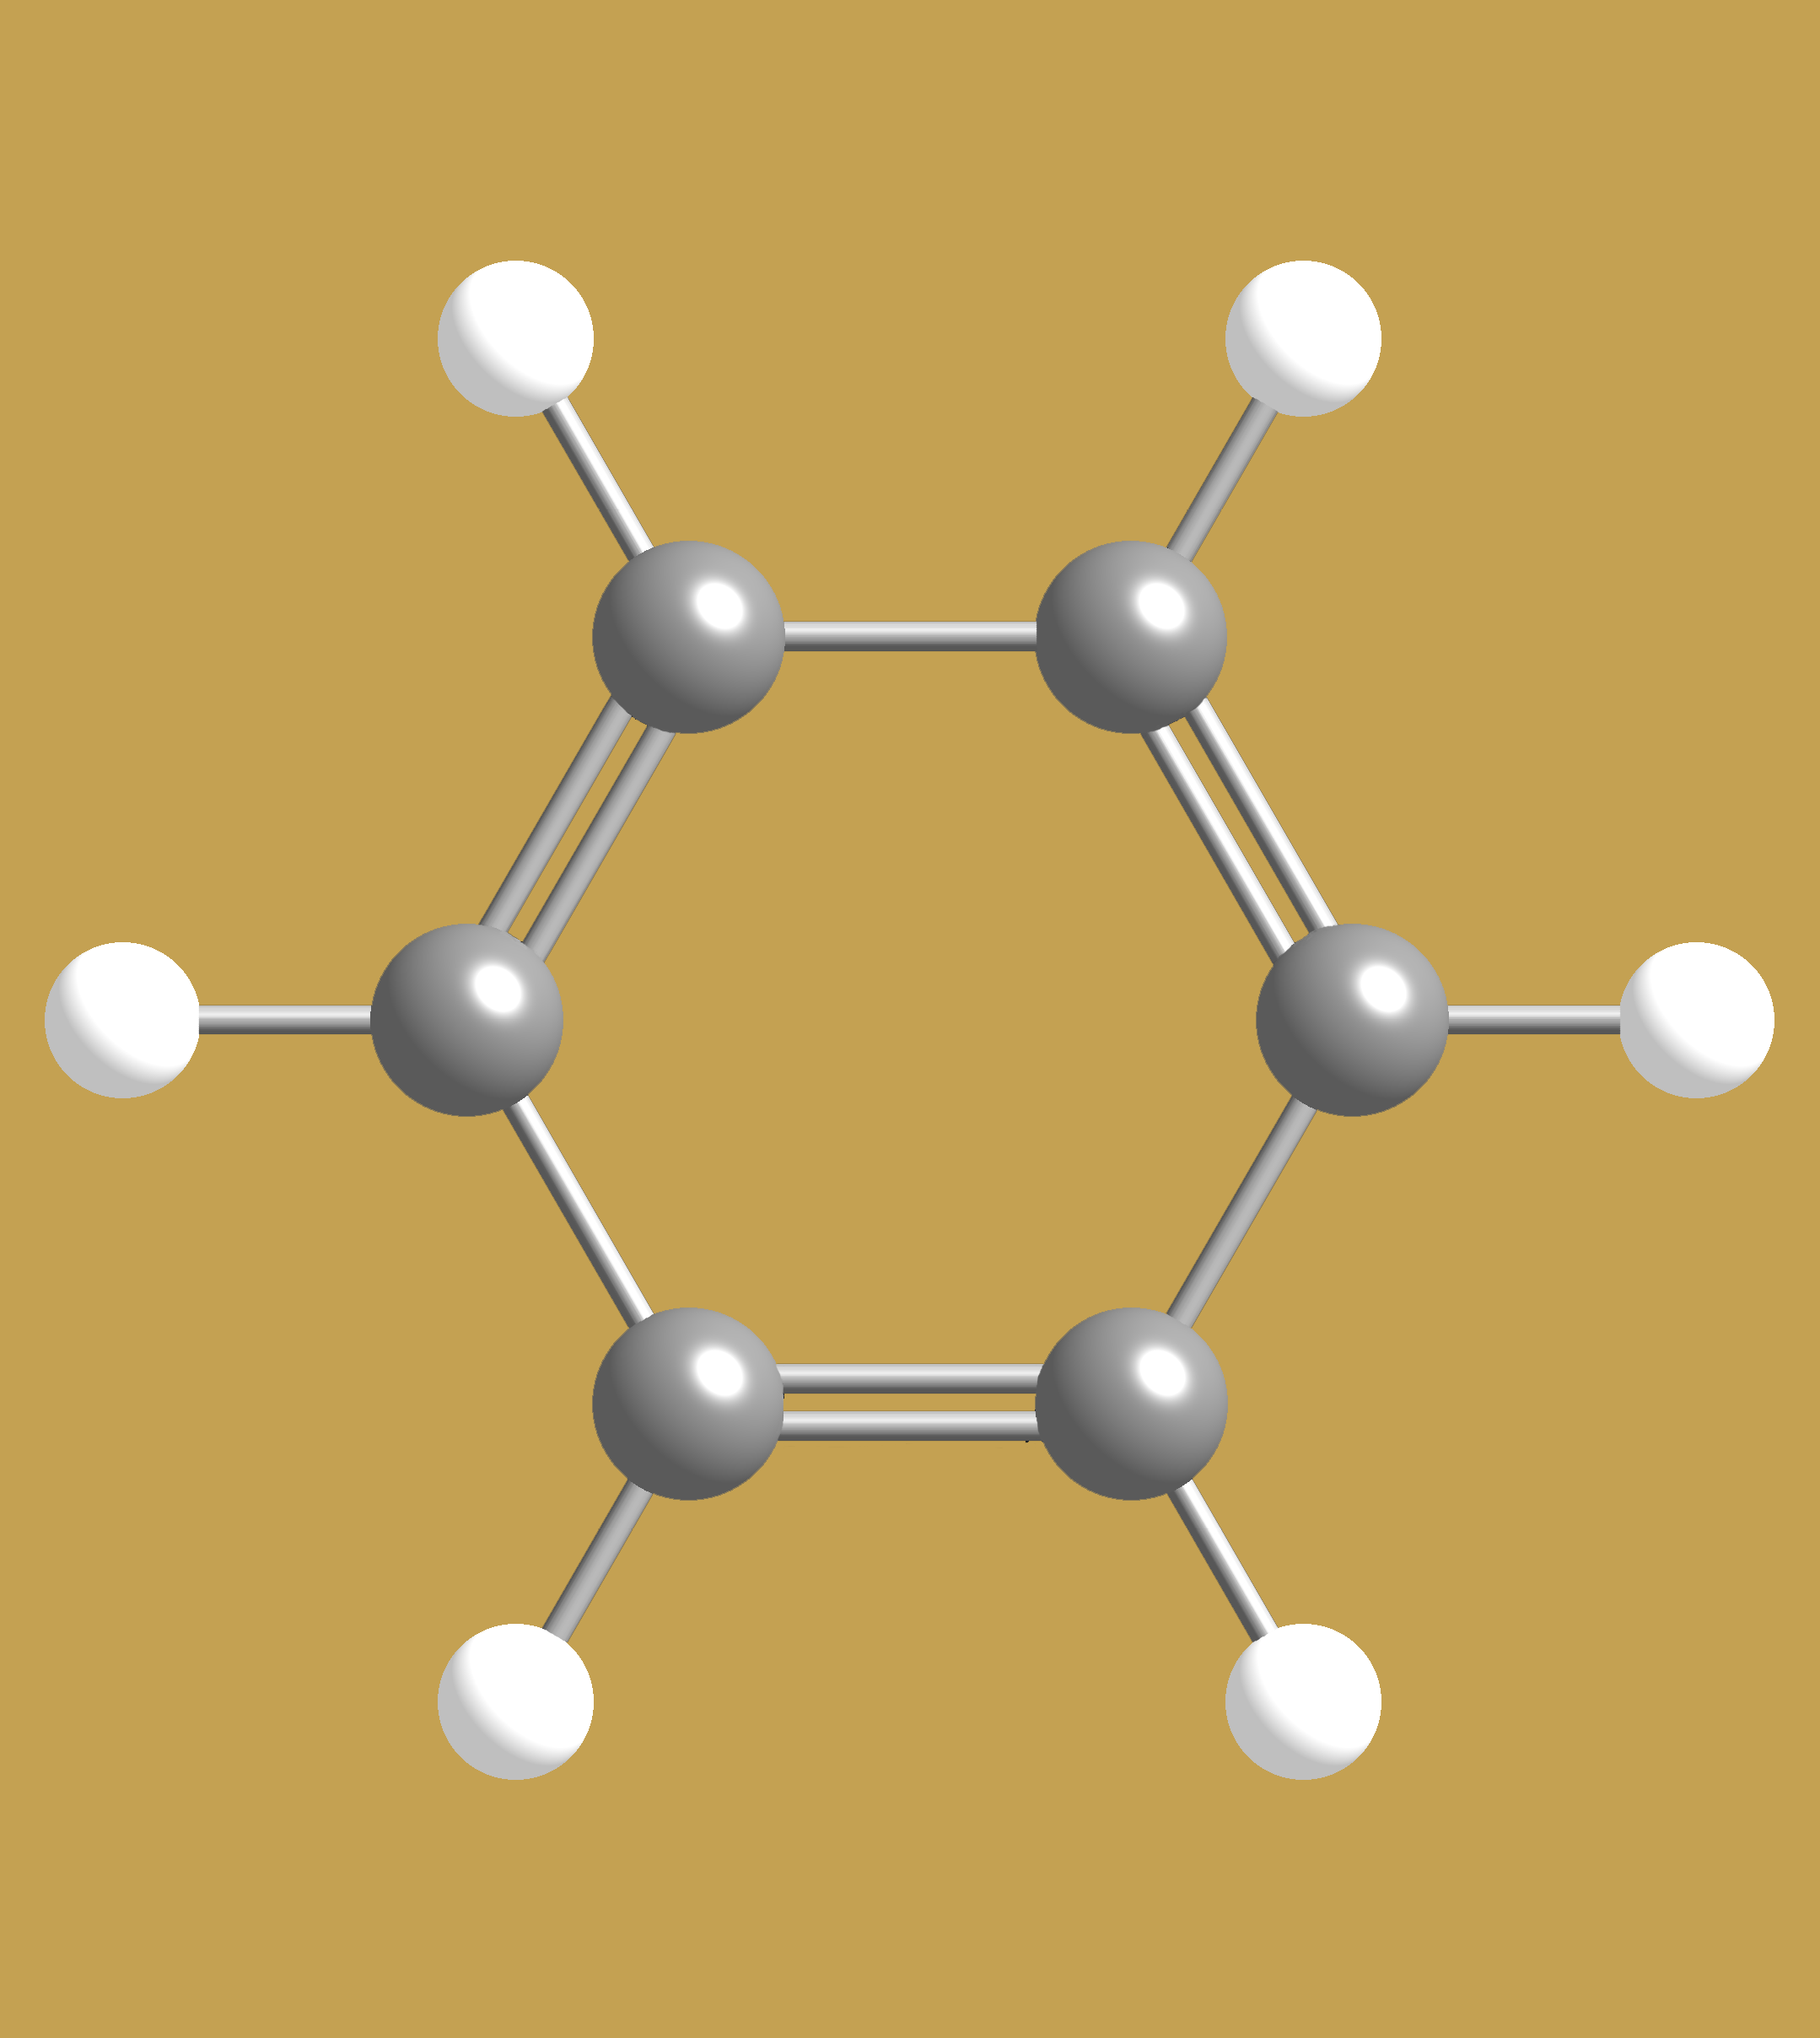


Molecules have shapes
How many ways can you arrange Carbon and Hydrogen?
Guess the shape of Benzene
C₆H₆
Planar
Tetrahedral
Linear
Friedrich August Kekulé discovered benzene’s structure
Notes:
Friedrich August Kekulé wrote that he discovered the ring shape of the benzene molecule after dreaming of a snake seizing its own tail, a common symbol in many ancient cultures known as the Ouroboros. This dream he said came to him after years of studying the nature of carbon-carbon bonds. Kekulé claimed to have solved the problem of how carbon atoms could bond to up to four other atoms at the same time. Another explanation is that he obtained the inspiration from the figure of a hexagon in a tavern sign in Germany. However, the snake story first appeared in the Berichte der Durstigen Chemischen Gesellschaft (Journal of the Thirsty Chemical Society), a parody of the Berichte der Deutschen Chemischen Gesellschaft, which appeared annually in the late-19th century on the occasion of the congress of German chemists; accordingly, it should probably be treated with circumspection. While his claims were well publicized and accepted, by the early 1920s Kekulé's own biographer came to the conclusion that Kekulé's understanding of the tetravalent nature of carbon bonding depended on the previous research of Archibald Scott Couper (1831-1892) [1]. Furthermore, the Austrian chemist Josef Loschmidt (1821-1895) had earlier posited a cyclic structure for benzene [2] and many other cyclic systems as early as 1861, although he had not actually proved this structure to be correct [3] [4]. The cyclic nature of benzene was finally confirmed by the eminent crystallographer Kathleen Lonsdale [5] [6].
Benzene was also referred to as phene in the past; it is the root of the molecule phenol which is hydroxylated benzene.

Slide 38

The shape of a molecule is determined by molecular orbitals
When H₂ was formed from H, energy was released as heat.
So in H₂ each electron needs more energy than before to escape.
H
H
H₂
The electrons sit lower in the energy well than before

Slide 39



Molecules belong to families -- Hydrocarbons
What elements
are present?
Methane -- CH₄
Propane -- CH₃CH₂CH₃
(or C₃H₈)
Formulas?
All react to form CO₂ and H₂O
Octane -- CH₃CH₂CH₂CH₂CH₂CH₂CH₂CH₃
(or C₈H₁₈)
methane, propane, octane belong to
hydrocarbon family all three are used as fuels
2,2,4-Trimethylpentane
Notes:
C₁: 1 isomer—methane
C₂: 1 isomer—ethane
C₃: 1 isomer—propane
C₄: 2 isomers—n-butane, isobutane

Slide 40


What are you spending $4 a gallon for?
2,2,4-Trimethylpentane
Heptane
:
90:10

Slide 41



Another molecular family – Organic acids
CH₃CO₂H -- Acetic acid (gives vinegar its taste)
What groups of atoms
are common to all
three molecules?
CH₃(CH₂)₁₀CO₂H
Lauric acid – in coconut milk
CH₃__
CH₂ __
__ CO₂H (carboxyl)
CH₃(CH₂)₁₄CO₂H -- Palmitic acid (palm oils, and animals)
family of organic acids -
all three are in foods we eat

Slide 42


Amino Acids, the building blocks for protiens
What elements
are present?
NH₂CH₂CO₂H
NH₂CHCH₃CO₂H
Formulas?
What groups of atoms
are common to all
three molecules?
NH₂C₁₀H₉NHCO₂H
NH₂__ (amine)
__ CO₂H (Carboxyl)
family of amino acids –
acid group + amino group -- also in foods we eat

Slide 43
Deducing molecular formulae and structures: Time-of-Flight Mass Spectrometer
accelerator plates detector
Number of fragments
positive fragments
time
Length of flight path
kinetic energy = ½(mass)(speed)²
If all fragments are given the same kinetic energy, which ones get to the detector first, the heavy or the light? http://www.youtube.com/watch?v=OKxRx0ctrl0&feature=related

Slide 44

What molecule does this mass spectrum represent?
CO
H₂0
NO
CO₂

Slide 45


Deducing molecular structure with a mass spectrometer
Mass Spectroscopy
Masses of molecular
fragments
C₉O₄H₈
Aspirin
Parent peak:
Mass of the molecule
180 amu

Slide 46





Motion within a molecule
Bonds are not rigid
lengths change
Bond angles bend – angle opens and closes
The various types of stretches and bends occur with different energies
Energy depends on how stiff the bond is and the atomic masses that are moving.
http://www2.ess.ucla.edu/~schauble/MoleculeHTML/CH4_html/CH4_page.html

Slide 47

A simplified view of infrared spectroscopy
Absorption
IR spectrum
(continuous with
dark bands)
continuous
IR spectrum
Detector
Sample
Infrared Source
Analogous visible continuous spectrum
Analogous visible absorption spectrum

Slide 48

IR spectroscopy can be used to deduce chemical formulas and structures
IR Vibrational Spectroscopy
fingerprint region
C₉O₄H₈
Aspirin
C=O
Different molecular groups vibrate in different regions
Energy of vibration

Slide 49



A portion of the IR spectrum for each molecule is shown. Formulate a hypothesis about what portion of the molecule gives rise to the sharp set of peaks labeled P?
OH group
Hydrocarbon part
P
A
A
A
A

Slide 50


How do we deduce chemical formulas and structures?
Crystallography
X-Rays
Then just Fourier transform!

Slide 51

Principles of Chemical Reactivity

Slide 52



Misconception
TNT is not Dynamite
Trinitrotoluene is not Nitroglycerin

Slide 53






Review Molecular Orbitals
Atomic orbitals
s
p
d
f
If it has 4n+2 Pi orbitals, it smells!
Hückel's rule

Slide 54
Shape of heat releasing Chemical Reaction
Energy
Reaction

Slide 55
Shape of Chemical Reaction Rate
2H₂
2H₂0
O₂
Number of molecules
Time

Slide 56

Conservation of Matter: Balancing Chemical Reactions
Matter is not created or destroyed in chemical reactions
This is reflected in the way we write them
Write a balanced equation for the conversion of hydrogen and oxygen into water.
Count the atoms!

Slide 57

Which way of writing the reaction of hydrogen with oxygen to make water best complies with conservation of matter and describes what happens?
H₂ + O₂ → H₂O
H₂ + ½ O₂ → H₂O
2H₂ + O₂ → 2 H₂O

Slide 58

Electrolysis
http://www.youtube.com/watch?v=2t13S-KpGeE&NR=1

Slide 59

Reactions Take Time
Enzymatic browning: polyphenol oxidase, catechol oxidase and other enzymes that create melanins and benzoquinone, resulting in a brown color.
Simple reason: Oxidation(loss of electrons)

Slide 60


Iron and Oxygen combine at different speeds depending on conditions
Write a balanced reaction for combining Iron (Fe) and Oxygen (O₂) into rust (Fe₂O₃)
4Fe(s) + 3O₂(g) → 2Fe₂O₃(s)
3Fe(s) + 2O₂(g) → Fe₃O₄(s)

Slide 61


Reactions Go at Different Speeds
Cellulose + O₂ → CO₂ + H₂O
Dead tree in forest
Wood in fire
Sawdust in explosion
Why?
2 C₇H₅N₃O₆ → 3 N₂ + 5 H₂O + 7 CO + 7 C

Slide 62
What Governs Speed of a Reaction?
Definition: rate that reactants are consumed, or products are produced
Factors:
Collision rate
Temperature (a reflection of molecular speed)
Pressure (for gases) or concentration (for liquids)
Physical state
Energetic requirements
Entropic (organization) requirements
http://www.chm.davidson.edu/vce/kinetics/ReactionRates.html

Slide 63


The effect of entropy on reaction rates

Slide 64

Effect of Energy
The net energy released (or consumed) does not affect rates
The energy required to reach the transition state (“activation energy”) has large effect
Transition state
The critical arrangement of atoms where the reacting system “decides” whether or not to make products
Typically involves breaking and/or formation of bonds

Slide 65





Why doesn’t your diamond turn into pencil lead or burst into flames?
At room temperature and pressure, graphite and carbon dioxide are much more energetically favorable for the electrons in carbon.

Slide 66

Catalysts Decrease energy or increase entropy of activation without themselves being consumed; speed up rate
H₂O₂ decomposes spontaneously
Much faster in presence of Br⁻ or I⁻

Slide 67

Catalysts in biology
Hexokinase - Enzyme that catalyses the transfer of phosphate from ATP to glucose to form glucose-6 phosphate, the first reaction in the metabolism of glucose via the glycolytic pathway.

Slide 68

Catalyzing the formation of water
H₂ + O₂ w/ Pd/C catalyst
Pd surface stretches the H-H bond, helping it break and lowering transition state energy

Slide 69


Catalytic converter
90% conversion of carbon monoxide, hydrocarbons, and nitrogen oxides into less harmful gases.
Platinum
Palladium
Rhodium
Notes:
The most common catalytic converter is located between the engine and muffler on your car. Essentially, it consists of a can that is separated into many sections by clay sheets. These clay sheets have dozens of very fine holes in them. These holes are lined with a thin metal oxide and small particles of platinum and rhodium. Creating many small surfaces on the metal is necessary because reactions only happen on the surfaces and these metals are very expensive. Chemicals like carbon monoxide and nitric oxides bond to the surfaces of these metals as they react to form less harmful gases such as carbon dioxide, nitrogen, oxygen and water.

Slide 70
Reactions are more likely to occur if
There are more collisions between atoms and the collisions are more vigorous
Increase the concentration of atoms
Increase the pressure
Increase the temperature
2. The energy of the system will decrease
3. The entropy of the system will increase
Demos

Slide 71








Demo 1: Biodiesel production
Fatty Acid Methyl Esters 1/10 toxicity of NaCl
Oil
Methanol
Lye
Glycerin
FAME

Slide 72




Demo 2: Paper combustion
carbon dioxide
cellulose
Water

