Slide 1
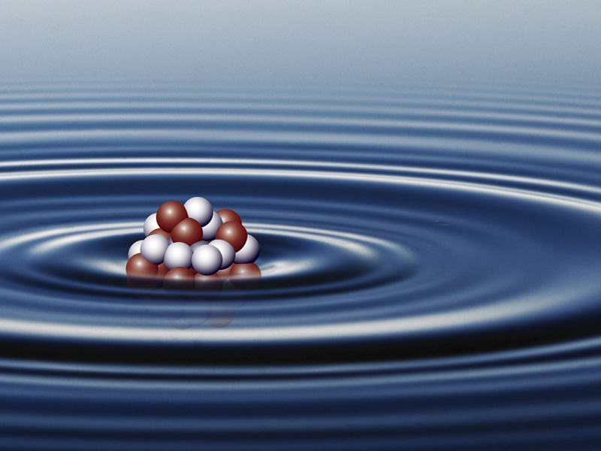
Chapters 15,16 and 17: Quiz
Open book to page 203

Slide 2
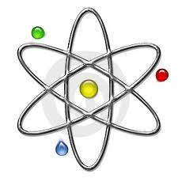
Which state change represents emission of a photon with the shortest wavelength?
1
Atomic Energy Levels
E
D
Ground State
A
B
C

Slide 3
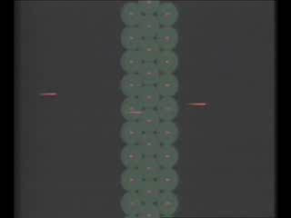
The “bullets” used by Rutherford to probe gold atoms were:
2
Electrons
Alpha Particles
Helium Atoms
Rubber Bullets
Helium Nuclei
Neutrons

Slide 4
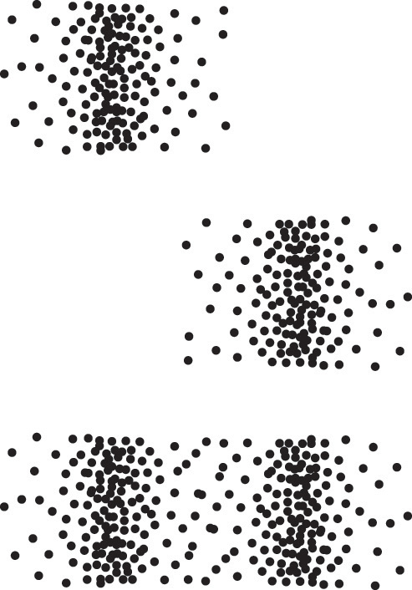
Concerning electrons through a double slit, when you...
3,4
Don’t measure which hole the electron goes through → _____-like behavior.
Do measure which hole the electron goes through → _____-like behavior.

Slide 5
The Uncertainty Principle and waves
5,6
Unclear position but clear _________.
Clear position but unclear _________.

Slide 6
What new property do we consider when allowing two electrons to occupy the same orbital?
7

Slide 7
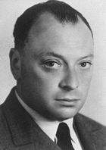
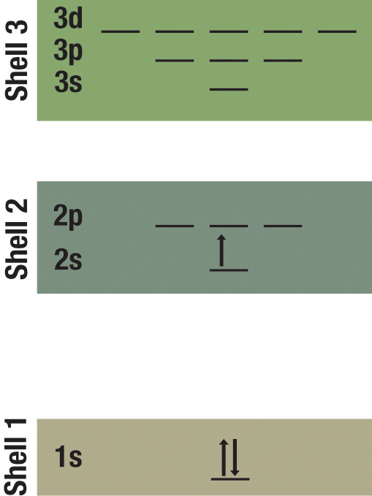
The ______ ___________ Principle
8,9
No more than two electrons can occupy the same orbital (in a given shell).
If two electrons are in the same orbital, they must have different spins.

Slide 8

Understanding Atoms
10
How do electrons fill the orbitals as we move along the periodic table?
Electrons fill the highest energy levels first
Electrons fill only p orbitals until further notice
Electrons fill the lowest energy levels first
Electrons do not assume any standing wave forms!
2
1
3

Slide 9
Vocabulary
11,12,13,14
_______: atoms all having the same number of protons in the nucleus
__________: number of protons in the nucleus
__________: total number of nucleons (protons and neutrons) in a nucleus
____________: the relative mass of the atoms of an element compared to carbon atoms which have arbitrarily been given a mass of twelve

Slide 10
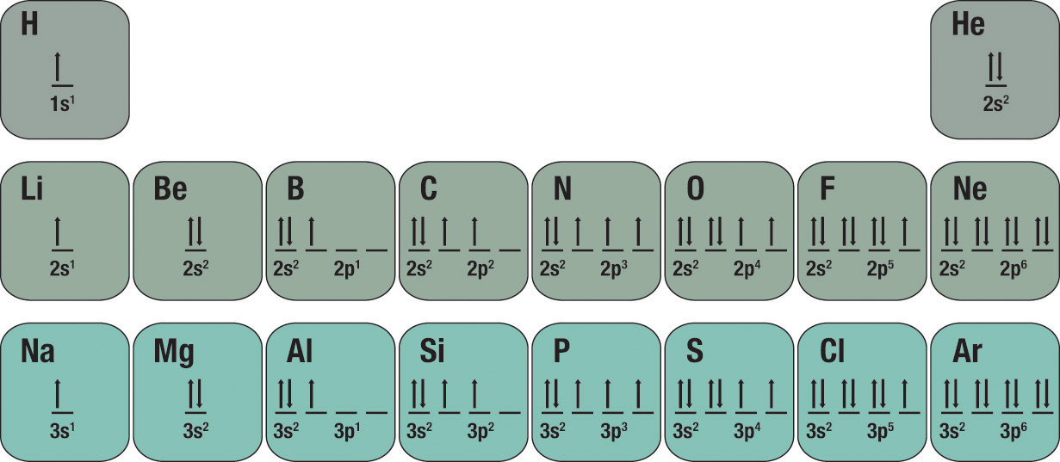
Outermost electrons
15
Chemical behavior is determined by the outermost electrons, called _______ electrons
Elements in the same column (group) of the periodic table have similar _______ electron structures, and are chemically similar.

Slide 11
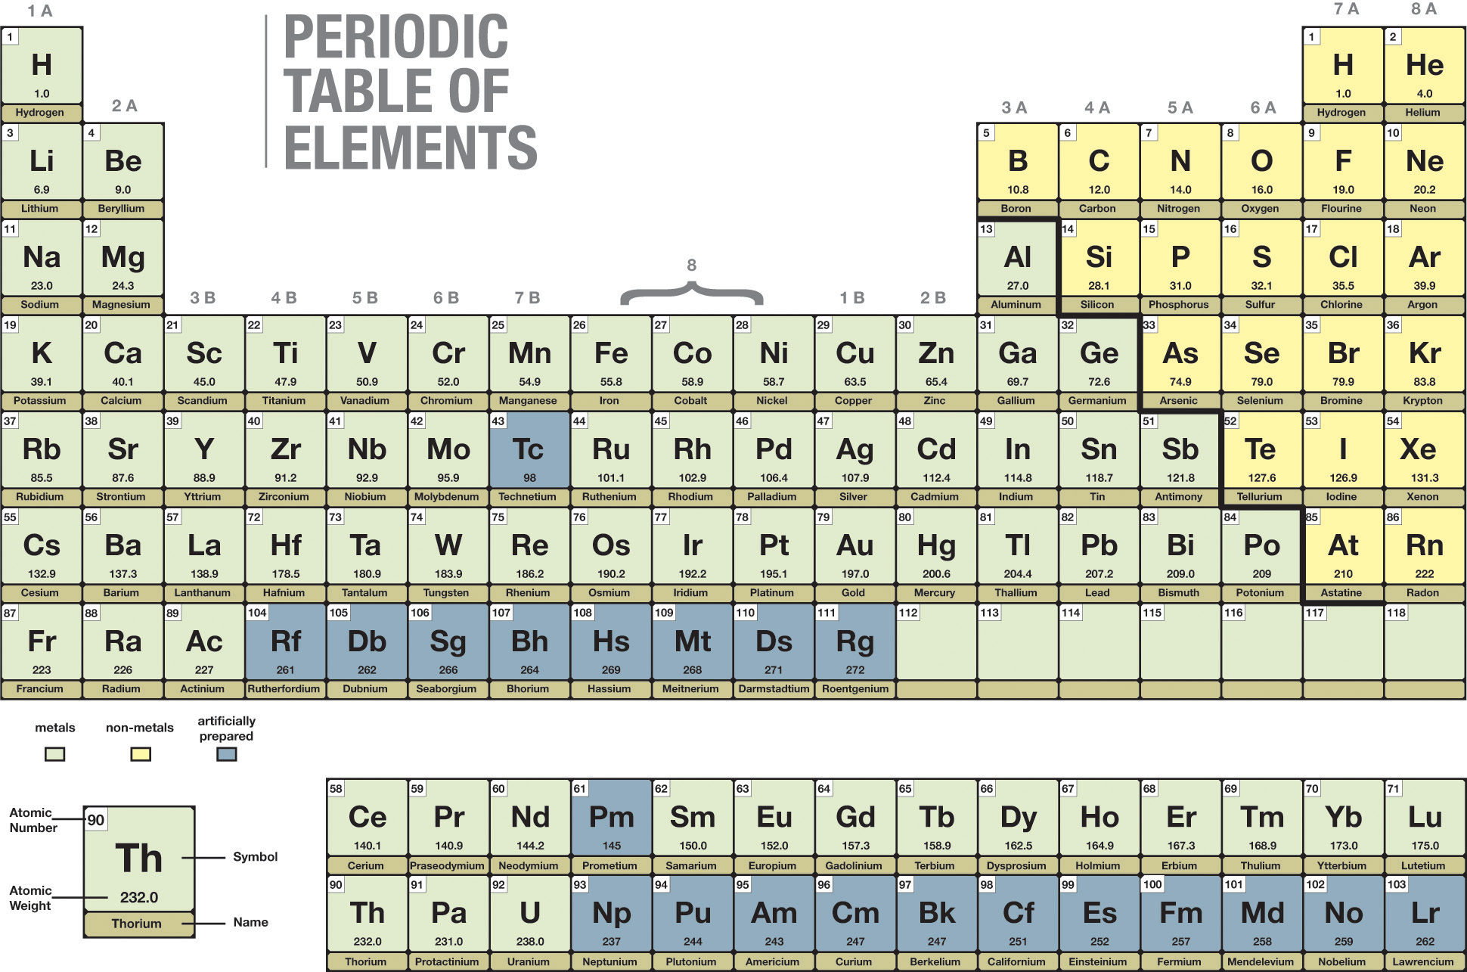
Which 2 groups are the most reactive.
16,17

Slide 12
Which group is the least reactive?
18

Slide 13
Ionization energy-What is it?
19
The energy required to bring an electron to the highest energy level
Energy required to free a valence shell electron from bound atomic state
Energy required for a reaction in free space
Energy of covalent ground state
Energy required to spin an inner shell electron from bound atomic state

Slide 14
Which of the following do you expect to have the largest ionization energy?
20
Neon
Sodium
Oxygen
Helium
Nitrogen

