Slide 1
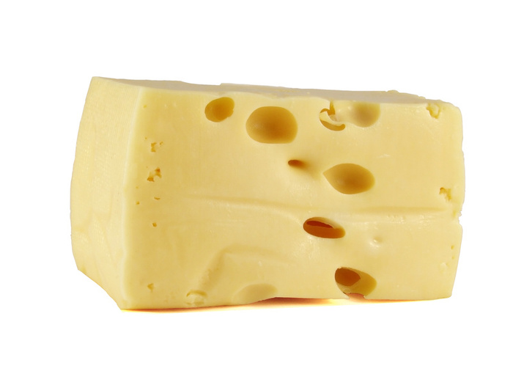
Chapters 12,13 and 14 exam
Properties of matter

Slide 2
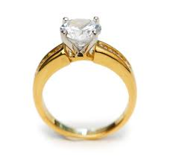
The Physical Properties of Matter
1
Misconceptions
Gold vs. Diamond
Which is more dense?
Which is harder?

Slide 3
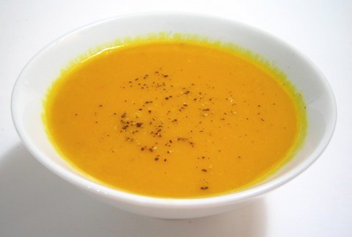

The Physical Properties of Matter
2
Kinetic Theory
How are you able to cool soup by blowing on it?

Slide 4
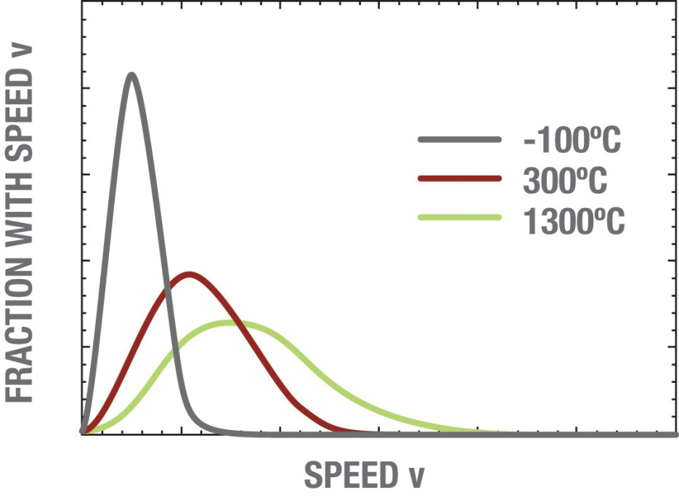
The Physical Properties of Matter
3
Shapes
A
B
C
Each curve is a Boltzmann distribution for a gas of the same molecular species. Which one is hottest A,B or C?

Slide 5
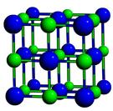
Crystal Structures
4
If the blue spheres are chlorine and the green spheres are sodium, what is this substance?
Sugar
Corn Starch
Salt
Mango

Slide 6
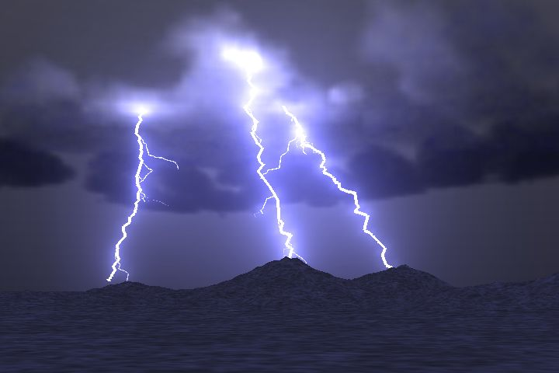
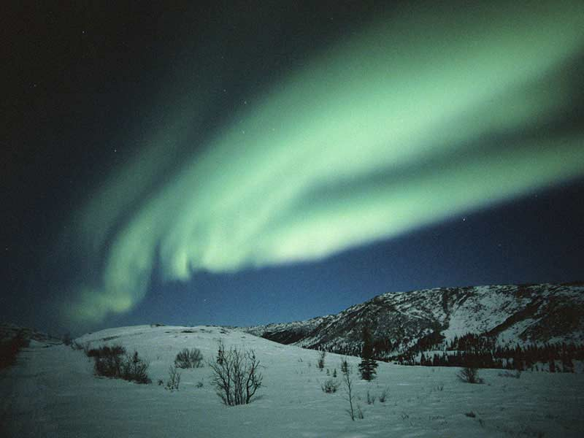
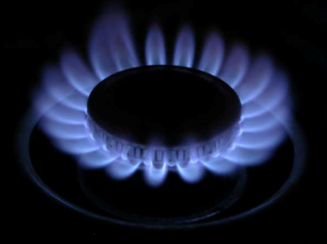
What is this state of matter?
5

Slide 7
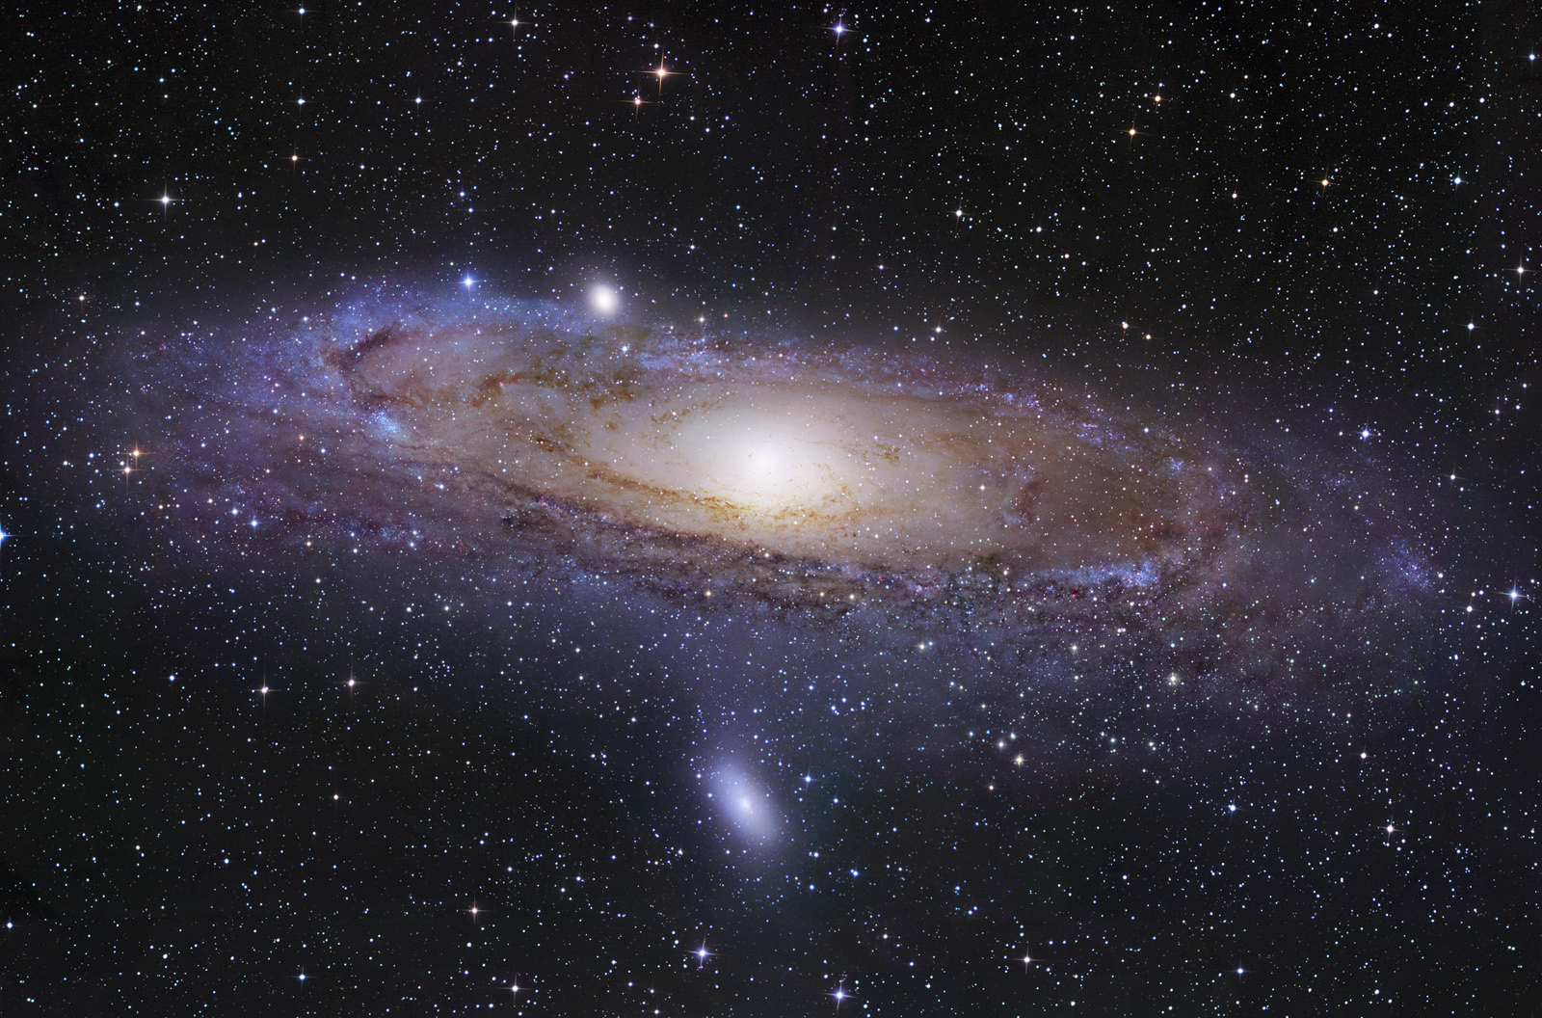
What is the most common state of matter in the visible universe?
6
Solid
Liquid
Gas
Plasma
Earth

Slide 8
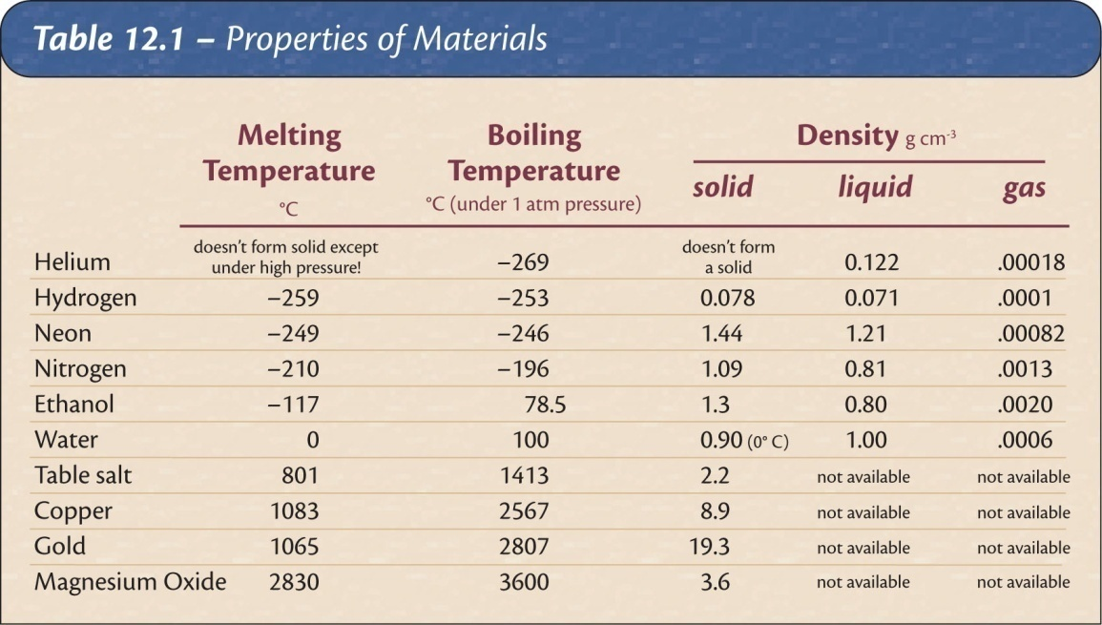
An unknown solid melts at -50 degrees. Which of the following would most likely be its boiling point?
7
1000 degrees
90 degrees
0 degrees
-120 degrees

Slide 9
Density vs. Weight
8
What is heavier, 3lbs. of steel or 3 lbs. of Styrofoam?
Styrofoam
Steel

Slide 10
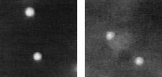
Random Molecular Collision Motion
9
What is this erratic, jittery motion called?
Greenian Motion
Soberiety Waltz
Kinetic Theory
Brownian Motion
Anxiety Induction
Notes:
In both cases the fluorescent particles are 2 microns in diameter. The left picture shows particles moving in pure water; the right picture shows particles moving in a concentrated solution of DNA, a viscoelastic solution in other words. The movies are 4 seconds of data, total; you can see a slight jump in the movie when it loops around.
http://www.deas.harvard.edu/projects/weitzlab/research/brownian.html

Slide 11

Temperature is a measure of
10
The number of particles in a system
The average kinetic energy of the molecules.
The rate of change of chemical reactions
Heat flow in the room
Nitrogen content
Notes:
Because the oven doesn't go to 700 degrees.

Slide 12
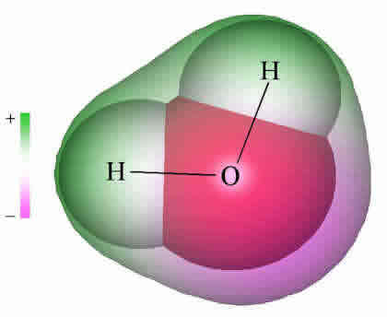

Why does water expand when it freezes?
11
Notes:
Deflect water drops using a staticly charged rod.

Slide 13
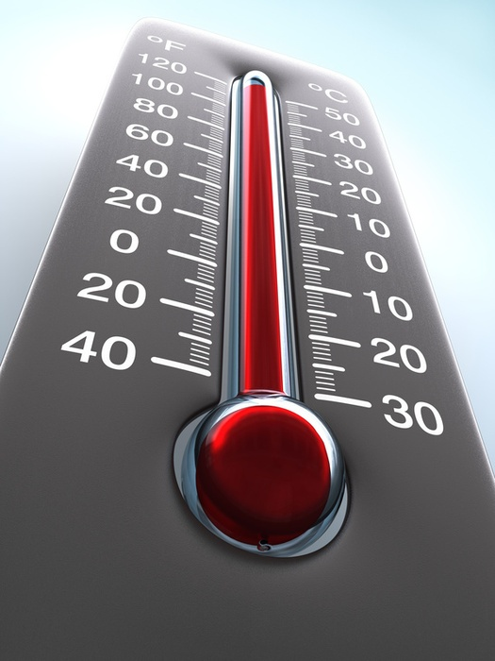
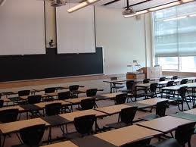
If the temperature in a closed room increases…
12
The pressure decreases
The pressure increases
The number of gas molecules increases

Slide 14
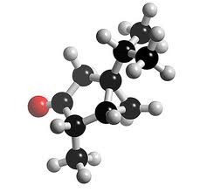
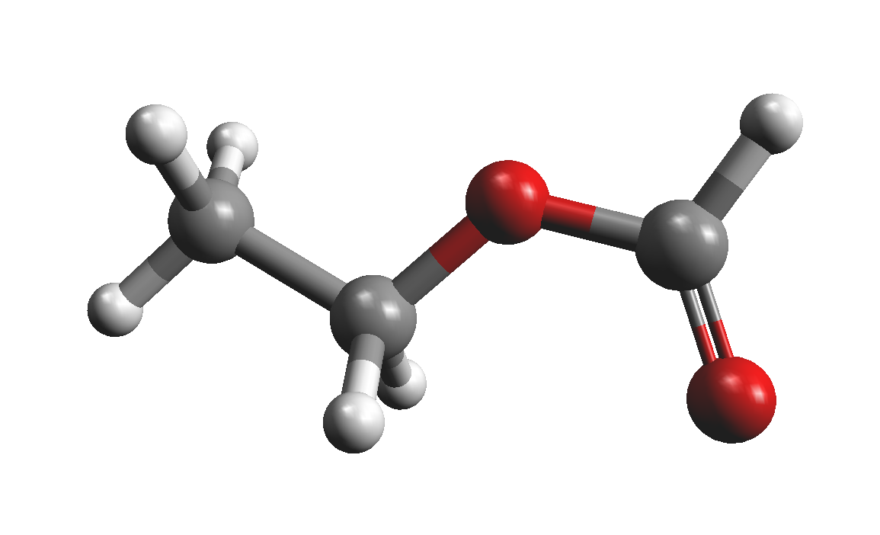
Which 2 does the molecular model fail to explain?
13
Pressure
Color
Temperature
Energy Levels
Heat conduction

Slide 15
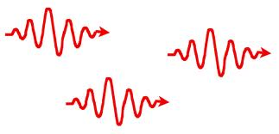
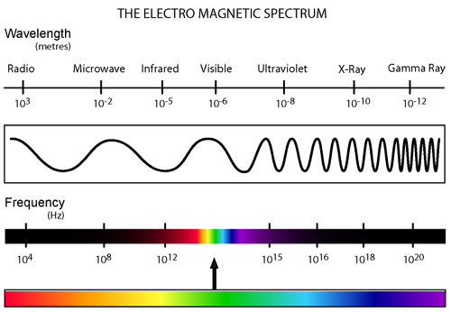
Review: Which type of electromagnetic radiation has the lowest energy per photon?
14
Radio Waves
Infrared
Green light
Red light
Ultraviolet
Gamma Rays

Slide 16
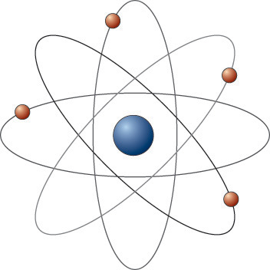
What is a problem with the Solar System model?
15

Slide 17
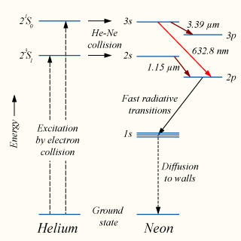
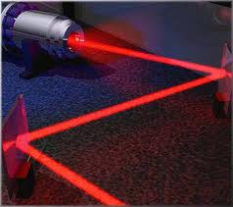
Laser
16
Which transition emits red light?
3s-3p
3s-2p
2s-2p
2s-3p

Slide 18
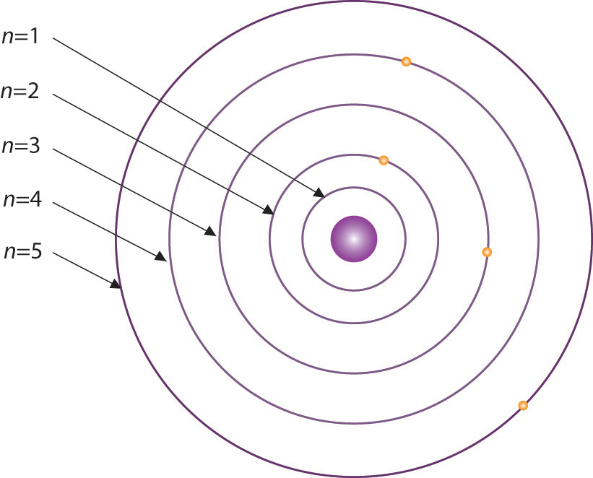
Problem with the “Bohr Model”
17
Why are only certain ______ possible?(not like a solar system!)

Slide 19
18,19, and 20
Student created questions

