Slide 1
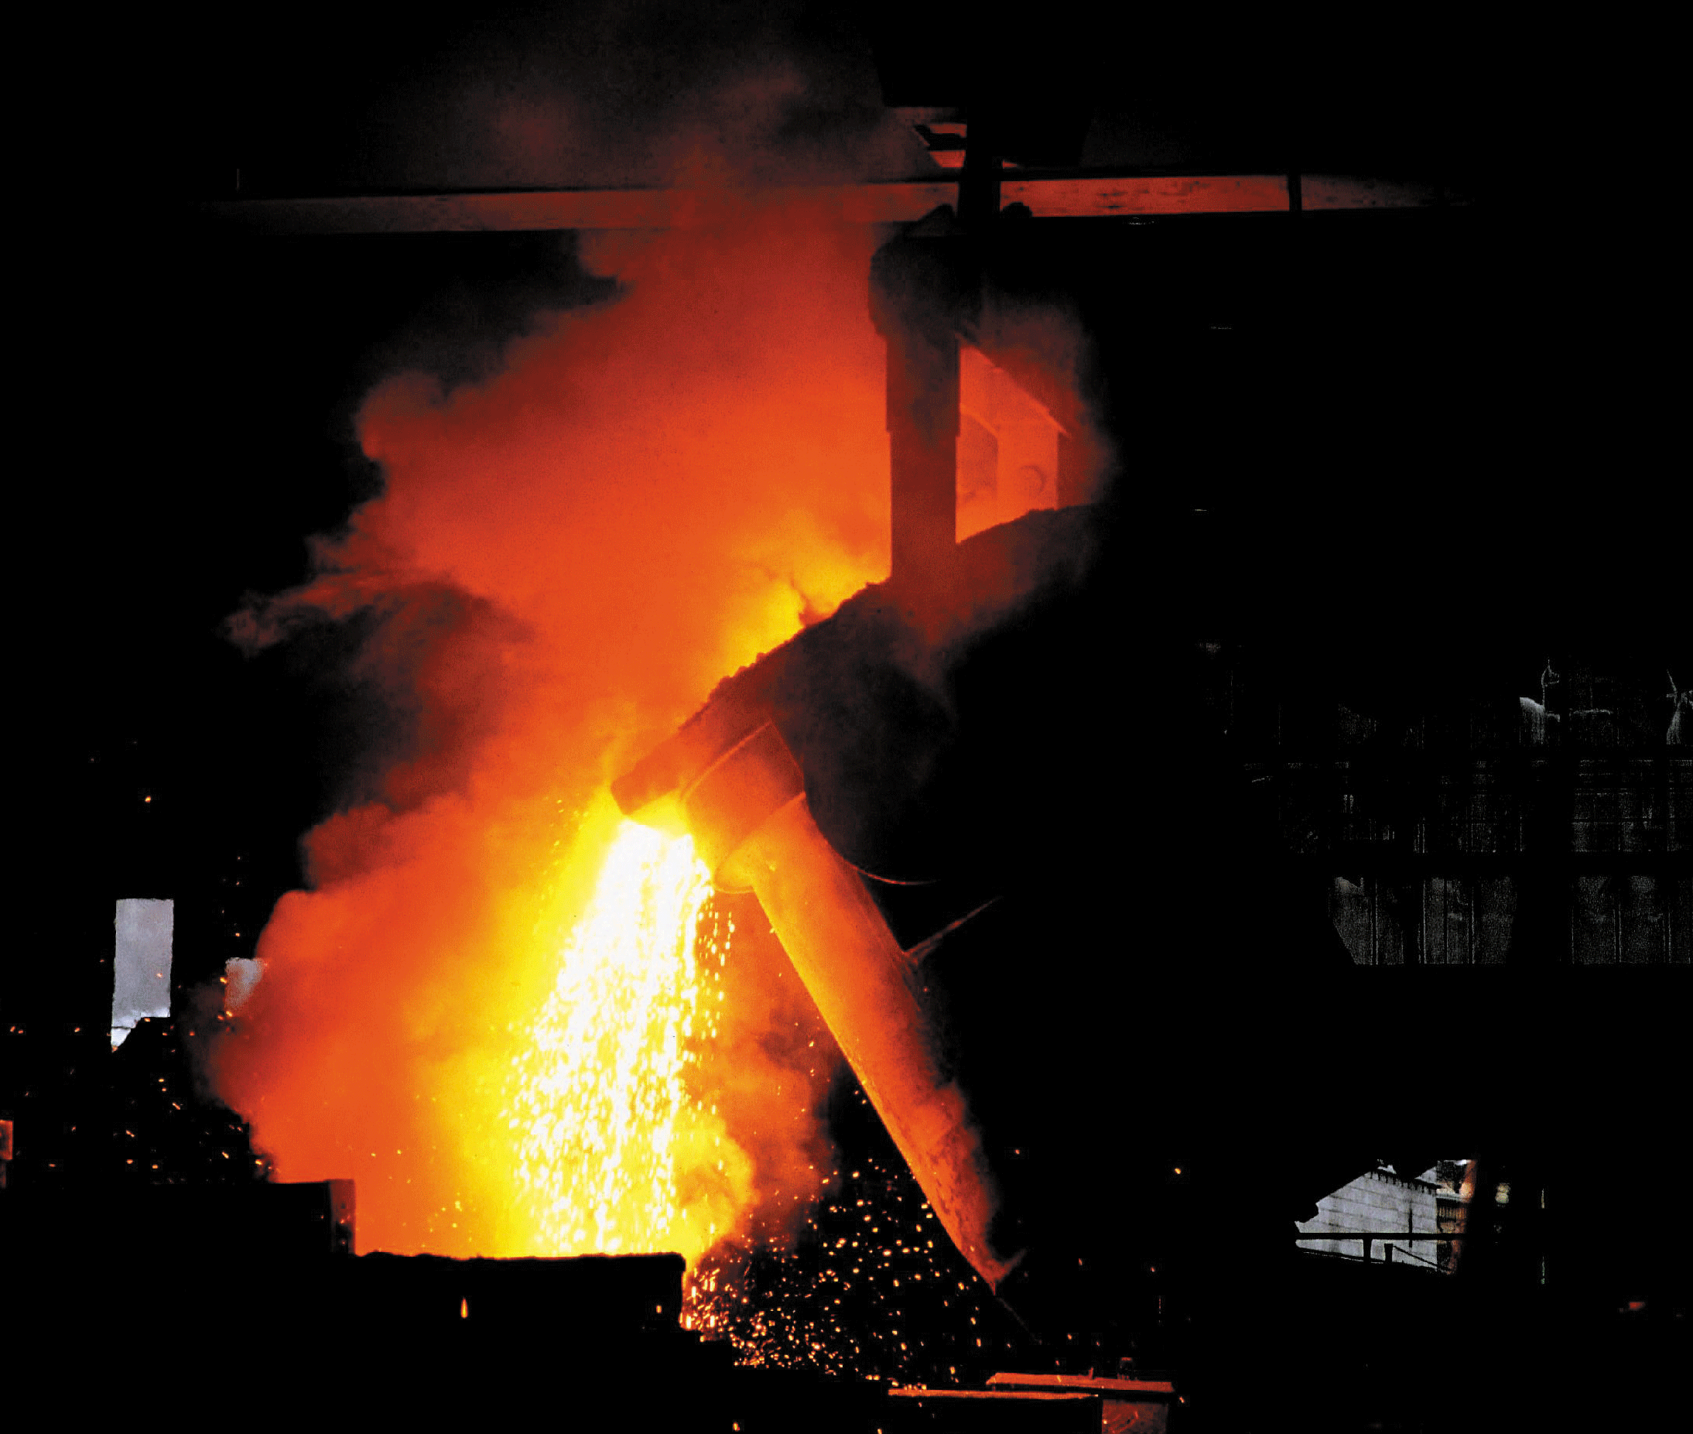
The Physical Properties of Matter

Slide 2
The Physical Properties of Matter
Midterm options
No Midterm, just bigger final
Midterm project due March 10th
Midterm exam on March 10th

Slide 3
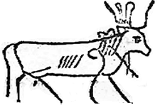
New quiz question symbol!

Slide 4
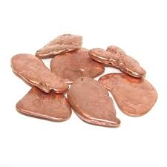
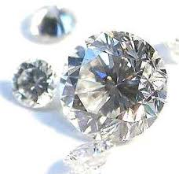
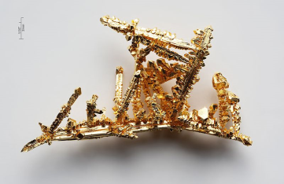
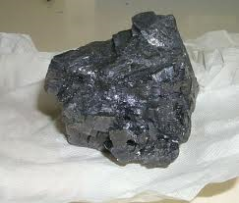
The Physical Properties of Matter
Misconception
Copper vs. Diamond
Which one is denser?
Which one is harder?
Gold vs. Lead
Which one is denser?
Copper is 3 times more dense!
Diamond is 3 times harder!
Gold 2 times more dense than lead!
But lead has an atomic mass of 207 g/mole which is more than gold at 197 g/mole?!?!

Slide 5
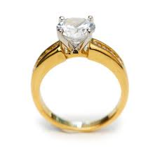
The Physical Properties of Matter
Misconceptions
Gold vs. Diamond
Which is more dense?
Which is harder?

Slide 6

Density vs. Weight
What is more dense, lead or wood?
Wood
lead

Slide 7
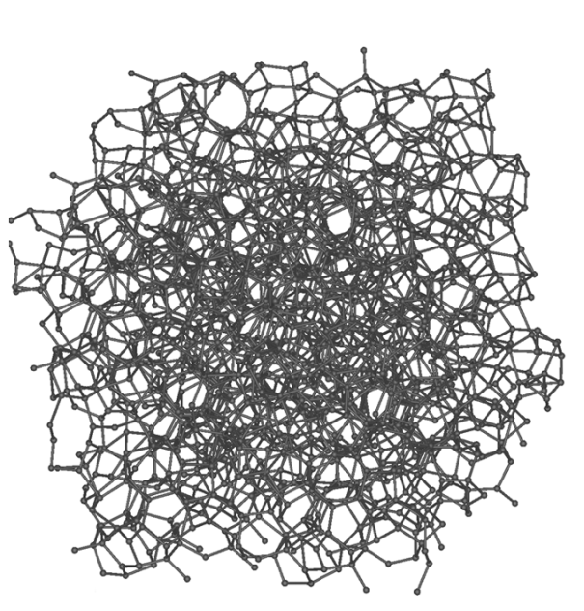

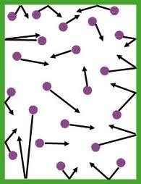

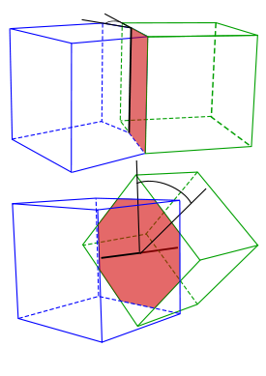
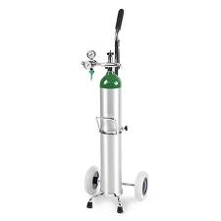

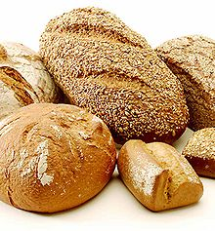
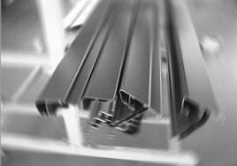
Internal atomic structure of materials
Polycrystalline Solid
Amorphous Solid
Gas
Liquid

Slide 8
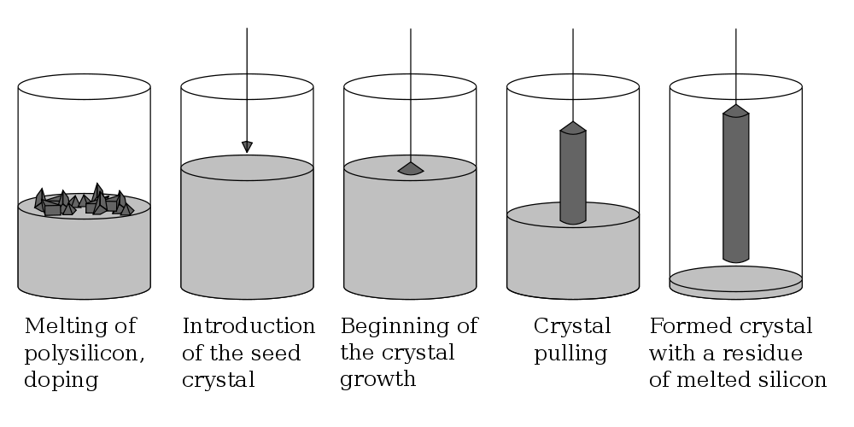
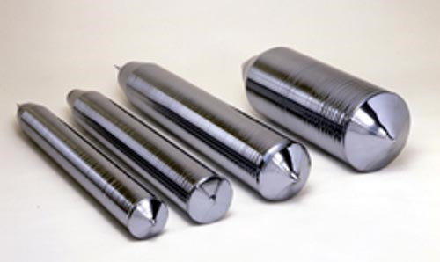
How about a perfect crystal with long range order?
Perfect Silicon Crystal growth

Slide 9
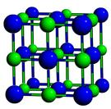

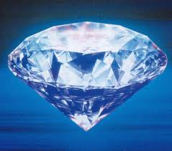
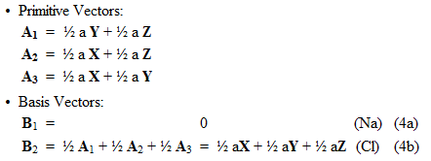
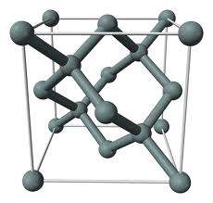
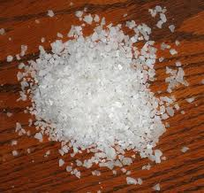
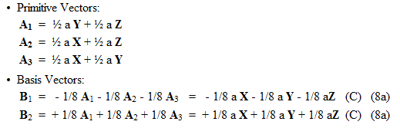
Mathematical Crystal Structures
chlorine
sodium
Diamond is hard but not dense. It has strong directional bond strengths and a very open crystal structure.

Slide 10
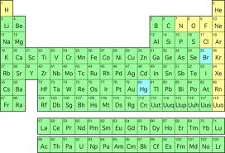
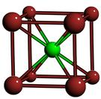
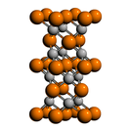
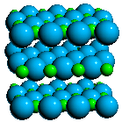
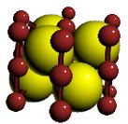
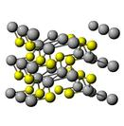
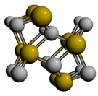

Supercomputer predicts nature
Choose 2 elements
Choose a crystal structure
  …
  3. Calculate likelihood of natural existence
Mary-Lou at BYU
512 nodes at 12 cores per node – 6144 cores
24GB of DDR3 1066 MHz memory per node!
Hex-core Intel
Westmere (2.67 GHz)

Slide 11
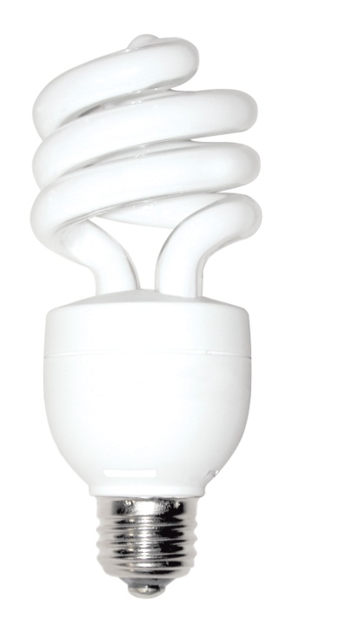
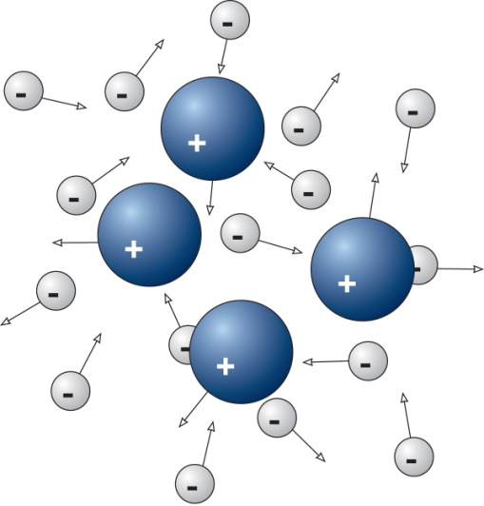
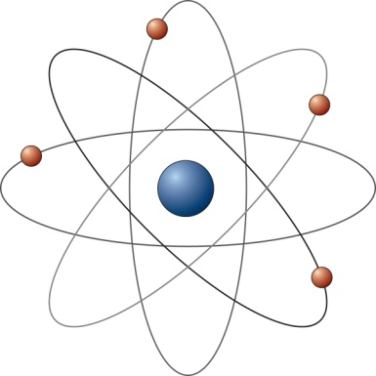
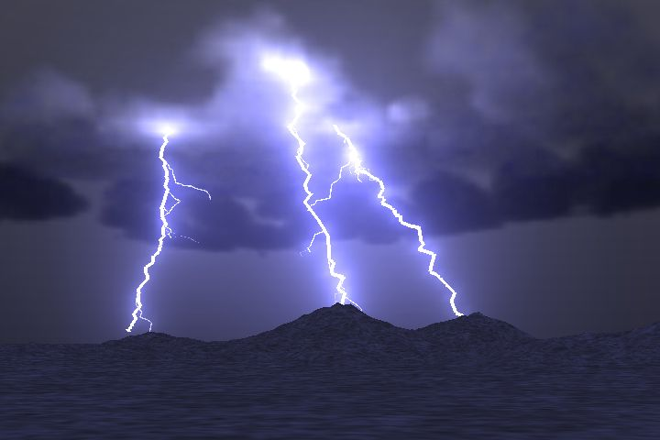
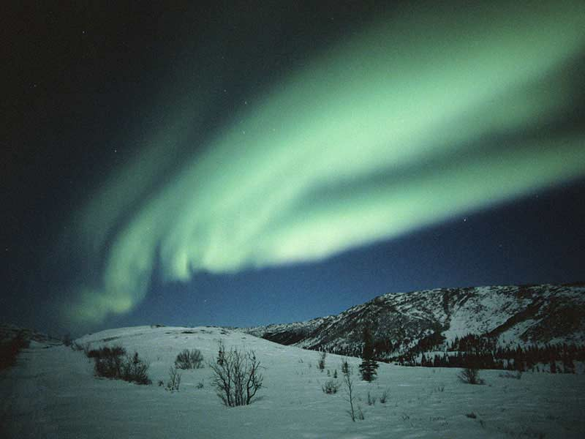
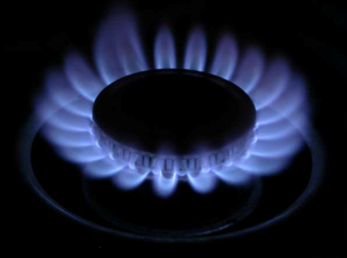
A 4th state of matter… Plasma
Plasma: ionized gas; electrons become detached from atoms

Slide 12
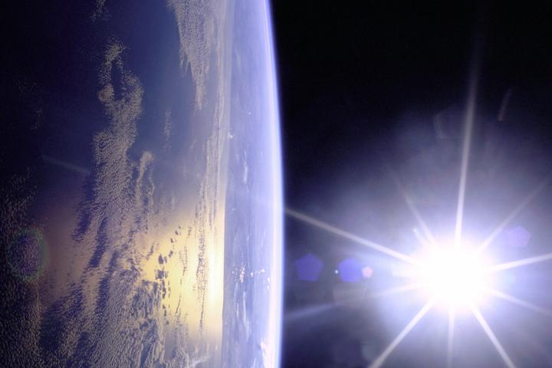

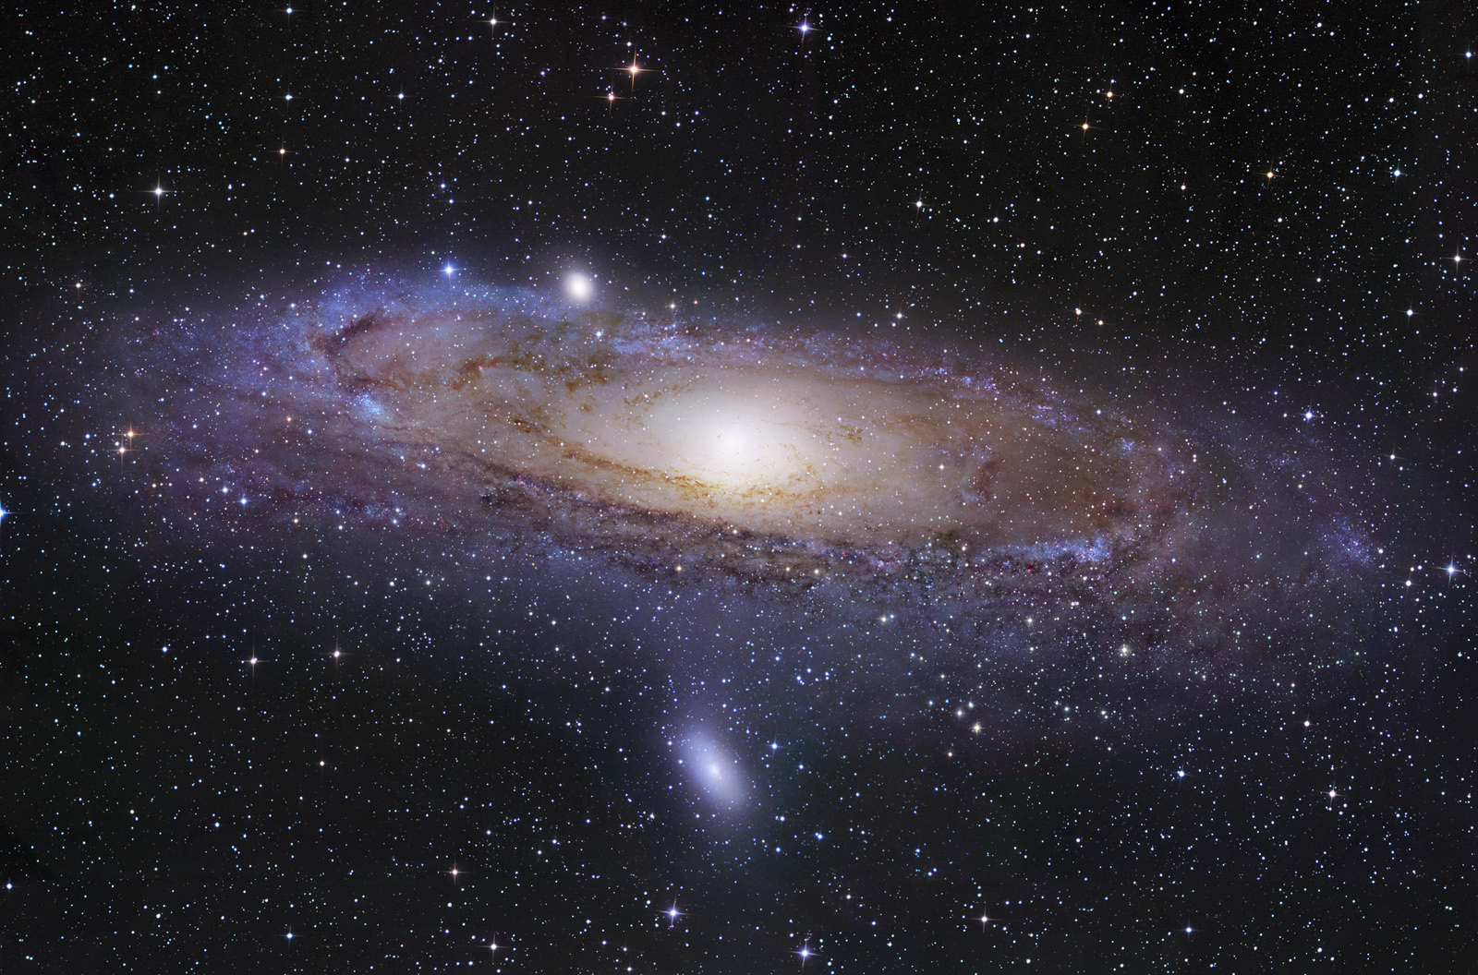
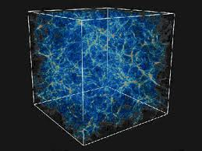
What is the most common state of matter in the visible universe?
Solid
Liquid
Gas
Plasma
The visible universe!
Earth
A galaxy

Slide 13
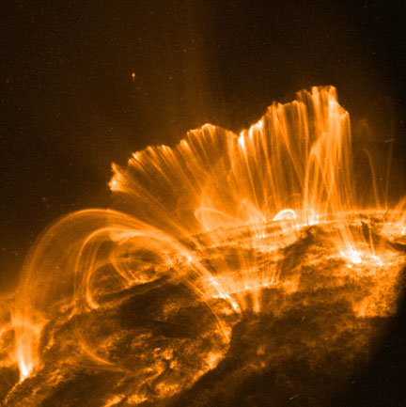
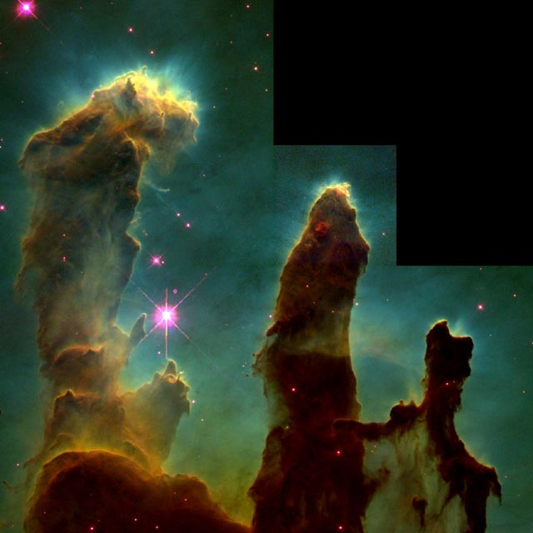
Over 99% of the visible universe is in the plasma state
Coronal Loops on the Sun (~250,000 miles long)
Eagle Nebula (Fingers are ~1 Light Year)
Notes:
Close-up images reveal an active surface with coronal loops emerging and disappearing all over the Sun's surface and can span a length of about 250,000 miles, or about 30 times the diameter of Earth.
Image is hubble view of eagle nebula, those tremendous pillars of gas and dust are more than a light year in length

Slide 14
An Interesting Parallel
Ancient (Aristotle)
Four elements of matter
  Earth
  Water
  Air
  Fire
Modern (Quantum Mechanics)
Four states of matter
  Solid
  Liquid
  Gas
  Plasma

Slide 15
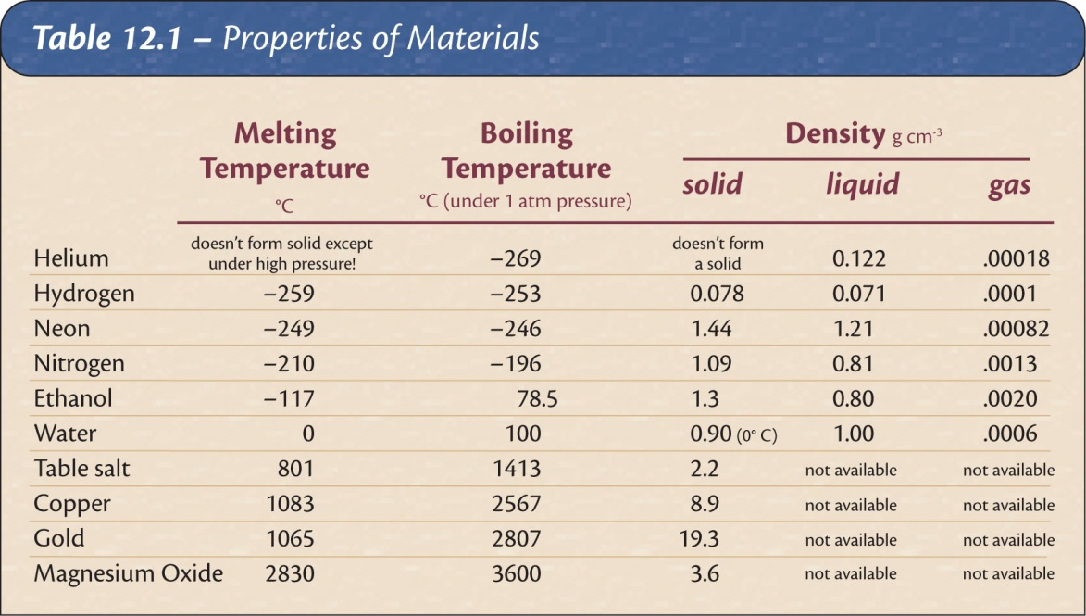
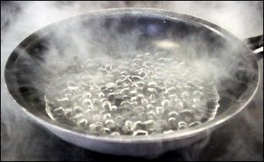
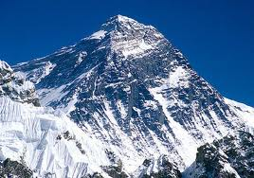
Changes of State
State is a function of temperature (and pressure).
Different materials change state at different temperatures.
As water begins to boil on the top of Mt. Everest, would it burn you?
1/3 atm
156.2 °F

Slide 16
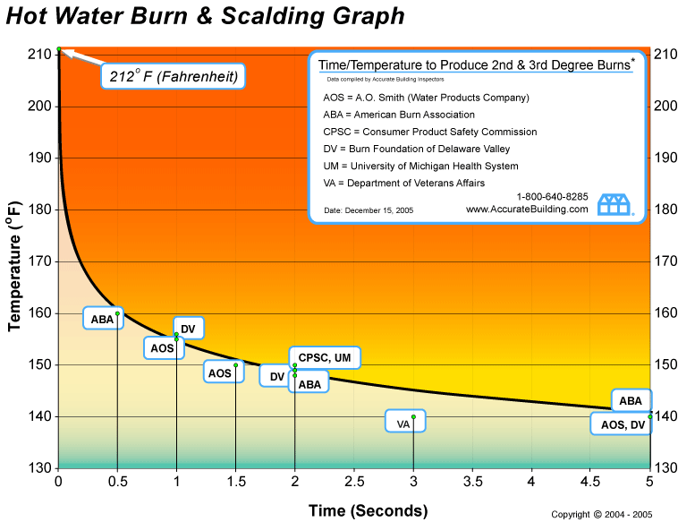
Varying sources of truth

Slide 17
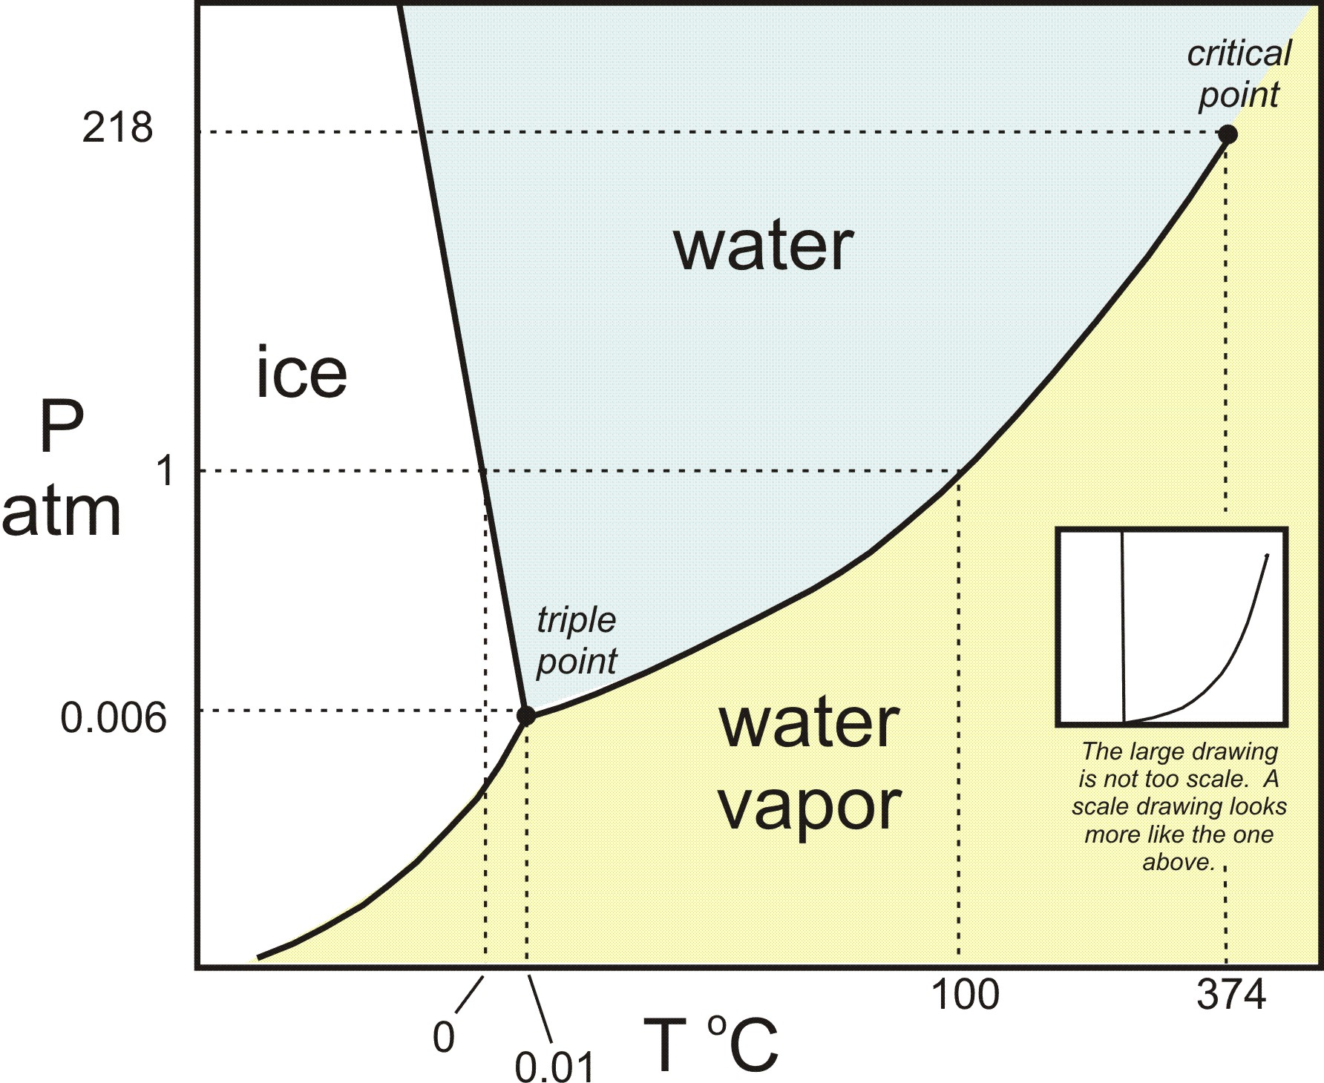

An example – Dihydrogen-Monoxide
Pressure
(atm)
$$\frac{1}{3}\text{atm}$$
69 °C
Temperature(Celsius)

Slide 18
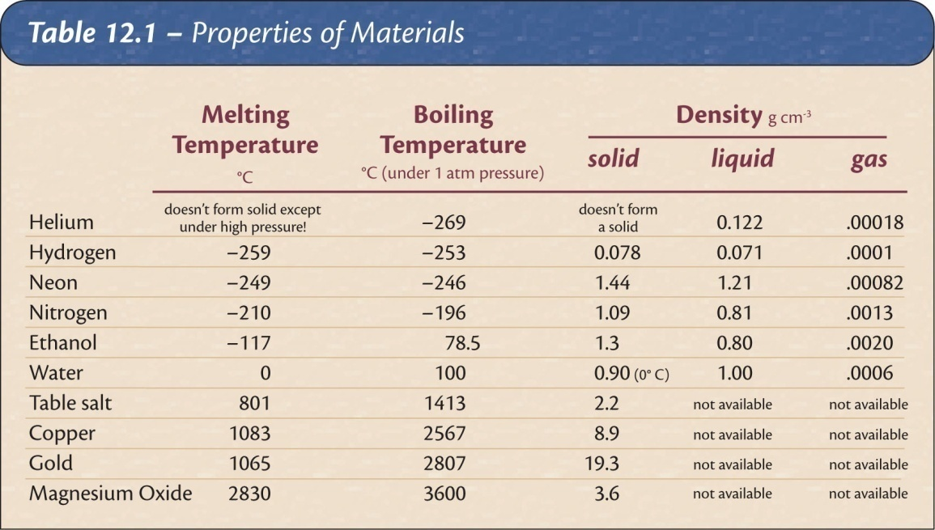
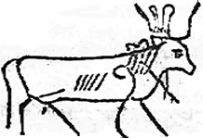
An unknown solid melts at -50 degrees. Which of the following would most likely be its boiling point?
-120 degrees
0 degrees
90 degrees
1,000 degrees
The temperatures at which substance transform from solid to liquid and liquid to gas give information about the strength of the bonds holding the material together.

Slide 19
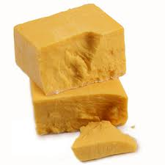
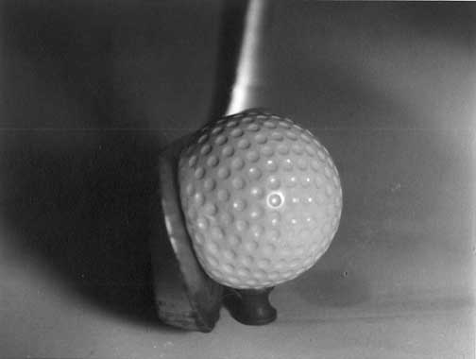


Deformation
Elastic deformation: object returns to its original shape after the deforming force is removed.
Plastic deformation: object retains its new shape when the force is removed.
Elastic limit: transition point between elastic and plastic deformation for a material.
Notes:
Which has the larger elastic constant, rubber band or table?

Slide 20
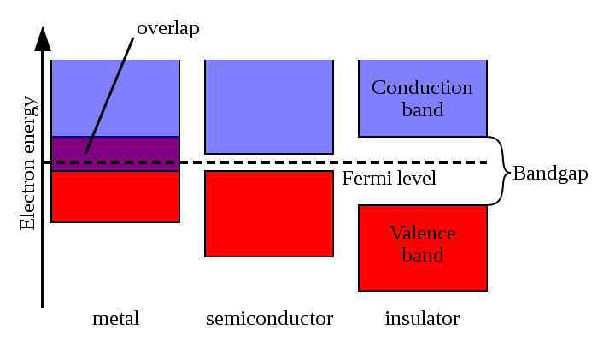



Electrical conductivity of solids
Conductor - electric current flows easily
Semiconductors - allow current under special conditions
Insulator - resists flow of current
conductor
semiconductor
conductor
semiconductor
insulator
insulator
Notes:
Metals: silver, copper, gold
Semiconductors: germanium, silicon
Insulators: glass, mica, polyethylene

Slide 21



Electrical Conductivity of liquids
Ionic materials – make water more conductive
Nonionic – make water less conductive
Notes:
Metals: silver, copper, gold
Semiconductors: germanium, silicon
Insulators: glass, mica, polyethylene

Slide 22

Electrical Conductivity of gases
Click!
Notes:
Metals: silver, copper, gold
Semiconductors: germanium, silicon
Insulators: glass, mica, polyethylene

Slide 23


The color of an object gives information about its composition
The color of an object is determined by what wavelengths of light it reflects (or emits)
  Examples: Tomatoes reflect red light, and absorb other colors.
  Clover reflects green colors, absorbs others

Slide 24
The spectrum of light source is a measure of which wavelengths are present
continuous spectrum
discrete spectrum -- only a few specific colors
Discrete absorption spectrum – All colors but a few lines

Slide 25



Chapter 13: The Molecular Model of Matter

Slide 26
The Molecular Model
All matter is made of tiny particles called molecules which are:
  Too small to see, even with an optical microscope
  In constant motion
  Governed by Newton’s laws of motion, energy conservation, etc.
Each different kind of matter has a different kind of molecule

Slide 27

Continuous model of matter

Slide 28
Continuous Model
Useful in many situations:
  Fluid dynamics
  Classical Electrodynamics
Has many limitations
  Charge and light come in distinct packets
  How do changes of state occur??!?
  Etc.

Slide 29

Brownian Motion
The erratic, jittery motion of a dust speck in a fluid is strong evidence supporting the molecular model.
  The speck is colliding randomly with unseen molecules.
Notes:
In both cases the fluorescent particles are 2 microns in diameter. The left picture shows particles moving in pure water; the right picture shows particles moving in a concentrated solution of DNA, a viscoelastic solution in other words. The movies are 4 seconds of data, total; you can see a slight jump in the movie when it loops around.
http://www.deas.harvard.edu/projects/weitzlab/research/brownian.html

Slide 30

States Explained
Solid: The molecules are frozen in place but still vibrate.
Liquid: The molecules move past each other but still have a weak attraction.
Gas: The molecules only interact when they collide.
Plasma: The molecules collide with enough energy to break into charged pieces.

Slide 31

Temperature Explained
Temperature is a measure of the average kinetic energy of the molecules.
  Cold → slowly moving
  Hot → rapidly moving
  Absolute zero → motion ceases (-460 F, -273 C)
Example: At room temperature molecules are moving about 1,000 ft/s
Example: At room temperature molecules are on average about .0000002 feet apart
Notes:
Because the oven doesn't go to 700 degrees.

Slide 32


Temperature is a measure of the average kinetic energy of a collection of molecules

Slide 33


Off to the molecular races
K.E. = ½ mv²
the same for both NH₃ and HCl
but HCl has about twice the mass

Slide 34


Evaporation Explained
Temperature is a measure of the average kinetic energy.
Some molecules go faster and some go slower.
The fast ones escape as a gas even when the average temperature is below boiling.
How are you able to cool soup by blowing on it?

Slide 35

State changes and the molecular model
Temperature is molecular kinetic energy.
Internal energy includes kinetic plus electrical potential energy from how the molecules are arranged.

Slide 36

Gas Pressure Explained
Like throwing a huge number of tiny balls against a wall repeatedly.

Slide 37
Gas Pressure and Temperature
Gas pressure increases with temperature if the gas cannot expand. The hotter molecules hit the container walls harder and more often than the cold ones.
Colder
Hotter

Slide 38


If the temperature in a closed room increases…
The pressure decreases
The pressure increases
The number of gas molecules increases

Slide 39


Finally, we have actually “seen” atoms using special microscopes
Graphite
Iron on Copper (Gen shi = atom)

Slide 40


Why does water expand when it freezes?
Go to PhET
Notes:
Deflect water drops using a staticly charged rod.

Slide 41
Some things we haven’t explained
Where does color come from?
How are the parts of molecules arranged?
Why does metal conduct heat well, but wood does not?
Why does metal conduct electricity, but not wood?
Pressure
Color
Temperature
Energy Levels
Heat conduction

Slide 42

Chapter 14: The Nuclear Atom

Slide 43


Review: Which type of electromagnetic radiation has the highest energy per photon?
Radio Waves
Infrared
Ultraviolet
Green light
Red light
Visible wavelength range 400nm to 700nm

Slide 44

Thompson Model of the Atom (Plum Pudding)
Atom
Positive “pudding”
Negative particles

Slide 45



Death of Plum Pudding model
Rutherford, Geiger, and Marsden
Expectation
Result

Slide 46

Another New Model:
The Solar System Model

Slide 47
Problems at the start!
Accelerating electrons should radiate, loose energy, and spiral into the nucleus.
The model soon died.

Slide 48

More clues from light spectra
continuous spectrum -- all colors
discrete spectrum -- only a few specific colors
Discrete absorption spectrum – All colors but a few lines
Visible wavelength range 400nm to 700nm

Slide 49


The Bohr Model: The Rutherford model plus a patch

Slide 50



Absorption vs. Emission spectra
Visible wavelength range 400nm to 700nm
Absorption
Emission

Slide 51






Light Amplification by Stimulated Emission of Radition
Light
Amplification by
Stimulated
Emission of Radiation
$$E_{2}→E_{1}$$
emits light
Hydrogen “energy level diagram”
~700nm

Slide 52










L.A.S.E.R.
$$E_{4}$$
Which transition emits green light?
-
-
-
-
$$E_{3}$$
$$E_{4}→E_{3}$$
$$E_{2}$$
$$E_{4}→E_{2}$$
$$E_{3}→E_{1}$$
$$E_{1}$$
$$E_{2}→E_{4}$$
$$E_{0}$$
Ground state
Visible wavelength range 400nm to 700nm
Not a visible transition
Nd:YAG (neodymium-doped yttrium aluminium garnet; Nd:Y₃Al₅O₁₂)

Slide 53
Problems with the “Bohr Model”
Why are only certain orbits possible (not like a solar system!)
Why doesn’t the undisturbed atom radiate? (Why don’t the electrons fall into the nucleus?)
‘Because Bohr says so’
is not a good answer.
So we continue looking!

Slide 54
Create your own quiz question
Write on a strip of paper
Come up with a question that you think would be a good quiz qeustion
Pass them forward to me

Slide 55
The Physical Properties of Matter
Midterm options
No Midterm, just bigger final
Midterm project due March 10th
Midterm exam on March 10th

