Slide 1
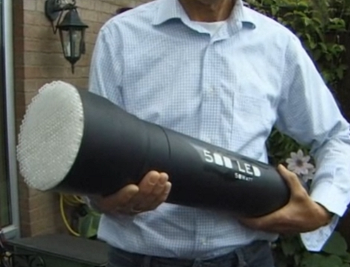
Chapters 10 and 11 quiz

Slide 2


What type of waves are these?
1
A
B

Slide 3
Matching - Wave properties
2
Wavelength
Frequency
Amplitude
Speed
the number of wave crests which pass a point per second
the rate at which the wave travels away from the source
the distance between similar parts of a wave
the maximum amount the medium is disturbed from equilibrium

Slide 4
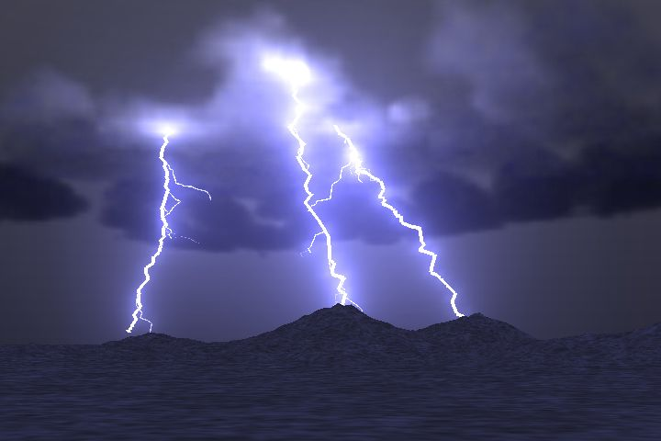
Wave Properties: Speed
3
The speed of sound is 1/5 mile/sec
You hear the thunder 10 seconds after seeing the lightning.
How many meters away is the lightening?

Slide 5

If you cut the wavelength in half and the speed stays the same, the frequency will
4
Double
Be cut in half
Quadruple
Remain unchanged
Speed = frequency × wavelength

Slide 6
Matching – Crude wave behavior descriptions
5
Bending when the medium changes
Bouncing off an interface
Combining waves to strengthen or weaken the total wave
Bending around corners
Reflection
Refraction
Diffraction
Interference

Slide 7
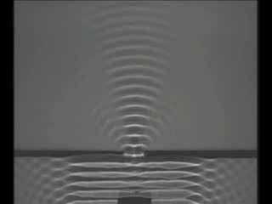
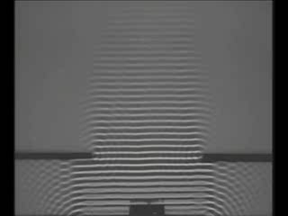
T/F
6
A wave diffracts much more when the incoming wavelength is much smaller than the opening.

Slide 8
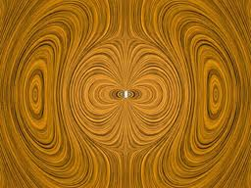
7
Electron Source
Electromagnetic radiation is given off whenever electrons __________.

Slide 9
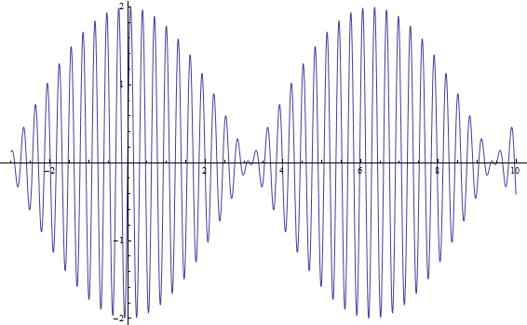
Wave Particle Duality
8
Why is light both like a wave and a particle?

