Slide 1
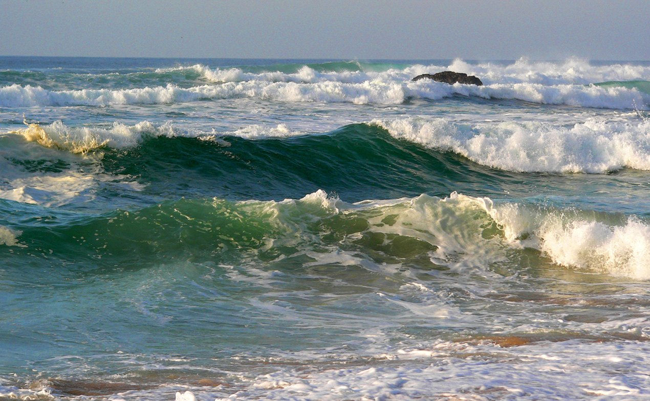
Chapter 10: Waves

Slide 2


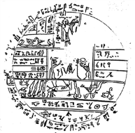
Wave concepts
A wave is a “disturbance” that travels (usually through a medium).
They carry energy away from a source.
The disturbance travels while the material does not.
compression
transverse

Slide 3
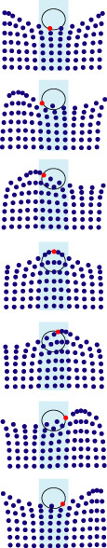
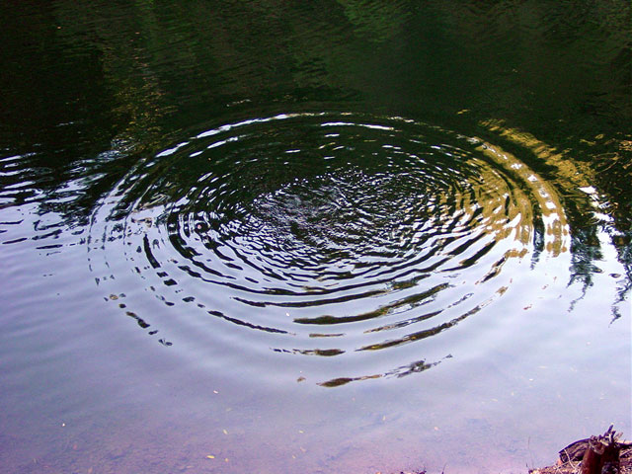

Types of Waves: Surface Waves

Slide 4
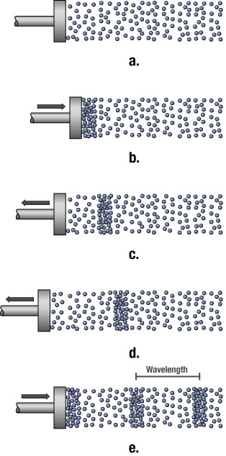
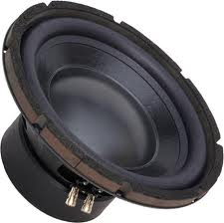
Types of Waves: Compression Waves
Come from compressing atoms (or molecules) close together and then pulling them apart
Air is the “medium”
The oscillations are parallel/antiparallel to the direction of travel
DEMO!
SPEAKER through AIR

Slide 5
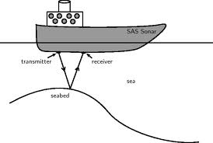
Types of Waves: Compression Waves
Compression waves can also travel through solids and fluids
Solid
Liquid
Gas
example

Slide 6
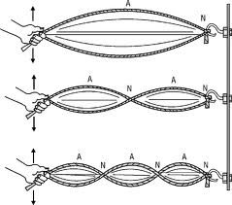
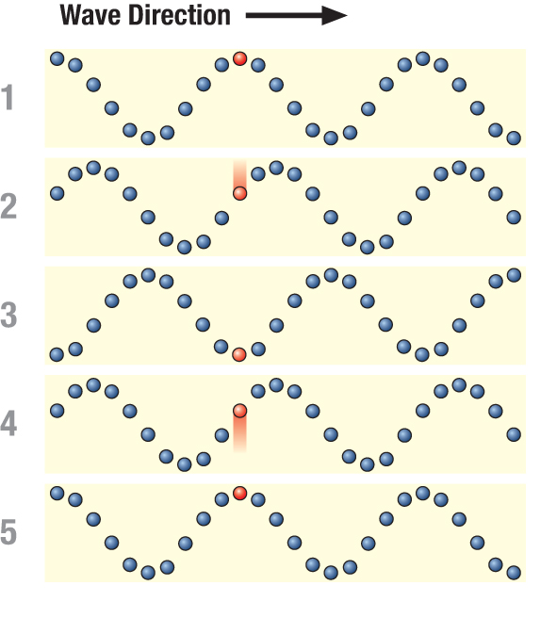
Types of Waves: Transverse waves
The oscillations in a transverse wave are perpendicular to the direction of travel
Would a student in the front row please tap down gently on one end exhibit A?
DEMO!
Wave on a spring

Slide 7
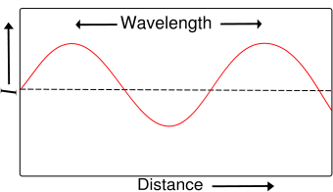
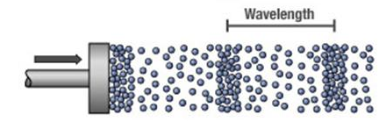
Wave Properties: Wavelength
Wavelength is the distance between two similar parts of the wave
Compression Wave
Transverse Wave
Notes:
Radio: 10 feet (FM) to close to a mile (AM)
Light: 10⁻⁶ m (1/1000 mm)

Slide 8
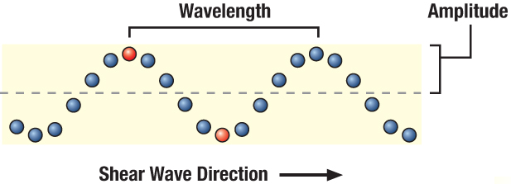
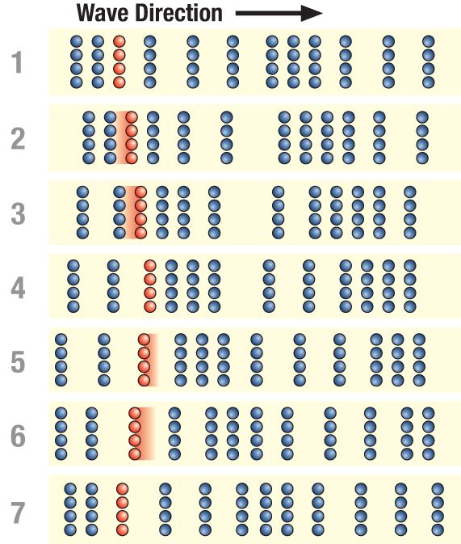
Wave Properties: Amplitude
Amplitude is the amount of displacement from the rest position
A measure of the wave energy
Related to loudness (sound) or brightness (light)
Amplitude

Slide 9
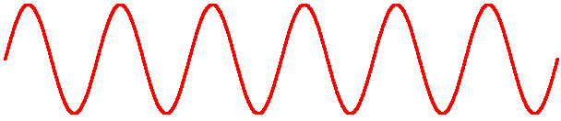
Wave Properties: Frequency
Frequency is the number of wave crests which pass a point per second.
  sound: pitch, 20 to 20,000 Hz
  light: color, 10¹⁵ Hz
  earthquake: 10 to 1,000 Hz
  radio: kHz (AM) to MHz (FM)

Slide 10
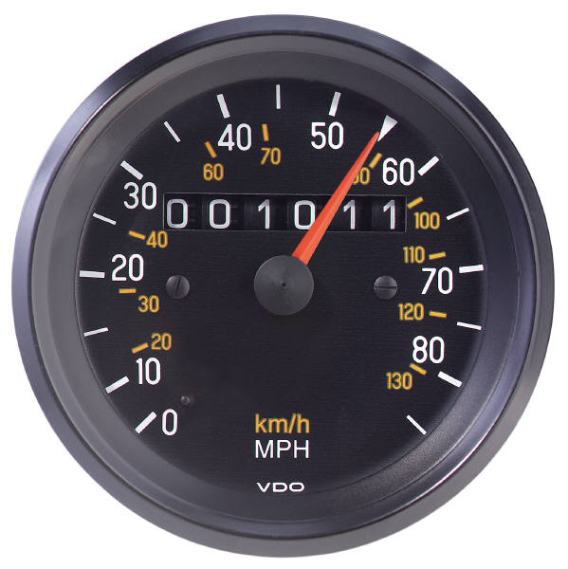
Wave Properties: Speed
Speed = frequency × wavelength
Speed usually depends almost exclusively on the medium.
However, frequency/wavelength can play an extremely minor role in special cases.
  This is how we get rainbows

Slide 11
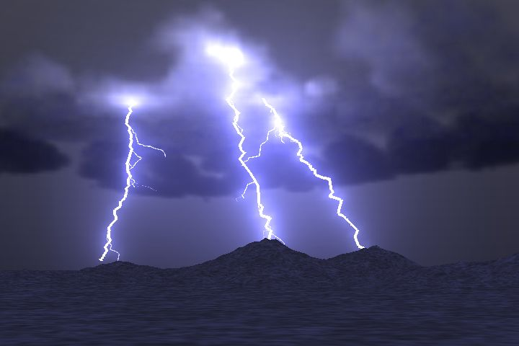
Wave Properties: Speed
The speed of sound is about 1/5 mile/sec
You hear the thunder five seconds after seeing the lightning.
How far away is the lightening?

Slide 12
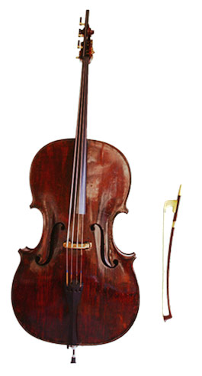
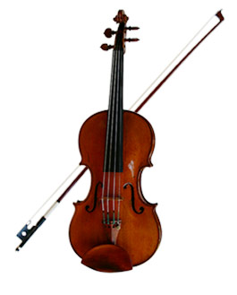
If you double the frequency of a wave, the speed will(keep wavelength the same)
Double
Be cut in half
Remain essentially unchanged
Speed = frequency × wavelength.

Slide 13

Visible Light
A transverse wave (but what is waving?)
Long wavelength, low frequency → red light
Short wavelength, high frequency → blue light
Speed is the same for all colors (in our model)

Slide 14
Wave Behavior
All waves will
  Reflect
  Refract
  Diffract
  Interfere

Slide 15
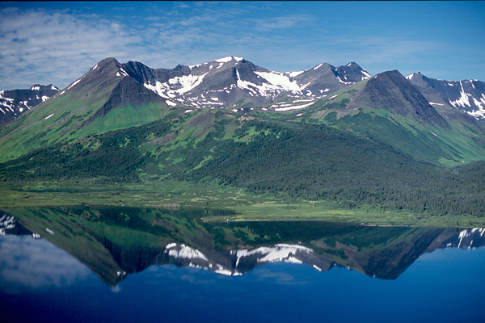
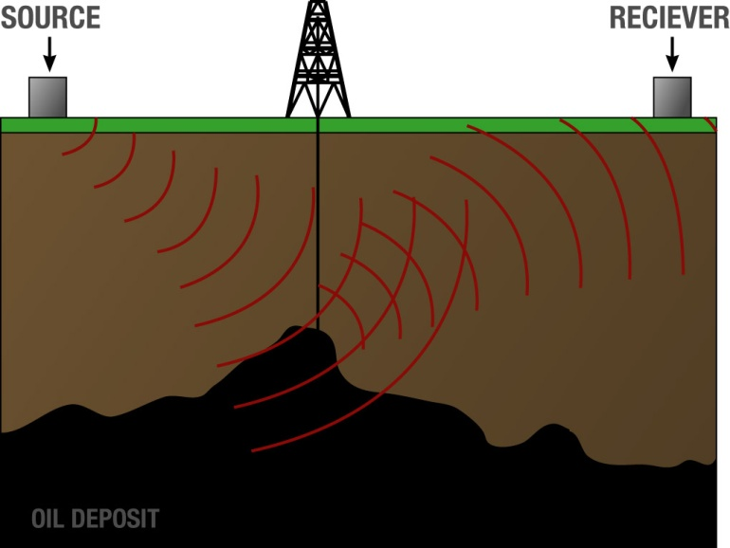
Reflection

Slide 16
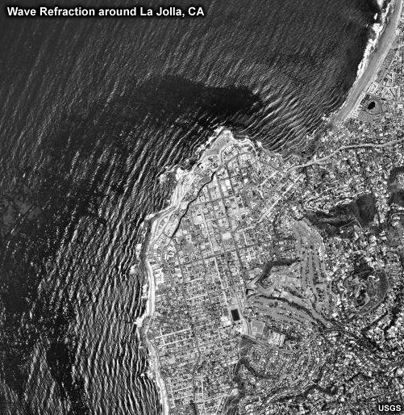

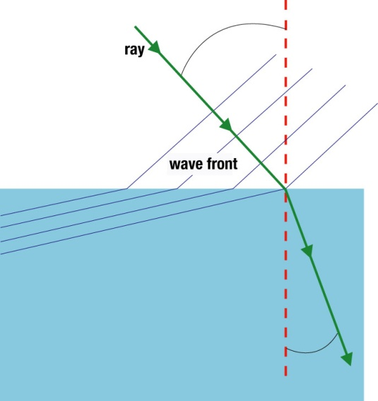

Refraction
The bending of a wave as it enters a medium with different properties so that the wave speed changes.

Slide 17
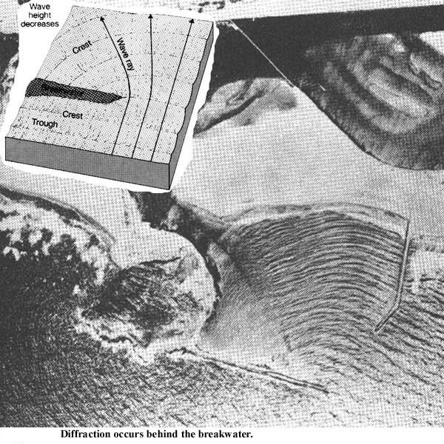
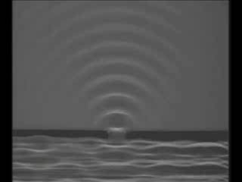
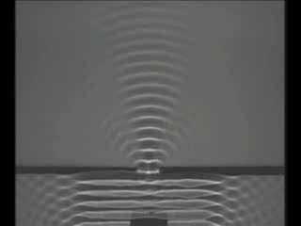
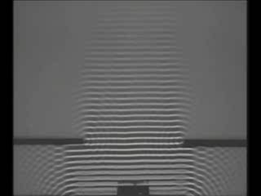
Diffraction
The wave fans out when it encounters an obstacle or opening.
The amount of diffraction depends on relationship between wavelength and size of opening:
  most when wavelength is similar to opening
  small when wavelength is much smaller than opening.

Slide 18
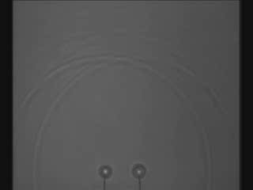
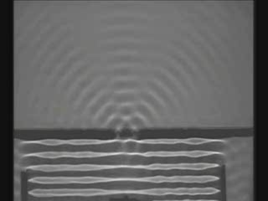
Interference
When two or more waves meet.
  constructive interference: two crests add together
  destructive interference: crest and trough cancel

Slide 19


Example - Noisy Tractors
Tractor cab

Slide 20
Standing waves
DEMO!
Wave on string
Points of the medium that are permanently at rest are called Nodes
Points of the medium that have maximum oscillation are called Anti-Nodes
Only certain frequencies produce standing waves in a given system. These are called resonance frequencies.
The energy of a wave is associated with its frequency.
We can create one dimensional standing waves using a rope:
antinodes
No good. No standing wave will form.
nodes

Slide 21

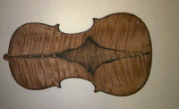
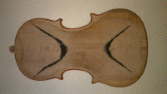
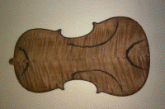
Higher Dimensions
Standing waves are possible in two dimensions as well

Slide 22
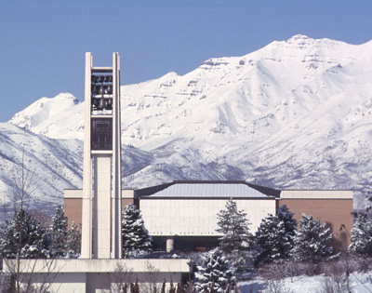

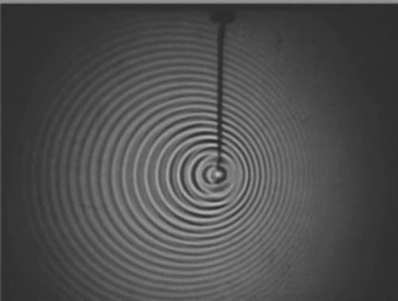
The Doppler Effect
When the source and the observer are in motion relative to one another, the observed frequency can change.
If they are moving together, frequency increases
If they are moving apart, frequency decreases
Notes:
show video clip #21 with Doppler shift of a train horn
Emphasize: higher frequency if moving towards you, lower frequency if moving away.
Other demonstration--swinging a speaker.

Slide 23
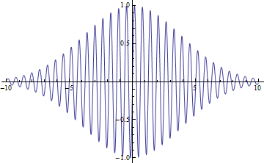
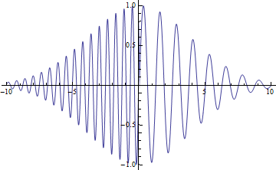
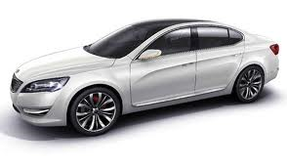
Mathematical Shape- Doppler
Which graph of pressure amplitude vs. time is correct for a car passing by?

Slide 24
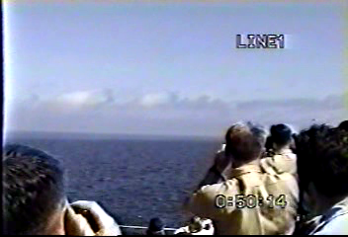
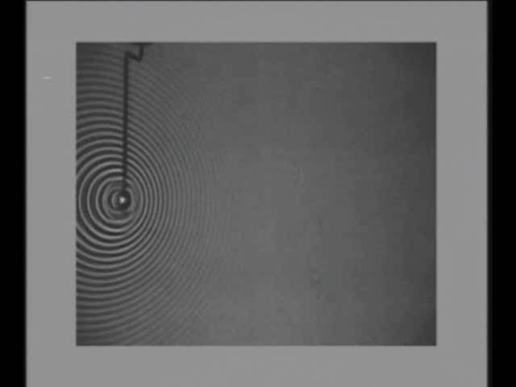

Bonus material: Shock waves
If a source is moving faster than the speed of the wave, shock waves form.

Slide 25
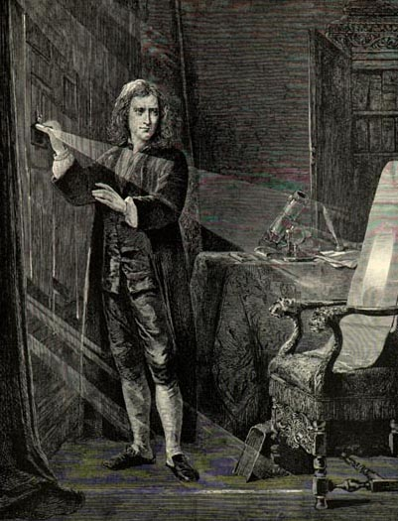
So what is light? Newton thought light was a particle because it cast sharp shadows

Slide 26
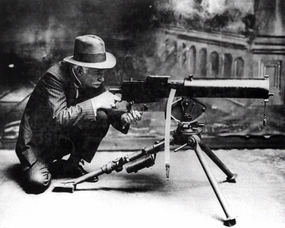
What happens when particles strike slits?
Single slit scatter pattern
Double slit scatter pattern
Notes:
First show that light must be a wave with these two slides. Demonstrate interference effects with pen clip or laser showing that light must be a wave. We don’t see bunching up like particles do, that can’t give dark spots like we are seeing. Use these next two viewgraphs to help them understand that this is convincing evidence that light is a wave.

Slide 27
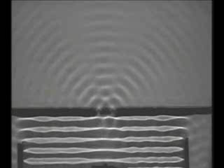
Diffraction is distinctly a wave phenomenon
Constructive Interference
Destructive Interference
Diffraction occurs when the wavelength is the same size as the opening
Notes:
After this viewgraph, show the slide of the picture of the woman at various light intensities.

Slide 28
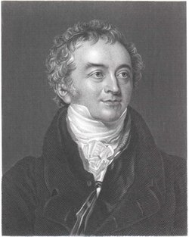
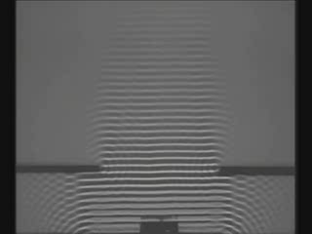
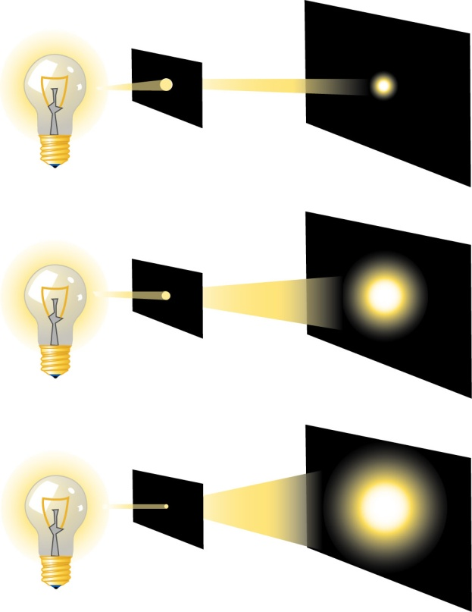
Thomas Young showed that light showed wave properties, it just has a very short wavelength
Thomas Young
Light exhibits diffraction

Slide 29
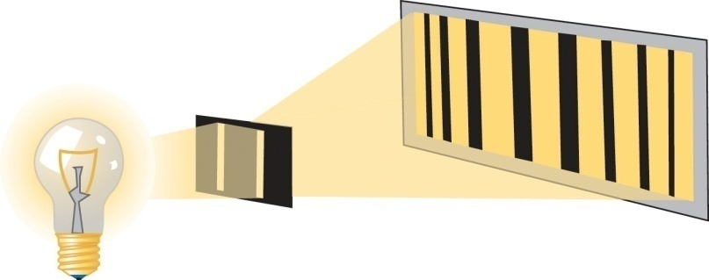
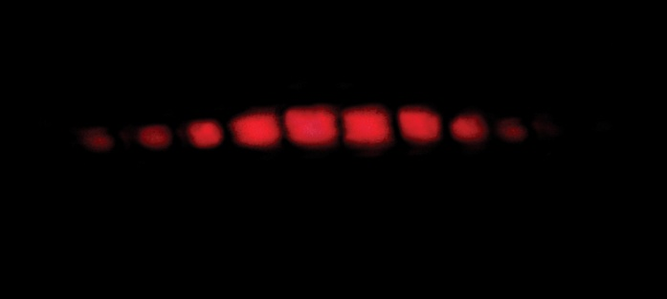
Thomas Young showed that light showed wave properties, it just has a very short wavelength
DEMO!
interference

Slide 30
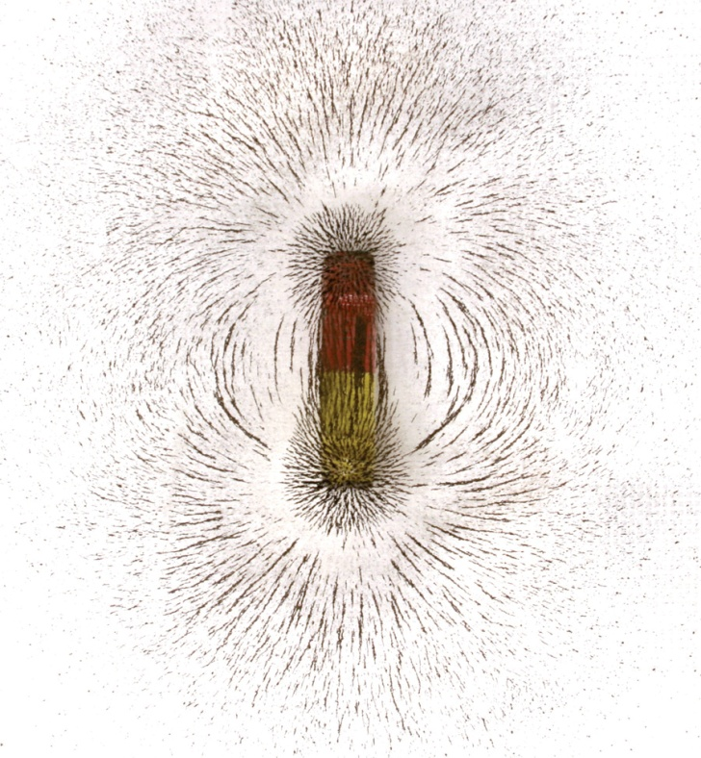
Electric and Magnetic fields describe how a magnet or charged particle respond
+

Slide 31
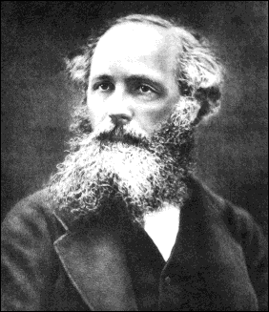
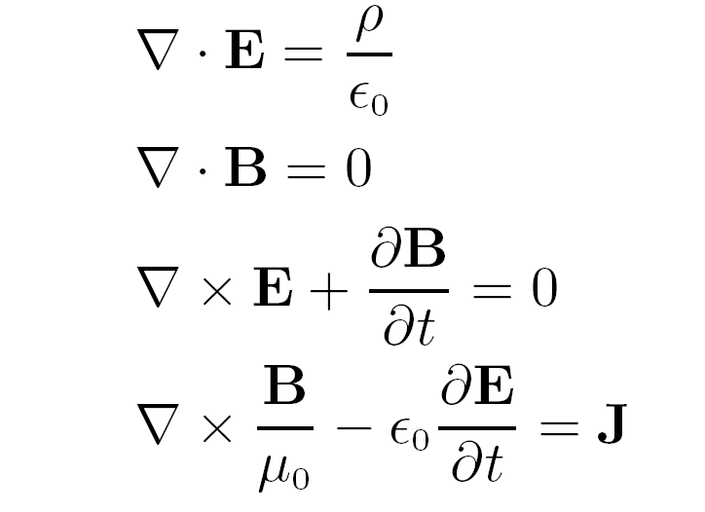
Maxwell came up with equations that showed that the electric and magnetic fields could “wave”
and there was light!

Slide 32
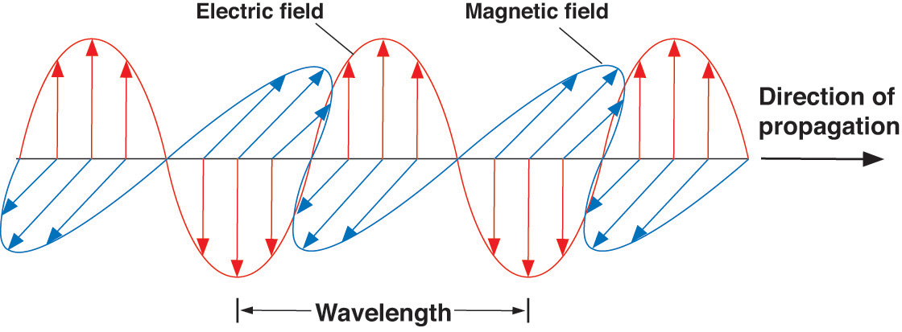
Light as an electromagnetic wave
+
No need for a propagation medium!

Slide 33



Accelerating Electrons
Electromagnetic radiation is given off whenever electrons accelerate.
It, in turn, causes other electrons to accelerate. (TV, microwave oven)

Slide 34

Color
DEMO!
spectroscope
Is the color in the glass or the light?

Slide 35



The electromagnetic spectrum
The pot at the end of the rainbow…
Notes:
Finally,
someone has managed to photograph
the pot at the end of the rainbow!!!
Wouldn't you know it!!!!!

Slide 36

If light is a wave then…

Slide 37

Particle Behavior- The photoelectric effect
Energy in a normal wave is proportional to amplitude.
  i.e. What determines if a wave has enough energy to knock you over at the beach?
However, it wasn’t the amplitude that determined whether light could eject electrons, it was the frequency!
  Energy = h x (frequency)
Explained if light is interacting like a particle with the electrons in the metal!
  Greater energy = greater numbers of photons.
  Each individual photon has an energy of hf where h = Planck’s constant (very small) and f = frequency.

Slide 38


Wave Particle Duality
Light is both a wave and a particle.
  It behaves like a wave when unobserved
    It travels through both slits like a wave
  It is detected like a particle
    It hits the screen as individual dots

Slide 39

If this bothers you, you are in good company!
“All these 50 years of pondering have not brought me any closer to answering the question, ‘what are light quanta?’ These days every Tom, Dick, and Harry thinks he knows it, but he is mistaken.”
~ A. Einstein
Notes:
From P. A. Schlipp, “Albert Einstein: philosopher-scientist” Harper and Row Publishers, New York, 1959,
as quoted in Todd Pittman’s Dissertation

Slide 40

Superstring Ghost demo
DEMO!
Notes:
From P. A. Schlipp, “Albert Einstein: philosopher-scientist” Harper and Row Publishers, New York, 1959,
as quoted in Todd Pittman’s Dissertation

