Slide 1
Summary: Forms of energy
Kinetic Energy
Gravitational Potential Energy
Electrical Potential Energy
Internal Energy
  Thermal (internal kinetic)
  Elastic potential (internal electrical)
  Chemical Potential (internal electrical)
Radiant Energy

Slide 2
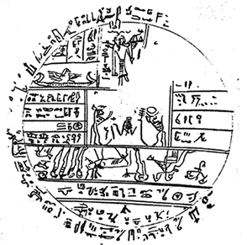
Energy Transfer and Transformation
Radiation: energy is transmitted by visible light, infrared radiation, ultraviolet radiation, X-rays, or radio waves. (sun, space heater)
Conduction (Heat Flow ): a process in which internal energy is transferred because of a difference in temperature. (electric stove, soldering iron)
Convection: internal energy is transferred because matter moves from one place to another. (hot air furnace)
Work: energy is transferred or transformed by forces acting on an object. (friction, muscles, electric motor)
Combustion: chemical potential energy is transformed into another form (gasoline engine, dynamite, light stick)

Slide 3
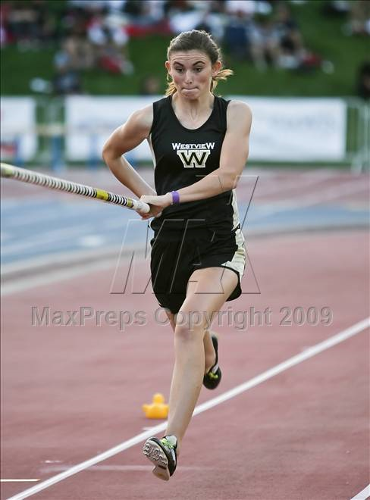
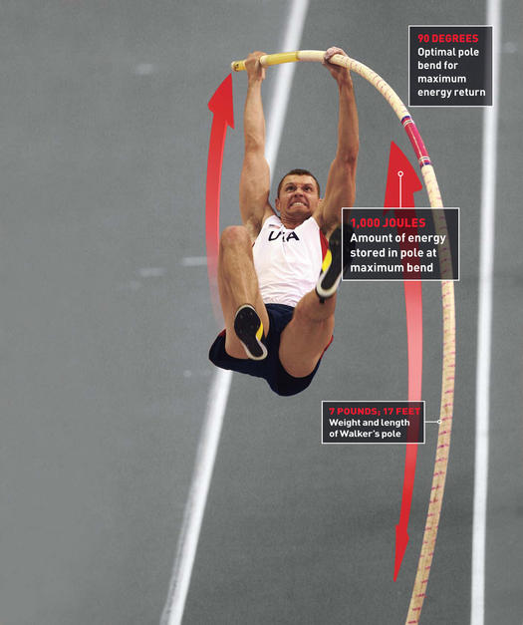
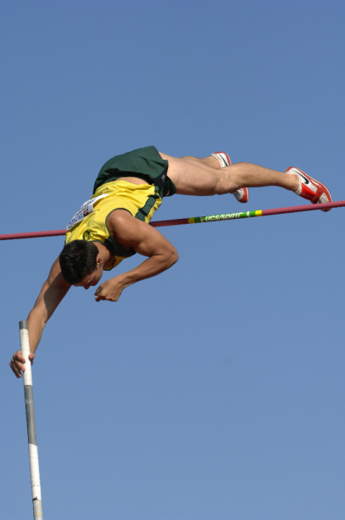
Kinetic
Elastic potential
Gravitational potential
6.15m
7:25
Sergei Bubka
http://www.youtube.com/watch?v=IWGyzPNXI_U

Slide 4
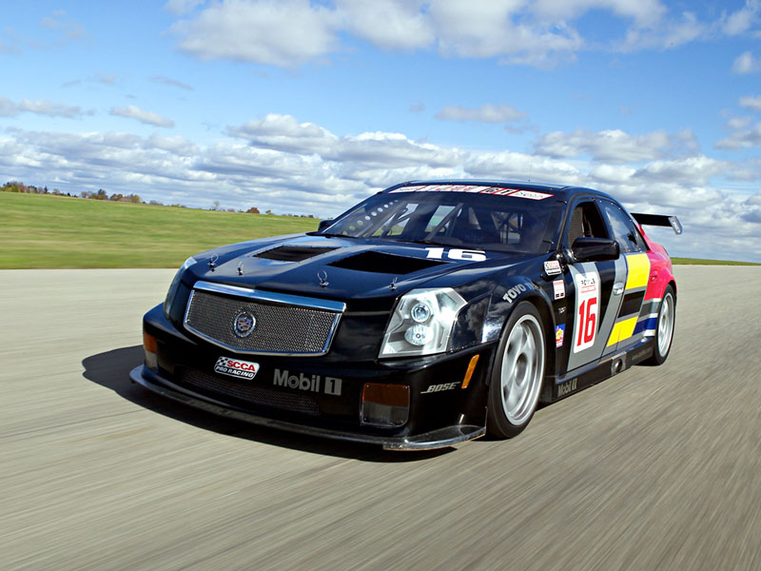
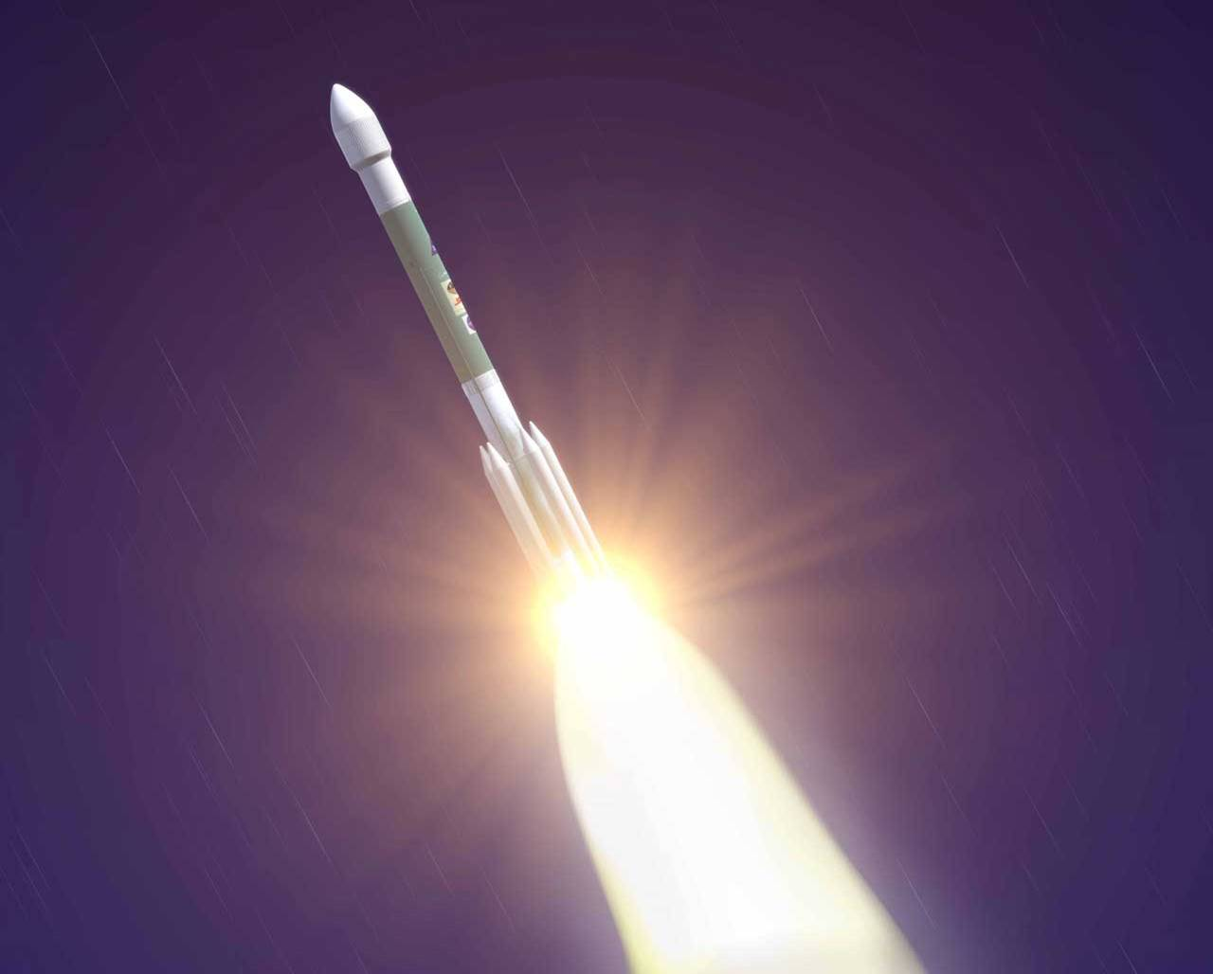
Kinetic energy from Chemical Potential
The engine is running, doing work on the car.
There is a lot of chemical potential energy in the fuel but we can only get so much macroscopic kinetic energy out of it.
We are in a power crisis not an energy crisis

Slide 5
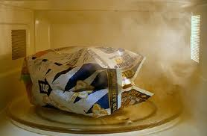
The method of heat transfer used to cook microwave popcorn is
radiation
conduction
convection

Slide 6
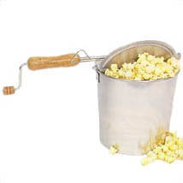
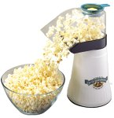
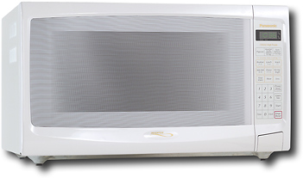
Popcorn
Three methods for popping popcorn
  Microwave --
  Hot air --------
  Stove top ----
Identify the method of heat transfer for each.
Radiation
Convection
Conduction

Slide 7
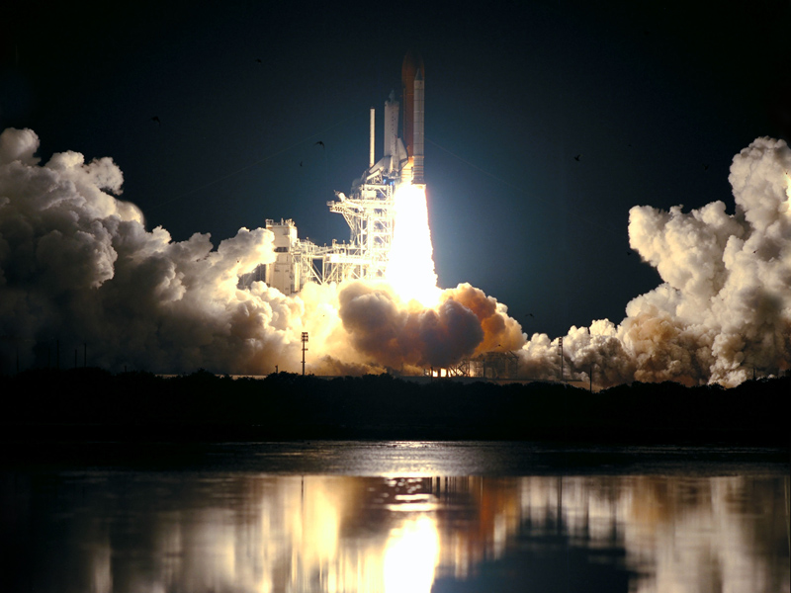


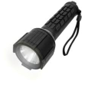



Chapters 8, and 9 quiz

Slide 8
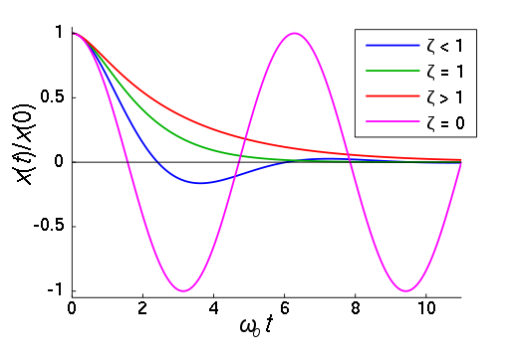
Harmonic motion
1
Which color best represents a critically damped system(a perfect screen door)?

Slide 9
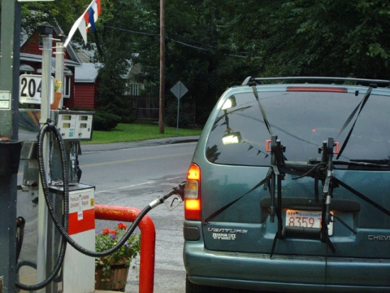
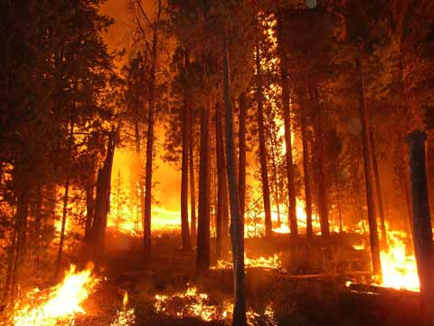
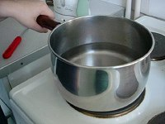
Conservation of Mass
2
Choose one example and explain how the mass changes forms
Examples
  gasoline in car
  forest fire
  boiling water

Slide 10
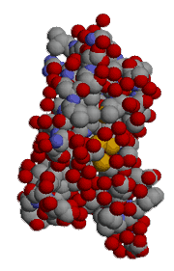
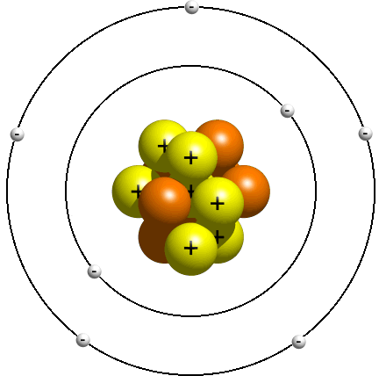
Molecules and Atoms
3
The force holding these things together is the ____________ force.
Electrons to Nucleus
Atoms to other Atoms

Slide 11
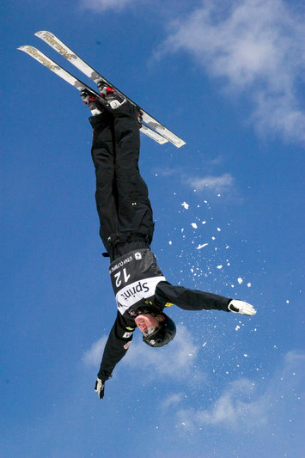
Conservation of ?
4
When this freestyler tucks in to a fetal position he will begin to flip around faster. This is an example of _________ being conserved.

Slide 12
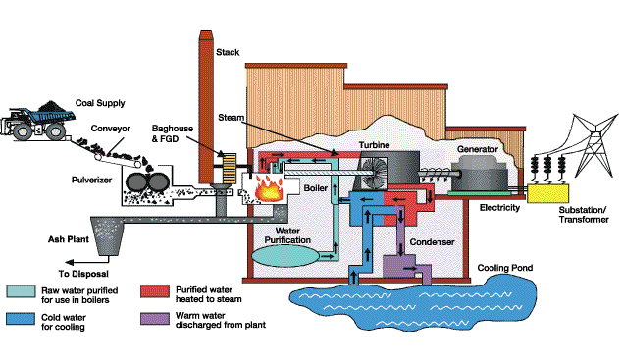
Sometimes it is hard to describe all of the motion in a system
5
What conservation law is easiest to use when analyzing complex systems?

Slide 13

In physics, the word “work” has precise meaning
6
W=Fd
Does gravity do work on a pencil when it falls off the table on to the floor?
F
d

Slide 14
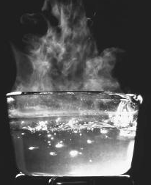
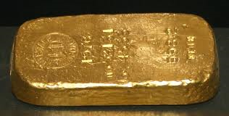
Thermal Energy
7
Why can two objects at the same temperature have different amounts of thermal energy?
They each convect it differently
They have different temperatures
They have different Heat Capacities
They have the same amounts of thermal energy

Slide 15
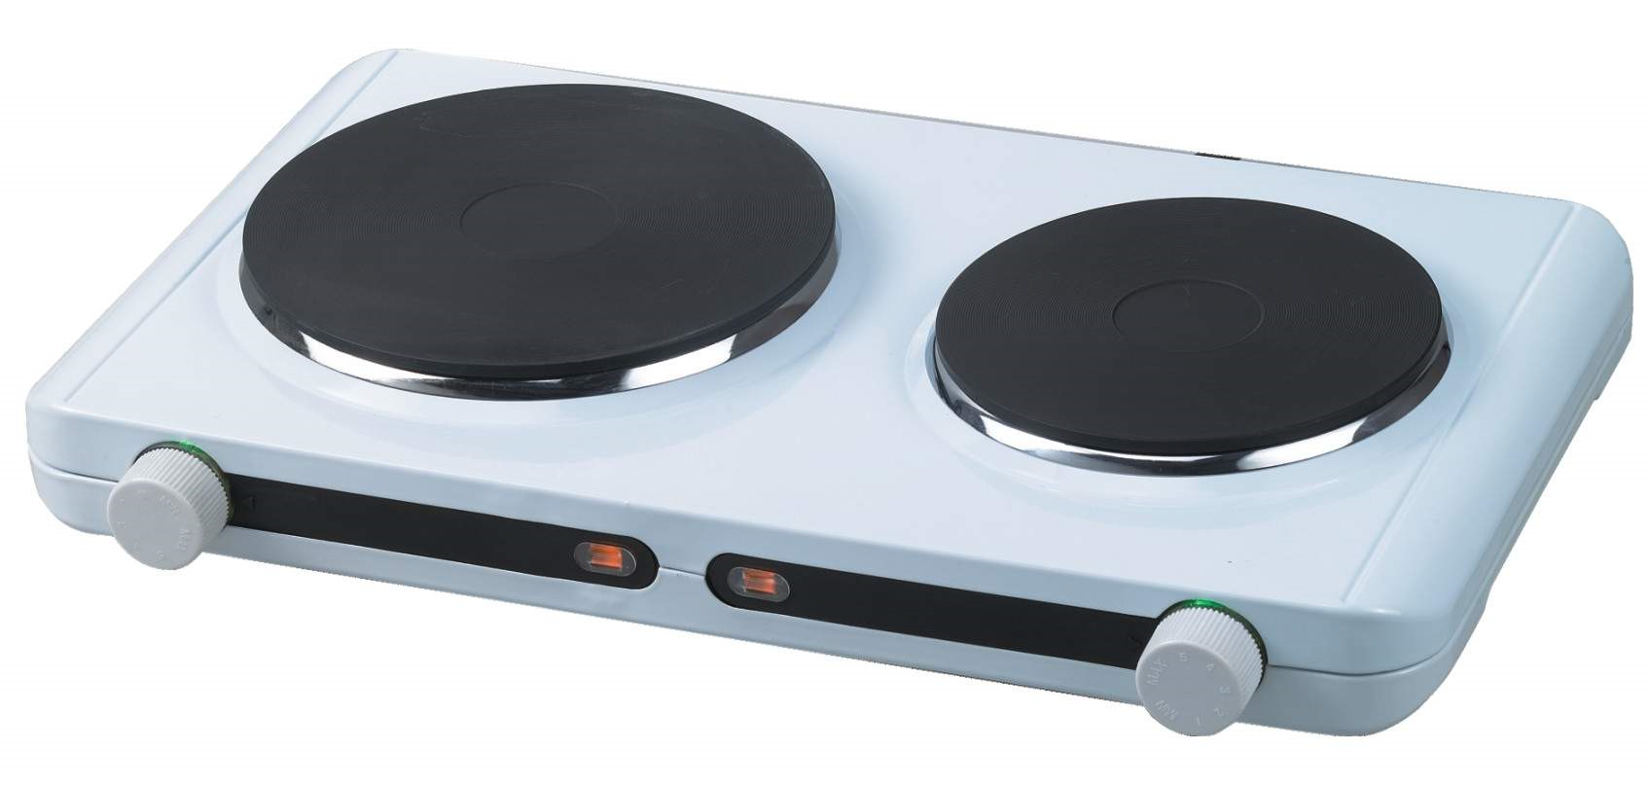
What type of heat transfer occurs when you touch a hot surface?
8
radiation
conduction
convection

Slide 16
9
_________ __________ _________
Describe what forms the total energy is taking in each picture

Slide 17
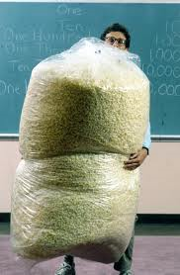
Which of the following are methods of heat transfer used to pop popcorn?
10
conduction
correction
radiation
on the valley top
convection
specific heat
gravity

