Slide 1
Review
Pressure
Archimedes Principle
Density

Slide 2

Review
Pressure
Archimedes Principle
Density
Iron Cylinders
Which exerts more force?
Which exerts more pressure?
A
B

Slide 3
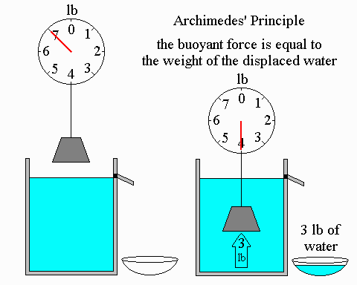
Review
Pressure
Archimedes Principle
Density

Slide 4


Review
Pressure
Archimedes Principle
Density
Which is more dense?

Slide 5
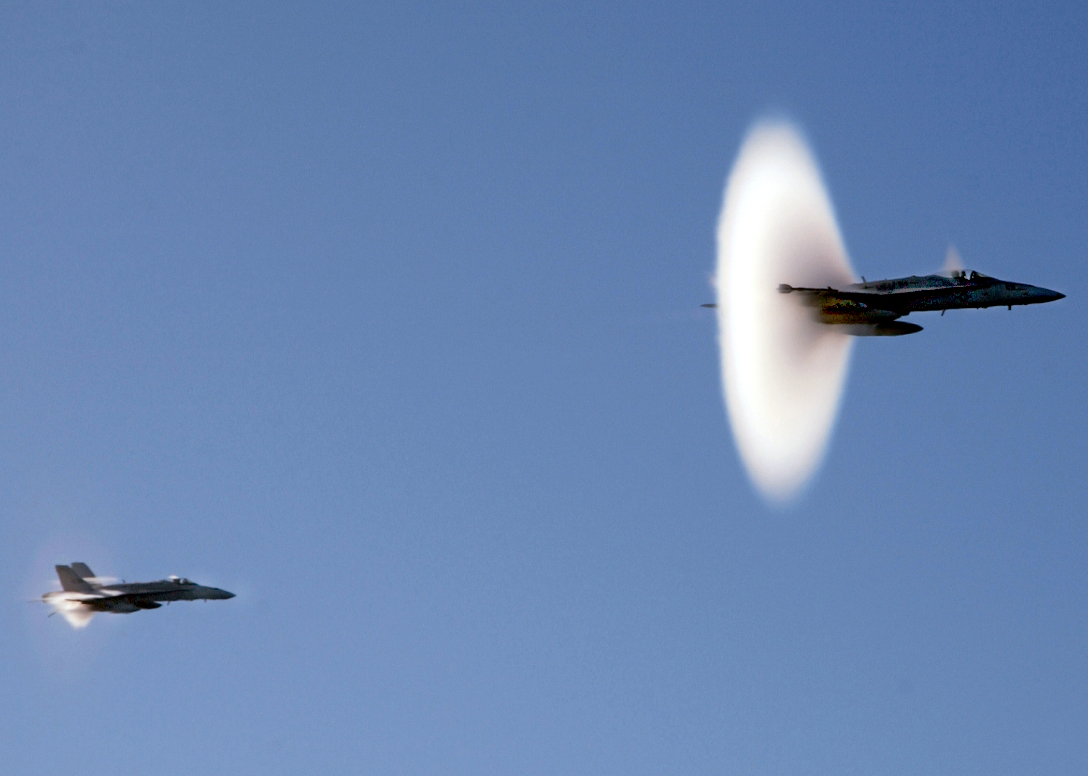
Chapter 7
Motion at High Speed

Slide 6
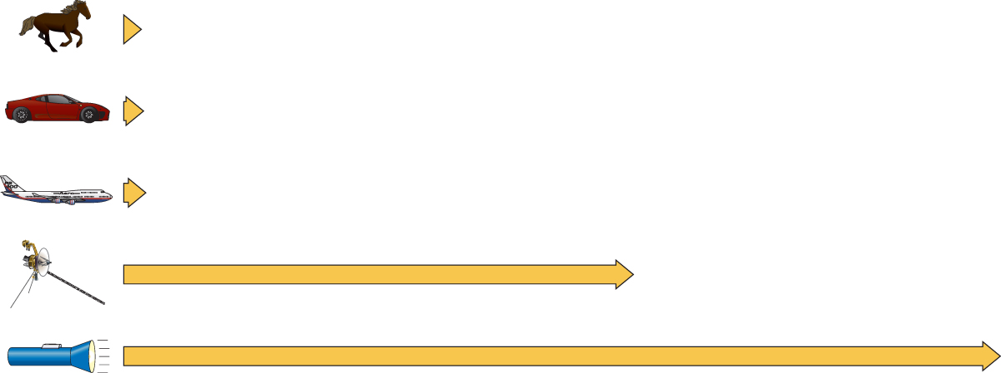
How fast is “high speed”
If your traveling at the speed of light and you turn on a flash light what happens???
50 mph
Invalid Question!
225 mph
550 mph
50,000 mph
Extends off the screen about 20 miles
Speed of light: 670,000,000 mph

Slide 7
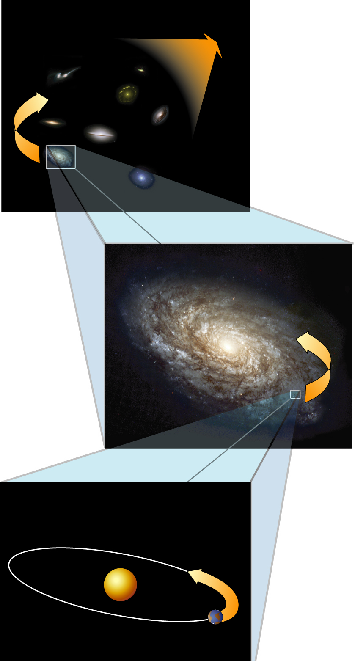
All Motion is relative
2,500,000 light years to
Andromeda Galaxy
We must define a reference frame in which to measure the motion.
The idea that all motion is determined relative to its reference frame is called “relativity”
100,000 light years
.000015 light years
Or
7.884 light minutes

Slide 8

There are two types of reference frames
Inertial reference frames do not accelerate
Non-inertial reference frames accelerate.
Could you tell the difference between two inertial frames?
Could you tell the difference between an inertial frame and a non-inertial frame?

Slide 9
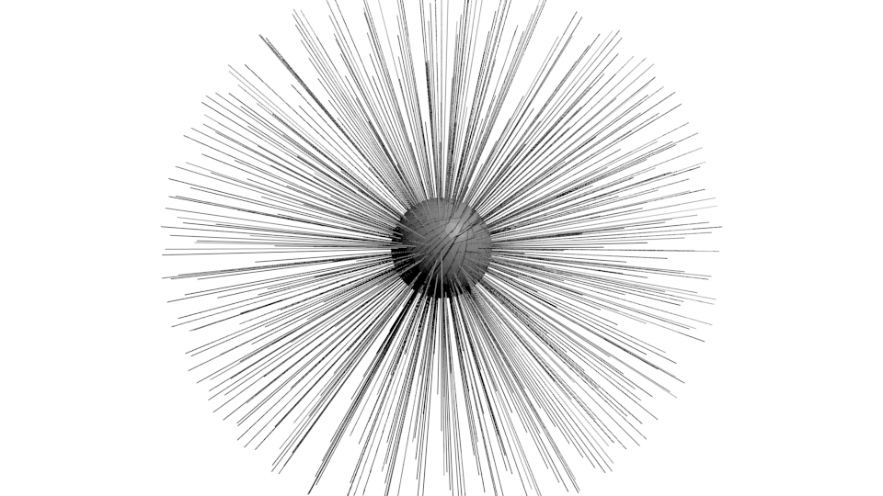
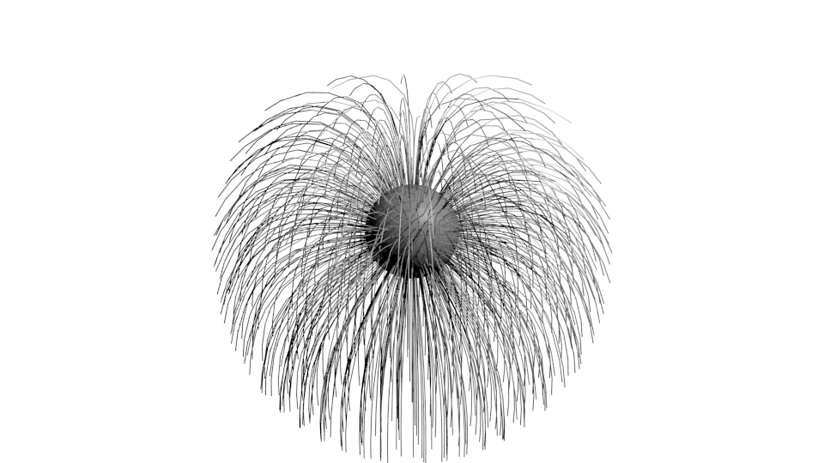
Hair equivalence
Go to blender

Slide 10
When viewed from an inertial reference frame, the motion of another inertial frame is
Motion in a straight line
Motion in a straight line with unchanging speed
Motion in a straight line with changing speed
Motion in a circle with unchanging speed

Slide 11
When viewed from an inertial reference frame, the motion of another inertial frame is
Motion in a straight line
Motion in a straight line with unchanging speed
Motion in a straight line with changing speed
Motion in a circle with unchanging speed

Slide 12
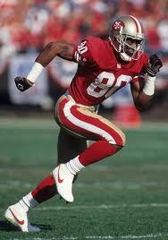
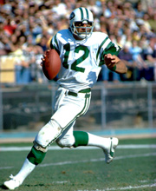
Galilean relativity application – relative velocities
10 mph
20 mph
Then Joe throws the ball to Jerry at a speed of 35 mph relative to himself.
How fast will the ball be going relative to the ground?
How fast will the ball be going relative to Jerry?

Slide 13
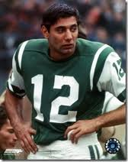
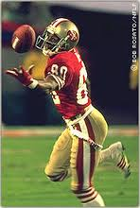

Velocity addition
35 mph
How fast will the ball be going relative to the ground?
25 mph
How fast will the ball be going relative to Jerry?
5 mph
E.C. 50 pts.
How?...cause 35 - 10 = 25 and 25 – 20 = 5

Slide 14
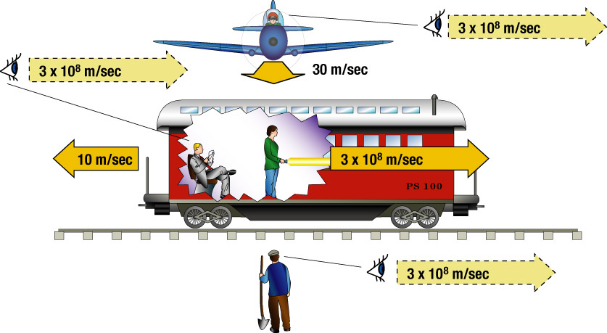
Relativity and the Speed of Light

Slide 15
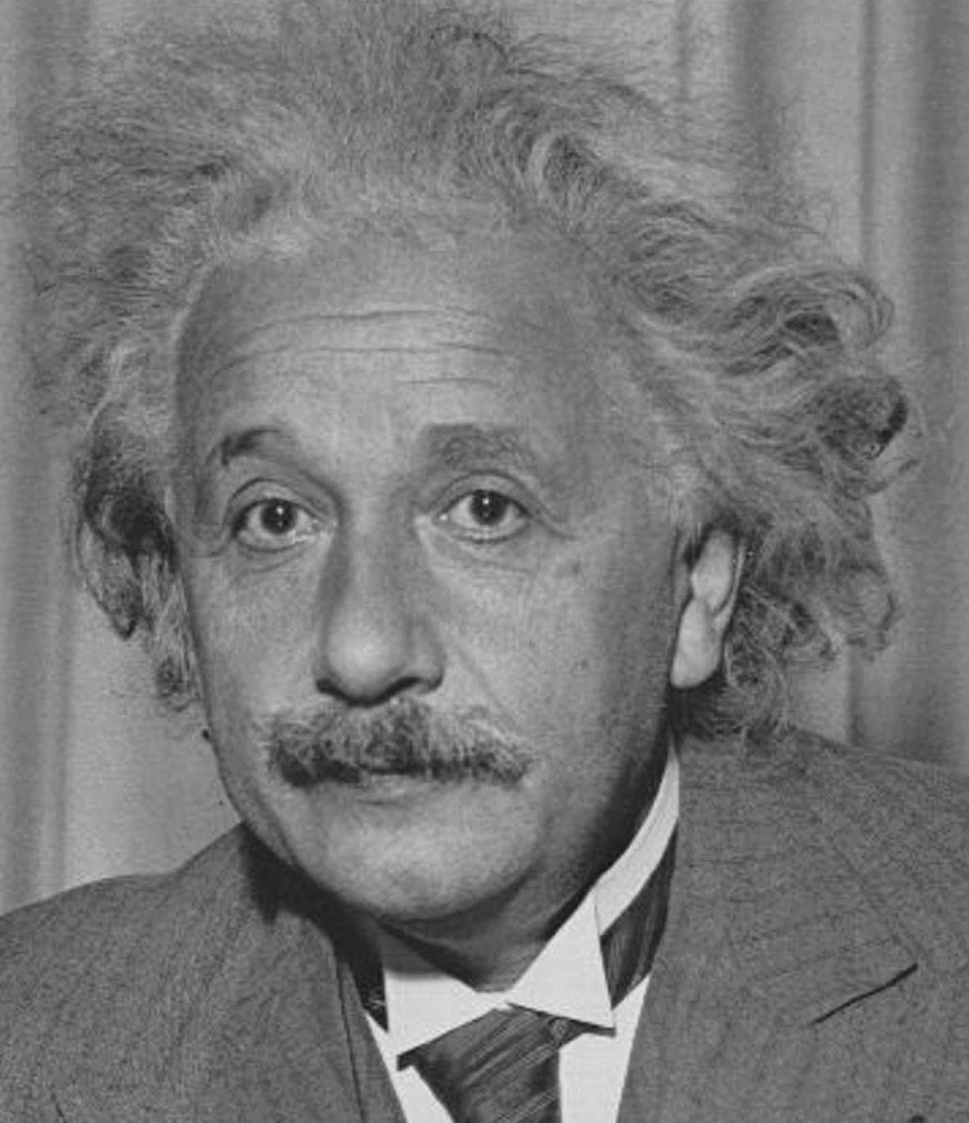
Special Relativity Postulates
The laws of nature are the same for all observers who are in uniform motion.
The speed of light in empty space is the same for all observers regardless of their motion or the motion of the source of light.
"Everything should be made as simple as possible, but not simpler.“ ~Albert Einstein

Slide 16

A word of caution
We will use phrases like
  The observer sees
  It appears to him
  It looks like
These do not refer to optical illusions, but to what an observer would measure with scientific instruments (rulers and clocks)
Count the number of black dots

Slide 17
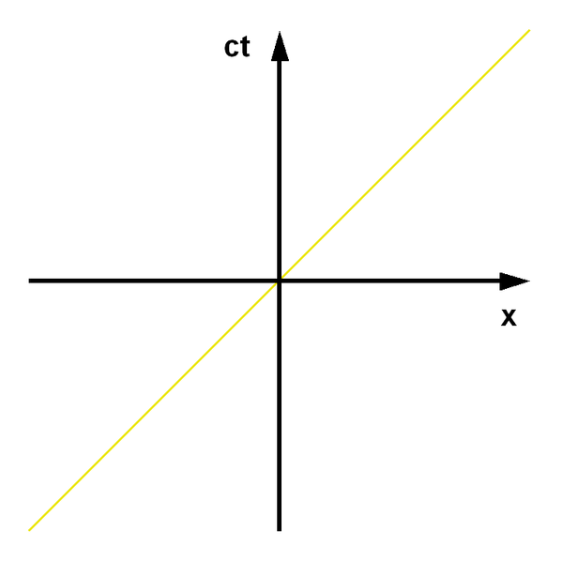
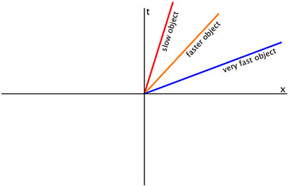
World Line
http://upload.wikimedia.org/wikipedia/commons/e/e4/orentz_transform_of_world_line.gif
A curve in space-time which traces out the history (time) of an object.
Speed of light
“Impossible”

Slide 18
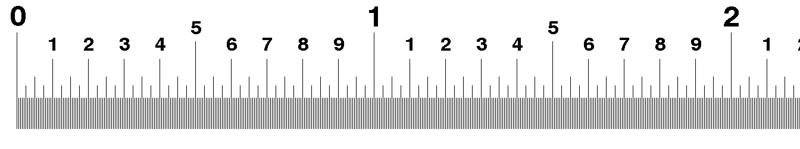

Example: How to measure a pen
At rest
In a moving frame
  Make marks on a ruler at the same time as the pen flies by
  If the mark at the front is made before the mark at the back, the pen is measured to be shorter than it “actually is”.
Notes:
These are the props. You own a barn, 40m long, with automatic doors at either end, that can be opened and closed simultaneously by a switch. You also have a pole, 80m long, which of course won't fit in the barn.
Now someone takes the pole and tries to run (at nearly the speed of light) through the barn with the pole horizontal. Special Relativity (SR) says that a moving object is contracted in the direction of motion: this is called the Lorentz Contraction. So, if the pole is set in motion lengthwise, then it will contract in the reference frame of a stationary observer.
You are that observer, sitting on the barn roof. You see the pole coming towards you, and it has contracted to a bit less than 40m, in your reference frame. (Does it actually look shorter to you? See Can You See the Lorentz-Fitzgerald Contraction? for the surprising answer. But in any case, you would measure its length as a bit less than 40m.)
So, as the pole passes through the barn, there is an instant when it is completely within the barn. At that instant, you close both doors simultaneously, with your switch. Of course, you open them again pretty quickly, but at least momentarily you had the contracted pole shut up in your barn. The runner emerges from the far door unscathed.
But consider the problem from the point of view of the runner. She will regard the pole as stationary, and the barn as approaching at high speed. In this reference frame, the pole is still 80m long, and the barn is less than 20 meters long. Surely the runner is in trouble if the doors close while she is inside. The pole is sure to get caught.
Well does the pole get caught in the door or doesn't it? You can't have it both ways. This is the "Barn-pole paradox." The answer is buried in the misuse of the word "simultaneously" back in the first sentence of the story. In SR, that events separated in space that appear simultaneous in one frame of reference need not appear simultaneous in another frame of reference. The closing doors are two such separate events.
SR explains that the two doors are never closed at the same time in the runner's frame of reference. So there is always room for the pole. In fact, the Lorentz transformation for time is

Slide 19
Example: How to measure a pen
Time and space are connected!
Notes:
These are the props. You own a barn, 40m long, with automatic doors at either end, that can be opened and closed simultaneously by a switch. You also have a pole, 80m long, which of course won't fit in the barn.
Now someone takes the pole and tries to run (at nearly the speed of light) through the barn with the pole horizontal. Special Relativity (SR) says that a moving object is contracted in the direction of motion: this is called the Lorentz Contraction. So, if the pole is set in motion lengthwise, then it will contract in the reference frame of a stationary observer.
You are that observer, sitting on the barn roof. You see the pole coming towards you, and it has contracted to a bit less than 40m, in your reference frame. (Does it actually look shorter to you? See Can You See the Lorentz-Fitzgerald Contraction? for the surprising answer. But in any case, you would measure its length as a bit less than 40m.)
So, as the pole passes through the barn, there is an instant when it is completely within the barn. At that instant, you close both doors simultaneously, with your switch. Of course, you open them again pretty quickly, but at least momentarily you had the contracted pole shut up in your barn. The runner emerges from the far door unscathed.
But consider the problem from the point of view of the runner. She will regard the pole as stationary, and the barn as approaching at high speed. In this reference frame, the pole is still 80m long, and the barn is less than 20 meters long. Surely the runner is in trouble if the doors close while she is inside. The pole is sure to get caught.
Well does the pole get caught in the door or doesn't it? You can't have it both ways. This is the "Barn-pole paradox." The answer is buried in the misuse of the word "simultaneously" back in the first sentence of the story. In SR, that events separated in space that appear simultaneous in one frame of reference need not appear simultaneous in another frame of reference. The closing doors are two such separate events.
SR explains that the two doors are never closed at the same time in the runner's frame of reference. So there is always room for the pole. In fact, the Lorentz transformation for time is

Slide 20
Simultaneous events
Two events are said to be simultaneous if light from the events reaches an observer located half way between the events at the same time.

Slide 21
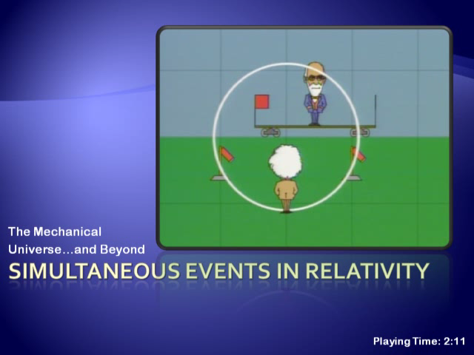

Slide 22
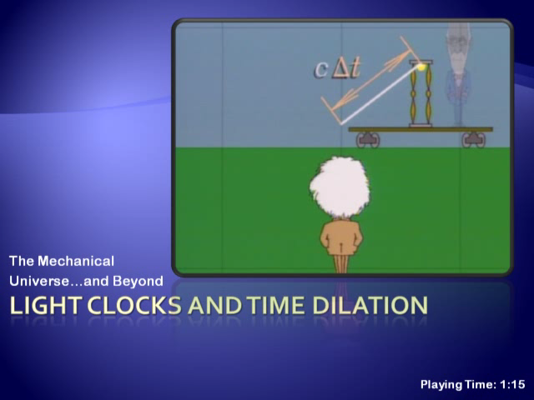

Slide 23
Enough Gedankens, on to reality…
Mu Mesons
Hafele / Keating
GPS satellites

Slide 24
Muon Decay
Cosmic ray muons created in upper atmosphere
These muons travel close to the speed of light
Muons live such a short time, they can’t travel very far
  With an average lifetime of 2x10⁻⁶ sec, they should only travel ~600 meters at the speed
So how do they get from the top to the bottom of a tall mountain?
Proton
Atmosphere
nuclei
Pion
Neutrino
Muon
video
Notes:
show the video from the Mt. Washington Experiment done at M.I.T.

Slide 25
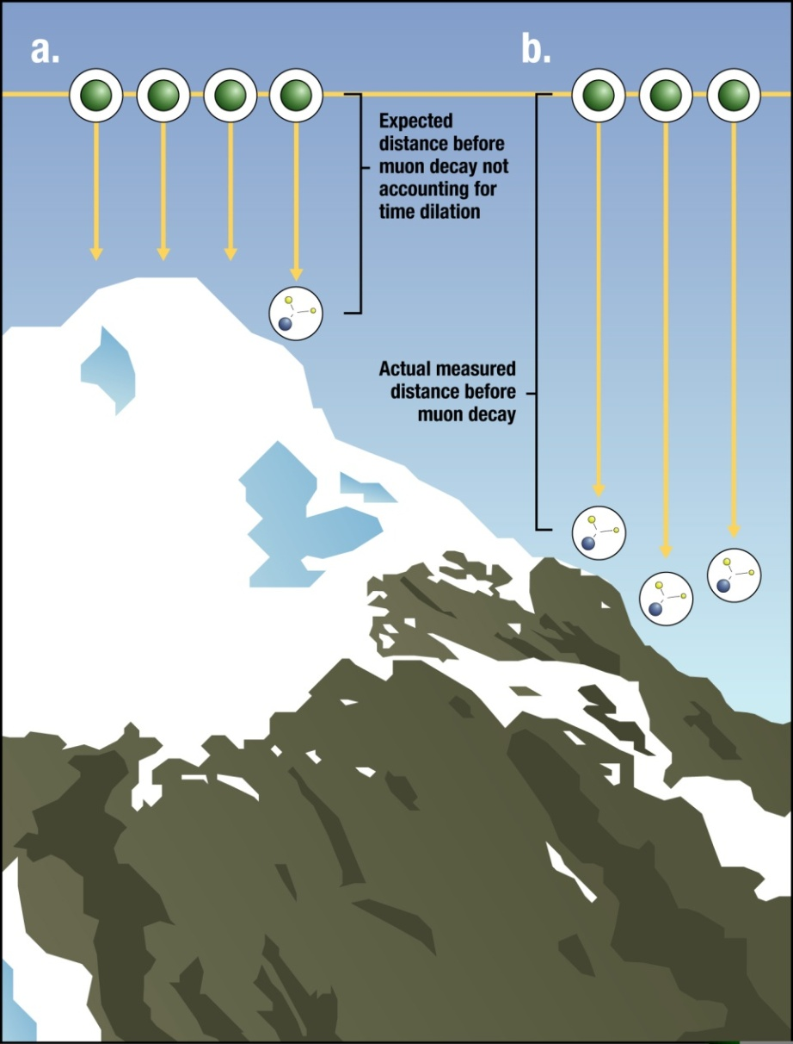
Muon Decay
In our frame, the muon’s time slows down, so they live longer.
In the muon’s frame, the mountain is only a few feet tall.
Notes:
show the video from the Mt. Washington Experiment done at M.I.T.

Slide 26
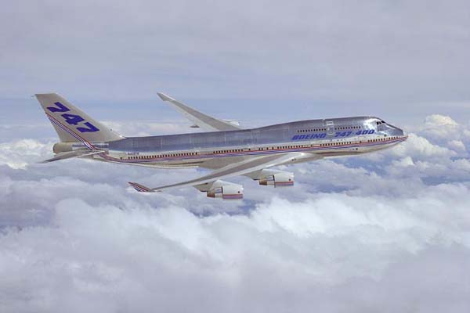
General relativity – Hafele/Keating
Atomic clocks sent on trips come back running slow.
Notes:
The Hafele–Keating experiment was a test of the theory of relativity.
In October of 1971, Joseph C. Hafele and Richard E. Keating took four
cesium-beam atomic clocks aboard commercial airliners and flew twice
around the world, first eastward, then westward, and compared the clocks
against those of the United States Naval Observatory.

Slide 27
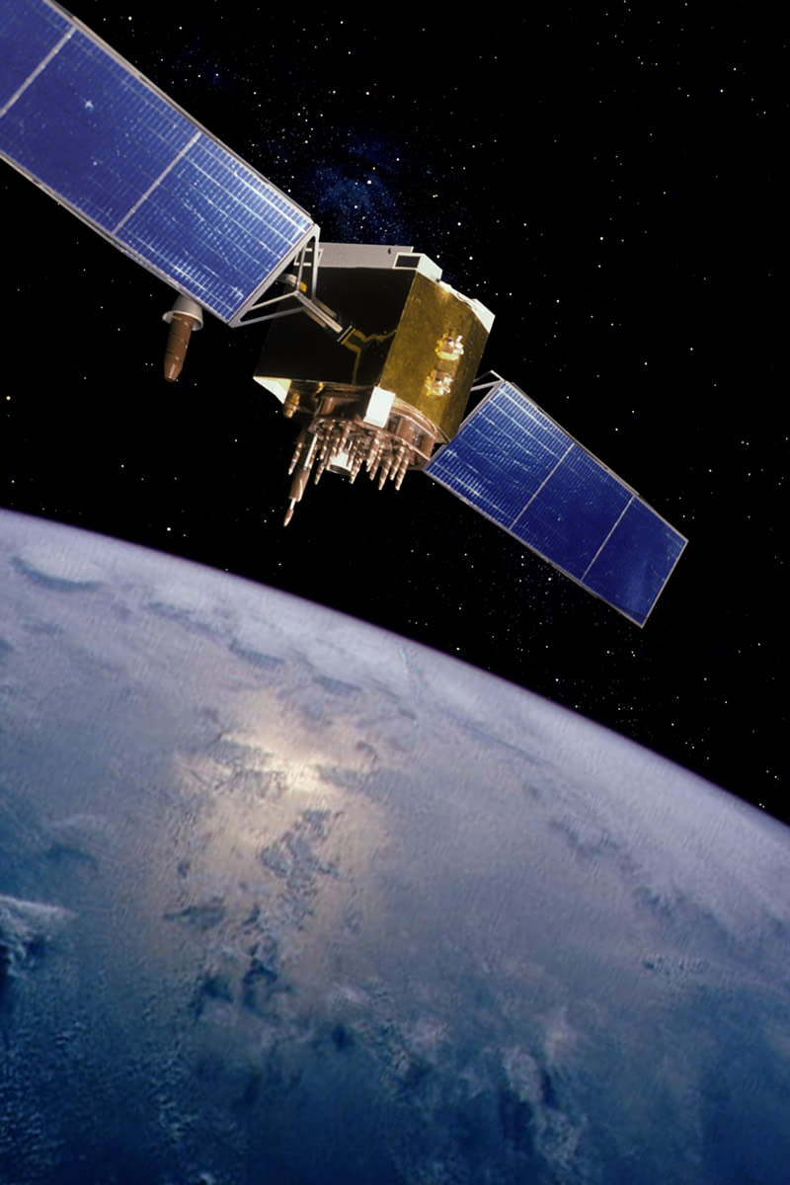

GPS systems rely on very precise clocks in orbit around the earth.
These are clocks from a different space-time metric!

Slide 28
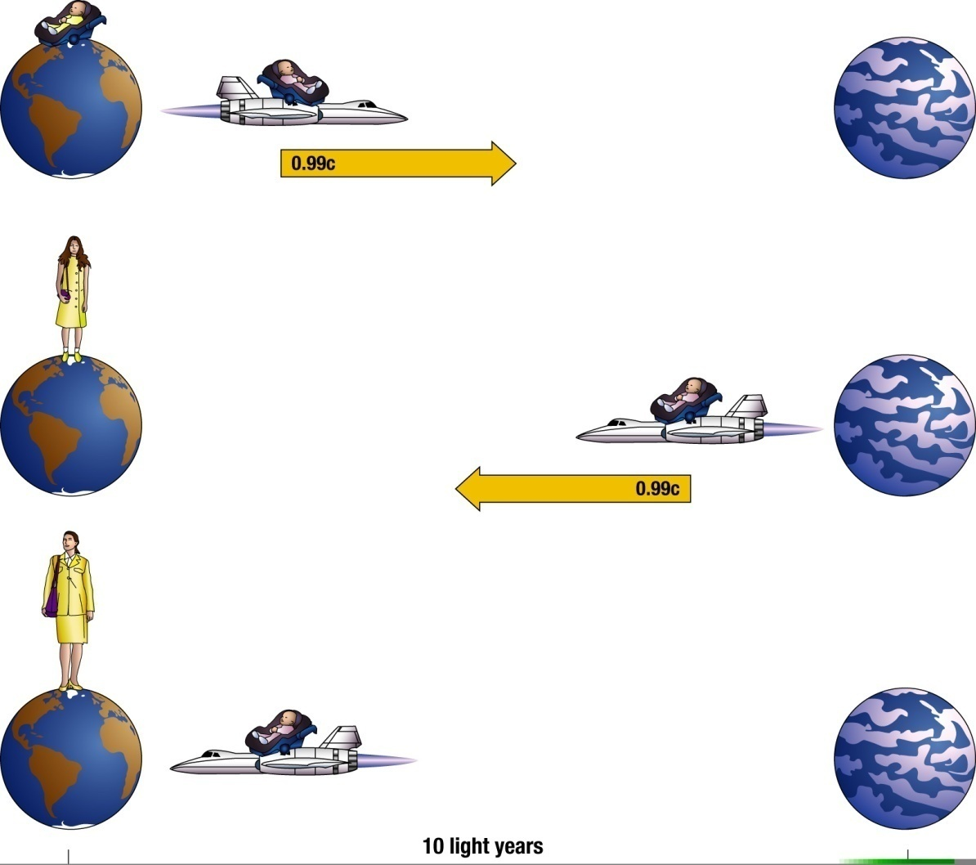
The “twin paradox”

Slide 29
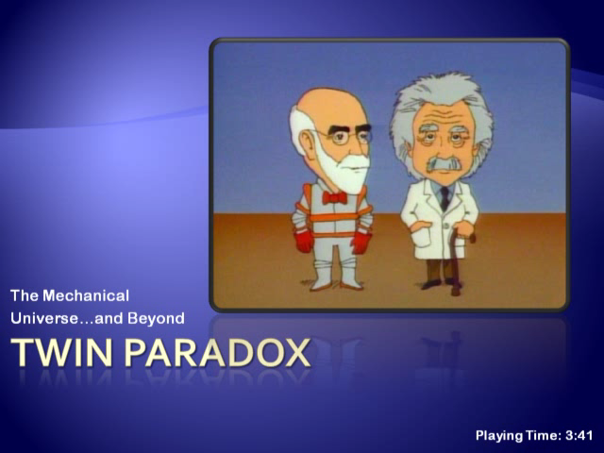

Slide 30
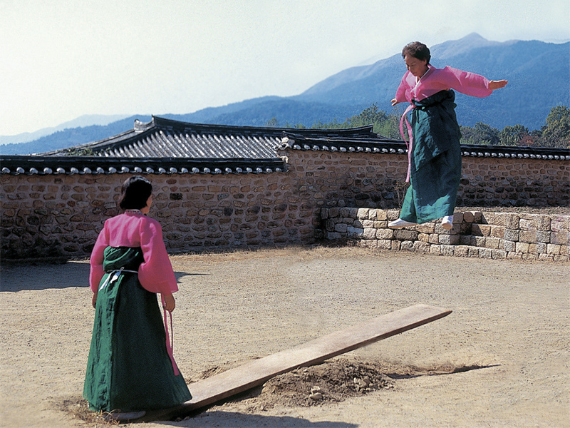
Chapter 8: Conservation Laws

Slide 31

Conservation of Nonsense

Slide 32
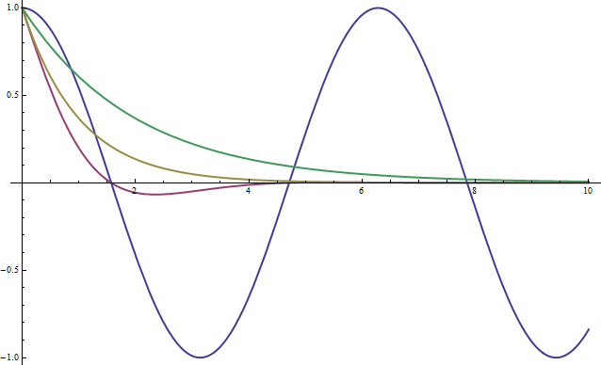
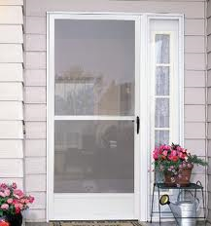
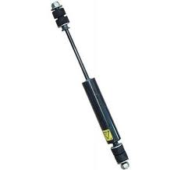

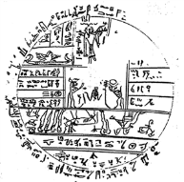
Mathematical Shapes – screen door
displacement
time
undamped, overdamped, critically, underdamped
Symbol for quiz question
oscillator
damper

Slide 33
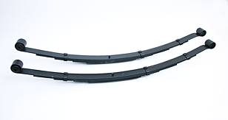
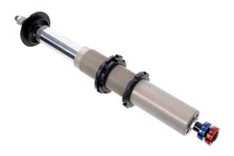
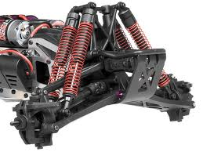
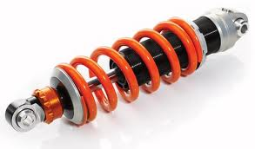
Which is best for car suspension?
displacement
time
undamped, overdamped, critically, underdamped

Slide 34
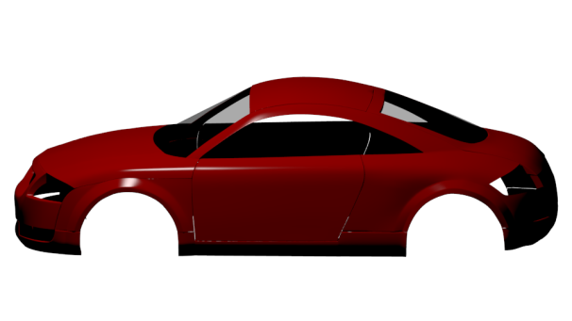

Cartoon 1

Slide 35
Cartoon 2
~Slightly underdamped

Slide 36
Where does the energy go?
displacement
time

Slide 37
Argue this
Energy is a fuel.
FALSE: Fuel is a source of energy but is not itself energy. Fuel is a resource such as coal, oil, and the food we eat. Fuels have potential energy in the chemical bonds that make up the substance.
Energy Crisis?...More like Power Crisis

Slide 38
Energy crisis?
Power is the ability to do work in a certain amount of time.
This work comes from transforming an energy source.
Power Crisis?
What about inefficient transformation processes?
What about slow transformation processes?

Slide 39
Conservation Laws
What does it mean to conserve something?
A conserved quantity:
_______ can neither be created or destroyed, but can be changed from one form to another or transferred from one object to another.

Slide 40
Consider this a closed system. Which one is energy being conserved in?
displacement
time

Slide 41
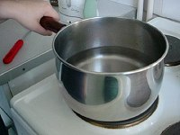
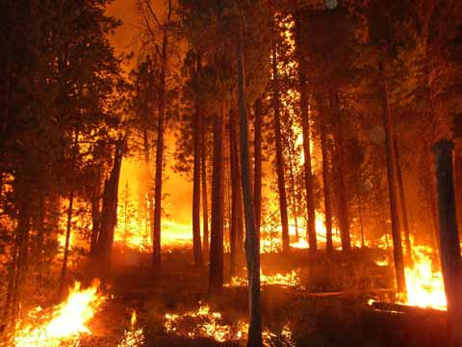
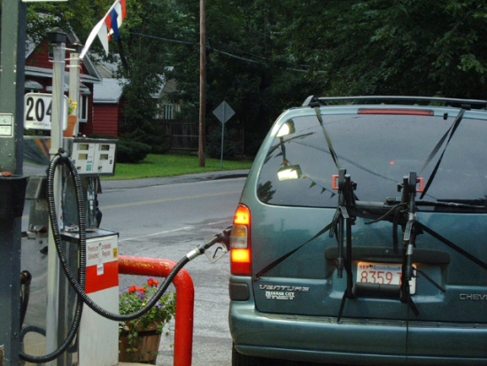
Conservation of Mass
Mass is neither created nor destroyed. Mass may change from one form to another, but the total mass after the transformation is always the same as that before.
Examples
  boiling water
  forest fire
  gasoline in car
  How can we be sure… what the byproducts are exactly?

Slide 42
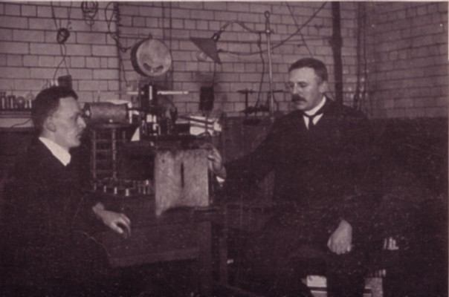
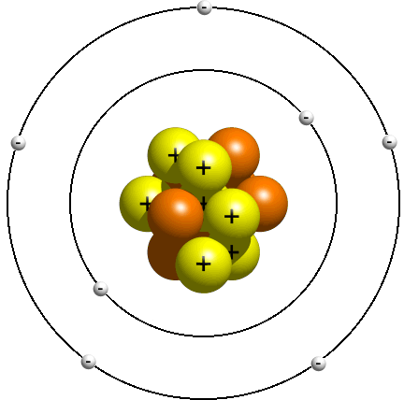
Atoms
Size ~ 10⁻¹⁰ meters. An atom is mostly empty space…ha!
The only relevant force is the electromagnetic one which holds the electrons to the nucleus.
What are we made of?
Hans Geiger and Ernest Rutherford

Slide 43
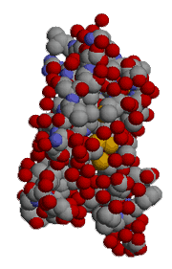
Molecules
Size ~ 10⁻⁹ – 10⁻⁸ meters
Held together by the electromagnetic force via sharing electrons.
It’s just a bunch of atoms

Slide 44
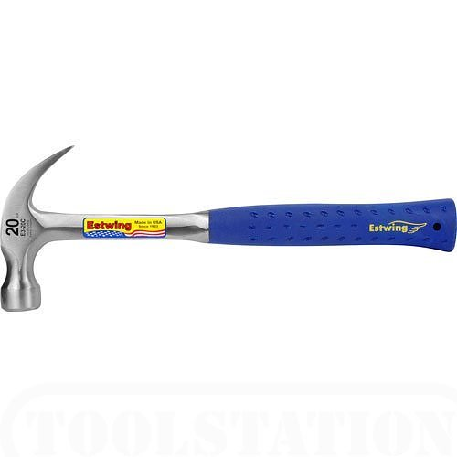
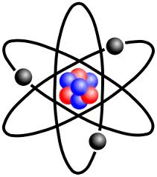
At this point, we’ve reached the limit of what you can see with light.
We can use other methods to “see” finer details
Mostly, we just use hammers to break the particles apart and try to detect the pieces.
atom

Slide 45
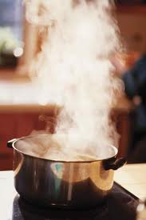
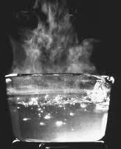
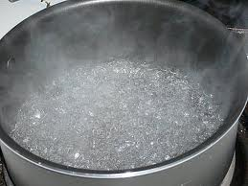
Conservation of Mass
Mass is neither created nor destroyed. Mass may change from one form to another, but the total mass after the transformation is always the same as that before.

Slide 46
Conservation of Mass

Slide 47
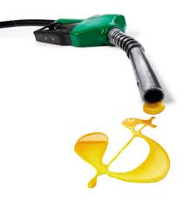
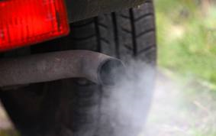
Ignition Fuels
Mass is neither created nor destroyed. Mass may change from one form to another, but the total mass after the transformation is always the same as that before.
  Piston @Motion
14 Air+1 Gas→ 15 Exhaust
C₈H₁₈ +11 O₂ → CO +CO₂ + 2 H₂O

Slide 48
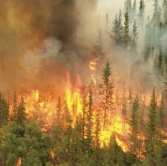
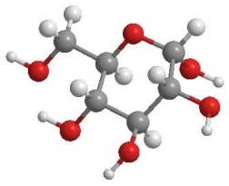



Forest Fires
Mass is neither created nor destroyed. Mass may change from one form to another, but the total mass after the transformation is always the same as that before.
1 Cellulose + 6 Oxygen → 7 Smoke
+
+
C₆H₁₂O₆ + 6 O₂ = 6 CO₂ + 6 H₂O

Slide 49
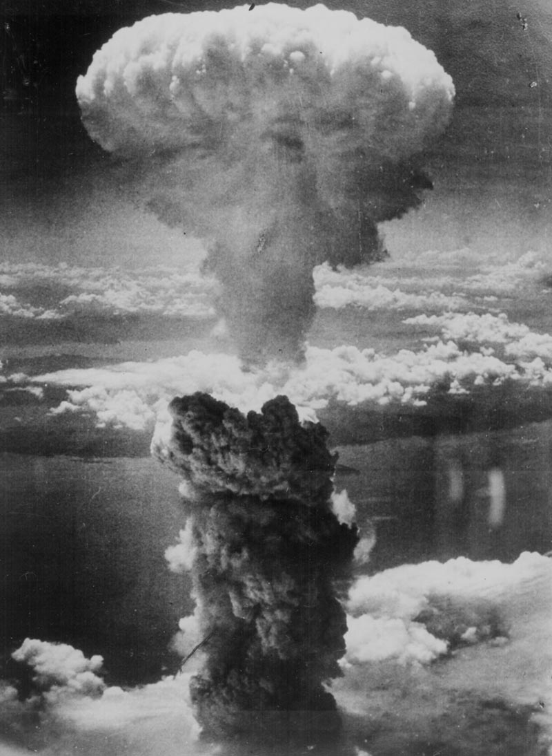
Electrons seem fundamental (we can’t break them into pieces), but the nucleus comes apart.
nucleus
fissioned

Slide 50
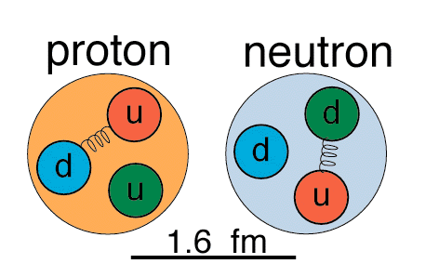
Nucleons have parts (but we never see them separately)
Size ~ 10 ⁻¹⁵ meters
Only 2 nucleons
  Protons: charge = +1
  Neutrons: no charge
Their masses are essentially the same
They are thought to be composed of simpler entities called quarks. (Nobel Prize in 1990)
Find the James Joyce book “Finnegans Wake”
Find the page # that says, “Three quarks for muster Mark”
Don’t tell anyone else!

Slide 51
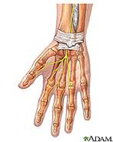







So what are we really made of?
flesh
There are conservation laws for even these tiny particles
cell matrices
Electrons
cells
nucleic and amino acids
nucleotides
atoms
Quarks

Slide 52

Macroscopic properties conserved in motion:
Linear Momentum
Momentum is (mass) x (velocity)
Conserved in the absence of external net force
Examples
  Collisions
  Cannon

Slide 53


Momentum transfer
mv = mv
velocity of bullets
velocity of gun
v
v
m
m
http://www.youtube.com/watch?v=4CfREbZ1V5o

Slide 55
Conservation of momentum means:
total momentum before = total momentum after
total momentum =

Slide 56


Slide 59

Momentum is conserved even when the various parts of the system split due to internal forces
Initial
Final
Energy and Momentum
are conserved during
elastic collisions
At rest
At rest
Only momentum
is conserved during
inelastic collisions
At rest

Slide 61


Conservation of angular momentum
Angular momentum is mass x speed x radius
Examples:
  Diver
  Ice skater
  Riding a bike
Equal masses but different shapes
50*2 = 4*25
It speeds up!

Slide 62

Newton’s Cradle
To explain this behavior we need something else to be conserved. This will turn out to be Energy

Slide 63




Chapter 9
Energy

Slide 64
Sometimes it is hard to describe all of the motion in a system, and we want something simpler

Slide 65

Energy
A more complicated example: Power plant
E_{in}
E_{stack}
E_{friction}
E_{friction}
E_{electricity}
boiler
turbine
generator

Slide 66
Energy
Energy is
  the capacity “to do something”
  Ability to exert a force on an object while moving it through a distance
Energy can either be associated with an objects position (potential) or its motion (kinetic)
Total energy is conserved: Energy can be neither created nor destroyed. The total amount of energy in the universe never changes. However, energy can change from one form to another, or be transferred from one object to another.

Slide 67
Forms of Energy
Kinetic Energy
Gravitational Potential Energy
Electrical Potential Energy
Internal Energy
  Thermal (internal kinetic)
  Elastic potential (internal electrical)
  Chemical Potential (internal electrical)
Radiant Energy

Slide 68
Kinetic Energy
Kinetic energy is the energy of motion.
Kinetic Energy = ½ mv²
½ mv² = ½ mv²
mv = mv
What about a ball rolling up a hill?

Slide 70


Gravitational Potential Energy
energy associated with the height of an object
gravitational potential energy = (weight) x (height)
Examples
  Balls rolling on tracks (energy transfers from potential to kinetic)
  Pendulum
  Ski Jump
  Bouncing ball
http://www.youtube.com/watch?v=bHBN7Cds07I&feature=related

Slide 71


In physics, the word “work” has precise meaning that is somewhat different than you may be used to.
Work = (force) x (distance parallel to force)
For work to be done in the physics sense, a force must be applied and the object must have some motion parallel to the force
Work is a method of transferring energy, it is not a form of energy itself.
He pushed up
Gravity pushed down

Slide 72
Equal and opposite work
Work = F*d
The distance it moved was up.
He is pushing up
Gravity is pushing down
Therefore, he did positive work on the weight while gravity did negative work on the weight. If he drops it, what happens?

Slide 73


Thermal Energy
Internal energy associated with kinetic energy of individual particles.
Related to temperature (average KE of atoms and molecules)
A warm object has more internal energy than when it is cold
Two objects at the same temperature may have different amounts of thermal energy, why?
  water 1 cal/gºC
  gold .03 cal/gºC

Slide 74


Thermal Energy
Why can two objects at the same temperature have different amounts of thermal energy?
They each convect it differently
They have different temperatures
They have different Heat Capacities
They have the same amounts of thermal energy

Slide 75


Chemical Potential Energy
Internal electrical potential energy of atoms in a material
Examples
  change of state (rearrangement of atoms)
  chemical bonds
    burning gasoline, natural gas, or wood
    exploding firecracker

Slide 76


Elastic Potential Energy
Energy stored in a material by deforming it in such a way that its molecules are displaced from their equilibrium positions.
A form of internal electrical potential energy
Examples:
  deformation (springs, balls)
  Rubber band
  Trampoline

Slide 77




Radiant Energy

Slide 78

Conservation of Mass-Energy
Mass and energy are two manifestations of the same quantity
The total amount of mass-energy in an isolated system is constant
Mass and energy can be converted from one form to the other
E=mc²
Notes:
Resolution of problem with conservation of mass and conservation of energy.

Slide 79










Combustion fuels – Hippie Methodologies
Add Heat, Chemical Potential Energy and Kinetic energy
Lose Heat and Chemical potential energy
Gain Transformed Chemical Potential energy
Add Chemical potential energy and Kinetic energy
Lose Heat
Gain Transformed Chemical Potential energy
Add Kinetic Energy
Lose Heat
Gain Electromagnetic Energy
Add Chemical potential energy and small Kinetic energy
Lose Heat and Chemical Potential energy
Gain Kinetic Energy
Add Electromagnetic Energy
Lose Heat
Gain An operating appliance of your choice

Slide 80

Look for alternatives, bottlenecks and synergies

Slide 81



Example: Practical application

Slide 82
Summary: Forms of energy
Kinetic Energy
Gravitational Potential Energy
Electrical Potential Energy
Internal Energy
  Thermal (internal kinetic)
  Elastic potential (internal electrical)
  Chemical Potential (internal electrical)
Radiant Energy

Slide 83
Energy Transfer and Transformation
Radiation: energy is transmitted by visible light, infrared radiation, ultraviolet radiation, X-rays, or radio waves. (sun, space heater)
Conduction (Heat Flow ): a process in which internal energy is transferred because of a difference in temperature. (electric stove, soldering iron)
Convection: internal energy is transferred because matter moves from one place to another. (hot air furnace)
Work: energy is transferred or transformed by forces acting on an object. (friction, muscles, electric motor)
Combustion: chemical potential energy is transformed into another form (gasoline engine, dynamite, light stick)

Slide 84



Kinetic
Elastic potential
Gravitational potential
6.15m
7:25
Sergei Bubka
http://www.youtube.com/watch?v=IWGyzPNXI_U

Slide 85


Kinetic energy from Chemical Potential
The engine is running, doing work on the car.
There is a lot of chemical potential energy in the fuel but we can only get so much macroscopic kinetic energy out of it.
We are in a power crisis not an energy crisis

Slide 86

The method of heat transfer used to cook microwave popcorn is
radiation
conduction
convection

Slide 87



Popcorn
Three methods for popping popcorn
  Microwave --
  Hot air --------
  Stove top ----
Identify the method of heat transfer for each.
Radiation
Convection
Conduction

