Slide 1
Quiz 2
Chapters 4, 5, and 6
Notes:
The Braille says “Guy loves Sarah Silvern”

Slide 2
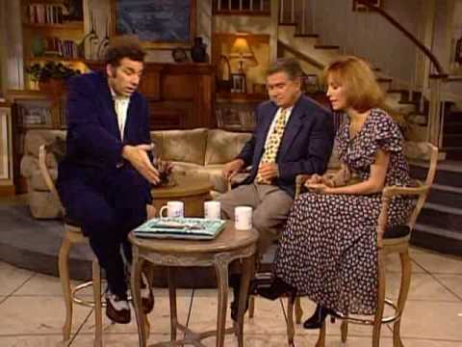
A book is at rest on a table. The force paired with a book’s weight (via Newton’s third law) is:
1
The force exerted by the table on the floor
The force of gravity exerted by the book on the earth
The contact force of the table on the book
Cannot be determined without more information
Notes:
Question One

Slide 3
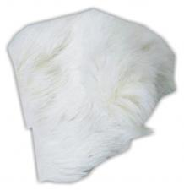
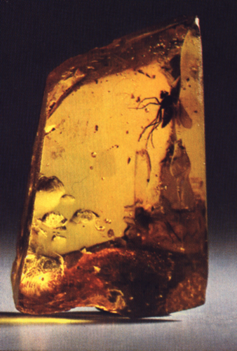
Electron
2
The ______ noticed by at least _____ that amber rubbed with fur could attract things.
Notes:
None

Slide 4
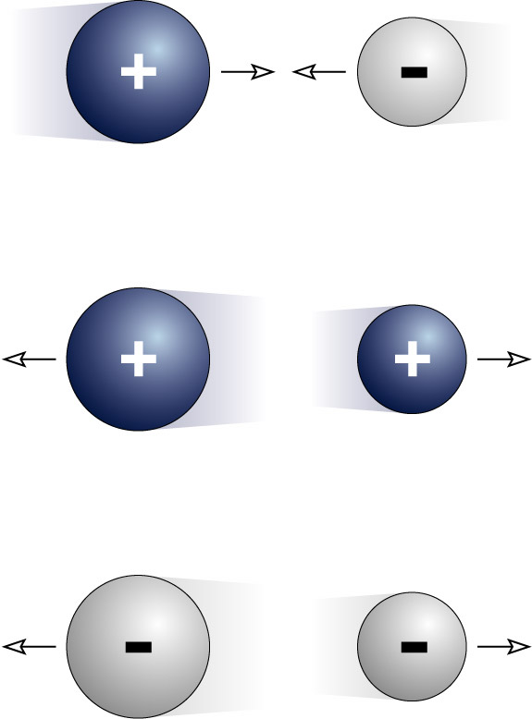
Electric Forces: Which of the 3 figures on the right is correct?
3
1
1 and 2
1 and 3
Only the first one
1,2 and 3
None of them
2
3

Slide 5
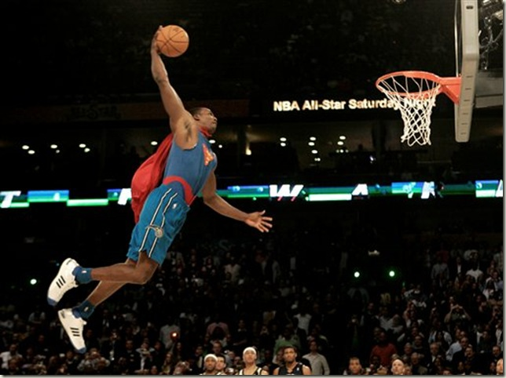
At the top of his jump, the basketball player throws the ball down (through the hoop, of course). This action…
4
increases hang time
does not affect hang time a bit
decreases hang time
is impossible

Slide 6
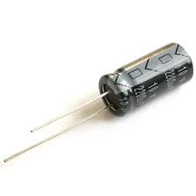
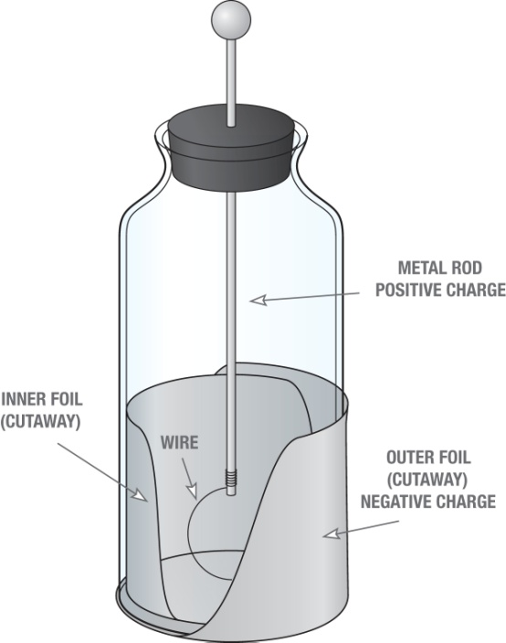
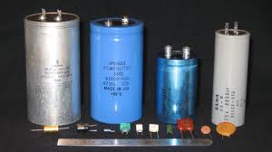
What can a Leyden jar do that’s so special?
5
Hint: Leyden jars are just like capacitors

Slide 7
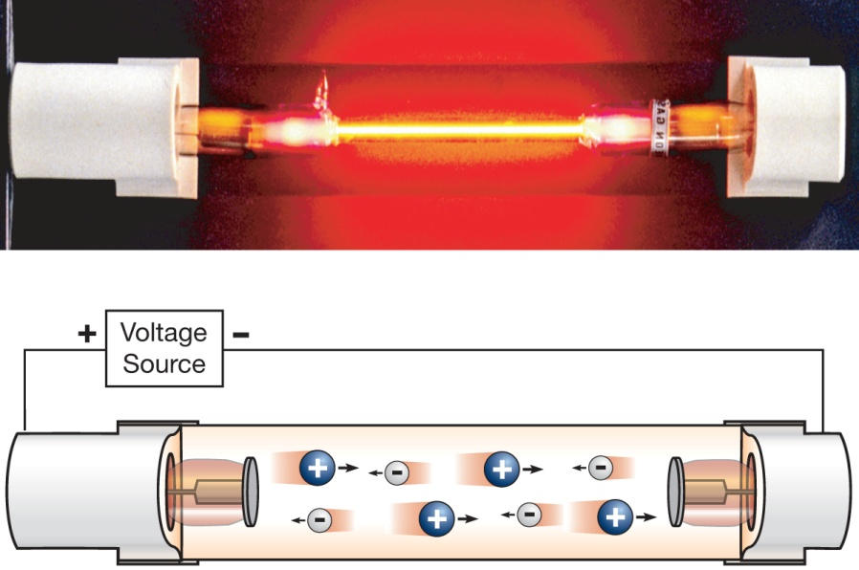
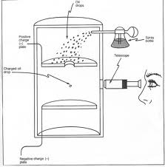
Who showed that Ben Franklin’s “fluid” model was not entirely correct?
6

Slide 8
How is Coulomb's law similar to Newton’s Law of Gravitation?
7
Newton’s
Coulomb’s

Slide 9
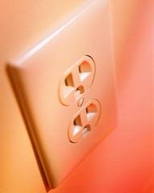
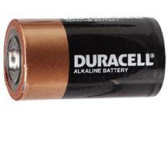
Which one is a source of Direct Current?
8
A
B

Slide 10
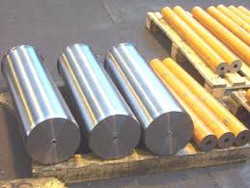
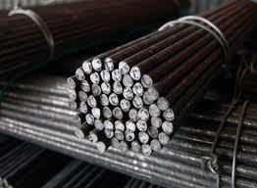
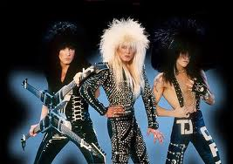
T or F: Magnets can pick up(magnetize) anything that is metal?
9
S
N

Slide 11
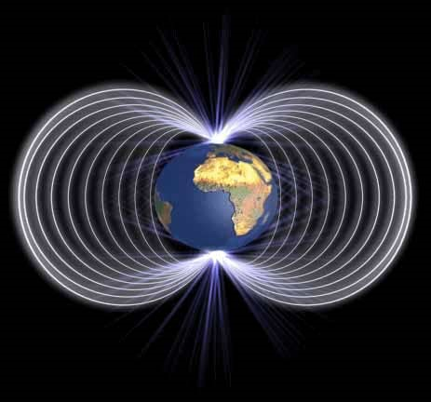
What is the source of all magnetic fields?
10
Moving electric charges
Charges in static equilibrium
Two different types of rocks stuck together

Slide 12
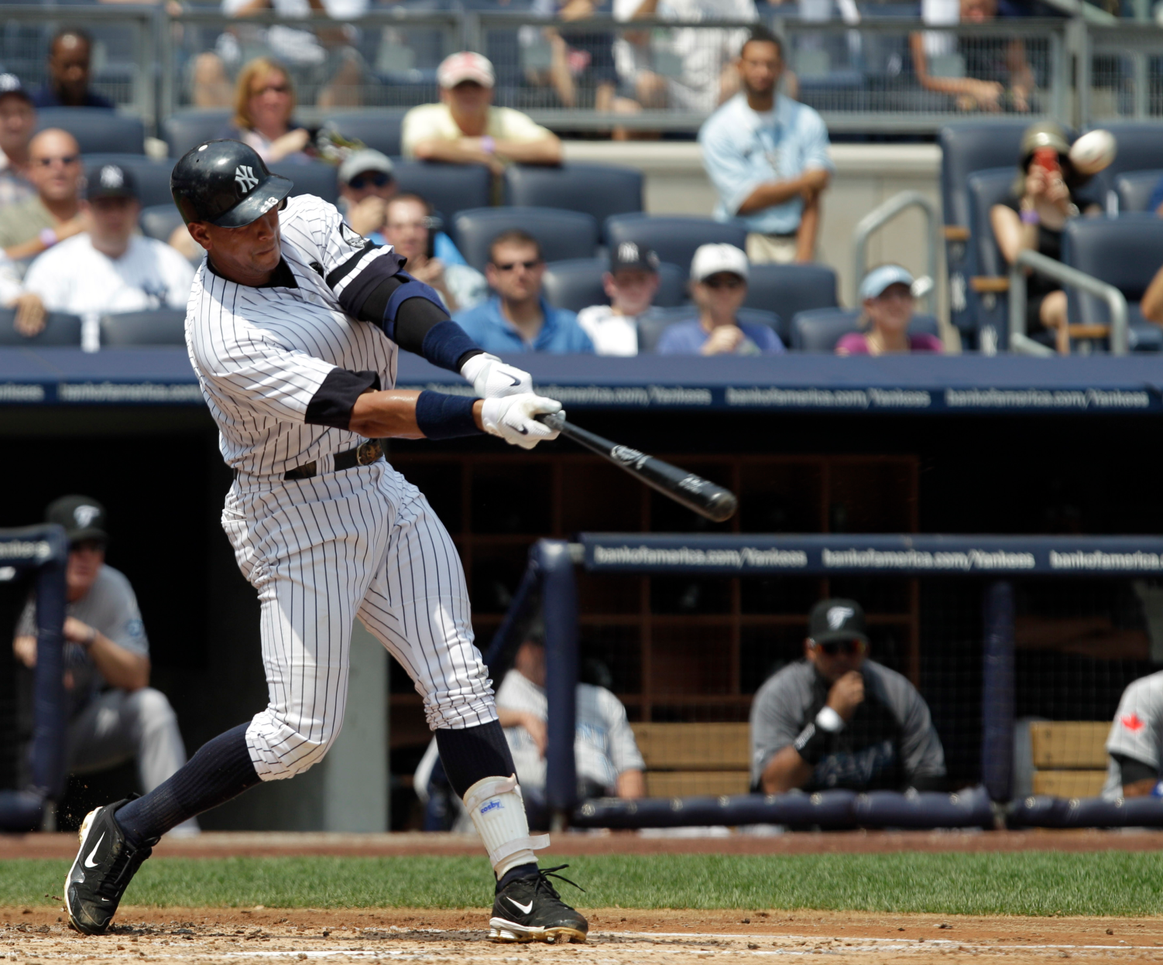
Draw the trajectory of a homerun with no air resistance and write what the shape is called
11

Slide 13
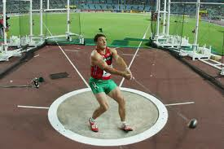
Hammer throw
12
When you swing this ball around clockwise at a constant speed what letter is the ball accelerating towards?
B
A
C

Slide 14
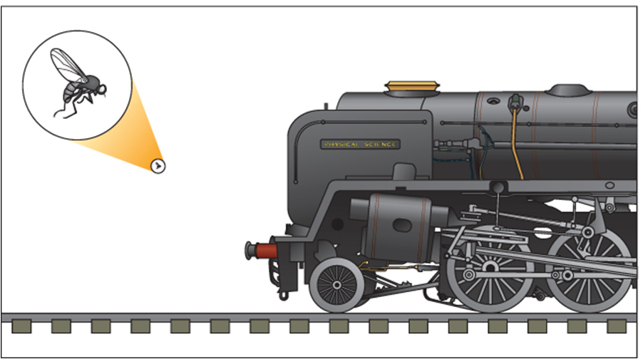
The acceleration of the fly will be
13
Smaller than the train of the acceleration
Equal to the acceleration of a flying train
Less than the acceleration of the train
Greater than the acceleration of the train
Cannot be determined without more flies

Slide 15
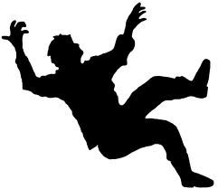
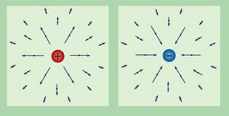
When analyzing motion…
14
which two of the four fundamental forces are most important to consider?

Slide 16

Projectile Motion
15
Throwing a ball straight up, after you let go…
What is its acceleration when it momentarily stops at the top?

Slide 17
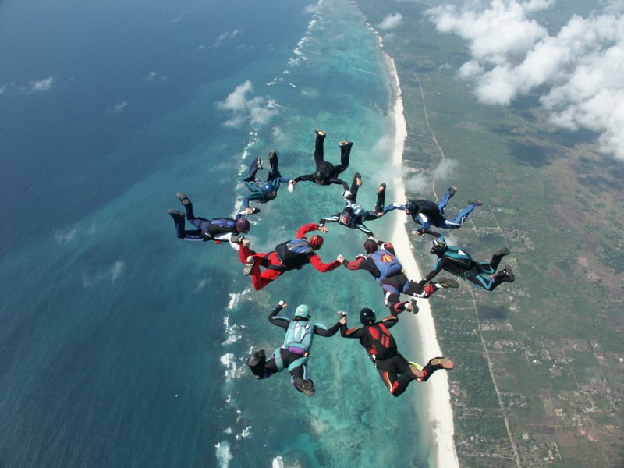
Add some air resistance: True or False
16
In the presence of air resistance, a falling object will reach a constant velocity?

Slide 18
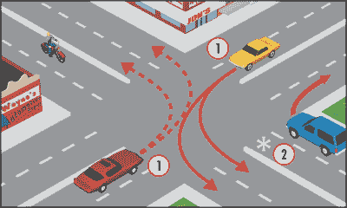
You turn left in that red car at a constant speed. The horizontal force from the seat on you…
17
Pushes you away from Wayne’s Deli
Pushes you towards Wayne’s Deli
Pushes you up and out of the sun roof
Wayne’s Deli
Bonus point: Is it a real force?

Slide 19
Draw the trajectory of a homerun with no air resistance and write what the shape is called

Slide 20
Hammer throw
When you swing this ball around clockwise at a constant speed what letter is the ball accelerating towards?
B
C
A

Slide 21
The acceleration of the fly will be
Smaller than the train of the acceleration
Equal to the acceleration of a flying train
Less than the acceleration of the train
Greater than the acceleration of the train
Cannot be determined without more flies

Slide 22
When analyzing motion…
What two forces are most important to consider?

Slide 23
A moose is chained to a log…
You tell him to pull the log, but he says he can’t, because every time he pulls on the log it pulls back with an equal force Thus he cannot move the log. Motivate the moose with physical principles.

Slide 24
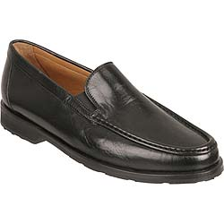
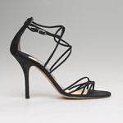
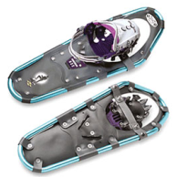
What would you know… about… pressure?!
To decrease the pressure caused by a force how must you change the area it’s applied to?

Slide 25
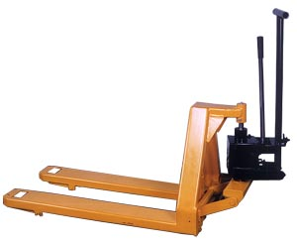
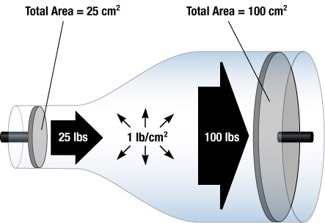
Hydraulics (bounded fluid)
You can push heavy things with the right side of this hydraulic press easily by pressing on the left side at the expense of what?

Slide 26
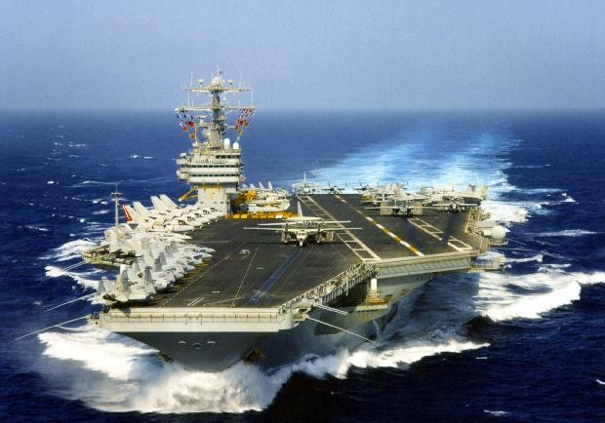
How much water does an aircraft carrier displace?
A few minutes
An equal length of water equilibrated to the mass of the water in equilibrium
A volume of water equal to the charge of the ship’s surface
A mass of water equal to the mass of the ship

Slide 27
2 ways to say something floats above the surface of a fluid
It is ___ dense than the surrounding fluid.
It weighs ___ than an equal volume of fluid.

Slide 28
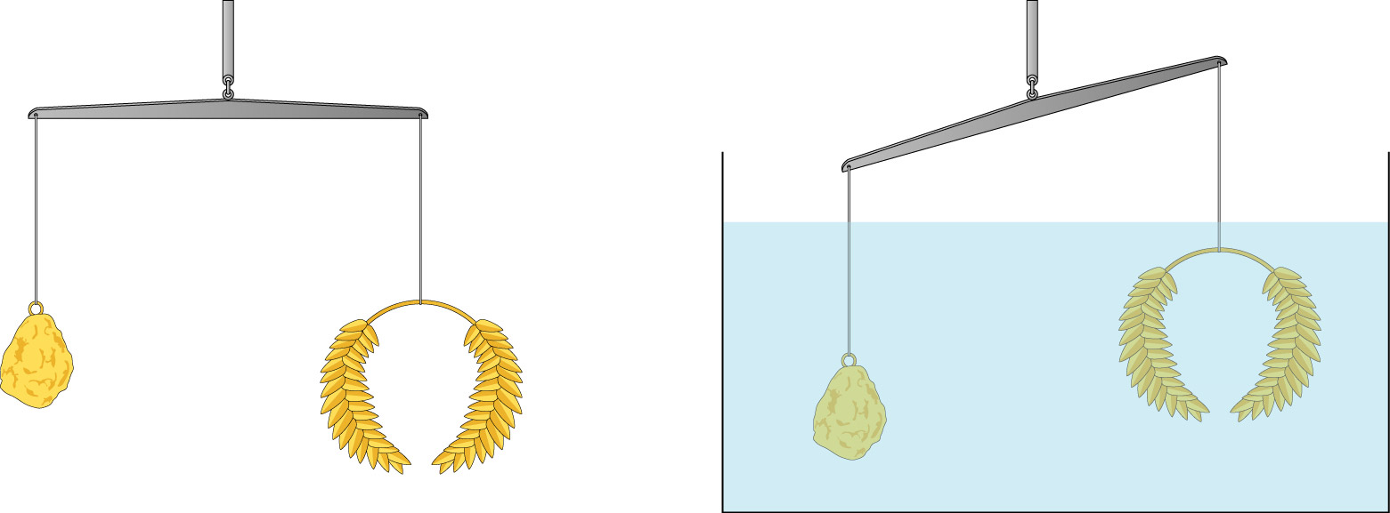
Extra point: true or false
Destiny = Mass/volume

