Slide 1
First Quiz
Get out a piece of paper and something to write with please

Slide 2
Misconception of the week
1
Do heavier objects fall faster than lighter ones?
Al
Au
No, lighter objects fall faster because they accelerate quicker.
Yes, the heavier one has a greater force of gravity on it.
No, they have the same accelerations.
No, one of them is wooden

Slide 3
Which color represents the person walking fastest?
2
Back of the room
Middle of the room
Front of the room
4:00:00 PM
4:00:05 PM

Slide 4
What is the difference in order of magnitude between these two numbers?
3
1x10¹⁰ and 1x10⁻¹¹
0
21
10
-1
-11

Slide 5
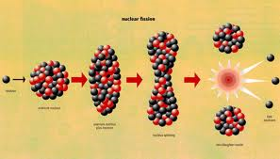
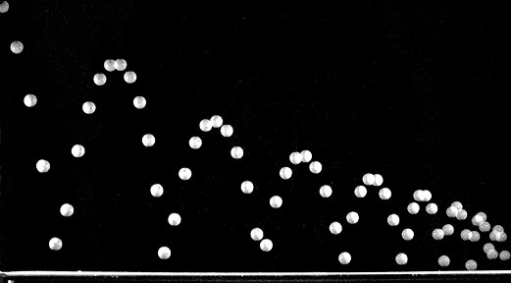
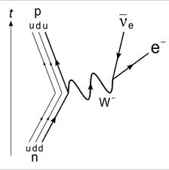
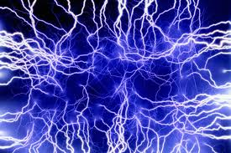
Which two of the four fundamental forces do we deal with most in our daily lives?
4

Slide 6
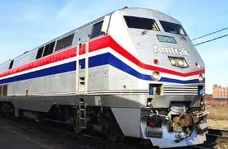

A fly is flying at the same speed before and after a collision with a huge train.
5
After
Before
ma = ma
If its speed never changes then why is the fly’s acceleration so big?

Slide 7

You’re stuck on a frictionless ice pond with a huge physics book.
6
What is the best way to get back to the shore?
North

Slide 8
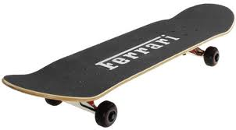
A guy and his girlfriend are on skateboards. They decide on a mutual break up and push each other.
7
Even though the force is equal and opposite, one of them experiences a greater acceleration than the other, who is it?

Slide 9
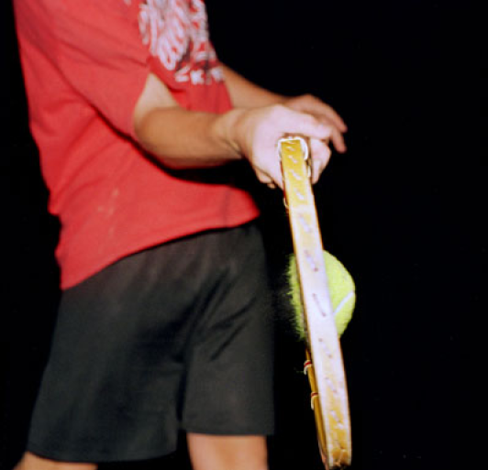
Which statement best describes the situation pictured below
8
The racket is exerting a force on the ball
The ball is exerting a force on the racket
Both A and B are correct, but the force on the ball is greater
Both A and B are correct and the forces are equal in magnitude
Photo by Amoz Eckerson, 1995
What is the action-reaction pair here?

Slide 10
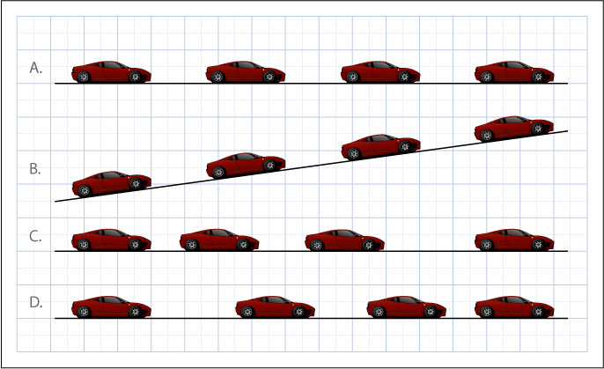
In which of the following cases is the car in accelerated motion?
9

Slide 11
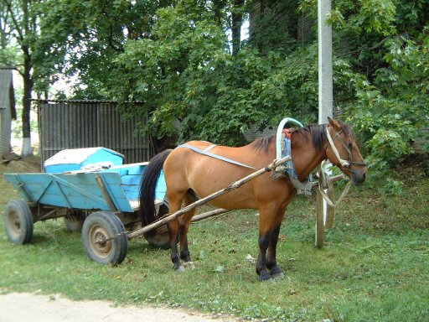
What can you say to this horse to convince it that it can get his work done?
10
“Every time I pull on the cart, it pulls back with equal force. Therefore I cannot pull the cart.”

Slide 12
What do the symbols in Newton’s 2nd Law equation stand for?
11
Newton’s 2nd Law equation

Slide 13

If I drop a book, how fast will it be going one second later?
12
Please write answer in feet per second

Slide 14
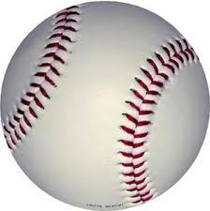
What is this baseball’s acceleration at the top of its flight?
13

Slide 15

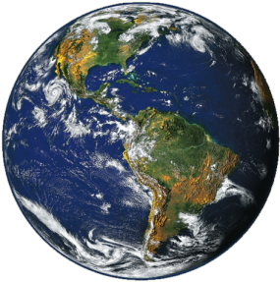
What direction is the moon accelerating?
14
b
a
c
d
e

Slide 16
If d₂ is twice as large as d₁, how is the force different for the d₂ case?
15
The force is four times larger
The force is twice as much
The force is half as much
The force is one quarter as much
M
m
d₁
M
m
d₂

Slide 17
If m₂ is twice as small as m₁, How is the force different?
16
The force is the same
The force is twice as much
The force is half as much
Need more information to tell
M
m₁
d
M
m₂
d

Slide 18
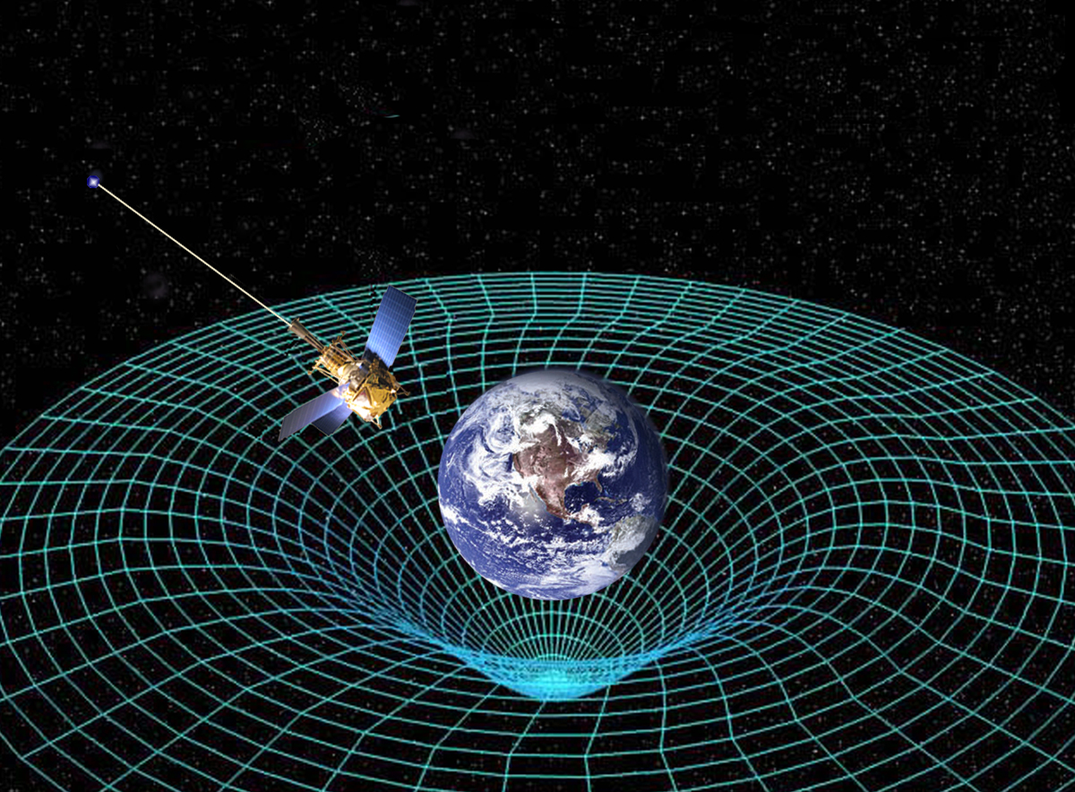
What is the equivalence principle?
17

Slide 19
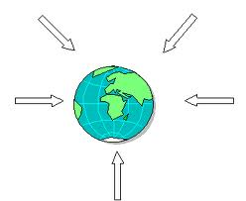
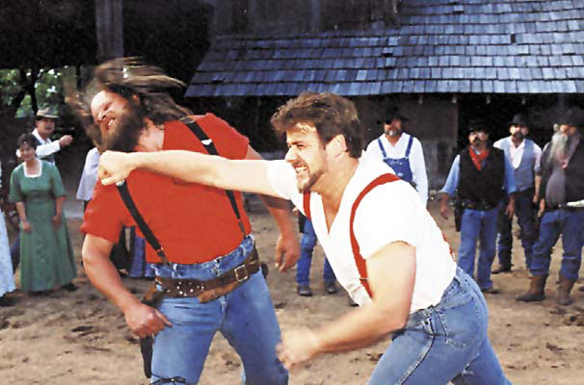
Which 2 of these 4 fundamental forces do we deal with most in our lives?
18
Nuclear Strong
Nuclear Weak
Electromagnetic
Gravity

Slide 20
A book is at rest on a table. The force paired with a book’s weight (via Newton’s third law) is:
19
The force exerted by the table on the floor
The contact force of the table on the book
The force of gravity exerted by the book on the earth
Cannot be determined without more information
Notes:
Question One

Slide 21
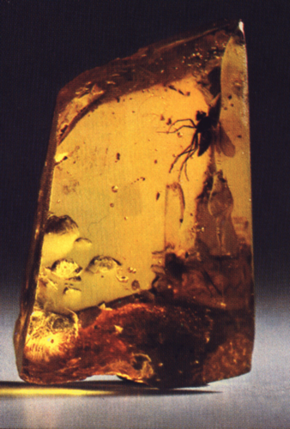
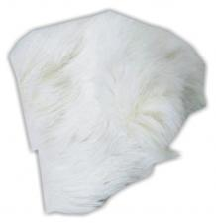
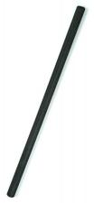
Elektron
20
The ______ noticed by at least _____that amber rubbed with fur could attract things.
(Elektron, amber in Greek)
Notes:
None

Slide 22
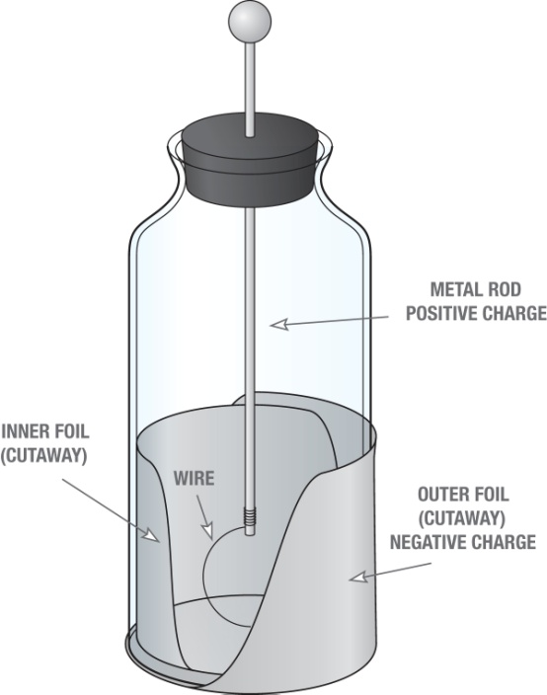
What is this called and what does it do?
21

Slide 23
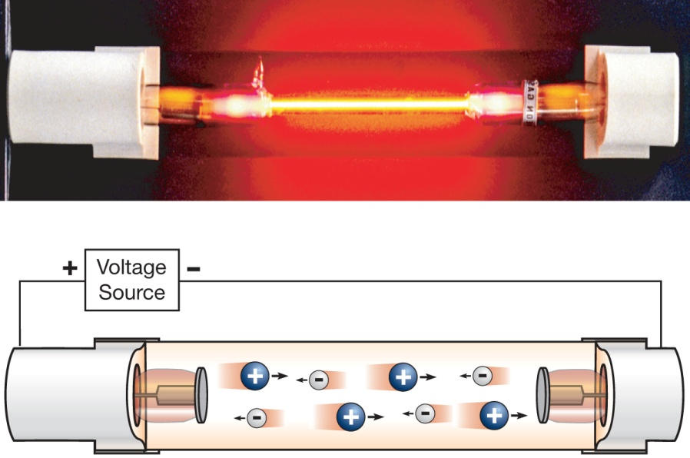
____________ showed that Franklin’s “fluid” model was not entirely correct.
22

Slide 24
How is Coulomb's law similar to Newton’s Law of Gravitation?
23
kQq
____
F=
2
d

Slide 25
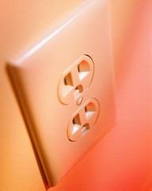
Which one is a source of Direct Current?
24
B
A

Slide 26
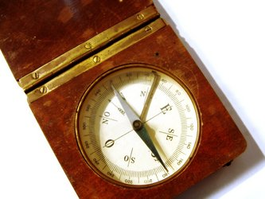
Does a compass have a magnet in it?
25

Slide 27
What direction would the right magnet spin when released, CW or CCW?
26
N
N
S
S
Fixed
Can Spin

Slide 28
What happens to these two charges when they are released from rest?
27
-
+
They move away from each other
They move toward each other
They stay where they are

Slide 29
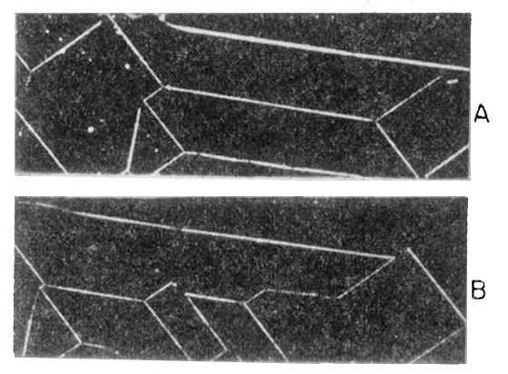
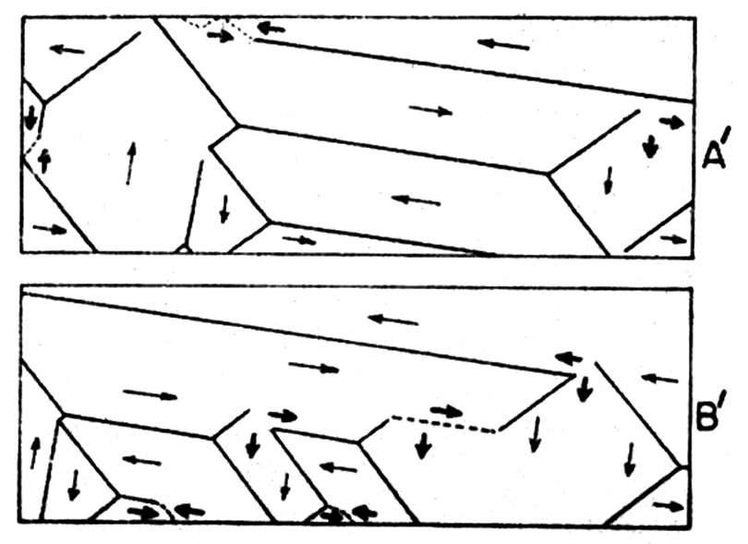
True or False
28
A magnet attracts anything that is metal.

Slide 30
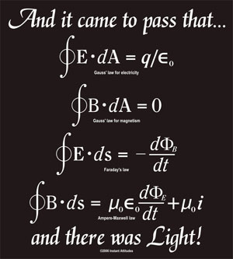
Which equation has the speed of light?
29
Extra Point Chance, who is the equation named after?

Slide 31
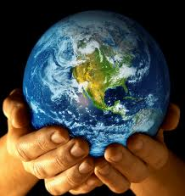
What are the 6 Basic Assumptions of Science?
30
E
C
P
T
N
O
Us
Little Green Men

