Slide 1
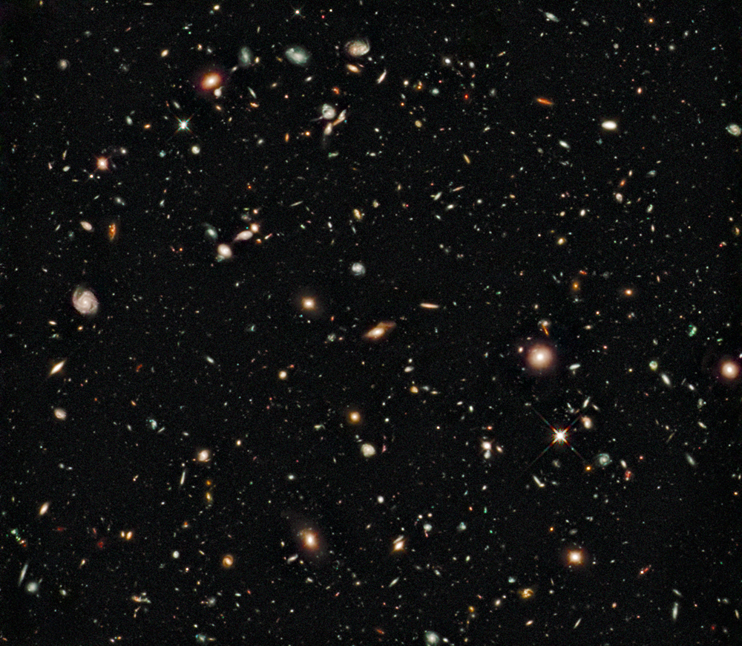
Cosmology

Slide 2
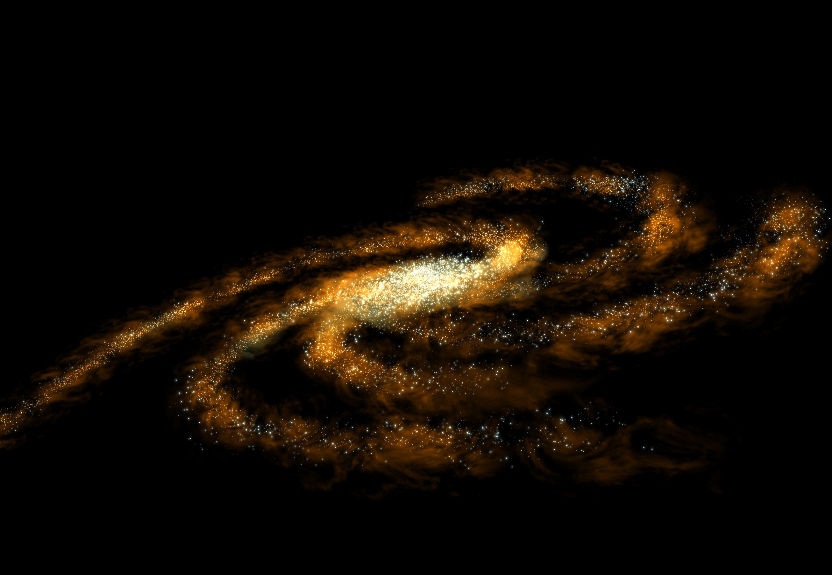
The Milky Way
100,000 light years across
Contains about 200-400 billion stars
We are in the Orion arm
The dust and stars in the center obscure our view with optical telescopes. To see into the center you need radio telescopes
Notes:
Detailed studies of the motions of interstellar gas clouds fills in this picture considerably by letting us plot the locations and speeds of these clouds, and in most versions of these studies, a distinct spiral pattern emerges

Slide 3
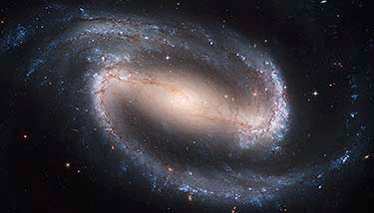
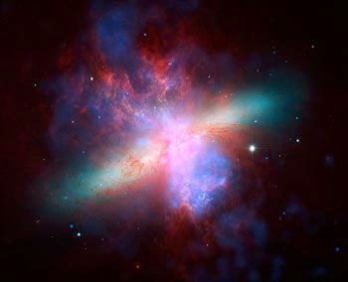
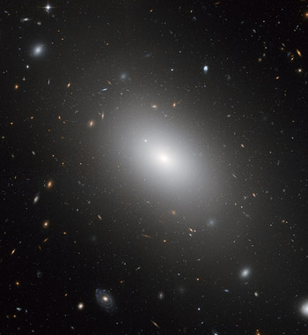
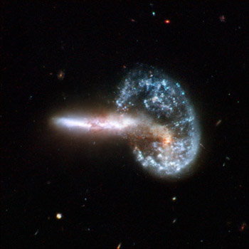
Not all galaxies are spiral
NGC 1300
Chandra/Hubble/Spitzer X-ray/Visible/Infrared Image of M82
NGC 1132
Arp 148

Slide 4
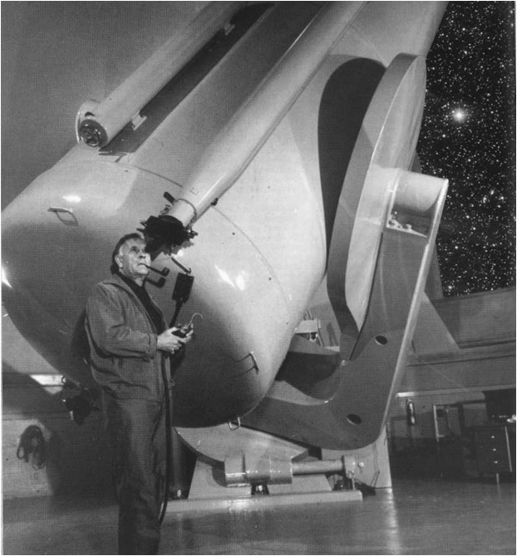
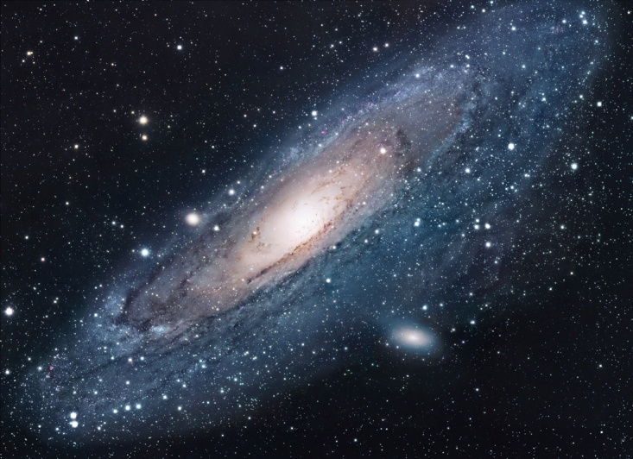
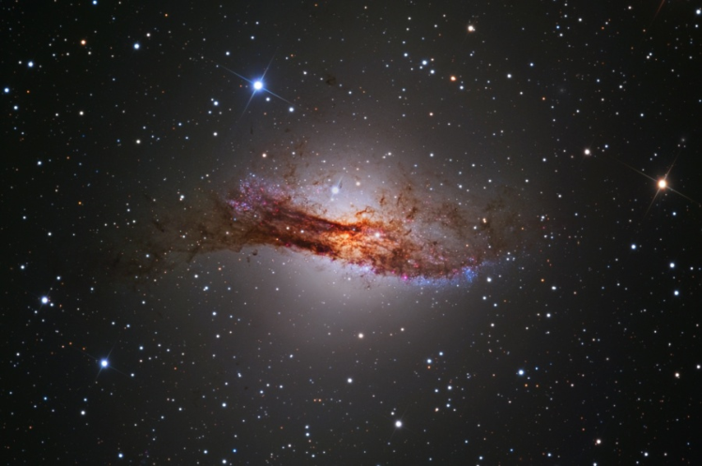
External Galaxies
It wasn’t until 1923 that we fully realized the universe consisted of more than the Milky Way.
Andromeda (HST)
Edwin Hubble finds Andromeda galaxy
Centaurus A
SSRO-South (Steve Mazlin, Jack Harvey, Daniel Verschatse, Rick Gilbert)
and Kevin Ivarsen (PROMPT / CTIO / UNC)

Slide 5
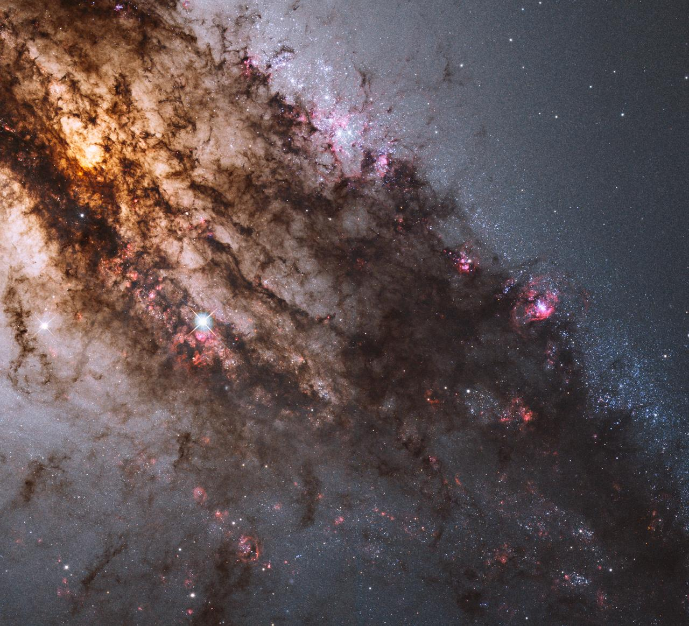
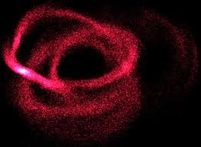
Centaurus A
Canis Major
25,000 light-years
Notes:
25,000 light-years away

Slide 6
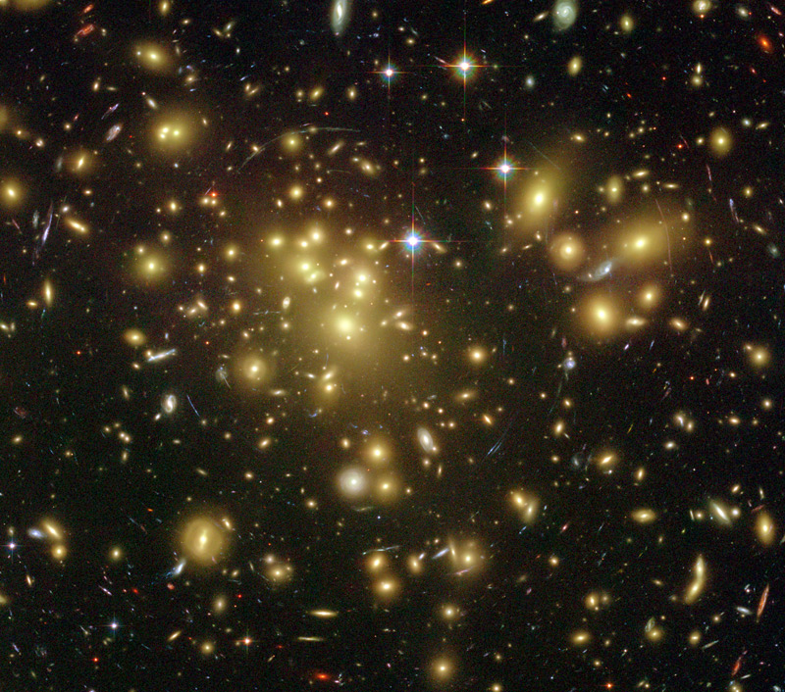
Galaxy Clusters
Galaxies are held together in small to large groups by gravity.

Slide 7
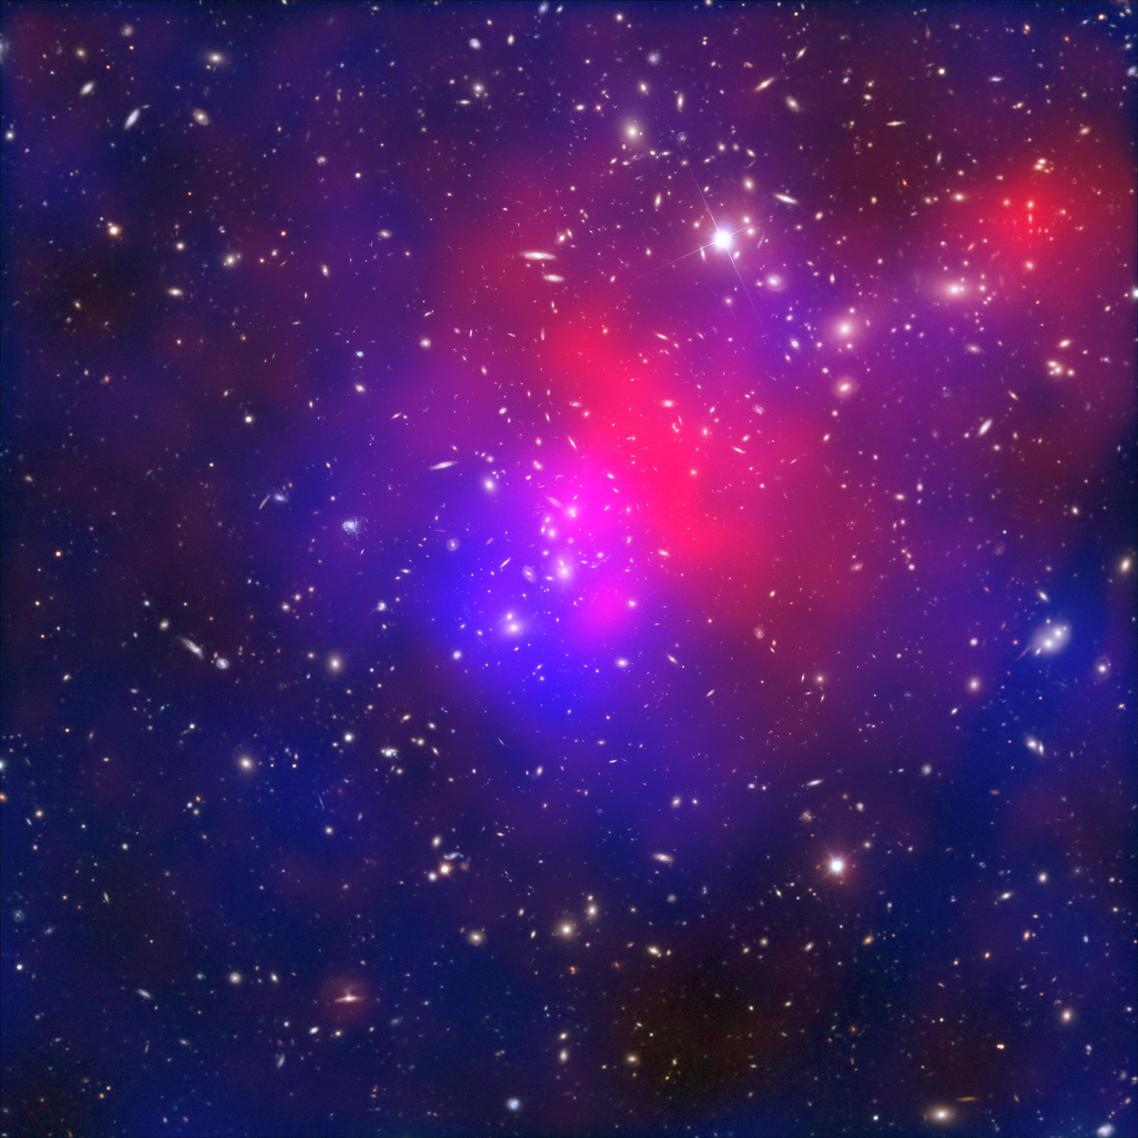
Pandora's Cluster – Abell 2744

Slide 8
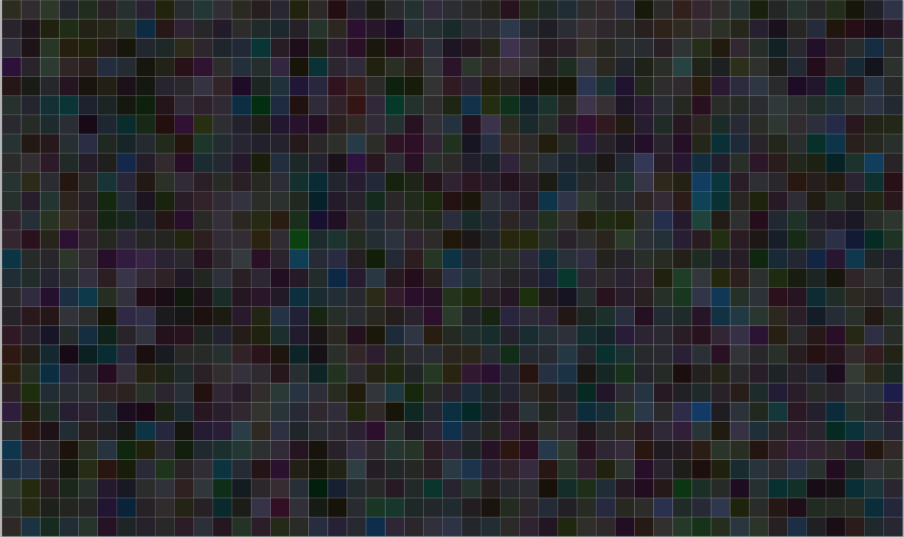
Hubble ultra deep field

Slide 9

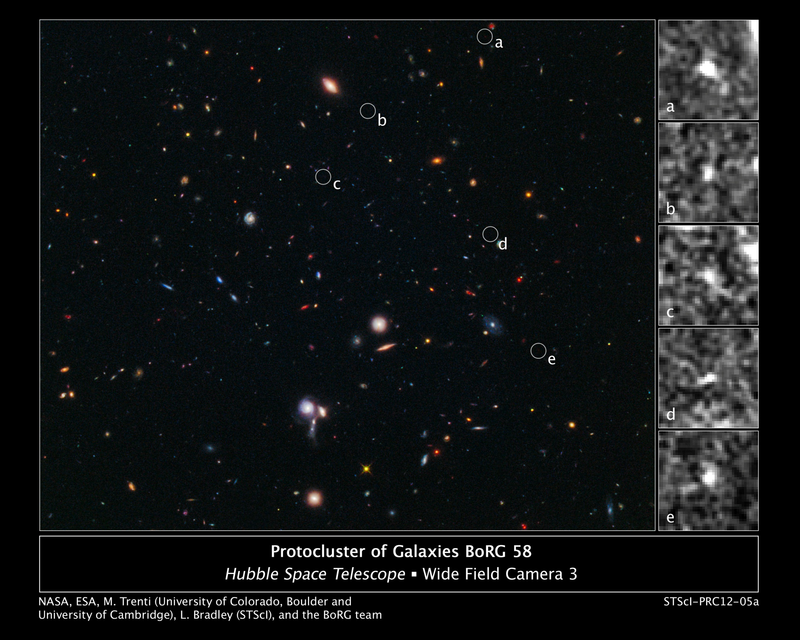


Slide 10

Color Auto-level

Slide 11

Highest contrast, brightness threshold 1

Slide 12
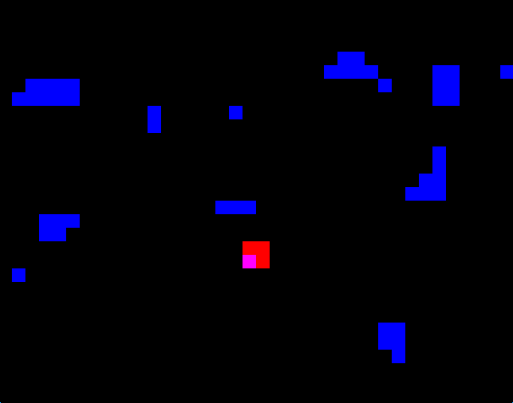
Highest contrast, brightness threshold 2
13.1 billion years old!

Slide 13
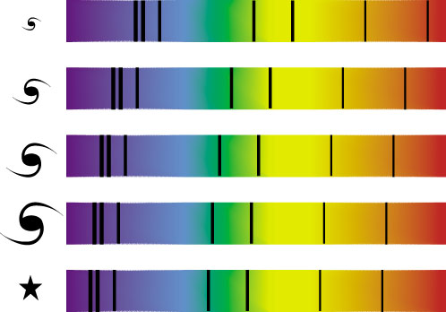
“Red” Shift from Galaxies(Absorption spectra)
Faraway galaxy
Same pattern
of lines; each
line is shifted
toward red end of
spectrum.
Nearby star

Slide 14
Implications
The further away a galaxy is
the bigger its red shift (on average)
the faster it is moving (away from us)
EXPANDING UNIVERSE

Slide 15

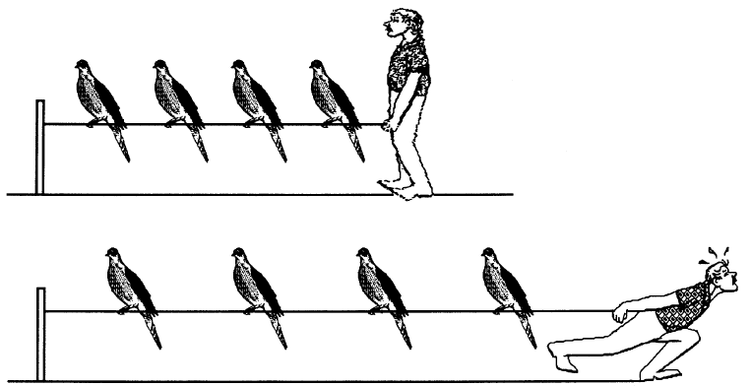

Expanding Universe
If the universe is expanding, the farther away two galaxies are, the faster they move apart.
Also, all galaxies would appear to be moving away from all other galaxies so our view is not unique.

Slide 16
Key observations that a viable cosmological model must explain
The “expanding” universe (the red shift)
The “age” of the universe.
The abundance of hydrogen (75%), helium (24%), and other elements.
The cosmic microwave background radiation
The structure of observed matter – general uniformity of radiation and matter.
Our current models are all based on general relativity – the “Big Bang”

Slide 17
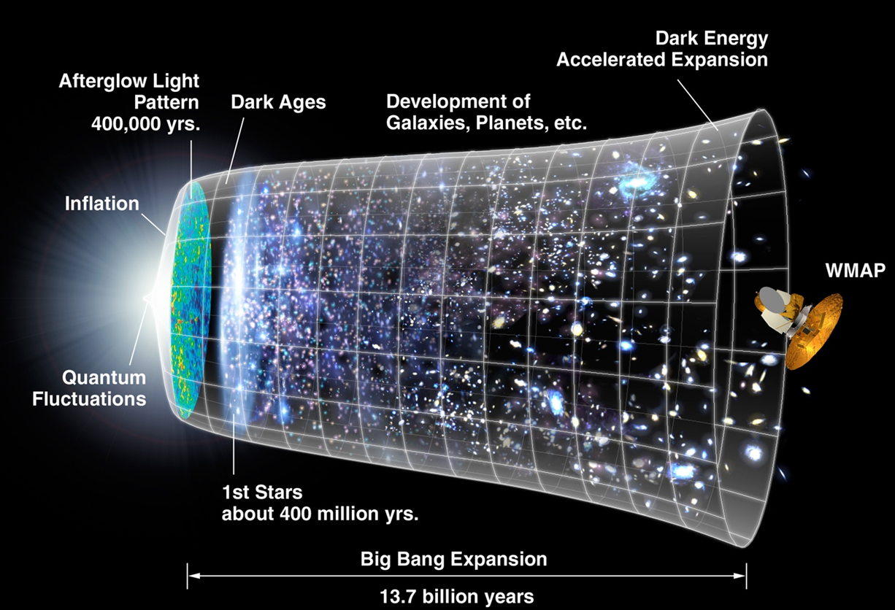
Big-Bang Theory
The observed expansion of the universe has led to the only viable cosmological model: The Big Bang.
  The universe began as a great infusion of pure energy about 13.7 billion years ago.
  Space expanded from that point in time. The energy cooled into matter.
10⁻⁴³ sec | huge | ???
10⁻³⁵ sec | 10²⁶ deg | quarks, gluons, electrons, neutrinos, photons
.001 sec | 10¹¹ deg | protons and neutrons
3 minutes | 10⁹ deg | ³H, ³He, ⁴He nuclei
1/2 hour | 10⁸ deg | ²H nucleus
500,000 yrs | 30000 deg | atoms
Notes:
The baryonic matter in the universe consisted of ionized plasma, and it only became neutral when it gained free electrons during "recombination," thereby releasing the photons creating the CMB. When the photons were released (or decoupled) the universe became transparent. At this point the only radiation emitted is the 21 cm spin line of neutral hydrogen. There is currently an observational effort underway to detect this faint radiation, as it is in principle an even more powerful tool than the cosmic microwave background for studying the early universe.

Slide 18

Experimental Evidence
cosmological red shift
  Everything is moving away from us
helium/hydrogen ratio (25%/75%)
  Fusion early after the big bang would produce that ratio of H to He
Big Bang
Stellar Fusion
Supernova
Notes:
age of stars and formation of galaxies still open to some question
Note that Dr. McNamara has made some important discoveries on this question just this year (1997).
Best current estimates: universe is about 12-18 billion years. Earth about 5 billion years (oldest crust about 4.3 billion years)

Slide 19
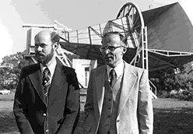
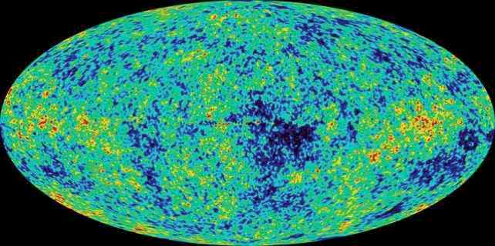
Evidence Supporting the Big Bang
We see a faint glow left from the original high temperatures
  Called the Cosmic Microwave Background or 3° K Background Radiation.
  It can’t be completely uniform, or galaxies would not have formed.
Arno Penzias and Robert Wilson
Notes:
age of stars and formation of galaxies still open to some question
Note that Dr. McNamara has made some important discoveries on this question just this year (1997).
Best current estimates: universe is about 12-18 billion years. Earth about 5 billion years (oldest crust about 4.3 billion years)
Like investigators at a crime scene, astronomers have been combing the Universe for physical evidence to test the big bang theory-the most widely accepted scientific theory for how the Universe evolved. The first evidence that turned up was predicted in advance but discovered by accident. Some scientists thought the big bang should still be visible as a faint glow of radio light filling the sky in all directions. In 1964 Arno Penzias and Robert Wilson discovered that light, called the cosmic background radiation.
Maybe It's the Pigeons...?
Arno Penzias and Robert Wilson were puzzled. The two scientists at Bell Labs in Holmdel, New Jersey, had ruled out everything they could think of that could create the static their satellite communications antenna was picking up. Pigeons had taken to roosting in the radio antenna's large horn. They thought that perhaps heat from pigeon droppings was the cause.
They set out a trap to catch the pigeons, but that didn't resolve the mystery either. No matter where in the sky they pointed their radio antenna, they kept picking up that faint, persistent hiss.
Their determination in 1964 that the entire sky seemed to be dimly glowing with radio light confirmed physicists' predictions and later earned Penzias and Wilson a Nobel Prize. The two scientists had, quite by accident, discovered the fading flash from the big bang.

Slide 20
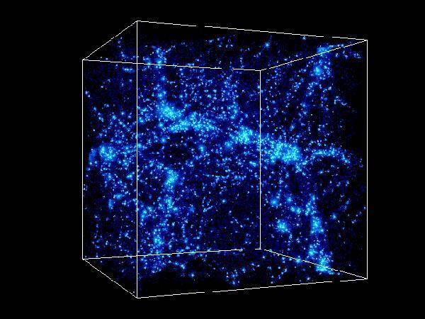
Evidence suggests that the rate of expansion of the universe is accelerating. Which of the four fundamental forces accounts for this?
Gravitational
Electromagnetic
Strong nuclear
Weak nuclear
None of the above.
Dark matter and dark energy

Slide 21
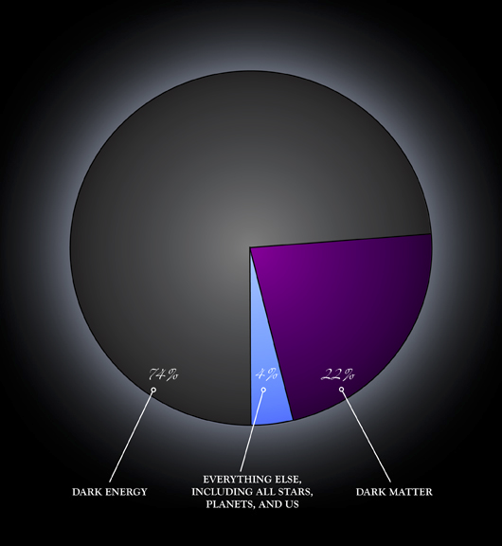
Mass and energy content of the universe

Slide 22
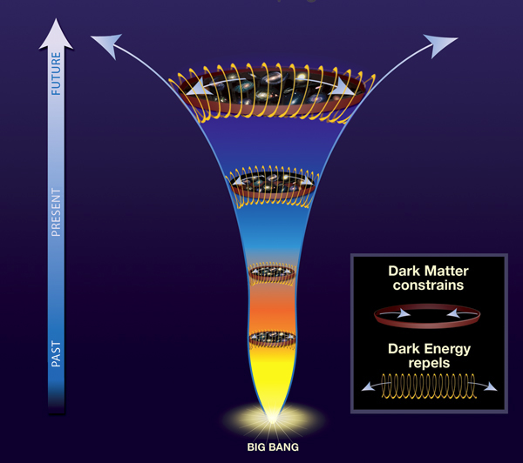
Dark matter and dark energy unbalanced

Slide 23
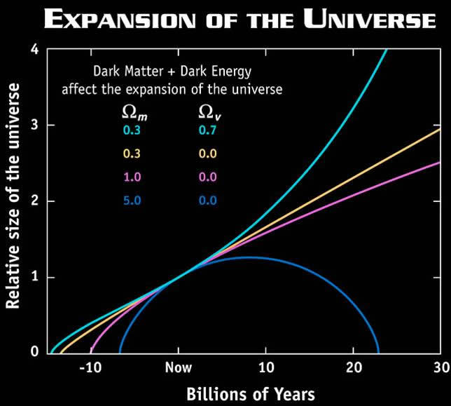
The Ultimate Fate of the Universe
Gravity always pulls, never pushes, so the expansion must slow down unless there is another force pushing out.
Not enough mass
  open universe
Just right
  flat universe
Too much mass
  Closed universe (big crunch)
Another force
  Runaway universe.
  This is what we think is happening as best we can observe!

Slide 24

Where are you?

Slide 25

on a “tʃɛ́r ”

Slide 26
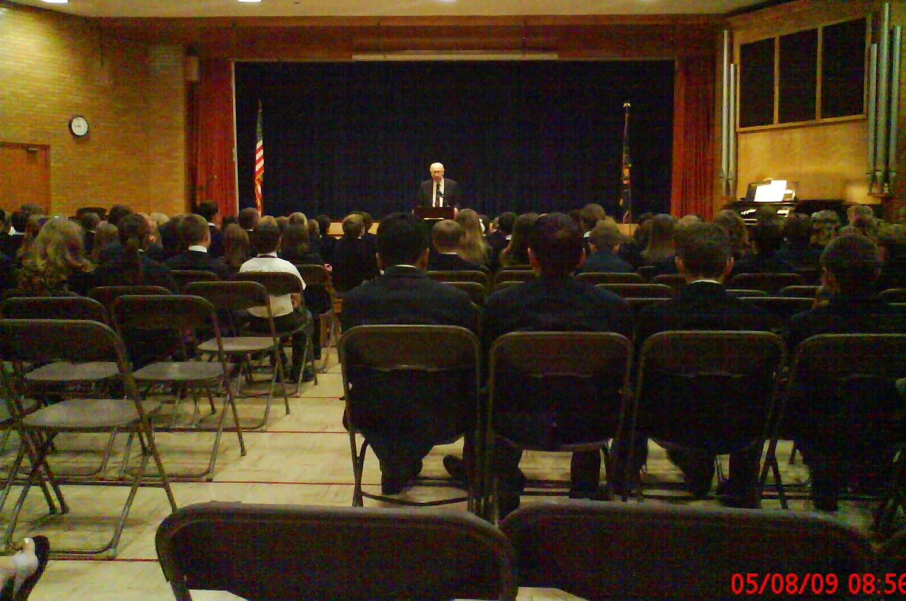
in a “rúm”

Slide 27

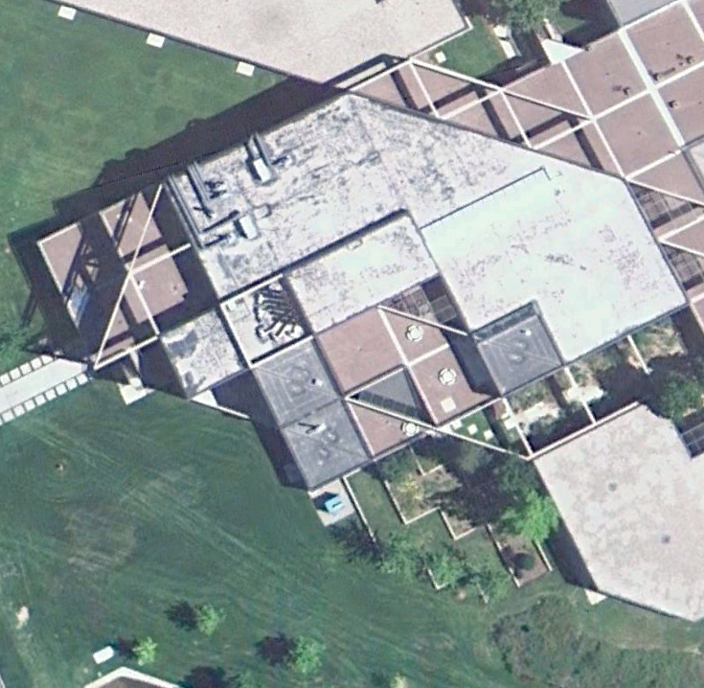
in a “bɪ́ldɪŋ ”

Slide 28
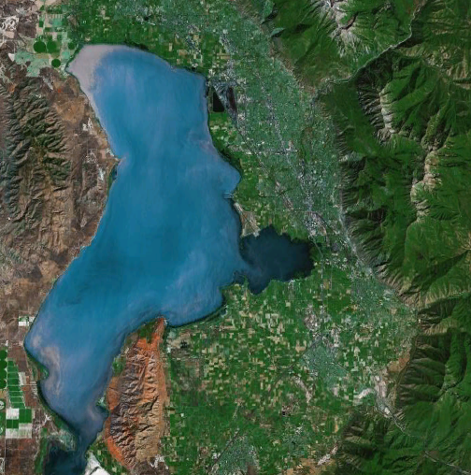
in a “vǽli”

Slide 29

on a “kɑ́ntənənt”

Slide 30
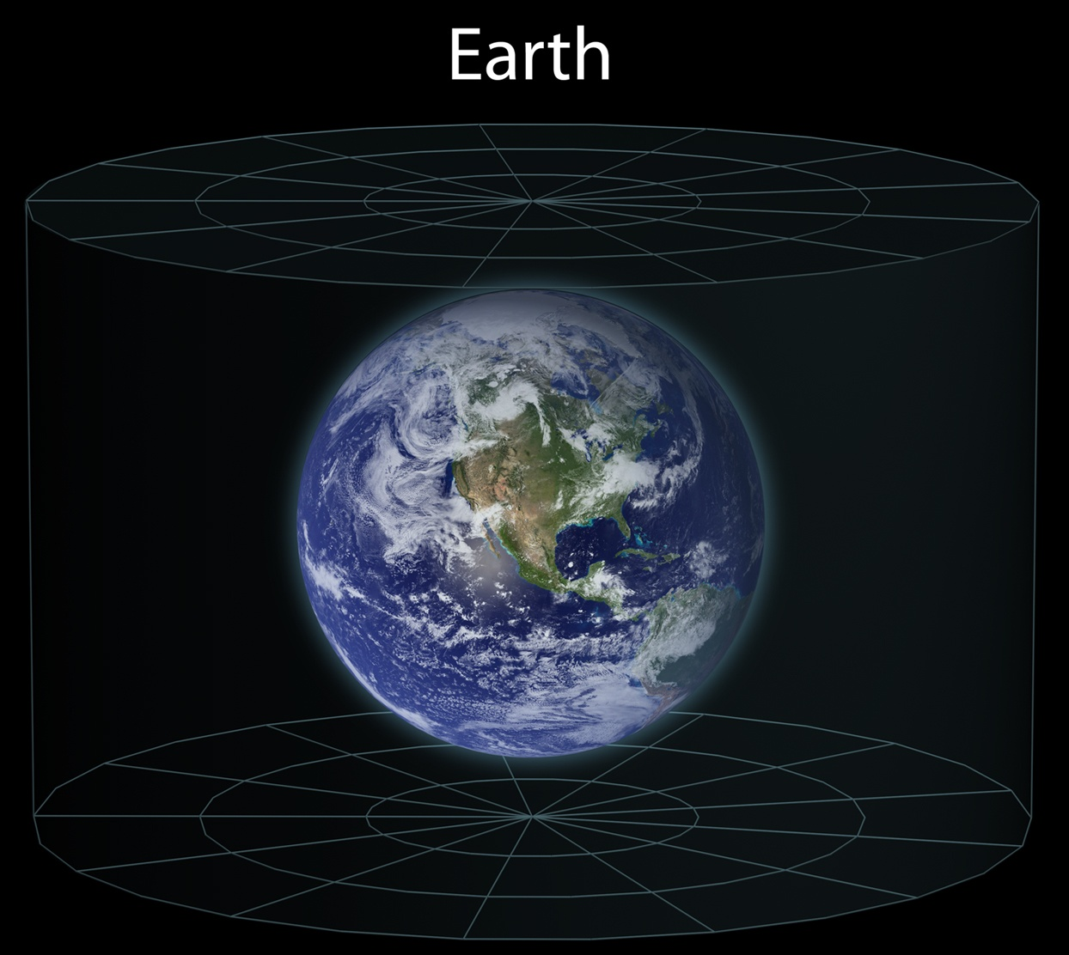
on a “plǽnət”

Slide 31
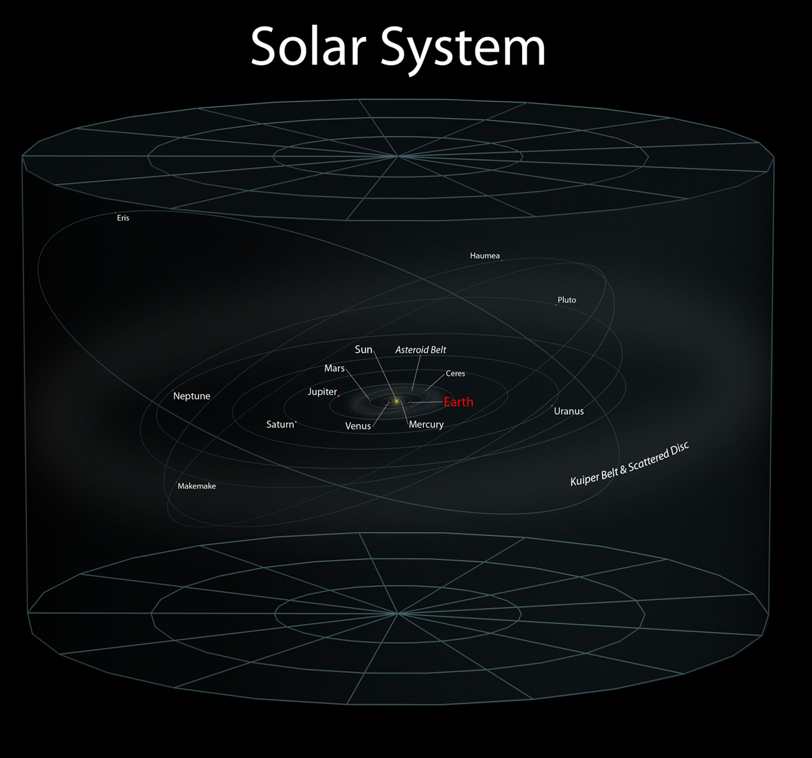
in a “sólər sɪ́stəm”

Slide 32
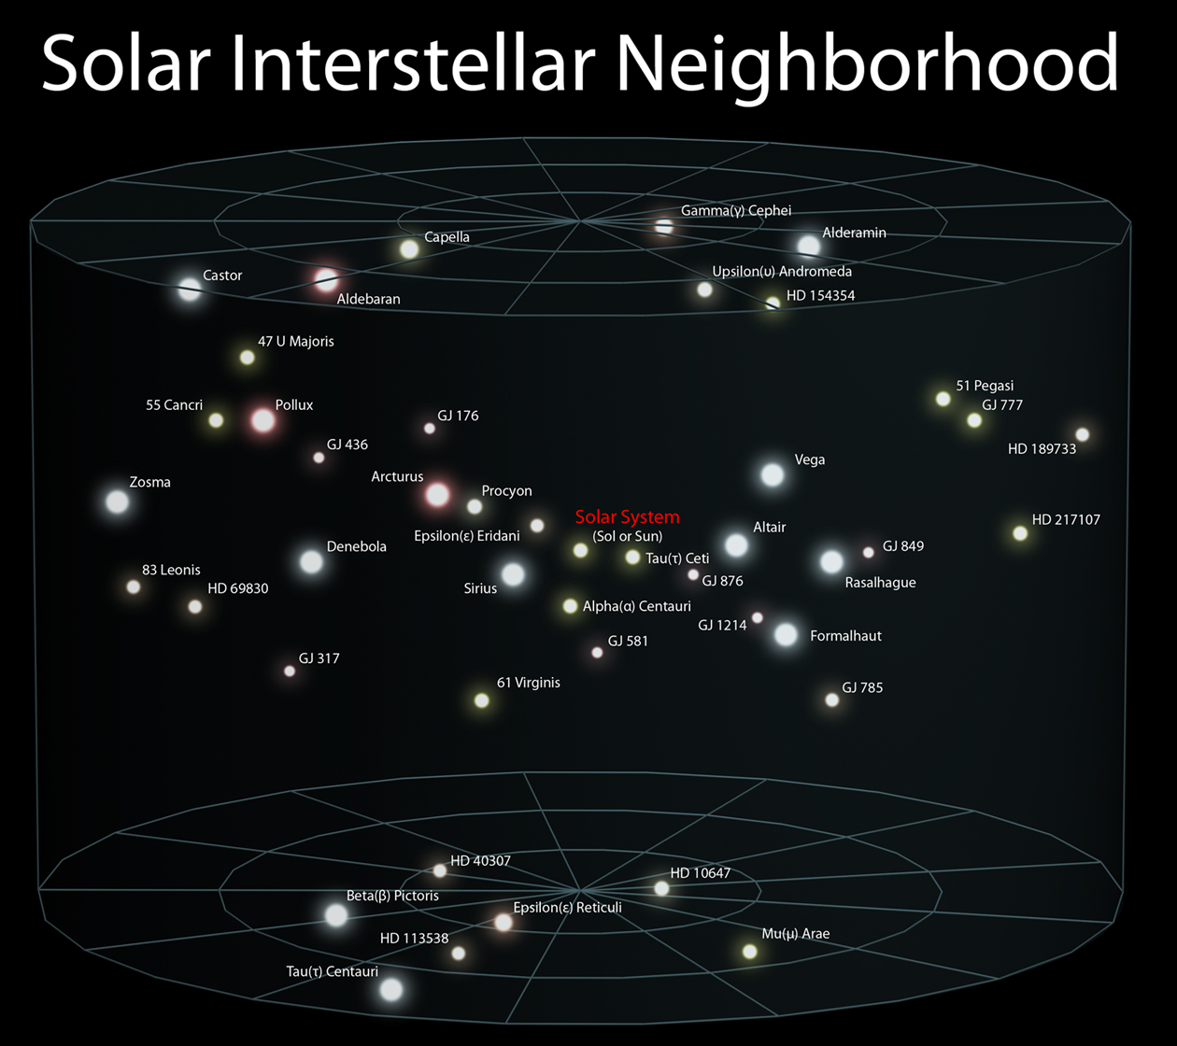
in a “sólər ɪ̀ntərstɛ́lər nébərhʊ̀d”

Slide 33
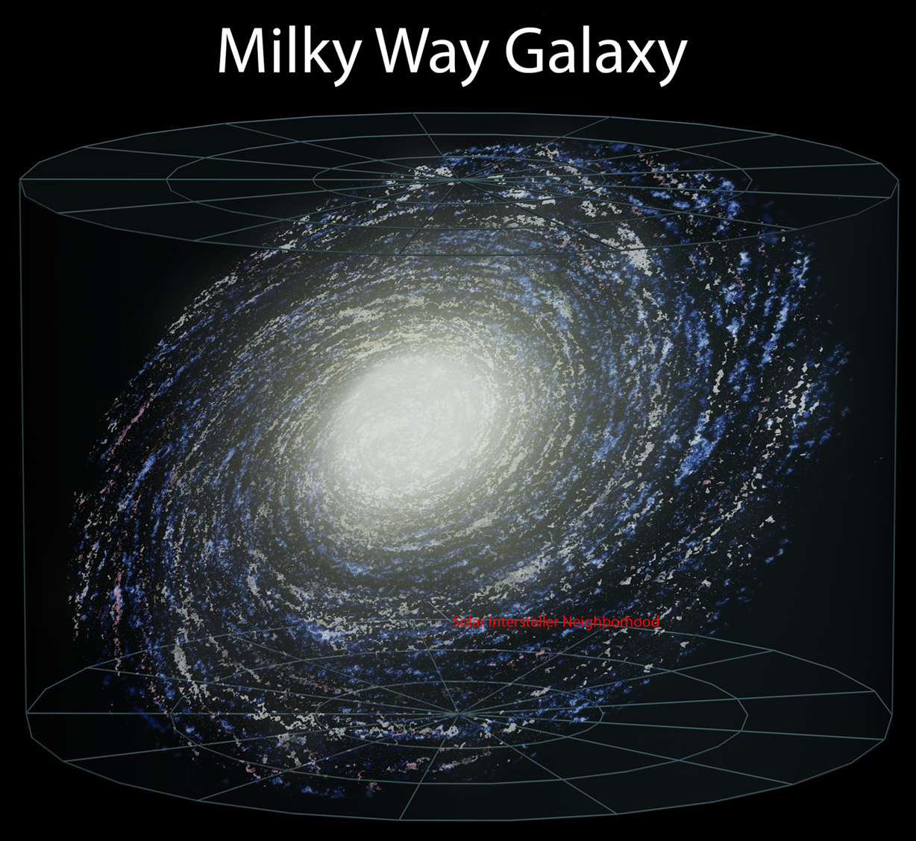
on the “ɑ́rm” of a “gǽləksi”

Slide 34
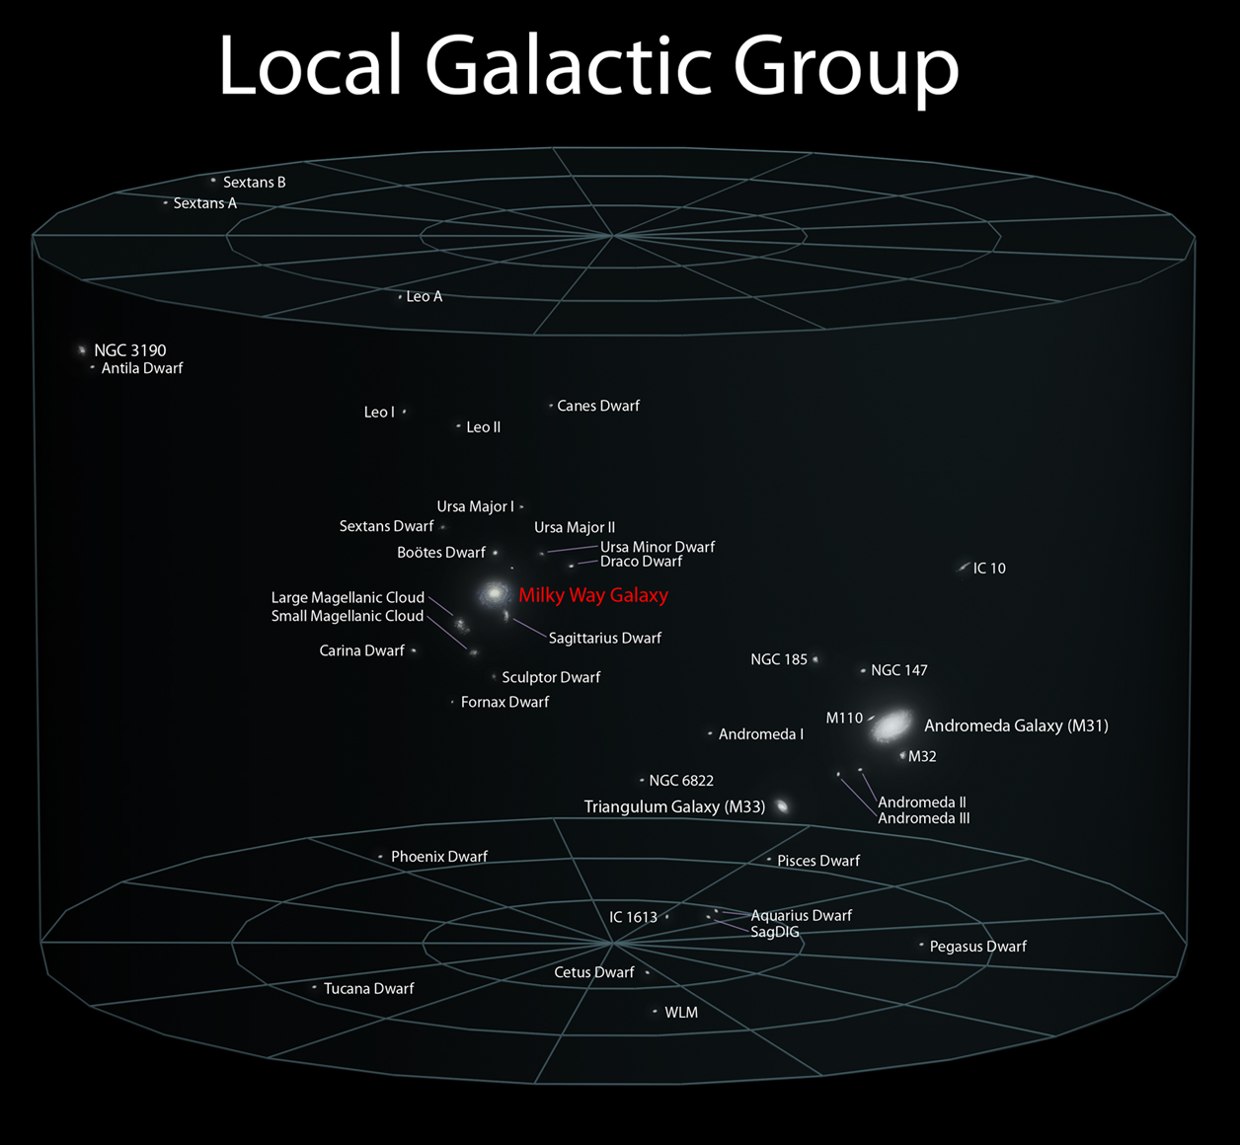
In a “lókəl gəlǽktɪk grúp”

Slide 35
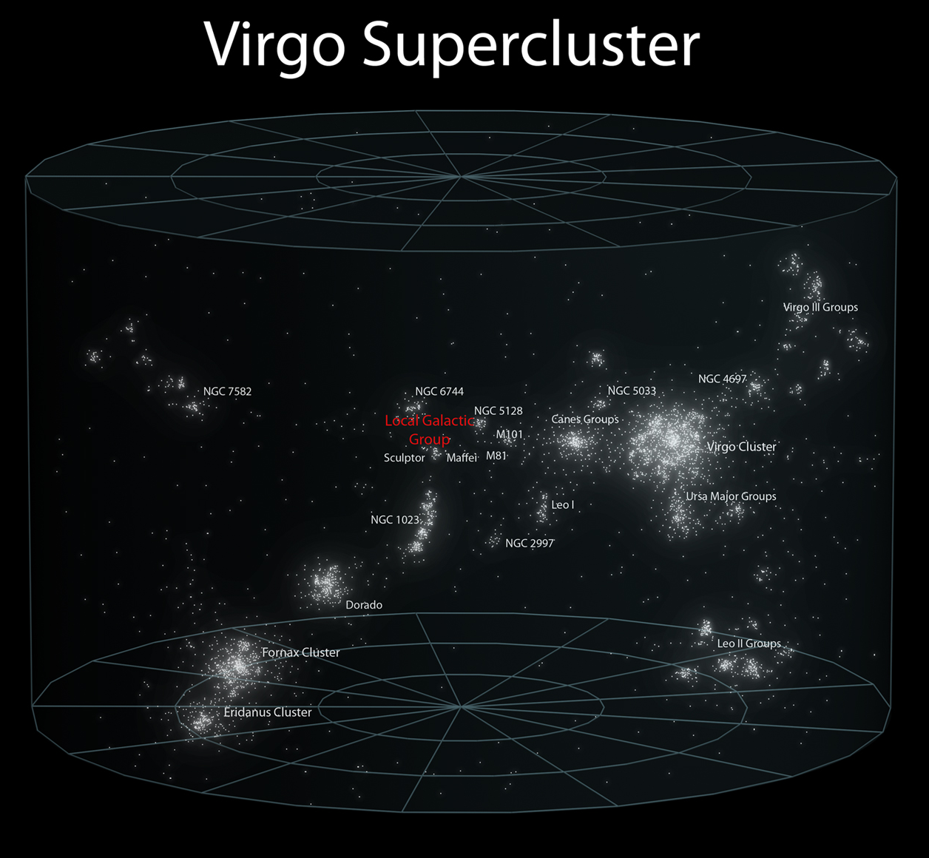
In a “súpər-klə́stər”

Slide 36
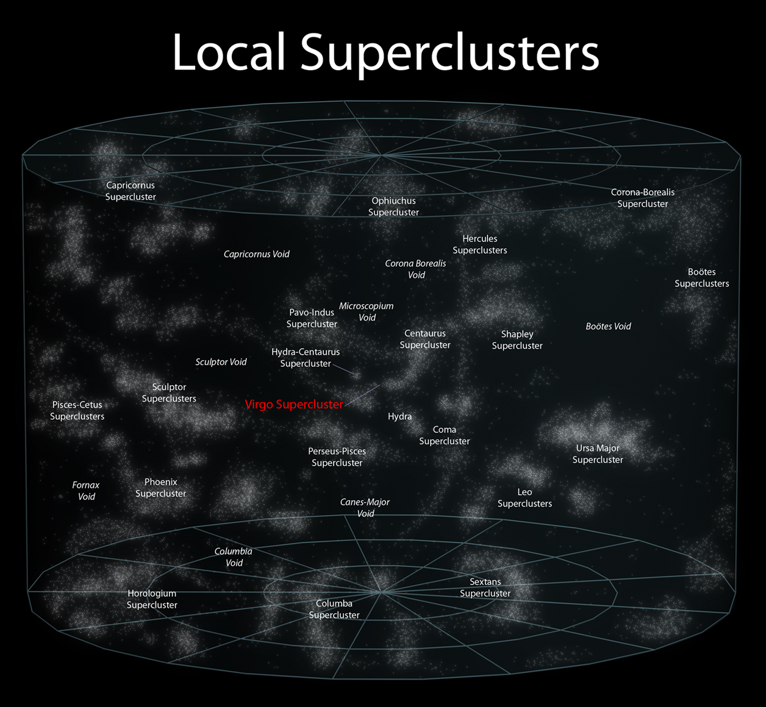
By other “súpər-klə́stərs”

Slide 37
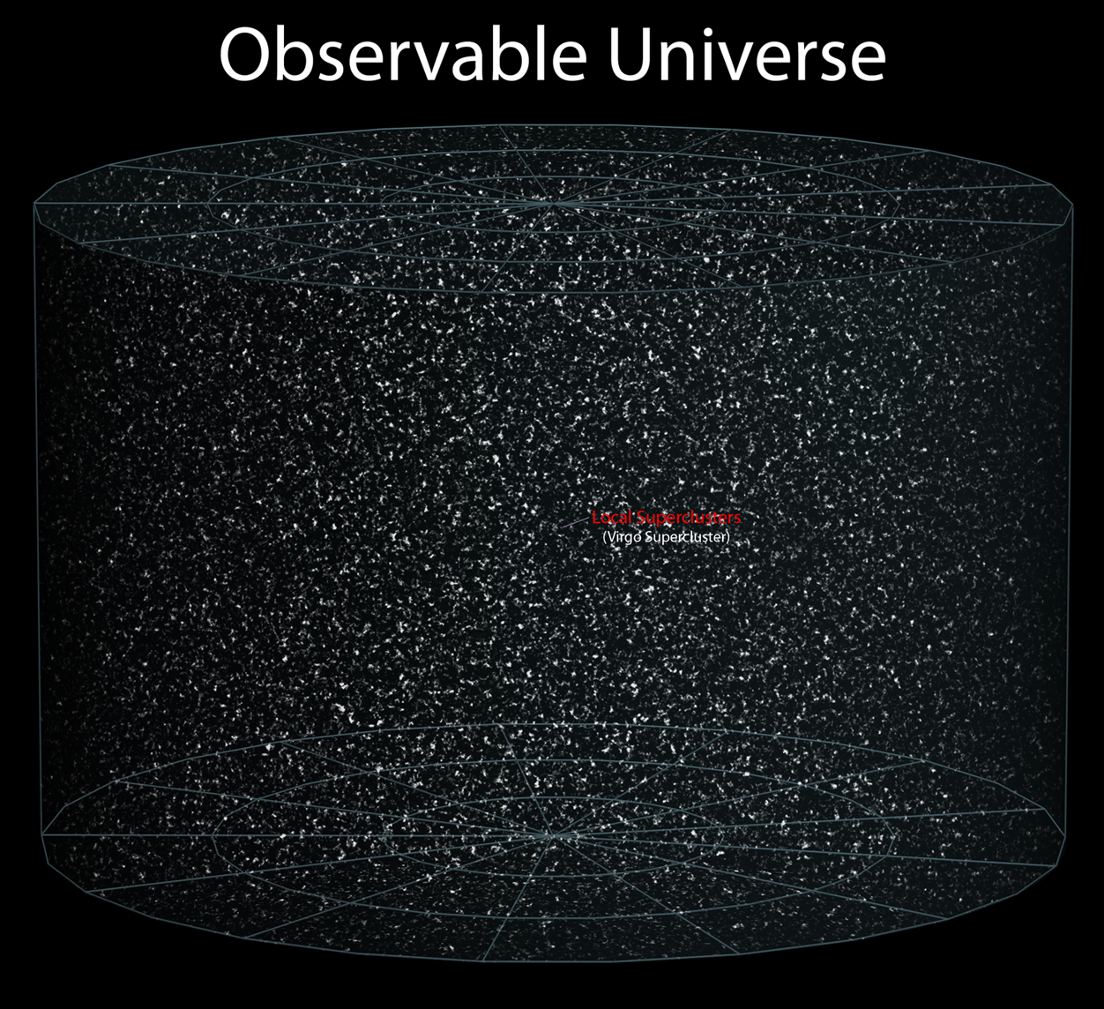
In an “əbzə́rvəbəl júnɪvə̀rs ”

Slide 38
Source Slides

Slide 39
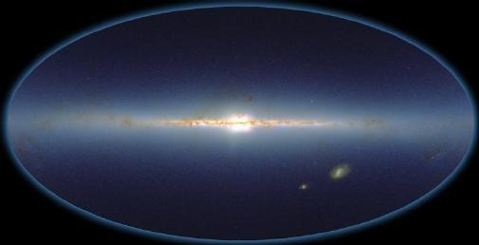
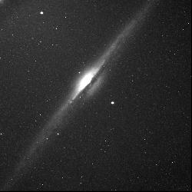
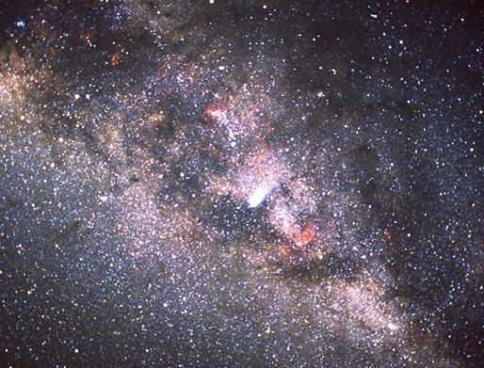
How do we know it’s spiral?
The milky way
NGC 4565
Detailed studies of the motions of interstellar gas clouds fills in this picture considerably by letting us plot the locations and speeds of these clouds, and in most versions of these studies, a distinct spiral pattern emerges.
Using our knowledge of the shapes of other galaxies, we easily conclude it must be a version of a spiral-type galaxy

Slide 40
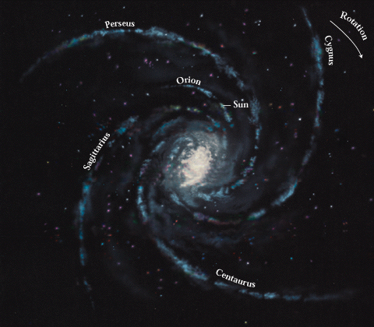
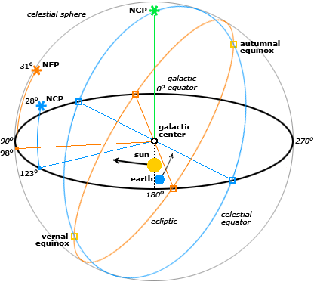
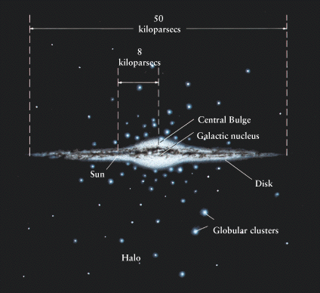
Position of the Sun in the Milky Way
Its position was found by measuring distances to the globular star clusters that orbited about the center of the Milky Way.
Variable stars were used to find the distances.

