Slide 1
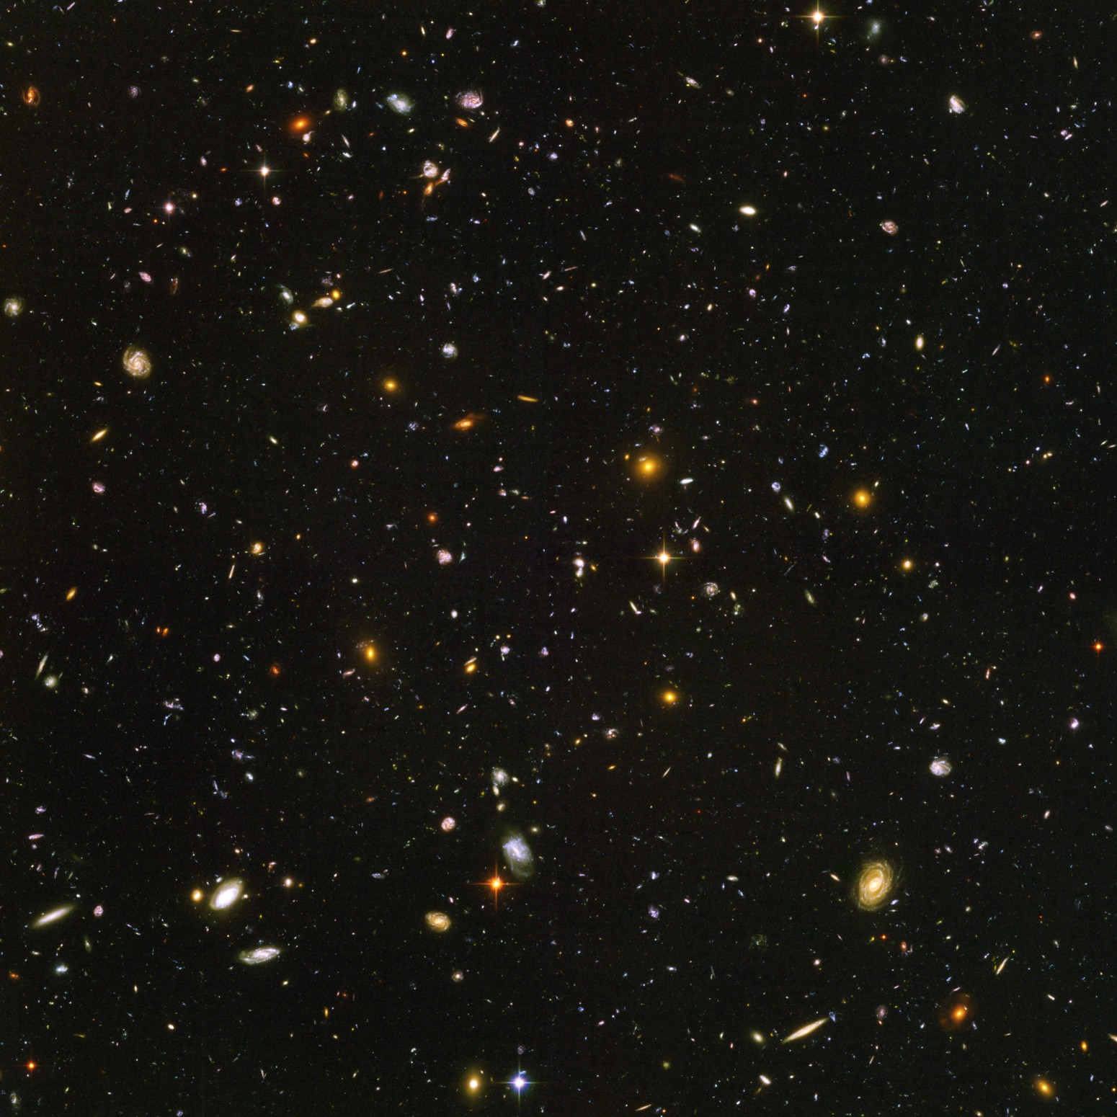
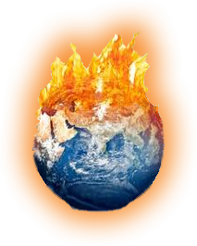
Climate and space quiz

Slide 2
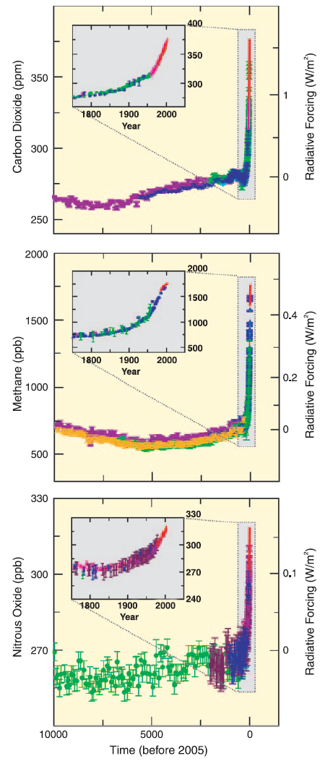
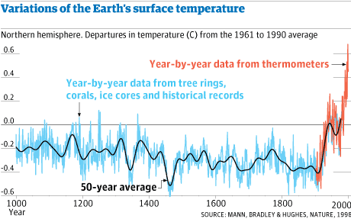
What are these famous graphs called?

Slide 3
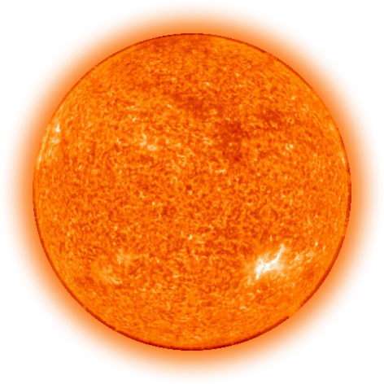
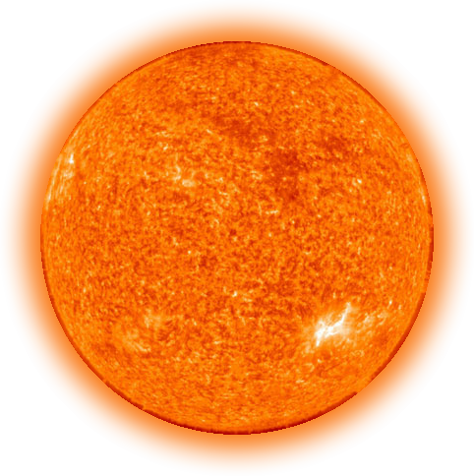
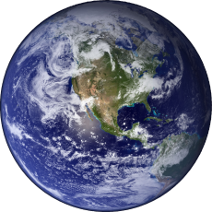
Name one natural cause of climate change

Slide 4
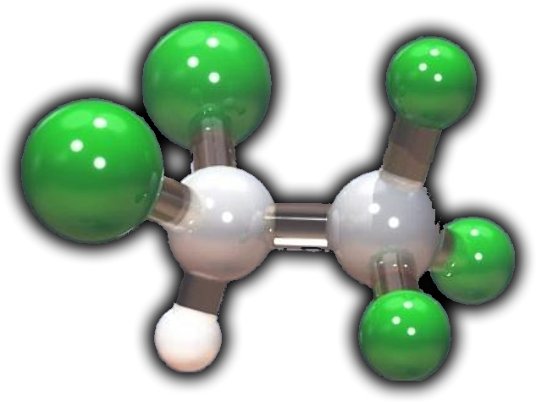
What’s the main problem with Chlorofluorocarbons?
CFC-11 and CFC-12
They absorb the earth’s in the upper atmosphere
High toxicity forces waste management solutions that are costly and emit greenhouse gases
They are light molecules that emit gamma-rays that poison and mutate ocean life
They rise up into the stratosphere and break apart from high solar radiation exposure causing a depletion in the ozone layer

Slide 5

The hockey stick graph!
“The hockey stick controversy”
Mann, M. E.; Bradley, R. S.; Hughes, M. K. (1998). Nature 392 (6678): 779–787. Bibcode 1998Natur.392..779M. doi:10.1038/33859
http://www.ipcc.ch/pdf/assessment-report/ar4/wg1/ar4-wg1-spm.pdf
United Nations Environnent Programme | World Meteorological Organization
“A report of Working Group I of the Intergovernmental Panel on Climate Change, Summary for Policymakers”, Figure SPM.1

Slide 6
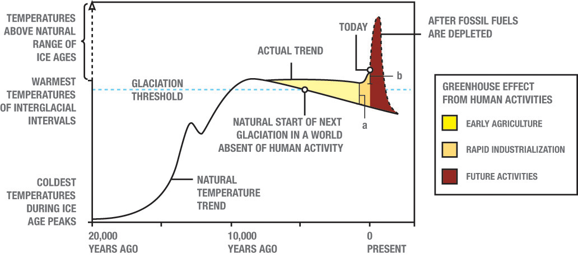
What time eras do the 3 colored regions represent?
1
2
3

Slide 7
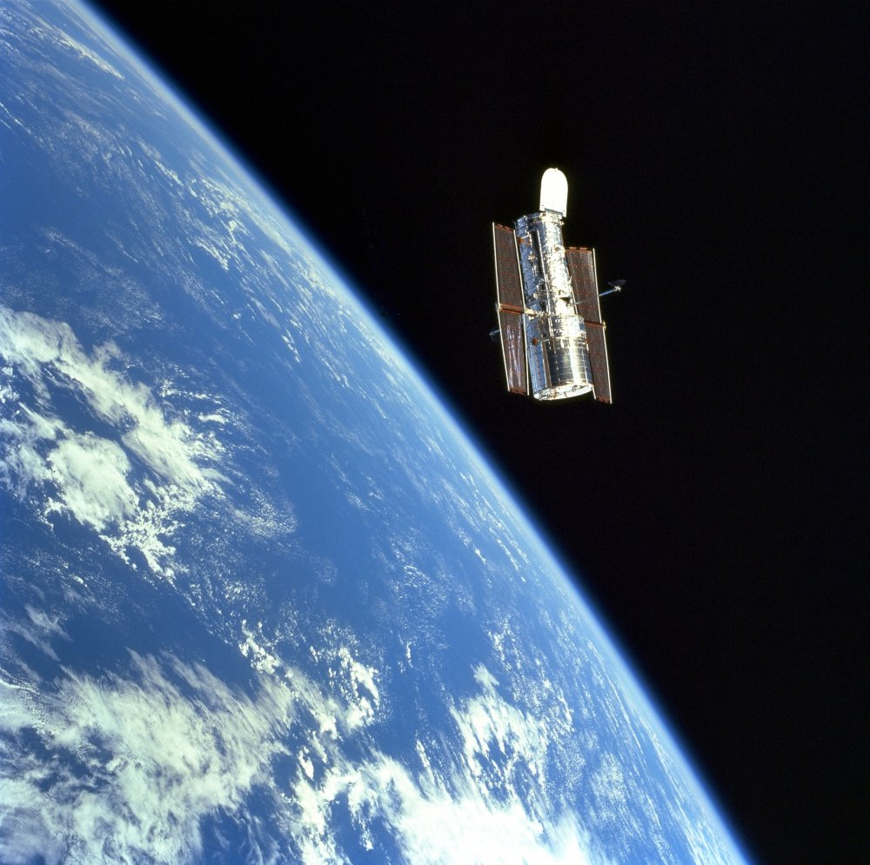
Why do optical telescopes work better when they are in space?

Slide 8
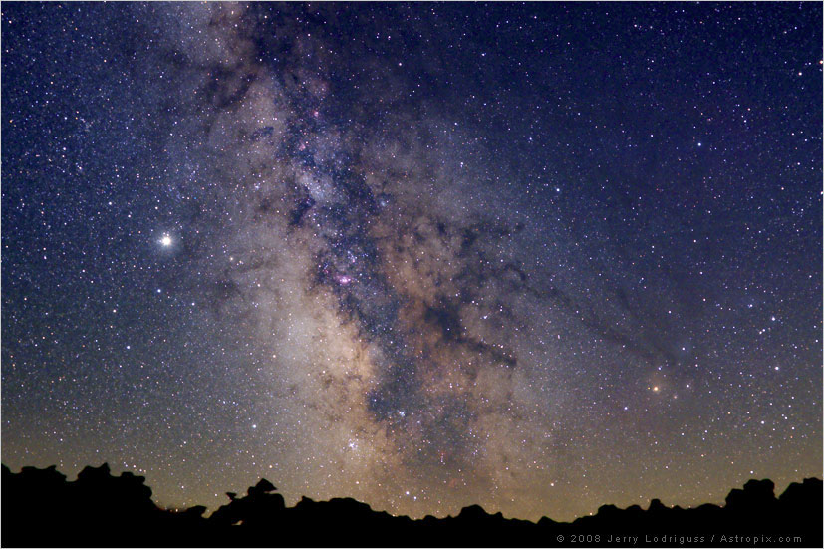
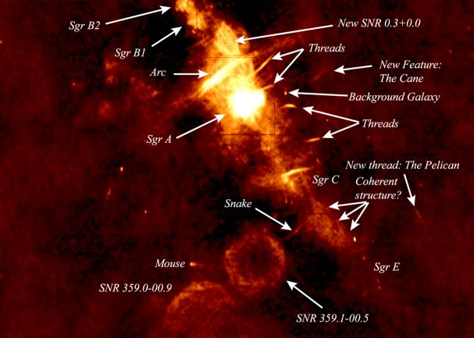
What part of the electromagnetic spectrum allows us to look into the center of the Milky-Way?

Slide 9
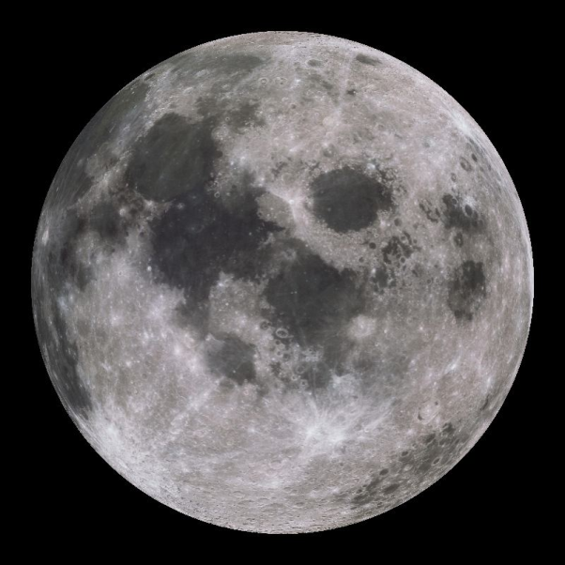
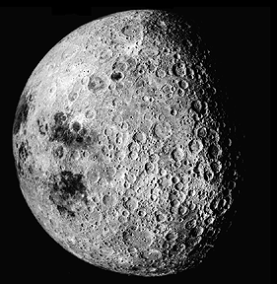
What is true about the moon?
We always see the same side
Its orbital period is the same as the Earth’s about the sun
It rotates around its own axis faster than it orbits Earth
It is not in hydrostatic equilibrium
The temperature ranges from 90 to 370 Fahrenheit.

Slide 10
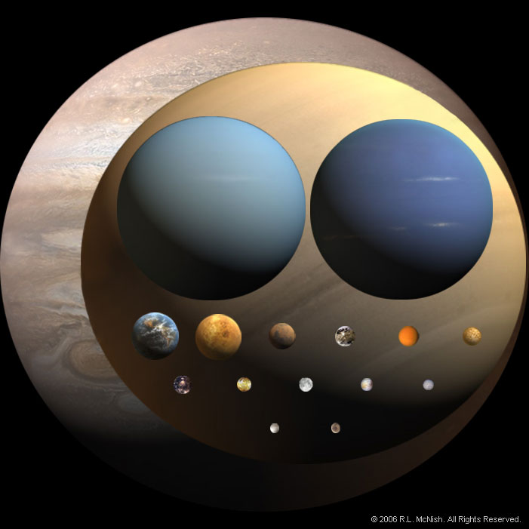
Come up with your own mnemonic acronym device to memorize the planets

Slide 11
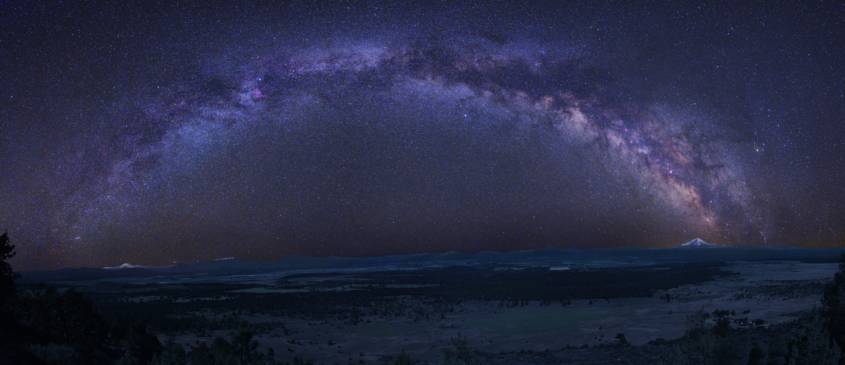
Name one method used to measure astronomical distances.

Slide 12
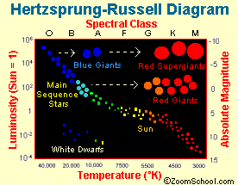
Quiz: Three main sequence stars have different colors, but the same brightness. Which one is closest to the Earth?
The bluest one
The reddest one
The yellowest one
Impossible to tell from color

Slide 13
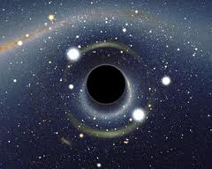
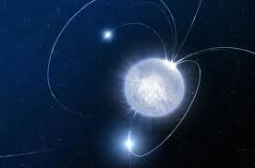
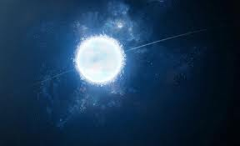
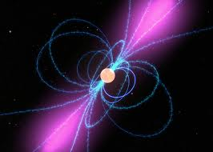
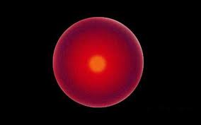
A very massive star (more than 10 times the size of our sun) becomes what at the very end of its life?
Black hole
Neutron star
White dwarf
Pulsar
Red giant

Slide 14
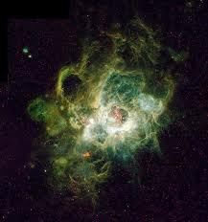
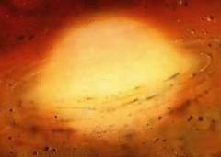
According to the currents models of stellar evolution, our sun will eventually become a
Cloud of hydrogen gas
Protostar
Neutron star
Black hole
White dwarf

Slide 15
Why does fusion stop at Iron?
10
Elements lighter than iron undergo fission.
There is an energy density limit of the fundamental forces
Elements heavier than iron do undergo fusion.
Average nucleon mass
0
of
5
Fe
Atomic mass number
Answer Now

Slide 16
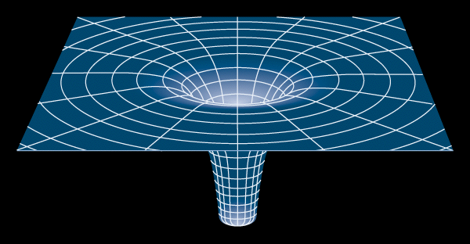
Name one piece of experimental evidence in support of general relativity.

