Slide 1
Logistics
7th
14th
21st
Global Warming and Space
Cosmology and Final Review
Final 9am-11am

Slide 2
Rules for final
You can bring in extra credit the day of the final
Same format as midterm
30 multiple choice(scantron)
20 short answer
Open nothing
Half of the question will be from the midterm

Slide 3
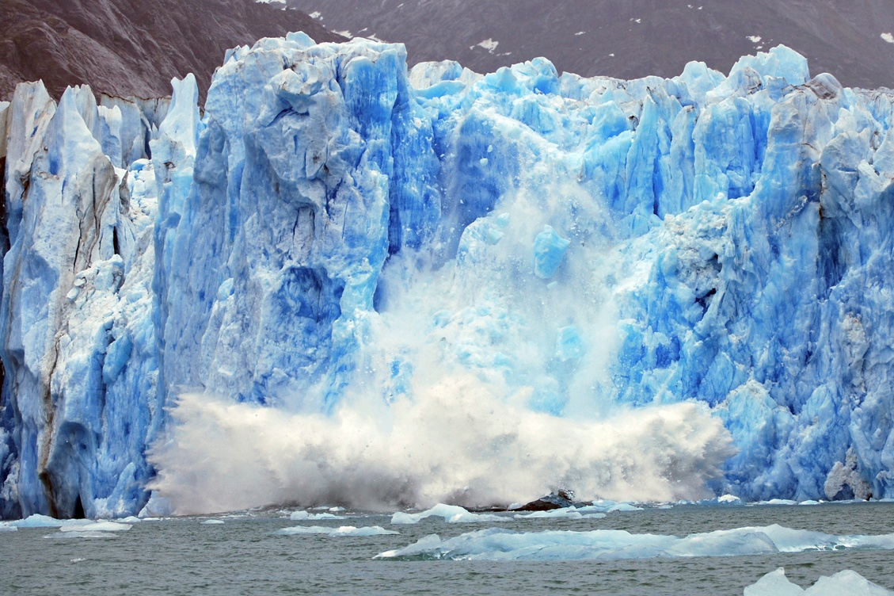
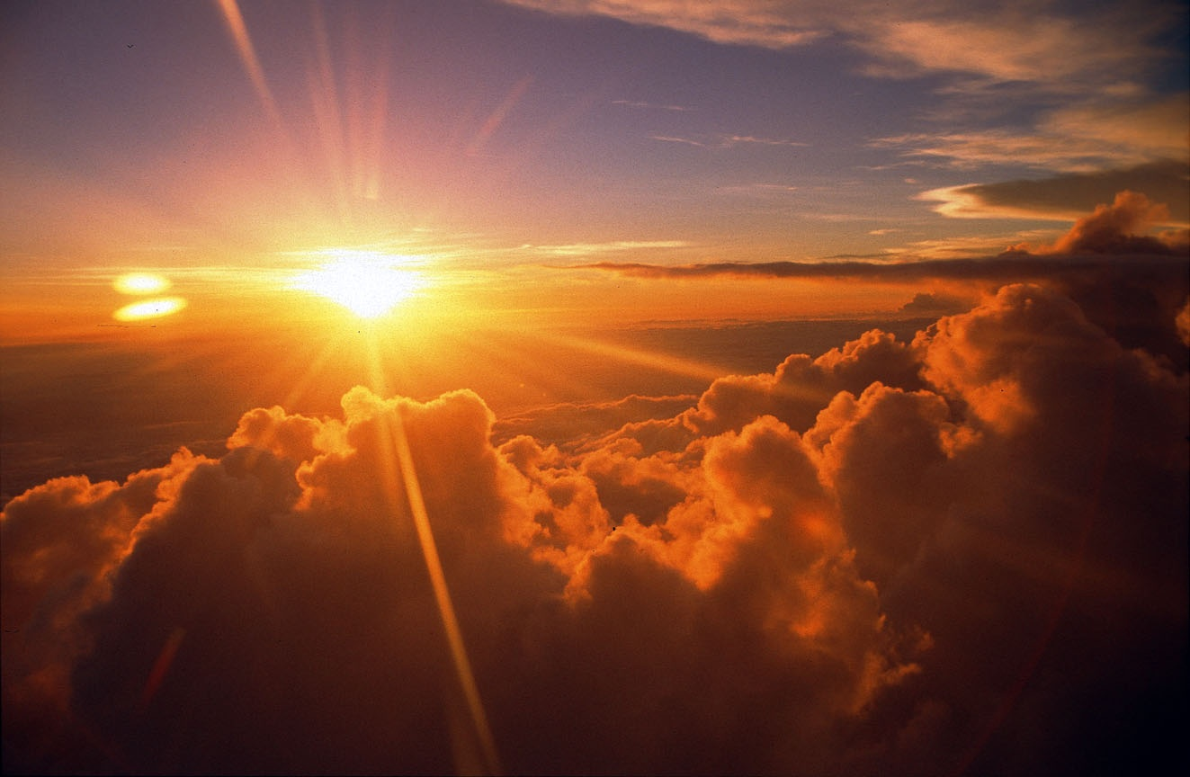
Global warming

Slide 4
Which best describes your opinion on global warming?
This is just political hype. No action is needed.
We should wait until the models are better before we do anything.
I’d like beachfront property in Utah. Do nothing and party on!
We should invest the $billions needed to find ways to reduce greenhouse gas emissions.
We are already in danger. We should immediately stop driving cars!
0

Slide 5
Natural causes(a.k.a. forcings, drivers)
Known drivers of past climate change include:
Changes in the Earth's orbit
Changes in the sun's intensity
Volcanic eruptions
Aerosol emissions
Carbon dioxide emissions
These climate change drivers trigger other drivers:
Changes in greenhouse gas concentrations – heat the ocean/release CO₂
Changes in ocean currents – large unexpected regional climate changes
http://epa.gov/climatechange/science/pastcc.html#ref

Slide 6
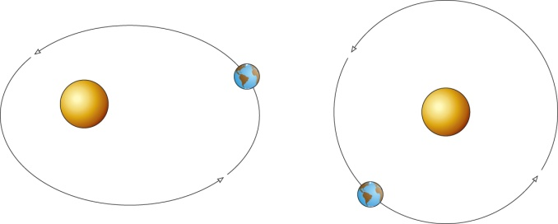
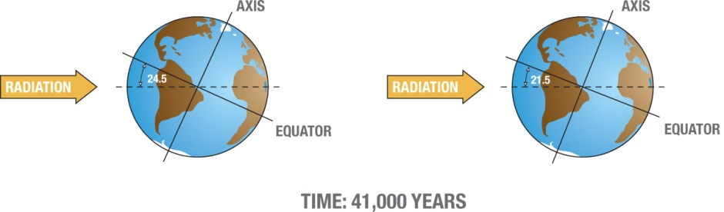
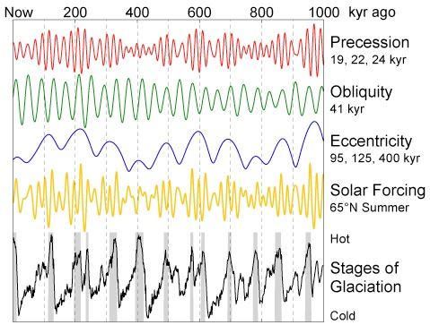
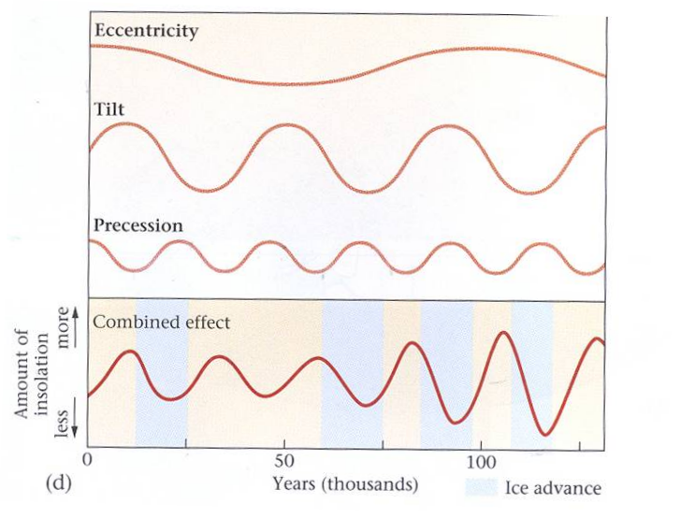
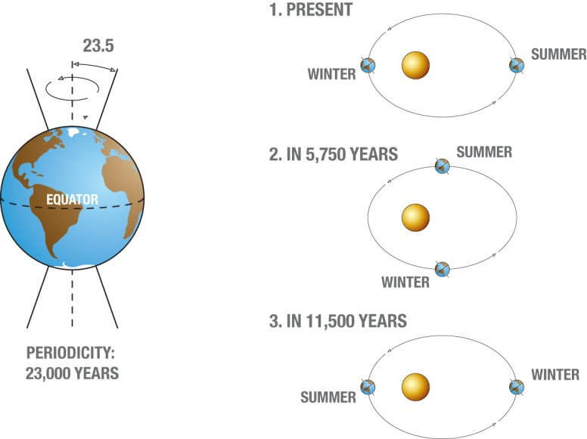
Natural driver - Changes in the Earth's orbit
Milankovitch Cycles
Eccentricity (100,000 yr cycle) (.005 to 0.058) currently .017
Tilt(41,000 yr cycle) (22.1 and 24.5) currently 23.44 and decreasing
Precession(23,000 yr cycle)
http://www.eoearth.org/article/Milankovitch_cycles

Slide 7
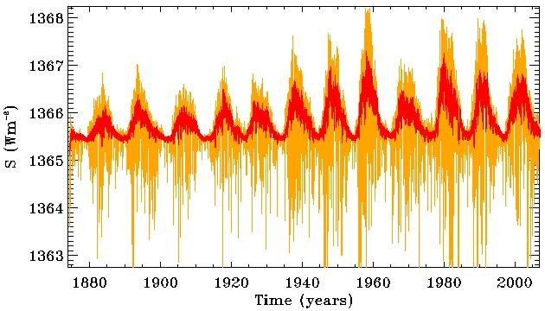
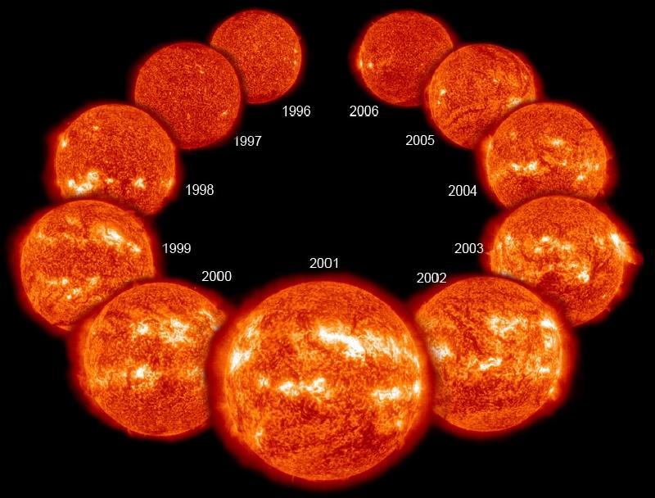
Natural driver - Changes in the sun's intensity
The intensity of the Sun varies along with the 11-year sunspot cycle.
NASA/GSFC/Steele Hill
Goddard Space Flight Center
http://glory.gsfc.nasa.gov/overview-tsi.html

Slide 8
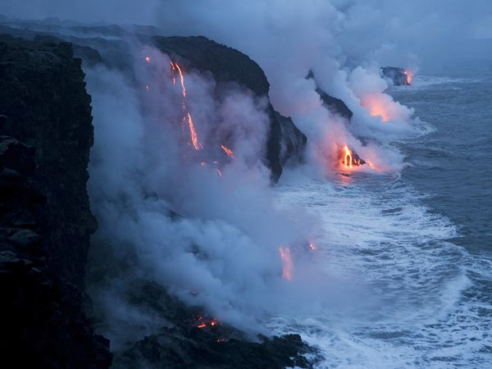
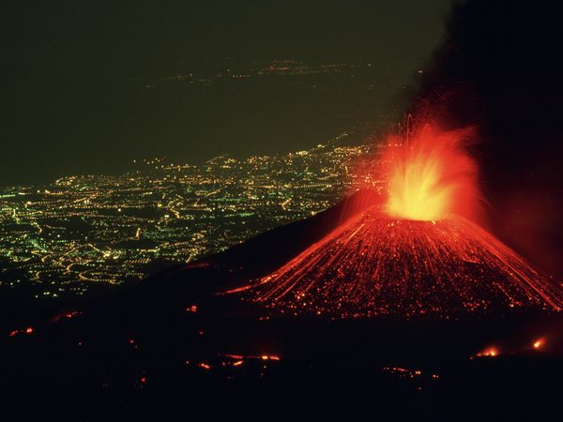
Natural driver – Aerosol and Carbon dioxide emissions
Left: Lava Flowing Into the Pacific
Photograph by Stephen Alvarez, National Geographic
With a hiss of steam, lava flows into the Pacific Ocean in Hawaii Volcanoes National Park, Hawaii. Similar flows of molten rock have built up the Hawaiian islands over the course of more than 70 million years.
Left: Mount Etna, Italy
Photograph by Carsten Peter, National Geographic
Perched above the lighted city of Catania, Italy, Mount Etna hurls a fountain of fire skyward as rivers of lava spill down its flanks. In spite of its dazzling displays, Mount Etna is a relatively safe volcano with rare, compact eruptions and slow-flowing lava that gives people a chance to escape.
http://environment.nationalgeographic.com/environment/photos/volcano-general/

Slide 9
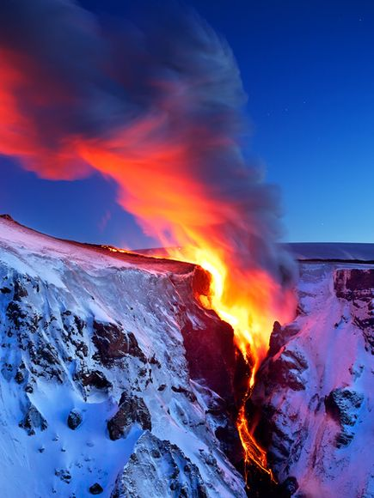
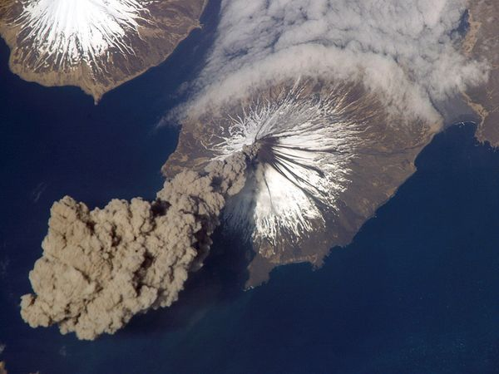
Natural driver - Aerosol and Carbon dioxide emissions
Left: Lava Falls
Photograph by Snorri Gunnarsson
Lava flows into a valley in southern Iceland near the Eyjafjallajökull volcano.
Above: Cleveland Volcano, Alaska
Photograph courtesy NASA Earth Observatory
Cleveland Volcano releases a plume of ash that rises almost 20,000 feet (6,000 meters) above the North Pacific Ocean in this aerial photograph. Cleveland Volcano, located in the Aleutian Islands southwest of Alaska, failed to produce an eruption and the plume of ash detached from the volcano two hours after it formed.
http://environment.nationalgeographic.com/environment/photos/volcano-general/

Slide 10
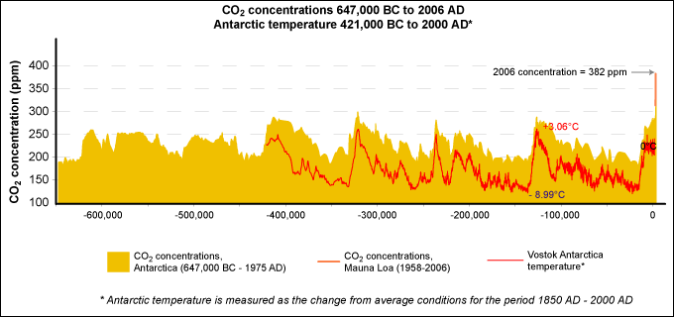
Evidence of climate change history
http://epa.gov/climatechange/science/pastcc_fig1.html
Ice cores are unique with their entrapped air inclusions enabling direct records of past changes in atmospheric trace-gas composition.
Carbon Dioxide Information Analysis Center | DOE's Oak Ridge National Laboratory | World Data Center for Atmospheric Trace Gases
http://cdiac.ornl.gov/trends/co2/siple.html
National Climatic Data Center | National Oceanic and Atmospheric Administration
ftp://ftp.ncdc.noaa.gov/pub/data/paleo/icecore/antarctica/vostok/deutnat.txt

Slide 11
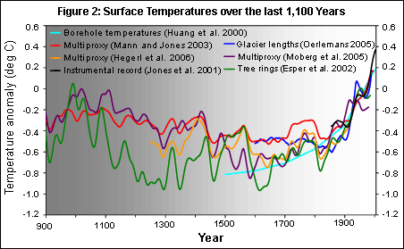

The hype
The concern is the possible anthropogenic impact
Medieval Climate Anomaly
The little ice age
Industrial era
Environmental Protection Agency | National Research Council, 2006. (Figure reprinted with permission from Surface Temperature Reconstructions© (2006) by the National Academy of Sciences, Courtesy of the National Academies Press , Washington, D.C.)
http://epa.gov/climatechange/science/pastcc.html

Slide 12
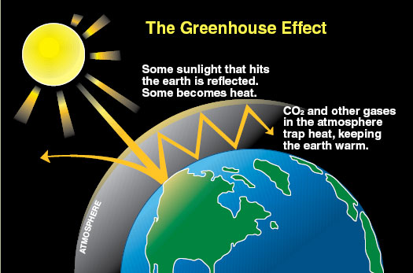


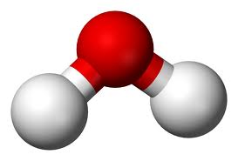
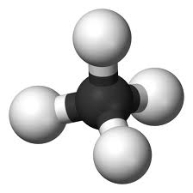

Trapping solar radiation in the atmosphere
some greenhouse gases
Carbon Dioxide
Ozone
Diatomic Oxygen
Water
Methane

Slide 13
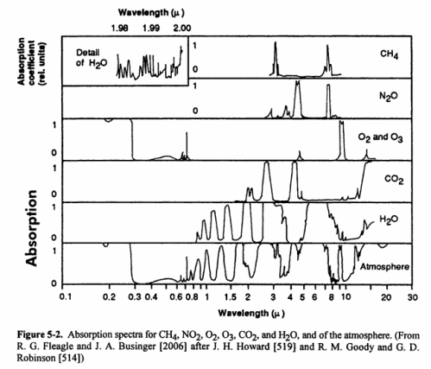

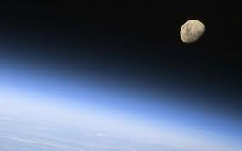
Spectral absorption data of common greenhouse gases
+
Water vapor | H₂O | 36 – 72 %
Carbon dioxide | CO₂ | 9 – 26 %
Methane | CH₄ | 4 – 9 %
Ozone | O₃ | 3 – 7 %

Slide 14
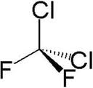
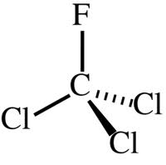

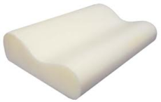
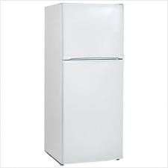
Indirect problems - Chlorofluorocarbons
CFC-11 and CFC-12
they are very stable compounds
means very low toxicity and very low flammability
gases at normal room temperatures and pressures
can be liquefied by putting them under pressures just slightly above normal pressures
CF₂Cl₂.
useful:
propellants in aerosol cans
solvents
expansion gases in the production of foams
the heat-exchanging fluid in air conditioners
the working fluid in refrigerators
CFCl₃

Slide 15



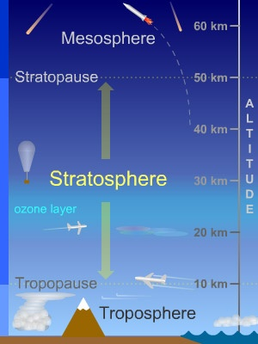
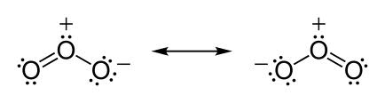
Problems when they rise up in the sky
215nm photons break the chlorine-carbon covalent bond liberating a chlorine atom
Cl
Cl
Cl+ O₃ ClO+ O₂
Depletion of ozone!

Slide 16
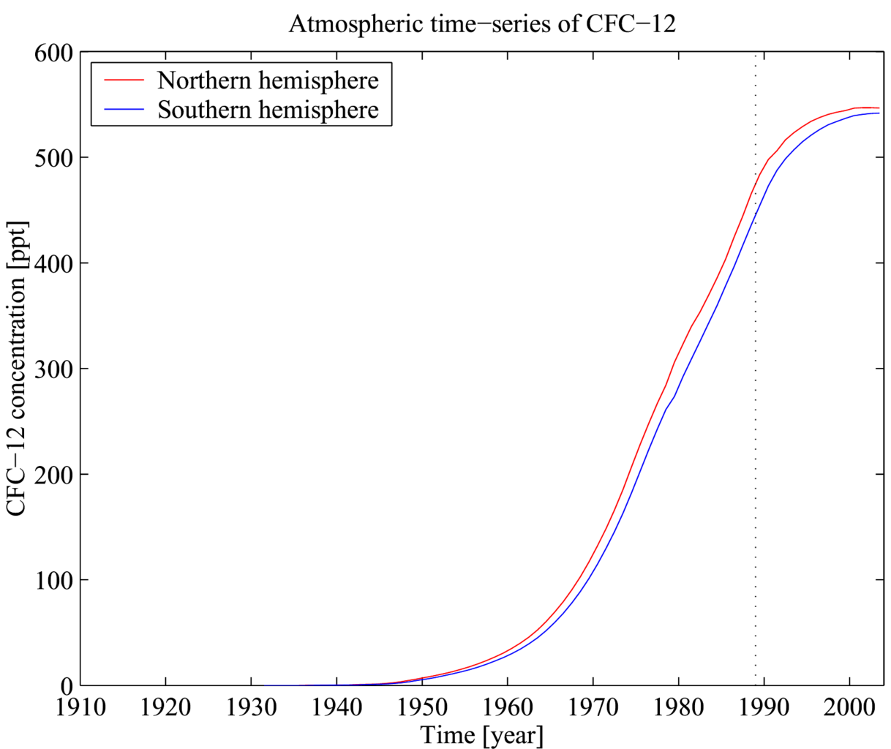
History of Chlorofluorocarbon concentration
Walker, S. J., R. F. Weiss & P. K. Salameh (2000) Reconstructed histories of the annual mean atmospheric mole fractions for the halocarbons CFC-11, CFC-12, CFC-113 and carbon tetrachloride. Journal of Geophysical Research 105, 14285—14296.

Slide 17
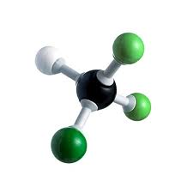
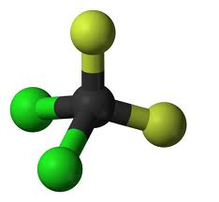
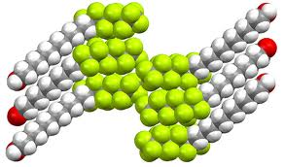
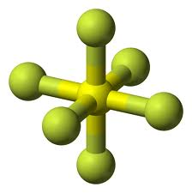
Dichlorodifluoromethane(Freon)
Global warming potential*
GWP
Carbon-dioxide
1
Methane
21
Nitrous Oxide
310
Chlorodifluoromethane
125
132
6500
Perfluorocarbons
Sulfur hexafluoride
23,900
*for 100 year time-horizon
GRID-Arendal | United Nations Environment Programme http://www.grida.no
Notes:
Perfluorocarbon derivatives can function as fluoropolymers, refrigerants, solvents, anesthetics, fluorosurfactants, and ozone depletors.

Slide 18
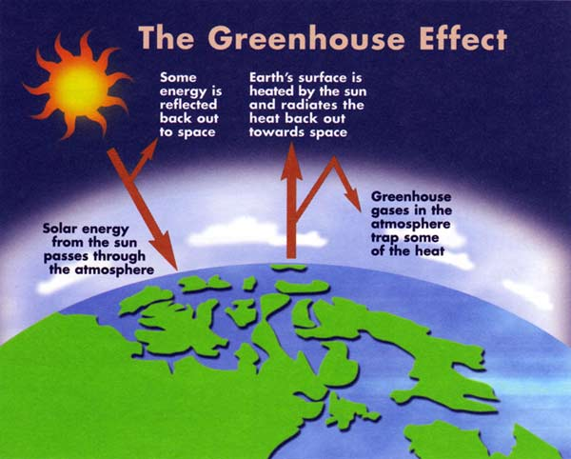
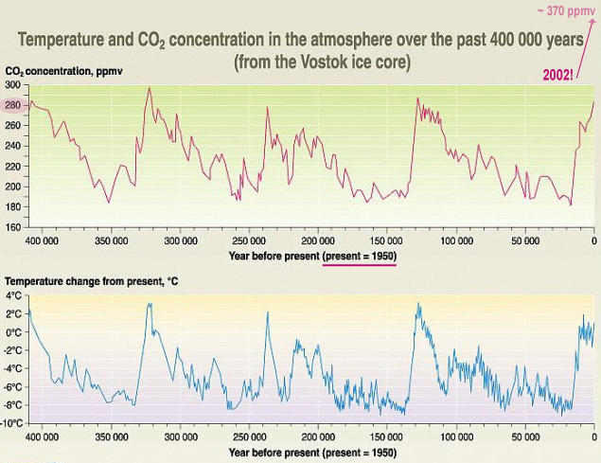
Let’s research one thing – the correlation between temperature and CO₂
So does temperature drive CO₂ or does CO₂ drive temperature?
Yes.
GRID-Arendal | United Nations Environment Programme
J.R. Petit, J. Jouzel. et. al. Climate and atmospheric history of the past 420 000 years from the Vostok ice core in Antarctica, Nature 399 (3June), pp 429-436, 1999
http://www.grida.no/graphicslib/detail/temperature-and-co2-concentration-in-the-atmosphere-over-the-past-400-000-years_25ae

Slide 19
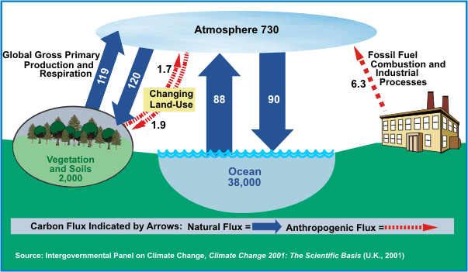
Carbon cycle
Earth System Research Laboratory | National Oceanic and Atmospheric Administration | U.S. Department of Commerce
http://www.esrl.noaa.gov/research/themes/carbon

Slide 20
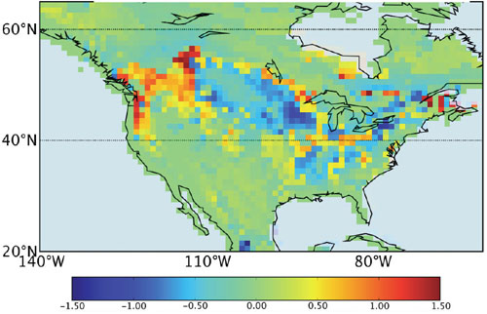
Sources and Sinks
Regions or processes that predominately produce CO₂ are called sources of atmospheric CO₂, while those that absorb CO₂ are called sinks.
North American CO₂ source and sink model
Earth System Research Laboratory | National Oceanic & Atmospheric Administration | U.S. Department of Commerce
http://www.esrl.noaa.gov/research/themes/carbon

Slide 21
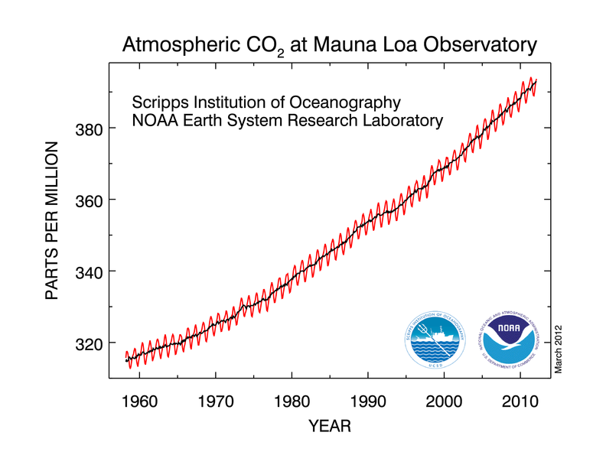
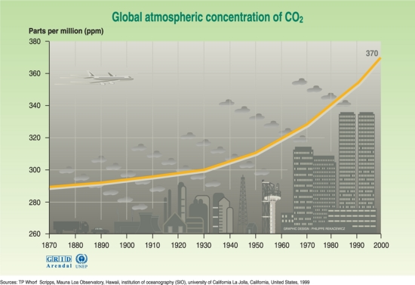
What do we know about the Carbon Cycle?
The amount of CO₂ in the atmosphere has been increasing globally since the onset of the industrial revolution.
Based on 50 years of direct observations of the atmosphere, it is clear that this trend continues and is accelerating.
Dr. Pieter Tans, NOAA/ESRL (www.esrl.noaa.gov/gmd/ccgg/trends/) and Dr. Ralph Keeling, Scripps Institution of Oceanography (scrippsco2.ucsd.edu/). Pieter.Tans@noaa.gov
GRID-Arendal | United Nations Environment Programme
http://www.grida.no/graphicslib/collection/vital-climate-graphics
Earth System Research Laboratory | National Oceanic and Atmospheric Administration | U.S. Department of Commerce
http://www.esrl.noaa.gov/research/themes/carbon
Notes:
Mauna Loa was originally chosen as a monitoring site because, located far from any continent, the air sampled is a good average for the central pacific. Being high, it is above the inversion layer where most of the local effects are present. There was already a rough road to the summit built by the military.

Slide 22
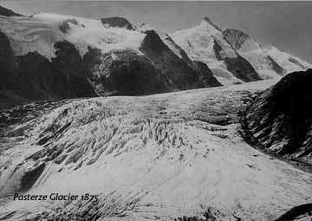
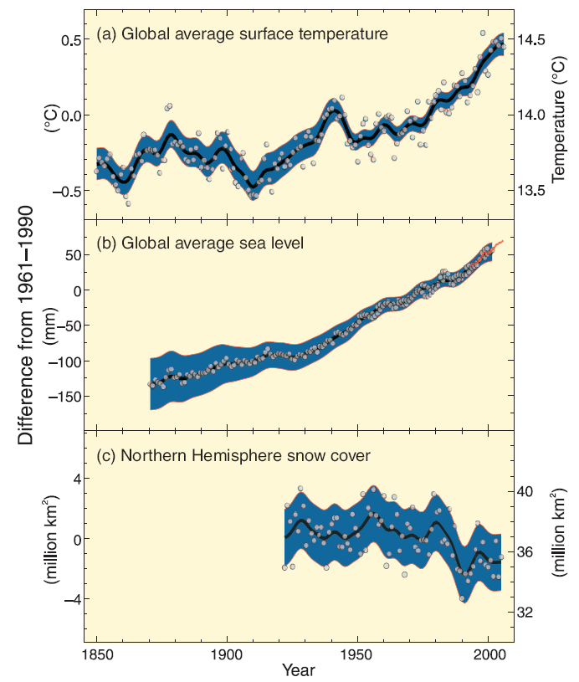
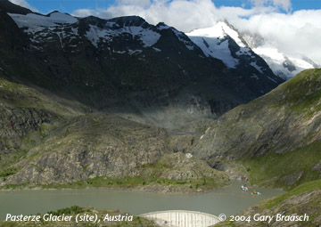
Pasterze Glacier, Austria
So what has been happening recently?
IPCC (Intergovernmental Panel on Climate Change) AR4 Synthesis Report
http://www.ipcc.ch/graphics/syr/spm1.jpg

Slide 23
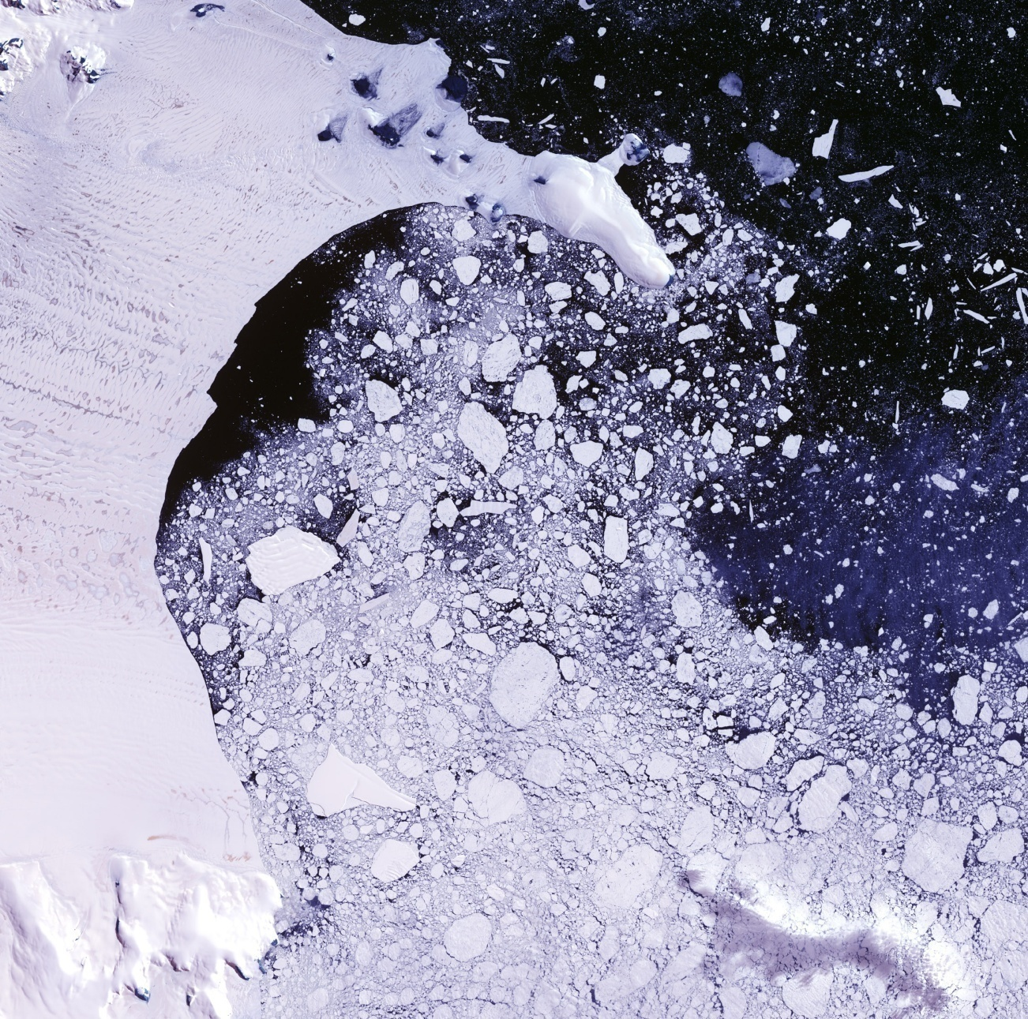
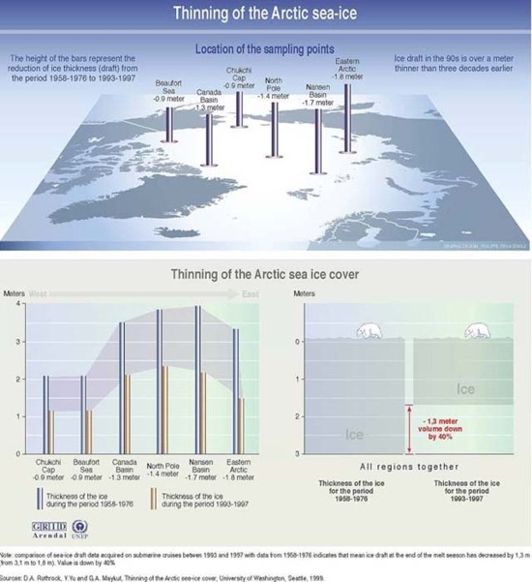
Antarctic Peninsula - Larsen Ice Sheet Breakup
More glaciers are receding than advancing today.
GRID-Arendal | United Nations Environment Programme
http://www.grida.no/graphicslib/collection/vital-climate-graphics
This photograph shows the break up of the Larsen Ice Shelf in 2001.
http://www.universetoday.com/52546/antarctica-pictures/

Slide 24
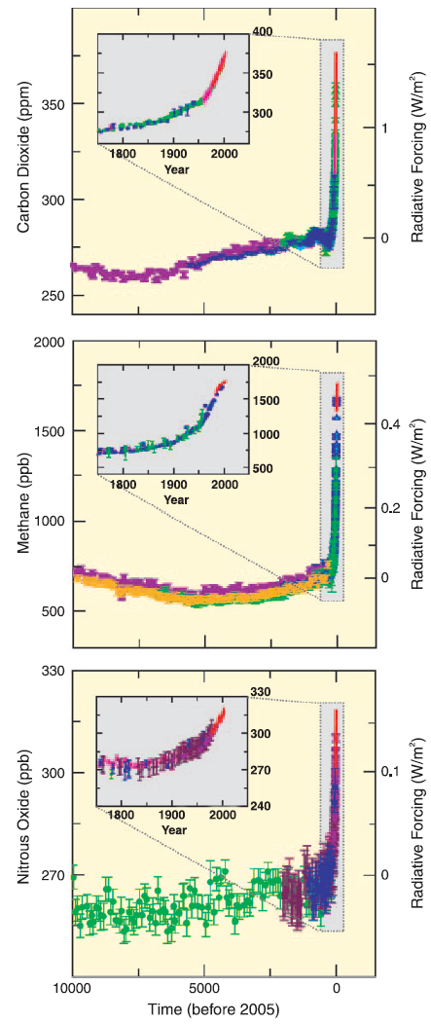
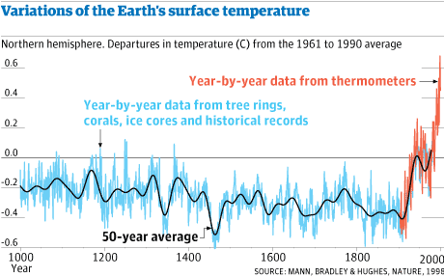

The hockey stick graph!
“The hockey stick controversy”
Mann, M. E.; Bradley, R. S.; Hughes, M. K. (1998). Nature 392 (6678): 779–787. Bibcode 1998Natur.392..779M. doi:10.1038/33859
http://www.ipcc.ch/pdf/assessment-report/ar4/wg1/ar4-wg1-spm.pdf
United Nations Environnent Programme | World Meteorological Organization
“A report of Working Group I of the Intergovernmental Panel on Climate Change, Summary for Policymakers”, Figure SPM.1

Slide 25
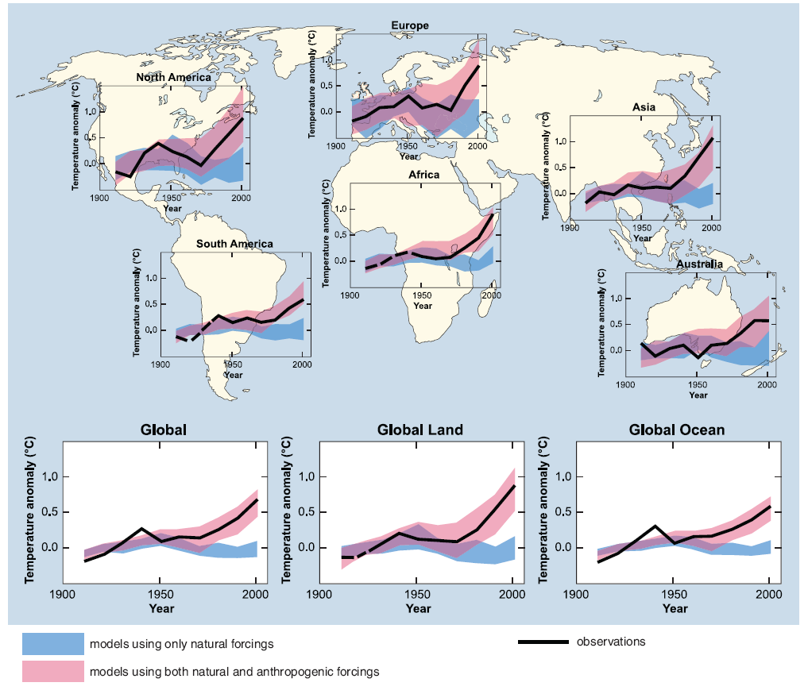
What do the current climate models tell us?
www.ipcc.ch/graphics/ar4-wg1/jpg/spm4.jpg
United Nations Environment Programme | World Meteorological Organization | Intergovernmental Panel on Climate Change
Contribution of Working Group I to the Fourth Assessment Report of the Intergovernmental Panel on Climate Change
Solomon, S., D. Qin, M. Manning, Z. Chen, M. Marquis, K.B. Averyt, M. Tignor and H.L. Miller (eds.).
Cambridge University Press, Cambridge, United Kingdom and New York, NY, USA, 996 pp.

Slide 26
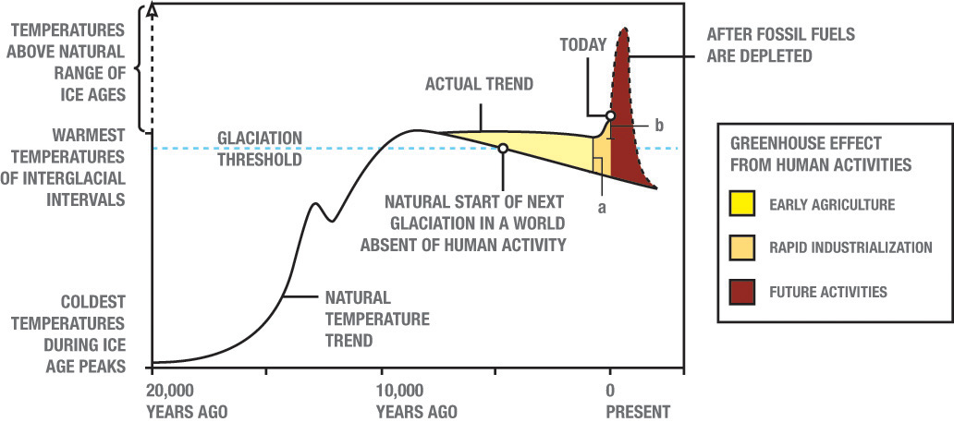
Should we do anything?
BYU Academic Publishing | Illustrations | Christopher Henderson
What exactly are we to do?

Slide 27
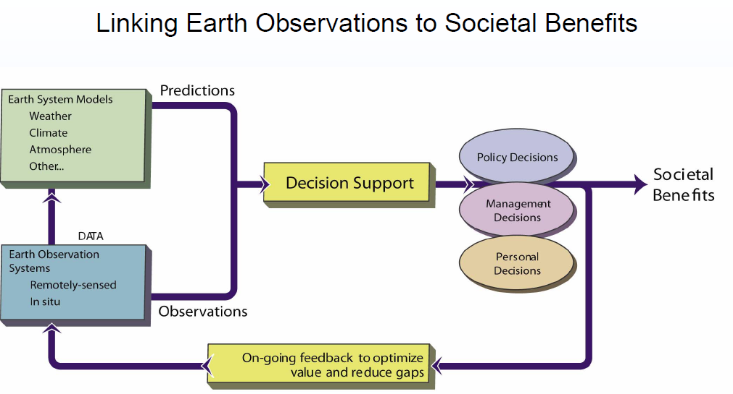
Complexity of the situation
United States Group Earth Observations
http://usgeo.gov/docs/EOCStrategic_Plan.pdf

Slide 28
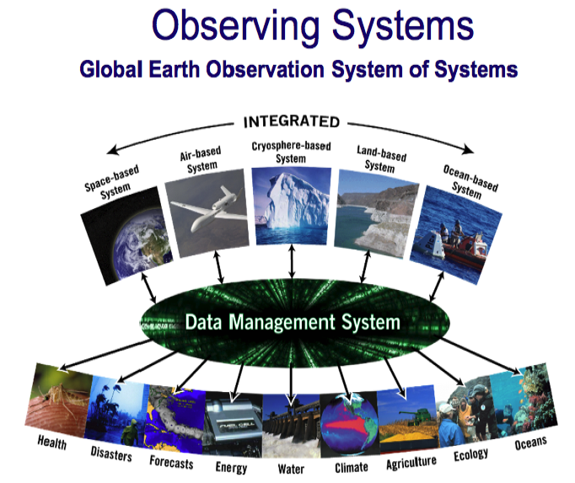
Fidelity of multi-disciplinary observations
Earth System Research Laboratory | National Oceanic and Atmospheric Administration
http://www.esrl.noaa.gov/

Slide 29
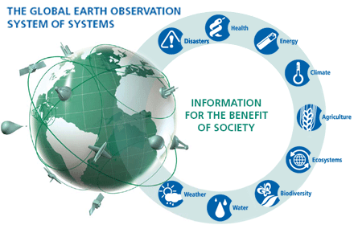
GEOSS is trying to help.
Developed in 2002 by eight leading industrialized countries
GEO is a voluntary partnership of governments and international organizations. As of March 2012, GEO’s Members include 88 Governments and the European Commission. In addition, 64 intergovernmental, international, and regional organizations with a mandate in Earth observation or related issues have been recognized as Participating Organizations.
Global Earth Observation System of Systems | United States Group Earth Observations
http://www.earthobservations.org/geoss.shtml

Slide 30

World societal benefits
Reducing loss of life and property from natural and human-induced disasters
Understanding environmental factors affecting human health and well-being
Improving the management of energy resources
Understanding, assessing, predicting, mitigating, and adapting to climate variability and change
Improving water resource management through better understanding of the water cycle
Improving weather information, forecasting and warning,
Improving the management and protection of terrestrial, coastal and marine ecosystems
Supporting sustainable agriculture and combating desertification
Understanding, monitoring and conserving biodiversity
Global Earth Observation System of Systems | United States Group Earth Observations
http://www.earthobservations.org/geoss.shtml

Slide 31
Which best describes your opinion on global warming?
This is just political hype. No action is needed.
We should wait until the models are better before we do anything.
I’d like beachfront property in Utah. Do nothing and party on!
We should invest the $billions needed to find ways to reduce greenhouse gas emissions.
We are already in danger. We should immediately stop driving cars!
0

Slide 32
END

Slide 33
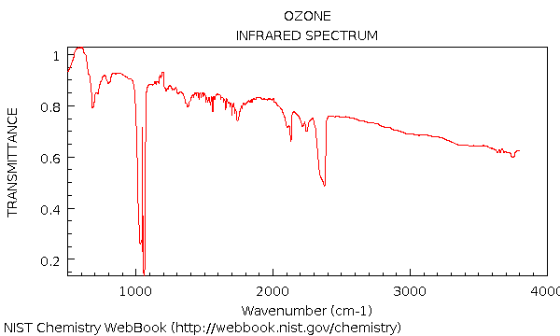



NIST sources

Slide 34

Even more problems

Slide 35




Source slides

Slide 36


