Slide 1
Survey of Physical Science PHSC-1000
Utah Valley University - Main Campus CRN -12453
Saturdays 10:45 am-01:15
Jan 07, 2012 - Apr 21, 2012
pm PS 005
Instructor: Tim G. Wendler (timoth500@yahoo.com)
Is this the class you thought it would be?

Slide 2
The Syllabus
Available on Canvas(the new Blackboard)
Can’t go there till tomorrow
Don’t worry all it has is the syllabus
Email me if you want the syllabus
timoth500@yahoo.com

Slide 3
Logistics
Each Saturday we..
Cover 2 or 3 chapters
Then take a quiz - you can use your notes
Homework
Due every Saturday before class
None assigned yet!

Slide 4
Grading
Quizzes (50%)
Homework due weekly (30%)
Written answers to questions from book, maybe involving short experiments.
Late submission receive half credit
Extra Credit is accepted
Ideas on Canvas
Optional math intensive problems
Final Exam (20%)

Slide 5
Introduction and how to get in touch of me
Tim Wendler
Office: Here
Office hours: After Class
Email: timoth500@yahoo.com

Slide 6
Let’s take that course pre-assessment test

Slide 7
Beginning the course…
Now

Slide 8
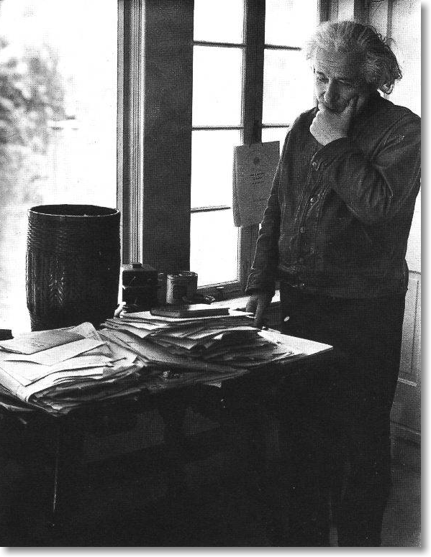
How do we really know anything?
Authority
Intuition
Reason
Sensory Data
The scientific method rests on sensory data and reason. However, we also recognize the role of authority and intuition in guiding our reasoning.

Slide 9
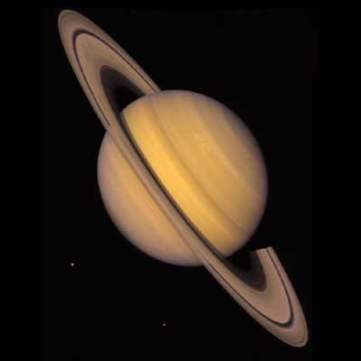
What Planet is this?
Jupiter
Earth
Mars
Saturn
Pluto

Slide 10
How do you know this planet is called Saturn
Authority
Intuition
Reason
Sensory Data

Slide 11
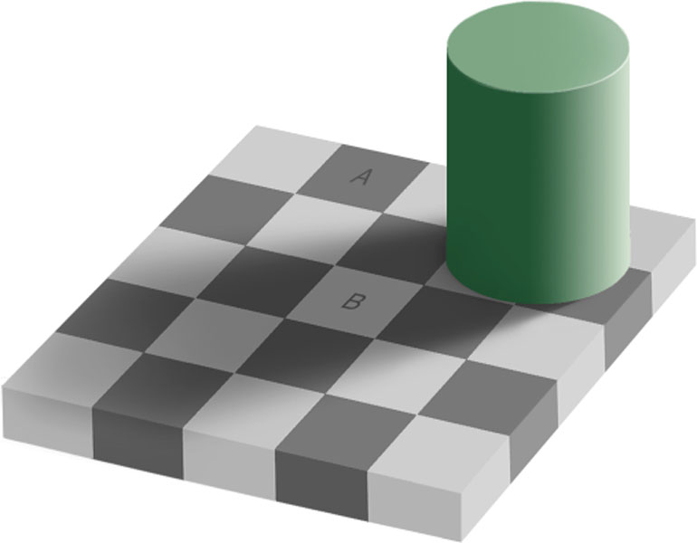
Which square is a darker shade of gray?
A is darker
B is darker
They are the same

Slide 12
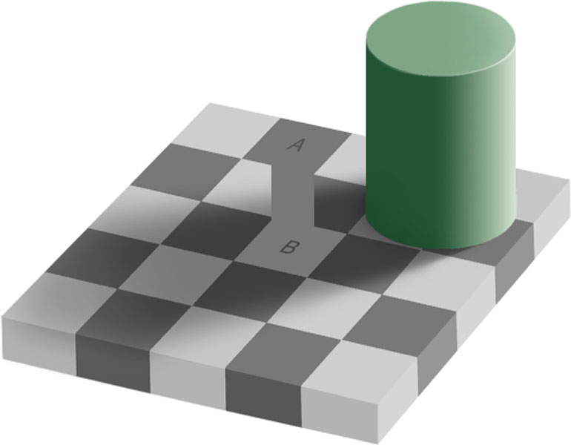
Which square is a darker shade of gray?
A is darker
B is darker
They are the same

Slide 13
6 Basic Assumptions of Science
Existence
Causality
Position Symmetry
Time Symmetry
Noncontradiction
Occam’s razor

Slide 14
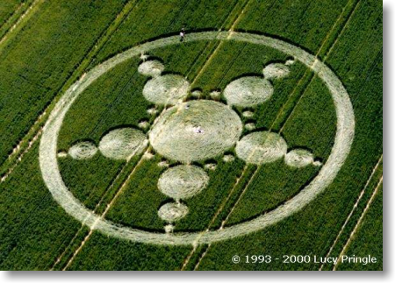
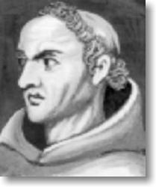
Occam’s Razor
When two ideas explain the same result and do not contradict, we favor the simpler one. i.e. Occam’s razor “slices away” the extraneous aspects leaving only the simple core.
William of Ockham 1288-1348
Notes:
Crop circle
From Wikipedia, the free encyclopedia
(Redirected from Crop circles)
Jump to: navigation, search
A crop circle pattern. See also: A crop circle on Google maps.
Crop circles are geometrical formations of flattened crops found in England and elsewhere. They have been found in wheat, barley, canola, rye, corn, linseed and soy.
The phenomenon itself was noticed in its current form after notable appearances in England in the late 1970s. Various explanations were offered for the phenomenon, which soon spread around the world. In 1991, two men, Doug Bower and Dave Chorley, revealed that they had been making crop circles in England since 1978 using planks, rope, hats and wire as their only tools[1][2]. Circlemakers.org[3] a UK-based arts collective founded by John Lundberg have been creating complex crop circles since the early 1990s. [4].
Despite the evidence that crop circles are of human origin various paranormal theories continue to enjoy some currency, although these violate Occam's Razor.[5]
History of crop circles
The phenomenon of crop circles became widely known in the late 1980s, after the media started to report crop circles (later found to have been created by Doug Bower and Dave Chorley) in Hampshire and Wiltshire. Subsequently crop circle enthusiasts have tried finding examples of the phenomenon before this. The earliest recorded crop circle is depicted in a 17th century woodcut called the Mowing-Devil. The image depicts a strange creature creating a circular design in a field of corn. The pamphlet the image appeared in states that the farmer, disgusted at the wage his mower was demanding for his work, insisted that he would rather have "the devil himself" perform the task.
A more recent historical report of crop circles was published in the journal Nature in 1880 (reproduced in 1991). An amateur scientist named Brandon Meland describes a field containing a number of crop circles, along with the suggestion that they might have been caused by "some cyclonic wind action".[1]
Although the pixie circles created by Elves in Scandinavian folklore were most likely caused by fungus colonies, there was also a rarer kind, consisting of circular patches where the grass had been flattened:
On lake shores, where the forest met the lake, you could find elf circles. They were round places where the grass had been flattened like a floor. Elves had danced there. By Lake Tisaren, I have seen one of those. It could be dangerous and one could become ill if one had trodden over such a place or if one destroyed anything there (an account given in 1926, Hellström 1990:36).
Not long after WWII, the aerial surveys that were being made over large areas of Britain revealed some unexpected phenomena, undetectable from the ground. When the surveys photographed ripening crops or drought-stressed terrain they revealed what were soon termed "crop marks", the differential ripening of the crop that revealed differences in the subsoil. These patterns were found to be caused by the buried remnants of ancient buildings. Archaeological investigations were soon instigated, but, though many previously unsuspected archaeological sites were found, no crop circles were ever recorded. Skeptics argue that this would have pointed to circles as a modern phenomenon, even if the initial pranksters had not revealed themselves; believers reply different agendas may simply be at work in the modern day.
Crop circles shot into prominence in the late 1970s as many circles began appearing throughout the English countryside. To date, thousands of circles have appeared at sites across the world, from disparate locations such as the former Soviet Union, the UK and Japan, as well as the U.S. and Canada. Some skeptics note a strong inverse correlation between crop circles and the presence of fencing and/or anti-trespassing legislation, as well as a great increase in the number of crop circles after media coverage.[citation needed]
[edit] Creators of crop circles
In 1991, more than a decade after the phenomenon began, two men from Southampton, England announced that the phenomenon of crop circles was an idea thought up one evening in a pub near Winchester, Hampshire in 1978. World War II veteran Doug Bower and his friend Dave Chorley revealed that they made their crop circles using planks, rope, hats and wire as their only tools. Bower and Chorley stated to reporters that a small group of people can stomp down a sizable area of crop in a single night using simple tools.
The pair became slightly frustrated that their work had not received as much publicity as they had hoped. In 1981 they created a crop circle in Matterley Bowl, a natural amphitheatre just outside Winchester, Hampshire - an area surrounded by roads from which a clear view of the field is available to drivers passing by.
Bower's wife had become increasingly suspicious of him due to noticing high levels of mileage in their car. Eventually, fearing that his wife suspected him of adultery, Bower confessed to her and subsequently informed a British national newspaper.
Bower revealed on TV the method he used. With a four-foot-long plank attached to a rope, circles of eight feet in diameter could be easily created. He stated that a 40-foot circle could be created by two men in a quarter of an hour. The designs were at first simple circles. When newspapers claimed that the circles could easily be explained by natural phenomena, Bower and Chorley chose more complex patterns. A simple wire with a loop, hanging down from a cap - the loop positioned over one eye - could be used to focus on a landmark to aid in the creation of straight lines. Later designs of crop circles became increasingly complex.
Dave Chorley died in 1996, and Doug Bower has made the occasional crop circle as recently as 2004. Bower has said that, had it not been for his wife's suspicions, he would have taken the secret to his deathbed, never revealing that it was a hoax.
Circlemakers.org, perhaps the best-known group of contemporary crop circle makers, was founded by John Lundberg. They have demonstrated that making what self-appointed cerealogist experts state are "unfakeable" crop circles is possible. One such cerealogist, Terence Meaden, was filmed claiming that a crop circle was genuine when the humans making the circle had been filmed the night before. On the night of July 11-12, 1992, a crop-circle making competition, for a prize of several thousand pounds (partly funded by the Arthur Koestler Foundation), was held in Berkshire. The winning entry was produced by three helicopter engineers, using rope, PVC pipe, a trestle and a ladder. Another competitor used a small garden roller, a plank and some rope. Minimal equipment and preparation sufficed to produce even the most complex crop circle designs.
Scientific American published an article by Matt Ridley[5], who started making crop circles in northern England in 1991. He wrote about how easy it is to develop techniques using simple tools that can easily fool later observers. He reported on "expert" sources such as the Wall Street Journal who had been easily fooled, and mused about why people want to believe supernatural explanations for phenomena that are not yet explained. Methods to create a crop circle are now well-documented on the Internet.[3]
The first people to be legally charged with creating a crop circle were Hungarian teenagers Gabor Takacs and Robert Dallos, both 17 and from the St. Stephen Agricultural Technicum, a high school in Hungary specializing in agriculture. On the night of June 8, 1992 they created a 36 meter diameter crop circle in a wheat field near Székesfehérvár, 43 miles southwest of Budapest. On September 3rd, they appeared on a Hungarian TV show and exposed the circle as a hoax showing photos of the field before and after the circle was made. As a result, Aranykalasz Co., the owners of the land, sued the youngsters for Fts.630,000 (approximately 6,000 UK pounds) in damages. The court eventually ruled that the boys were only responsible for the damage caused in the 36 meters diameter circle, amounting to about Fts.6,000 (47 UK pounds). They concluded that 99% of the damage to the crops was caused by the thousands of visitors that flocked to Szekesfehervar following the media's promotion of the circle. The fine was eventually paid for by the TV show, as were the boys' legal fees.
Paranormal enthusiasts, including Gerald Hawkins, argue that some designs have a degree of complexity that humans would not be able to easily recreate on paper, let alone in a field at night. They argue that the shapes of these formations are far too complex, and display a tremendously high level of precision which make it extremely difficult for a team of humans to create using just simple hand tools. Circle makers respond by noting that the only tool necessary for perfect symmetry is a measured length of rope rotated around a central pivot point[3], and more complex asymmetrical shapes are created by using marked ropes as straight edges to position elements.
Many popular arguments hinge on some part of the crop being left intact after the hoaxing. While something of this nature is difficult to ascertain, skilled crop circle creators are adept at using tractor tramlines and landscape features to avoid leaving other marks in the field. On the other hand, crop circles in Canada have been found in crop having no tramlines, as fertilization is done by aircraft.[6]
[edit] Investigators endorsing a non-human origin for some crop circles
Colin Andrews is held by some to be an investigator of the crop circle phenomenon, publishing two books including Crop Circles, Signs of Contact. His conclusion, which has gained support among some believers, is the 80/20% statement. "Based in our research, I concluded that approximately 80 percent of all the crop circles we investigated in England from 1999 through the year 2000 were manmade. This was one of the most important research findings to date because it cut to the core of what is truly important: the remaining 20 percent of the crop circles showed no sign of human hands."[3] This claim has been contested by the CSICOP, which notes that some of the alleged 20% 'genuine' crop circles have been documented as man-made and there is no reliable criterion for distinguishing between 'genuine' crop circles and those that are man-made. [2]
Another investigator, Freddy Silva, has published Secrets in the Fields.(2002)[7] He paraphrases Gerald Hawkin's summary "If crop circles are made by hoaxers, then they should stop doing it, because they are breaking the law and damaging the food supply. If they are made by UFO aliens, they shouldn't give us back the dates of our trips to Mars and the names of the men from the Titanic era - famous, clever, but now forgotten. If some are transcendental, the power behind it should realize that our culture is not now willing to accept transcendental happenings. But if they are indeed transcendental, then society will have to make a big adjustment in the years ahead."(p299)
[edit] Crop circle designs
Early examples of this phenomenon were usually simple circular patterns of various sizes, which led some people to speculate that it was a natural phenomenon. But after some years, more and more elaborate and complex geometric patterns have emerged. In general, the early formations (1970 - 2000) seemed to be based on the principles of sacred geometry. Later formations, those occurring after 2000, appear to be based on other principles, natural sciences and mathematics designs, including fractals. Many crop circles have fine intricate detail, regular symmetry and careful composition. Elements of three-dimensionality became more frequent, culminating in spectacular images of cube-shaped structures.
After the public admission of the original creators, crop circle activity skyrocketed. Each new design sought to be more complex than earlier designs. Today crop circle designs have increased in complexity to the point where they have become an art form in and of themselves.
Crop circle maker John Lundberg, in an interview with Mark Pilkington, spoke about this change in crop circle designs, "I am rather envious of circlemakers in other countries. Expectations about the size and complexity of formations that appear in the UK are now very high, whereas the rather shabby looking Russian formation made the national news. Even Vasily Belchenko, deputy secretary of the Russian Security Council, was on site gushing about its origin: "There is no doubt that it was not man-made... an unknown object definitely landed there. If the same formation appeared in the UK it would undoubtedly be virtually ignored by researchers and the media alike.".[3]
The Stonehenge Julia Set was first reported on 7 July, 1996. It measured 900 by 500 feet, with 151 circles. The Treble Julia Set, widely felt to be the pinnacle of the crop circle formations in that year, was found on Windmill Hill near Yatesbury, Wiltshire in July 1996.
[edit] Alternate origin theories
This article may require cleanup to meet Wikipedia's quality standards. Please discuss this issue on the talk page or replace this tag with a more specific message. This article has been tagged since July 2006.
Many alternate origin theories exist among enthusiasts, who contend that some crop circles are not created by people.
[edit] Unidentified flying objects
In this belief, crop circles are created by flying saucers landing in fields and forming patterns in crops.
[edit] Other causes
Often touted as evidence for the mystic origin of crop circles is the coincidence that many circles in the Avebury area of southern England occur near ancient sites such as earth barrows or mounds, white horses carved in the chalk hills, and stone circles. Other ideas on their formation have included tornadoes, freak wind patterns, ball lightning, and "plasma vortices".
A number of witnesses claim to have observed circles being created, saying that it takes a few seconds and the corn falls flat like a fan being opened[8] – though these accounts have never been supported by any evidence beyond the claimants' assertions.
There have been cases in which believers declared crop circles to be "the real thing", only to be confronted soon after with the people who created the circle and documented the fraud. [citation needed]
[edit] Similar phenomena
Lawn Cross of Eisenberg an der Raab
Unusual Ground Markings
In an unrelated phenomenon, fungal circles formed by a spreading mycelium. Older, larger fungal circles are not recognized when they have broken into arcs or patches. In Scandinavia and in Britain, the phenomenon of mushrooms or puffballs forming circles in a patch of meadow or pasture was referred to in folklore as älvringar, pixie circles or elf circles, and was attributed by countryfolk to mystical forces. This phenomenon is commonplace and is recognized [9] as the natural growth of fungus colonies.
[edit] In popular culture
In the TV show Monster Garage episode 45 featured a crew including abductee Travis Walton and crop circle maker John Lundberg turning an old tractor into a crop circle making machine.
In the TV show Pimp my Ride the first show of season 5 features a Chevrolet Malibu that is decorated inside and out with crop circle designs.
In the film Chicken Little (2005), crop circles are created by aliens as they chase the main characters in a corn field.
In the film Harold & Kumar Go to White Castle (2004), Harold and Kumar hang glide over a field with a crop circle pattern in the shape of male genitalia.
In the film Scary Movie 3 (2003), a spoof of Signs, Cindy has to investigate crop circles and prevent an alien invasion.
In the film A Place To Stay (2002), crop circles of Wiltshire are the background for a supernatural love story.
In the film Signs (2002), crop circles are attributed to the sinister motives of extraterrestrials.
In Fantastic Beasts and Where to Find Them, a book written by J. K. Rowling for the charity Comic Relief, a creature called a mooncalf occasionally performs strange dances flattening crops in fields "to the confusion of many muggles".
The film Mifune (1999) apparently featured the first appearance of a crop circle in a fiction film.
In Justice League Unlimited, Huntress is seen reading one of Question's theories about Girl Scouts being responsible for the phenomenon.
On the cover of Led Zeppelin Remasters.
In the Yu-Gi-Oh! Trading Card Game booster set, Power of the Duelist, there is a card called "Crop Circle" with the circle in the Egyptian Eye logo for Yu-Gi-Oh!.
[edit] Advertising
The UK based artists Circlemakers.org have been asked to create numerous crop circles since the mid 1990s for movies, TV shows, music videos, adverts and PR stunts. Clients to date have included Greenpeace, Microsoft, Nike, Shredded Wheat, AMD, Hello Kitty, Pepsi, Weetabix, BBC, The Sun, Mitsubishi, O2, Big Brother,National Geographic , NBC-TV, Orange Mobile, History Channel and the Discovery Channel.
New Age author Dan Joy in 1991 humorously suggested that crop circles are an advertising campaign displaying the logos of galaxy-wide corporations, preparing Earth for its forth coming admission to the Galactic Federation of planets.
[edit] Further reading
The Field Guide: The Art, History and Philosophy of Crop Circle Making by Rob Irving and John Lundberg, edited by Mark Pilkington (Strange Attractor 2006) ISBN 0-9548054-2-9
Round in Circles: Physicists, Poltergeists, Pranksters, and the Secret History of the Cropwatchers, by Jim Schnabel (Penguin 1993). ISBN 0-14-017952-6.
Circular Evidence: Bloomsbury, London by Colin Andrews and Pat Delgado, 1989, ISBN 0-7475-0635-3.
The Hypnotic Power of Crop Circles, by Bert Janssen, 2004. ISBN 1-931882-34-7
The Deepening Complexity of Crop Circles: Scientific Research and Urban Legends, by Eltjo H. Haselhoff, ISBN 0-285-63625-1.
Opening Minds by Dr. Simeon Hein, ISBN 0-9715863-0-6.
Hellström. 1990. En Krönika om Åsbro. ISBN 91-7194-726-4
Crop Circles by Lucy Pringle, 2004, Pitkin (an imprint of Jarrold Publishing) (largely in favour of the supernatural explanation of Crop Circles), ISBN 1-84165-138-9.
Carl Sagan, 1996. The Demon-Haunted world: Science as a Candle in the Dark; "Aliens" pp 73ff.
[edit] External links
Skeptical and scientific analysis:
http://news.nationalgeographic.com/news/2002/08/0801_020801_cropcircles.html This is an excellent introduction to crop circles, with a special emphasis on their value as art.
http://www.csicop.org/si/2002-09/crop-circles.html The Center for Scientific Investigation of Claims of the Paranormal looks at "crop circles" and is not impressed.
http://skepdic.com/cropcirc.html The Skeptic's Dictionary and CSICOP links to non-supernatural articles on crop circles.
Brief summary of scientific literature on causes of crop circles
Circle creators, and information on making your own crop circles:
http://www.circlemakers.org/ The most famous group of crop circle makers, founded by Doug Bower, Dave Chorley and John Lundberg.
http://www.amtsgym-sdbg.dk/as/crop/ufofake.HTM An entertaining report on how an elaborate crop circle made by astronomy students at Amtsgymnasiet in Sonderborg, Sweden fooled crop circle "researchers".
http://science.howstuffworks.com/crop-circle.htm How stuff Works explains how crop circles are made and how to make your own, with step by step pictures and complex circle patterns.
Pro paranormal explanation websites:
Discussion & pictures of crop circles
http://www.cropcircle-archive.com A complete crop circle database site with a search engine and flash animations of crop circle constructions using the "ruler and compass" rule.
http://www.cropcircleship.com/ A website attempting to put together a secret technology represented by the crop circles.
Photos, Documentaries and Geometry studies of Dutch researcher Bert Janssen
http://www.cropcircles.org
http://www.cropcircleresearch.com A page devoted to researching the phenomenon of Crop Circles - concentrating more on scientific research.
http://www.lucypringle.co.uk This site is the de facto standard for comprehensive aerial photographs of the UK's crop circles.
[edit] References
^ The Demon Haunted World, Carl Sagan (Random House, January 1996) pp. 73-77
^ Faking UFOs, Roel Van der Meulen (Self Published, 1994)
^ a b c d e http://www.circlemakers.org
^ The Field Guide: The Art, History and Philosophy of Crop Circle Making by Rob Irving and John Lundberg, edited by Mark Pilkington (Strange Attractor 2006) ISBN 0-9548054-2-9
^ a b Crop Circle Confession, How to get the wheat down in the dead of night by Matt Ridley, Scientific American, August 2002, p. 25
^ http://www.cccrn.ca/
^ Freddy Silva. Secrets in the Fields: The Science and Mysticism of Crop Circles. (2002) ISBN 1-57174-322-7
^ http://www.bltresearch.com/eyewitness2.html
^ http://plantclinic.cornell.edu/FactSheets/fairyring/fairyring.htm
Retrieved from "http://en.wikipedia.org/wiki/Crop_circle"

Slide 15
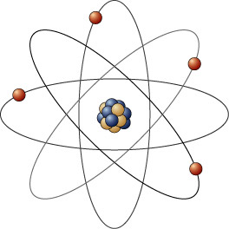
The Scientific Method
Models are used to represent reality. Science leads us to truth by building models and refining them through theory and data into general laws.

Slide 16
Where are we going in this class?
How stuff moves the way it does
Define what stuff is made out of
How the earth works

Slide 17
Motion is boring unless objects interact
We only know of four ways that objects can interact:
Nuclear Strong (relative strength: 10³⁸)
Nuclear Weak (relative strength: 10²⁵)
Electromagnetic (relative strength: 10³⁶)
Gravity (relative strength: 1)

Slide 18
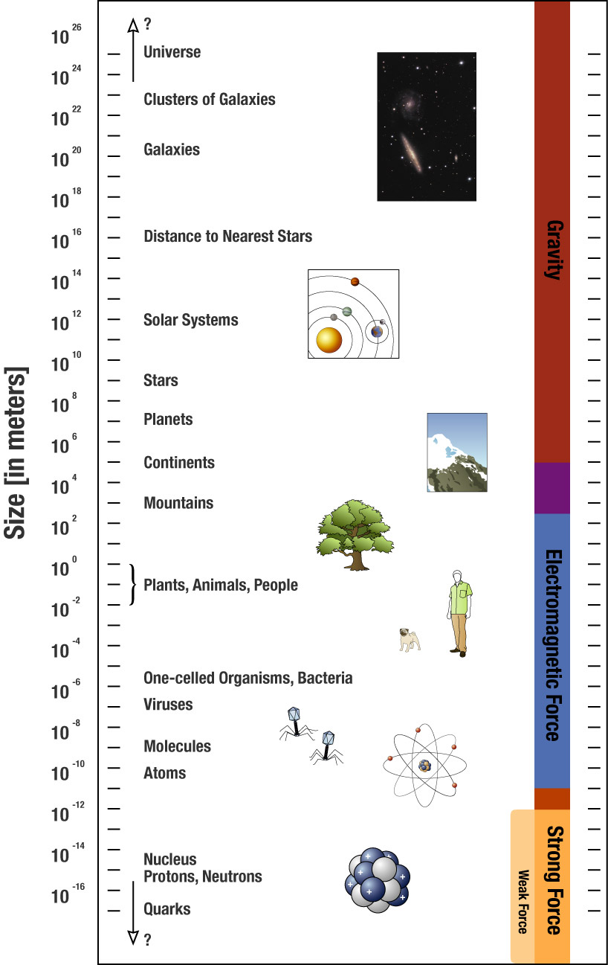
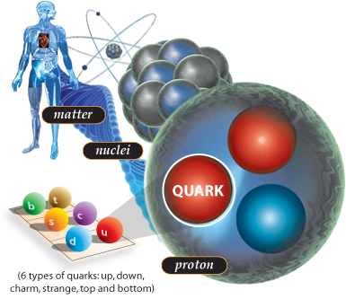
Interaction length scales

Slide 19
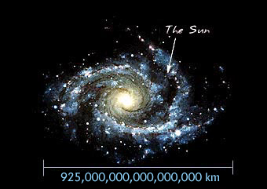
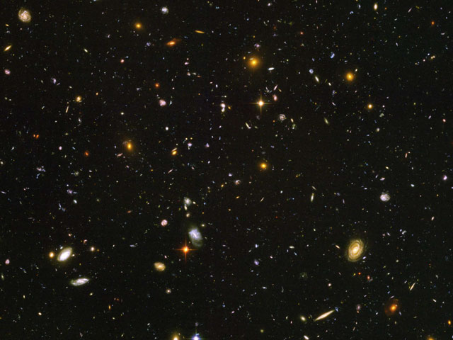
At cosmic scales only gravity matters

Slide 20
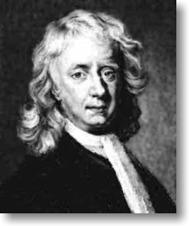
An example
Newton used 4 simple ideas to explain all motion in earth and heaven
Three laws of motion and one law of gravity
These are the assumptions that the description of motion rests upon.
This is where our study of physical science begins.
Isaac Newton age 83

Slide 21
Common Misconception
Do heavier objects fall faster than lighter ones?
Al
Au
No, the speed up at the same rate.
They have the same acceleration.

Slide 22
Misconception
What if they roll off a box at the same initial horizontal speed, will they hit the ground at the same time?
With different initial horizontal speeds?
Yes and Yes

Slide 23
Mathematical Shape – Linear on a Position vs. Time graph
Back of the room
Middle of the room
Front of the room
4:00:00 PM
4:00:05 PM

Slide 24
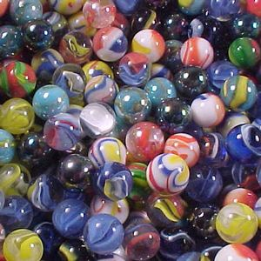
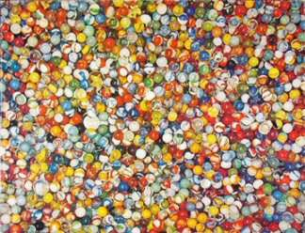
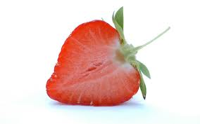
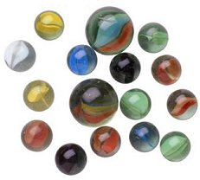

Large and small numbers
Large and small numbers are hard to visualize
3 Marbles
1,079 marbles
? marbles
16 marbles
Small numbers: imagine fractions (pie slices).

Slide 25
Large and small numbers
Large and small numbers are hard to visualize
We will often need to use “scientific notation” to write large and small numbers
Examples
1x10⁵ =100,000
1x10⁴² =1,000,000,000,000,000,000,000,000,000,000,000,000,000,000
1x10⁻⁵ =0.00001
1x10⁻⁴² =0.000000000000000000000000000000000000000001
Number of atoms in an average human body 1x10²⁸
Number of atoms in the known universe 1x10⁸⁰

Slide 26
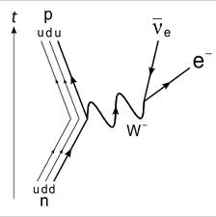
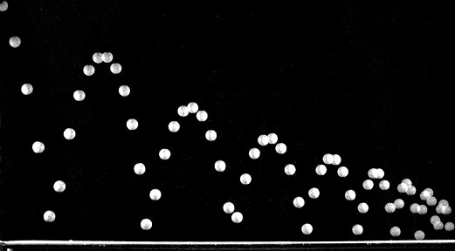
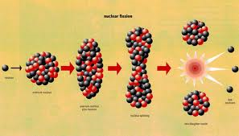
As scientists, we are very interested in changes in motion. This is the essential element of all change that we observe.
Changes in an object’s motion arise only through interactions between pairs of objects.
We have only been able to identify four ways that objects can interact: Relative Strengths
Nuclear Strong 10³⁸
Nuclear Weak 10³⁶
Electromagnetic 10²⁵
Gravity 1
Not all objects interact through all four methods. The properties of an object determine which interactions can occur.

Slide 27
Newton described motion in terms of a few basic laws - The first law
Inertia
Every object in a state of rest, or in a state of uniform motion in a straight line with unchanging speed, will stay in that state of rest or of uniform motion, until compelled to do otherwise by forces acting upon it.

Slide 28
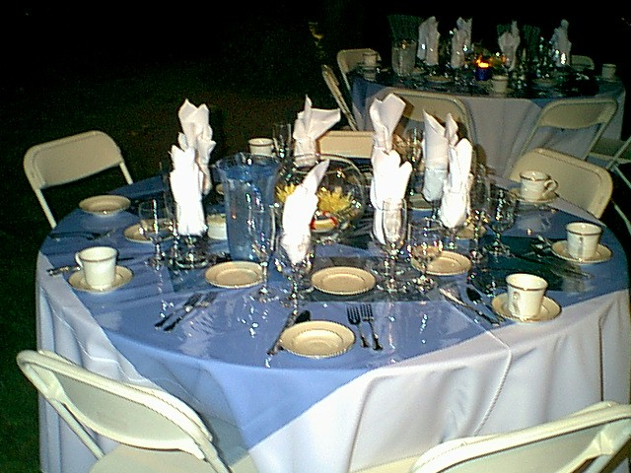
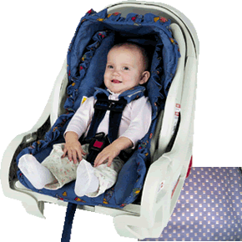
Some examples of the first law
The “dinner table” magic trick
Car seats and safety belts

Slide 29
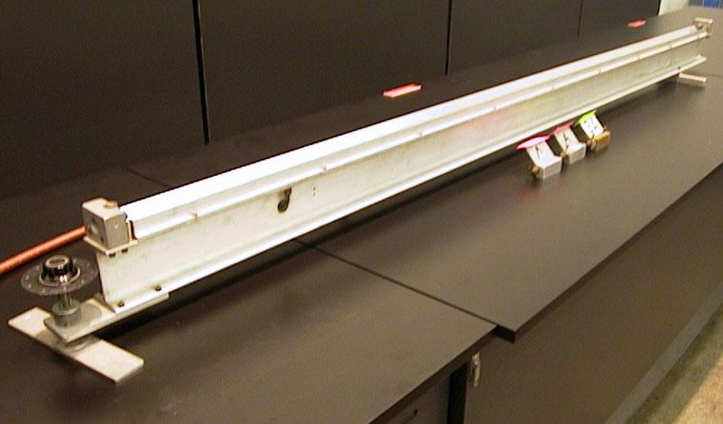
Definitions
Objects interact to create a “push” or “pull.” This push or pull is called a force.
Uniform motion is motion at a constant speed in a straight line.

Slide 30
Concepts for Newton’s second law
A body of mass m subject to a force F undergoes an acceleration a.
F = ma.
Force = mass.acceleration
This is for only one body

Slide 31
Concepts for Newton’s second law
Velocity versus acceleration
Acceleration: a change in velocity
Speeding up
Slowing down (deceleration)
Changing directions (centripetal)

Slide 32
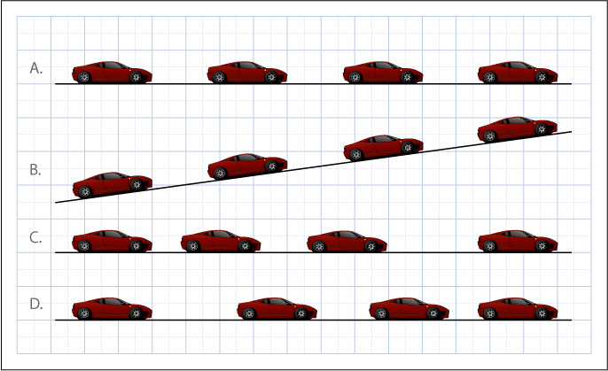
In which of the following cases is the car in accelerated motion?

Slide 33
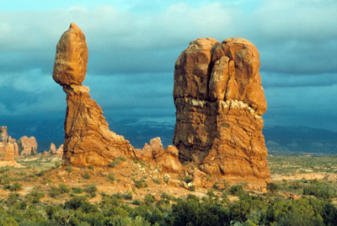
Net force
Are there forces acting on the rock?
Is there a net force on the rock?
What are the forces on the rock at left? Are they balanced or unbalanced?

Slide 34
Some Key Ideas
If you observe an object at rest or in uniform motion then:
The acceleration is 0 by definition.
There are no unbalanced forces.
If you observe an acceleration then:
There is an unbalanced force.
NO EXCEPTIONS!!!!

Slide 35
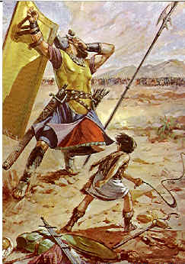
David and Goliath
At what point should David let go of the rock?
David’s Head
C
D
B
Goliath’s Head
A

Slide 36
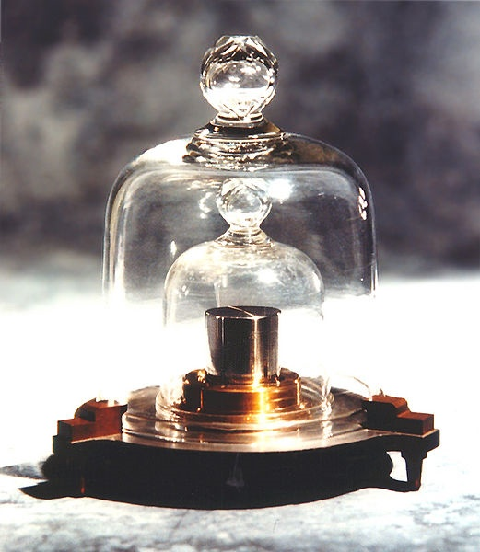
In addition to the net force, an object’s mass also determines how it will accelerate
Mass determines how much objects accelerate in response to a given applied force
The IPK(international prototype kilogram), is the kilogram. There are many through out the world.

Slide 37
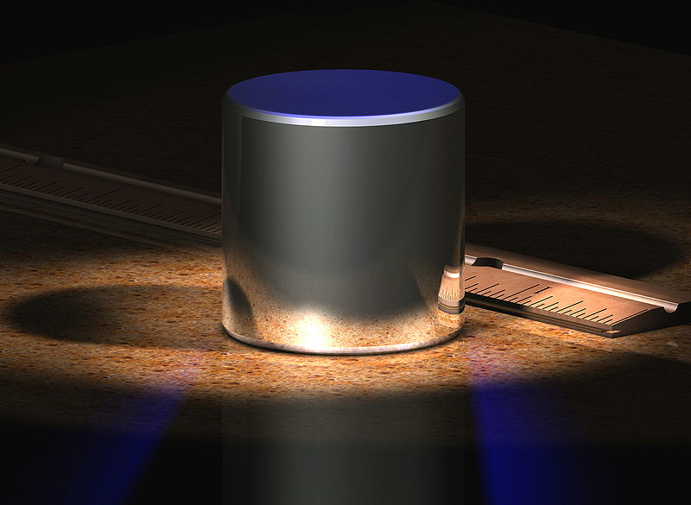
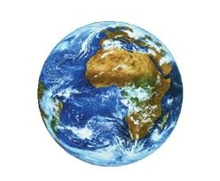

Some comments on units.
Metric units are used in most of the civilized world.
The metric unit of mass is the kilogram (or grams, centigrams, etc.)
What is the unit of mass in the English system of units?
Mass is not the same thing as weight!
Does your mass change on the moon?

Slide 38
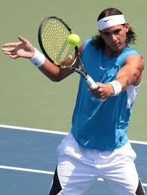
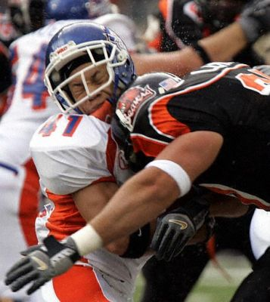
The Third Law
All forces result from interaction between pairs of objects.
When interacting, each object exerting a force on the other. The two forces have the same strength, and act in exactly opposite directions.
This is for two bodies

Slide 39
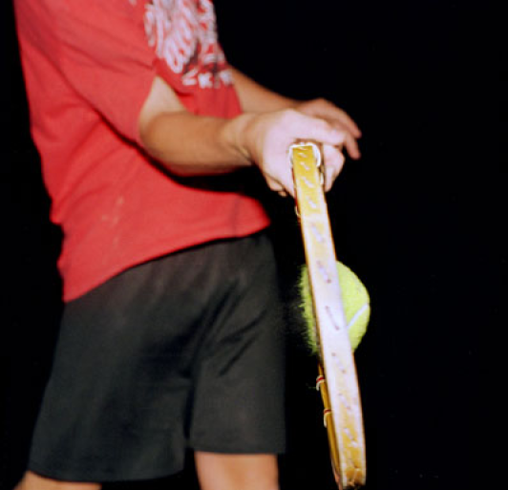
Which statement best describes the situation pictured below
The racket is exerting a force on the ball
The ball is exerting a force on the racket
Both A and B are correct, but the force on the ball is greater
Both A and B are correct and the forces are equal in magnitude
Photo by Amoz Eckerson, 1995
What is the action-reaction pair here?

Slide 40
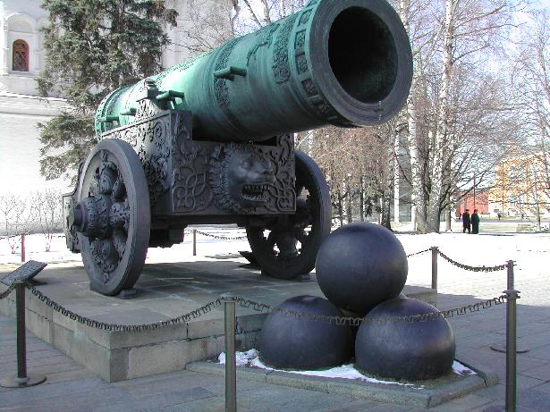
Artillery experiment
Did we create a force on the cannonball?
What exerted the force on the cannonball?
Did the cannonball exert a force on anything?
Why did the two objects accelerate differently?
10 KNO₃ + 3 S + 8 C → 2 K₂CO₃ + 3 K₂SO₄ + 6 CO₂ + 5 N₂.

Slide 41
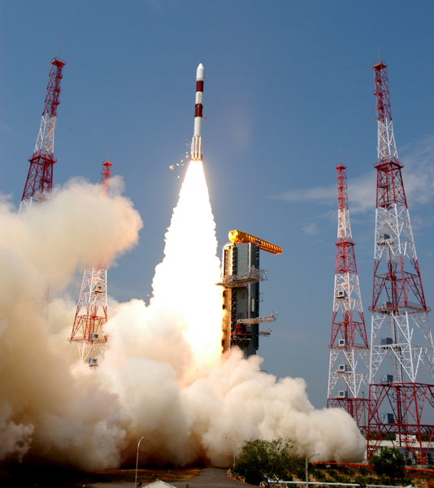
How does a rocket work?

Slide 42
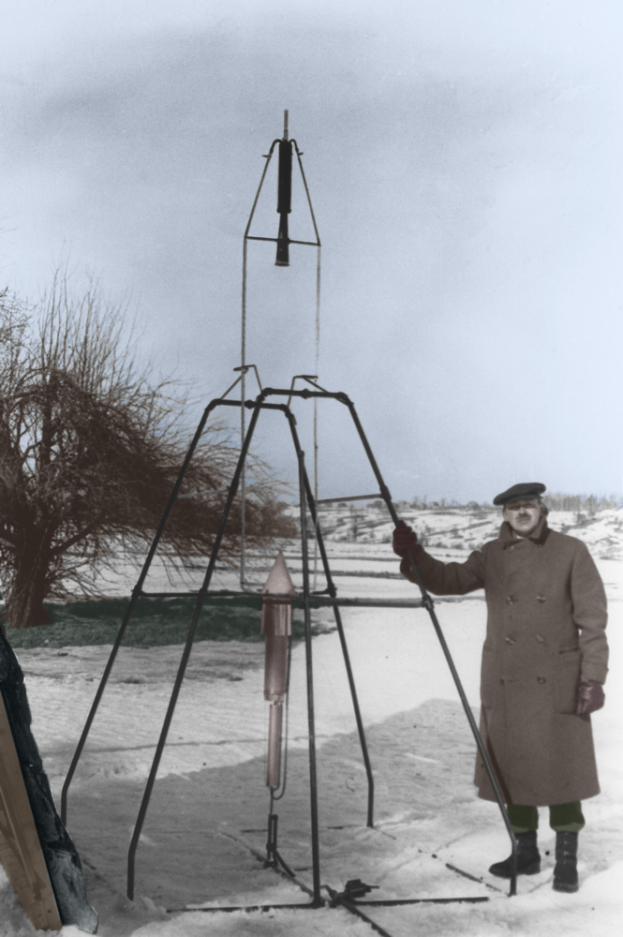
New York Times on Robert Goddard January 13, 1920
… after the rocket quits our air and really starts on its longer journey it will neither be accelerated nor maintained by the explosion of the charges it then might have left. To claim that it would be is to deny a fundamental law of dynamics, and only Dr. Einstein and his chosen dozen, so few and fit are licensed to do that. …
[Professor Goddard] …does not know of the relation of action to reaction, and the need to have something better than a vacuum against which to react.
[He] only seems to lack the knowledge ladled out daily in high schools.

Slide 43
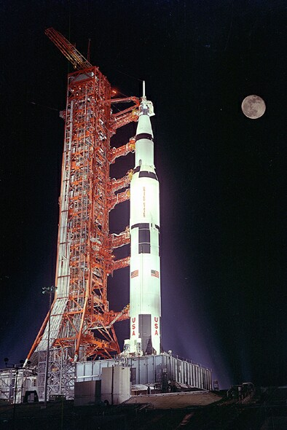
New York Times on Robert Goddard July 17, 1969
Further investigation and experimentation have confirmed the findings of Isaac Newton in the 17th century and it is now definitely established that a rocket can function in a vacuum as well as in an atmosphere. The Times regrets the error.

Slide 44
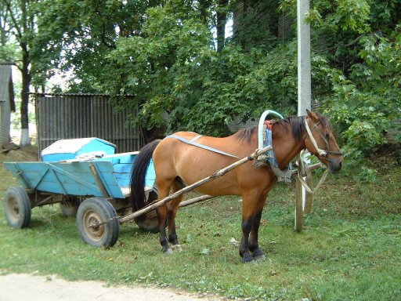
Something to think about: The reluctant horse
“Every time I pull on the cart, it pulls back with equal force. Therefore I cannot pull the cart.”

Slide 45
Acceleration
Acceleration is a change in velocity.
Velocity is speed with a direction.
You accelerate by changing your…
speed
and/or
direction

Slide 46
Acceleration is a change in velocity.
Scenerio:
cruise control at 65 mph going North
Are you accelerating?
no
slow down
speed up
turn left
turn right
go downhill
go uphill
How can you accelerate?

Slide 47
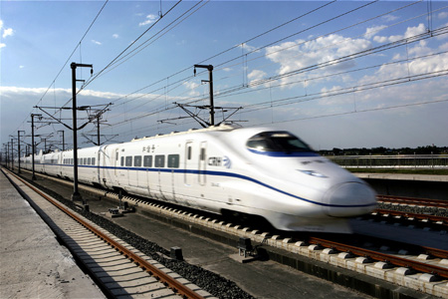

Train vs. Fly
velocity vectors
A train is speeding towards a fly. Their speeds are represented by the length of the arrows. What happens when they collide?

Slide 48
Equal and Opposite forces!
force vectors
ma = ma
F = F

Slide 49
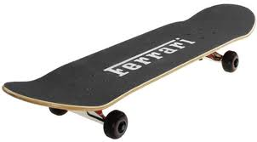
2 guys of equal mass are on frictionless skateboards. One of them pushes the other but you did not see.
1
2
Afterwards you see them moving away from each other. Can you tell who pushed who? If they were different masses could you tell?

Slide 50
Two masses approach each other with the same speed
m
m
force vectors
What does Newton’s first law tell us?
What does Newton’s second law tell us?
What does Newton’s third law tell us?

Slide 51
Collisions of different masses
m
m
ma = ma
F = F

Slide 52
Two masses approach each other with the same speed
Newton’s first law tell us that before and after they collide…
F = 0
F = 0
Every object in a state of uniform, will stay in that state until compelled to do otherwise by forces acting upon it.
F = 0
F = 0
The yellow arrows are velocity vectors

Slide 53
Two masses approach each other with the same speed
Newton’s second law tell us…
F = ma
F = ma
A body of mass m subject to a force F undergoes an acceleration a.

Slide 54
Two masses approach each other with the same speed
Newton’s third law tell us? …
F = F
ma = ma
When interacting, each object exerting a force on the other. The two forces have the same strength, and act in exactly opposite directions.

Slide 55
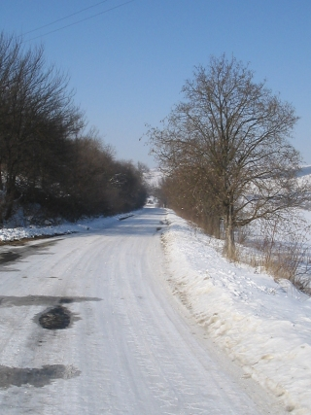
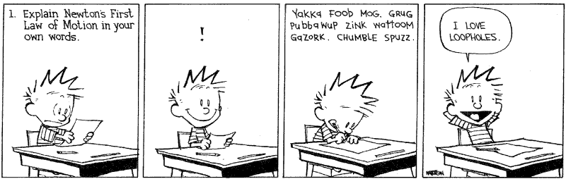
Review
Use Newton’s first law to explain why you should drive slowly in ice and snow around corners.

Slide 56
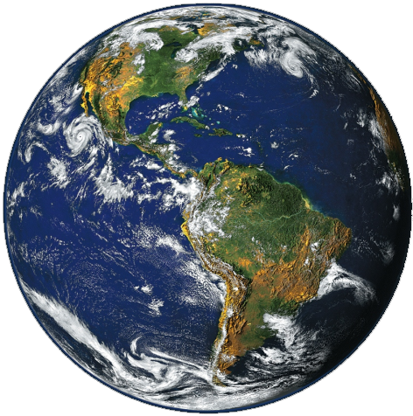
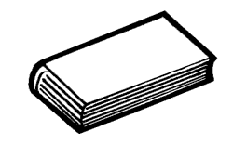
First let’s briefly consider distance for everyday interactions
~3 feet
Conclusion: For everyday interactions, the gravitational distance to the center of the earth is roughly constant, so the force (i.e. the weight) is constant
Radius of the earth ~4,000 miles

Slide 57
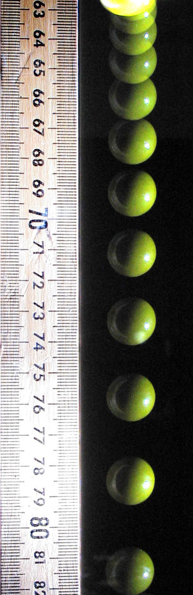
Experimental observation
Time (s) | Distance (m) | Speed (m/s) | Acceleration (m/s²)
0 | 0 | 0 | 9.8
0.1 | 0.049 | 0.98 | 9.8
0.2 | 0.196 | 1.96 | 9.8
0.3 | 0.441 | 2.94 | 9.8
0.4 | 0.784 | 3.92 | 9.8
0.5 | 1.225 | 4.9 | 9.8
0.6 | 1.764 | 5.88 | 9.8
0.7 | 2.401 | 6.86 | 9.8
0.8 | 3.136 | 7.84 | 9.8
0.9 | 3.969 | 8.82 | 9.8
1 | 4.9 | 9.8 | 9.8
If the ball falls at 9.8 meters per second squared, how fast will it be going in one second?

Slide 58
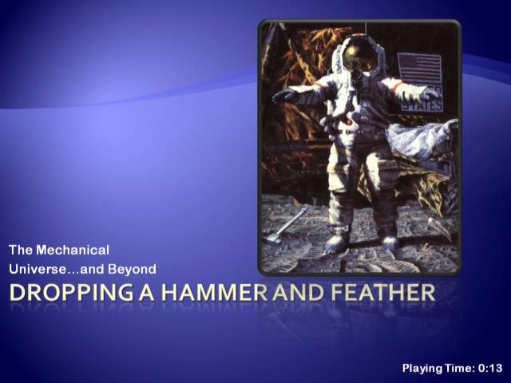
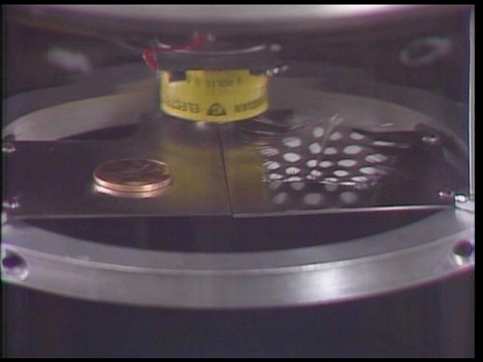
Gravity causes a uniform acceleration at the planet’s surface (independent of mass)

Slide 59

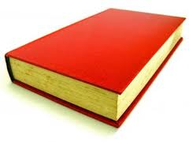
Air Drag - If I drop a book and a piece of paper, which one will hit the table first?
The book
The paper
Neither, they hit the same time
It Depends!
Cross Section
Mass
Drag Coefficient

Slide 60
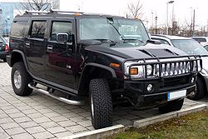
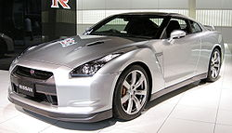
Drag coefficients
Jeb Corliss " Grinding The Crack"

Slide 61
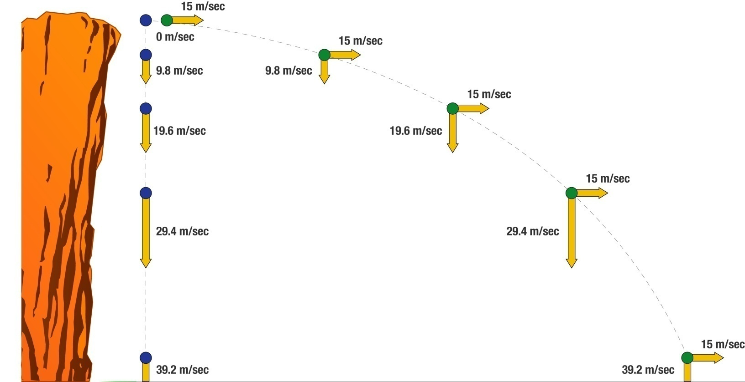
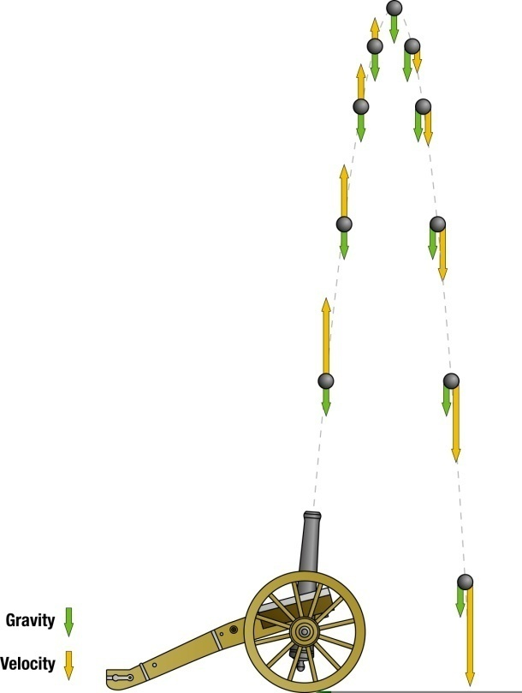
Decomposing motion into its components

Slide 62

If objects are gravitationally attracted to each other, why doesn’t the moon fall to the earth?
It is falling, accelerating is falling.
Anything moving in a circle at constant speed is accelerating towards the center.
It’s continually changing its direction(part of velocity) toward the center.

Slide 63


Slide 64


The moon is falling (Dependence of the force of gravity on distance)

Slide 65
Gravity
The equation for gravity is
F is the force of gravity on each mass
G is just a small number
M
m
d

Slide 66
If d₂ is twice as large as d₁, how is the force different for the d₂ case?
The force is four times bigger
The force is twice as much
The force is half as much
The force is one quarter as much
M
m
d₁
M
m
d₂

Slide 67
If m₂ is twice as large as m₁, How is the force different (d is the same in both cases)?
The force is the same
The force is twice as much
The force is half as much
Need more information to tell
M
m₁
d
M
m₂
d

Slide 68
A very little math…
Newton’s law of gravity
describes the gravitational force on any object of mass “m” exerted by a body of mass “M”.
Newton’s second law of motion, F = ma, describes the acceleration experienced by an object that feels a force “F”.

Slide 69

And thus we see…
Gravitational acceleration of any body is independent of its mass!
Heavy and light things all fall at the same rate.

Slide 70


Slide 71



Two types of mass: Inertial and gravitational
F=ma
Equivalence principle: Gravitational mass is identical to inertial mass

Slide 72



“Weightlessness”

Slide 73

The vomit comet

Slide 74

A book is at rest on a table. The force paired with a book’s weight (via Newton’s third law) is:
The force exerted by the table on the floor
The force of gravity exerted by the book on the earth
The contact force of the table on the book
Cannot be determined without more information

Slide 75
Plan to stop here and take quiz
Video Courtesy of NOVA

Slide 76



A book is at rest on a table. The force paired with a book’s weight (via Newton’s third law) is:

Slide 77
Molecular Interactions

Slide 78



Early observations
The Greeks noticed by at least 600 B.C. that amber rubbed with fur could attract things.
(Elektron, amber in Greek)

Slide 79


Franklin hypothesized that a “fluid” was exchanged between the fur and the rod
Stores Electrical
Potential Energy
Leyden Jar
A typical design consists of a glass jar with conducting metal foil coating the inner and outer surfaces. A rod electrode projects through the mouth of the jar, electrically connected by a wire to the inner foil, to allow it to be charged. The jar is charged by an electrostatic generator or other source of electric charge, connected to the inner electrode while the outer foil is grounded. The inner and outer surfaces of the jar store equal but opposite charges.

Slide 80

Example Van de Graff - Electrostatic Generator
Which number should be in contact with the rod on the jar?
What about the outer foil?
Notes:
1) hollow metal sphere 2) upper electrode 3) upper roller (metal) 4) side of the belt with positive charges 5) opposite side of the belt with negative charges 6) lower roller (for example an acrylic glass) 7) lower electrode (ground) 8) spherical device with negative charges, used to discharge the main sphere 9) spark produced by the difference of potentials

Slide 81

Lightning
The static charge in air typically breaks down
at around 33,000 volts per centimeter

Slide 82

Is lightning the same stuff stored in a Leyden jar?
Objects attracted to an electrified rubber rod are positively charged
while those attracted to a glass rod are negatively charged.

Slide 83



J. J. Thompson showed that Franklin’s “fluid” model was not entirely correct.
Matter is composed of positive and negative charged particles
The positive parts of atoms have essentially the same mass as the atoms
The negative parts all have the same mass, and behave the same for all substances.

Slide 84
Static electricity discharge conclusion
+
Human hands
Rabbit Fur
Glass
Nylon
Wool
Fur
Silk
Paper
Steel
Wood
Amber
Hard rubber
Nickel, Copper
Brass, Silver ,Gold, Platinum
Polyester ,Styrofoam
Saran Wrap .Scotch Tape
Vinyl
Silicon
Teflon
Materials with weakly bound electrons tend to lose them
tendency to charge positively (lose electrons)
Materials with sparsely filled outer shells tend to gain them
tendency to charge negatively (gain electrons)
-
Notes:
Human hands (usually too moist, though) Very positive
Rabbit Fur
Glass
Human hair
Nylon
Wool
Fur
Lead
Silk
Aluminum
Paper
Cotton
Steel Neutral
Wood
Amber
Hard rubber
Nickel, Copper
Brass, Silver
Gold, Platinum
Polyester
Styrene (Styrofoam)
Saran Wrap
Polyurethane
Polyethylene (like Scotch Tape)
Polypropylene
Vinyl (PVC)
Silicon
Teflon Very negative

Slide 85

Electrically charged objects attract or repel one another one another
Like charges repel and opposite charges attract.
The more “charged” the objects are, the stronger the interaction.
The closer charged objects are, the stronger the interaction.
http://www.lon-capa.org/~mmp/applist/coulomb/orbit.htm

Slide 86

Coulomb quantified the electric force law
Familiar “inverse square” relationship.
Q and q can be positive or negative (M and m could only be positive in gravity).
k is much, much bigger than G, so the electrical interaction is much stronger than the gravitational interaction.
Charles-Augustin de Coulomb

Slide 87


The Millikan/Fletcher oil drop experiment provided conclusive proof that charges come in lumps
http://projects.cbe.ab.ca/sss/science/physics/map_north/applets/millikan/millikan.html

Slide 88
Summary
The “+” and “-” labels came from Benjamin Franklin.
Charge comes in discrete chunks or particles. The most common charge carrying particles (by far!) are electrons (e-) and protons (p+).
e- and p+ charge magnitudes are the same but the p+ mass is 1836 times the e- mass.
So which one would accelerate the most when they attract each other?
Which fundamental force is causing most of this acceleration?

Slide 89


Electric current: Charges in motion
Generally the wire remains neutral, even though charge is flowing
Resistance to flow causes energy loss
DC is one way, AC alternates
http://www.falstad.com/circuit/

Slide 90


Let’s play with electricity
Notes:
To make this work, put van degraff on edge of table, and have them stand away with one hand on ball—otherwise the electrons escape.

Slide 91


On to magnetism

Slide 92




Changing magnetic fields can produce moving charges. This is how we usually generate electric current

Slide 93



Magnets produce a force on another magnet (and can induce magnetism in some materials)
The direction of the force is a little more complicated than for electrically charged particles, but it still depends on distance between the magnets

Slide 94
Let go of the one on the right, which way does it spin?
S
N
S
N

Slide 95


Permanent Magnets
Magnetism arises when the atoms (which act as tiny permanent magnets) align themselves in tiny domains.
Not all metals can be magnetized!

Slide 96
All Magnetic Fields are caused by…
Moving
Charges
-
Magnetic field coming out of the screen

Slide 97

The grand scheme of science
The speed of light was found in Maxwell’s
Equations. The last equation has
the permeability and
permittivity of free space revealing the speed of Light!
Ampere’s Law
Celeritas is a Latin word, translated as "swiftness" or "speed".

