Slide 1

Final Review

Slide 2



Final review
A bullet is fired horizontally from a gun at the same time that another bullet is dropped from the same height as the gun(air resistance is neglected).
h
Will they hit the ground at the same time?
YES!
Why? Their vertical accelerations are the same.
What if the masses of the two bullets are not the same, will they hit the ground at the same time?
YES!

Slide 3
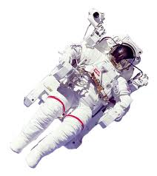
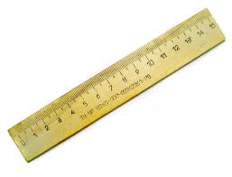

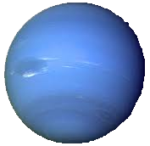
Final review
An astronaut measures the mass and length of a ruler before taking it on a flight to Neptune
While travelling at a speed near the speed of light, the astronaut measures the mass and length of the ruler again.
No!
Will either the mass or length change?
Why? The two measurements were made in the same reference frame.

Slide 4
Final review
The basic difference between red and green light viewed in a vacuum is that…
The wavelengths are not the same.
Green light has more energy

Slide 5
Final review
Which of the following chemical equations is properly balanced?
H₂ + O₂ → H₂O
H₂ + 2O₂ → H₂O
2H₂ + O₂ → 2 H₂O

Slide 6
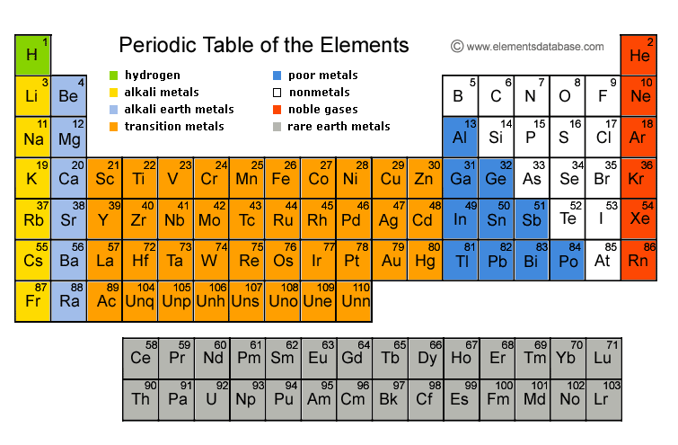
Final review
The number of valence electrons in sulfur (S) is
6

Slide 7
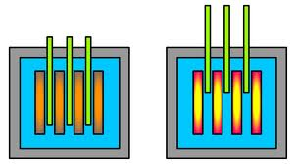
Final review
The control rods in a nuclear fission reactor can reduce the energy production of the reactor by what
n
n
n
n
n
n
n
n
n
Reduce the number of free neutrons in the core

Slide 8
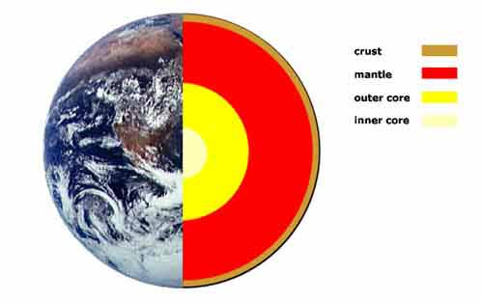
Final review
Our understanding of the interior structure of the earth is primarily determined from
Measuring waves produced by earthquakes on the other side

Slide 9
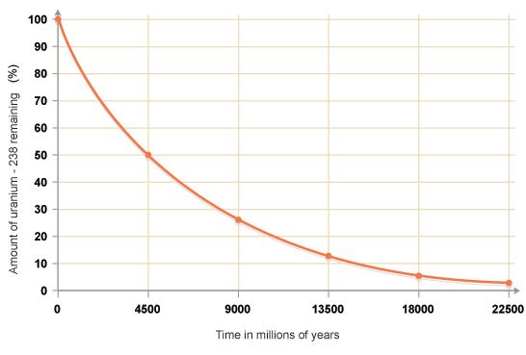
Final review
The geological age of the earth is estimated to be 4.55 billion years by using
Radiometric dating

Slide 10
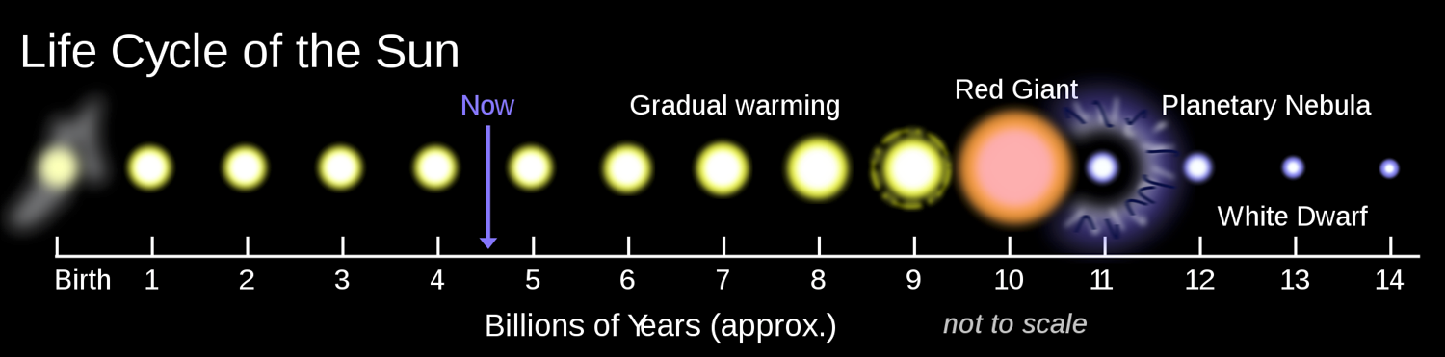
Final review
The final state of the Sun will be a
White dwarf

Slide 11
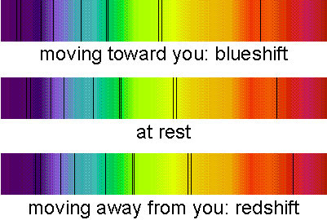
Final review
Of the following, which is the best evidence for an expanding universe?
Red shift of far away galaxies

Slide 12
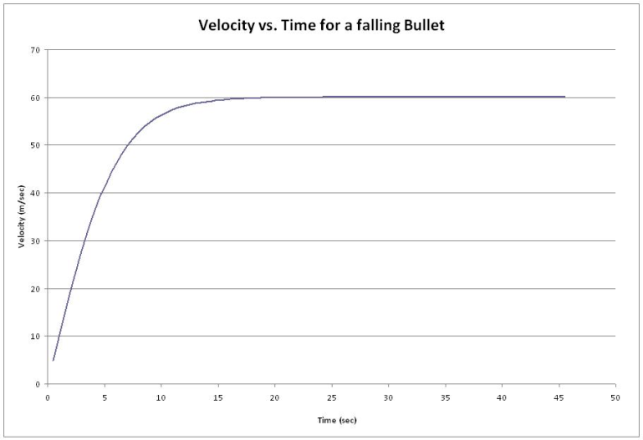
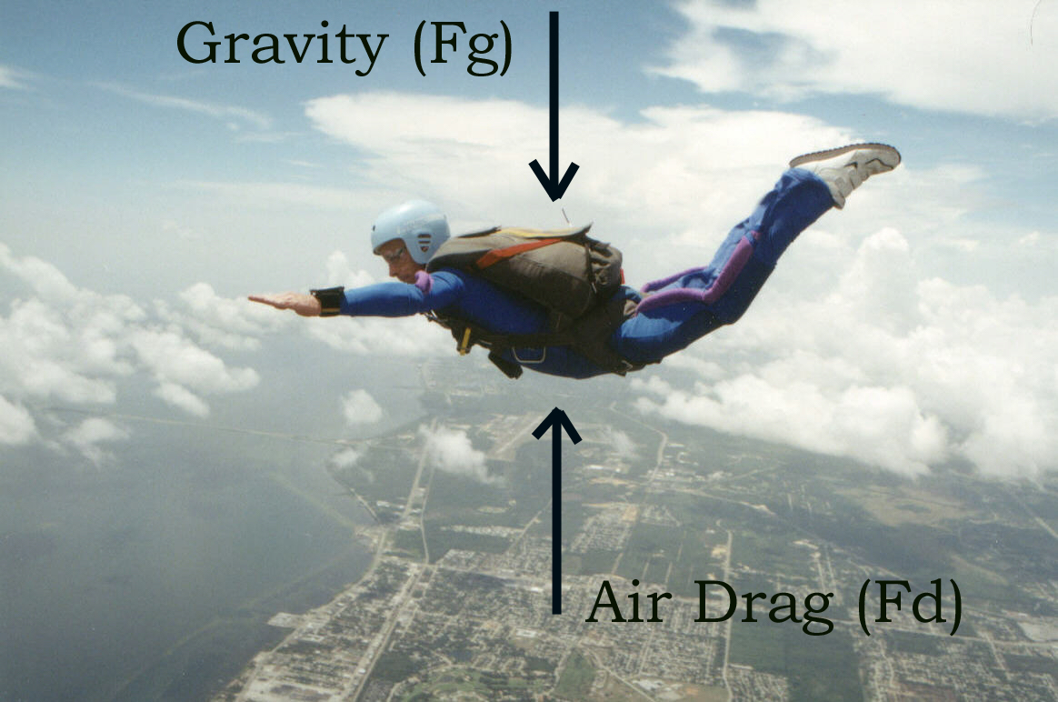
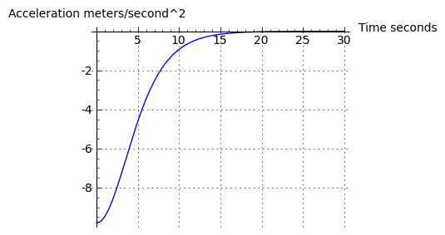
Final review
What is true about air resistance?
a constant speed
an acceleration of zero
The falling object will reach…

Slide 13
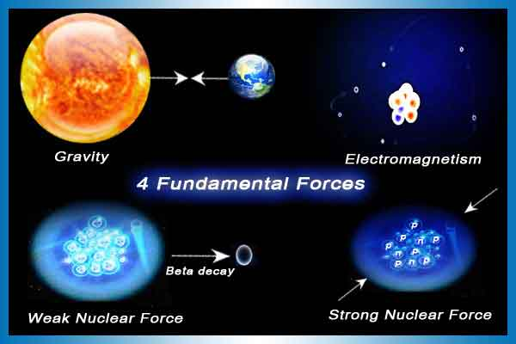
Final review
Which two of the four fundamental forces do we deal with most in our daily lives?

Slide 14

Final review
You throw a baseball up into the air. What is the baseball's acceleration at the top of its fight?

Slide 15


Final review
To decrease the pressure caused by a force, how must you change the area to which it's applied?
Increase the area

Slide 16
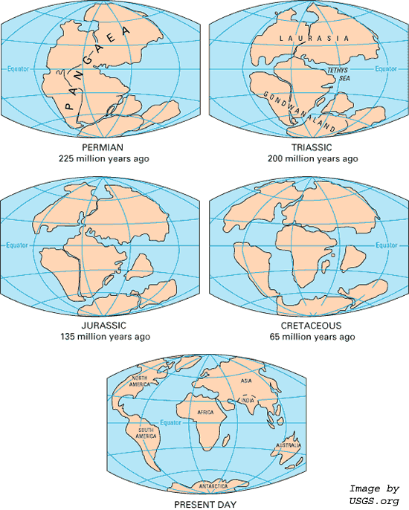
Final review
Besides fitting together like puzzle pieces, what are some major evidences for plate tectonics and Pangaea?
Magnetic field consistencies
Paleoclimatic consistencies
Glacier tracks consistencies
Volcano and earthquake patterns

Slide 17
Final review
A sample starts with 100% of a certain isotope at noon. At 8pm on the same day, the sample is down to 25%.
What is the half-life of this sample?
That means at 4pm it was 50%
so the half-life is 4 hours

Slide 18
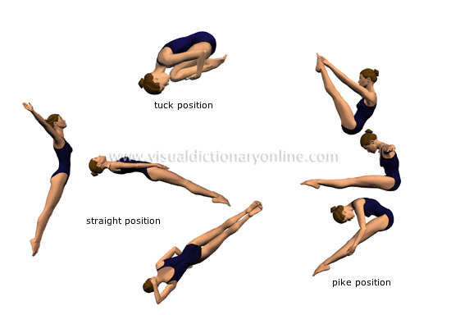
Final review
When a diver tucks in to a fetal position he will begin to flip around faster. This is an example of conservation
of...?
Angular momentum

Slide 19
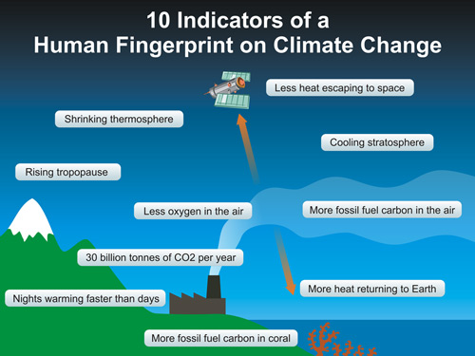
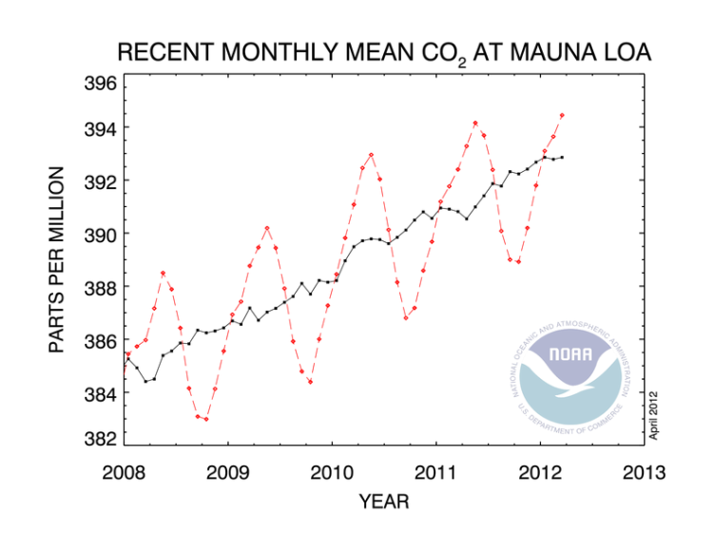
Final review
T/F: It is impossible for humans to change the chemical composition of the earth's atmosphere.
False

Slide 20


Final review
What type of heat transfer occurs when you touch a hot surface?
conduction

Slide 21
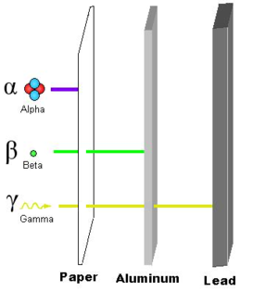
Final review
Which are the correct three radioactive particles and which one can penetrate matter the most?
Alpha
Beta
Gamma

Slide 22
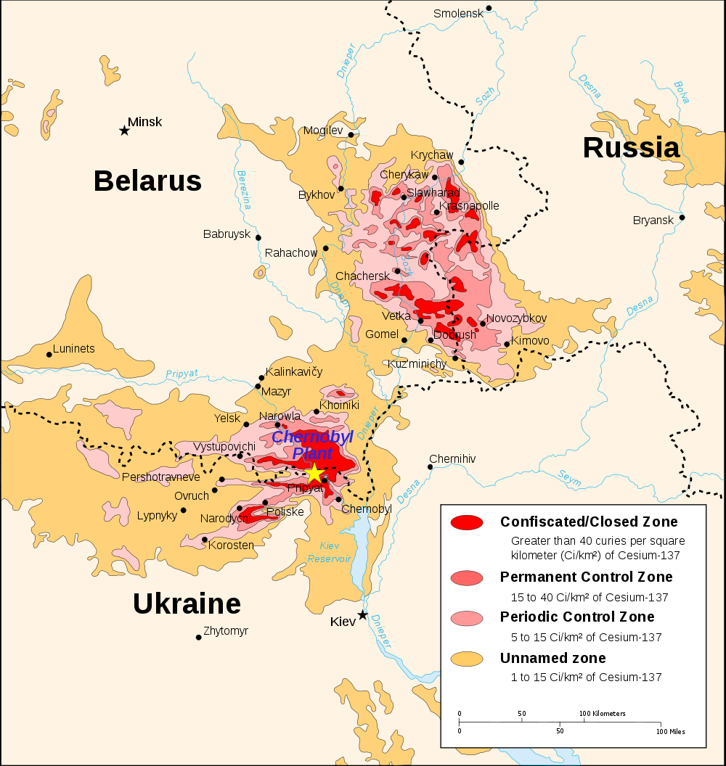
Final review
What is most dangerous about a radioactive isotope?
concentration
Curie’s per square kilometer

Slide 23
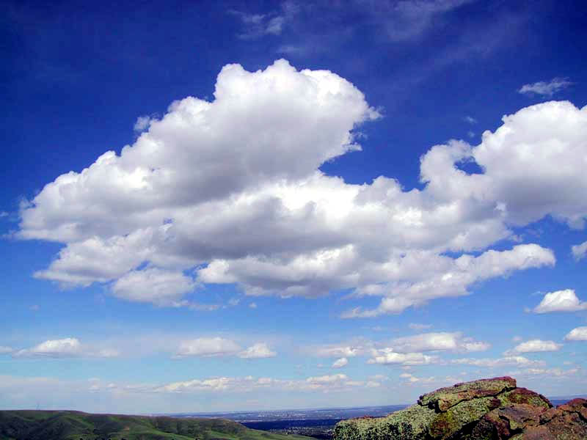
Final review
What greenhouse gas is most abundant?

Slide 24
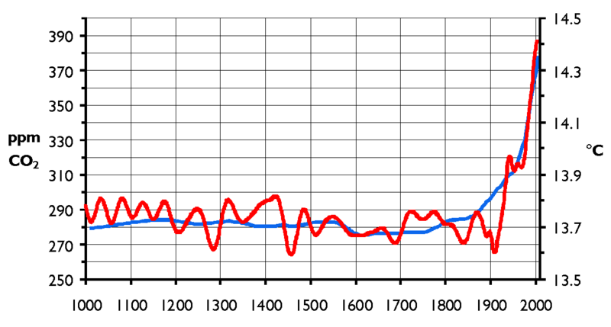
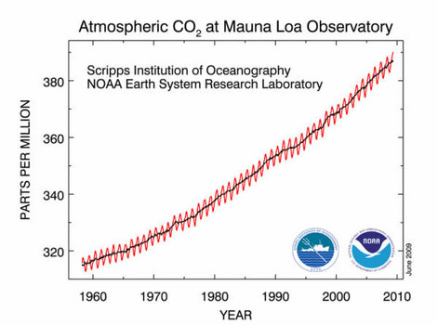
Final review
What is one empirical evidence for anthropogenic contributions to climate change?
Hockey stick graphs

Slide 25
Final review
Sound travels at about .2 miles per second. If you hear thunder 5 seconds after seeing lightning, about how many miles away is the lightening?
if
then

Slide 26
Final review
The valence electrons of an element have the electronic configuration 1s² 2s² 2p⁶. Identify the element and make a prediction about its tendency to react with other elements.
1
It’s a noble gas so it is very stable does react with other elements.
2

Slide 27
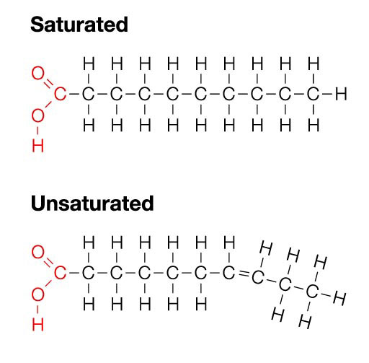
Final review
The major difference in the molecular structure of saturated and unsaturated fats is
Kinks

Slide 28
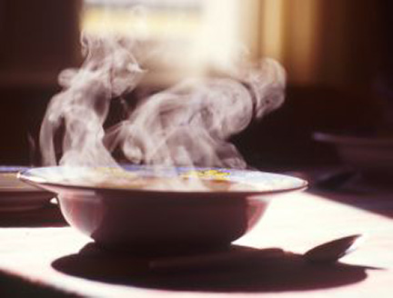
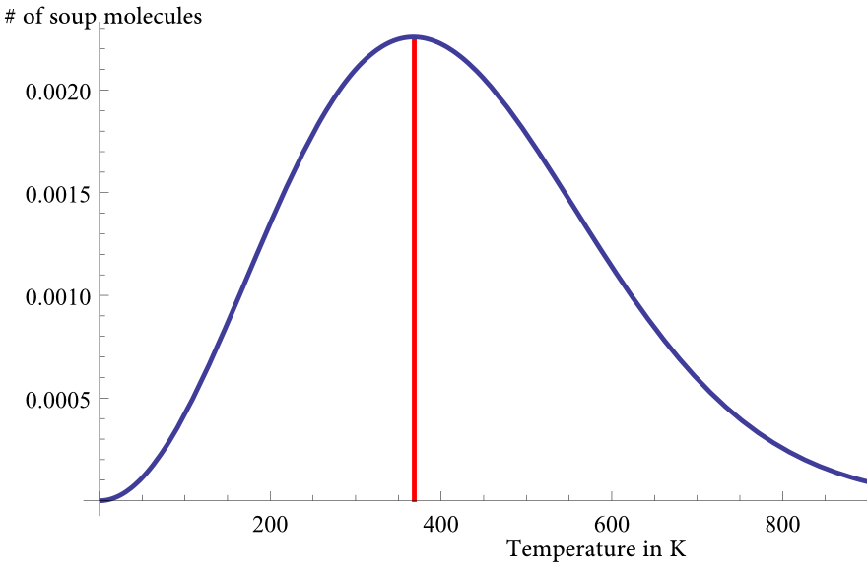
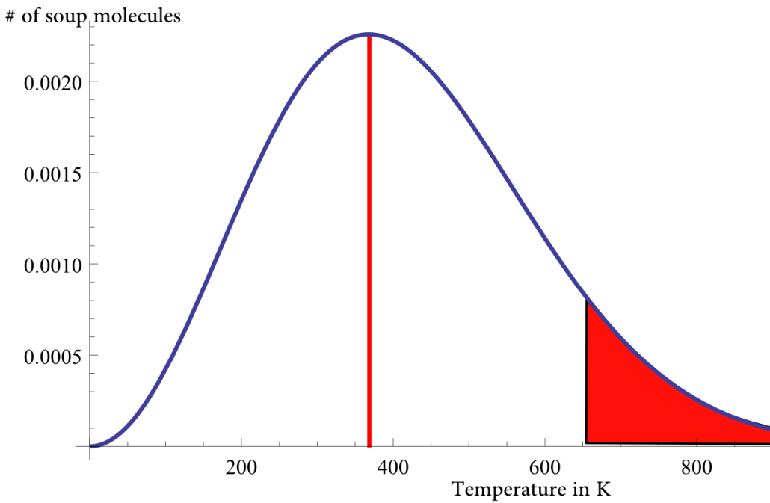
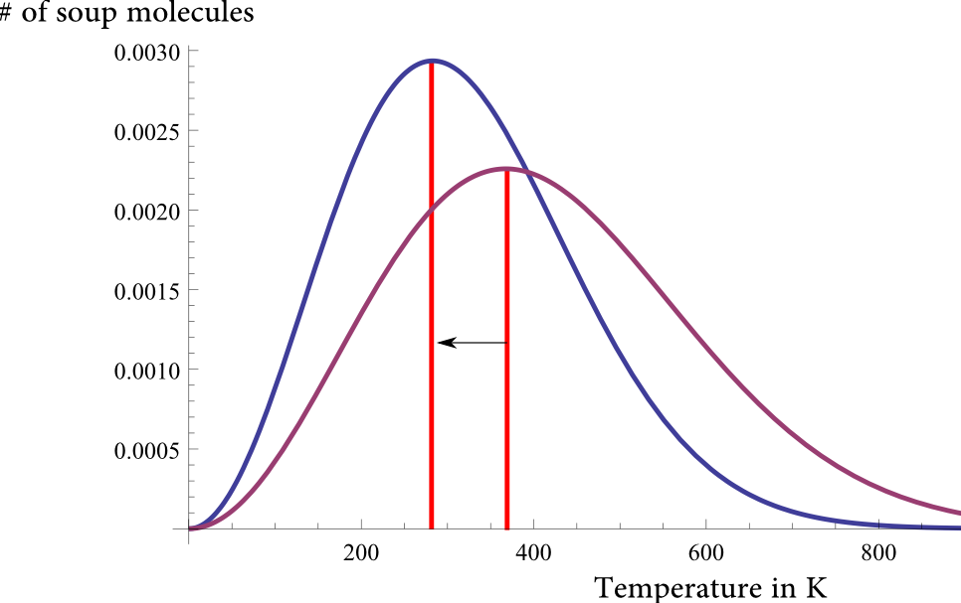
Final review
How are you able to cool soup by blowing on it?
Hottest soup molecules
~208F
Blow away the hottest molecules
~72F

Slide 29
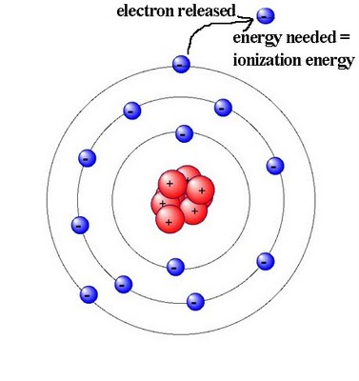
Final review
What is Ionization energy?
Energy required to free an electron from an atom

Slide 30
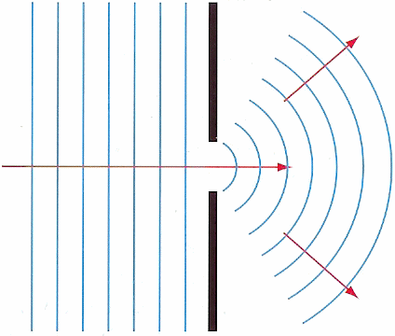
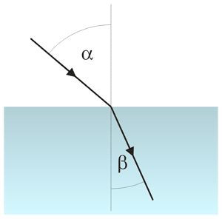
Final review
What is the difference between diffraction and refraction?
diffraction is light bending around corners
refraction is light bending at an interface between two different materials

Slide 31
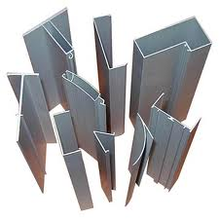

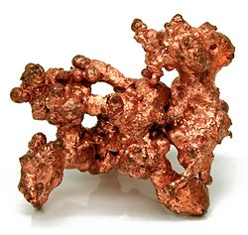
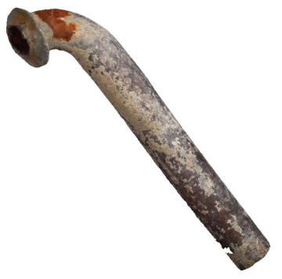
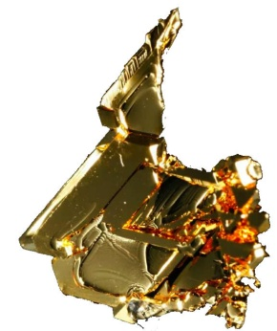
Final review
Rearrange the following materials in increasing density?
Aluminum Styrofoam lead gold copper

Slide 32

Final review
19.30 g·cm⁻³
11.34 g·cm⁻³
8.94 g·cm⁻³
2.70 g·cm⁻³
1.05 g·cm⁻³

Slide 33
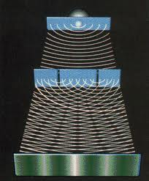
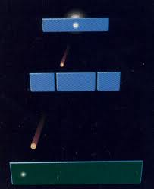


Final review
The double-slit experiment shows both the particle and the wave nature of matter by…
diffraction of electrons making inference patterns on a screen
…only when not observed at the slits

Slide 34
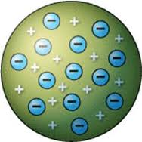
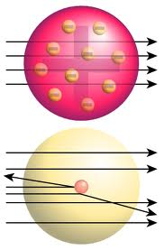
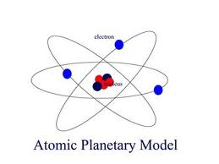
Final review
What were the sequence of events(experiments) and models that led to the Bohr model?
Atomic solar system model
Plum pudding model
Rutherford scattering experiment

Slide 35
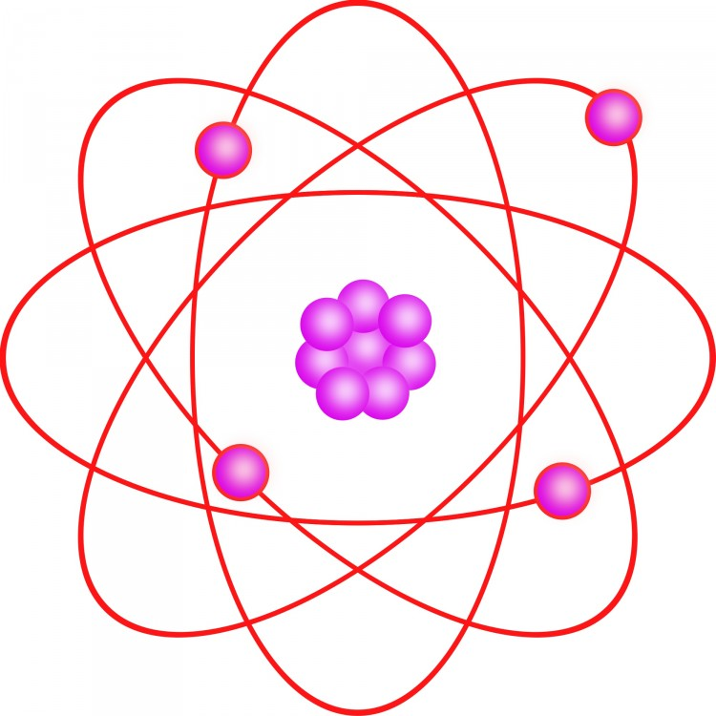
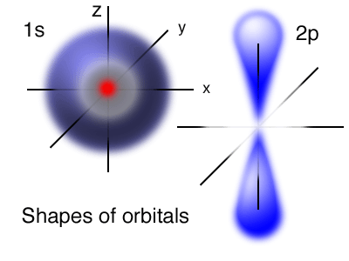
Final review
What is the difference between an orbital and an orbit?
orbit
orbital

Slide 36
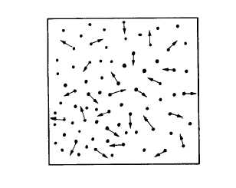
Final review
Temperature is a measure of…
Average kinetic energy of a system

Slide 37
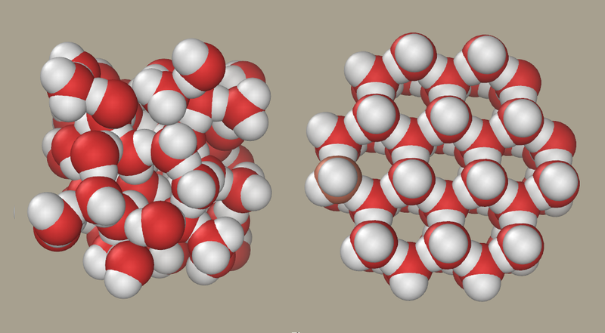
Final review
Why does water expand when it freezes?
The kinetic energy of the water molecules is low enough for hydrogen bonds between each water molecule to force the water into an open crystal.

Slide 38
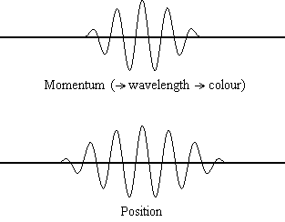
Final review
The Heisenberg uncertainty principle states:
There is a fundamental limit on which the position and momentum, can be simultaneously known.

Slide 39
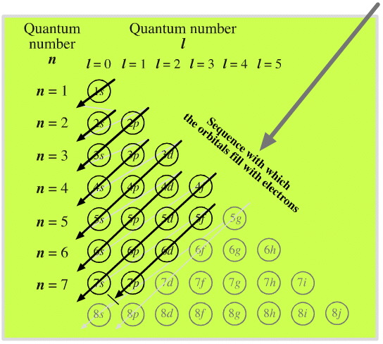
Final review
What principle states: No more than two electrons can occupy the same orbital (in a given shell)?
Pauli Exclusion Principle

Slide 40
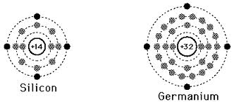
Final review
Chemical behavior is determined by the outermost electrons, called
Valence electrons

Slide 41
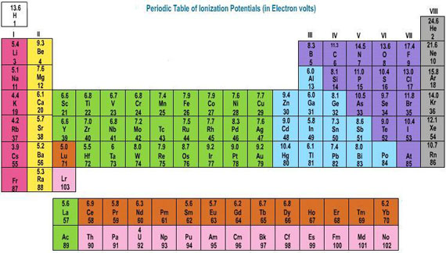
Final review
What is true about the periodic table?
Groups 1 and 17 are very reactive
Group 18 is very un-reactive

Slide 42
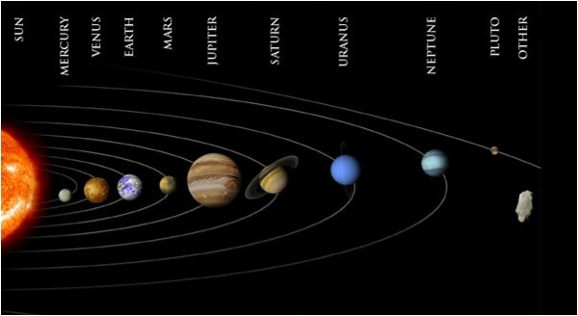
Final review
What’s true about our solar system?
Is the sun in the center of the Milky Way galaxy?

Slide 43
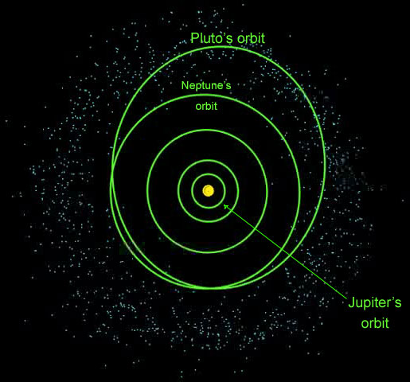
Final review
What exactly makes Pluto not a planet?
It does not clear its orbit…
Notes:
We see the "rule violation" that has arisen, but what does "cleared its neighborhood" mean? As planets form, they become the dominant gravitational body in their orbit in the Solar System. As they interact with other, smaller objects along their orbital path, they either consume them or sling them away with their gravity. Pluto is only 0.07 times the mass of the other objects in its orbit. The Earth, in comparison, has 1.7 million times the mass of the other objects in its orbit.

Slide 44
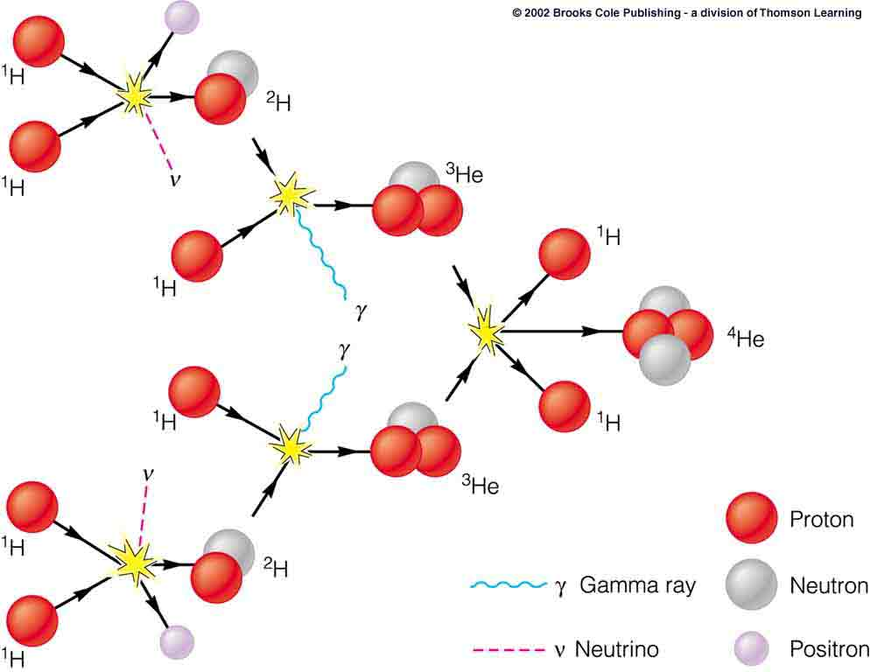
Final review
What element is in abundance within the Sun that will allow it to live another 5 billion years?
Hydrogen

Slide 45


Final review
A red star and a blue star have the same apparent brightness. What can you conclude about their distances away from you?
The red star is closer

Slide 46
Final review
What is the name of the diagram with the color/temperature relation in the main sequence of stars?
The Hertzsprung-Russell diagram

Slide 47


Final review
Super-massive black hole at the center of the Milky Way galaxy
Sagittarius A* is a

Slide 48

Final review
What happens to a star with a mass above 1.4 solar masses?
It eventually creates at least a Type Ia supernova.

Slide 49

Final review
The expansion of the universe is moving galaxies away from each other, but what is happening within the galaxies?
They are not expanding themselves…

Slide 50

Final review
According to the Hubble ultra deep field, about how old is the universe?
13.75 Billion Years old

Slide 51

Final review
Only 4% of the universe is matter that is familiar to us, i.e. atoms. What is the rest made of?

