Slide 1

November
Today
Ch. 25

Slide 2

December
Last class
Final Exam
Grades

Slide 3
Relax and read
“A New York plumber of foreign extraction with a limited command of English wrote the National Bureau of Standards and said he found that hydrochloric acid quickly opened drainage pipes when they got clogged and asked if it was a good thing to use.
A bureau scientist replied:
‘The efficacy of hydrochloric acid is indisputable, but the corrosive residue is incompatible with metallic permanence.’
The plumber wrote back thanking the bureau for telling him the method was all right.
The scientist was a little disturbed and showed the correspondence to his boss, another scientist.
The latter wrote the plumber: ‘We cannot assume responsibility for the production of toxic and noxious residue with hydrochloric acid and suggest you use an alternative procedure.’
The plumber wrote back that he agreed with the Bureau---hydrochloric acid works fine.
A tops scientist—the boss of the first two broke the impasse by tearing himself loose from technical terminology and writing this letter:
‘Don’t use hydrochloric acid. It eats the hell out of pipes.’”
- F.F. Colton, ScientificMonthly, 1949

Slide 4
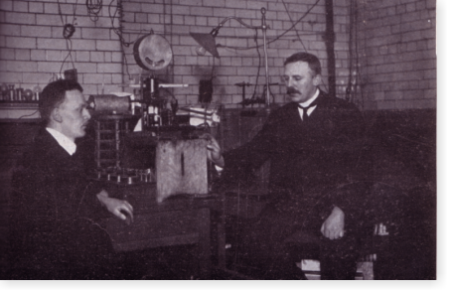
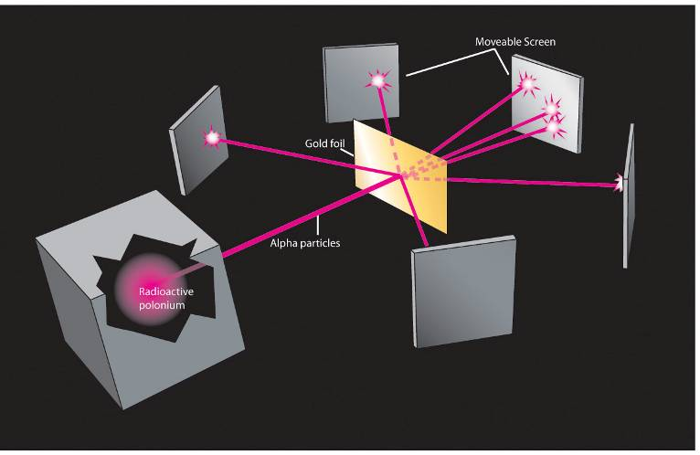
Chapter 25 Nuclear Physics
The atomic nucleus…
Contains positively charged protons.
Is held together by the Nuclear Strong Force.
Is very tiny

Slide 5
Modeling the nucleus
All of the previously discovered rules still apply.
Electric force law – protons will repel each other.
Wave-particle duality – protons and neutrons will behave as waves of probability.
Pauli exclusion principle – only one proton (or neutron) can occupy each possible state.

Slide 6
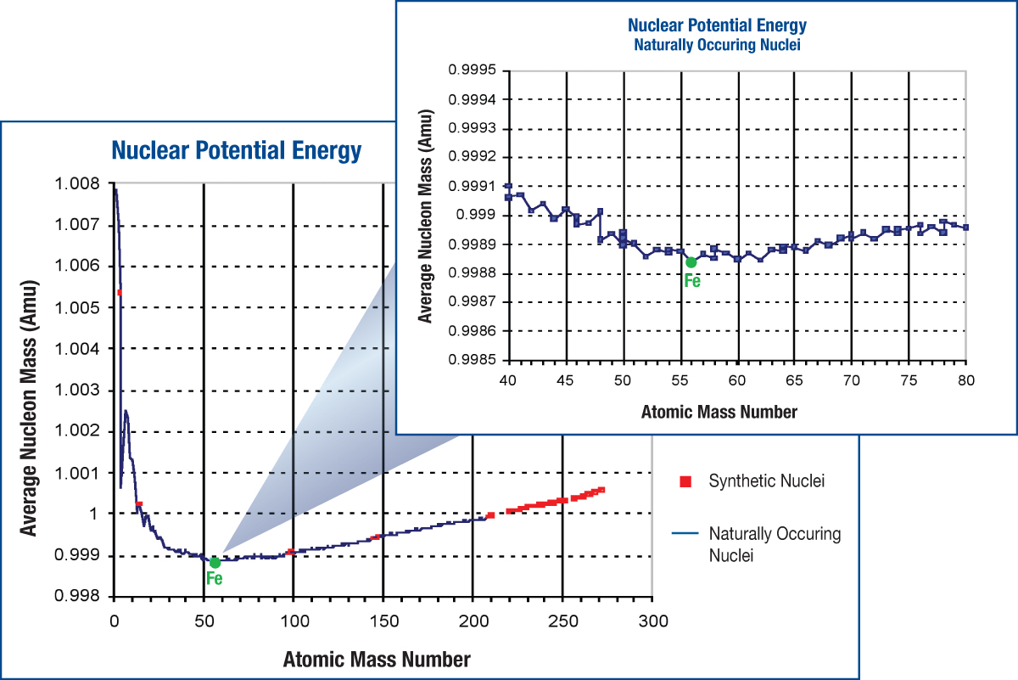
Where does the mass go? Why does the graph go down at low atomic mass?
E = mc²

Slide 7
Why would the graph increase at large atomic mass?
E = mc²

Slide 8
The graph abruptly ends. What does this tell us about the range of the nuclear strong force?
E = mc²

Slide 9

Q.Q. 7 Nuclear energy.
Which has more mass?
A proton by itself
A proton in an Iron nucleus
A proton in a Helium nucleus
An electron in a hydrogen atom

Slide 10
What two fundamental forces combine to make this shape for nuclei formation?
Energy
Nuclear strong and electromagnetic
Electromagnetic force
Strong force
He
Fe
Lv
Size of nucleus

Slide 11
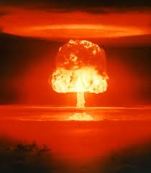
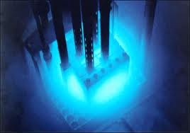
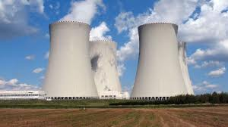
Energy is released or absorbed for nuclear process depending on the element…
Energy Released or Absorbed for nuclear process involving element “A”?
Mass | A < Iron | A > Iron
Fusion | Released | Absorbed
Fission | Absorbed | Released
Notes:
During World War I and after, young women at the U. S. Radium Corporation in Orange were employed painting luminous dial watches with a radium material. Apparently, the women were directed to point up their brushes with their tongues, imbibing radioactive paint. After the war, it was discovered that these women were dying of anemia and a disease called radium necrosis (radium poisoning) which ate away their jawbones. The initial investigation was made by Katherine Wiley of the Consumers League of New Jersey, who was called in by the family of one of the women in 1924. The League campaigned successfully to have radium necrosis recognized as an occupational disease by the State Workmen's Compensation Board in 1926, too late, however, to benefit women who had suffered from radium poisoning before the law was passed. The League aided them with their lawsuits until 1935, when all proceedings for damages against U. S. Radium were stopped. The universal horror caused by this case contributed to the passage in 1949 of a bill making all industrial diseases compensable and extending the time during which workers could discover illness.

Slide 12
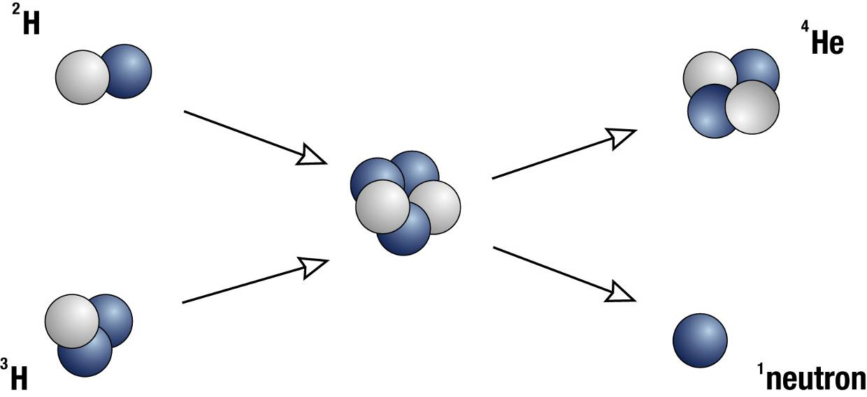
Fusion
Combining two small nuclei to make a larger one gives off energy.
Abundant fuel (in sea water) and large energy gain make this a very exciting possibility.
The catch: Because nuclei are positively charged, you need either extremely hot reactants or large confining forces.
What forces do you have available for confinement?

Slide 13
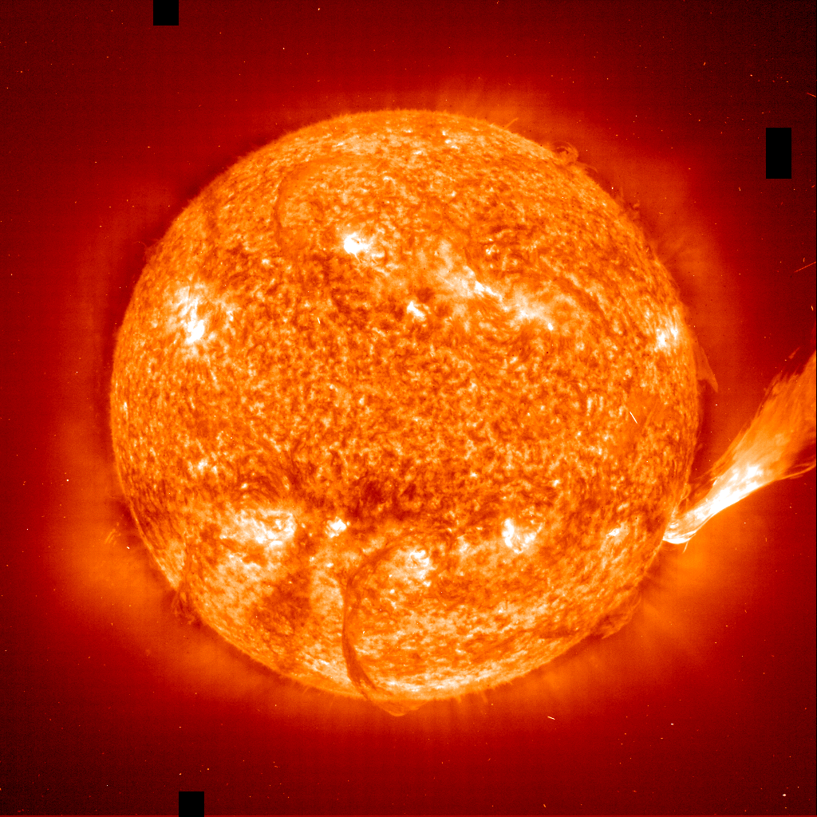
Gravitational confinement

Slide 14
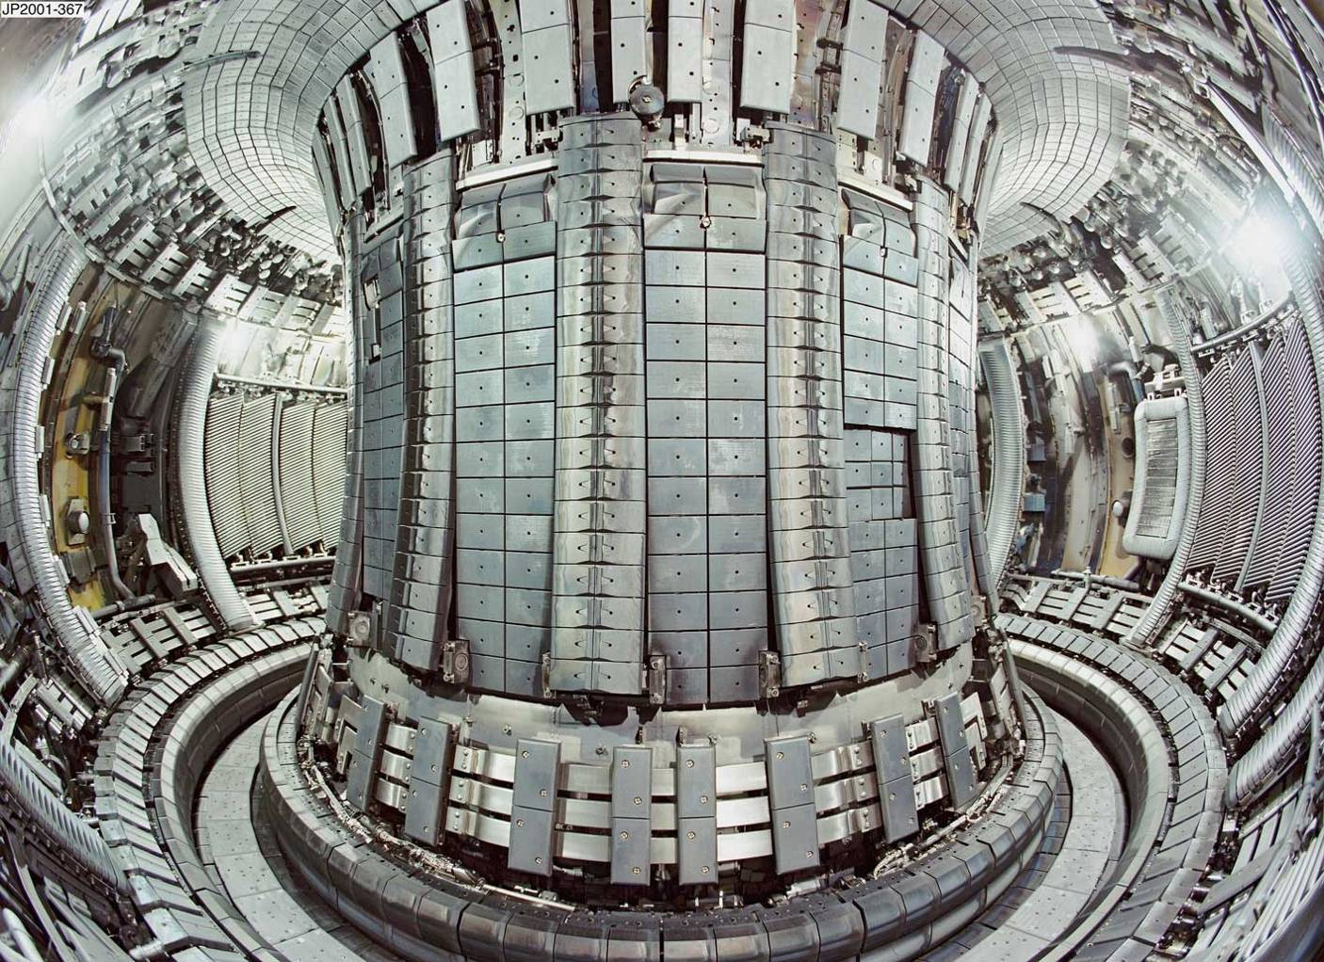
Confinement using magnetic fields: Tocamak

Slide 15
Q.Q. 8 What two fundamental forces combine to make this shape for nuclei formation?
Energy
Distance between nucleons

Slide 16
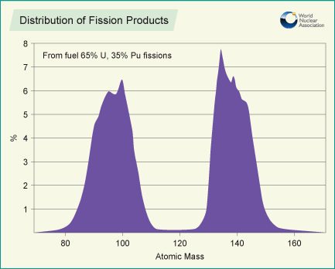
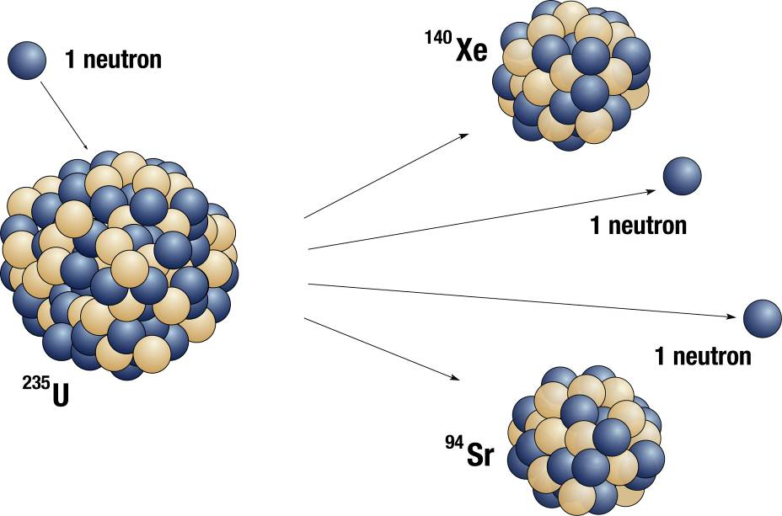
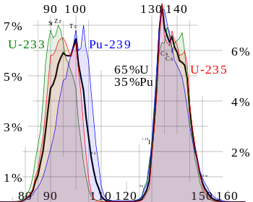
Fission
Breaking one extremely large nucleus into two smaller ones gives off energy.
Free neutrons from one fission can trigger another fission, creating a chain reaction.

Slide 17
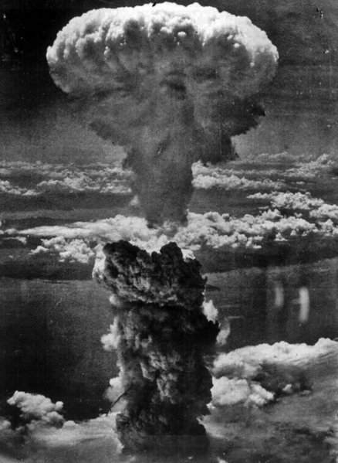
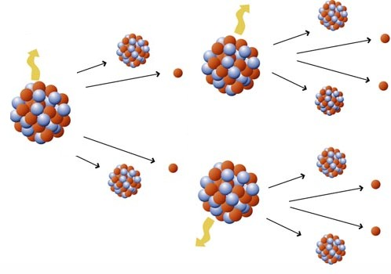
Fission Process
Notes:
mass of fragments vary, but usually 2 fragments and 2-4 neutrons come out. The extra neutrons can trigger other reactions. This process is much more probable with slow neutrons (they spend more time near the nucleus and have more time to react).

Slide 18
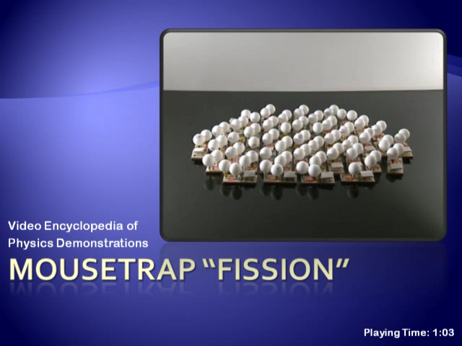
A chain reaction

Slide 19
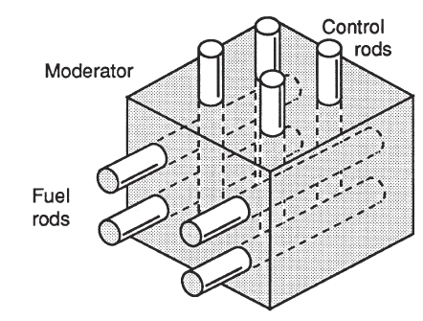
Fission Reactor
Fissile material (fuel rods)
²³⁵U, ²³⁹Pu
Moderator
Slow neutrons down
Control rods
Absorb extra neutrons
Problems
radioactive waste
fuel is rare
fuel can be misappropriated for weapons
mistakes are costly
Notes:
²³⁹Pu can be produced in a breeder reaction
fuel rods, ²³⁵U and ²³⁹Pu
good control rod: cadmium
good moderator: graphite, water
wastes have a long half life. Yucca Mountain--repository in Nevada: a place to put this (Nevada residents do not want to be the nuclear dumping ground of the nation). Nearby states (including Utah) don’t want fuel going through their state on the way there.

Slide 20
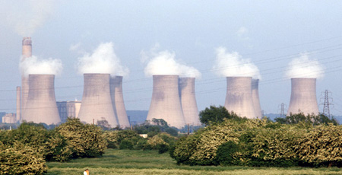
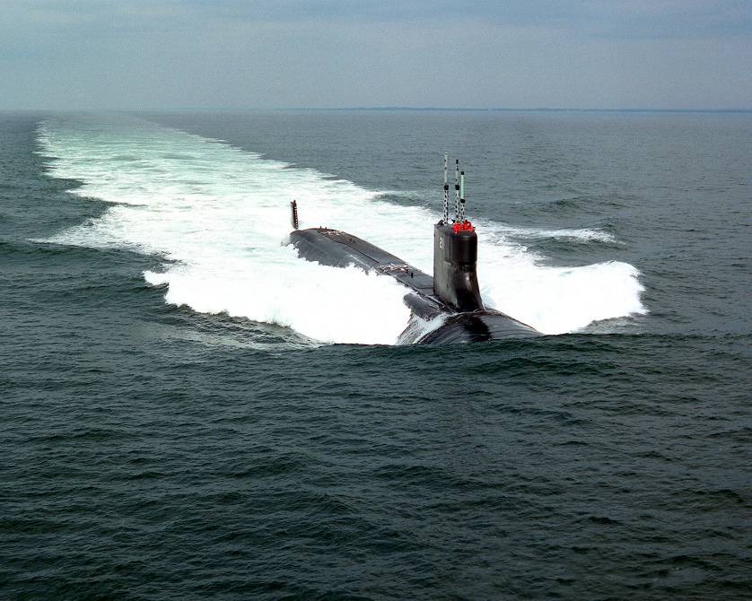

Current applications for fission reactors

Slide 21
Radioactive decay
Alpha decay
A nucleus emits 2 protons and 2 neutrons
Beta decay
A nucleus emits 1 electron
Gamma decay
A nucleus emits a high-energy photon

Slide 22
Ionizing Radiation
The particles released in decay carry a lot of energy
often a million times typical molecular binding energies
danger to living cells
damage RNA or DNA causing death of cells or mutations
disrupt metabolic processes
cells with high activity seem more prone to damage than others (cancer therapy)
Notes:
damage could be direct (damage RNA directly) or disrupt other molecules that then damage DNA or RNA
cal also be used to control cancer

Slide 23
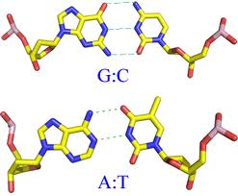
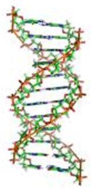

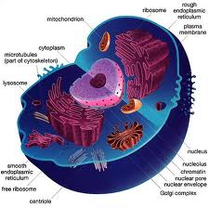
The nuclear truth
Highly radioactive isotopes are dangerous if…
there are many of them highly concentrated
they have high R.B.E.
a number that expresses the relative amount of damage that a fixed amount of ionizing radiation of a given type can inflict on biological tissues
alpha particles
beta particles
Gamma rays

Slide 24
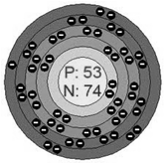
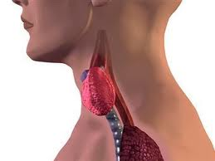
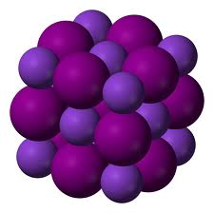
Potassium Iodide pills prevent concentration of I-131 in the thyroid
I-131
I-127

Slide 25
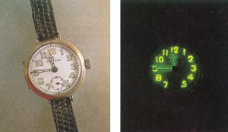
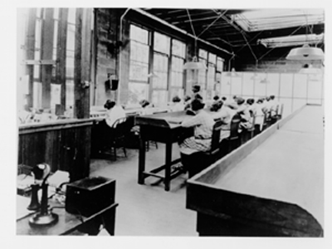
Radium watches
During World War I and after, young women at the U. S. Radium Corporation in Orange were employed painting luminous dial watches with a radium material. Apparently, the women were directed to point up their brushes with their tongues, imbibing radioactive paint. After the war, it was discovered that these women were dying of anemia and a disease called radium necrosis (radium poisoning) which ate away their jawbones.
Notes:
During World War I and after, young women at the U. S. Radium Corporation in Orange were employed painting luminous dial watches with a radium material. Apparently, the women were directed to point up their brushes with their tongues, imbibing radioactive paint. After the war, it was discovered that these women were dying of anemia and a disease called radium necrosis (radium poisoning) which ate away their jawbones. The initial investigation was made by Katherine Wiley of the Consumers League of New Jersey, who was called in by the family of one of the women in 1924. The League campaigned successfully to have radium necrosis recognized as an occupational disease by the State Workmen's Compensation Board in 1926, too late, however, to benefit women who had suffered from radium poisoning before the law was passed. The League aided them with their lawsuits until 1935, when all proceedings for damages against U. S. Radium were stopped. The universal horror caused by this case contributed to the passage in 1949 of a bill making all industrial diseases compensable and extending the time during which workers could discover illness.

Slide 26
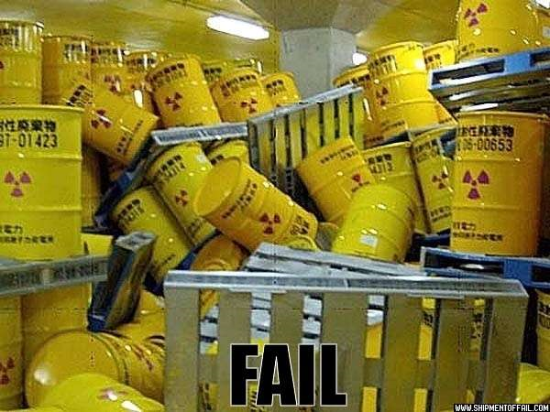
Q.Q. 9 What are the three types of radioactive decay?
Don’t
me

Slide 27
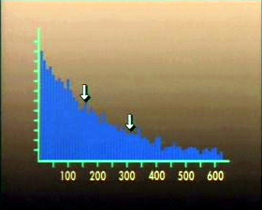
Half Life
The half life is the time it takes half a sample of radioactive nuclei to decay
Importance examples
¹⁴C --> ¹⁴N + e + neutrino (half life of 5730 years)
⁴⁰K + e --> ⁴⁰Ar + neutrino (half life of 1.3 billion years)
is applicable only to matter which was once living and presumed to be in equilibrium with the atmosphere, taking in carbon dioxide from the air for photosynthesis.
Carbon-14 decays with a halflife of about 5730 years by the emission of an electron of energy 0.016 MeV. This changes the atomic number of the nucleus to 7, producing a nucleus of nitrogen-14. At equilibrium with the atmosphere, a gram of carbon shows an activity of about 15 decays per minute.

Slide 28
Q.Q. 10 What nuclear reaction is this?

Slide 29
Radioactive Dating
Each half-life, half of the remaining atoms are left undecayed.
One half-life--> ½
Two half-lives--> ½ x ½ = 1/4
Three half-lives--> ½ x ½ x ½ = 1/8
If the original number of atoms is known, the age of the sample can be determined by the fraction of atoms left.
This process is known as radioactive dating

Slide 30
A sample of radioactive gas is produced. After 20 minutes, only ¼ of the original gas remains. What is the half life of the gas?
5 minute
10 minutes
15 minutes
20 minutes

Slide 31
A sample of radioactive material with a half-life of 6 hours sits for a day (24 hrs). How much of the original material remains?
A half
A quarter
An eighth
A sixteenth

Slide 32
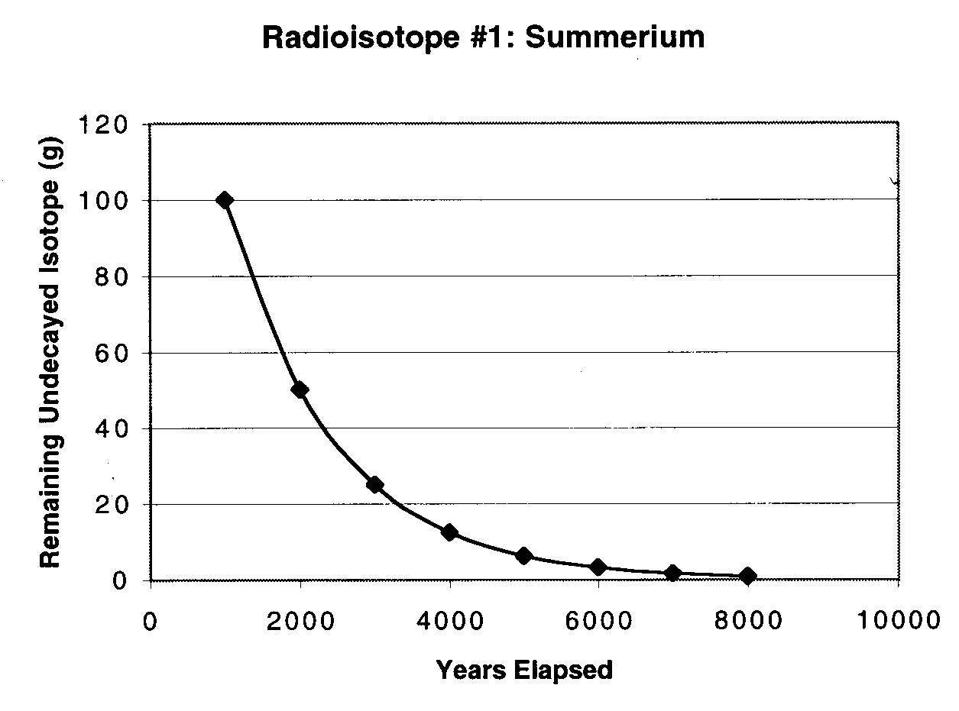
Procedure to find half-life of an element

Slide 33
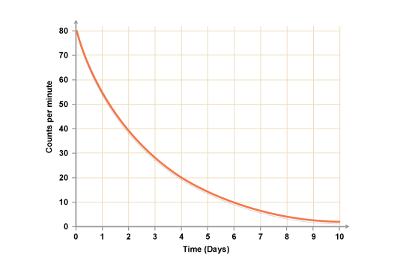
Q.Q. 11 Half Life
What is the Half Life of this radioactive sample?

