Slide 1
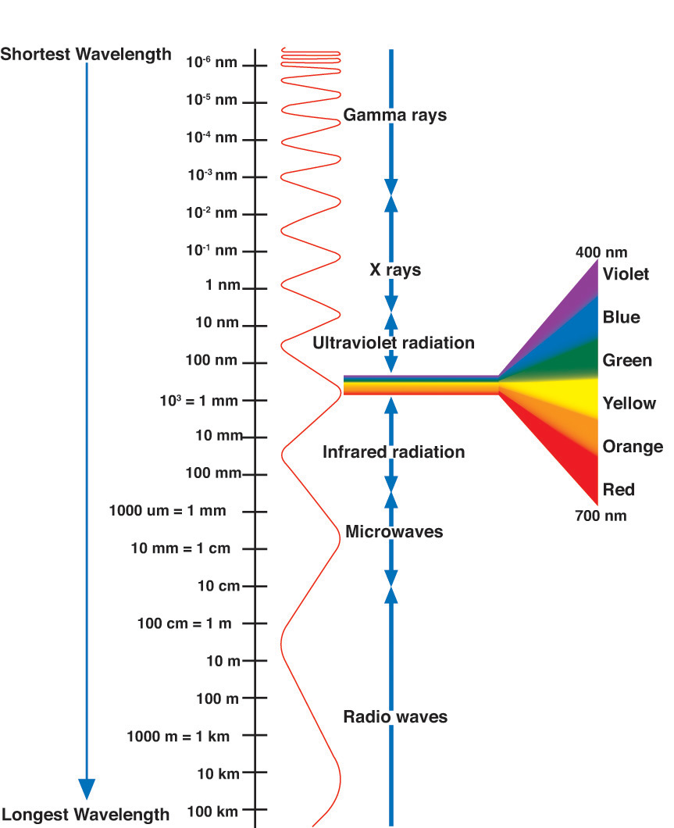
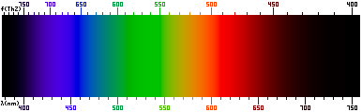
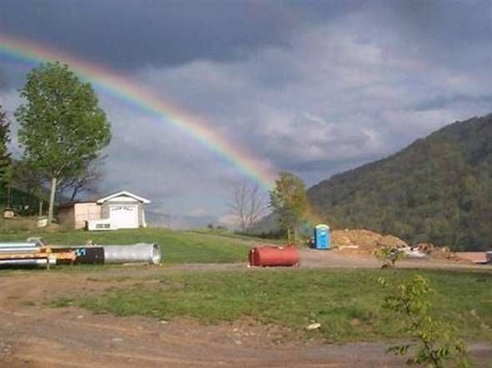
The electromagnetic spectrum
The pot at the end of the rainbow…
Notes:
Finally,
someone has managed to photograph
the pot at the end of the rainbow!!!
Wouldn't you know it!!!!!

Slide 2

If light is a wave then…
It can Doppler shift like sound!

Slide 3
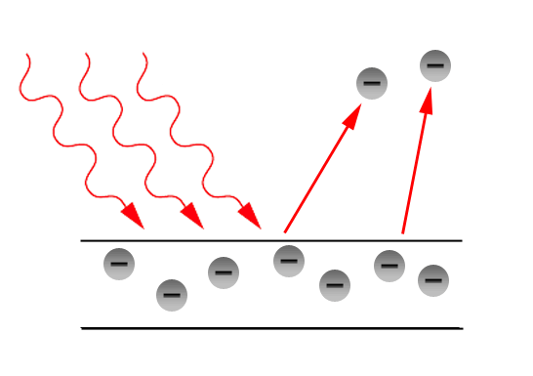
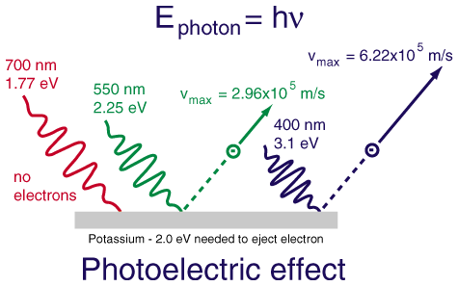
Particle Behavior- The photoelectric effect
Energy in a normal wave is proportional to amplitude.
i.e. What determines if a wave has enough energy to knock you over at the beach?
However, it wasn’t the amplitude that determined whether light could eject electrons, it was the frequency!
Energy = h x (frequency)
Explained if light is interacting like a particle with the electrons in the metal!
Greater energy = greater numbers of photons.
Each individual photon has an energy of hf where h = Planck’s constant (very small) and f = frequency.

Slide 4
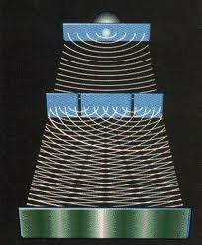
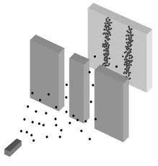
Wave Particle Duality
Light is both a wave and a particle.
It behaves like a wave when unobserved
It travels through both slits like a wave
It is detected like a particle
It hits the screen as individual dots

Slide 5
If this bothers you, you are in good company!
“All these 50 years of pondering have not brought me any closer to answering the question, ‘what are light quanta?’ These days every Tom, Dick, and Harry thinks he knows it, but he is mistaken.”
~ A. Einstein
Notes:
From P. A. Schlipp, “Albert Einstein: philosopher-scientist” Harper and Row Publishers, New York, 1959,
as quoted in Todd Pittman’s Dissertation

Slide 6
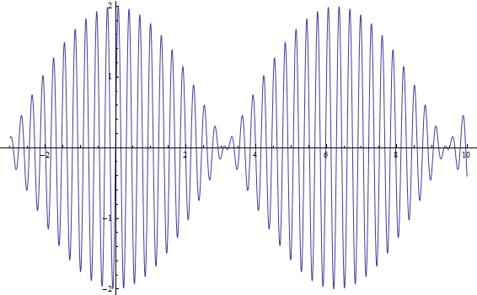
QQ1: Wave Particle Duality
Why is light both like a wave and a particle?

Slide 7
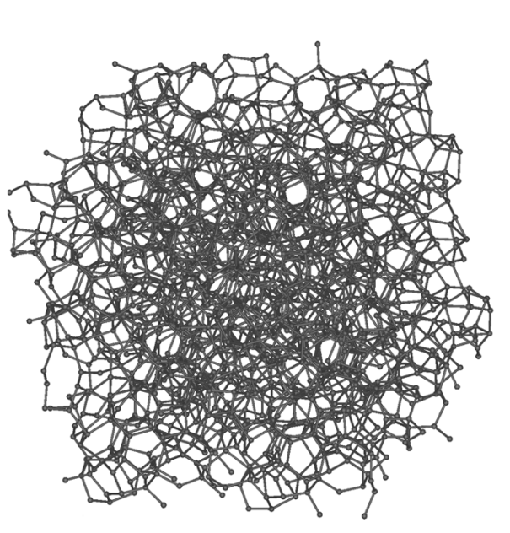

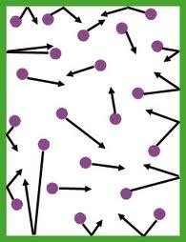
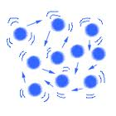
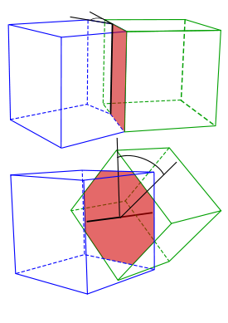
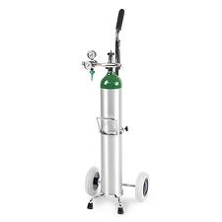

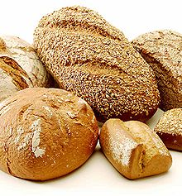
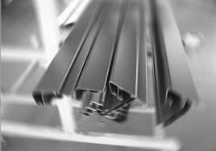
Moving on: Internal atomic structure of materials
Polycrystalline Solid
Amorphous Solid
Gas
Liquid

Slide 8
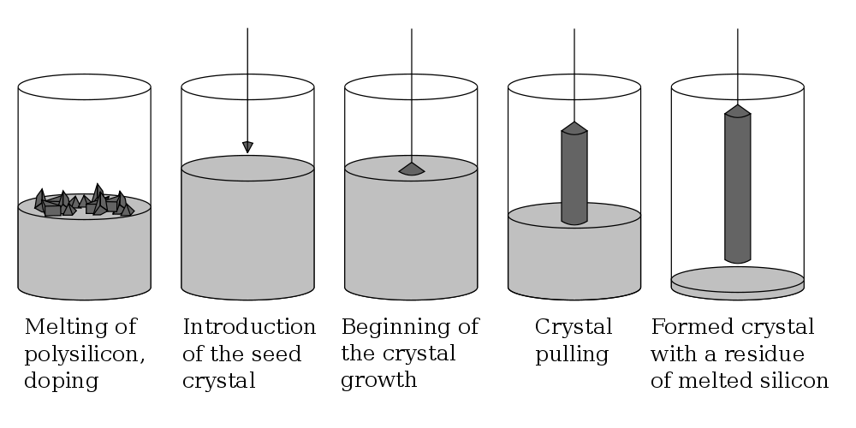
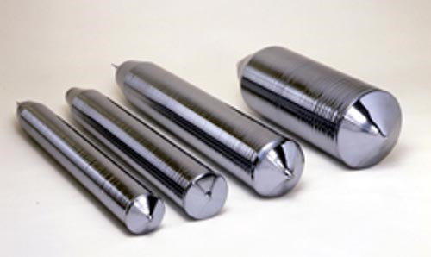
How about a perfect crystal with long range order?
Perfect Silicon Crystal growth

Slide 9
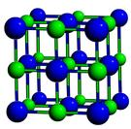

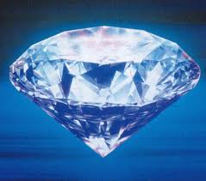
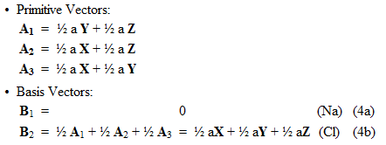
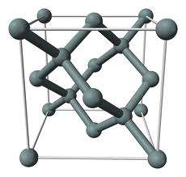
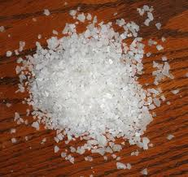
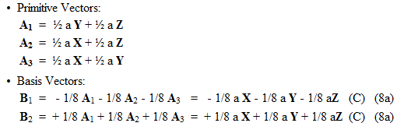
Mathematical Crystal Structures
Table Salt!
chlorine
sodium
Diamond is hard but not dense. It has strong directional bond strengths and a very open crystal structure.

Slide 10
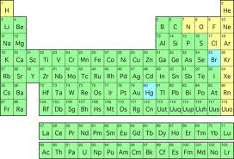
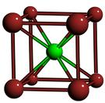
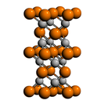
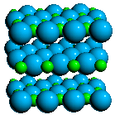
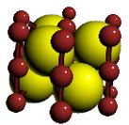
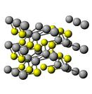
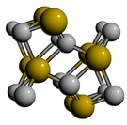

Supercomputer predicts nature
Choose 2 elements
Choose a crystal structure
…
3. Calculate likelihood of natural existence
Mary-Lou at BYU
928 nodes 9796 cores 28 TB memory
Hex-core Intel Westmere (2.67 GHz)
L1 cache 64KB per core L2 cache 256KB per core L3 cache 4MB to 30MB shared
Connected by Infiniband

Slide 11
QQ2: Crystal Structures
If the blue spheres are chlorine and the green spheres are sodium, what is this substance?
Sugar
Corn Starch
Salt
Mango

Slide 12
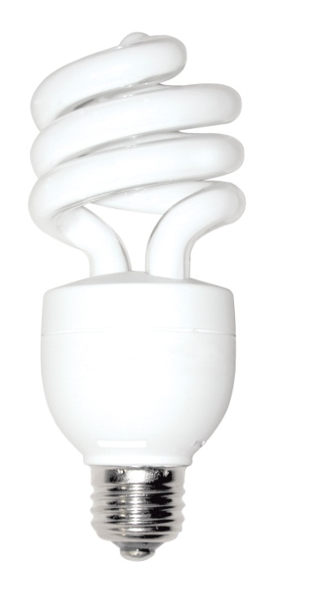
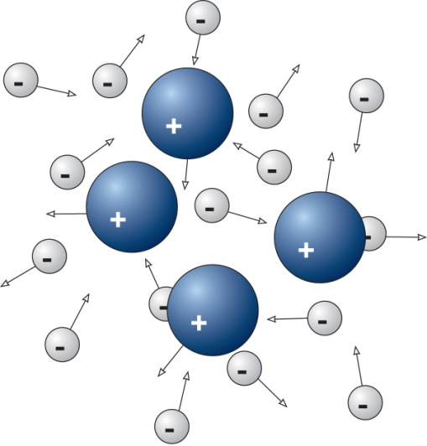
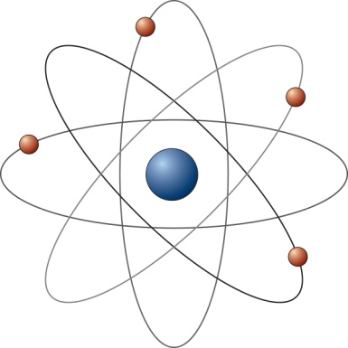
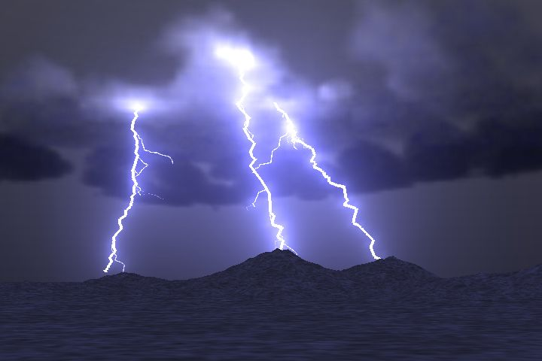
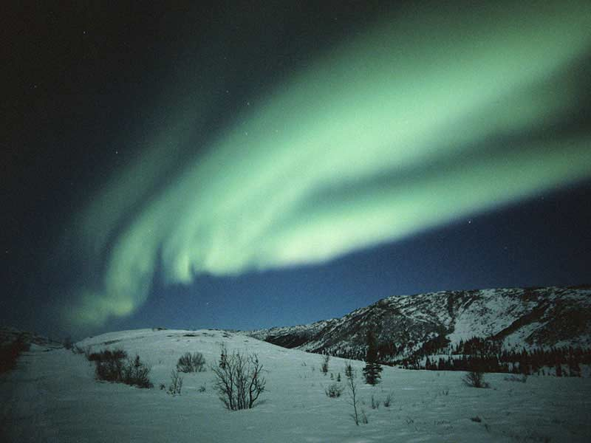
A 4th state of matter… Plasma
Plasma: ionized gas; electrons become detached from atoms

Slide 13
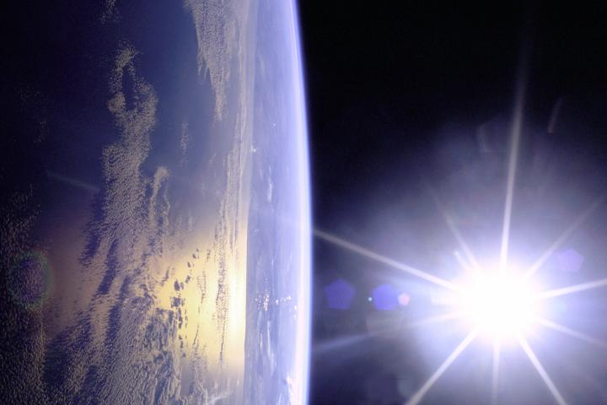

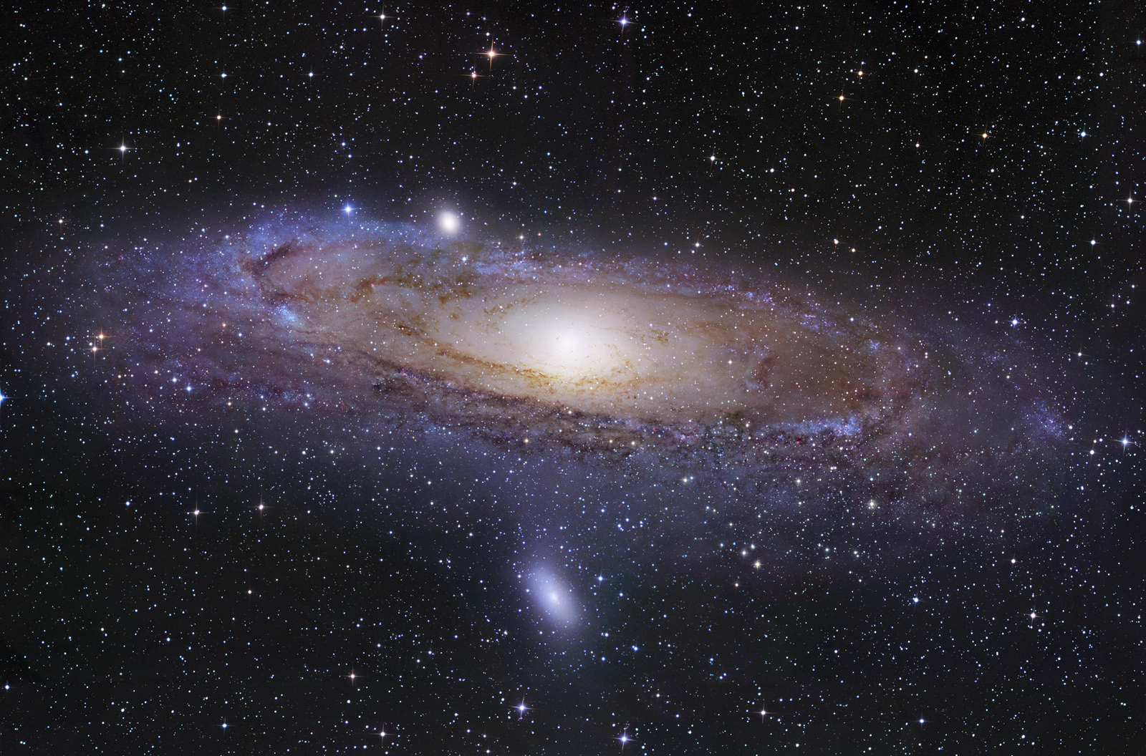
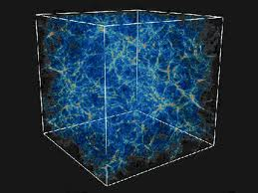
What is the most common state of matter in the visible universe?
Solid
Liquid
Gas
Plasma
The visible universe!
Earth
A galaxy

Slide 14
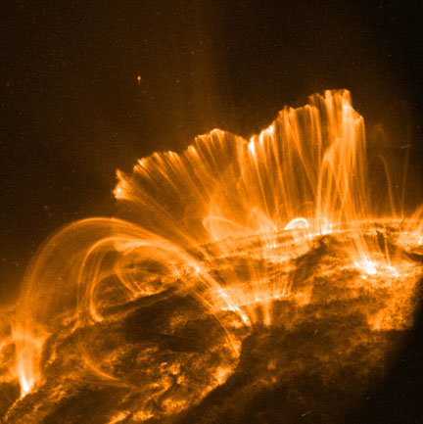
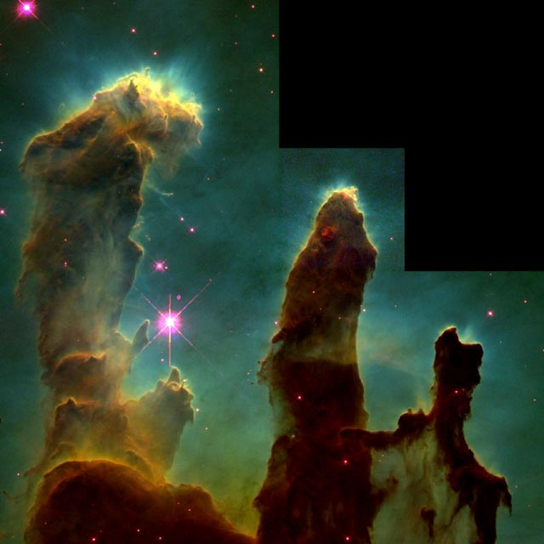
Over 99% of the visible universe is in the plasma state
Coronal Loops on the Sun (~250,000 miles long)
Eagle Nebula (Fingers are ~1 Light Year)
Notes:
Close-up images reveal an active surface with coronal loops emerging and disappearing all over the Sun's surface and can span a length of about 250,000 miles, or about 30 times the diameter of Earth.
Image is hubble view of eagle nebula, those tremendous pillars of gas and dust are more than a light year in length

Slide 15
An Interesting Parallel
Ancient (Aristotle)
Four elements of matter
Earth
Water
Air
Fire
Modern (Quantum Mechanics)
Four states of matter
Solid
Liquid
Gas
Plasma

Slide 16
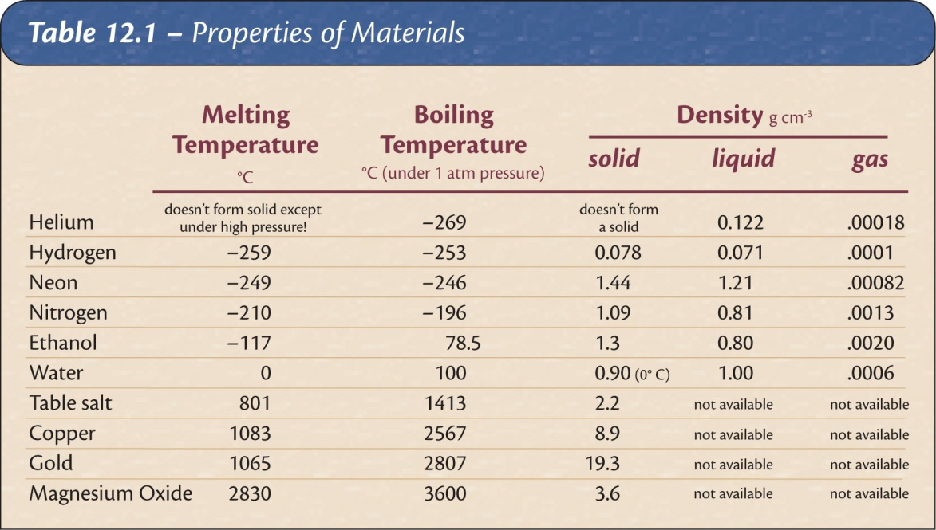
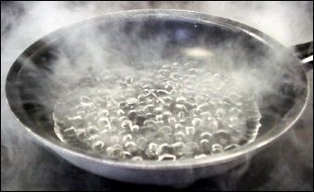
Changes of State
State is a function of temperature (and pressure).
Different materials change state at different temperatures.

Slide 17
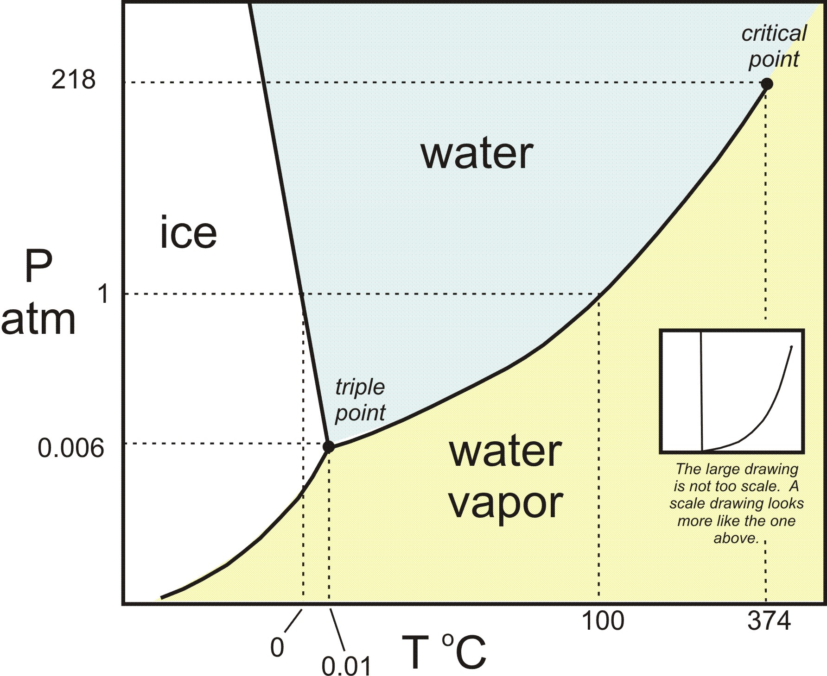

An example – Dihydrogen-Monoxide
Pressure
(atm)
$$\frac{1}{3}\text{atm}$$
69 °C
Temperature(Celsius)

Slide 18
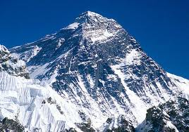
Recreation
State is a function of temperature (and pressure).
Different materials change state at different temperatures.
As water begins to boil on the top of Mt. Everest, would it burn you?
1/3 atm
156.2 °F

Slide 19
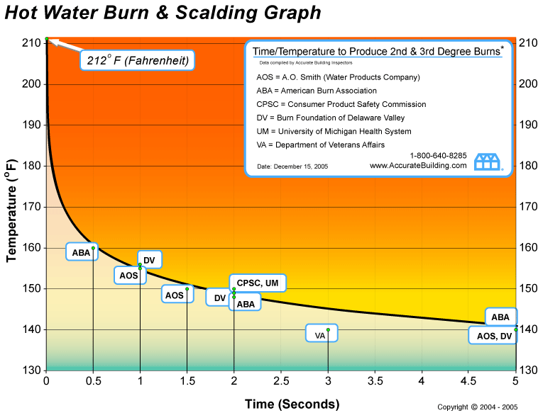
Varying sources of truth

Slide 20
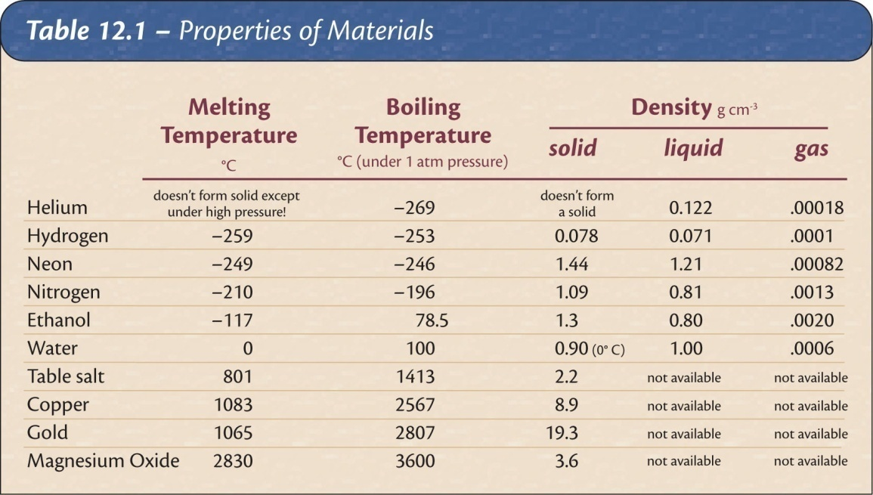
An unknown solid melts at -50 degrees. Which of the following would most likely be its boiling point?
-120 degrees
0 degrees
90 degrees
1,000 degrees
The temperatures at which substance transform from solid to liquid and liquid to gas give information about the strength of the bonds holding the material together.

Slide 21
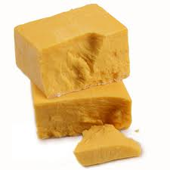
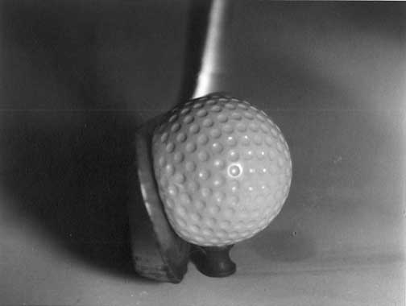


Deformation
Elastic deformation: object returns to its original shape after the deforming force is removed.
Plastic deformation: object retains its new shape when the force is removed.
Elastic limit: transition point between elastic and plastic deformation for a material.
Notes:
Which has the larger elastic constant, rubber band or table?

Slide 22
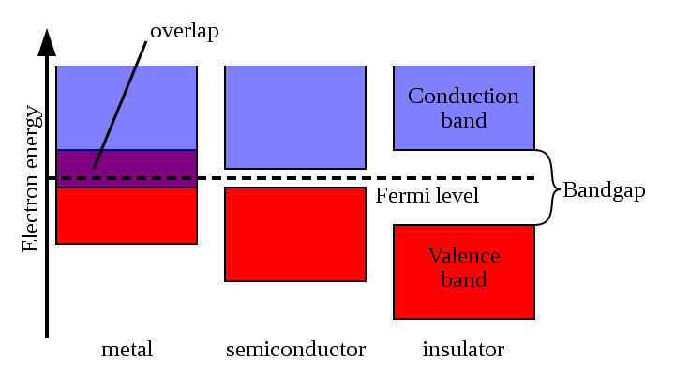



Electrical conductivity of solids
Conductor - electric current flows easily
Semiconductors - allow current under special conditions
Insulator - resists flow of current
conductor
semiconductor
conductor
semiconductor
insulator
insulator
Notes:
Metals: silver, copper, gold
Semiconductors: germanium, silicon
Insulators: glass, mica, polyethylene

Slide 23



Electrical Conductivity of liquids
Ionic materials – make water more conductive
Nonionic – make water less conductive
Notes:
Metals: silver, copper, gold
Semiconductors: germanium, silicon
Insulators: glass, mica, polyethylene

Slide 24

Electrical Conductivity of gases
Click!
Notes:
Metals: silver, copper, gold
Semiconductors: germanium, silicon
Insulators: glass, mica, polyethylene

Slide 25
QQ3: What is this state of matter?

Slide 26
QQ4: What is the most common state of matter in the visible universe?
Solid
Liquid
Gas
Plasma
Earth

Slide 27


The color of an object gives information about its composition
The color of an object is determined by what wavelengths of light it reflects (or emits)
Examples: Tomatoes reflect red light, and absorb other colors.
Clover reflects green colors, absorbs others

Slide 28
The spectrum of light source is a measure of which wavelengths are present
continuous spectrum
discrete spectrum -- only a few specific colors
Discrete absorption spectrum – All colors but a few lines

Slide 29



The Molecular Model of Matter

Slide 30

Continuous model of matter

Slide 31
QQ5: Density vs. Weight
What is heavier, 3lbs. of steel or 3 lbs. of Styrofoam?
Styrofoam
Steel

Slide 32
Continuous Model
Useful in many situations:
Fluid dynamics
Classical Electrodynamics
Has many limitations
Charge and light come in distinct packets
How do changes of state occur??!?
Etc.

Slide 33

Brownian Motion
The erratic, jittery motion of a dust speck in a fluid is strong evidence supporting the molecular model.
The speck is colliding randomly with unseen molecules.
Notes:
In both cases the fluorescent particles are 2 microns in diameter. The left picture shows particles moving in pure water; the right picture shows particles moving in a concentrated solution of DNA, a viscoelastic solution in other words. The movies are 4 seconds of data, total; you can see a slight jump in the movie when it loops around.
http://www.deas.harvard.edu/projects/weitzlab/research/brownian.html

Slide 34

States Explained
Solid: The molecules are frozen in place but still vibrate.
Liquid: The molecules move past each other but still have a weak attraction.
Gas: The molecules only interact when they collide.
Plasma: The molecules collide with enough energy to break into charged pieces.

Slide 35
Temperature Explained
Temperature is a measure of the average kinetic energy of the molecules.
Cold → slowly moving
Hot → rapidly moving
Absolute zero → motion ceases (-460 F, -273 C)
Notes:
Because the oven doesn't go to 700 degrees.

Slide 36
Temperature Explained
Example: At room temperature molecules are moving about 1,000 ft/s
Notes:
Because the oven doesn't go to 700 degrees.

Slide 37
Temperature Explained
Example: At room temperature molecules are on average about .0000002 feet apart
Notes:
Because the oven doesn't go to 700 degrees.

Slide 38


Temperature is a measure of the average kinetic energy of a collection of molecules

Slide 39
Off to the molecular races
K.E. = ½ mv²
the same for both NH₃ and HCl
but HCl has about twice the mass

Slide 40

Evaporation Explained
Temperature is a measure of the average kinetic energy.
Some molecules go faster and some go slower.
The fast ones escape as a gas even when the average temperature is below boiling.
How are you able to cool soup by blowing on it?

Slide 41
QQ6: Temperature is a measure of
The number of particles in a system
The average kinetic energy of the molecules.
The rate of change of chemical reactions
Heat flow in the room
Nitrogen content
Notes:
Because the oven doesn't go to 700 degrees.

Slide 42

State changes and the molecular model
Temperature is molecular kinetic energy.
Internal energy includes kinetic plus electrical potential energy from how the molecules are arranged.

Slide 43
QQ7: Random Molecular Collision Motion
What is this erratic, jittery motion called?
Greenian Motion
Soberiety Waltz
Kinetic Theory
Brownian Motion
Anxiety Induction
Notes:
In both cases the fluorescent particles are 2 microns in diameter. The left picture shows particles moving in pure water; the right picture shows particles moving in a concentrated solution of DNA, a viscoelastic solution in other words. The movies are 4 seconds of data, total; you can see a slight jump in the movie when it loops around.
http://www.deas.harvard.edu/projects/weitzlab/research/brownian.html

Slide 44

Gas Pressure Explained
Like throwing a huge number of tiny balls against a wall repeatedly.

Slide 45
Gas Pressure and Temperature
Gas pressure increases with temperature if the gas cannot expand. The hotter molecules hit the container walls harder and more often than the cold ones.
Colder
Hotter

Slide 46


If the temperature in a closed room increases…
The pressure decreases
The pressure increases
The number of gas molecules increases

Slide 47
QQ7: If the temperature in a closed room increases…
The pressure decreases
The pressure increases
The number of gas molecules increases

Slide 48

The Physical Properties of Matter
QQ8: Kinetic Theory
How are you able to cool soup by blowing on it?

Slide 49


Finally, we have actually “seen” atoms using special microscopes
Graphite
Iron on Copper (Gen shi = atom)

Slide 50


Why does water expand when it freezes?
Go to PhET
Notes:
Deflect water drops using a staticly charged rod.

Slide 51
The Physical Properties of Matter
QQ9: Shapes
A
B
C
Each curve is a Boltzmann distribution for a gas of the same molecular species. Which one is hottest A,B or C?

Slide 52


Review: Which type of electromagnetic radiation has the highest energy per photon?
Radio Waves
Infrared
Ultraviolet
Green light
Red light
Visible wavelength range 400nm to 700nm

Slide 53
QQ10: Why does water expand when it freezes?
Notes:
Deflect water drops using a staticly charged rod.

Slide 54

Thompson Model of the Atom (Plum Pudding)
Atom
Positive “pudding”
Negative particles

Slide 55



Death of Plum Pudding model
Rutherford, Geiger, and Marsden
Expectation
Result

Slide 56

Another New Model: The Solar System Model

Slide 57
Problems at the start!
Accelerating electrons should radiate, loose energy, and spiral into the nucleus.
The model soon died.

Slide 58

More clues from light spectra
continuous spectrum -- all colors
discrete spectrum -- only a few specific colors
Discrete absorption spectrum – All colors but a few lines
Visible wavelength range 400nm to 700nm

Slide 59


The Bohr Model: The Rutherford model plus a patch

Slide 60
QQ11: What is a problem with the Solar System model?

Slide 61

Absorption vs. Emission spectra
Visible wavelength range 400nm to 700nm
Absorption
Emission

Slide 62





Light Amplification by Stimulated Emission of Radition
Light
Amplification by
Stimulated
Emission of Radiation
$$E_{2}→E_{1}$$
emits light
Hydrogen “energy level diagram”
~700nm

Slide 63










L.A.S.E.R.
$$E_{4}$$
Which transition emits green light?
-
-
-
-
$$E_{3}$$
$$E_{4}→E_{3}$$
$$E_{2}$$
$$E_{4}→E_{2}$$
$$E_{3}→E_{1}$$
$$E_{1}$$
$$E_{2}→E_{4}$$
$$E_{0}$$
Ground state
Visible wavelength range 400nm to 700nm
Not a visible transition
Nd:YAG (neodymium-doped yttrium aluminium garnet; Nd:Y₃Al₅O₁₂)

Slide 64
Problems with the “Bohr Model”
Why are only certain orbits possible (not like a solar system!)
Why doesn’t the undisturbed atom radiate? (Why don’t the electrons fall into the nucleus?)
‘Because Bohr says so’
is not a good answer.
So we continue looking!

Slide 65


QQ11: Laser
Which transition emits red light?
3s-3p
3s-2p
2s-2p
2s-3p

Slide 66
QQ12: Problem with the “Bohr Model”
Why are only certain ______ possible?(not like a solar system!)

