Slide 1


2 classes of waves
compression
transverse

Slide 2
Wave Behavior
All waves will
  Reflect
  Refract
  Diffract
  Interfere

Slide 3

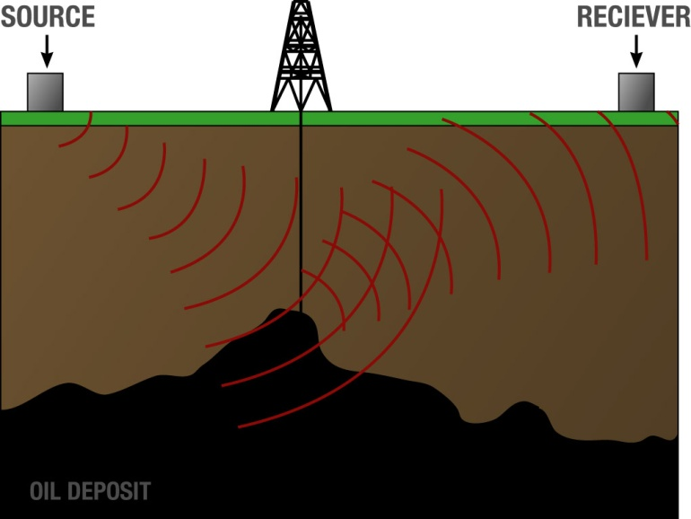
Reflection

Slide 4
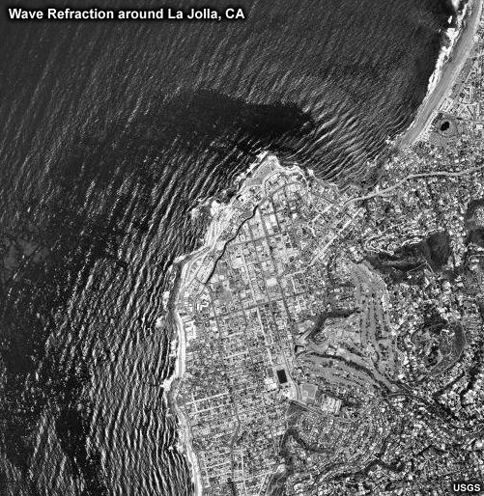

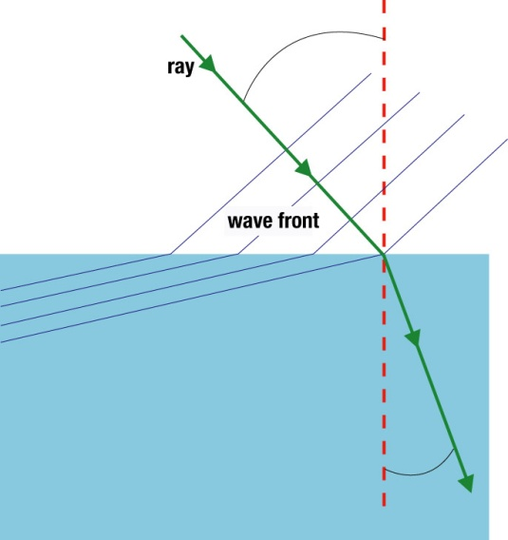

Refraction
The bending of a wave as it enters a medium with different properties so that the wave speed changes.

Slide 5
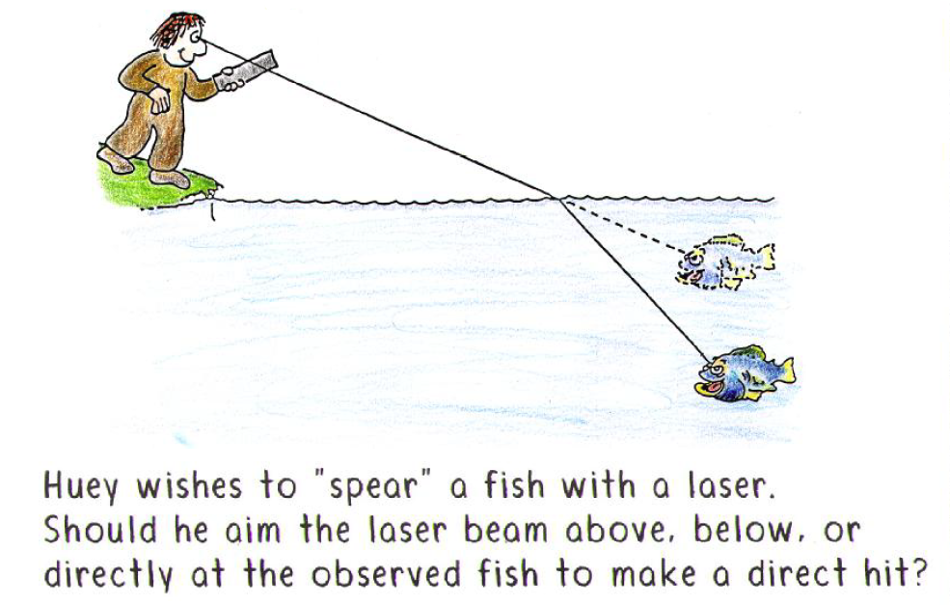

Slide 6
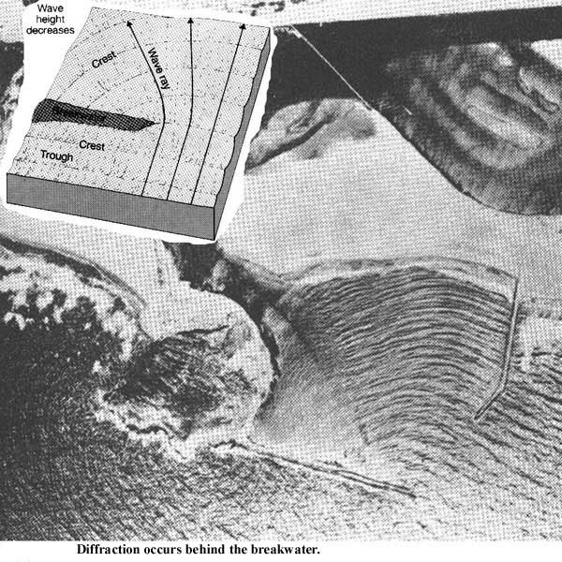
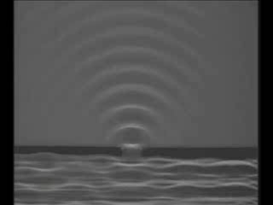
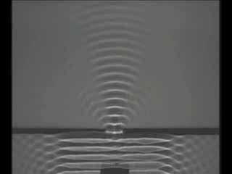
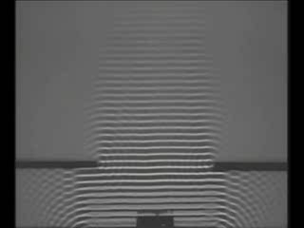
Diffraction
The wave fans out when it encounters an obstacle or opening.
The amount of diffraction depends on relationship between wavelength and size of opening:
  most when wavelength is similar to opening
  small when wavelength is much smaller than opening.

Slide 7
Quiz 1,2,3,and 4: Matching –
Wave properties
Wavelength
Frequency
Amplitude
Speed
the number of wave crests which pass a point per second
the rate at which the wave travels away from the source
the distance between similar parts of a wave
the maximum amount the medium is disturbed from equilibrium

Slide 8
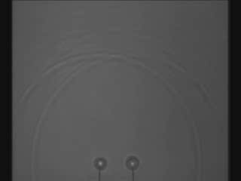
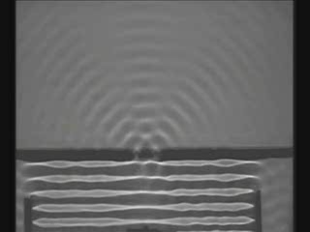
Interference
When two or more waves meet.
  constructive interference: two crests add together
  destructive interference: crest and trough cancel

Slide 9


Example - Noisy Tractors
Demo – Rock chorus
Tractor cab

Slide 10
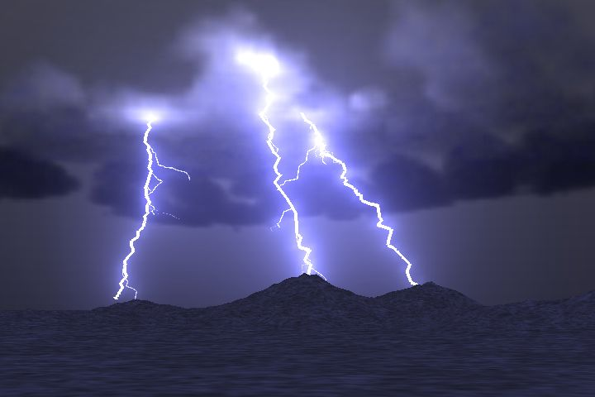
Quiz 6: Wave Properties: Speed
The speed of sound is 1/5 mile/sec
You hear the thunder 10 seconds after seeing the lightning.
How many miles away is the lightening?

Slide 11
Standing waves
DEMO!
Wave on string
Points of the medium that are permanently at rest are called Nodes
Points of the medium that have maximum oscillation are called Anti-Nodes
Only certain frequencies produce standing waves in a given system. These are called resonance frequencies.
The energy of a wave is associated with its frequency.
We can create one dimensional standing waves using a rope:
antinodes
No good. No standing wave will form.
nodes

Slide 12

Quiz 5: If you cut the wavelength in half and the speed stays the same, the frequency will
Double
Be cut in half
Quadruple
Remain unchanged
Speed = frequency × wavelength

Slide 13
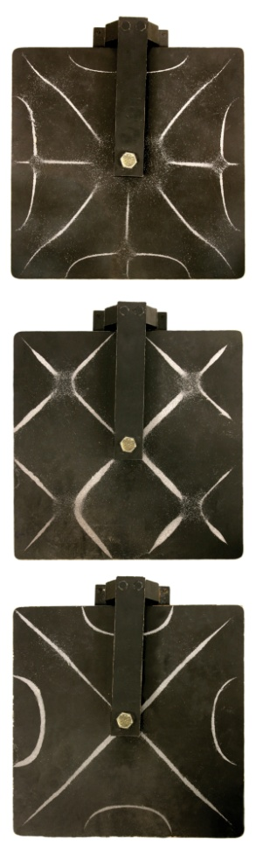
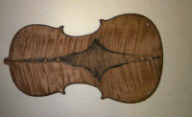
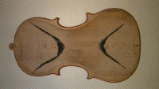
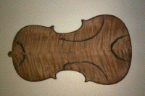
Higher Dimensions
Standing waves are possible in two dimensions as well

Slide 14
Quiz 6,7,8,and 9: Matching – Crude wave behavior descriptions
Bending when the medium changes
Bouncing off an interface
Combining waves to strengthen or weaken the total wave
Bending around corners
Reflection
Refraction
Diffraction
Interference

Slide 15
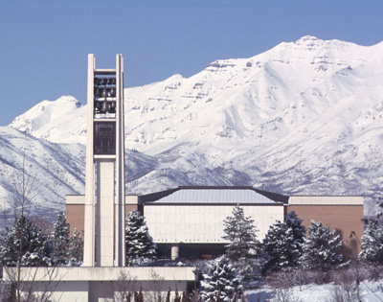

The Doppler Effect
When the source and the observer are in motion relative to one another, the observed frequency can change.
If they are moving together, frequency increases
If they are moving apart, frequency decreases
Notes:
show video clip #21 with Doppler shift of a train horn
Emphasize: higher frequency if moving towards you, lower frequency if moving away.
Other demonstration--swinging a speaker.

Slide 16
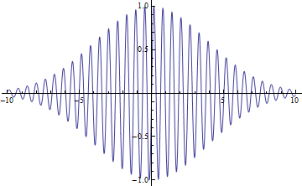
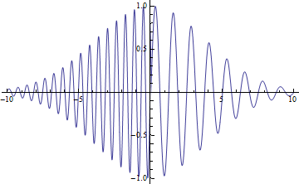

Mathematical Shape- Doppler
Which graph of pressure amplitude vs. time is correct for a car passing by?

Slide 17
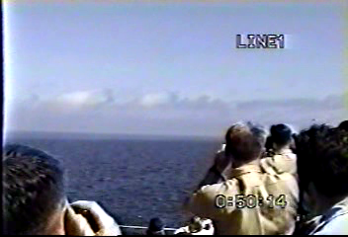
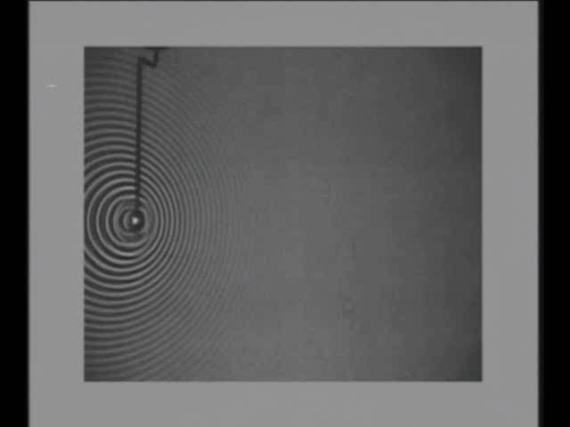

Bonus material: Shock waves
If a source is moving faster than the speed of the wave, shock waves form.

Slide 18
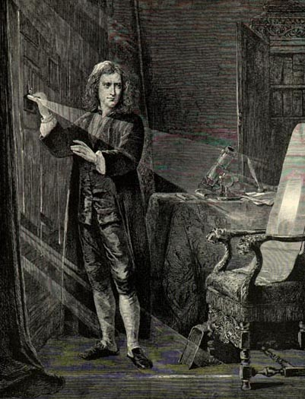
So what is light? Newton thought light was a particle because it cast sharp shadows

Slide 19

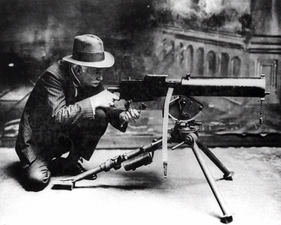

What happens when particles strike slits?
Notes:
First show that light must be a wave with these two slides. Demonstrate interference effects with pen clip or laser showing that light must be a wave. We don’t see bunching up like particles do, that can’t give dark spots like we are seeing. Use these next two viewgraphs to help them understand that this is convincing evidence that light is a wave.

Slide 20
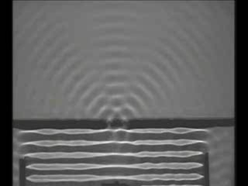
Diffraction is distinctly a wave phenomenon
Constructive Interference
Destructive Interference
Notes:
After this viewgraph, show the slide of the picture of the woman at various light intensities.

Slide 21
Not like classical physics!!!
?
Notes:
First show that light must be a wave with these two slides. Demonstrate interference effects with pen clip or laser showing that light must be a wave. We don’t see bunching up like particles do, that can’t give dark spots like we are seeing. Use these next two viewgraphs to help them understand that this is convincing evidence that light is a wave.

Slide 22
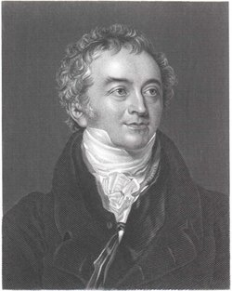
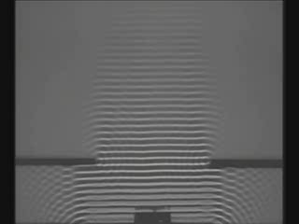
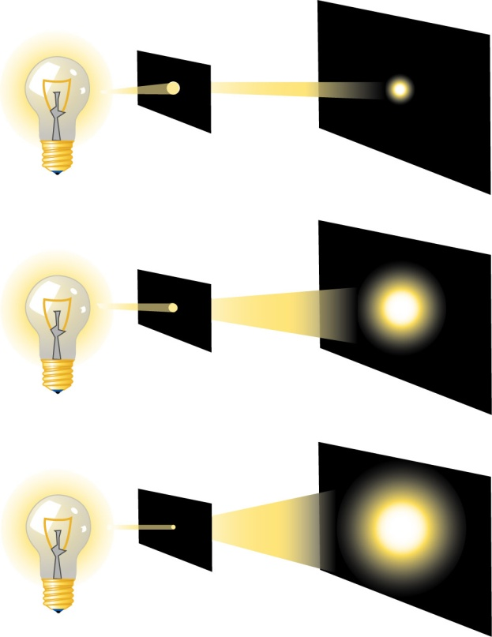
Thomas Young showed that light showed wave properties, it just has a very short wavelength
Thomas Young
Light exhibits diffraction

Slide 23
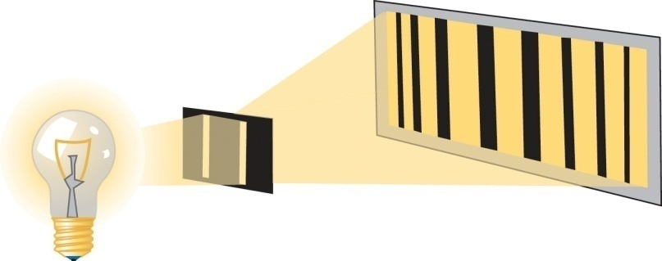
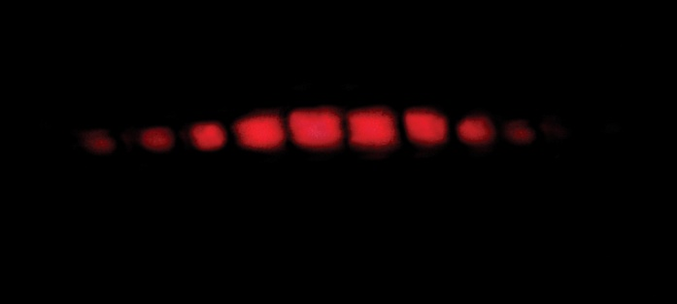
Thomas Young showed that light showed wave properties, it just has a very short wavelength
DEMO!
interference

Slide 24
T/F
A wave diffracts much more when the incoming wavelength is much smaller than the opening.
Diffraction occurs when the wavelength is the same size as the opening

Slide 25
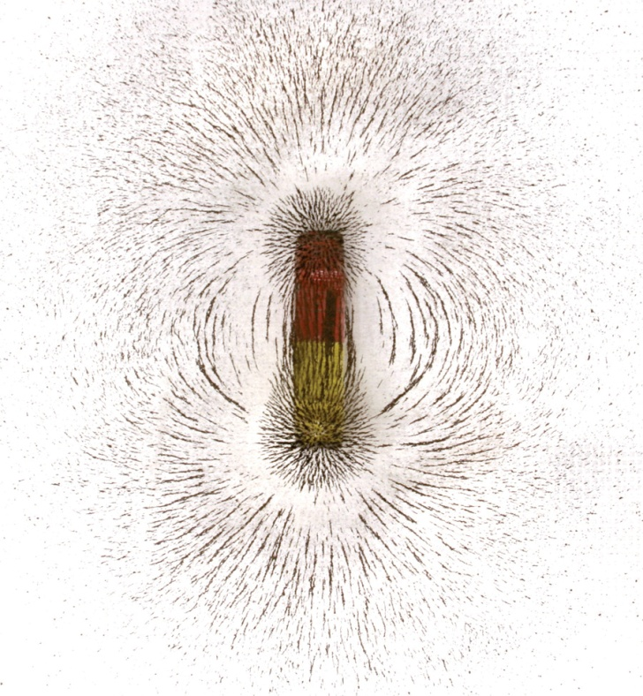
Electric and Magnetic fields describe how a magnet or charged particle respond
+

Slide 26
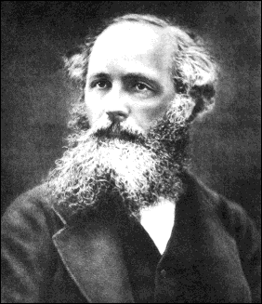
Maxwell came up with equations that showed that the electric and magnetic fields could “wave”
and there was light!

Slide 27
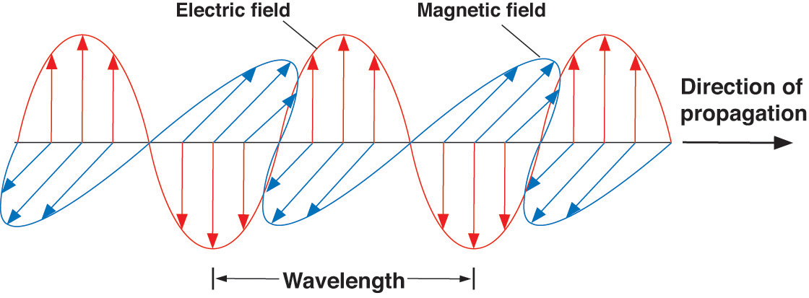
Light as an electromagnetic wave
+
No need for a propagation medium!

Slide 28
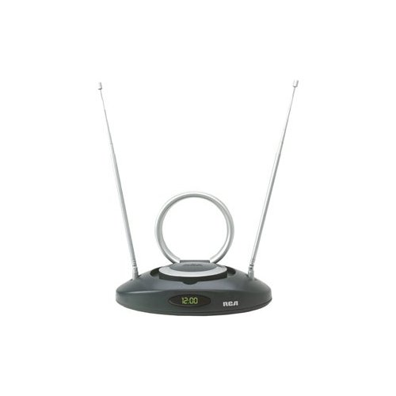
Accelerating Electrons
Electromagnetic radiation is given off whenever electrons accelerate.
It, in turn, causes other electrons to accelerate. (TV, microwave oven)

Slide 29
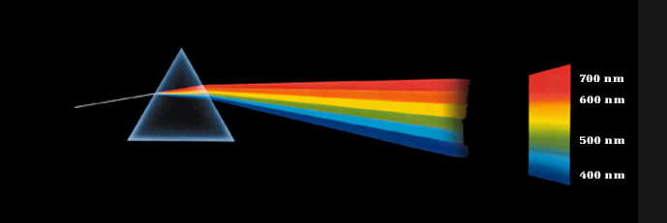
Color
DEMO!
spectroscope
Is the color in the glass or the light?

Slide 30
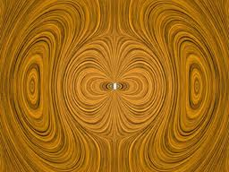
Quiz Q10: Electron Source
Electromagnetic radiation is given off whenever electrons __________.

Slide 31
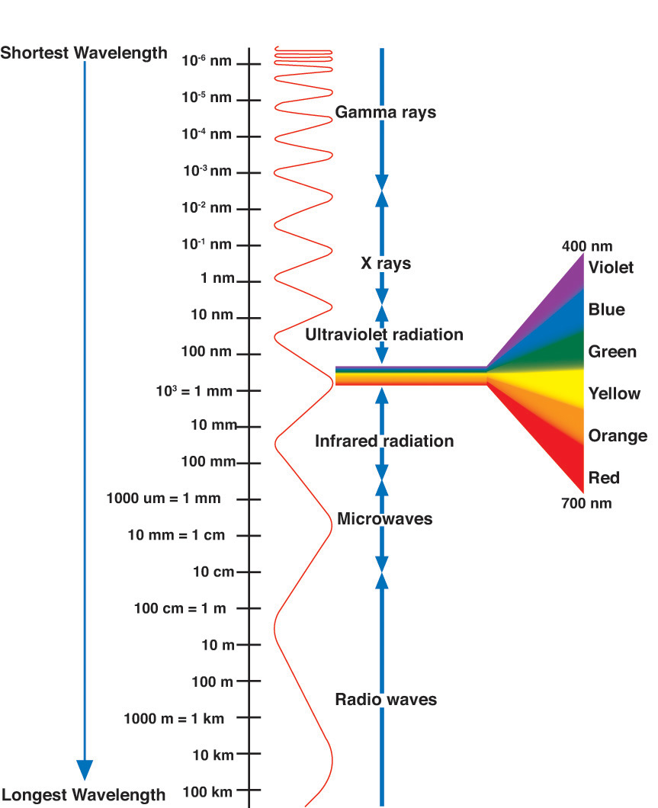
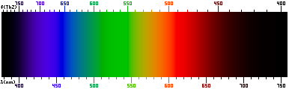

The electromagnetic spectrum
The pot at the end of the rainbow…
Notes:
Finally,
someone has managed to photograph
the pot at the end of the rainbow!!!
Wouldn't you know it!!!!!

Slide 32
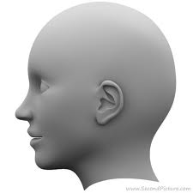
If light is a wave then…
It can Doppler shift like sound!

Slide 33
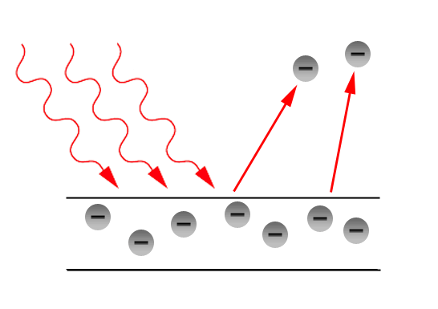
Particle Behavior- The photoelectric effect
Energy in a normal wave is proportional to amplitude.
  i.e. What determines if a wave has enough energy to knock you over at the beach?
However, it wasn’t the amplitude that determined whether light could eject electrons, it was the frequency!
  Energy = h x (frequency)
Explained if light is interacting like a particle with the electrons in the metal!
  Greater energy = greater numbers of photons.
  Each individual photon has an energy of hf where h = Planck’s constant (very small) and f = frequency.

Slide 34
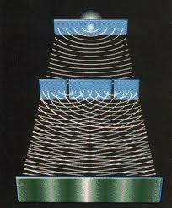
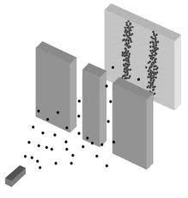
Wave Particle Duality
Light is both a wave and a particle.
  It behaves like a wave when unobserved
    It travels through both slits like a wave
  It is detected like a particle
    It hits the screen as individual dots

Slide 35
If this bothers you, you are in good company!
“All these 50 years of pondering have not brought me any closer to answering the question, ‘what are light quanta?’ These days every Tom, Dick, and Harry thinks he knows it, but he is mistaken.”
~ A. Einstein
Notes:
From P. A. Schlipp, “Albert Einstein: philosopher-scientist” Harper and Row Publishers, New York, 1959,
as quoted in Todd Pittman’s Dissertation

Slide 36
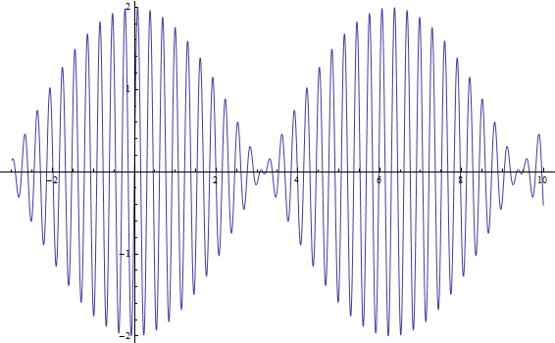
Wave Particle Duality
Why is light both like a wave and a particle?

Slide 37
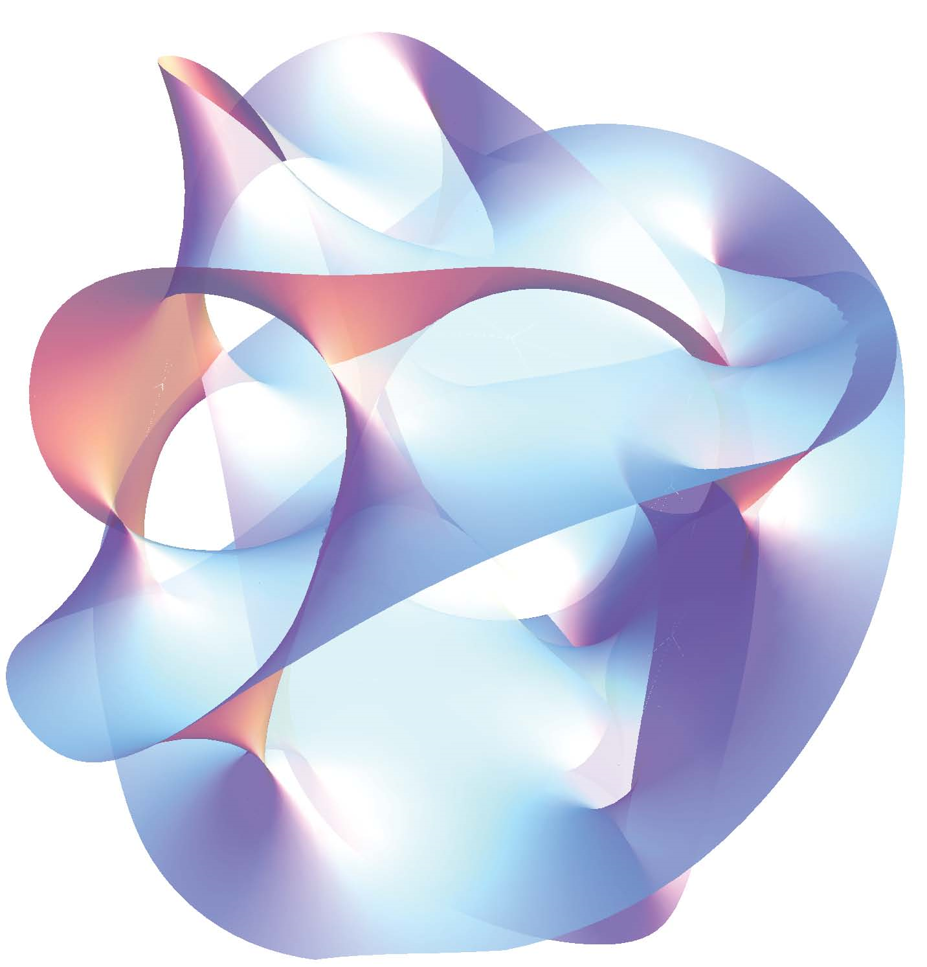
Superstring Ghost demo
DEMO!
Notes:
From P. A. Schlipp, “Albert Einstein: philosopher-scientist” Harper and Row Publishers, New York, 1959,
as quoted in Todd Pittman’s Dissertation

