Slide 1
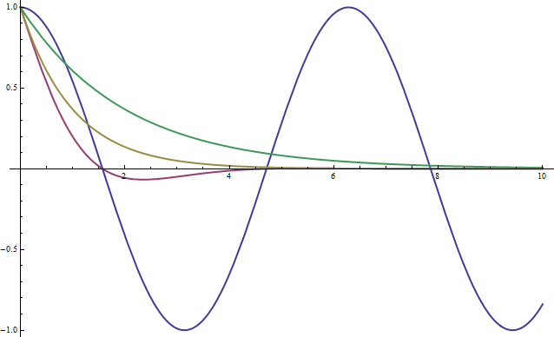
Which color represents
displacement
time

Slide 2

Next slide
QQ1

Slide 3
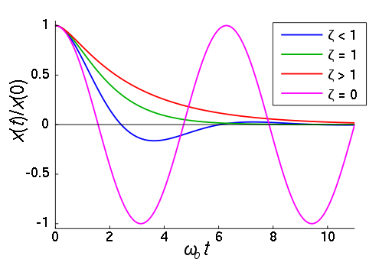
Harmonic motion
QQ1
Which color best represents a critically damped system(a perfect screen door)?

Slide 4
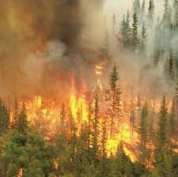
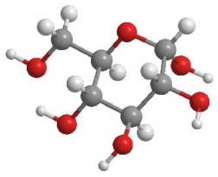



Forest Fires
Mass is neither created nor destroyed. Mass may change from one form to another, but the total mass after the transformation is always the same as that before.
1 Cellulose + 6 Oxygen → 7 Smoke
+
+
C₆H₁₂O₆ + 6 O₂ = 6 CO₂ + 6 H₂O

Slide 5

Next slide
QQ2

Slide 6
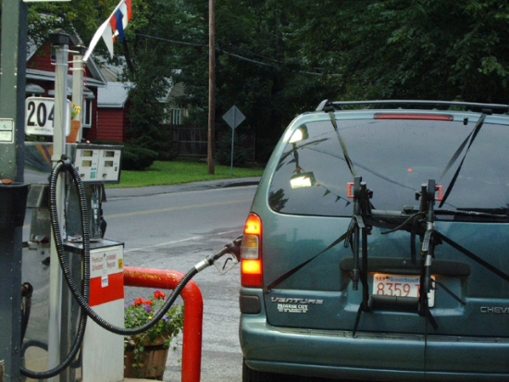
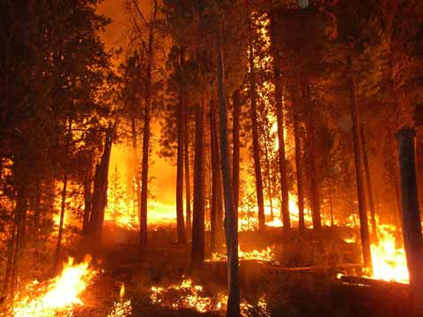
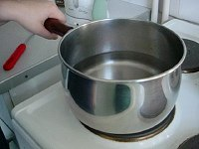
Conservation of Mass
QQ2
Choose one example and explain how the mass changes forms
Examples
  gasoline in car
  forest fire
  boiling water

Slide 7
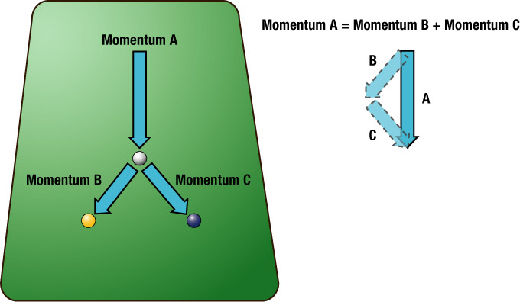
Macroscopic properties conserved in motion:
Linear Momentum
Momentum is (mass) x (velocity)
Conserved in the absence of external net force
Examples
  Collisions
  Cannon

Slide 8
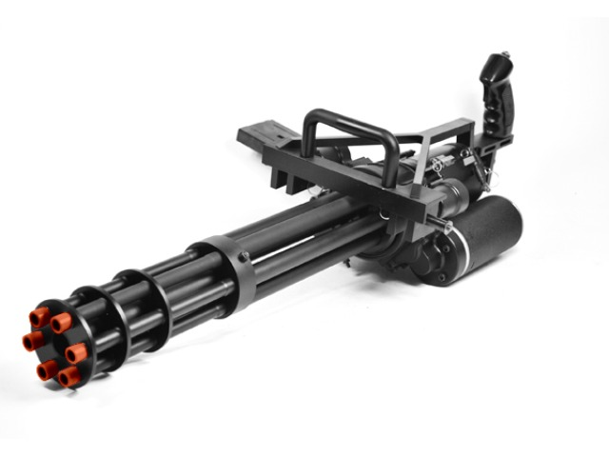

Momentum transfer
mv = mv
velocity of bullets
velocity of gun
v
v
m
m
http://www.youtube.com/watch?v=4CfREbZ1V5o

Slide 10
Conservation of momentum means:
total momentum before = total momentum after
total momentum =

Slide 13

Next slide
QQ3

Slide 14
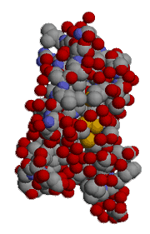
Molecules and Atoms
QQ3
The force holding these things together is the ____________ force.
Electrons to Nucleus
Atoms to other Atoms

Slide 15
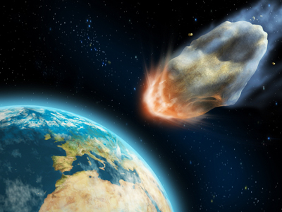
Momentum is conserved even when the various parts of the system split due to internal forces
Initial
Final
Energy and Momentum
are conserved during
elastic collisions
At rest
At rest
Only momentum
is conserved during
inelastic collisions
At rest

Slide 17
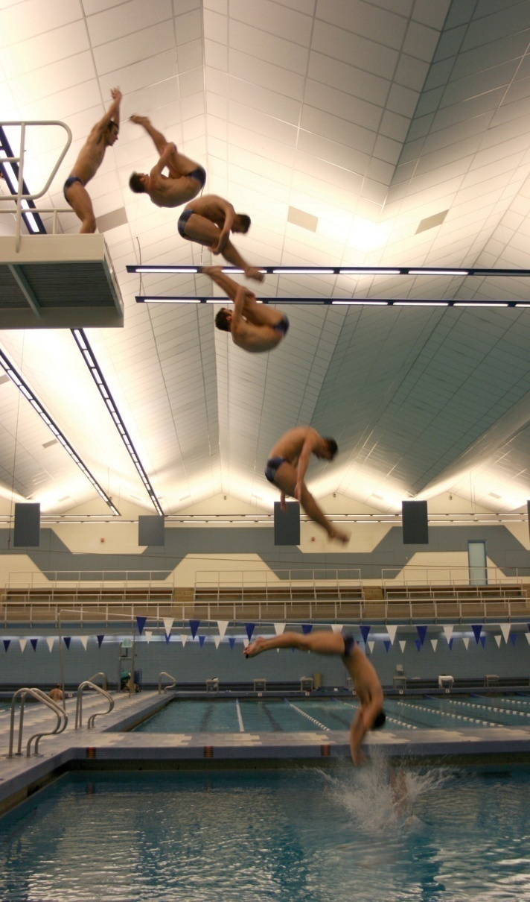
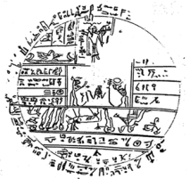
Conservation of angular momentum
Angular momentum is mass x speed x radius
Examples:
  Diver
  Ice skater
  Riding a bike
Equal masses but different shapes
50*2 = 4*25
It speeds up!

Slide 18
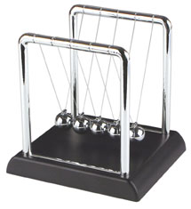
Newton’s Cradle
To explain this behavior we need something else to be conserved. This will turn out to be Energy

Slide 19
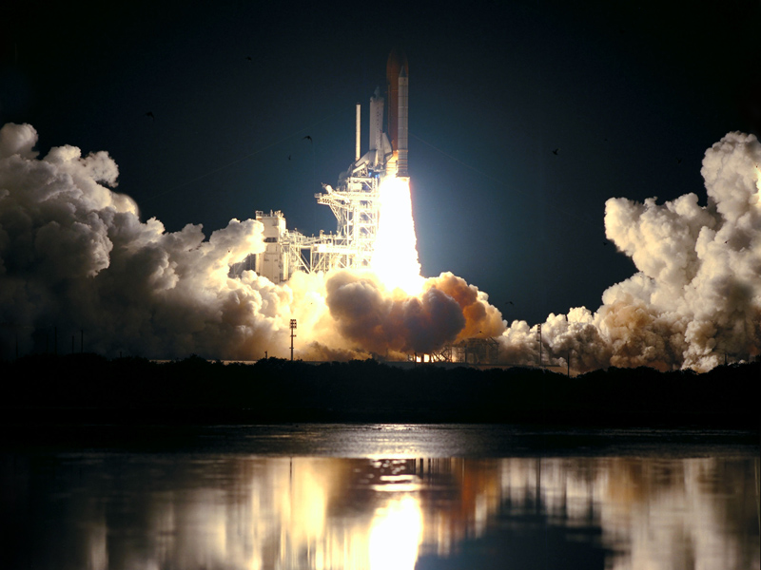



Chapter 9
Energy

Slide 20
Sometimes it is hard to describe all of the motion in a system, and we want something simpler

Slide 21
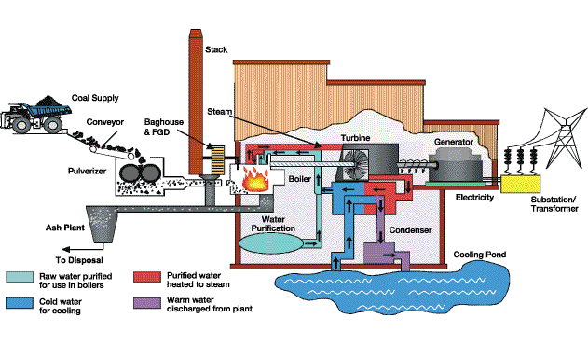
Energy
A more complicated example: Power plant
E_{in}
E_{stack}
E_{friction}
E_{friction}
E_{electricity}
boiler
turbine
generator

Slide 22

Next slide
QQ4

Slide 23
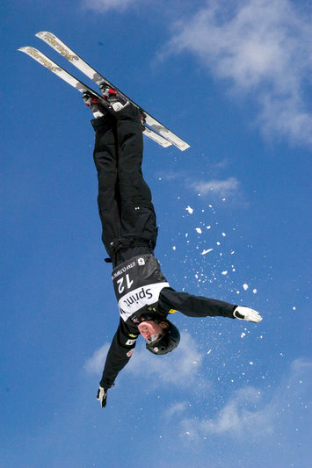
Conservation of ?
QQ4
When this freestyler tucks in to a fetal position he will begin to flip around faster. This is an example of _______ momentum being conserved.

Slide 24
Energy
Energy is
  the capacity “to do something”
  Ability to exert a force on an object while moving it through a distance
Energy can either be associated with an objects position (potential) or its motion (kinetic)
Total energy is conserved: Energy can be neither created nor destroyed. The total amount of energy in the universe never changes. However, energy can change from one form to another, or be transferred from one object to another.

Slide 25
Forms of Energy
Kinetic Energy
Gravitational Potential Energy
Electrical Potential Energy
Internal Energy
  Thermal (internal kinetic)
  Elastic potential (internal electrical)
  Chemical Potential (internal electrical)
Radiant Energy

Slide 26
Kinetic Energy
Kinetic energy is the energy of motion.
Kinetic Energy = ½ mv²
½ mv² = ½ mv²
mv = mv
What about a ball rolling up a hill?

Slide 28
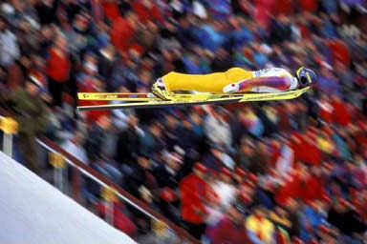
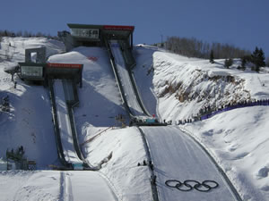
Gravitational Potential Energy
energy associated with the height of an object
gravitational potential energy = (weight) x (height)
Examples
  Balls rolling on tracks (energy transfers from potential to kinetic)
  Pendulum
  Ski Jump
  Bouncing ball
http://www.youtube.com/watch?v=bHBN7Cds07I&feature=related

Slide 29
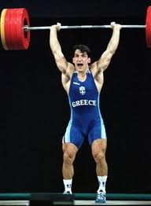
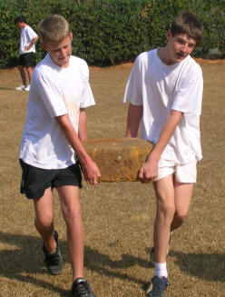
In physics, the word “work” has precise meaning that is somewhat different than you may be used to.
Work = (force) x (distance parallel to force)
For work to be done in the physics sense, a force must be applied and the object must have some motion parallel to the force
Work is a method of transferring energy, it is not a form of energy itself.
He pushed up
Gravity pushed down

Slide 30
Equal and opposite work
Work = F*d
The distance it moved was up.
He is pushing up
Gravity is pushing down
Therefore, he did positive work on the weight while gravity did negative work on the weight. If he drops it, what happens?

Slide 31
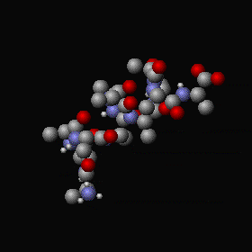

Thermal Energy
Internal energy associated with kinetic energy of individual particles.
Related to temperature (average KE of atoms and molecules)
A warm object has more internal energy than when it is cold
Two objects at the same temperature may have different amounts of thermal energy, why?
  water 1 cal/gºC
  gold .03 cal/gºC
Different Heat Capacities

Slide 32
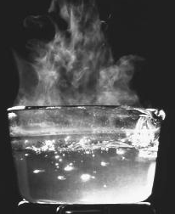
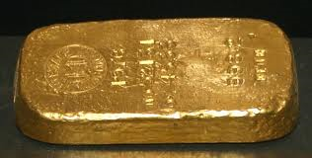
Thermal Energy
Why can two objects at the same temperature have different amounts of thermal energy?
They each convect it differently
They have different temperatures
They have different Heat Capacities
They have the same amounts of thermal energy

Slide 33
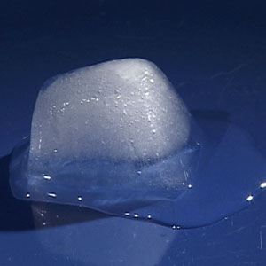
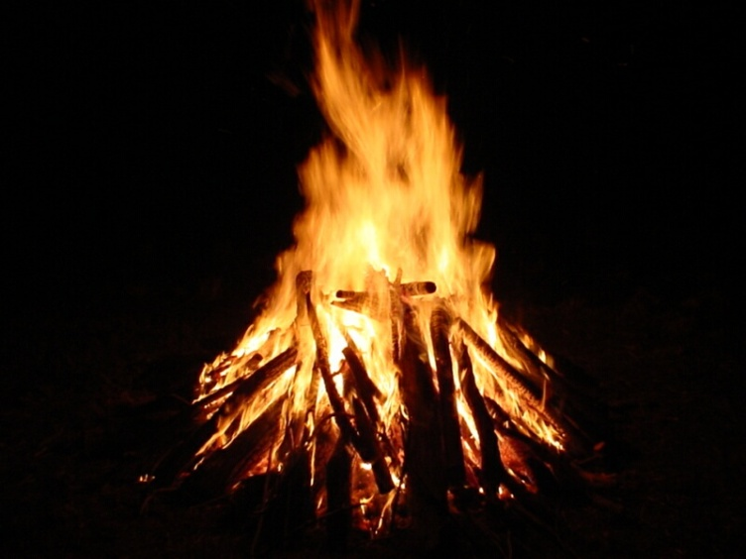
Chemical Potential Energy
Internal electrical potential energy of atoms in a material
Examples
  change of state (rearrangement of atoms)
  chemical bonds
    burning gasoline, natural gas, or wood
    exploding firecracker

Slide 34
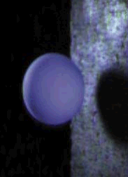
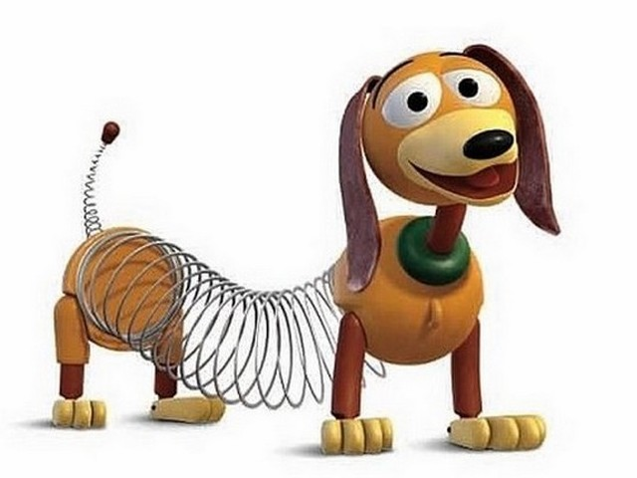
Elastic Potential Energy
Energy stored in a material by deforming it in such a way that its molecules are displaced from their equilibrium positions.
A form of internal electrical potential energy
Examples:
  deformation (springs, balls)
  Rubber band
  Trampoline

Slide 35
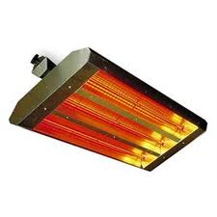
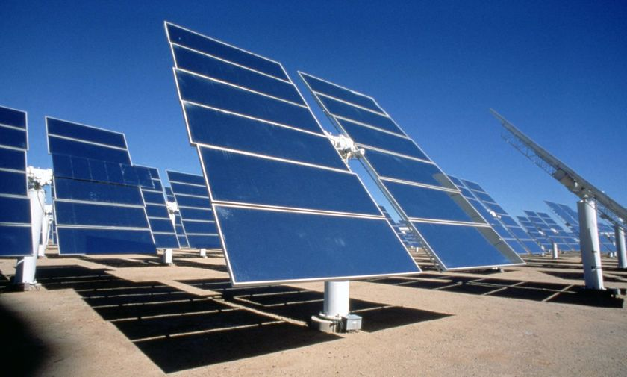
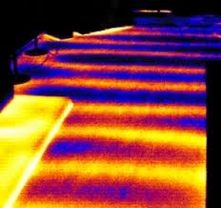
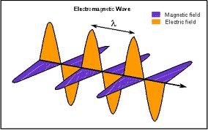
Radiant Energy

Slide 36

Next slide
QQ5

Slide 37
QQ5
What conservation law is easiest to use when analyzing complex systems?

Slide 38
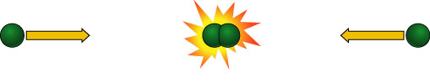
Conservation of Mass-Energy
Mass and energy are two manifestations of the same quantity
The total amount of mass-energy in an isolated system is constant
Mass and energy can be converted from one form to the other
E=mc²
Notes:
Resolution of problem with conservation of mass and conservation of energy.

Slide 39
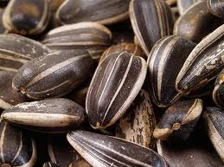
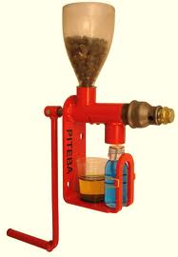
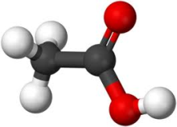
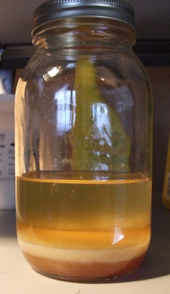
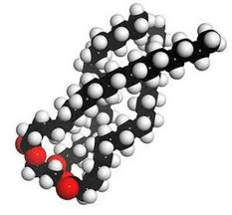
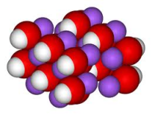
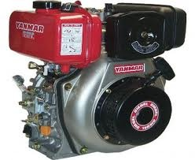
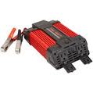
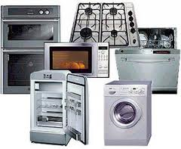
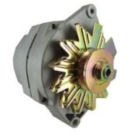
Combustion fuels – Hippie Methodologies
Add Heat, Chemical Potential Energy and Kinetic energy
Lose Heat and Chemical potential energy
Gain Transformed Chemical Potential energy
Add Chemical potential energy and Kinetic energy
Lose Heat
Gain Transformed Chemical Potential energy
Add Kinetic Energy
Lose Heat
Gain Electromagnetic Energy
Add Chemical potential energy and small Kinetic energy
Lose Heat and Chemical Potential energy
Gain Kinetic Energy
Add Electromagnetic Energy
Lose Heat
Gain An operating appliance of your choice

Slide 40

Look for alternatives, bottlenecks and synergies

Slide 41
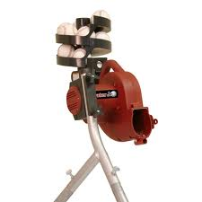

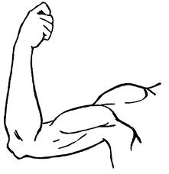
Example: “Practical application”

Slide 42

Next slide
QQ6

Slide 43

In physics, the word “work” has precise meaning
QQ6
W=Fd
Does gravity do work on a pencil when it falls off the table on to the floor?
F
d

Slide 44

Next slide
QQ7

Slide 45
QQ7
Why can two objects at the same temperature have different amounts of thermal energy?
They each convect it differently
They have different temperatures
They have different Heat Capacities
They have the same amounts of thermal energy

Slide 46
Summary: Forms of energy
Kinetic Energy
Gravitational Potential Energy
Electrical Potential Energy
Internal Energy
  Thermal (internal kinetic)
  Elastic potential (internal electrical)
  Chemical Potential (internal electrical)
Radiant Energy

Slide 47
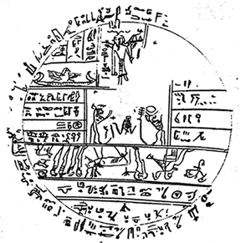
Energy Transfer and Transformation
Radiation: energy is transmitted by visible light, infrared radiation, ultraviolet radiation, X-rays, or radio waves. (sun, space heater)
Conduction (Heat Flow ): a process in which internal energy is transferred because of a difference in temperature. (electric stove, soldering iron)
Convection: internal energy is transferred because matter moves from one place to another. (hot air furnace)
Work: energy is transferred or transformed by forces acting on an object. (friction, muscles, electric motor)
Combustion: chemical potential energy is transformed into another form (gasoline engine, dynamite, light stick)

Slide 48
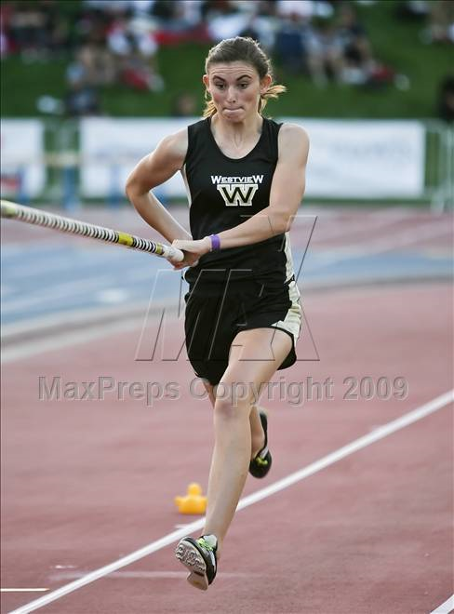
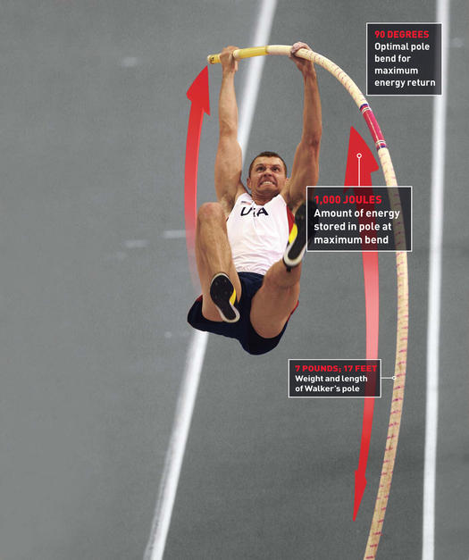
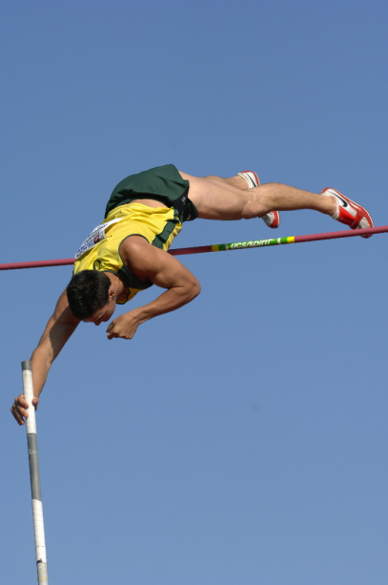
Kinetic
Elastic potential
Gravitational potential
6.15m
7:25
Sergei Bubka
http://www.youtube.com/watch?v=IWGyzPNXI_U

Slide 49

Next slide
QQ8

Slide 50
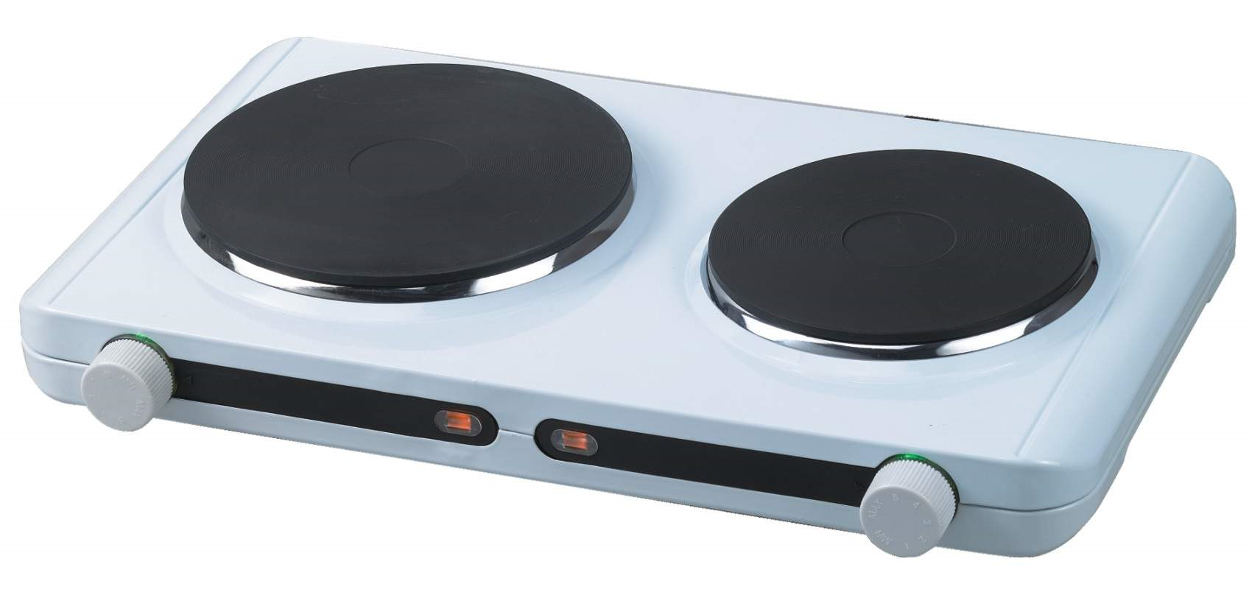
What type of heat transfer occurs when you touch a hot surface?
QQ8
radiation
conduction
convection

Slide 51


Kinetic energy from Chemical Potential
The engine is running, doing work on the car.
There is a lot of chemical potential energy in the fuel but we can only get so much macroscopic kinetic energy out of it.
We are in a power crisis not an energy crisis

Slide 52

Next slide
QQ9

Slide 53
QQ9
_________ __________ _________
Energy forms(one word for each space)

Slide 54

The method of heat transfer used to cook microwave popcorn is
radiation
conduction
convection

Slide 55




Popcorn
Three methods for popping popcorn
  Microwave --
  Hot air --------
  Stove top ----
Identify the method of heat transfer for each.
Radiation
Convection
Conduction

Slide 56

Next slide
QQ10

Slide 57

Which of the following are methods of heat transfer used to pop popcorn?
QQ10
conduction
correction
radiation
on the valley top
convection
specific heat
gravity

