Slide 1
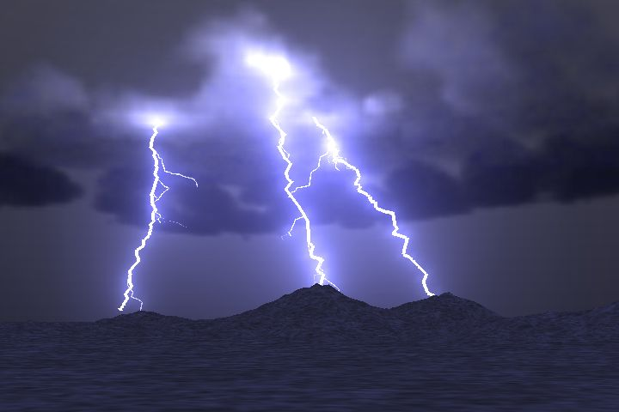
Wave Properties: Speed
The speed of sound is 1/5 mile/sec
You hear the thunder 15 seconds after seeing the lightning.
How many miles away is the lightening?

Slide 2

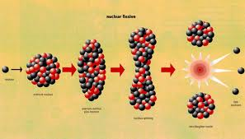
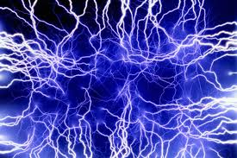
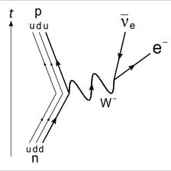
Which two of the four fundamental forces do we deal with most?

Slide 3
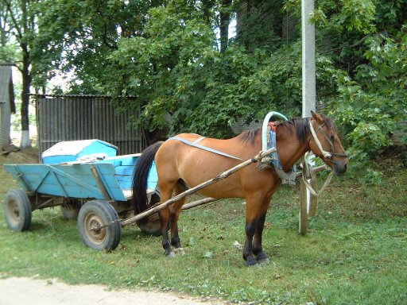
What can you say to this horse to convince it that it can get his work done?
“Every time I pull on the cart, it pulls back with equal force. Therefore I cannot pull the cart.”

Slide 4
What is the difference in order of magnitude between these two numbers?
1x10¹⁰ and 1x10²⁰
0
21
10
-1
-11

Slide 5

You’re stuck on a frictionless ice pond with a huge physics book.
What is the fastest way to get back to the shore?
Be specific
North

Slide 6


Which one is a sound wave and which one is a light wave?
A
B

Slide 7

If I drop a book, how fast will it be going one second later?
Please write answer in meters per second

Slide 8

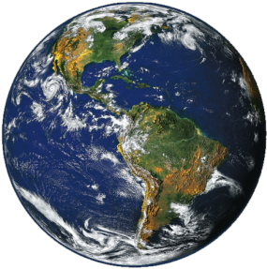
What direction is the moon accelerating?
b
a
c
d
e

Slide 9
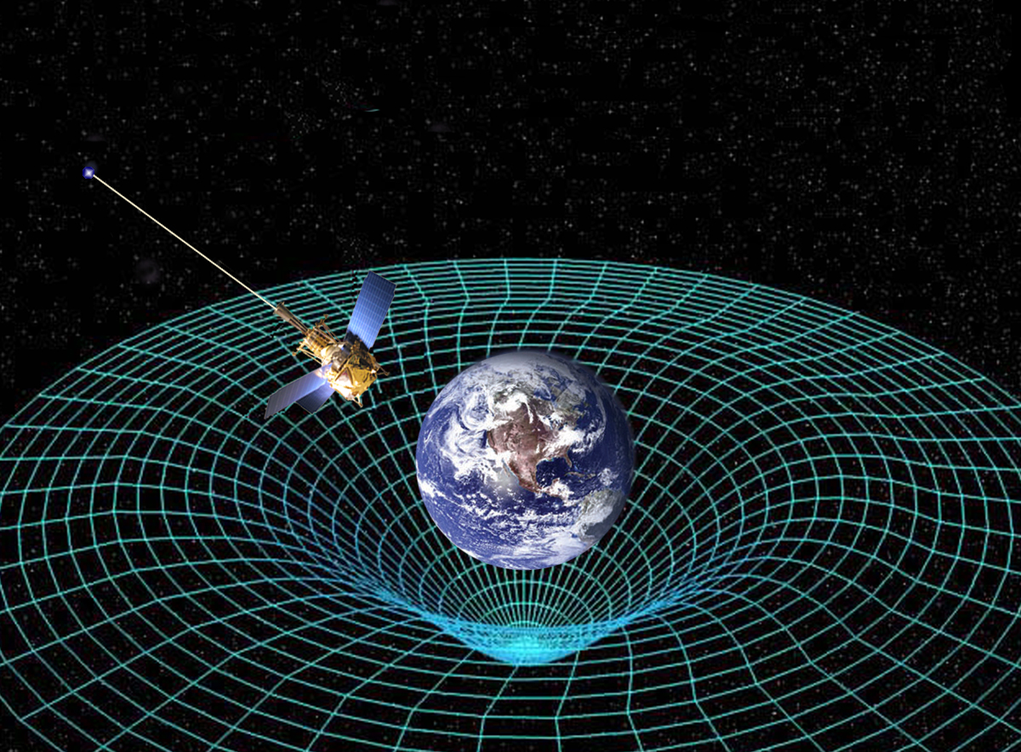
What is the equivalence principle?

Slide 10
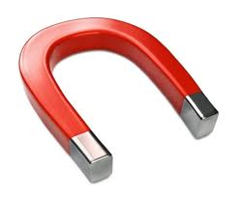
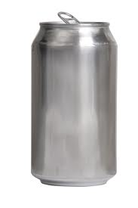
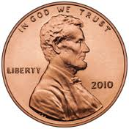
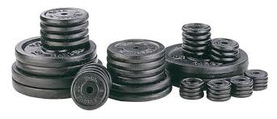
True or False
A magnet attracts anything that is metal.

Slide 11

Projectile Motion
Throwing a ball straight up, after you let go…
What is its acceleration when it momentarily stops at the top?

Slide 12
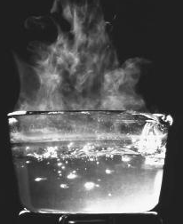
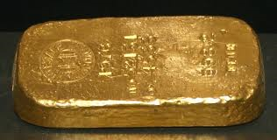
How can two objects at the same temperature have different amounts of thermal energy?
They each convect it differently
They have different temperatures
They have different Heat Capacities
They have the same amounts of thermal energy

Slide 13
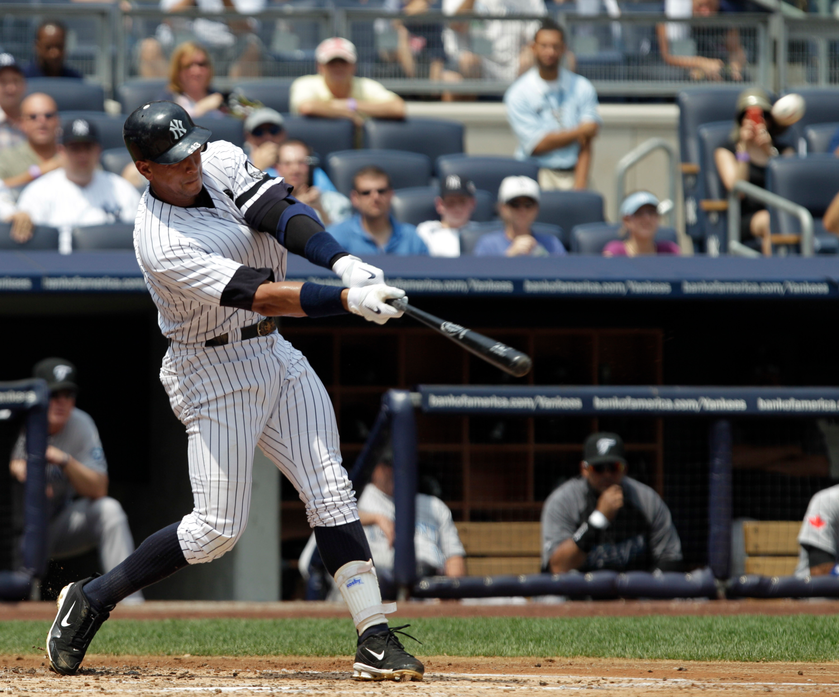
Draw the trajectory of a homerun with no air resistance and write what the shape is called

Slide 14
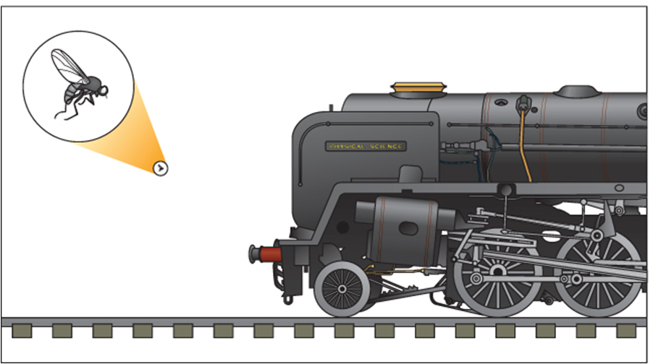
The acceleration of the fly will be
Smaller than the train of the acceleration
Equal to the acceleration of a flying train
Less than the acceleration of the train
Greater than the acceleration of the train
Cannot be determined without more flies

Slide 15
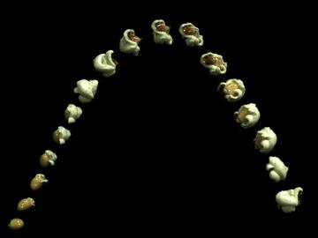
Which of the following are methods of heat transfer used to pop popcorn?
conduction
correction
radiation
on the valley top
convection
specific heat
gravity
There is more than one answer

Slide 16
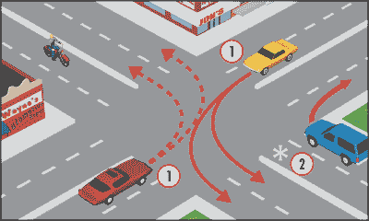
You turn left in that red car at a constant speed. The horizontal force from the seat on you…
Pushes you away from Wayne’s Deli
Pushes you towards Wayne’s Deli
Pushes you up and out of the sun roof
Wayne’s Deli
Bonus: Describe the equal and opposite the fictitious force

Slide 17
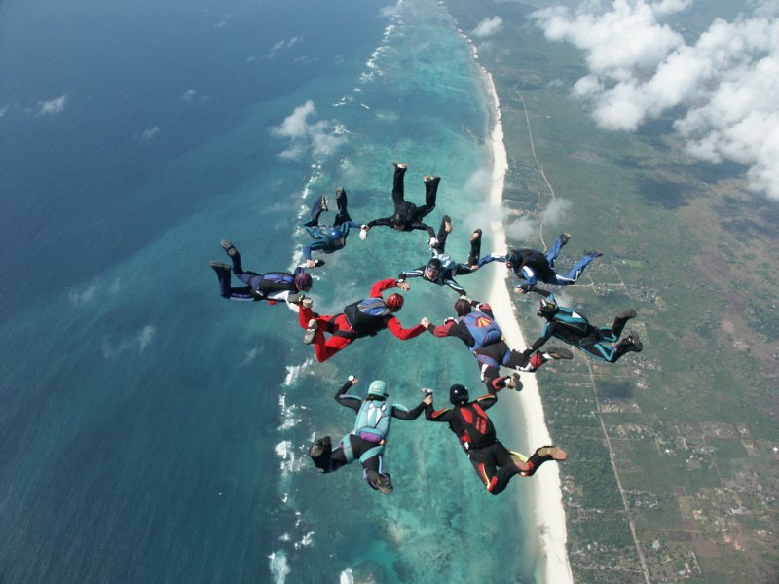
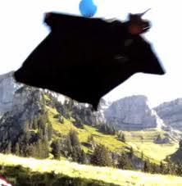
Add some air resistance: True or False
In the presence of air resistance, a falling object will reach a constant velocity?

Slide 18
Matching – Wave properties
Wavelength
Frequency
Amplitude
Speed
the number of wave crests which pass a point per second
the rate at which the wave travels away from the source
the distance between similar parts of a wave
the maximum amount the medium is disturbed from equilibrium

Slide 19
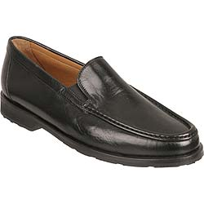
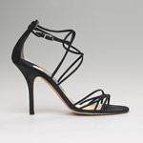
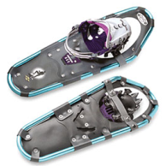
Force = Pressure x Area
To decrease the pressure caused by a force how must you change the area it’s applied to?

Slide 20
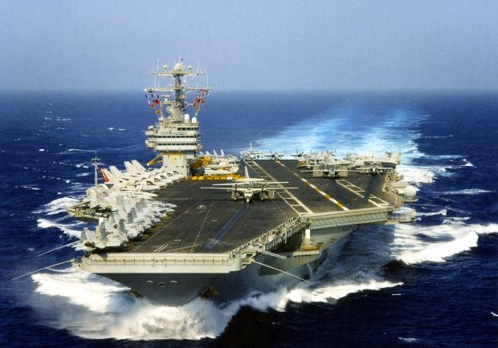
How much water does an aircraft carrier displace?
A few minutes
An equal length of water equilibrated to the mass of the water in equilibrium
A volume of water equal to the charge of the ship’s surface
A mass of water equal to the mass of the ship

Slide 21
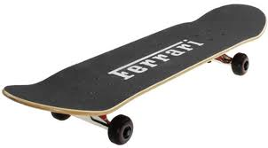
A guy and his girlfriend are on skateboards. They decide on a mutual break up and push each other.
Even though the force is equal and opposite, one of them experiences a greater acceleration than the other, who is it?

Slide 22
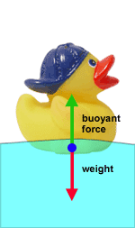
2 ways to say something floats above the surface of a fluid
It is ___ dense than the surrounding fluid.
It weighs ___ than an equal volume of fluid.

Slide 23
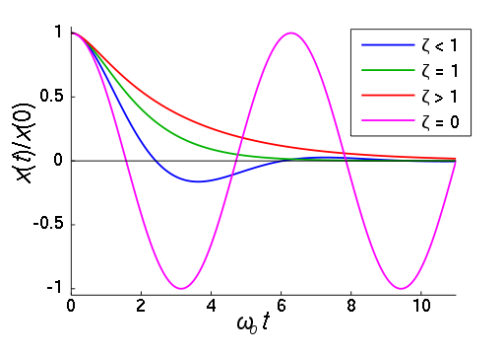
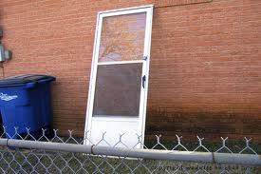
Harmonic motion
Which color best represents a critically damped system(a perfect screen door)?

Slide 24
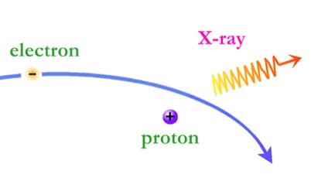
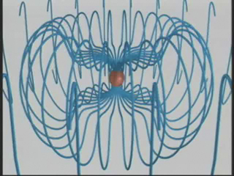
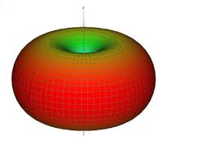
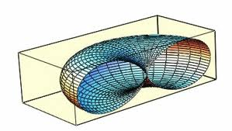
Electromagnetic radiation is given off whenever electrons __________.
0 sec
1 sec
2 sec
3 sec
-
-
-
-
= velocity
-
-
-

Slide 25
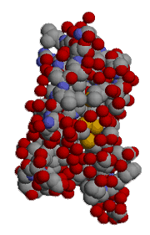
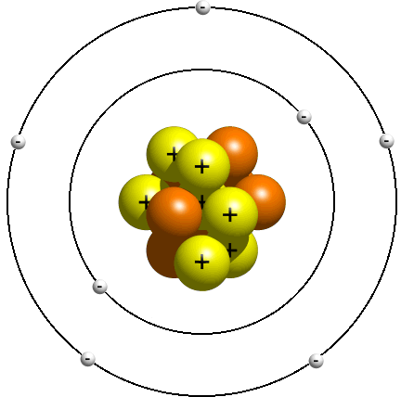
Molecules and Atoms
The force holding these things together is the ____________ force.
Electrons to Nucleus
Atoms to other Atoms

Slide 26
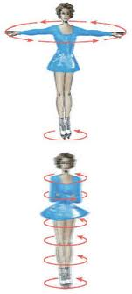
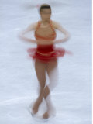
Fill in the blank
When this ice skater brings her arms in, she begins to spin faster. This is an example of _______ momentum being conserved.

Slide 27
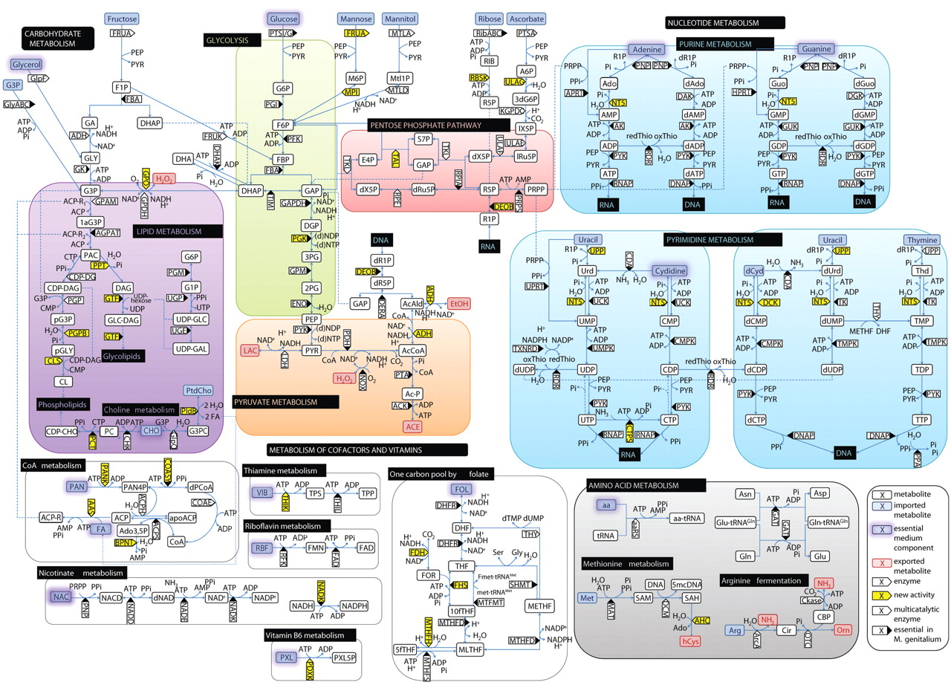
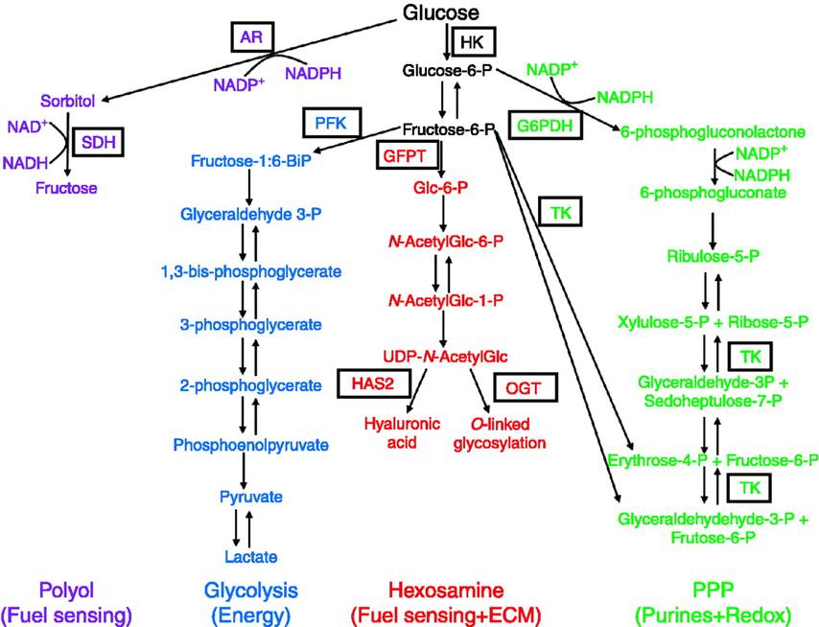
What conservation law is easiest to use when analyzing complex systems?

Slide 28
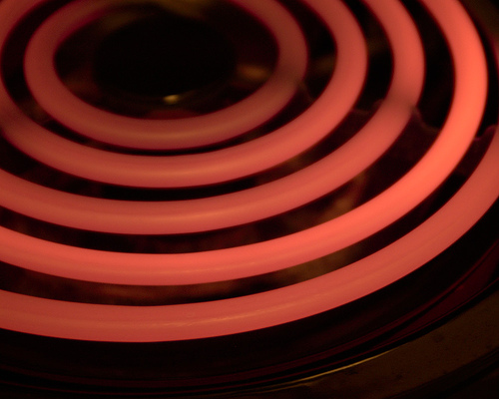
What type of heat transfer occurs when you touch a hot surface?
radiation
conduction
convection

Slide 29
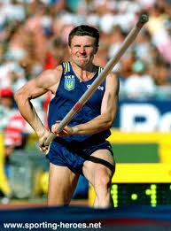
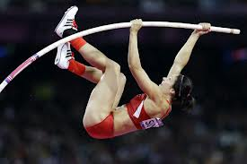
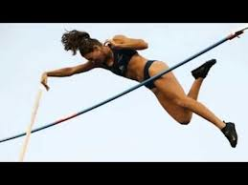
Fill in the blank
Energy forms
_________ __________ _________

Slide 30
Matching – Crude wave behavior descriptions
Bending when the medium changes
Bouncing off an interface
Combining waves to strengthen or weaken the total wave
Bending around corners
Reflection
Refraction
Diffraction
Interference

Slide 31
Misconception
Do heavier objects fall faster than lighter ones?
Al
Au
No, lighter objects fall faster because they accelerate quicker.
Yes, the heavier one has a greater force of gravity on it.
No, they have the same accelerations.
No, one of them is plastic

Slide 32
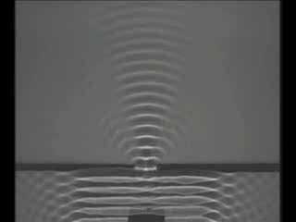
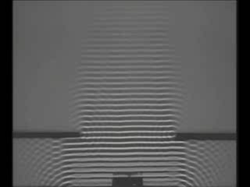
T/F
A wave diffracts much more when the incoming wavelength is much greater than the size of the opening.

