Slide 1
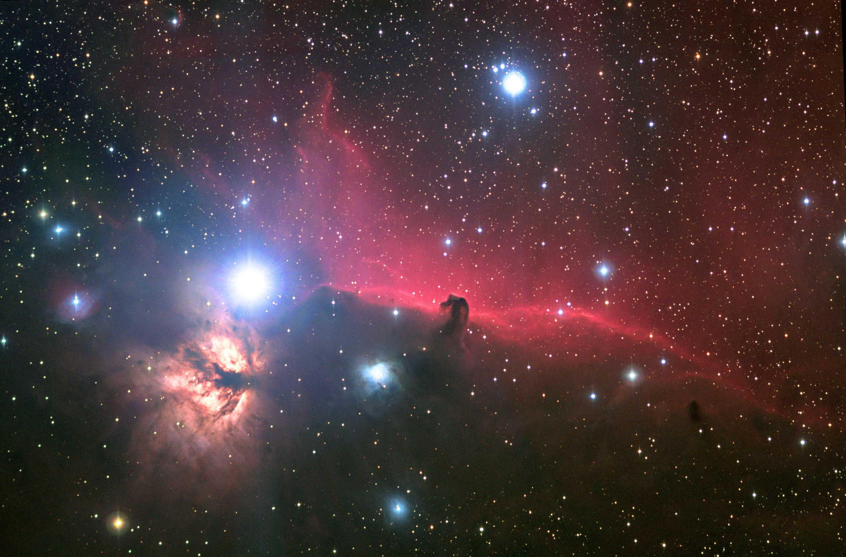
Chapter 34: Cosmology
Did you read chapter 34 before coming to class?
Yes
No

Slide 2
According to the currents models of stellar evolution, our sun will eventually become a
Cloud of hydrogen gas
Protostar
Neutron star
Black hole
White dwarf

Slide 3
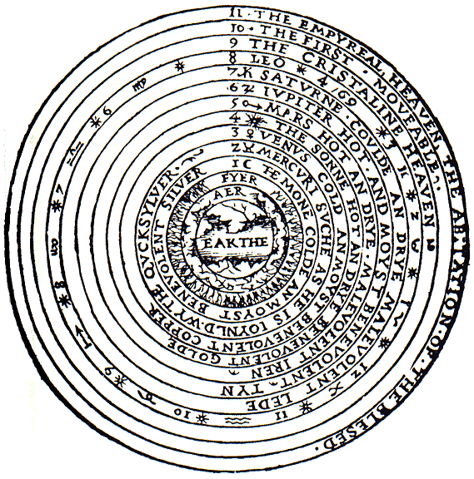
A Vast Universe of Galaxies
Anciently mankind thought that the universe was the solar system inside a sphere of stars.
By the 1900s we knew the sun was just one of billions of stars within the Milky Way galaxy.
At this time the Milky Way was thought to be the entire universe.

Slide 4
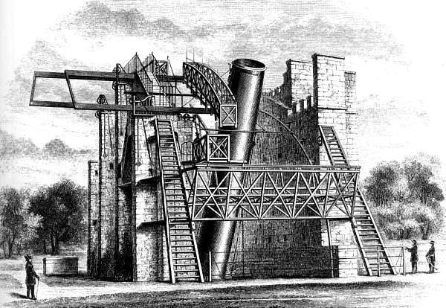
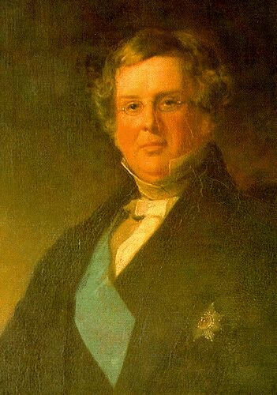
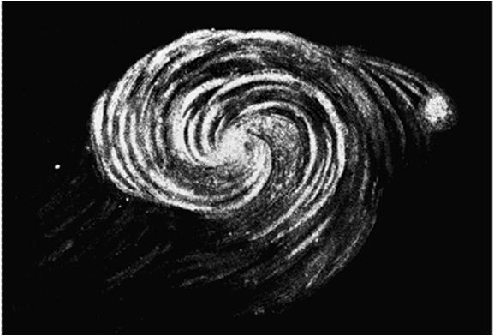
William Parsons studied external Galaxies, but thought they were solar systems forming in the Milky Way
The "Leviathan of Parsonstown"
Parson's 72-inch telescope
First Sketch of a galaxy, 1845
William Parsons, 3rd Earl of Rosse
Notes:
http://en.wikipedia.org/wiki/William_Parsons,_3rd_Earl_of_Rosse
William Parsons, 3rd Earl of Rosse (June 17, 1800 – October 31, 1867) was an Irish astronomer.
He became the third Earl of Rosse when his father died in 1841. Prior to this, his title was "Lord Oxmantown".
In the 1840s, he built his "Leviathan of Parsonstown" 72-inch (183cm) telescope at Birr, Ireland (then called "Parsonstown") in County Offaly, which was for many decades the largest telescope in the world. He had to invent many of the techniques he used in constructing this telescope, both because its size was without precedent and because earlier telescope builders had guarded their secrets or had simply failed to publish their methods. It was considered a marvelous technical and architectural achievement and images of it were circulated widely within the British commonwealth.
The telescope mirror was made from speculum metal. Because it tarnished so rapidly in the damp climate, the mirror had to be repolished every six months, and so Lord Rosse had two mirrors built so that one could be used while the other was being repolished. Building of the telescope had to be suspended during the Great Potato Famine, but in 1847 it was put into service. The light-gathering ability exceeded expectations, enabling 18th magnitude stars to be observed for the first time. However, the Irish sky was not kind to astronomy, and due to weather conditions very few good nights of viewing were available per year.
William Parsons
Lord Rosse carried out pioneering astronomical studies and discovered the spiral nature of some nebulas, today known to be spiral galaxies. The first spiral galaxy he detected was M51, and his drawings of it closely resemble modern photographs (today it is known as the Whirlpool Galaxy).
He named the Crab Nebula, based on an earlier drawing made with his older 36-inch (91cm) telescope in which it resembled a crab. A few years later, when the 72-inch (183cm) telescope was in service, he produced an improved drawing of considerably different appearance, but the name stuck anyway.
A main component of Rosse's nebular research was attempting to resolve the nebular hypothesis, which posited that planets and stars were formed by gravity acting on gaseous nebulae. Rosse himself did not believe that nebula were truly gaseous, but rather were made up of such an amount of fine stars that most telescopes could not resolve them individually (that is, he considered them stellar in nature). Rosse and his technicians claimed to resolve the Orion nebula into its individual stars, which would have both political and cosmological implications, as at the time there was considerable debate over whether or not the universe was "evolved" (in a pre-Darwinian sense), a concept Rosse disagreed with strongly. Rosse's primary opponent in this was John Herschel, who used his own instruments to claim that the Orion nebula was a "true" nebula, and discounted Rosse's instruments as flawed (an insult Rosse returned about Herschel's own). In the end, neither man (or telescope) could establish sufficient scientific authority in its results to solve the question by themselves (the convincing evidence for the gaseous nature of the nebula would come later from spectroscopic evidence, though it would not resolve the philosophical issues).
In addition to his astronomical pursuits, he served as a member of Parliament from 1821 to 1834, an Irish representative peer after 1845, president of the Royal Society (1848–1854), and chancellor of the University of Dublin (beginning in 1862).
Rosse crater, on the Moon, is named after him.
He married Mary Field in 1836 and they had four children, all sons. The eldest, Lawrence Parsons, succeeded him as Earl of Rosse and continued some astronomical observations; another son, Charles Algernon Parsons, is known for his commercial development of the steam turbine. Another son, Richard Clere Parsons apparently made a name for himself building railways in South America.

Slide 5
Cosmology: How the Universe Works
Cosmology is the study of the structure and evolution of the universe. To understand the universe we need to be able to tell
Where things are
How things are moving

Slide 6
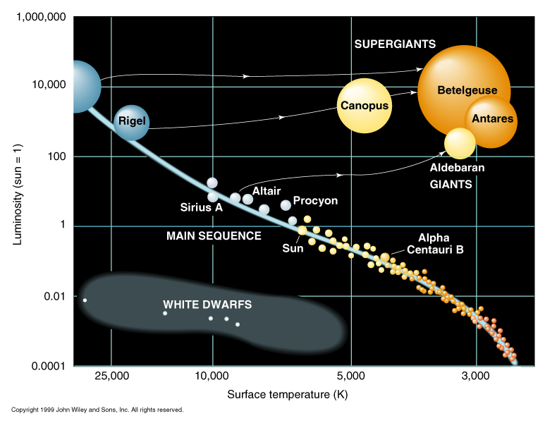
Measuring Astronomical Distances
Review: Methods for mesuring distance
Radar ranging: works in the solar system
Triangulation: can be used up to 3,000 light years (nearest 120,000 stars)
Brightness-distance: works for individual stars

Slide 7
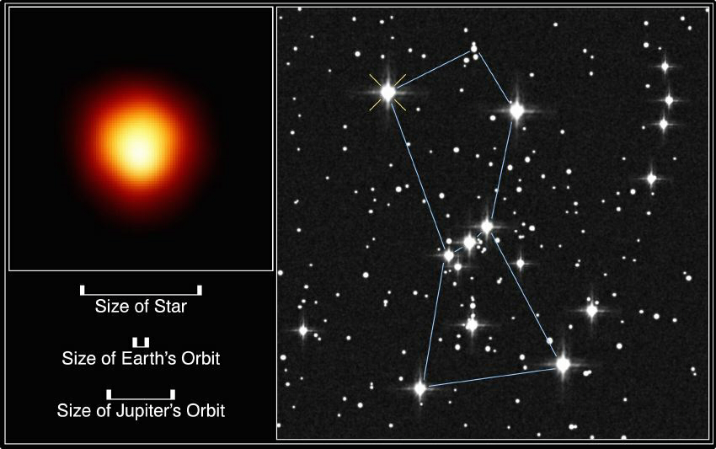
The Basic Idea Behind Finding Distances to Stars:
“Real” Brightness
Farther away
Farther away still
We measure the brightness we see.
We infer the real brightness.
We calculate the distance from the difference.

Slide 8
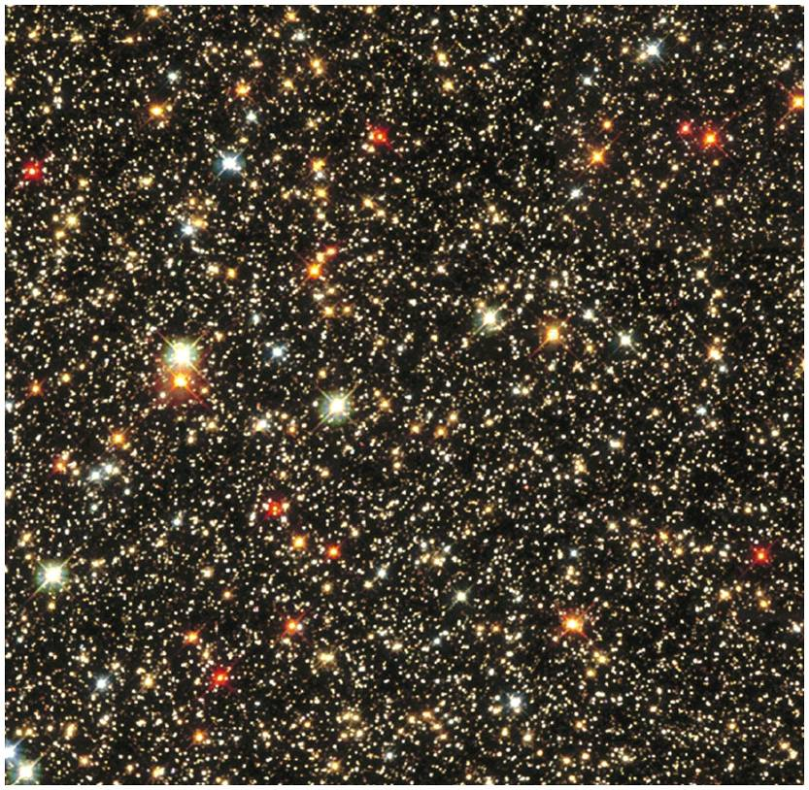
Color-Brightness Relation
The Next Rung on the distance ladder is from the relation between brightness and color.
Star colors and brightnesses are determined by their masses.

Slide 9
Brightness-Distance (Hertzsprung-Russell Method)
Absolute brightness -- the actual brightness of things viewed from the same distance
Read from the H-R diagram knowing the stars color
Apparent brightness -- how bright things look to us here on earth
near stars appear brighter than far stars of the same color
By comparing the absolute and apparent brightness, we can measure distance
This is useful for distances to all the stars in the Milky way Galaxy.

Slide 10
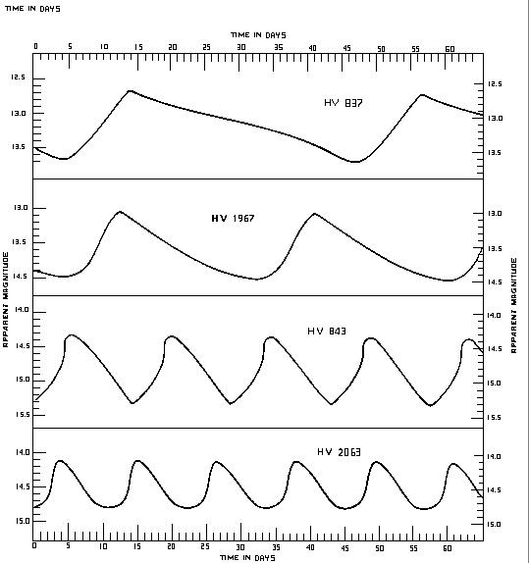
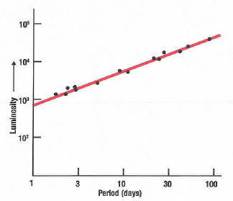
Variable Stars as Distance Indicators
A class of very bright stars called Cepheids, have a tight relation between their real brightness and their pulsation periods.
Pulsation period → real brightness → measured brightness → distance
The primary mission of the Hubble Space Telescope was to find distances to nearby galaxies using Cepheid variable stars.
45 days
*
*
30 days
*
15 days
10 days
Notes:
A Cepheid is usually a population I giant yellow star, pulsing regularly by expanding and contracting, resulting in a regular oscillation of its luminosity. The luminosity of cepheid stars range from 103 to 104 times that of the Sun. Because Cepheids are from population I, they are sometimes called Type I Cepheids, while the similar (but belonging to population II) W Virginis variables are known as Type II Cepheids.
The exact mass of Cepheids with given brightness or oscillations is not known to any great precision, but astronomers hope to gather data for this from the newly-discovered third star of the Polaris system [1].
The variation in luminosity is caused by a cycle of ionization of helium in the star's atmosphere, followed by expansion and deionization. While ionized, the atmosphere is more opaque to light. This cycle has a period roughly equal to the star's dynamical time scale, therefore giving information on the mean density of the body as well as its luminosity.
The oscillations of the stars have standard trvelling standing wave patterns that are described by spherical harmonics, etc. 3-d analogues to a drumhead in 2-d. The modes are driven by variable transmittance of partially ionized gasses interacting with the radiation pressure from within the star.
These are huge stars (upper right on H-R) because these are the ones that have most unstable configurations

Slide 11
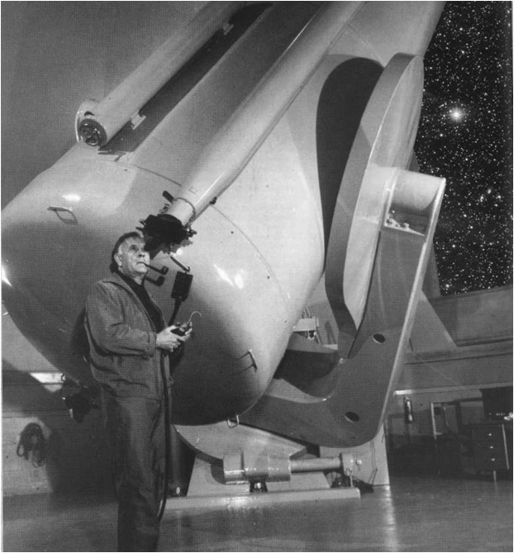
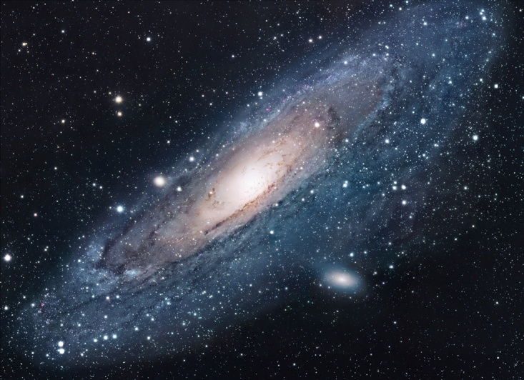
External Galaxies
It wasn’t until 1923 that we fully realized the universe consisted of more than the Milky Way.
In 1923 Edwin Hubble determined that Cepheid variable stars in the Andromeda galaxy are 2.5 million light-years away.
Since the milky way is only 100,000 light-years across, it became apparent that Andromeda was a separate system of stars.
Edwin Hubble with his 200 inch telescope
Andromeda (HST)

Slide 12
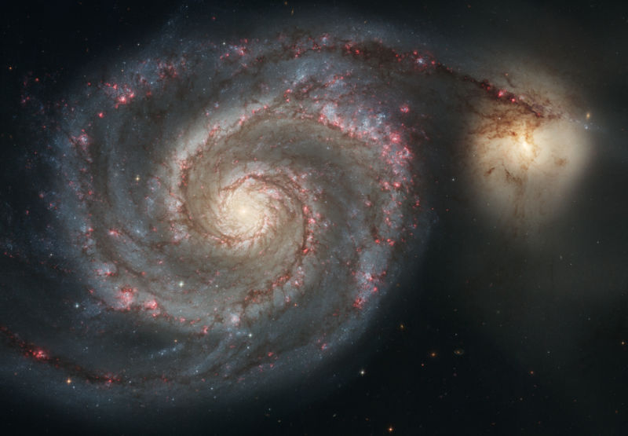
We are not alone in the universe
Soon it was realized that the spiral-shaped “nebula” were galaxies of stars similar to the Milky Way.
On average over 100 billion stars per galaxy!
Huge! The universe itself is only 10⁵ time larger than a typical galaxy.
At least 50 billion of them.
Sketch by William Parsons, 1845
HST photo of the “Whirlpool Galaxy” (also known as Messier 51a, M51a, or NGC 5194)
Notes:
http://en.wikipedia.org/wiki/William_Parsons,_3rd_Earl_of_Rosse
William Parsons, 3rd Earl of Rosse (June 17, 1800 – October 31, 1867) was an Irish astronomer.
He became the third Earl of Rosse when his father died in 1841. Prior to this, his title was "Lord Oxmantown".
In the 1840s, he built his "Leviathan of Parsonstown" 72-inch (183cm) telescope at Birr, Ireland (then called "Parsonstown") in County Offaly, which was for many decades the largest telescope in the world. He had to invent many of the techniques he used in constructing this telescope, both because its size was without precedent and because earlier telescope builders had guarded their secrets or had simply failed to publish their methods. It was considered a marvelous technical and architectural achievement and images of it were circulated widely within the British commonwealth.
The telescope mirror was made from speculum metal. Because it tarnished so rapidly in the damp climate, the mirror had to be repolished every six months, and so Lord Rosse had two mirrors built so that one could be used while the other was being repolished. Building of the telescope had to be suspended during the Great Potato Famine, but in 1847 it was put into service. The light-gathering ability exceeded expectations, enabling 18th magnitude stars to be observed for the first time. However, the Irish sky was not kind to astronomy, and due to weather conditions very few good nights of viewing were available per year.
William Parsons
Lord Rosse carried out pioneering astronomical studies and discovered the spiral nature of some nebulas, today known to be spiral galaxies. The first spiral galaxy he detected was M51, and his drawings of it closely resemble modern photographs (today it is known as the Whirlpool Galaxy).
He named the Crab Nebula, based on an earlier drawing made with his older 36-inch (91cm) telescope in which it resembled a crab. A few years later, when the 72-inch (183cm) telescope was in service, he produced an improved drawing of considerably different appearance, but the name stuck anyway.
A main component of Rosse's nebular research was attempting to resolve the nebular hypothesis, which posited that planets and stars were formed by gravity acting on gaseous nebulae. Rosse himself did not believe that nebula were truly gaseous, but rather were made up of such an amount of fine stars that most telescopes could not resolve them individually (that is, he considered them stellar in nature). Rosse and his technicians claimed to resolve the Orion nebula into its individual stars, which would have both political and cosmological implications, as at the time there was considerable debate over whether or not the universe was "evolved" (in a pre-Darwinian sense), a concept Rosse disagreed with strongly. Rosse's primary opponent in this was John Herschel, who used his own instruments to claim that the Orion nebula was a "true" nebula, and discounted Rosse's instruments as flawed (an insult Rosse returned about Herschel's own). In the end, neither man (or telescope) could establish sufficient scientific authority in its results to solve the question by themselves (the convincing evidence for the gaseous nature of the nebula would come later from spectroscopic evidence, though it would not resolve the philosophical issues).
In addition to his astronomical pursuits, he served as a member of Parliament from 1821 to 1834, an Irish representative peer after 1845, president of the Royal Society (1848–1854), and chancellor of the University of Dublin (beginning in 1862).
Rosse crater, on the Moon, is named after him.
He married Mary Field in 1836 and they had four children, all sons. The eldest, Lawrence Parsons, succeeded him as Earl of Rosse and continued some astronomical observations; another son, Charles Algernon Parsons, is known for his commercial development of the steam turbine. Another son, Richard Clere Parsons apparently made a name for himself building railways in South America.

Slide 13
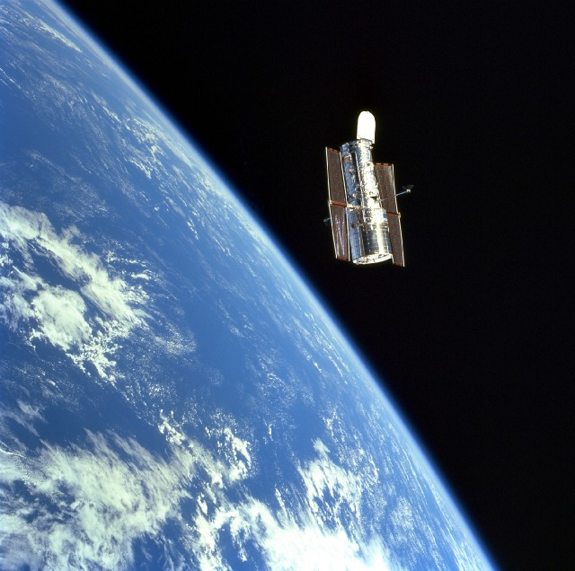
The Hubble Deep Field
Notes:
http://en.wikipedia.org/wiki/Hubble_Ultra_Deep_Field
The Hubble Ultra Deep Field or HUDF is an image of a small region of space composited from Hubble Space Telescope data accumulated over a period from September 3, 2003 through January 16, 2004. It is the deepest image of the universe ever taken in visible light, looking back in time more than 13 billion years. The HUDF contains an estimated 10,000 galaxies. The patch of sky in which the galaxies reside (just one-tenth the diameter of the full moon) was chosen because it had a low density of bright stars. Although most of the targets visible in the Hubble image can also be seen at infrared wavelengths by ground-based telescopes, Hubble is the only instrument which can make observations of these distant targets at visible wavelengths. Located southwest of Orion in the constellation Fornax at right ascension 3h 32m 40.0s, declination -27° 48' 00" (J2000), the image covers 3 arcminutes square, which is smaller than a grain of sand held at arm's length, and is tilted about 45° such that the upper left corner points toward north on the celestial sphere.
The million-second-long exposure reveals the first galaxies to emerge from the so-called "dark ages," the time shortly after the Big Bang when the first stars reheated the cold, dark universe. The view is actually two separate images taken by Hubble's Advanced Camera for Surveys (ACS) and the Near Infrared Camera and Multi-Object Spectrometer (NICMOS). In total, the image required 800 exposures taken over the course of 400 Hubble orbits around Earth. The total amount of exposure time was 11.3 days for the ACS and 4.5 days for the NICMOS.
The Big Bang theory suggests that the Universe has a finite age, and if this were true we might expect very distant (and hence very young) galaxies to look different from the typical older galaxies we see today. This is indeed seen in the HUDF, although some argue that the difference is partly a result of the unusual wavelength used for the HUDF (corresponding to ultraviolet light from the rest-frame of the most distant galaxies). The Hubble Ultra Deep Field also shows more evidence for galaxy formation and merging than in local studies, as expected for the early Universe.

Slide 15
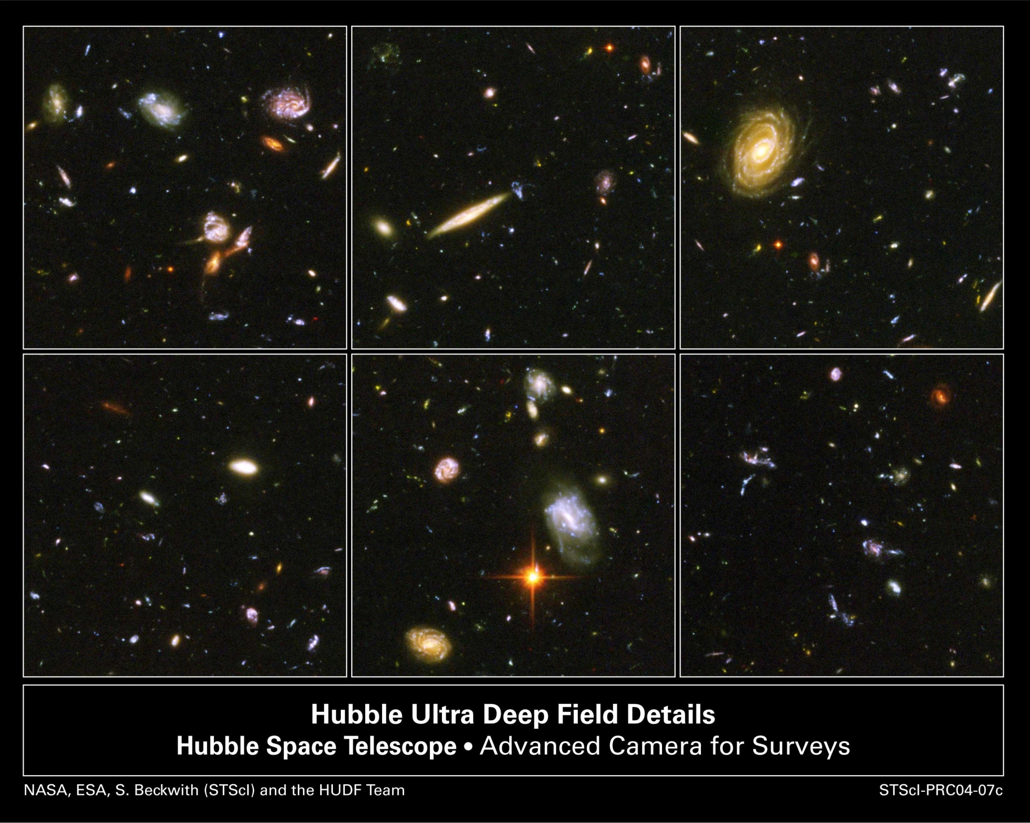

Slide 16
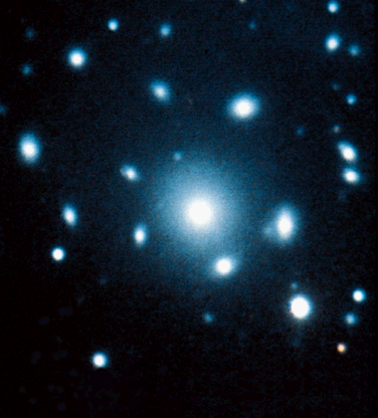
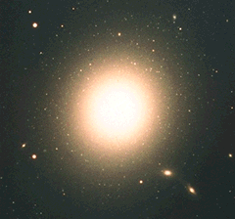
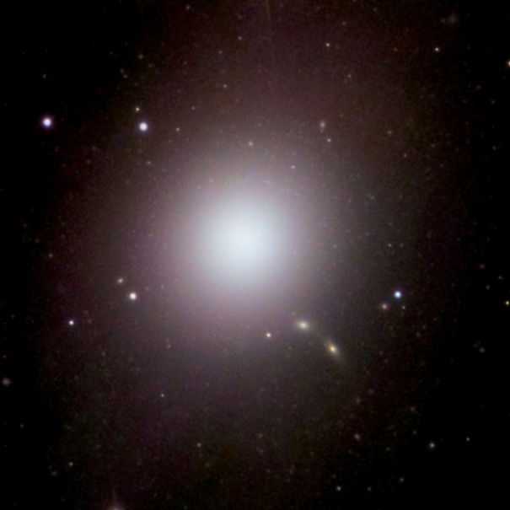
Elliptical Galaxies

Slide 17
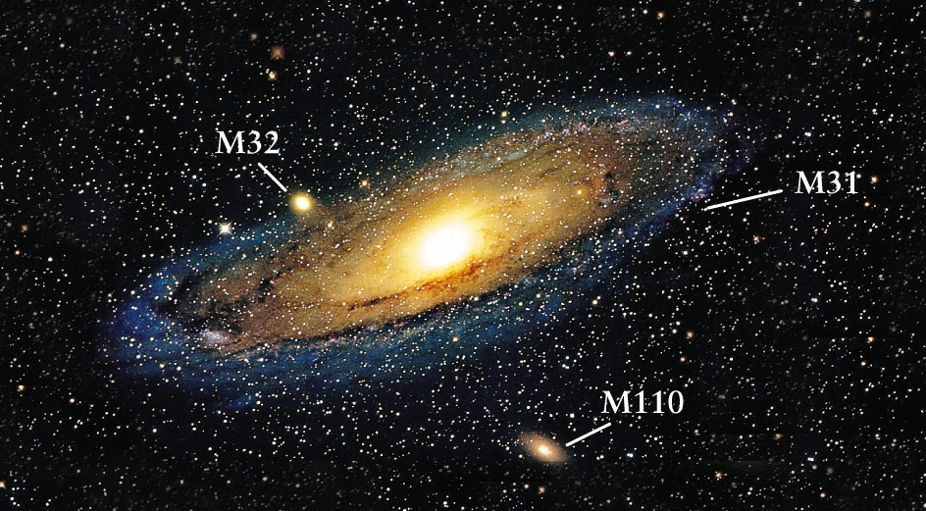
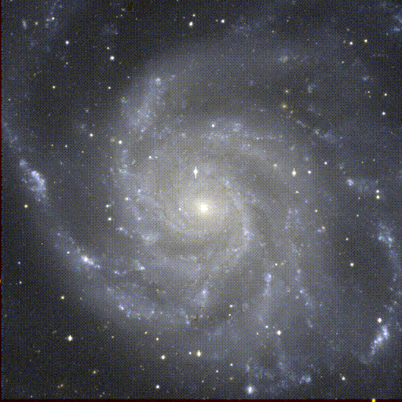
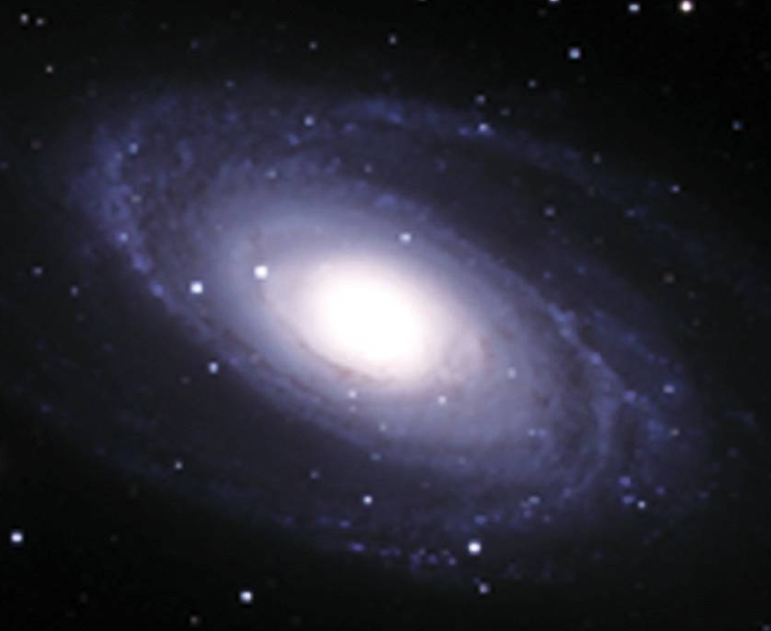
Spiral Galaxies

Slide 18
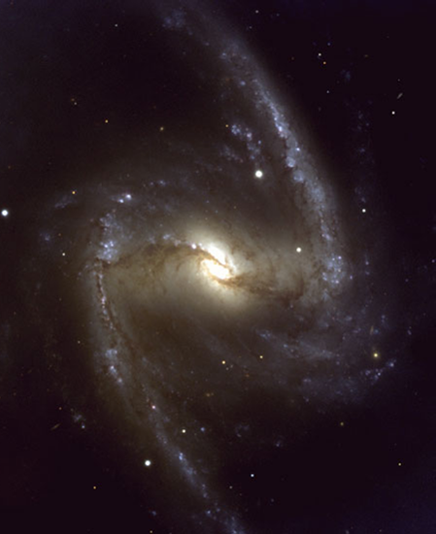
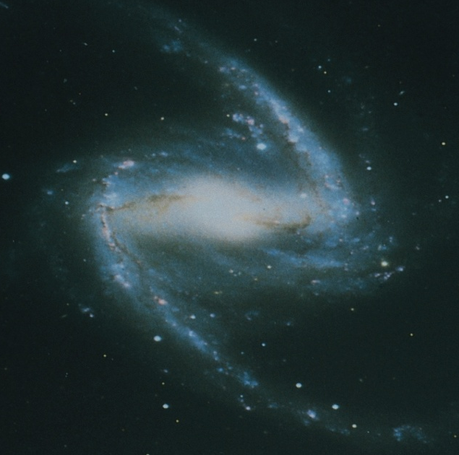
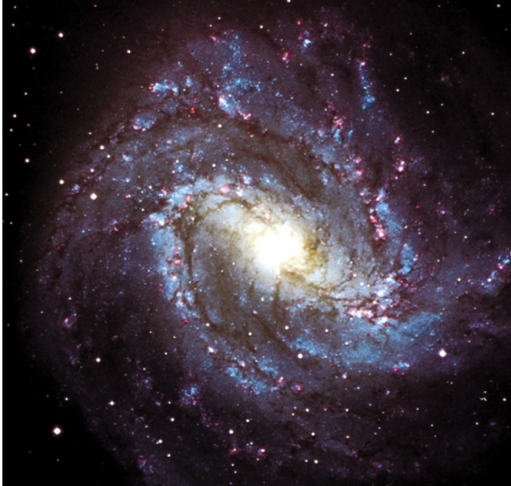
Barred Spirals

Slide 19
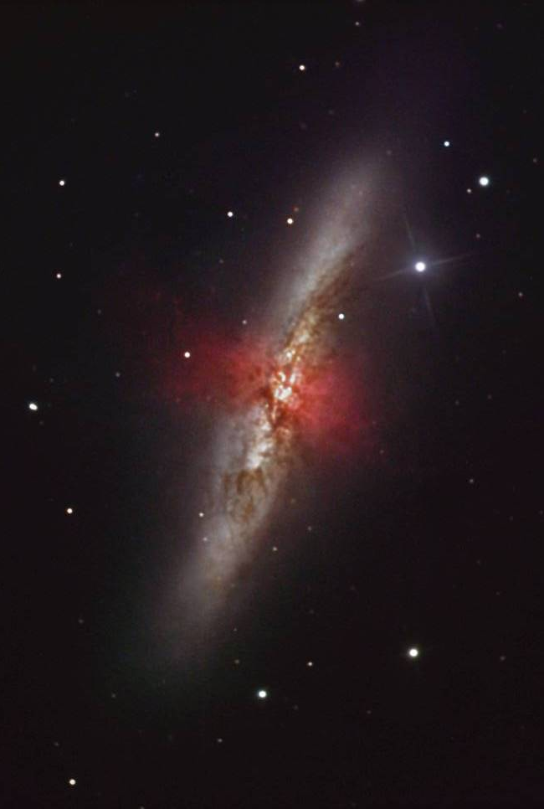
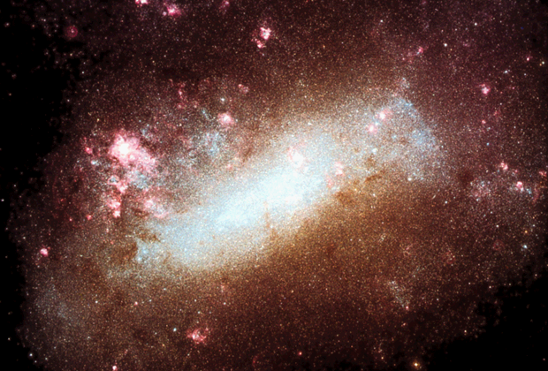
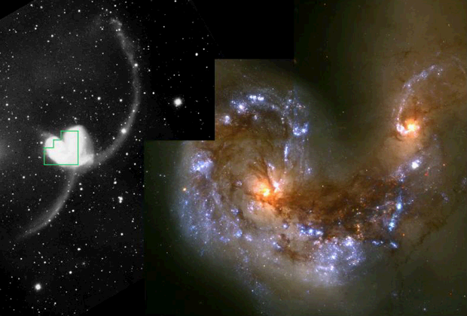
Irregular/Peculiar

Slide 20
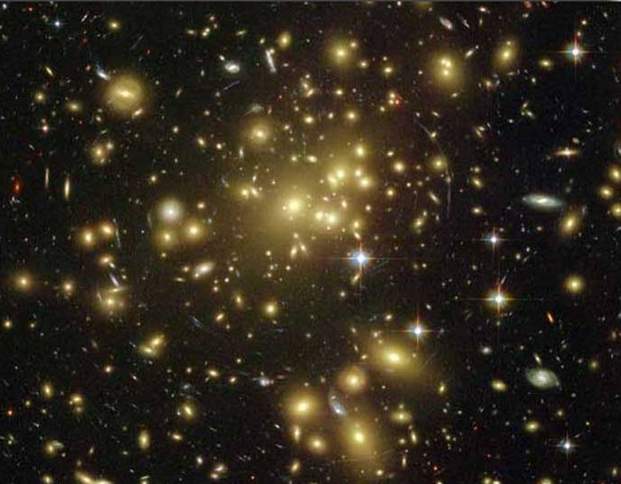
Galaxy Clusters
Galaxies are held together in small to large groups by gravity.

Slide 21
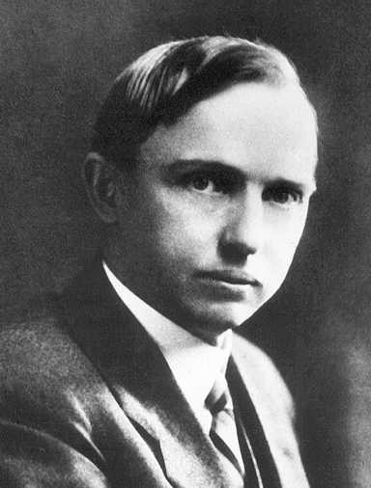
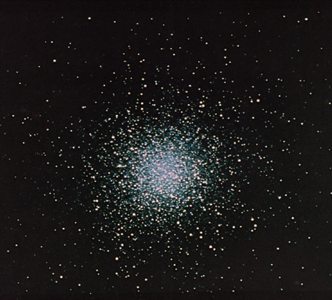
Harlow Shapley was able to point out that we are not at the center of the galaxy
He found the position by measuring distances to the globular star clusters that orbited about the center of the Milky Way.
Globular Cluster
Harlow Shapley
Notes:
Globular cluster
From Wikipedia, the free encyclopedia
A globular cluster is a spherical collection of stars that orbits a galactic core as a satellite. Globular clusters are very tightly bound by gravity, which gives them their spherical shapes and relatively high stellar densities toward their centers. The name of this category of star cluster is derived from the Latin globulus—a small sphere. A globular cluster is sometimes known more simply as a globular.
Globular clusters, which are found in the halo of a galaxy, contain considerably more stars and are much older than the less dense galactic, or open clusters, which are found in the disk. Globular clusters are fairly common; there are about 158^{[2]} currently known globular clusters in the Milky Way, with perhaps 10–20 more undiscovered.^{[3]} Large galaxies can have more: Andromeda, for instance, may have as many as 500.^{[4]} Some giant elliptical galaxies, such as M87,^{[5]} may have as many as 10,000 globular clusters. These globular clusters orbit the galaxy out to large radii, 40 kiloparsecs (approximately 131 thousand light-years) or more.^{[6]}
Every galaxy of sufficient mass in the Local Group has an associated group of globular clusters, and almost every large galaxy surveyed has been found to possess a system of globular clusters.^{[7]} The Sagittarius Dwarf and Canis Major Dwarf galaxies appear to be in the process of donating their associated globular clusters (such as Palomar 12) to the Milky Way.^{[8]} This demonstrates how many of this galaxy's globular clusters were acquired in the past.
Although it appears that globular clusters contain some of the first stars to be produced in the galaxy, their origins and their role in galactic evolution are still unclear. It does appear clear that globular clusters are significantly different from dwarf elliptical galaxies and were formed as part of the star formation of the parent galaxy rather than as a separate galaxy.^{[citation needed]} However, recent conjectures by astronomers suggest that globular clusters and dwarf spheroidals may not be clearly separate and distinct types of objects.^{[9]}
Harlow Shapley
From Wikipedia, the free encyclopedia
Harlow Shapley (November 2, 1885 – October 20, 1972) was an American astronomer.
He studied under Henry Norris Russell at Princeton University and used the period-luminosity relation for Cepheid variable stars (discovered by Henrietta Swan Leavitt) to determine distances to globular clusters. He was the first to realize that the Milky Way Galaxy was much larger than previously believed.
He participated in the "Great Debate" with Heber D. Curtis on the nature of nebulas and galaxies and the size of the universe. The debate took place on April 26, 1920. Shapley argued against the theory that the Sun was at the center of the galaxy, and promoted the idea that globular clusters and spiral nebulae are within the Milky Way. He was incorrect about the latter point, but correct about the former.
At the time of the debate, Shapley was working at the Mount Wilson Observatory. After the debate, however, he was hired to replace the recently deceased Edward Charles Pickering as director of the Harvard College Observatory.
He served as director of the HCO from 1921 to 1952. During this time, he hired his future wife Cecilia Payne-Gaposchkin, who became the first person to earn a doctorate at Harvard University in the field of astronomy.
In the 1940's, Shapley helped found government funded scientific associations, including the National Science Foundation. He is also responsible for putting the "S" in UNESCO (United Nations Educational, Scientific and Cultural Organization).
Politically, Shapely was a liberal, and found himself one of the victims of McCarthyism.
In 1950, Shapley was instrumental in organising a campaign in academia against the controversial US bestseller book Worlds in Collision by Russian expatriate psychiatrist Immanuel Velikovsky.
Incidentally, Shapley held a life long interest in myrmecology, the study of ants.
He is also the Grandfather of best-selling author Tracey Shapley and Pulitzer Prize winning accountant Christopher Shapley

Slide 22
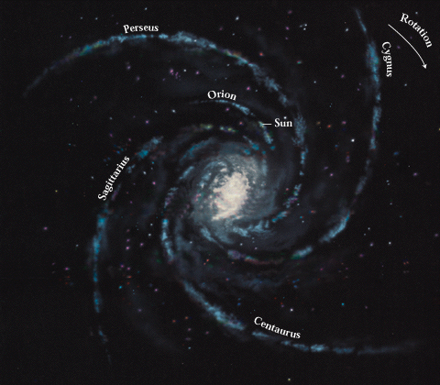
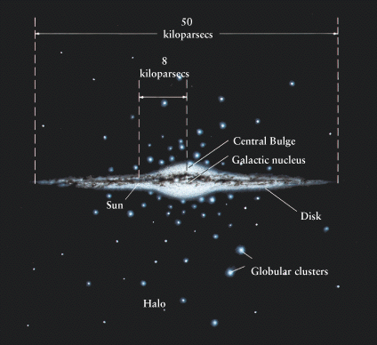
Position of the Sun in the Milky Way
The sun is 2/3 the way from the galaxy center to the edge.
Its position was found by measuring distances to the globular star clusters that orbited about the center of the Milky Way.
Variable stars were used to find the distances.
x
The Sun
x
Globular Clusters

Slide 23
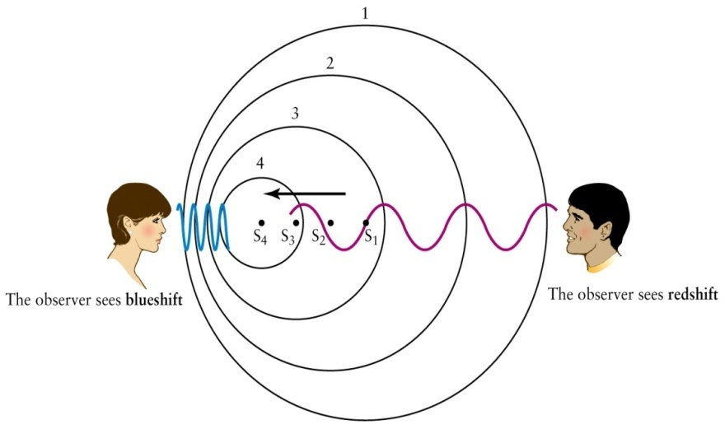
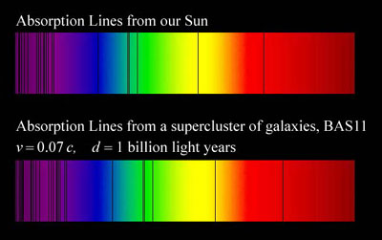
Cosmological Redshift and The Doppler Effect
A profound discovery of the early 1900s was that all distant galaxies have their absorption and emission spectral lines shifted to the red.
The amount of the shift is related to the speed of the galaxy.
Shift can be found because spectral emission lines have a characteristic pattern
Notes:
show video clip #21 with Doppler shift of a train horn
Emphasize: higher frequency if moving towards you, lower frequency if moving away.
Other demonstration--swinging a speaker.

Slide 24
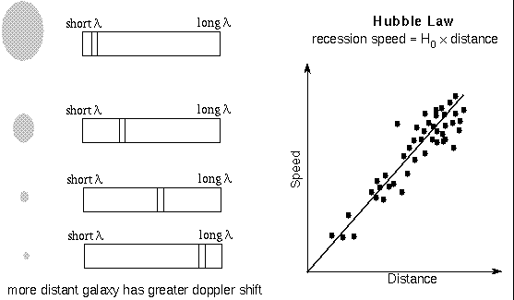
Hubble Law
The speed a galaxy moves away from us is proportional to its distance: The farther away the galaxy is, the faster it recedes.
The Hubble Law is used to find distances to the farthest galaxies
radar ranging | within solar system
triangulation | nearest 10,000 stars in galaxy
distance-brightness | within our galaxy and nearby galaxies
cosmological redshift | beyond nearby galaxies

Slide 25
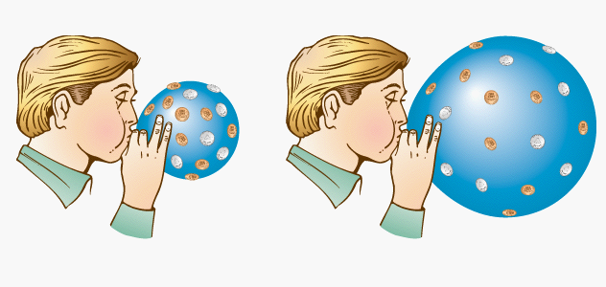
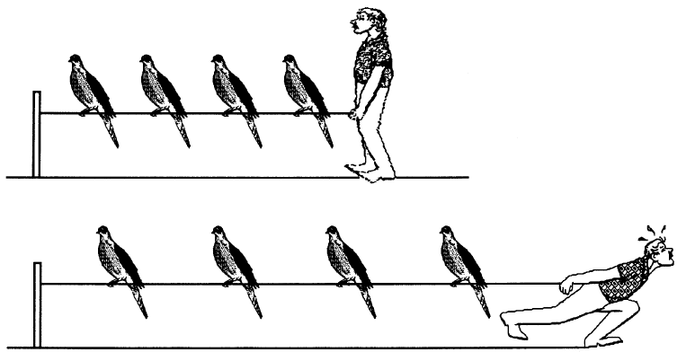

The expansion of the universe makes all distant galaxies appear to be moving away from us (and hence be red-shifted).
If the universe is expanding, the farther away two galaxies are, the faster they move apart.
Also, all galaxies would appear to be moving away from all other galaxies so our view is not unique.

Slide 26
Types of Cosmologies
Early ideas of the universe held that it was:
Infinitely old
Infinitely large
Unchanging in time
But this cannot be true because
The universe is seen to be expanding and thus it is changing with time.
An infinitely large and old universe would never know darkness. This is Olber’s paradox

Slide 27
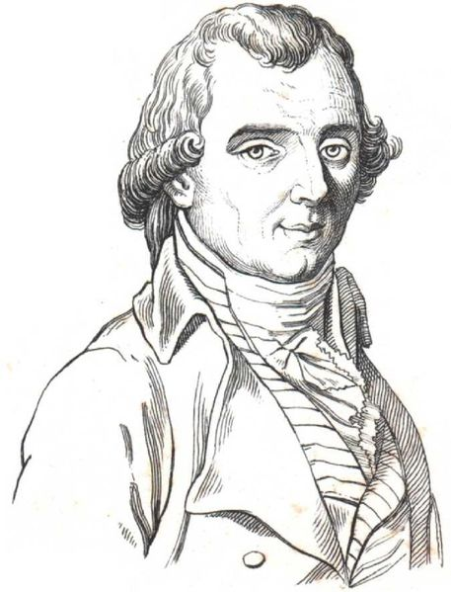
Olbers’ Paradox
All lines of sight end on a star! The sky should be ablaze with star light!
The solution is that the universe has a beginning
Light has not had time to reach us from the greatest distances
Glowing stars and galaxies have not always existed.
☼
☼
☼
☼
☼
☼
☼
☼
☼
☼
☼
☼
☼
☼
☼
☼
☼
Earth

Slide 28
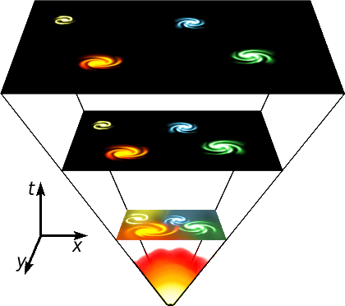
The observed expansion of the universe has led to the only currently viable cosmological theory: The Big Bang
The universe began as a great infusion of pure energy about 13.7 billion years ago.
Space expanded from that point in time. The energy cooled into matter.

Slide 29
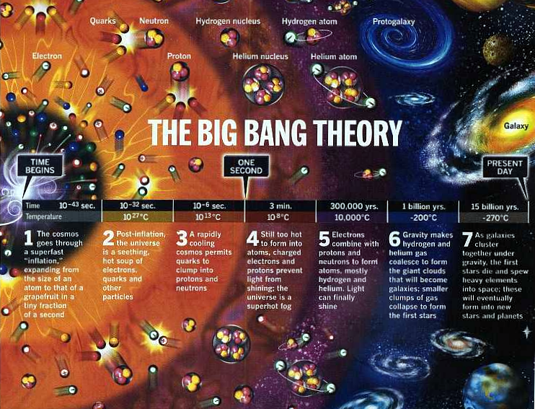
As the universe expanded, it would have cooled down

Slide 30
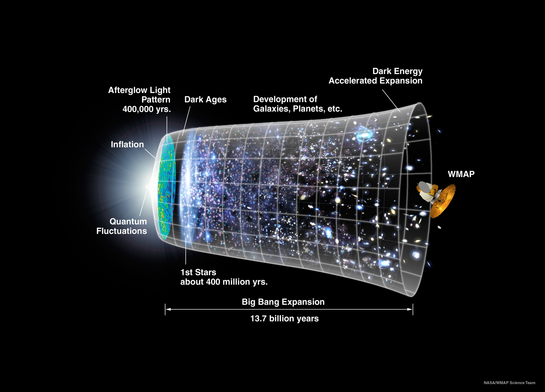
Notes:
Artist concept of the universe expansion, where space (including hypothetical non-observable portions of the universe) is represented at each time by the circular sections. Note on the left the dramatic expansion (not to scale) occurring in the inflationary epoch, and at the center the expansion acceleration. The scheme is decorated with WMAP images on the left and with the representation of stars at the appropriate level of development. Image from WMAP press release, 2006.
During the first few days of the universe, the universe was in full thermal equilibrium, with photons being continually emitted and absorbed, giving the radiation a blackbody spectrum. As the universe expanded, it cooled to a temperature at which photons could no longer be created or destroyed. The temperature was still high enough for electrons and nuclei to remain unbound, however, and photons were constantly "reflected" from these free electrons through a process called Thomson scattering. Because of this repeated scattering, the early universe was opaque to light.
When the temperature fell to a few thousand Kelvin, electrons and nuclei began to combine to form atoms, a process known as recombination. Since photons scatter infrequently from neutral atoms, radiation decoupled from matter when nearly all the electrons had recombined, at the epoch of last scattering, 379,000 years after the Big Bang. These photons make up the CMB that is observed today, and the observed pattern of fluctuations in the CMB is a direct picture of the universe at this early epoch. The energy of photons was subsequently redshifted by the expansion of the universe, which preserved the blackbody spectrum but caused its temperature to fall, meaning that the photons now fall into the microwave region of the electromagnetic spectrum. The radiation is thought to be observable at every point in the universe, and comes from all directions with (almost) the same intensity.
In 1964, Arno Penzias and Robert Wilson accidentally discovered the cosmic background radiation while conducting diagnostic observations using a new microwave receiver owned by Bell Laboratories.^{[19]} Their discovery provided substantial confirmation of the general CMB predictions—the radiation was found to be isotropic and consistent with a blackbody spectrum of about 3 K—and it pitched the balance of opinion in favor of the Big Bang hypothesis. Penzias and Wilson were awarded a Nobel Prize for their discovery.
In 1989, NASA launched the Cosmic Background Explorer satellite (COBE), and the initial findings, released in 1990, were consistent with the Big Bang's predictions regarding the CMB. COBE found a residual temperature of 2.726 K and in 1992 detected for the first time the fluctuations (anisotropies) in the CMB, at a level of about one part in 10⁵.^{[20]} John C. Mather and George Smoot were awarded Nobels for their leadership in this work. During the following decade, CMB anisotropies were further investigated by a large number of ground-based and balloon experiments. In 2000–2001, several experiments, most notably BOOMERanG, found the universe to be almost spatially flat by measuring the typical angular size (the size on the sky) of the anisotropies. (See shape of the universe.)
In early 2003, the first results of the Wilkinson Microwave Anisotropy satellite (WMAP) were released, yielding what were at the time the most accurate values for some of the cosmological parameters. This satellite also disproved several specific cosmic inflation models, but the results were consistent with the inflation theory in general,^{[21]} it confirms too that a sea of cosmic neutrinos permeates the universe, a clear evidence that the first stars took more than a half-billion years to create a cosmic fog. Another satellite like it, scheduled for launch in April 2009, the Planck Surveyor, will provide even more accurate measurements of the CMB anisotropies. Many other ground- and balloon-based experiments are also currently running; see Cosmic microwave background experiments.
The background radiation is exceptionally smooth, which presented a problem in that conventional expansion would mean that photons coming from opposite directions in the sky were coming from regions that had never been in contact with each other. The leading explanation for this far reaching equilibrium is that the universe had a brief period of rapid exponential expansion, called inflation. This would have the effect of driving apart regions that had been in equilibrium, so that all the observable universe was from the same equilibrated region.

Slide 31
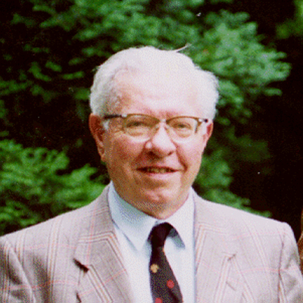
Fred Hoyle
Fred Hoyle gave the Big Bang theory its name (in a mocking manner, but it stuck)
Worked to disprove it, because it required an act of creation.
To date, it is the best theory we have to describe the creation and evolution of the universe.

Slide 32
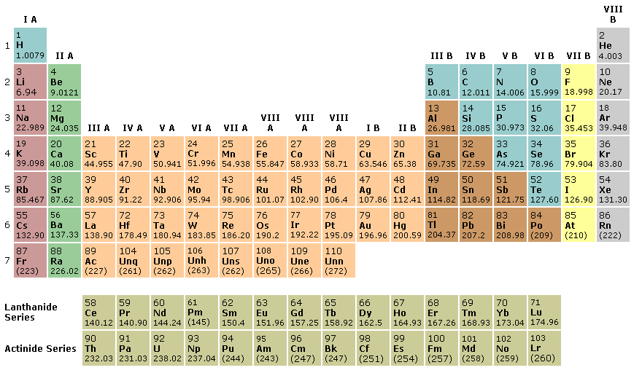
Experimental Evidence
cosmological red shift
Everything is moving away from us
helium/hydrogen ratio (25%/75%)
Fusion early after the big bang would produce that ratio of H to He
Big Bang
Stellar Fusion
Supernova
Notes:
age of stars and formation of galaxies still open to some question
Note that Dr. McNamara has made some important discoveries on this question just this year (1997).
Best current estimates: universe is about 12-18 billion years. Earth about 5 billion years (oldest crust about 4.3 billion years)

Slide 33
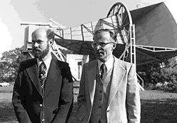
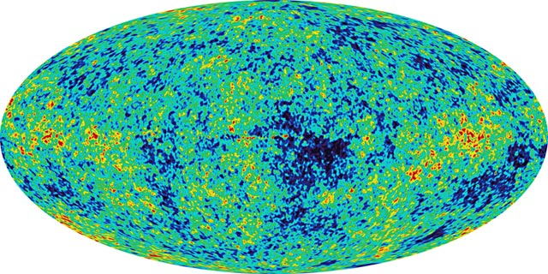
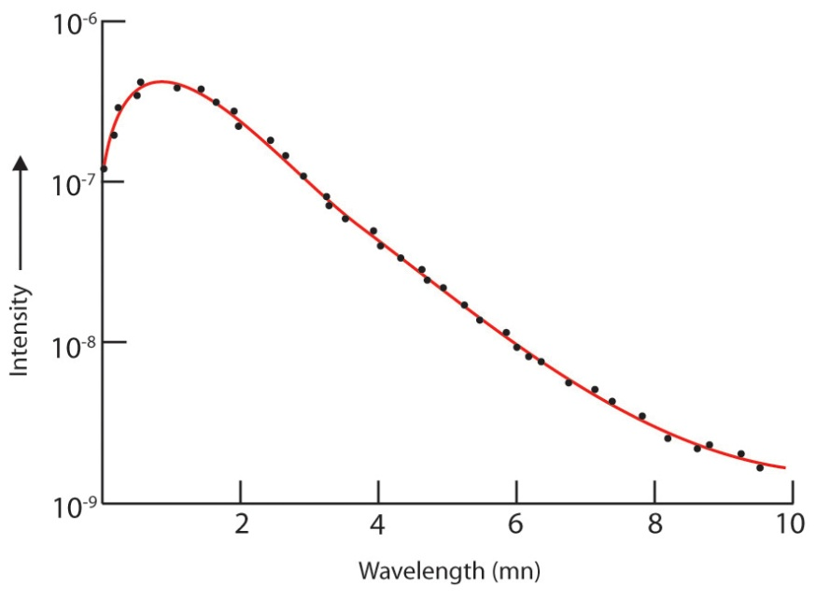
Evidence Supporting the Big Bang
We see a faint glow left from the original high temperatures
Called the Cosmic Microwave Background or 3° K Background Radiation.
Arno Penzias and Robert Wilson
Notes:
age of stars and formation of galaxies still open to some question
Note that Dr. McNamara has made some important discoveries on this question just this year (1997).
Best current estimates: universe is about 12-18 billion years. Earth about 5 billion years (oldest crust about 4.3 billion years)
Like investigators at a crime scene, astronomers have been combing the Universe for physical evidence to test the big bang theory-the most widely accepted scientific theory for how the Universe evolved. The first evidence that turned up was predicted in advance but discovered by accident. Some scientists thought the big bang should still be visible as a faint glow of radio light filling the sky in all directions. In 1964 Arno Penzias and Robert Wilson discovered that light, called the cosmic background radiation.
Maybe It's the Pigeons...? Arno Penzias and Robert Wilson were puzzled. The two scientists at Bell Labs in Holmdel, New Jersey, had ruled out everything they could think of that could create the static their satellite communications antenna was picking up. Pigeons had taken to roosting in the radio antenna's large horn. They thought that perhaps heat from pigeon droppings was the cause. They set out a trap to catch the pigeons, but that didn't resolve the mystery either. No matter where in the sky they pointed their radio antenna, they kept picking up that faint, persistent hiss. Their determination in 1964 that the entire sky seemed to be dimly glowing with radio light confirmed physicists' predictions and later earned Penzias and Wilson a Nobel Prize. The two scientists had, quite by accident, discovered the fading flash from the big bang.

Slide 34
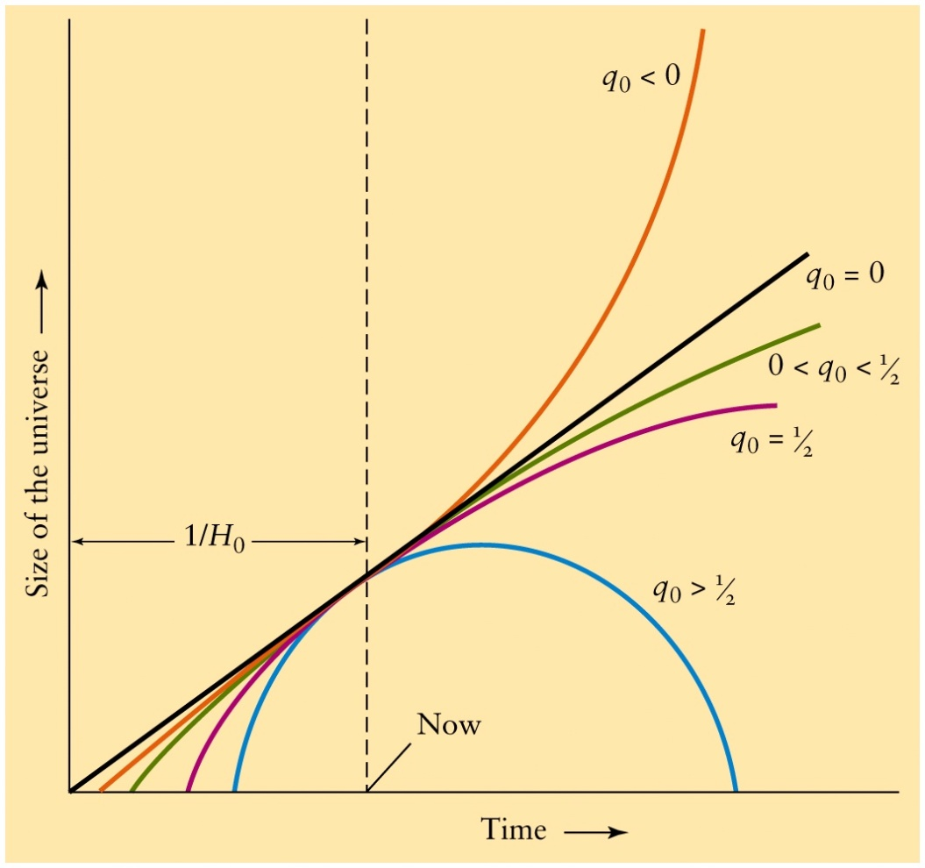
The Ultimate Fate of the Universe
Gravity always pulls, never pushes, so the expansion must slow down unless there is another force pushing out.
Not enough mass
open universe
Just right
flat universe
Too much mass
Closed universe (big crunch)
Another force
Runaway universe.
This is what we think is happening as best we can observe!

Slide 35
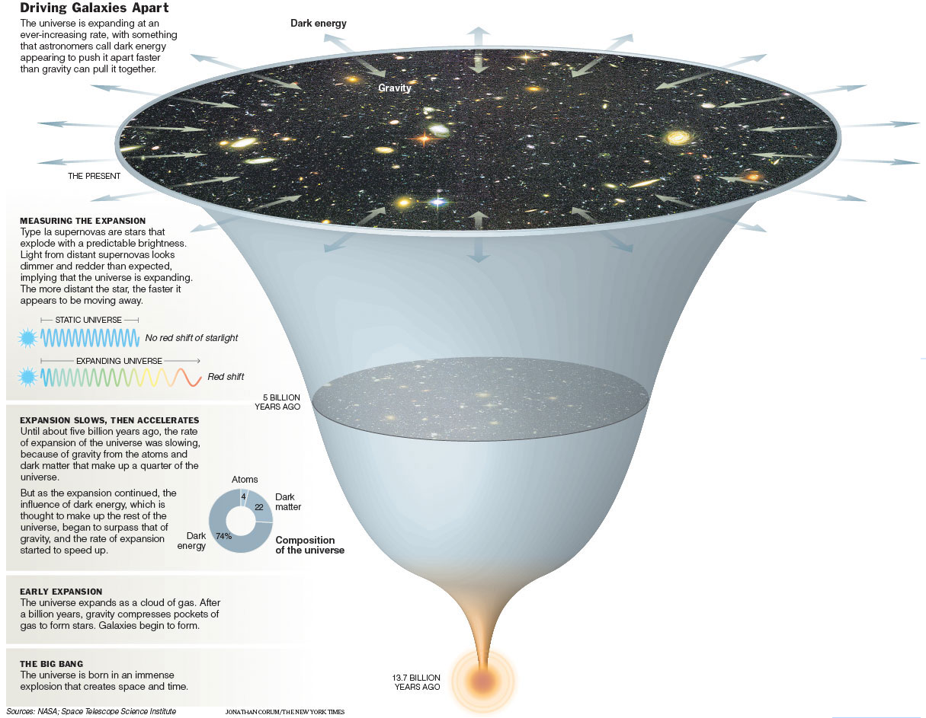

Slide 37
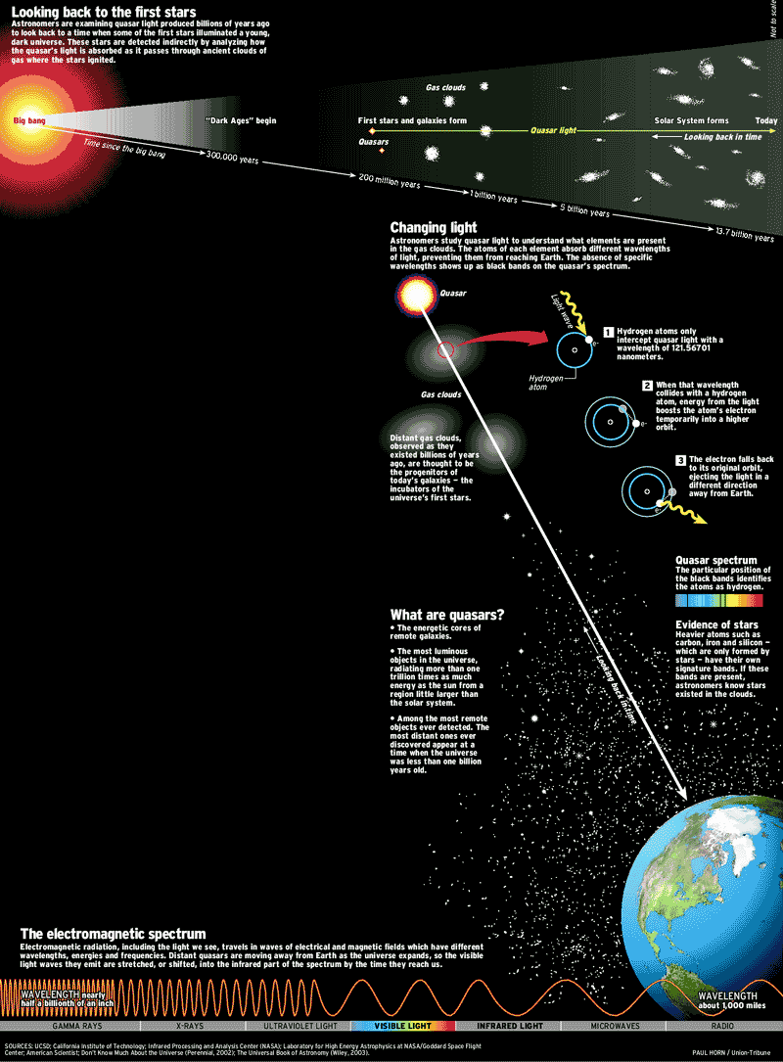
Looking back in time
A quasar is a supermassive black hole radiating through its accretion disk.

Slide 38
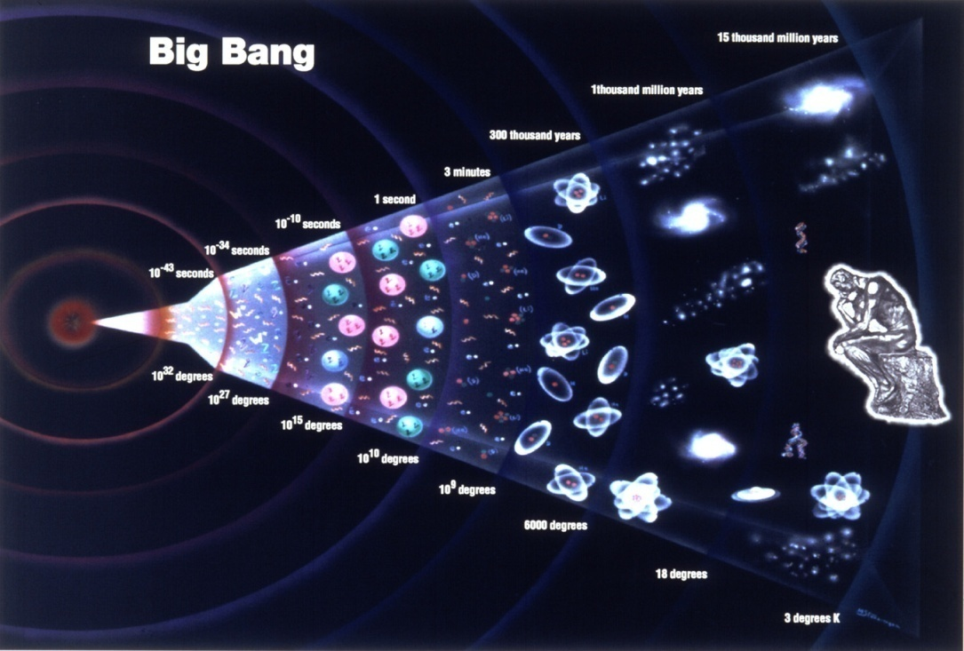
Big-Bang Theory
10⁻⁴³ sec | huge | ???
10⁻³⁵ sec | 10²⁶ deg | quarks, gluons, electrons, neutrinos, photons
.001 sec | 10¹¹ deg | protons and neutrons
3 minutes | 10⁹ deg | ³H, ³He, ⁴He nuclei
1/2 hour | 10⁸ deg | ²H nucleus
500,000 yrs | 30000 deg | atoms
universe began with an incredibly dense concentration of mass energy
in the process of rapid expansion and cooling matter was formed
point-like particles (electrons, quarks, photons, etc.)
nucleons (protons and neutrons)
simple nuclei (hydrogen and helium)
more complex nuclei, atoms, and molecules
The fate of the universe depends on its mass and energy
Open, it keeps expanding forever
Closed, it collapses back in on itself

