Slide 1
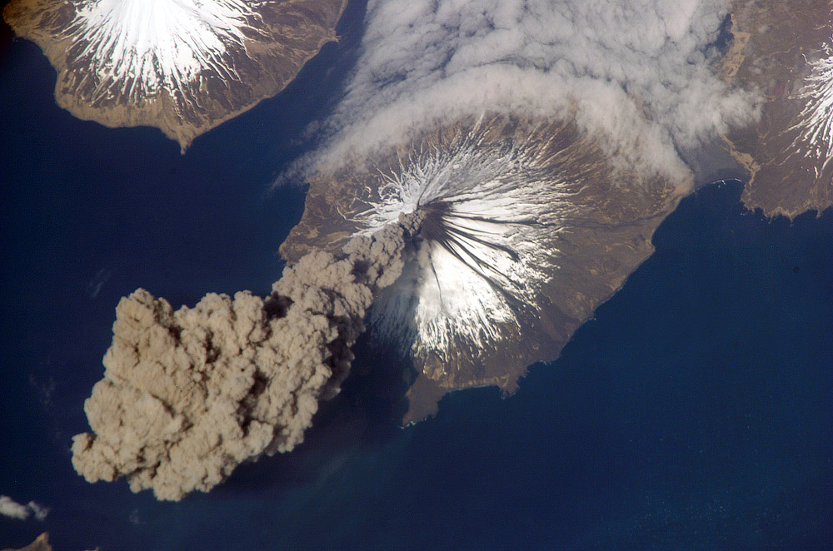
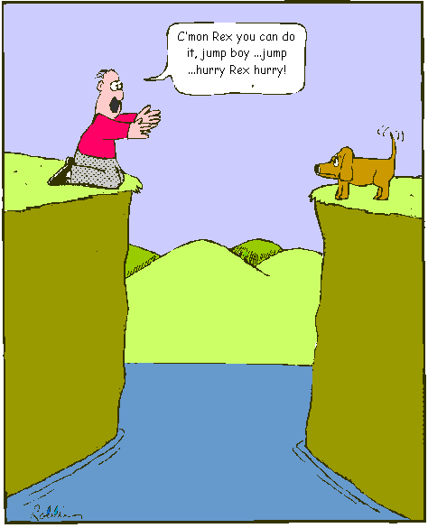
From Continental Drift to Plate Tectonics: The Evidence
Did you read chapter 29
before coming to class?
Yes
No
As the continents drift apart, Bob tries one last time to save his faithful dog Rex.

Slide 2
Secondary (shear) seismic waves will not propagate through the outer core. This is convincing evidence that the outer core is
Molten or liquid
Metallic
Composed primarily of oxides, silicates, and other minerals
Exactly located at the center of the earth
Very dense

Slide 3
Seismic wave speeds generally increase with depth, but at a specific depth called the Mohorovicic discontinuity there is a sharp drop in speed. This is evidence that:
The chemical composition of the crust changes at this depth
The density of the crust changes sharply at this depth
The pressure changes sharply at this depth
The temperature and pressure at this depth allows partial melting of the minerals

Slide 4
Reviews
I prefer reviews at the end of the lecture
I prefer reviews at the beginning of lecture
Don’t review, I’ve got it already.

Slide 5
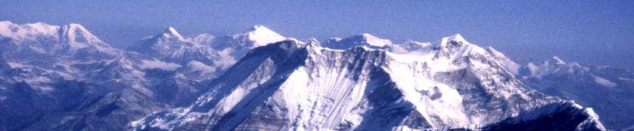
How are Mountains and Continents Formed?
Prior to the early 1900’s it was thought that mountains were pushed up from below somehow, but there weren’t good explanations.
So how would you go about trying to come up with an explanation (a theory)?
Collect evidence and make a hypothesis
Review the evidence to see if it fits the hypothesis
Revise the hypothesis and formulate a theory

Slide 6
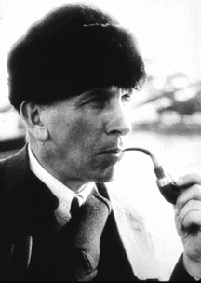
Alfred Wegner
Born Nov 1, 1880 in Germany
Earned PhD in astronomy in 1904, Univ. of Berlin
However, he was most interested in meteorology and geophysics
1914 drafted into German army, but was wounded early on and released
While convalescing in the hospital, he began to write and put together some ideas he had been thinking about for some time about the continents
A superb scholar who published books on polar climate.
In 1915 He published “The origins of Oceans and Continents”.
In it, he advocated Pangaea, an original land mass from which all others split.
His main evidence was how continents fit together
Published in 1915 the 1st edition of his treatise “The Origin of the Continents and Oceans”

Slide 7
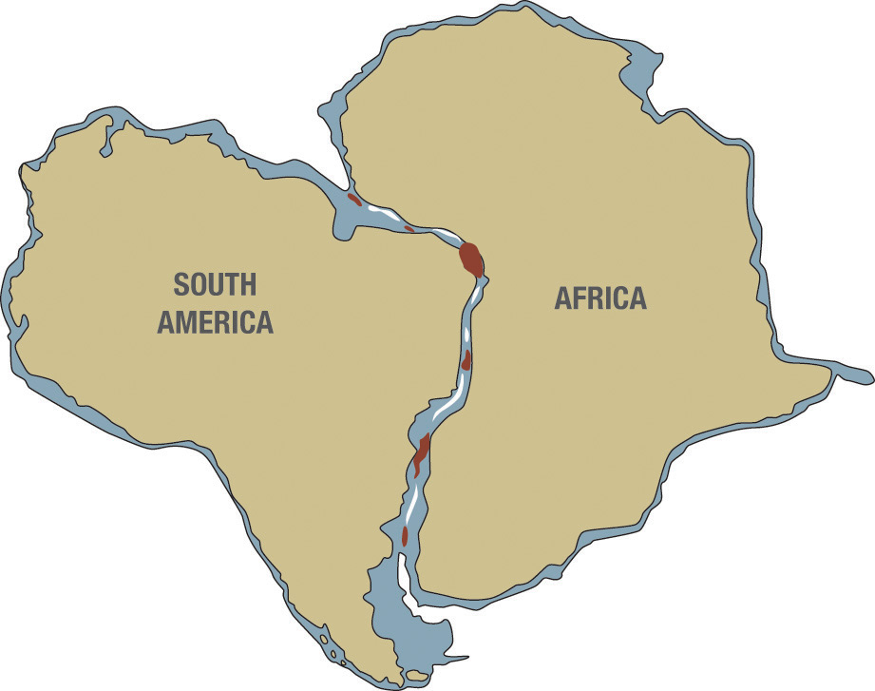
Jigsaw fit of the Continents
Many people had noticed the similarities of the coasts.
Becomes even more compelling when you consider the edges of the continental shelf.
Places where it didn’t fit were often located near river deltas.

Slide 8
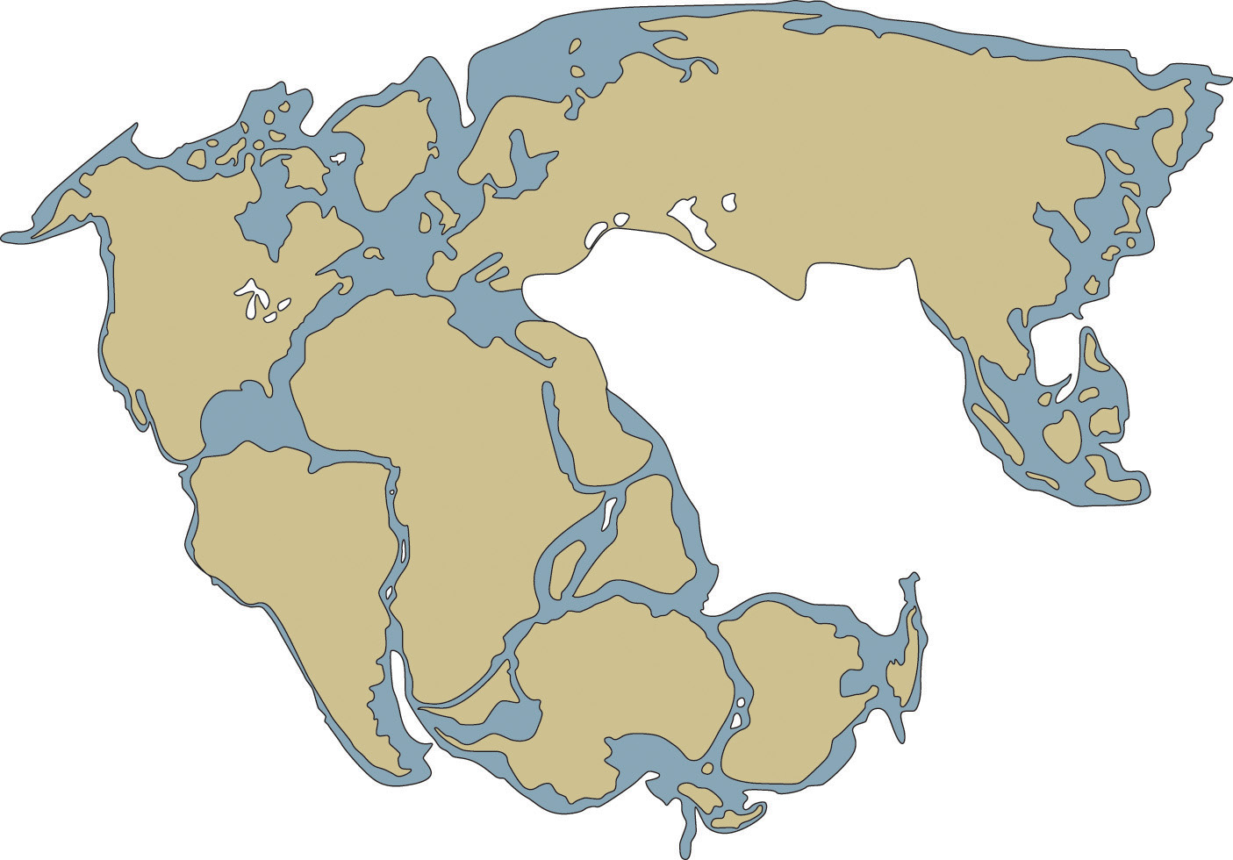
You can tile all of the continents together in the same way.

Slide 9
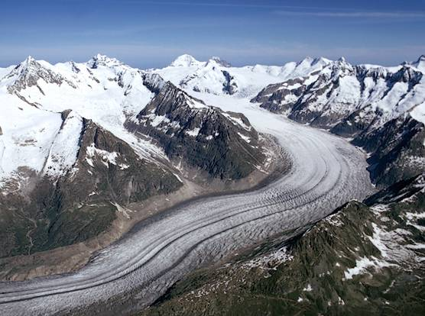
Glaciers erode the earths surface as they flow

Slide 10
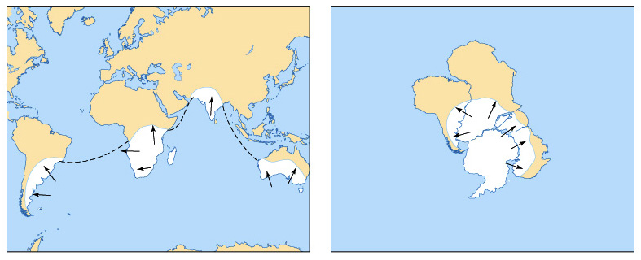
Patterns of Ancient Glaciation

Slide 11
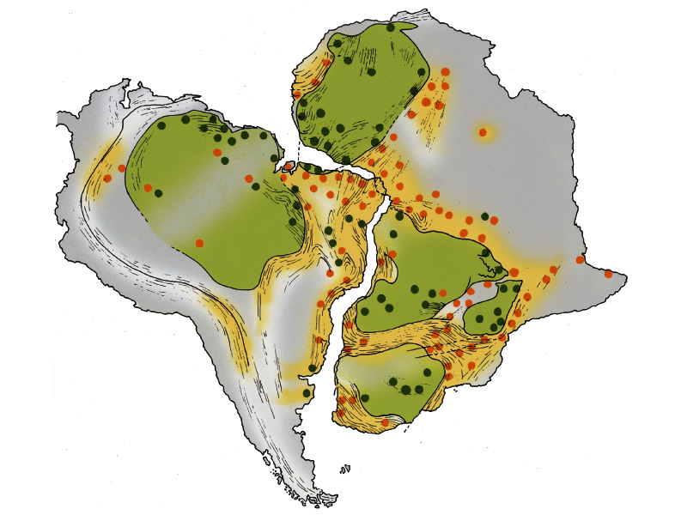
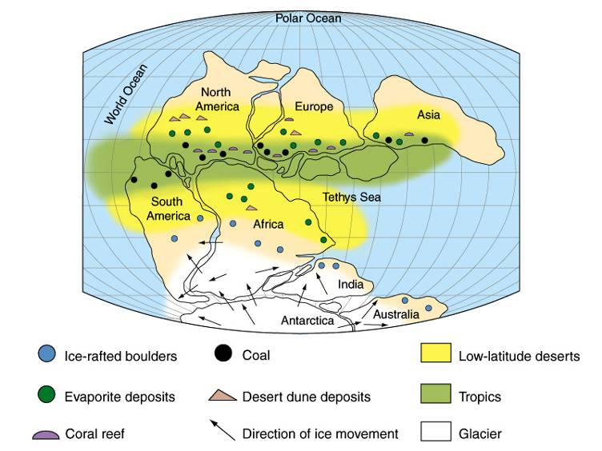
Paleoclimate Indicators and structural trends

Slide 12
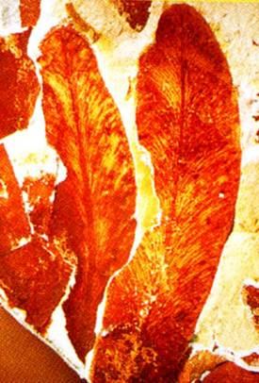
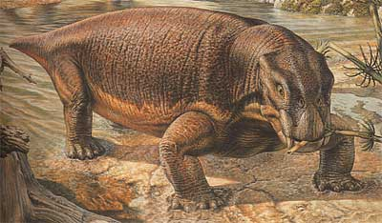
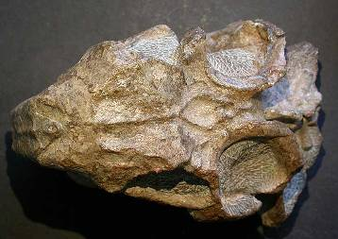
Patterns of Fossil Occurrence
Glossopteris
Lystrosaurus

Slide 13
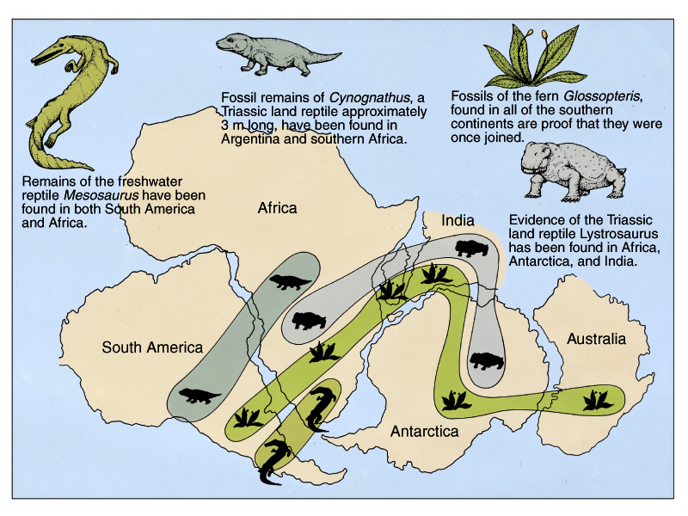
Patterns of Fossil Occurrence

Slide 14


How does your hard drive work?
Wouldn’t it be really cool if the earth had a hard drive recording magnetic fields?

Slide 15
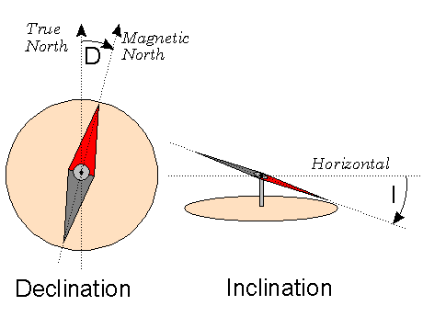
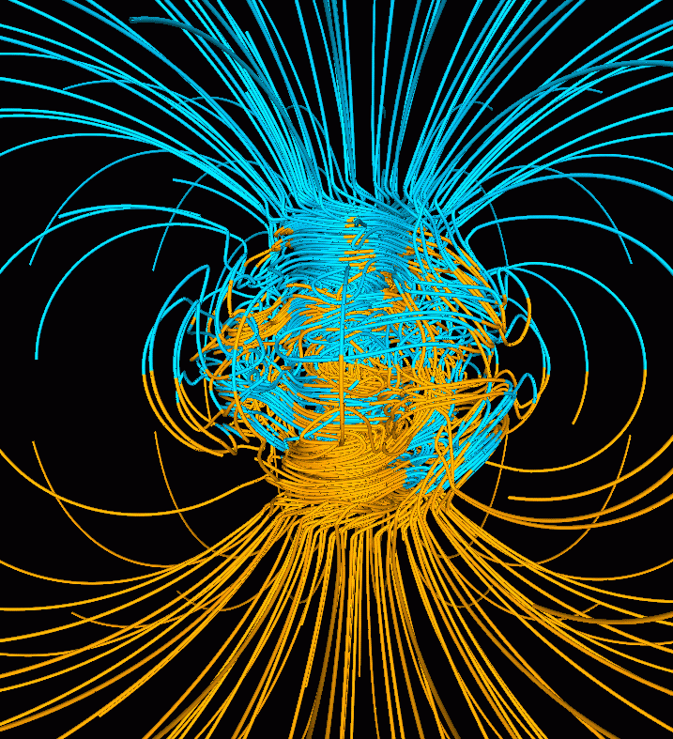
Earth’s Magnetic Field

Slide 16
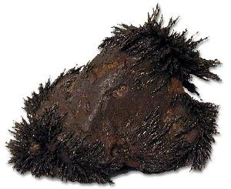
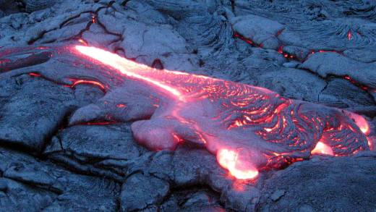
Rocks (magnetite) can record the orientation of Earth’s magnetic field

Slide 17
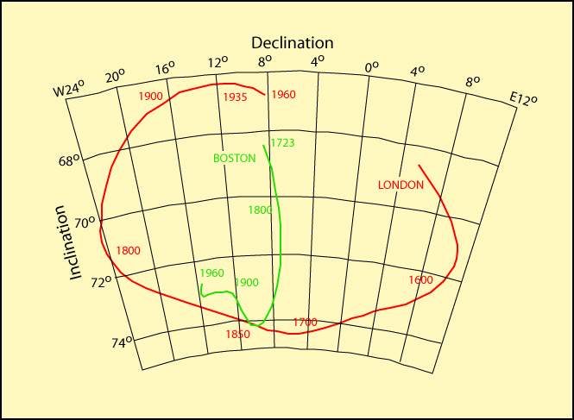
Apparent Polar Wander: Where have the magnetic poles been in the past?
What kind of polar wandering curves would we see if the continents were moving?
What would the curves be like if the continents were once together but have now drifted apart?
How could we get information on where the magnetic poles were in the past?

Slide 18
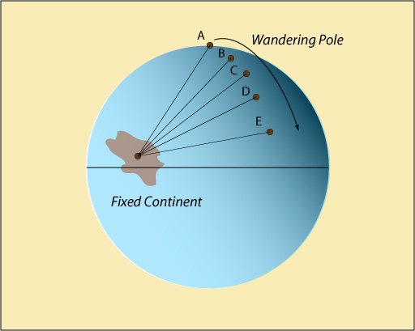
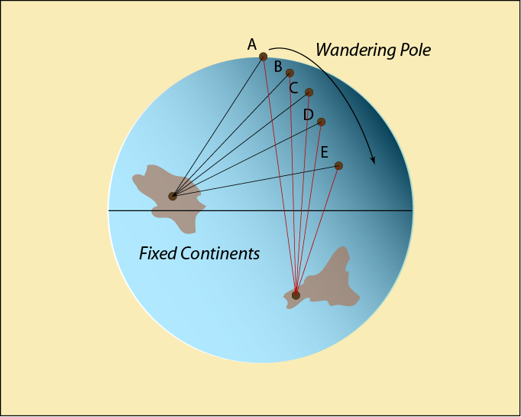
What would a fixed continent and a wandering pole look like?

Slide 19
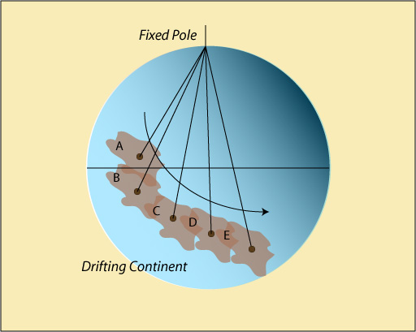
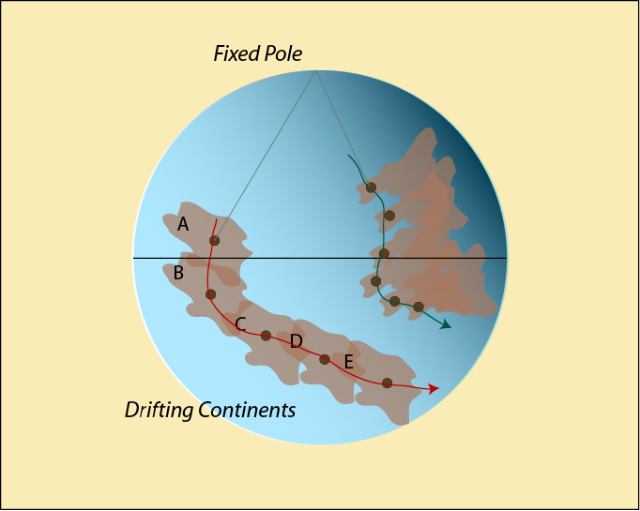
What would a fixed pole and a wandering continent look like?

Slide 20
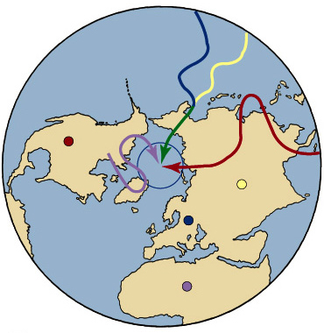
What do we actually find?

Slide 21
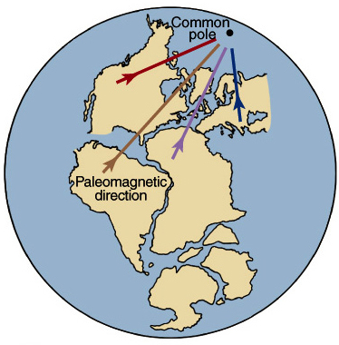
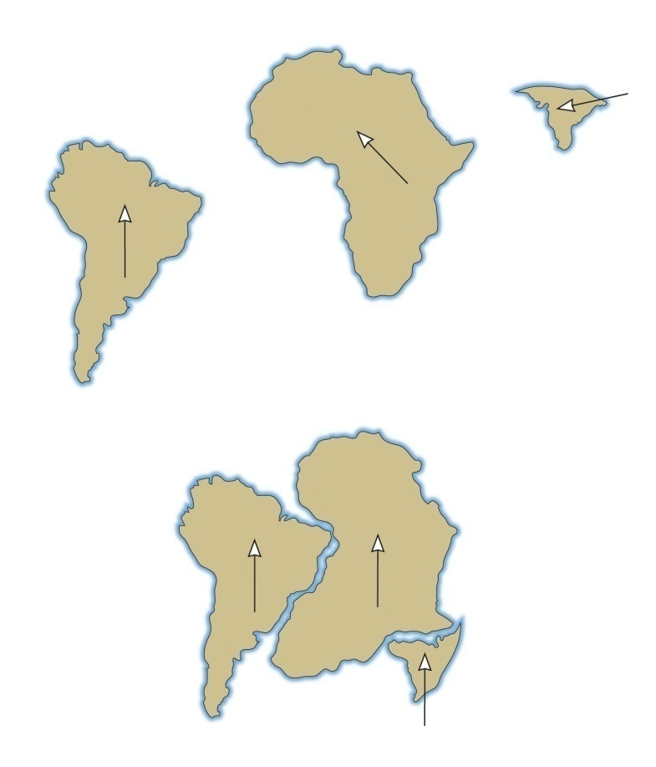
If the continents were together, then they do give a single location for the magnetic pole!

Slide 22
How was Wegener’s Theory received?
Rollin T. Chamberlin (U of Chicago,1928)
“Wegener’s hypothesis in general is of the foot-loose type, in that it takes considerable liberty with our globe, and is less bound by restrictions or tied down by awkward, ugly facts than most of its rival theories. Its appeal seems to lie in the fact that it plays a game in which there are few restrictive rules and no sharply drawn code of conduct.”

Slide 23
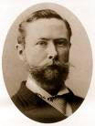
How was Wegener’s Theory received?
Bailey Willis (Stanford Univ.,1928)
“When we consider the manner in which the theory is presented, we find that the author offers no direct proof of its verity; that the indirect proofs assembled from geology, paleontology, and geophysics prove nothing in regard to drift…; that the fields of related sciences have been searched for arguments that would lend color to the adopted theory, whereas facts and principles opposed to it have been ignored. Thus the book leaves the impression that it has been written by an advocate rather than by an impartial investigator.

Slide 24
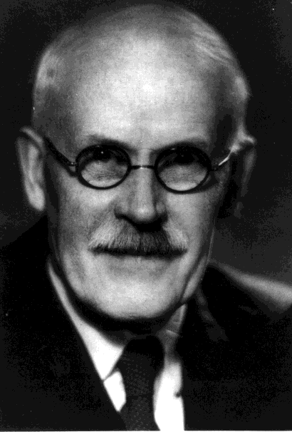
How was Wegener’s Theory received?
Harold Jeffreys (Cambridge U., 1924)
“It is an impossible hypothesis! How can a small force not only produce indefinitely great movement, but overcome a force many times greater acting in the opposite direction at the same time?”

Slide 25

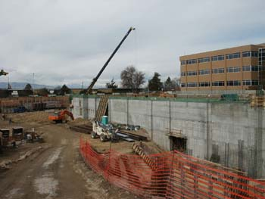
What was the hang-up? There was no known mechanism to move a continent
Example: what do you think it would take to move the JFSB over to the library? (And this is moving through soft dirt!)

Slide 26
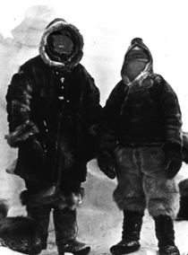
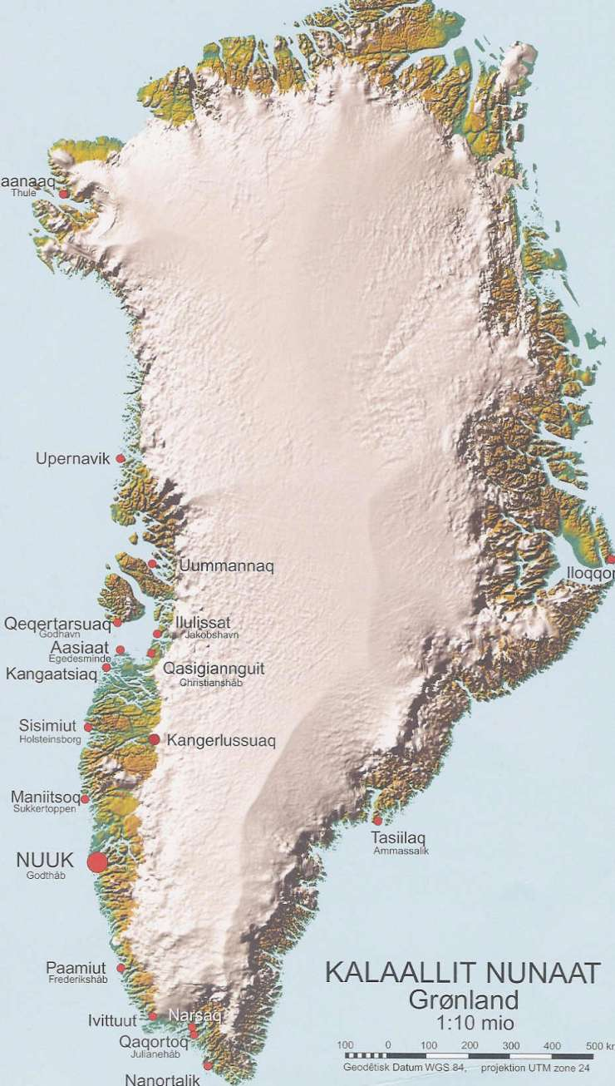
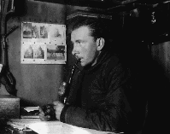
A loss in 1930
Notes:
In 1926 Wegener was given a professorship of meteorology and in 1930 he led a major expedition back to Greenland. On the second or third of November he got separated from his party during a storm and died of exposure and cold.

Slide 27
So, What Turned the Tide?
The discovery, after WWII, of things that were hidden beneath the oceans during Wegener’s lifetime (he died in 1930).
The weight of evidence became too great to ignore
The proposal of a mechanism (convection) for moving the continents.
Even though convection had been proposed in Wegener’s time, it was now looked at with renewed interest
This led to the development of the “Theory of Plate Tectonics”

Slide 28
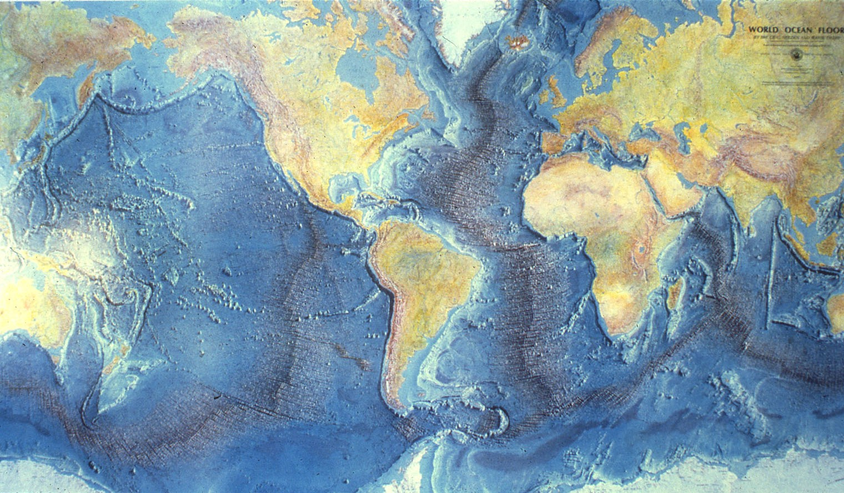
Topography of Seafloor

Slide 29
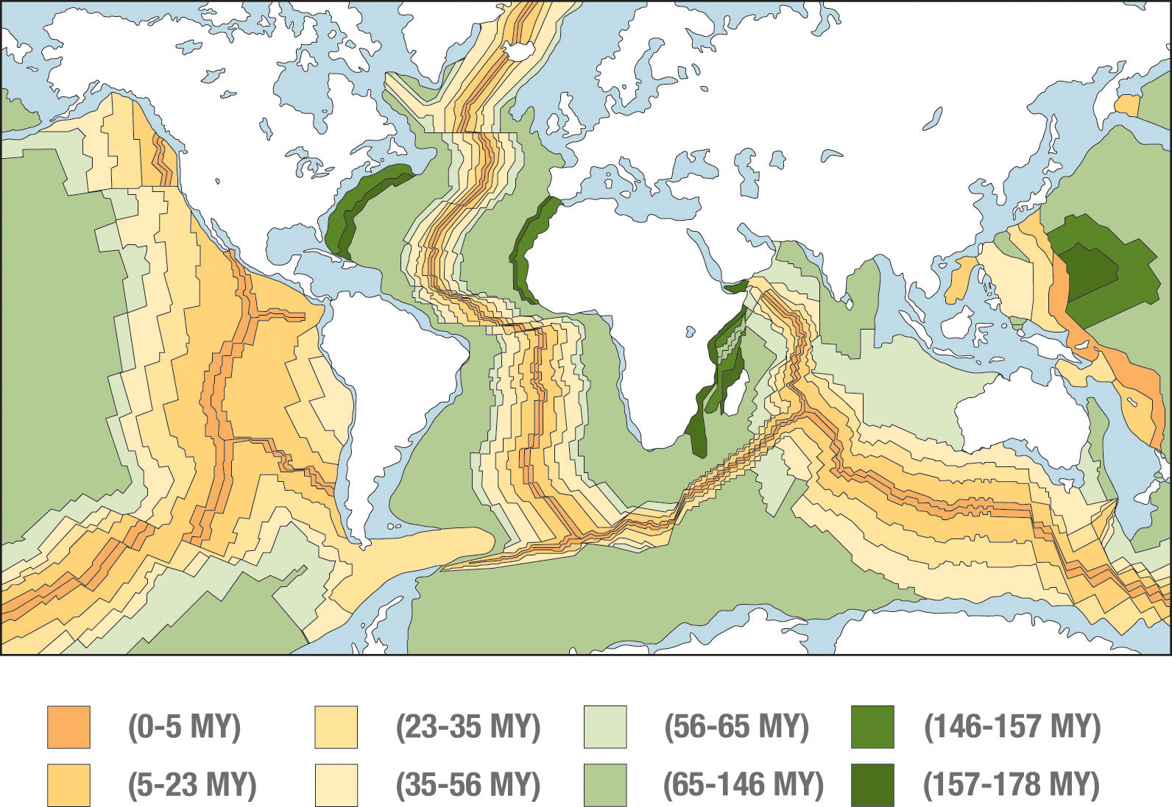
The ocean crust is youngest near the ridges

Slide 30
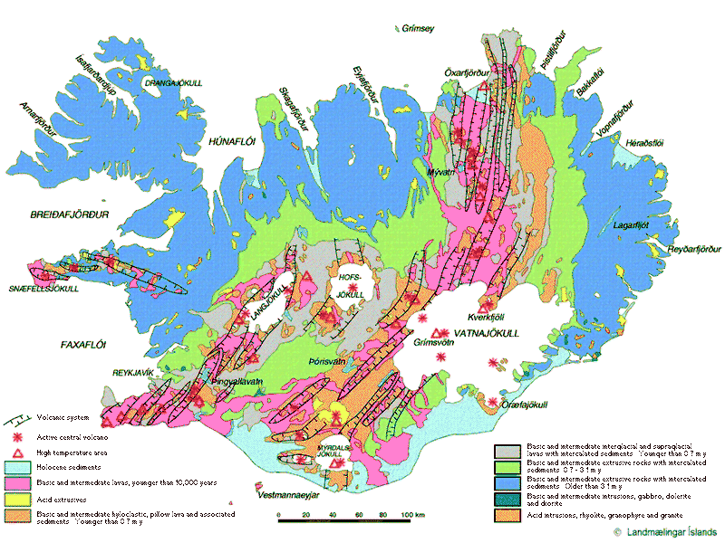
The case of Iceland

Slide 31
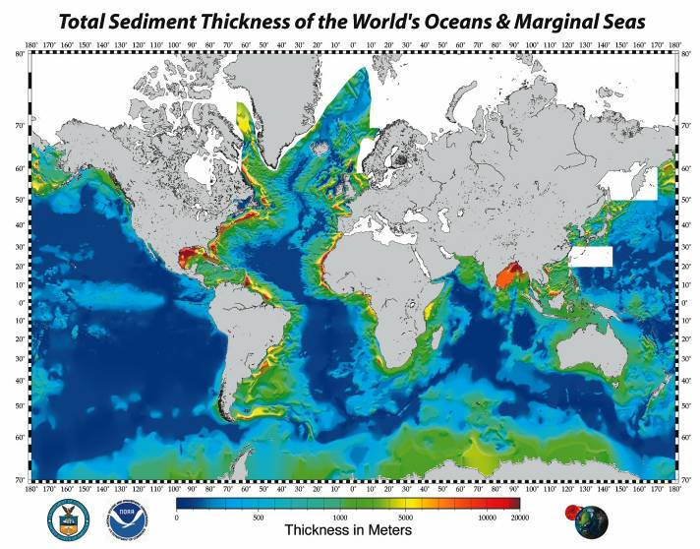
Thickness of Sediment on Seafloor

Slide 32
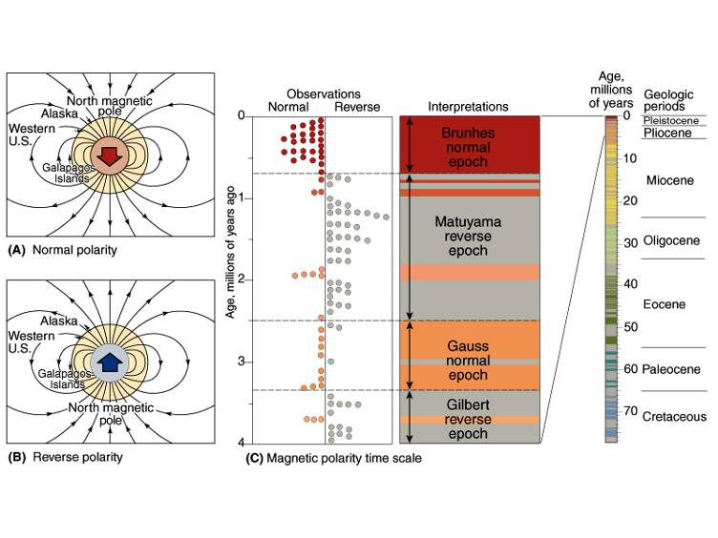
Magnetic Reversals

Slide 33
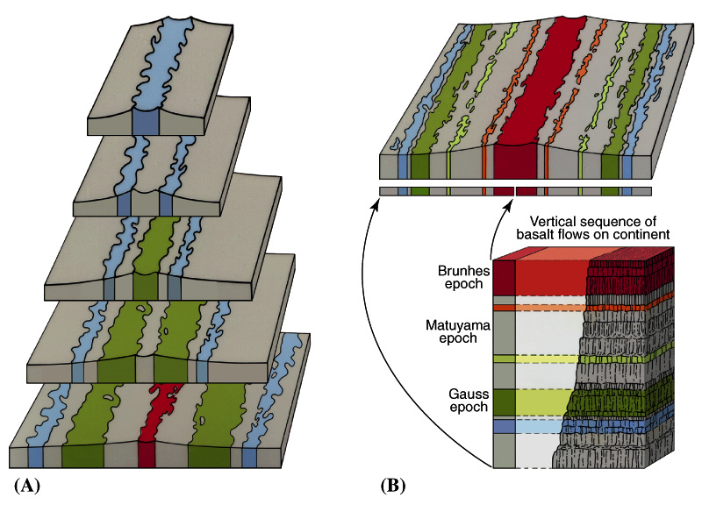
There are stripes of oppositely magnetized rock running parallel to the ridges.

Slide 34
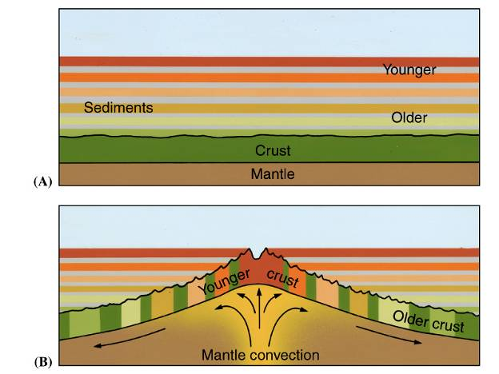
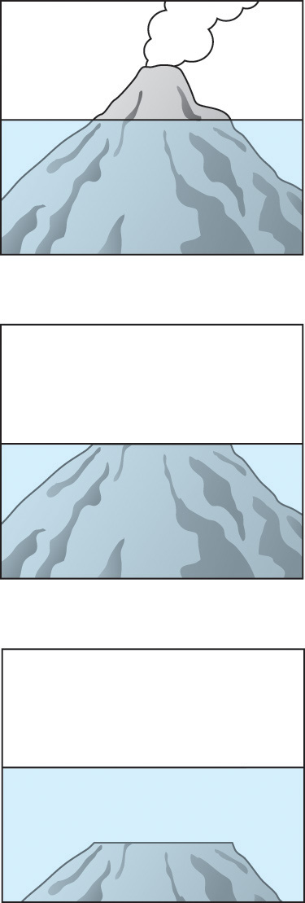
How can you explain these phenomena? Spreading occurs at the ridge.

Slide 35
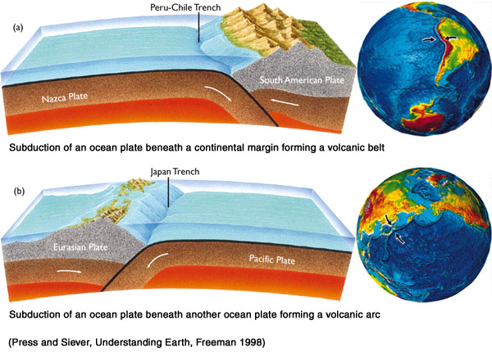
Since the surface area isn’t getting any bigger, we know that ocean crust is destroyed at trenches

Slide 36
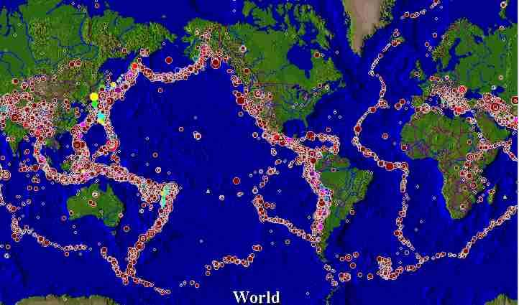
Patterns Earthquakes & Volcanoes

Slide 37
Benioff Zones – Subduction
Named for U.S. geophysicist Hugo Benioff
He observed a pattern of earthquake focal depths near trenches, which he concluded confirmed the idea of recycling of the oceanic crust and its convection.
What was this pattern?

Slide 38
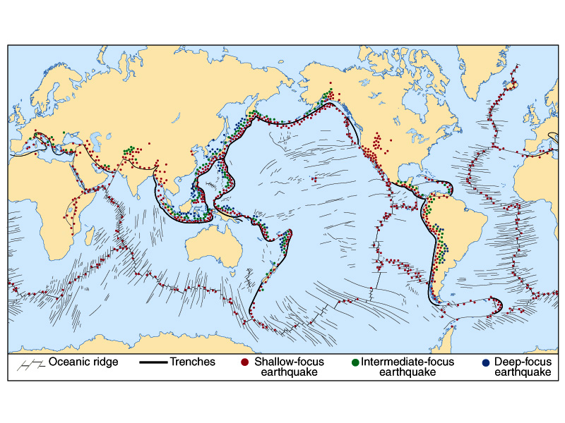
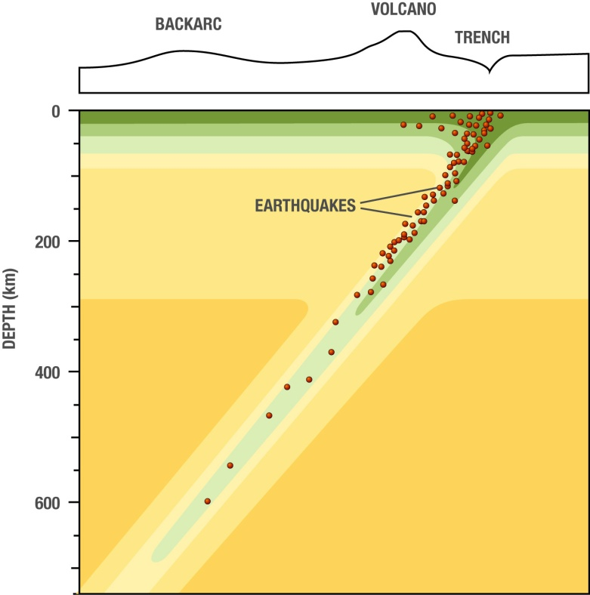
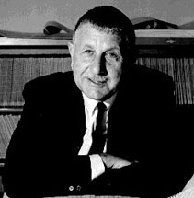
Subduction Zones –
Hugo Benioff

Slide 39
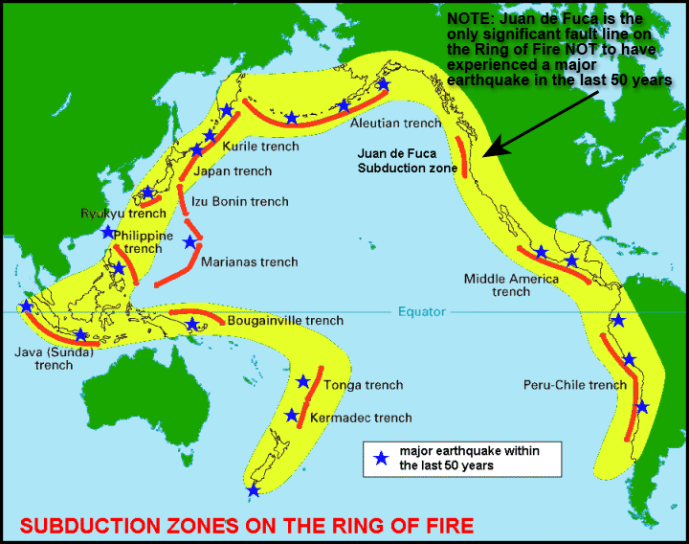

Slide 40
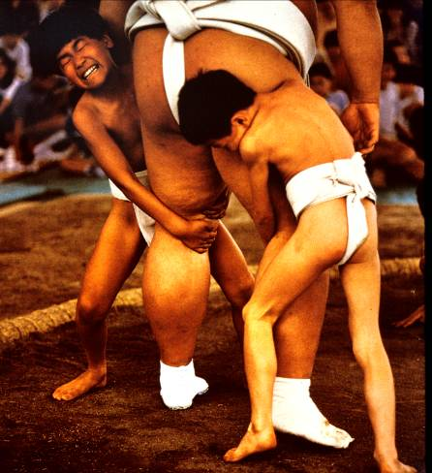
How Do You Move a Continent?
Come back next time an find out!

Slide 41
