Slide 1
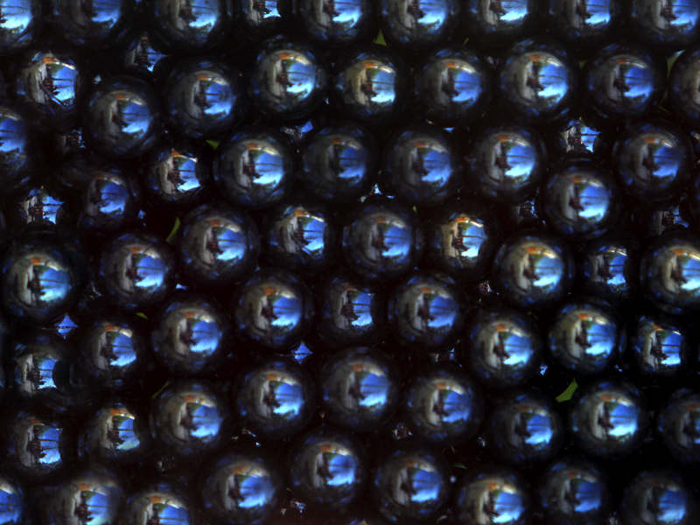
Chapter 21: Bonding in Metals, Alloys, and Semiconductors
Did you read Chapter 21 before coming to class?
Yes
No

Slide 2
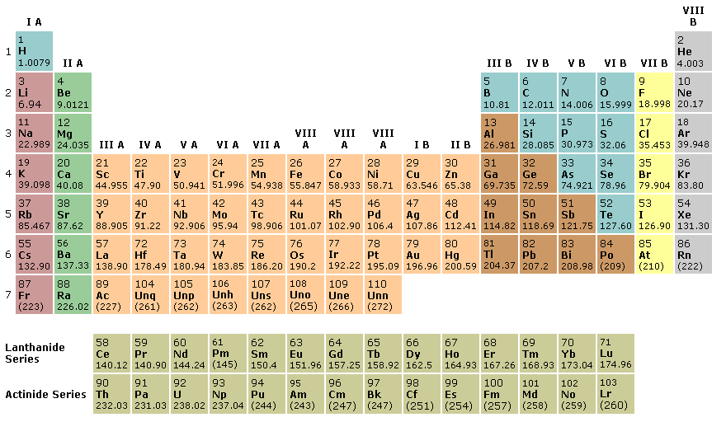
Basic Categories
The elements divide nicely into two categories, metals and nonmetals.
Nonmetals
Nonmetals
Metals
Metals

Slide 3

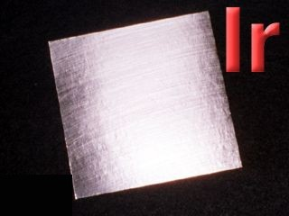
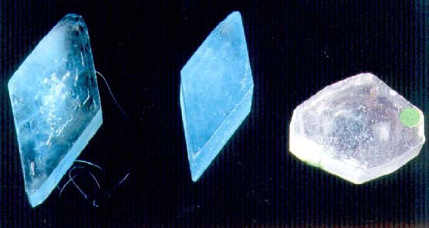
The three main types of bonds
Metal—Metal: “metallic bond”
Alloys. Characteristics are like a pure metal
Metal—Nonmetal: “Ionic bond”
Salts. Crystalline in form. Often toxic.
Nonmetal—Nonmetal: “Covalent bond”
Gases, Organic Compounds. Characteristics are like pure nonmetals.

Slide 4
How does melting temperature relate to the strength of bonds?
Temperature at which change of state takes place reflects the strength of forces holding matter together: high temperature changes reflect strong forces

Slide 5
Metals melt at high temperatures.
 | MELTING TEMPERATURE BC | BOILING TEMPERATURE BC (under 1 atm pressure) | State At Room Temperature
Helium | doesn’t form solid except under high pressure! | -269 | Gas
Hydrogen | -259 | -253 | Gas
Neon | -249 | -246 | Gas
Nitrogen | -210 | -196 | Gas
Water | 0 | 100 | Liquid
Ethanol | -117 | 78.5 | Liquid
Table salt | 801 | 1413 | Solid
Copper | 1083 | 2567 | Solid
Gold | 1065 | 2807 | Solid

Slide 6
Metals are dense.
 | DENSITY g / cm³
 | Solid | Liquid | Gas
Helium |  | 0.122 | 0.00018
Hydrogen | 0.078 | 0.071 | 0.0001
Neon | 1.54 | 1.21 | 0.00082
Nitrogen | 1.09 | 0.81 | 0.0013
Water | 0.90 (0ºC) | 1.00 | 0.0006
Ethanol | 1.3 | 0.80 | 0.0020
Table salt | 2.2 | Not available | Not available
Copper | 8.9 | Not available | Not available
Gold | 19.3 | Not available | Not available

Slide 7
What other properties do metals have?
Classified as network solids
Generally have:
High Melting T
High Boiling T
High Density
Conduct both heat and electricity
Malleable – flatten into thin sheets
Opaque – can’t see through even thin sheets
Reflective (Metallic Luster) – shiny

Slide 8
When molecular orbitals form, the total number of orbitals stays the same.
+
→
+
The two ground state atomic orbitals
Result in two new molecular orbitals

Slide 9
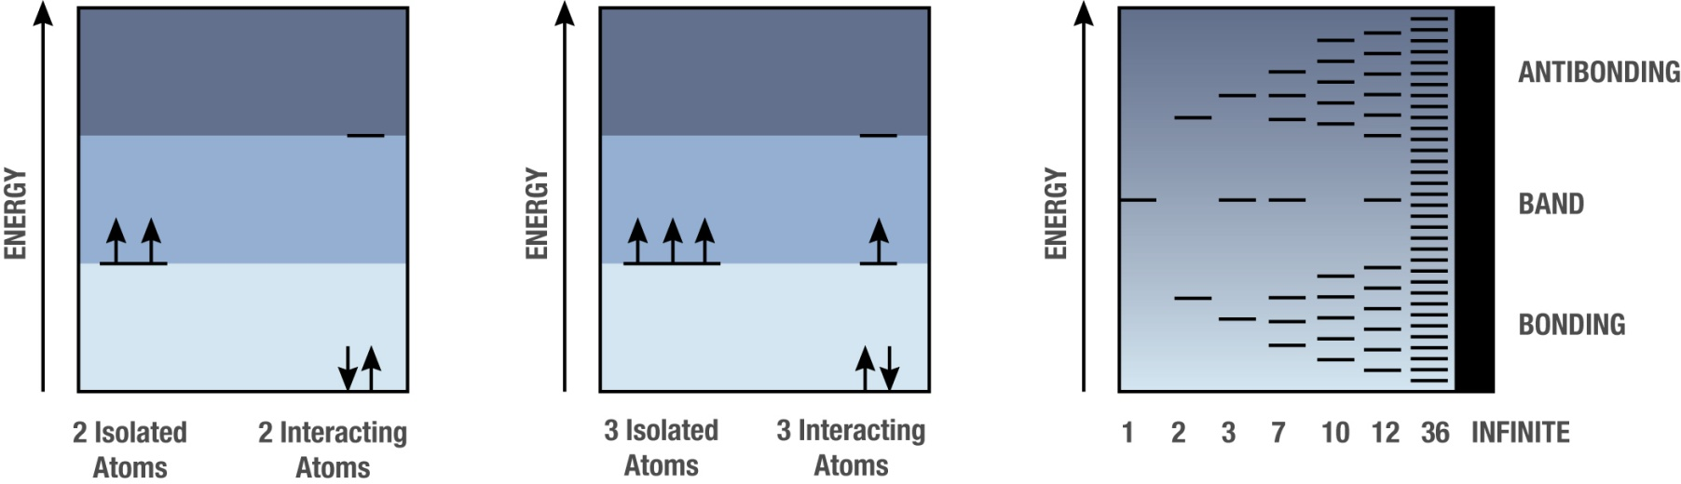
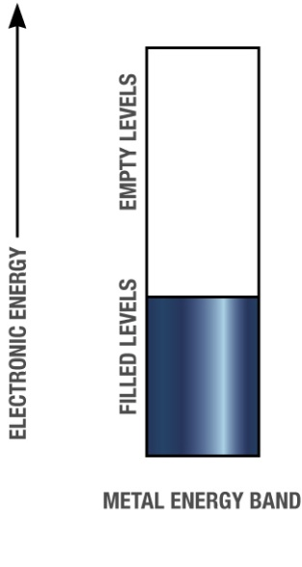
When you get enough atoms together, the resulting orbitals are very close in energy, and we think of them as energy bands.
Atomic orbitals on many identical atoms interact to form a continuous
set of closely spaced levels. The new orbitals are molecular orbitals.

Slide 10

Many molecular orbitals closely spaced in energy give rise to a band of energies
Metals have few valence electrons compared to number of orbitals
Electrons want to be in low energy states – “filled” levels
Empty levels still exist (and are easily available) even when there are no electrons in them

Slide 11
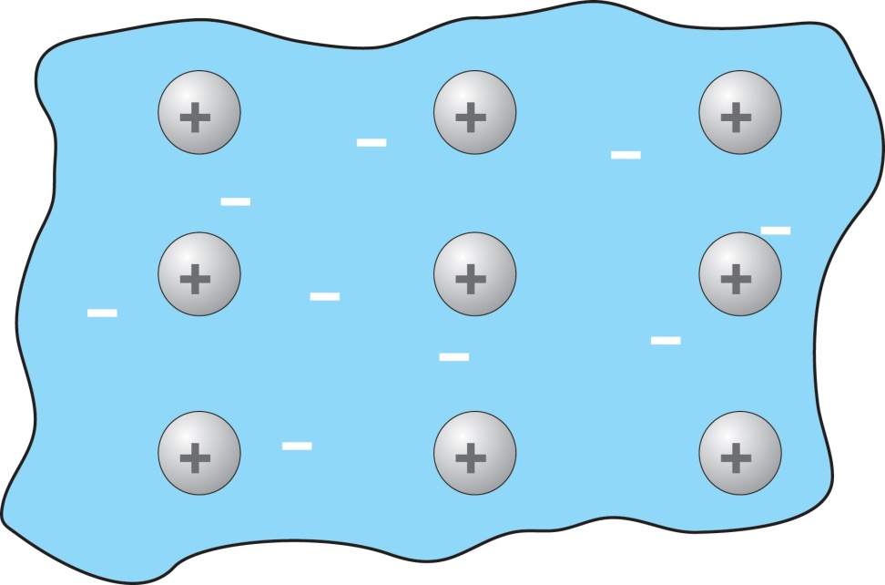
What do molecular orbitals look like in a metal?
Molecular orbitals extend essentially through the entire piece of metal
Lots of energy levels for electrons
Small amounts of energy can move electrons between orbitals
Electrons not tightly attached to any particular atom – “Sea of Electrons”
The energy band with mobile electrons explains all metallic properties!

Slide 12

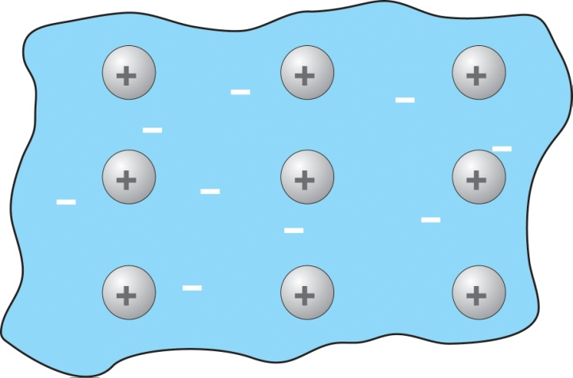
Properties arising from Energy Band Structure with mobile electrons
High melting temperatures – nuclei surrounded by electron sea
melting requires the breaking of strong attractive interactions
Electrical conductivity – mobile charge carriers are the electrons
Thermal conductivity – electrons can absorb/give up heat easily; transport
it away because of electron mobility
Malleability – electrons serve as lubricant, allowing layers of nuclei to
slide past one another

Slide 13
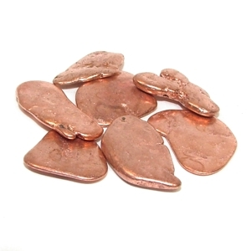
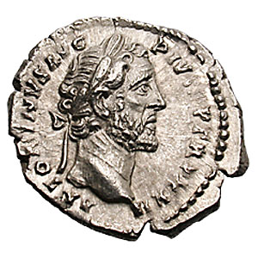
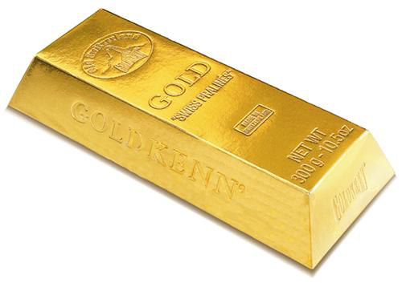
The Opacity, Luster, and Reflectivity of metals are tied to the existence of many available energy levels.

Slide 14
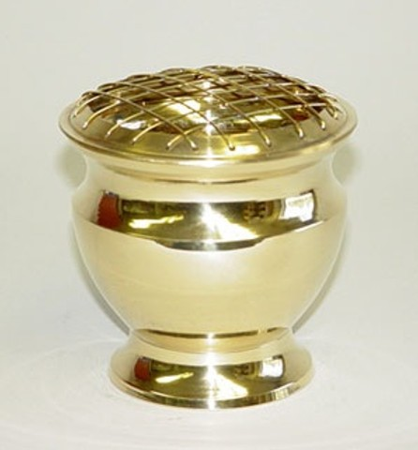
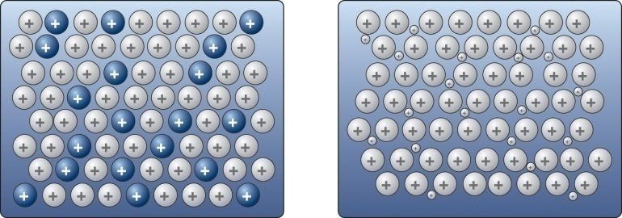
Alloys result when two or more elemental metals are combined to make a new metal
Examples:
Copper + Zinc → Brass
Copper + Tin → Bronze
Gold + Nickel (± Palladium, Zinc) → White Gold
Iron + Carbon → Steel
Iron + Chromium (± others) → Stainless Steel
Because all metal atoms have:
Few valence electrons
Low ionization energies

Slide 15
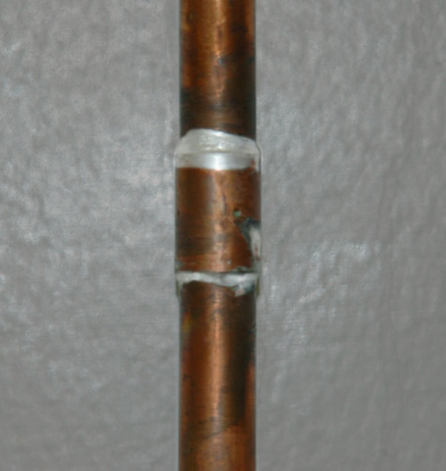

How do the properties of alloys differ from pure metals?
Alloys not as good conductors of electricity and heat
Alloys often melt at a lower temperature
Alloys may be less malleable than pure metals
low-melting solder
used to hold copper pipe
together is an alloy

Slide 16
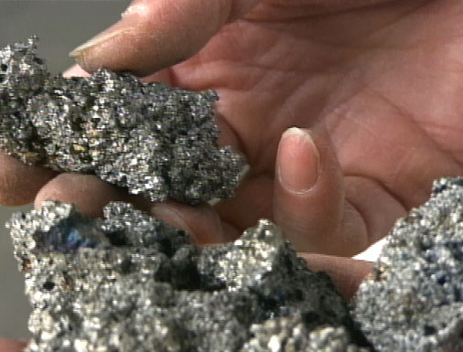

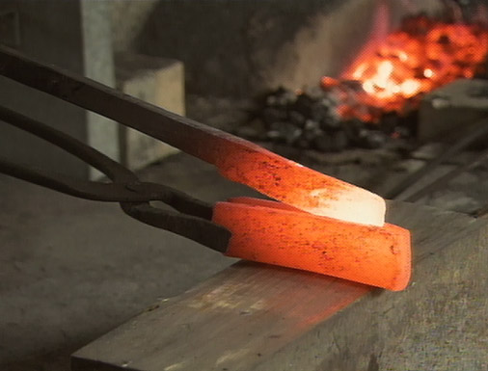

The amount of carbon in steel determines how brittle it is.
Notes:
Sword making images from NOVA

Slide 17
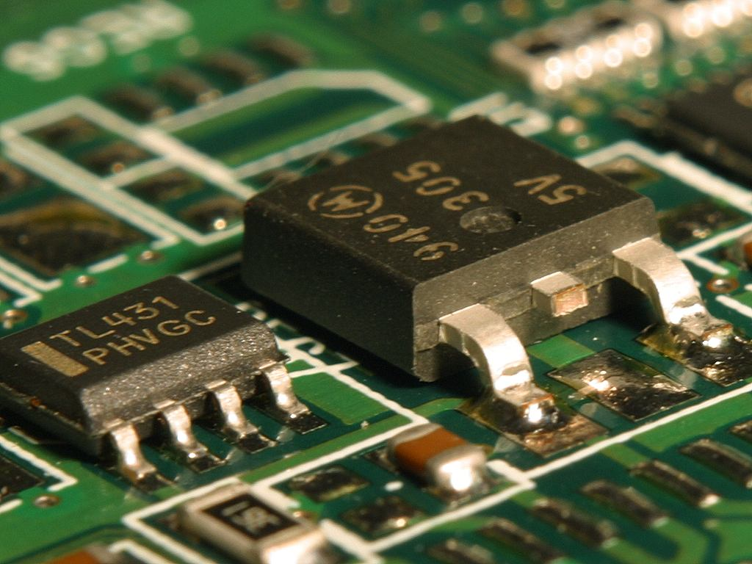
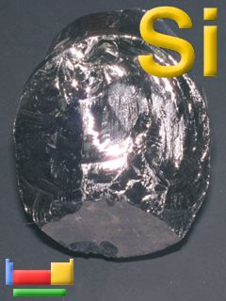
What is a Semi-conductor?
Not quite metals or non-metals
Higher ionization energies and more valence electrons give rise to change in the energy level structure
Have some properties of metals
Conduct electricity under certain conditions
Solids with high melting points
Widely used in computers and other electronic devices
Particularly, Si and Ge

Slide 18
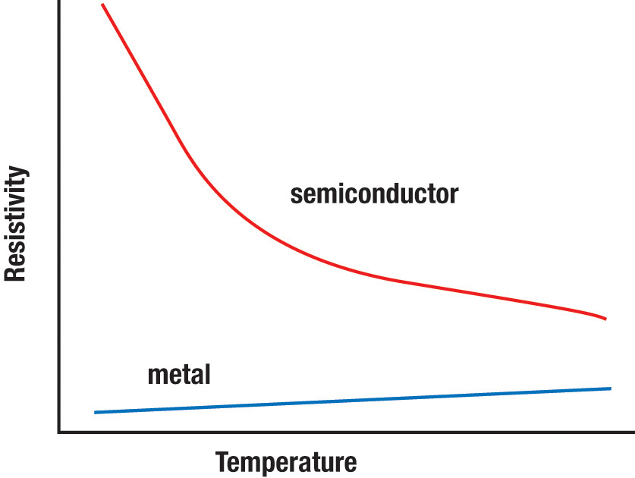
Why do semiconductors and metals behave differently at T increases?
1
poor conductor
Resistivity =
_________
Conductivity
better conductor
but still not as
good as metals

Slide 19
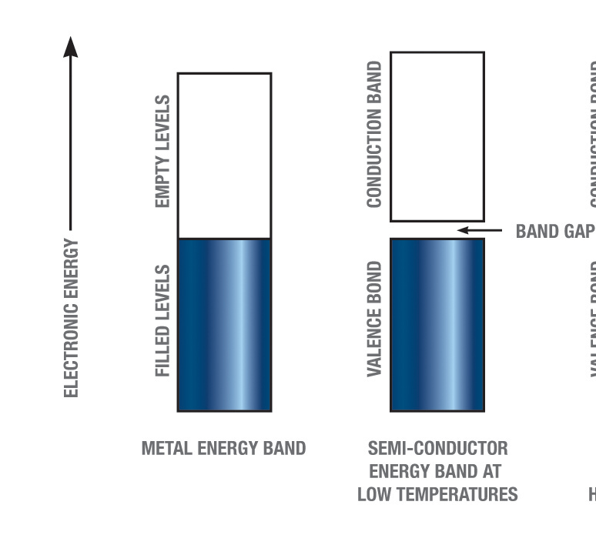
Semiconductors have Energy Band Split in Two. There are no orbitals with the energies in the gap
BAND
BAND
BAND
Band filled – no electrical conductivity possible
at low temperatures

Slide 20
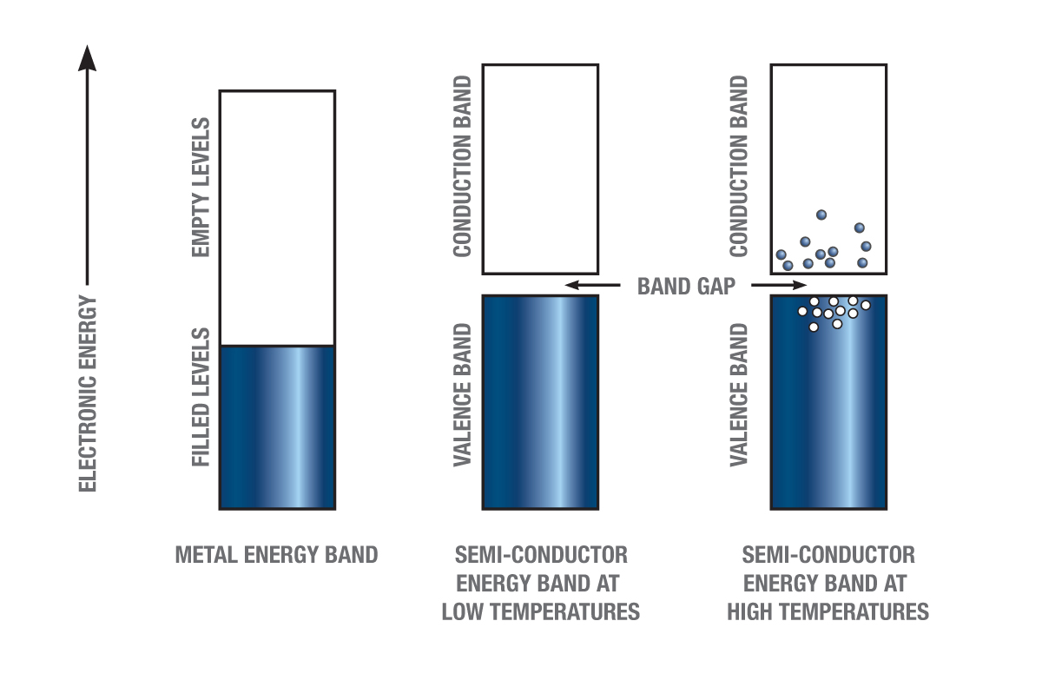
High temperature conductivity of semiconductors
Conductivity requires mobile electrons with empty energy Levels
At high temperature, some electrons get kicked “upstairs” (above the band gap) and gain access to empty levels.
This also creates “holes” down below that behave like positive charges.
We can also create holes and conduction band electrons by “doping” the semiconductor (e.g. Phosphorus adds an electron, Aluminum adds a hole)

Slide 21

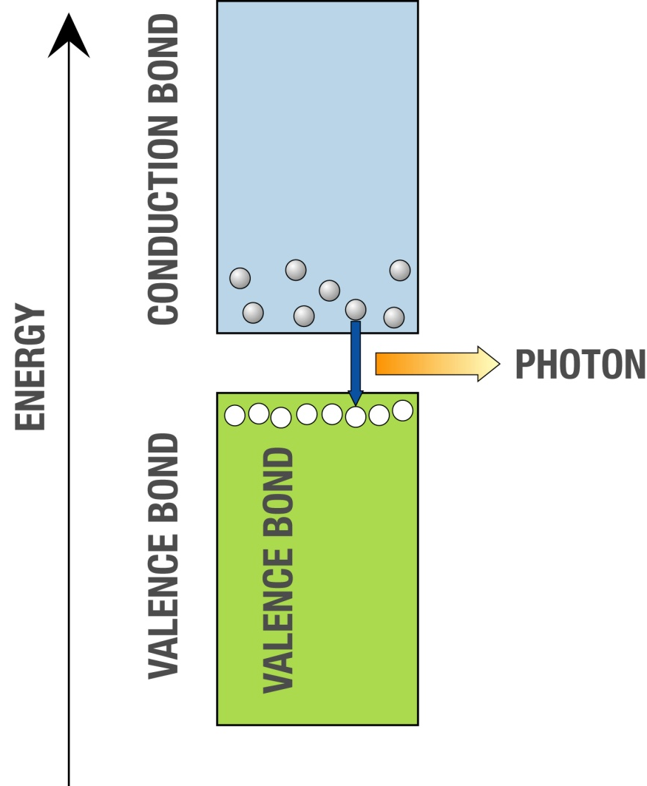
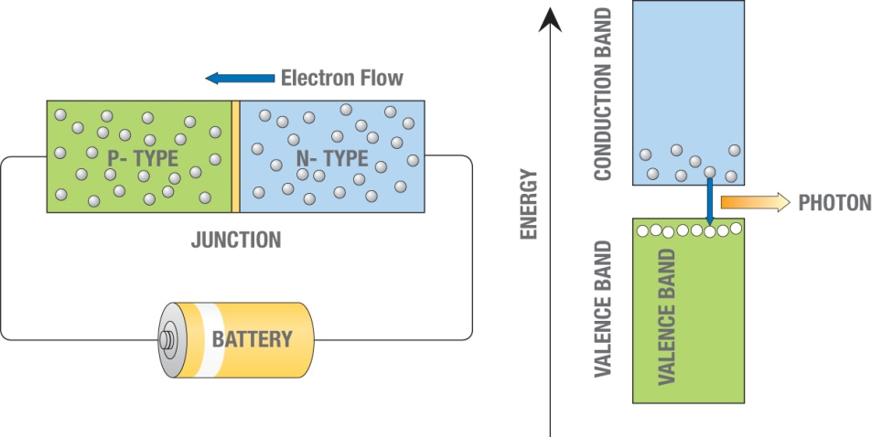
Light Emitting Diodes
Extra Holes
Extra electrons
Photon color emitted by diode
Is related to energy of band gap

Slide 22
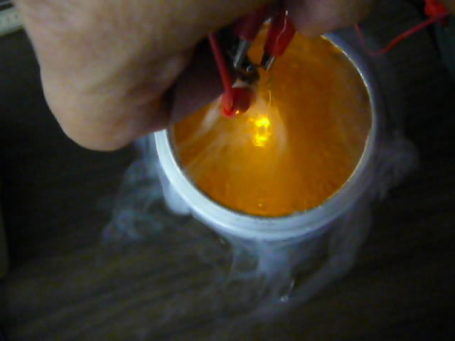

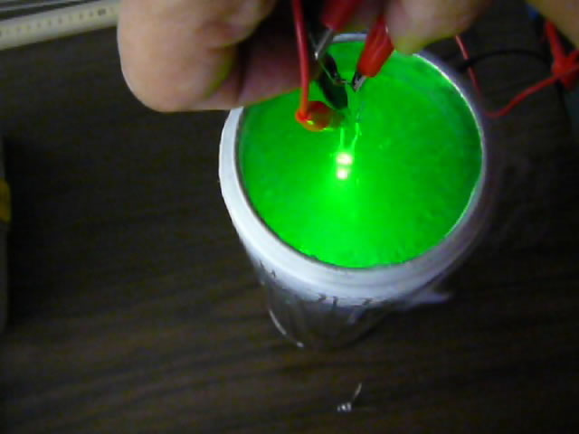
Band gap size vs. Temperature
As the temperature changes, the orbital energies shift and the size of the band gap changes.
Does the band gap get smaller or larger when you cool this LED?
Warmest
Coldest
Notes:
Basically you are just shifting the crystal structure

