Slide 1
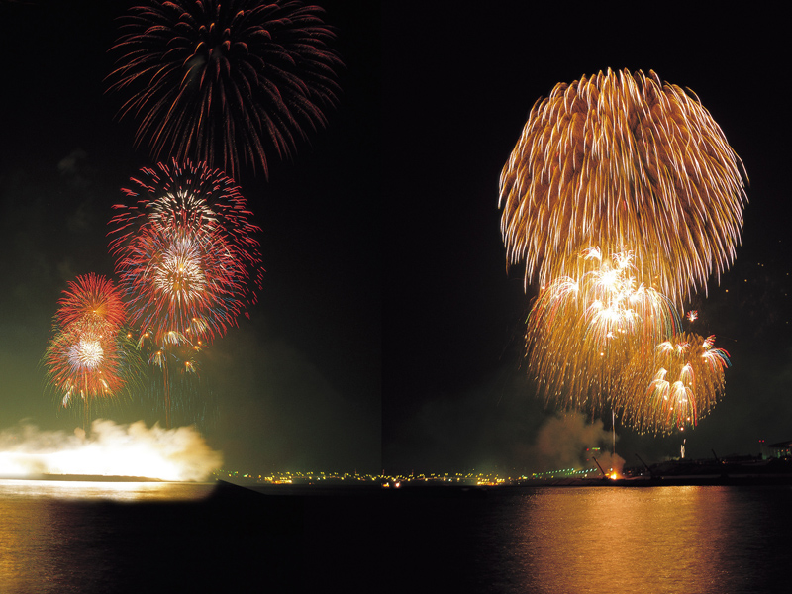
Principles of Chemical Reactivity
The Elements
Tom Lehrer
Did you read chapter 20
before coming to class?
Yes
No

Slide 2
Review: In a mass spectrometer, which fragments reach the detector first?
The most reactive fragments
The heaviest fragments
The lightest fragments
The biggest fragments
positive fragments
Length of flight path

Slide 3
Learning objectives
Why do atoms form chemical bonds?
Why are some reactions fast, and others slow?
How do energy and entropy play a role?
What is equilibrium?

Slide 4
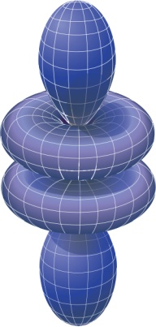
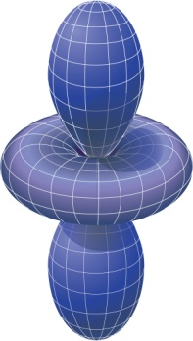


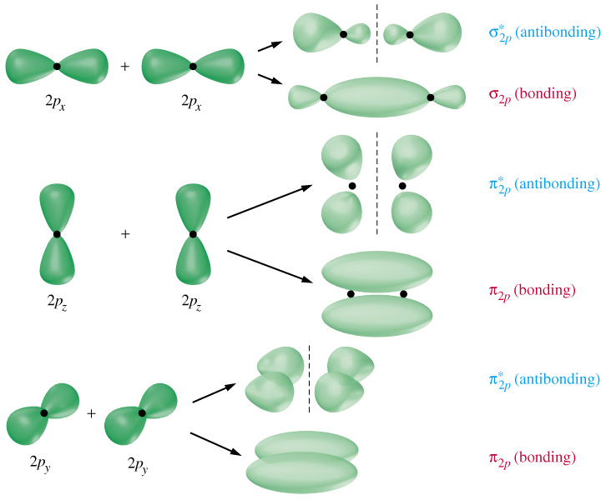
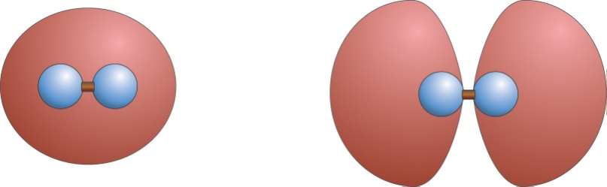
Molecular Orbitals
Atomic orbitals
Orbitals are electron probability standing waves
Shape of orbital depends on placement of the different nuclei.
New standing wave patterns (new shapes) when there are multiple nuclei
Molecular orbitals follow same rules as atomic orbitals:
2 electrons per orbital (opposite spins)
Fill lowest energy orbitals first
s
p
d
f
Molecular orbitals

Slide 5
Molecular Orbitals and Bonding
When atoms get close, molecular orbitals can form
If the electrons are lower in energy in the resulting molecular orbital than they were in the atomic orbitals, bonds form
Bonding and antibonding orbitals are possible
Energy
Bonding molecular orbitals have high electron density between nuclei
↑
+
↑
H•
H•
↓↑
H–H or H₂

Slide 6
A Thermodynamic View of Bonding
Bond formation is favorable if it leads to decreased energy for the system, and/or increased entropy for system + surroundings
3 ways to accomplish this
Lots of atoms share lots of electrons: metals
Nonmetals “take” electrons from metals: ionic materials
Nonmetals share electrons with each other: covalent materials

Slide 7
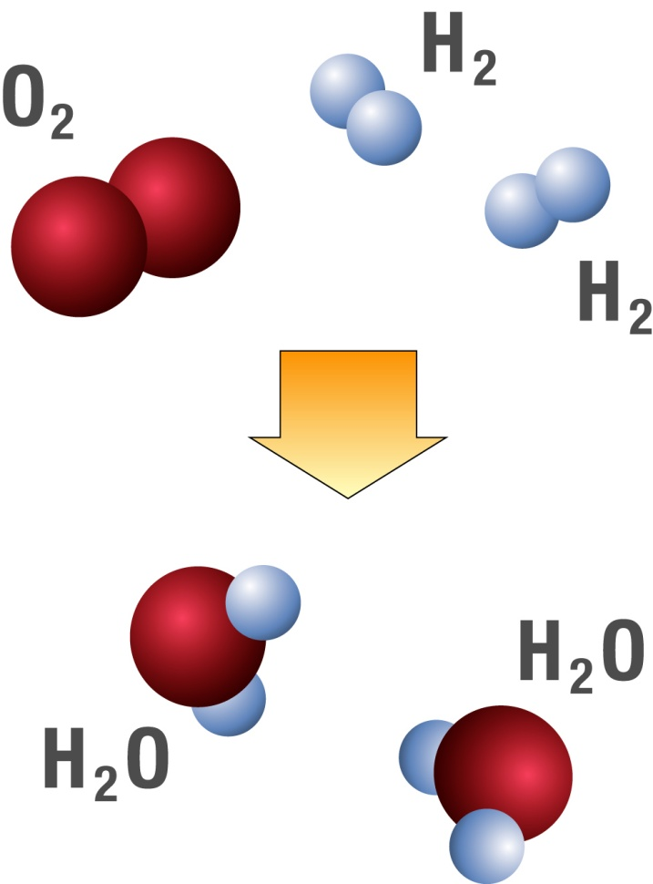
Conservation of Matter: Balancing Chemical Reactions
Matter is not created or destroyed in chemical reactions
This is reflected in the way we write them
Write a balanced equation for the conversion of hydrogen and oxygen into water.
Count the atoms!

Slide 8
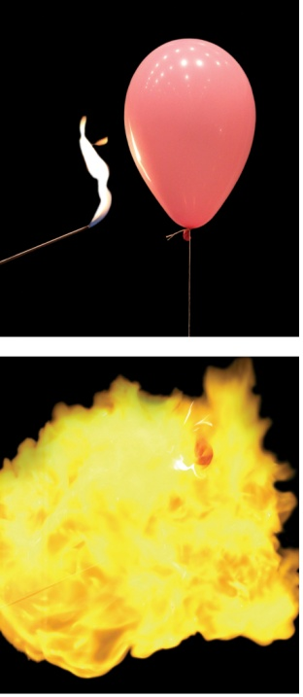
Which way of writing the reaction of hydrogen with oxygen to make water best complies with conservation of matter and describes what happens?
H₂ + O₂ → H₂O
H₂ + ½ O₂ → H₂O
2H₂ + O₂ → 2 H₂O

Slide 9
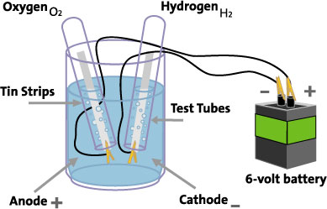
Electrolysis
You can run the reaction backward:
2H₂O + energy → 2H₂ + O₂
Pumping energy back into the system, one needs a battery or source of energy
For each water molecule that reacts, how many molecules of H₂ are produced?
Same question, for O₂?
http://www.youtube.com/watch?v=2t13S-KpGeE&NR=1

Slide 10
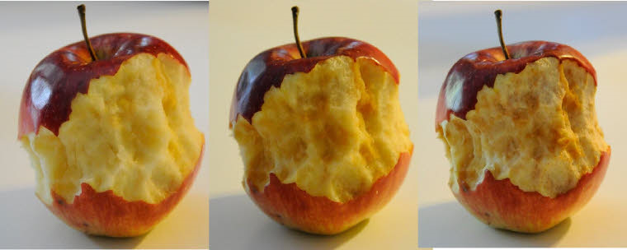
Reactions Take Time
Enzymatic browning: polyphenol oxidase, catechol oxidase and other enzymes that create melanins and benzoquinone, resulting in a brown color.

Slide 11
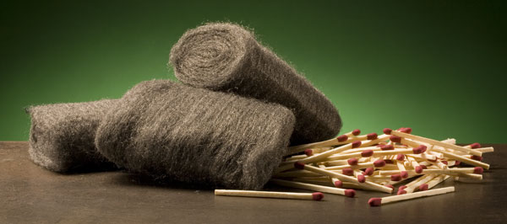
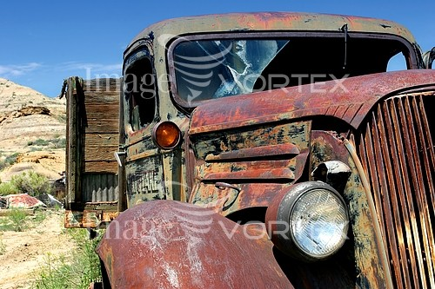
Iron and Oxygen combine at different speeds depending on conditions
Write a balanced reaction for combining Iron (Fe) and Oxygen (O₂) into rust (Fe₂O₃)
4Fe(s) + 3O₂(g) → 2Fe₂O₃(s)
3Fe(s) + 2O₂(g) → Fe₃O₄(s)

Slide 12
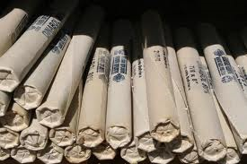
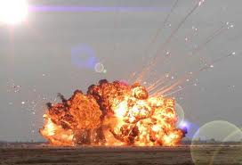
Reactions Go at Different Speeds
Cellulose + O₂ → CO₂ + H₂O
Dead tree in forest
Wood in fire
Sawdust in explosion
Why?
2 C₇H₅N₃O₆ → 3 N₂ + 5 H₂O + 7 CO + 7 C

Slide 13
What Governs Speed of a Reaction?
Definition: rate that reactants are consumed, or products are produced
Reactants must get close for electron clouds to interact
Factors:
Collision rate
Temperature (a reflection of molecular speed)
Pressure (for gases) or concentration (for liquids)
Physical state
Energetic requirements
Entropic (organization) requirements
http://www.chm.davidson.edu/vce/kinetics/ReactionRates.html

Slide 14
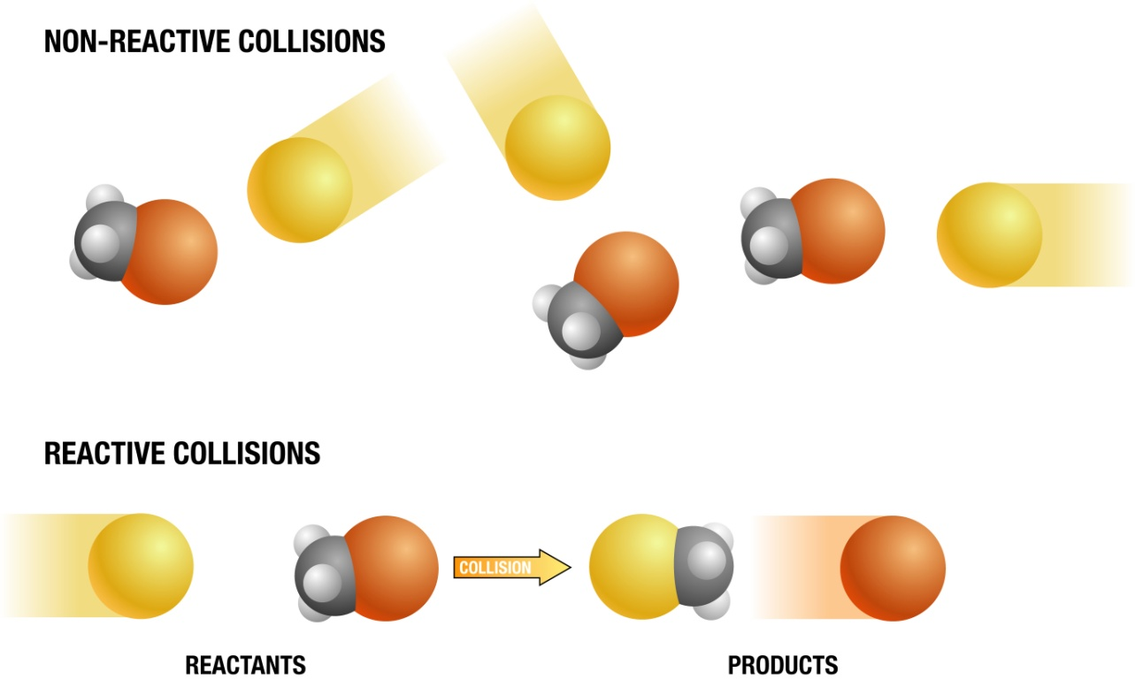
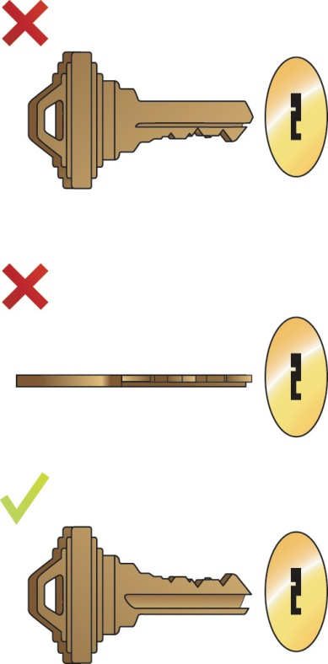
The effect of entropy on reaction rates
Reactants frequently must have a certain orientation at the transition state, or reaction will not occur
This corresponds to order in the transition state: entropy of activation

Slide 15
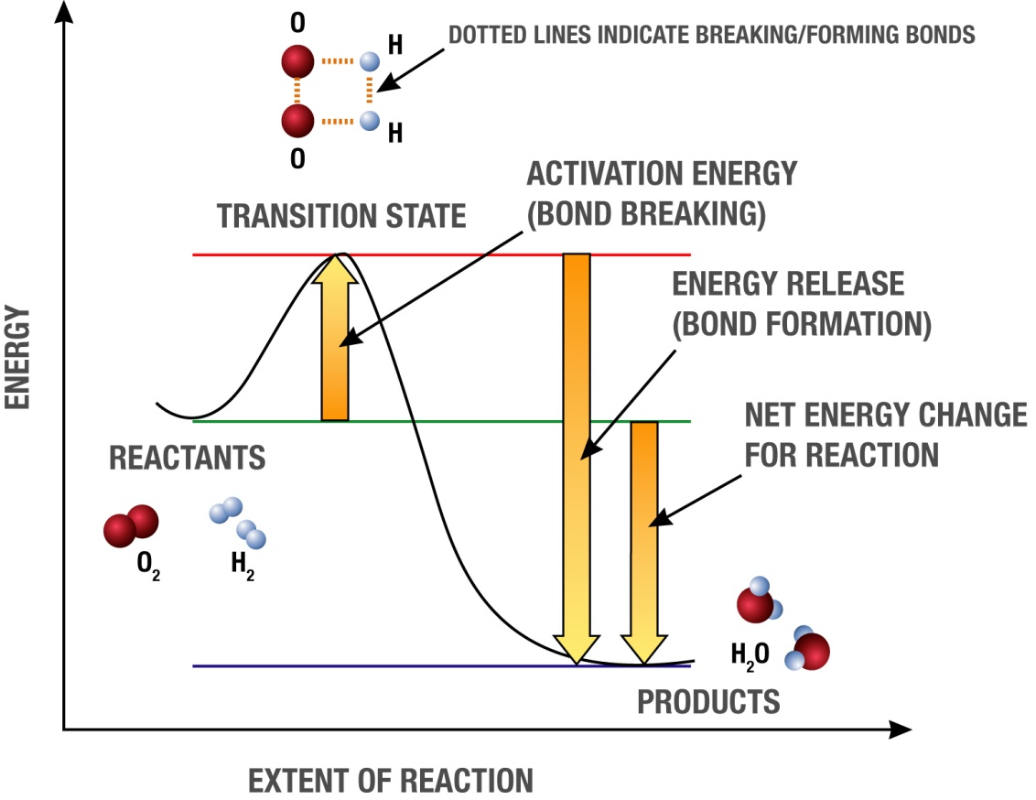
Effect of Energy
The net energy released (or consumed) does not affect rates
The energy required to reach the transition state (“activation energy”) has large effect
Transition state
The critical arrangement of atoms where the reacting system “decides” whether or not to make products
Typically involves breaking and/or formation of bonds

Slide 16
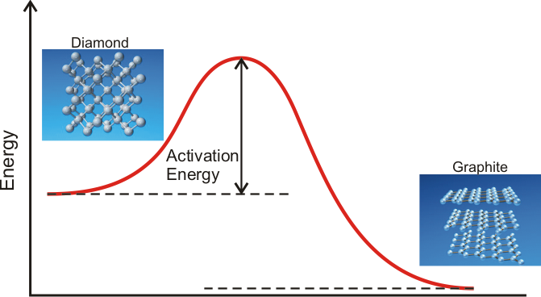
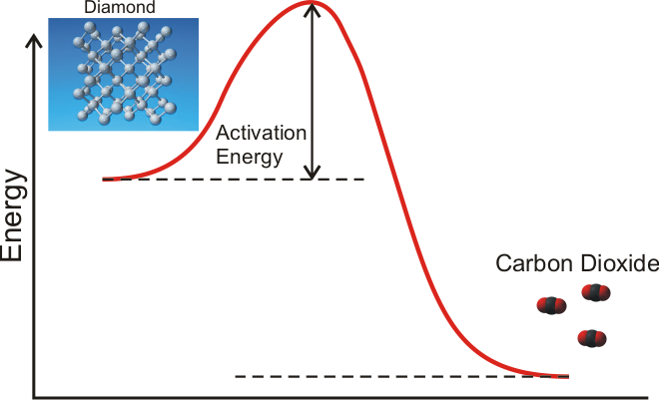
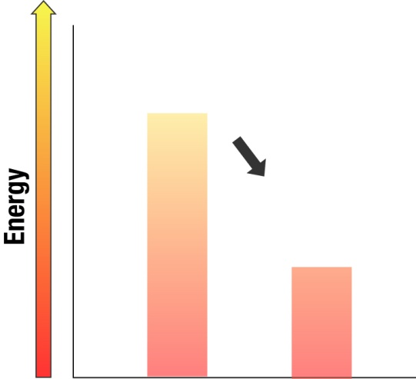
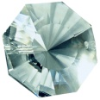
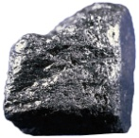
Why doesn’t your diamond turn into pencil lead or burst into flames?
At room temperature and pressure, graphite and carbon dioxide are much more energetically favorable for the electrons in carbon.

Slide 17
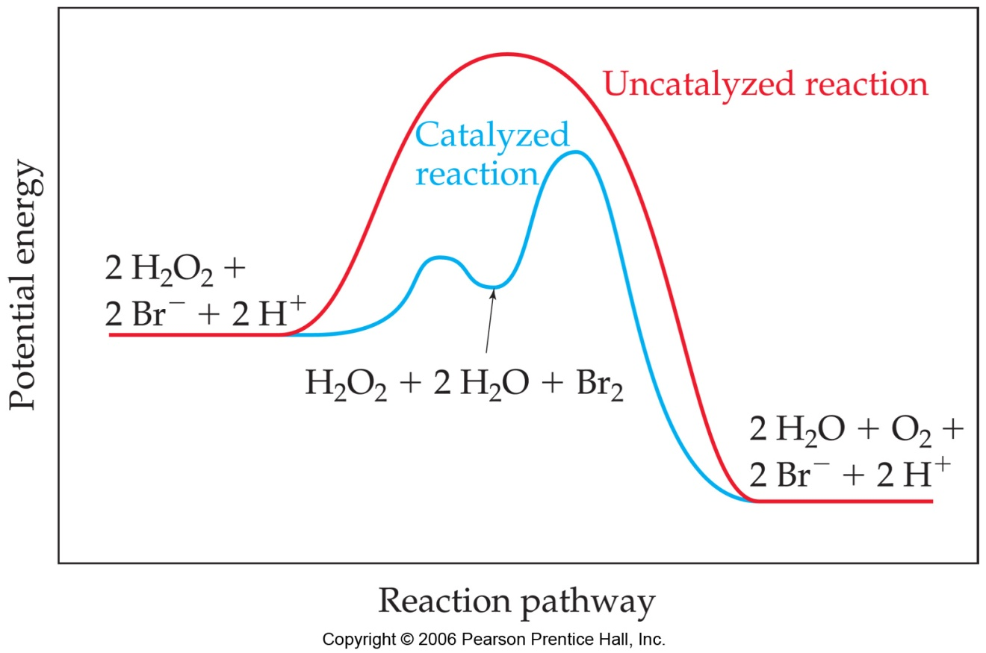
Catalysts Decrease energy or increase entropy of activation without themselves being consumed; speed up rate
H₂O₂ decomposes spontaneously
Much faster in presence of Br⁻ or I⁻
Catalyst makes new, lower energy route possible

Slide 18
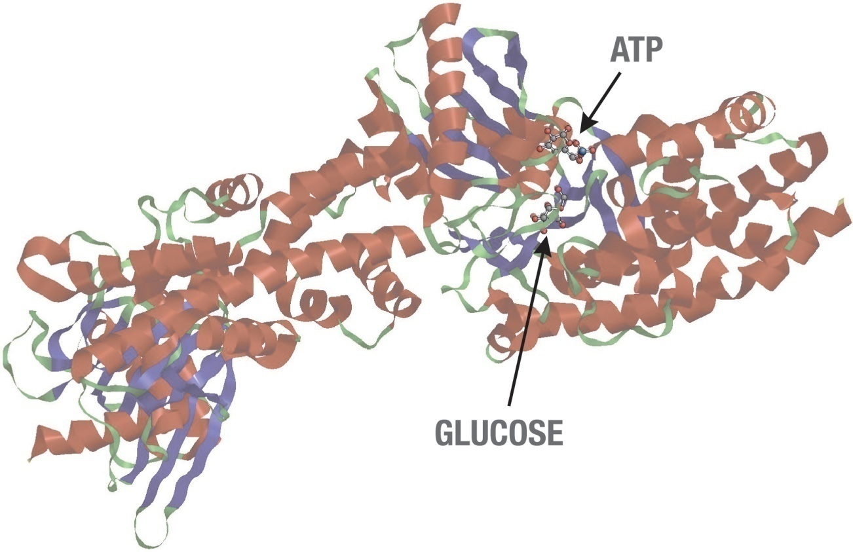
Catalysts in biology
Hexokinase - Enzyme that catalyses the transfer of phosphate from ATP to glucose to form glucose-6 phosphate, the first reaction in the metabolism of glucose via the glycolytic pathway.

Slide 19
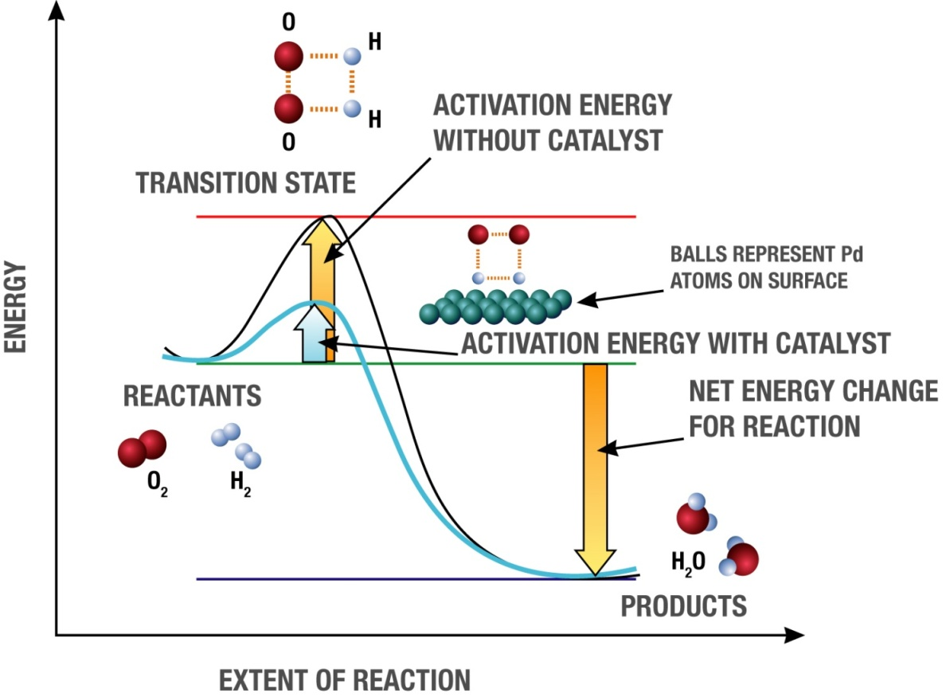
Catalyzing the formation of water
H₂ + O₂ w/ Pd/C catalyst
Pd surface stretches the H-H bond, helping it break and lowering transition state energy

Slide 20
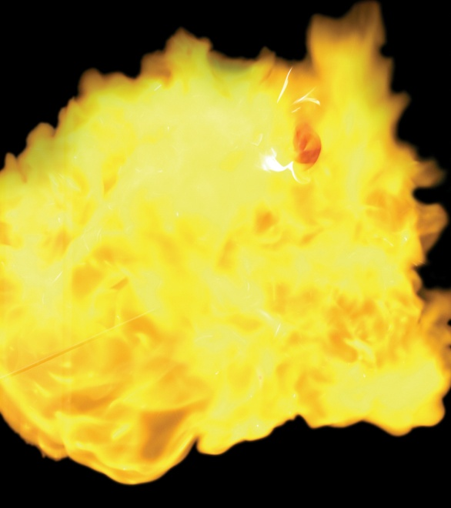
Why do we need to use a match to explode the balloon?
Products of combustion of the match catalyze reaction of H₂ + O₂
Heat from the match provides the required energy of activation
We need the match to pop the balloon and expose the H₂ to the O₂
Matches contain small amounts of palladium (Pd)

Slide 21
Reactions are more likely to occur if
There are more collisions between atoms and the collisions are more vigorous
Increase the concentration of atoms
Increase the pressure
Increase the temperature
2. The energy of the system will decrease
3. The entropy of the system will increase

Slide 22
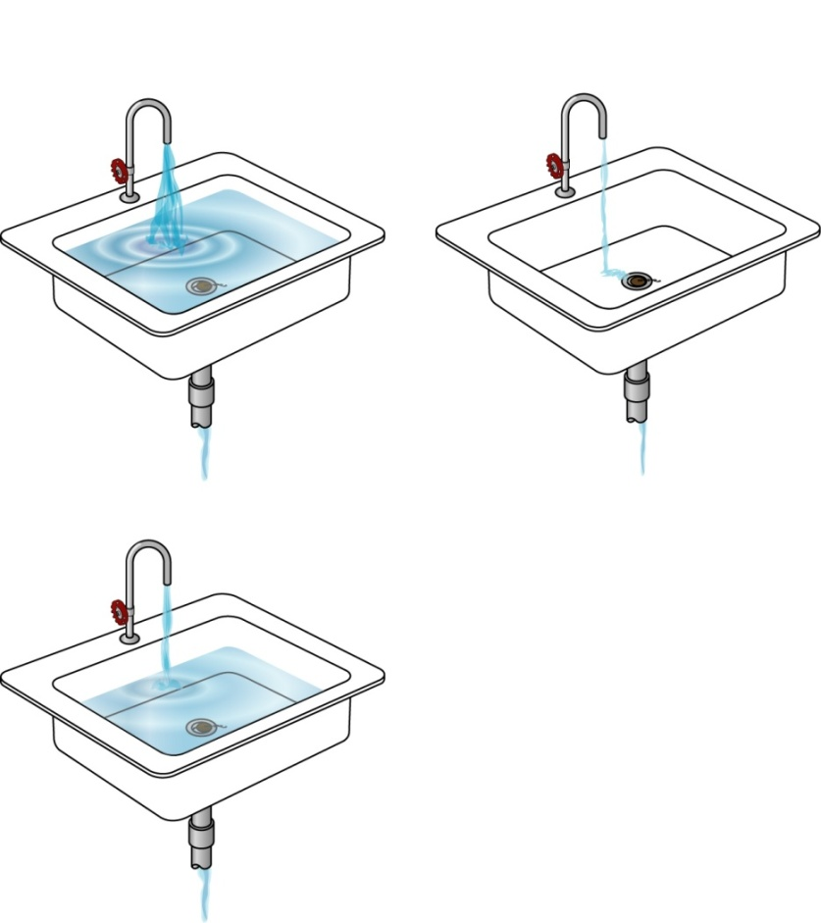
Equilibrium
Reactions go in both directions:
Reactants
Products
You’ve already seen this in the H₂ + O₂ reaction
When forward and reverse rates are equal, amount of reactant & product no longer changes
This dynamic balance is called “chemical equilibrium”
Equilibrium is the state of lowest energy, and maximum entropy; everything moves toward it

