Slide 1

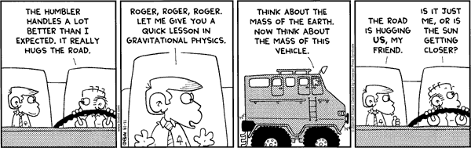

Chapter 3: The Gravitational Interaction
m
d
M
Did you read chapter 3
before coming to class?
Yes
No

Slide 2
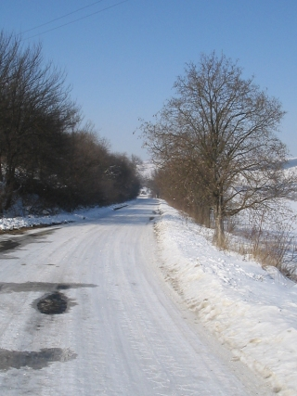
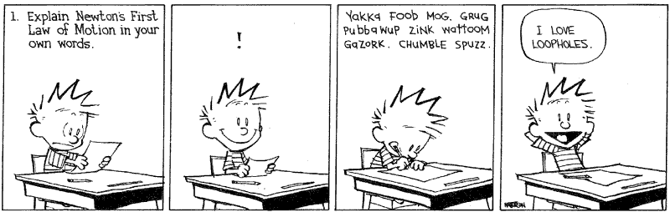
Review
Use Newton’s first law to explain why should you drive slowly in ice and snow.

Slide 3
Review
Its time to discipline your offspring. Give an explanation using Newton’s 3rd law as to why giving a spanking hurts you as much as the person receiving it.

Slide 4
Reminder
There are only four ways for objects to interact (create force pairs) :
Nuclear Strong
Electromagnetic
Nuclear Weak
Gravity

Slide 5
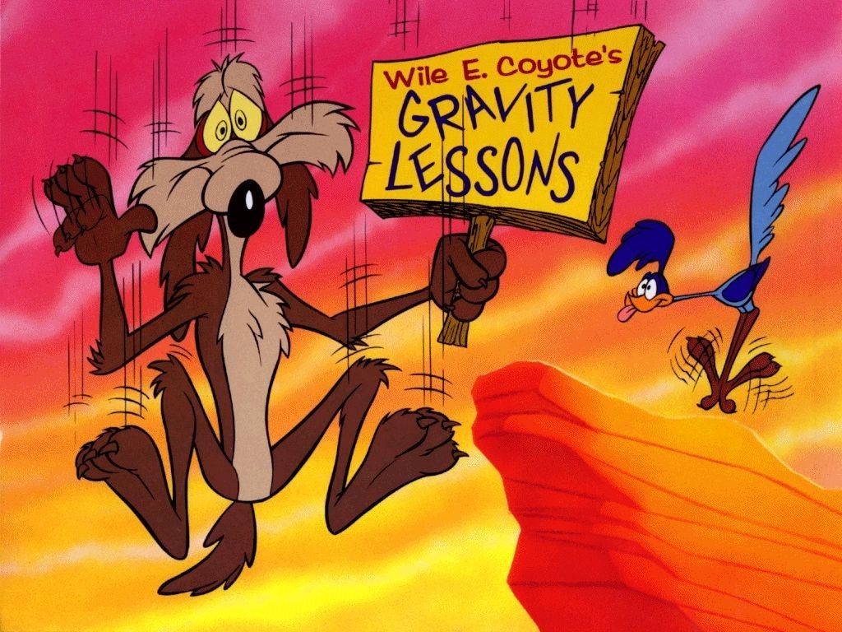
Understanding gravity, a plan of action
We will discover some things about gravity by studying the motion of objects.
We will assume that Newton’s second law (F=ma) is true, and ask what kind of force is necessary to explain the accelerations that we observe due to earth’s gravity.
We will assume that gravity depends only on the mass of the object and its distance from the center of the earth.

Slide 6

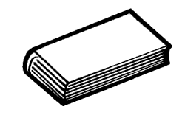
First let’s briefly consider distance for everyday interactions
~3 feet
Conclusion: For everyday interactions, the gravitational distance to the center of the earth is roughly constant, so the force (i.e. the weight) is constant
Radius of the earth ~4,000 miles

Slide 7
Experimental observation
Is anyone epileptic?
Time (s) | Distance (m) | Speed (m/s) | Acceleration (m/s²)
0 | 0 | 0 | 9.8
0.1 | 0.049 | 0.98 | 9.8
0.2 | 0.196 | 1.96 | 9.8
0.3 | 0.441 | 2.94 | 9.8
0.4 | 0.784 | 3.92 | 9.8
0.5 | 1.225 | 4.9 | 9.8
0.6 | 1.764 | 5.88 | 9.8
0.7 | 2.401 | 6.86 | 9.8
0.8 | 3.136 | 7.84 | 9.8
0.9 | 3.969 | 8.82 | 9.8
1 | 4.9 | 9.8 | 9.8

Slide 8
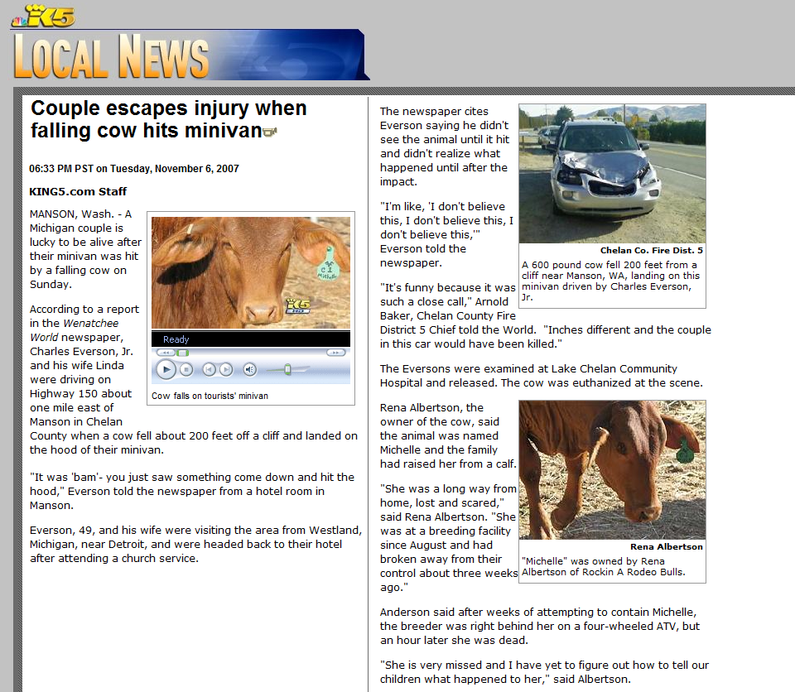
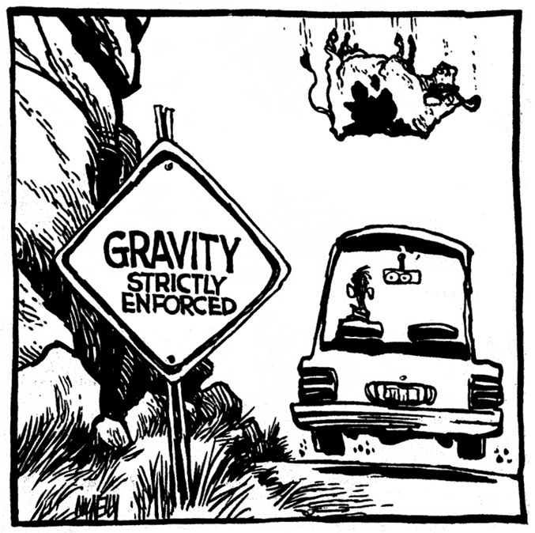
“Michelle” the cow in Manson Washington

Slide 9

A free falling body in the absence of air resistance
Time (sec) | acceleration (ft/s²) | Distance (feet) | Velocity (ft/sec) | Velocity (mph)
 | 32 | 0 | 0 | 0
1 | 32 | 16 | 32 | 22
2 | 32 | 64 | 64 | 44
3 | 32 | 144 | 96 | 66
4 | 32 | 256 | 128 | 88
5 | 32 | 400 | 160 | 110
6 | 32 | 576 | 192 | 132
7 | 32 | 784 | 224 | 154
8 | 32 | 1024 | 256 | 176
9 | 32 | 1296 | 288 | 198
10 | 32 | 1600 | 320 | 220
1 sec.
Force of Gravity
Acceleration
1 sec.
Velocity
1 sec.

Slide 10
If I drop a book and a piece of paper, which one will hit the table first?
The book
The paper
Neither, they hit the same time

Slide 11
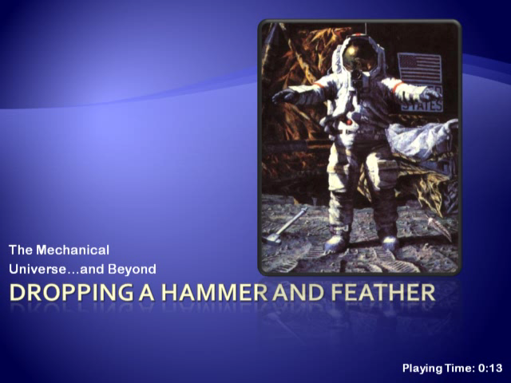
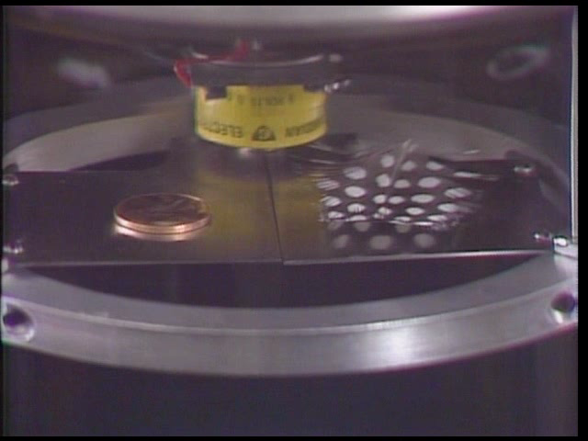
Gravity causes a uniform acceleration at the planet’s surface (independent of mass)
But Newton’s 2nd law said
?????

Slide 12
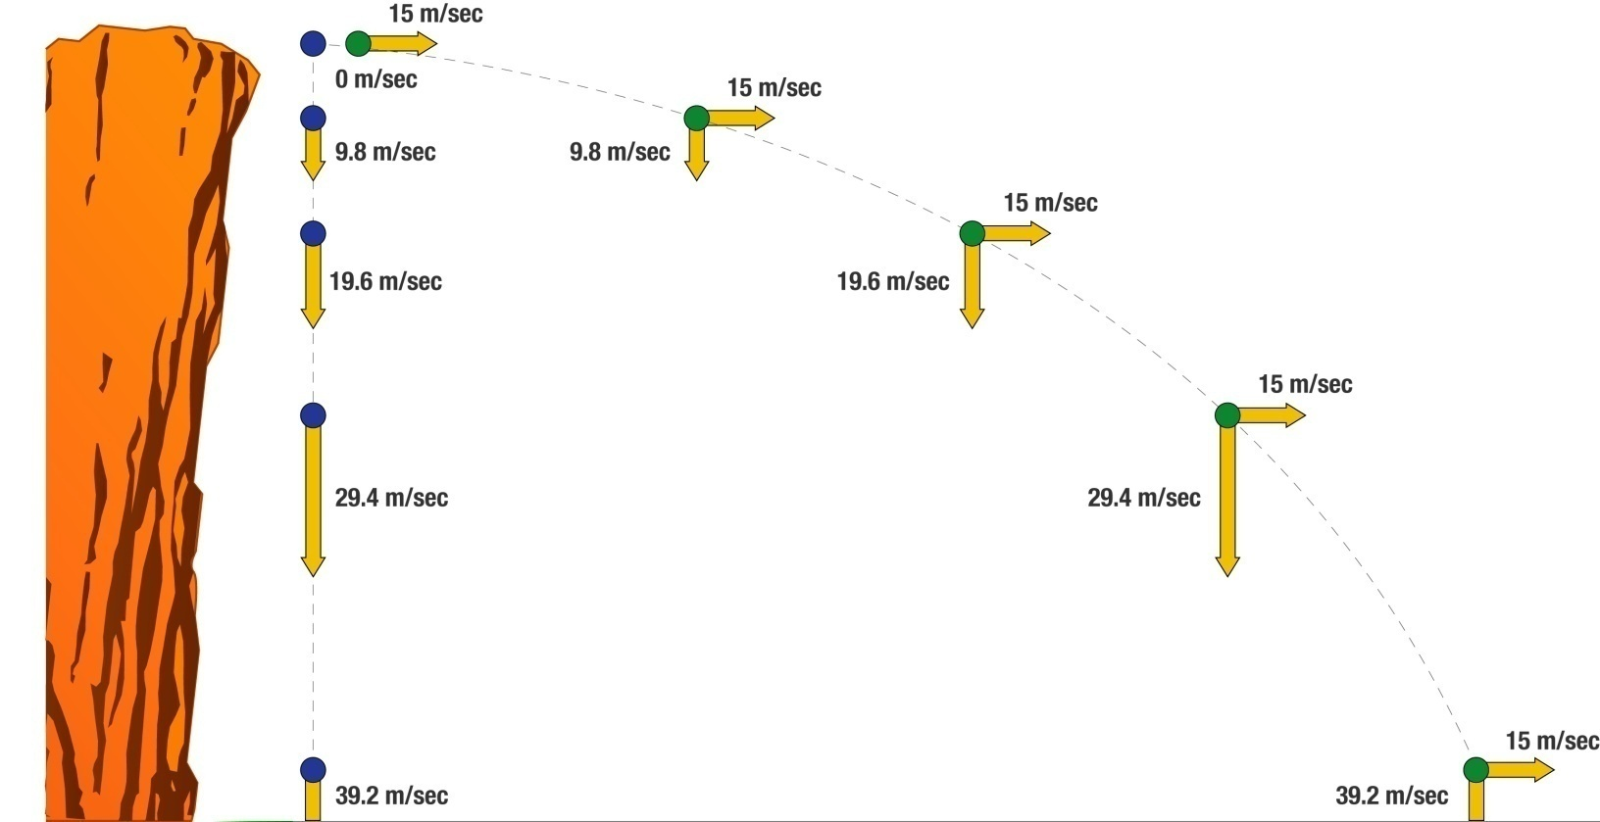
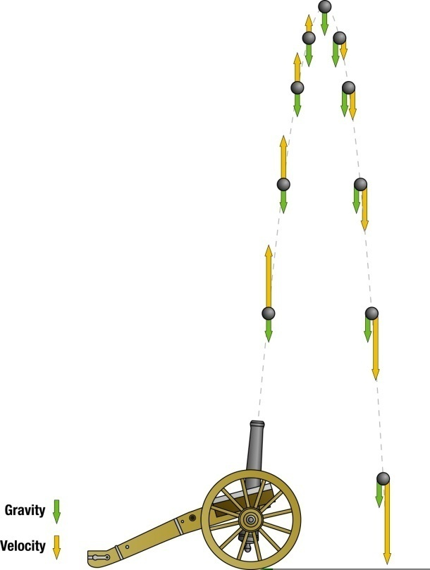
Decomposing motion into its components

Slide 13
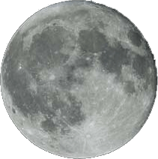
If objects are gravitationally attracted to each other, why doesn’t the moon fall to the earth?

Slide 14
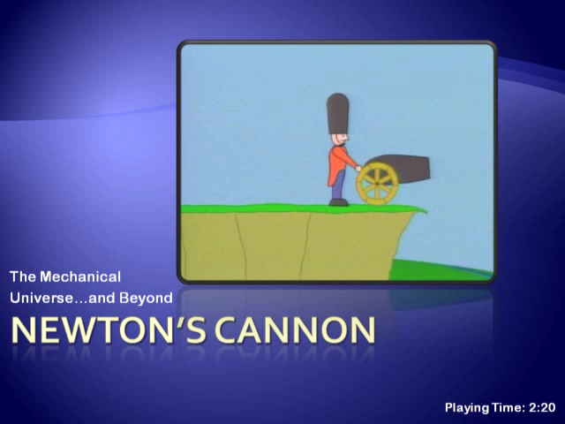

Slide 15


The moon is falling! (Dependence of the force of gravity on distance)
We can measure the acceleration of the moon (a = speed²/d)
Acceleration of the moon is 1/3,600 of the acceleration of objects near the surface.
+
The moon is 60 times farther from the center of the earth than the surface
=
Conclusion: the force of gravity is inversely proportional to the distance squared

Slide 16
Gravity
The equation for gravity is
F = force of gravity
G is just a small number
M
m
d

Slide 17
A very little math…
Newton’s law of gravity
describes the gravitational force on any object of mass “m” exerted by a body of mass “M”.
Newton’s second law of motion, F = ma, describes the acceleration experienced by an object that feels a force “F”.

Slide 18
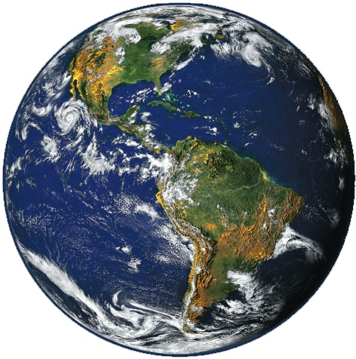
And thus we see…
More massive objects feel a greater force of gravity but resist accelerating by the same amount. Since the mass of the earth is constant, and the distance from the center of the earth only changes by a tiny fraction, gravitational acceleration of any body is independent of its mass! Heavy and light things all fall at the same rate.

Slide 19
If d₂ is twice as large as d₁, how is the force different for the d₂ case?
The force is four times bigger
The force is twice as much
The force is half as much
The force is one quarter as much
M
m
d₁
M
m
d₂

Slide 20
If m₂ is twice as large as m₁, How is the force different (d is the same in both cases)?
The force is the same
The force is twice as much
The force is half as much
Need more information to tell
M
m₁
d
M
m₂
d

Slide 21
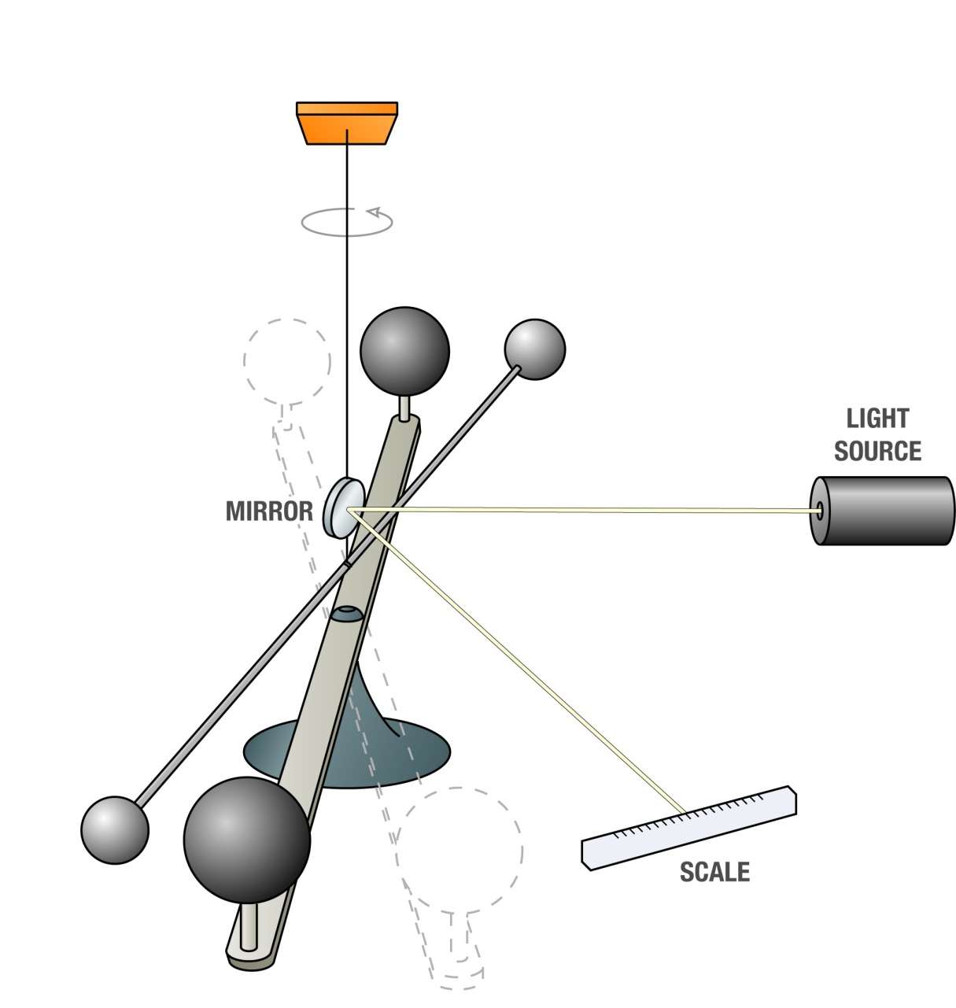
How do scientists measure G?

Slide 22
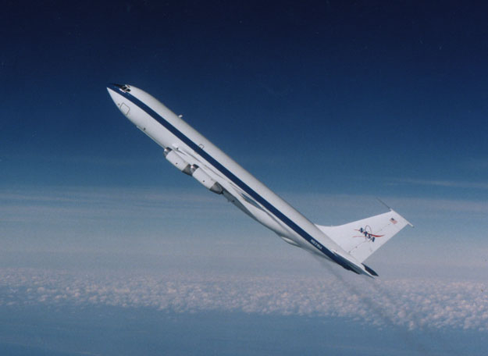
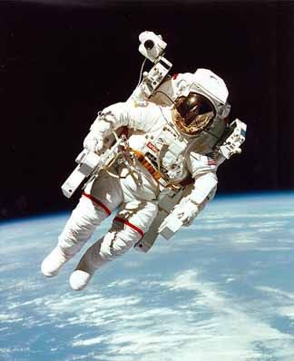
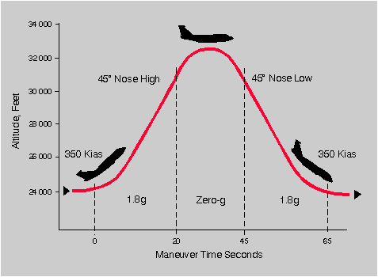
“Weightlessness” and “The Vomit Comet”

Slide 23
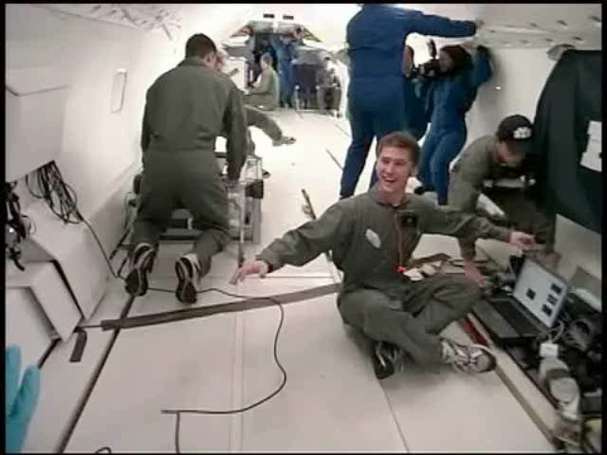
Eating on the vomit comet

Slide 24
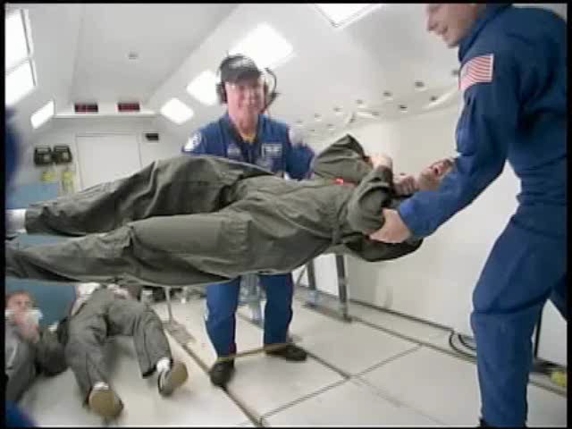
BYU Students on the vomit comet

Slide 25
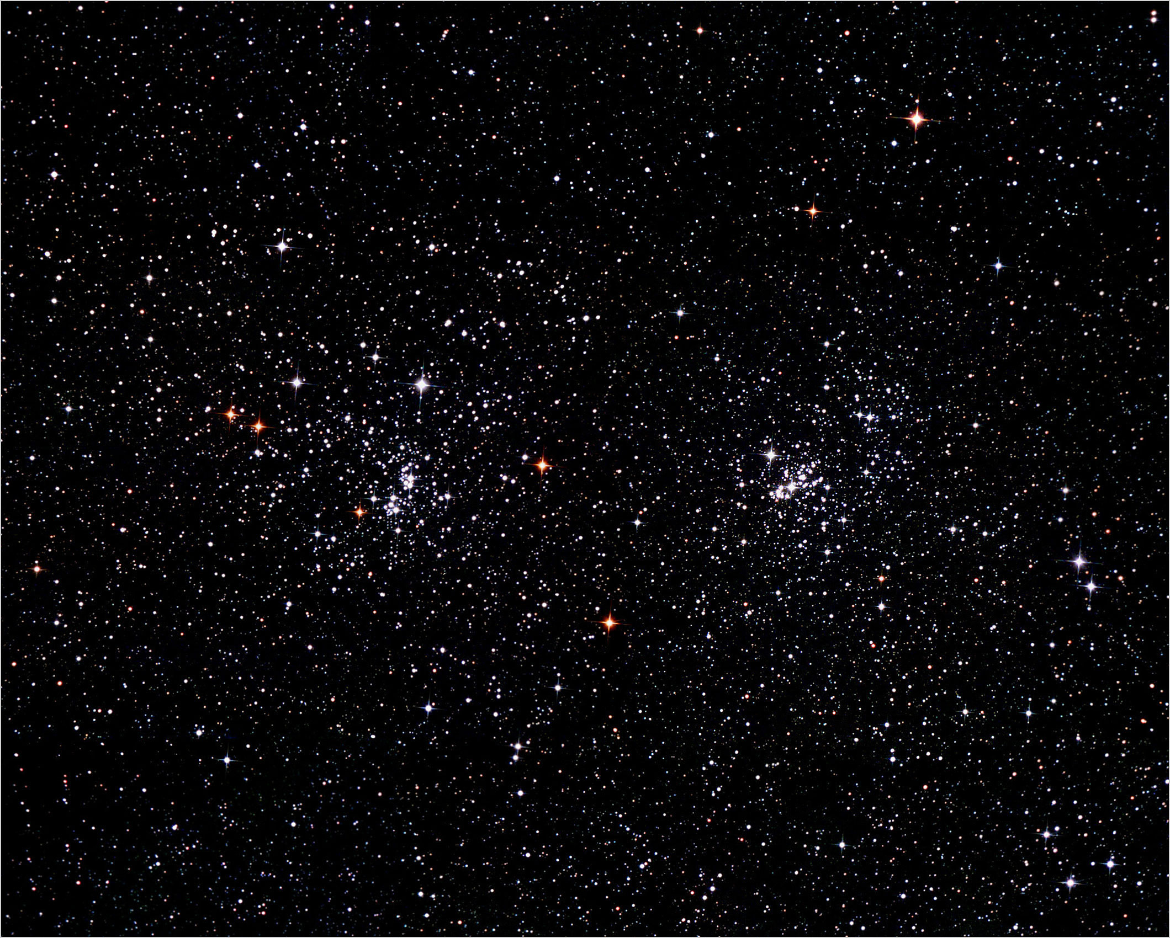
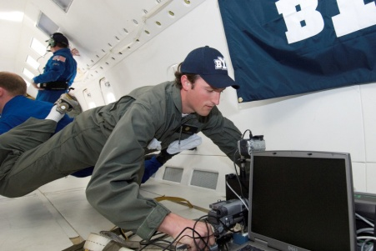


Slide 26
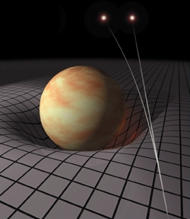
Two types of mass: Inertial and gravitational
F=ma

Slide 27

Video Courtesy of NOVA

Slide 28
The ship is sailing to the left. The ball is attached to the mast and then dropped. What will happen? (neglect air resistance)
It will fall straight along the mast
It will fall straight down towards the point above which it was dropped (the sailor might want to duck)
It will fall in front of the mast, so the sailor is safe

Slide 29
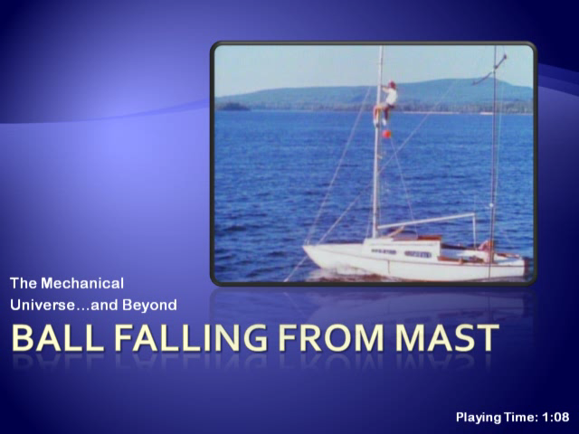
The first cartoon illustrates what people in Aristotle’s time (incorrectly) thought would happen. Galileo correctly predicted what really happens (shown in the live action).

Slide 30
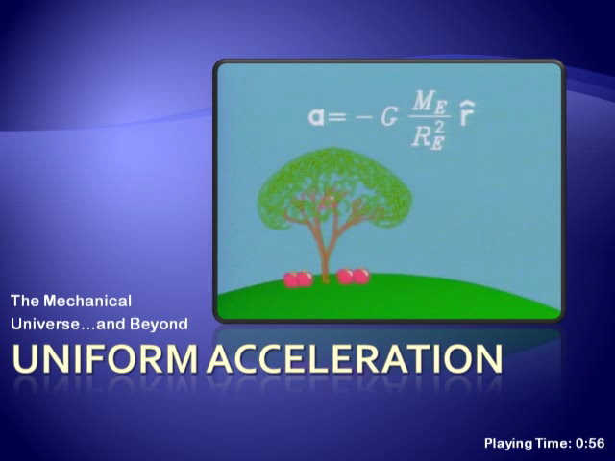

Slide 31
The cow, the Russian cargo plane, and the Japanese fishing trawler. (Courtesy of Dave Barry)
Notes:
The Sky is Falling
By Dave Barry (Miami Herald, February 20, 1998)
Recently, while visiting New York City (Civic Motto: ``I Got Yer Civic Motto Right Here''), I saw an alarming article in The New York Times, which is a newspaper up there, stating that large chunks of masonry were falling off some of the older buildings. As bad luck would have it in such a crowded city, several of these chunks, tragically, failed to land on George Steinbrenner.
The Times article quoted experts as saying that the solution to the falling-chunks problem was to inspect old buildings. With all due respect, that is the stupidest thing I ever heard. Inspections are not the answer. With falling chunks, as with so many problems afflicting modern urban society, the only lasting solution is to identify, and correct, the ``root cause'' of the problem. And that cause is: gravity.
I have been following this issue for many years, and in my opinion, gravity is getting worse than ever. For example, last year several hundred alert readers sent me articles from various publications concerning an incident in the Sea of Japan wherein a Japanese fishing boat was allegedly sunk by a falling cow. Yes. According to these articles, which I swear I am not making up, what apparently happened was that the crew of a Russian military cargo jet had stolen some cows in Siberia and were flying them home when the cows became upset, perhaps because there was no in-flight movie.
So the cows stampeded, and the crew, fearing that the plane would crash, opened the cargo door and let the cows run out of the plane at an altitude of 30,000 feet, which is somewhat in excess of the Recommended Safe Falling Distance for Cows of 1.3 inches. So you had these cows raining down on the Sea of Japan, and one of them, unfortunately, failed to land on George Steinbrenner. But it did allegedly strike the Japanese fishing boat, which sank. The fishermen all survived, although I am betting that they had an unpleasant talk with their insurance agent.
I don't know about you, but when I read about a tragedy like this, the phrase that comes into my mind is ``major motion picture.'' I'm thinking of something along the lines of Titanic. You'd have a pair of star-crossed Japanese fisherpersons, played by Kate Winslet and Leonardo DiCaprio, and just when you think they're going to overcome the obstacles facing them, they hear, in the distance, the chilling sound that mariners throughout the ages have always feared most of all -- ``moo'' -- and then WHAM, the boat is struck by a hurtling Hereford traveling in excess of 100 miles per hour. For the remaining 125 minutes of the movie, the lovers float romantically around on the wreckage as Leonardo proclaims his undying love for Kate and tenderly brushes chunks of brisket from her hair.
But getting back to the worsening gravity problem: I wish I could tell you that it is limited to cows. But unfortunately I cannot, not in light of an article from the Aug. 27, 1997, issue of The Calvert County (Md.) Recorder, sent in by alert reader Janice Rohme. This article states that on Aug. 25, Gloria Daniels, 68, of Lusby, Md., was working in her garden with a young neighbor boy when she was hit by a falling tomato. Then the boy was hit by a tomato. Then tomatoes -- more than 30 of them -- began raining down all over her yard. Friends, neighbors and the media were called in to investigate, but nobody could figure out where the tomatoes -- which appeared to be falling straight down out of the sky -- were coming from. Rob Terry, the reporter who wrote the story for The Recorder, states that, while on the scene, he personally was struck by a tomato, and although he quickly investigated, he could find no evidence that it was hurled by pranksters.
I called Gloria Daniels recently and asked her if anybody had come up with an explanation for the falling tomatoes, and she said nobody had.
``It's a mystery,'' she said.
I asked her if she had been in touch with anybody at The X-Files, and she said she'd never heard of it. This is a shame, if you ask me, because this incident could be the basis for a terrific episode. Of course, to make it sufficiently dramatic, they might have to alter a few facts slightly. They'd have some scene in an abandoned warehouse, wherein agents Scully and Mulder, their faces tense, their guns held out in front of them, are going from darkened room to darkened room, stalking -- and being stalked by -- a mutant bloodsucking zucchini the size of Shaquille O'Neal.
But my central point is that, wherever these tomatoes were coming from, they would never have represented a threat to innocent people, and neither would the cows, and neither would the New York building chunks, if they had not been attracted to the Earth by gravity. FACT: Gravity is a contributing factor in nearly 73 percent of all accidents involving falling objects. And yet the so-called ``federal government'' does nothing! So I guess it's up to you and me. Me, I'm going to lie down.
The Sky is Falling (Shortened)
By Dave Barry (Miami Herald, February 20, 1998)
Recently, while visiting New York City, I saw an alarming article in The New York Times stating that large chunks of masonry were falling off some of the older buildings. The Times article quoted experts as saying that the solution to the falling-chunks problem was to inspect old buildings. With all due respect, that is the stupidest thing I ever heard. Inspections are not the answer. With falling chunks, as with so many problems afflicting modern urban society, the only lasting solution is to identify, and correct, the ``root cause'' of the problem. And that cause is: gravity.
I have been following this issue for many years, and in my opinion, gravity is getting worse than ever. For example, last year in the Sea of Japan a Japanese fishing boat was allegedly sunk by a falling cow. Yes. According to [many newspaper] articles, which I swear I am not making up, what apparently happened was that the crew of a Russian military cargo jet had stolen some cows in Siberia and were flying them home when the cows became upset, perhaps because there was no in-flight movie.
So the cows stampeded, and the crew, fearing that the plane would crash, opened the cargo door and let the cows run out of the plane at an altitude of 30,000 feet, which is somewhat in excess of the Recommended Safe Falling Distance for Cows of 1.3 inches. So you had these cows raining down on the Sea of Japan, and one of them allegedly struck the Japanese fishing boat, which sank. The fishermen all survived, although I am betting that they had an unpleasant talk with their insurance agent.
My central point is that [these cows] would never have represented a threat to innocent people, and neither would the New York building chunks, if they had not been attracted to the Earth by gravity. FACT: Gravity is a contributing factor in [at least] 73 percent of all accidents involving falling objects. And yet the so-called ``federal government'' does nothing! So I guess it's up to you and me. Me, I'm going to lie down.

