Slide 1
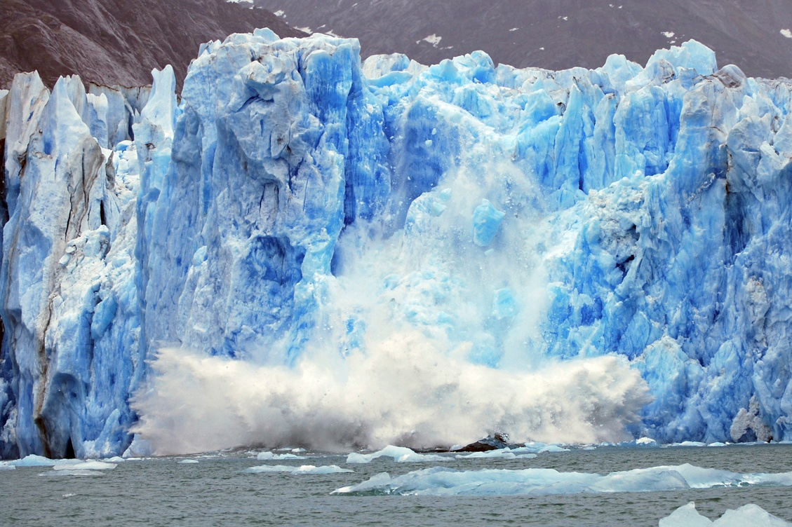
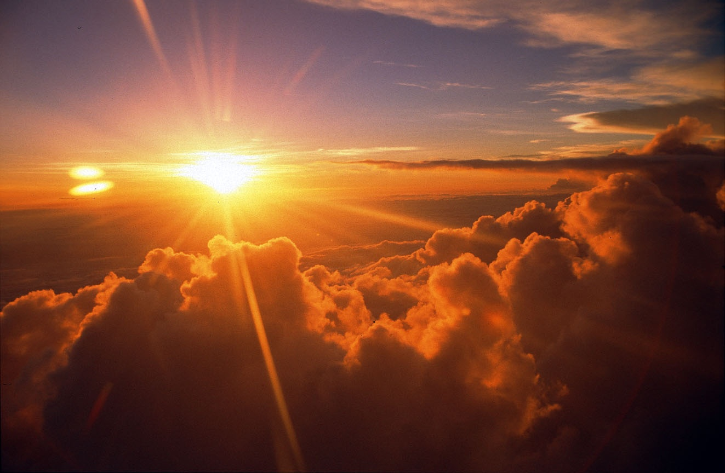
Global warming

Slide 2
Weather vs. Climate
Weather describes fluctuations in temperature, rainfall, etc. over short time scales, and is highly variable (day to day and by season)
Climate describes the average temperature, rainfall, etc. over long periods of time (many years at least).
Earth’s climate changes naturally over long time scales.
The current concern relates to climate change thought to be due to human activity.

Slide 3
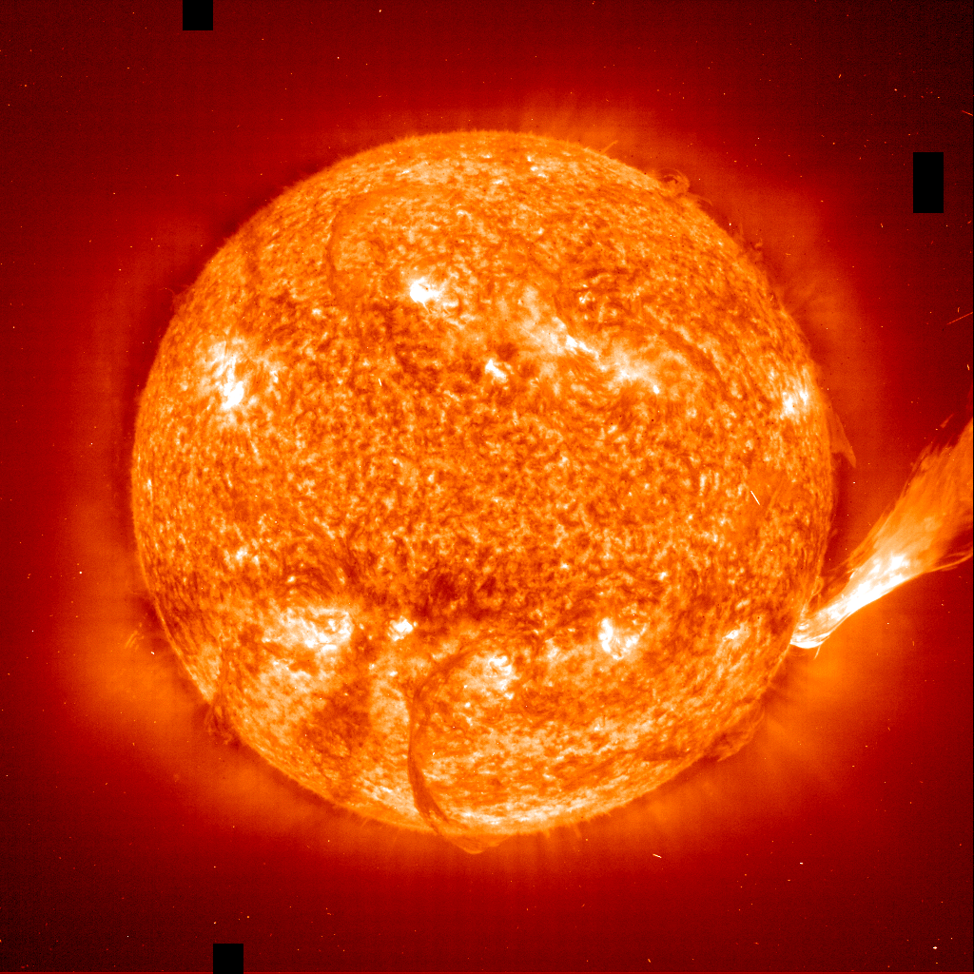
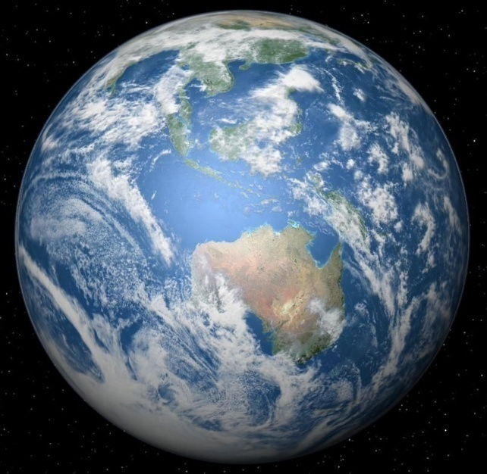
The global average temperature of the earth
The average temperature of the earth depends primarily on
  The amount of Solar radiation that reaches the Earth
  The fraction of Solar Radiation that gets trapped in the atmosphere
At times in the past the Earth has been much cooler and at other times much warmer

Slide 4
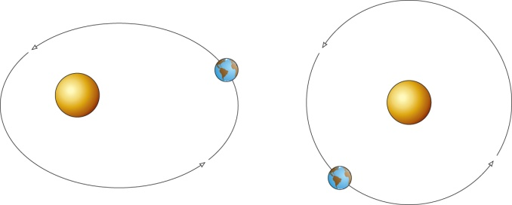
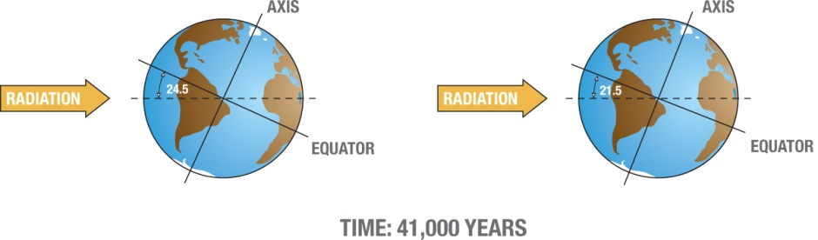
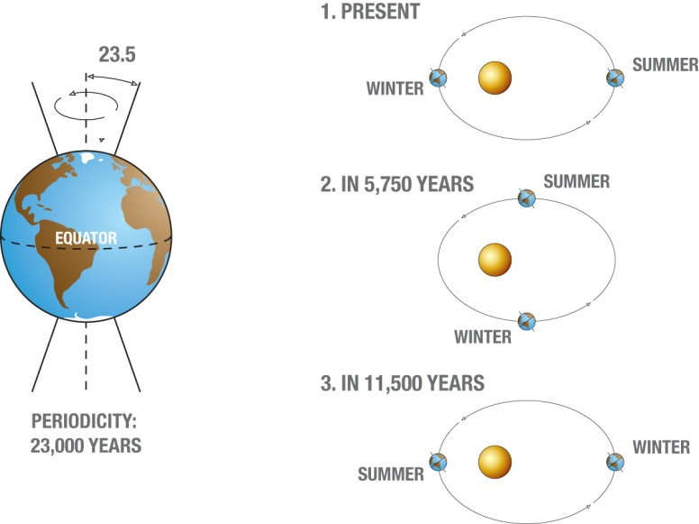
Solar Radiation Reaching the Earth
Milankovitch Cycles
  “Ellipticity” of Earth’s orbit around the Sun (100,000 yr cycle)
  Tilt of Earth on its axis (41,000 yr cycle)
  Precession of Earth on its axis (23,000 yr cycle)
Tilt and Precession
  Don’t change overall radiation, but can change seasonal extremes in weather.
  The arrangement of continents is not symmetric. Most of the land is in the northern hemisphere
  Land and ocean respond differently to seasons (glaciers vs. sea ice)

Slide 5
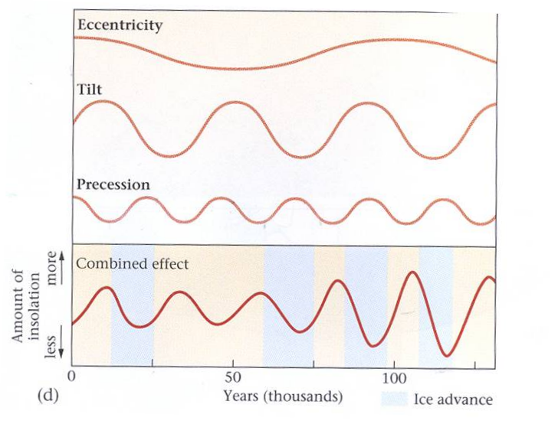
What does the past teach us?
The orbital cycles are reasonably good predictors of glaciations
  Orbital eccentricity: 100ky
  Axial inclination: 41ky
  Axial precession: 23ky
According to these cycles, we would predict that we would enter a new ice age sometime “soon” (on the thousands of years time scale)

Slide 6
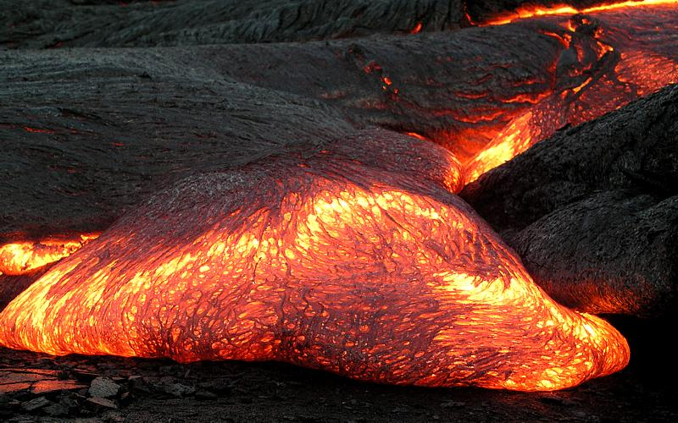
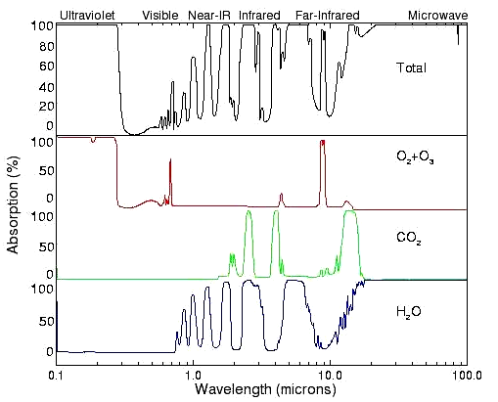
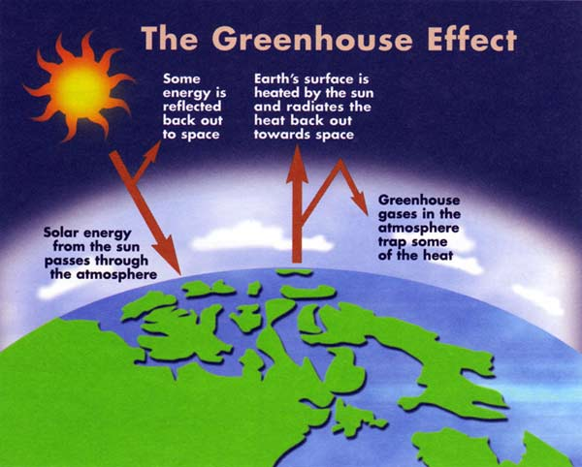
Trapping solar radiation in the atmosphere increases the fraction of solar radiation that is retained
If you treat the earth and sun as “black” bodies, you underestimate the earth’s temperature.
The (unfortunately named) greenhouse effect is the reason.
  Infrared light emitted by the earth is absorbed by greenhouse gases (Carbon Dioxide, Methane, Water Vapor)
  The absorbed energy heats the gases, that then re-radiate—half up and half down
  The net effect is that energy is trapped in the atmosphere longer, and the planet is warmer than it would be without this effect

Slide 7
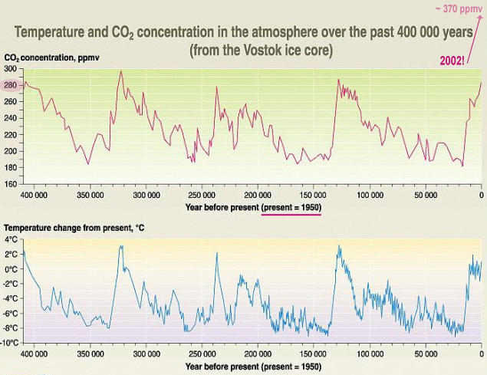
Historical correlation between temperature and greenhouse gas levels
So does temperature drive CO₂ or does CO₂ drive temperature?
Yes.

Slide 8
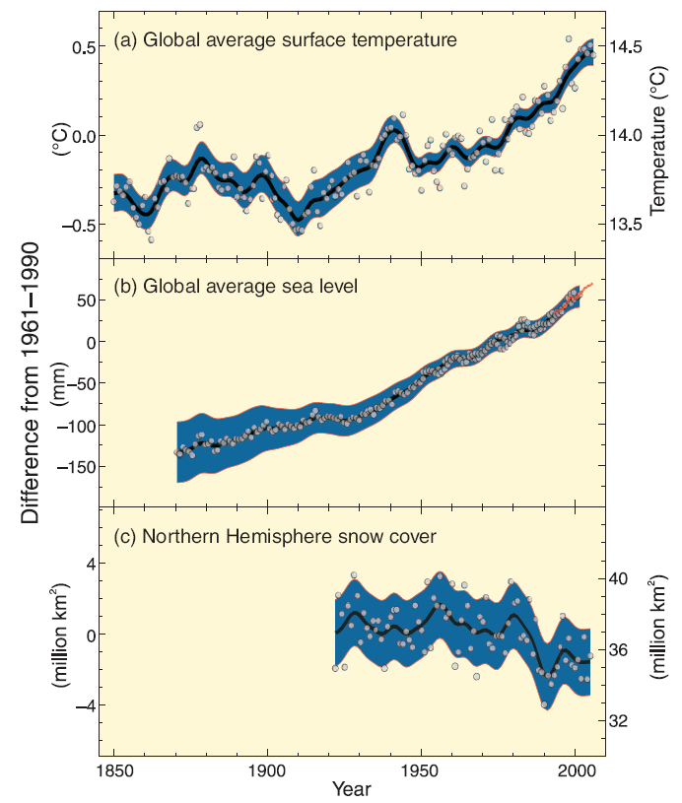
So what has been happening recently?
We have had good thermometers for a while now.
People on the coast keep good track of the sea level
Since the early 1900s we have good measurements of snow cover

Slide 9
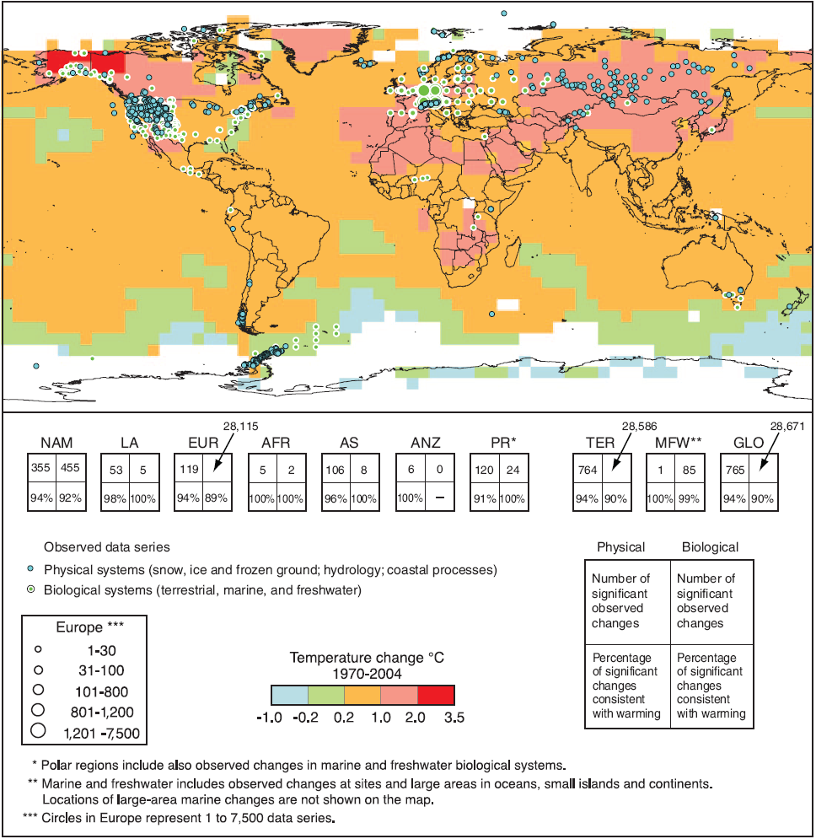
Current warming is generally greater over continents

Slide 10
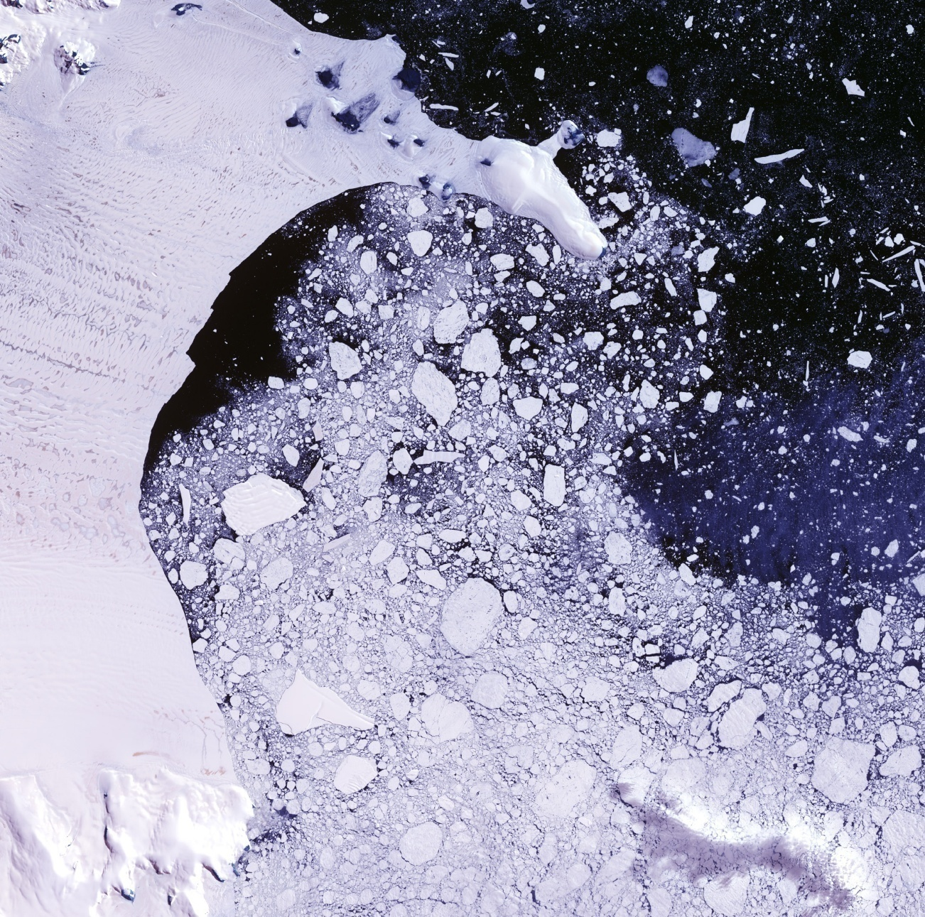
Larsen Ice Sheet Breakup
More glaciers are receding than advancing today.

Slide 11
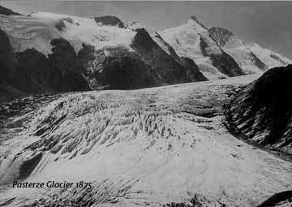
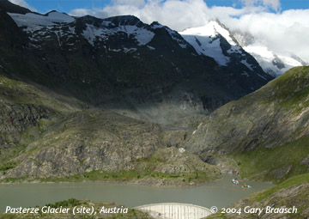
Pasterze Glacier, Austria
1875
2004

Slide 12
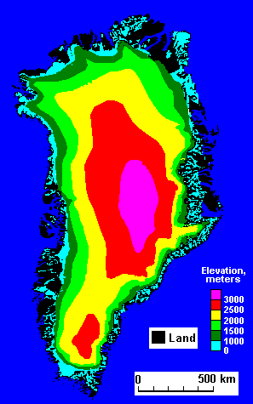
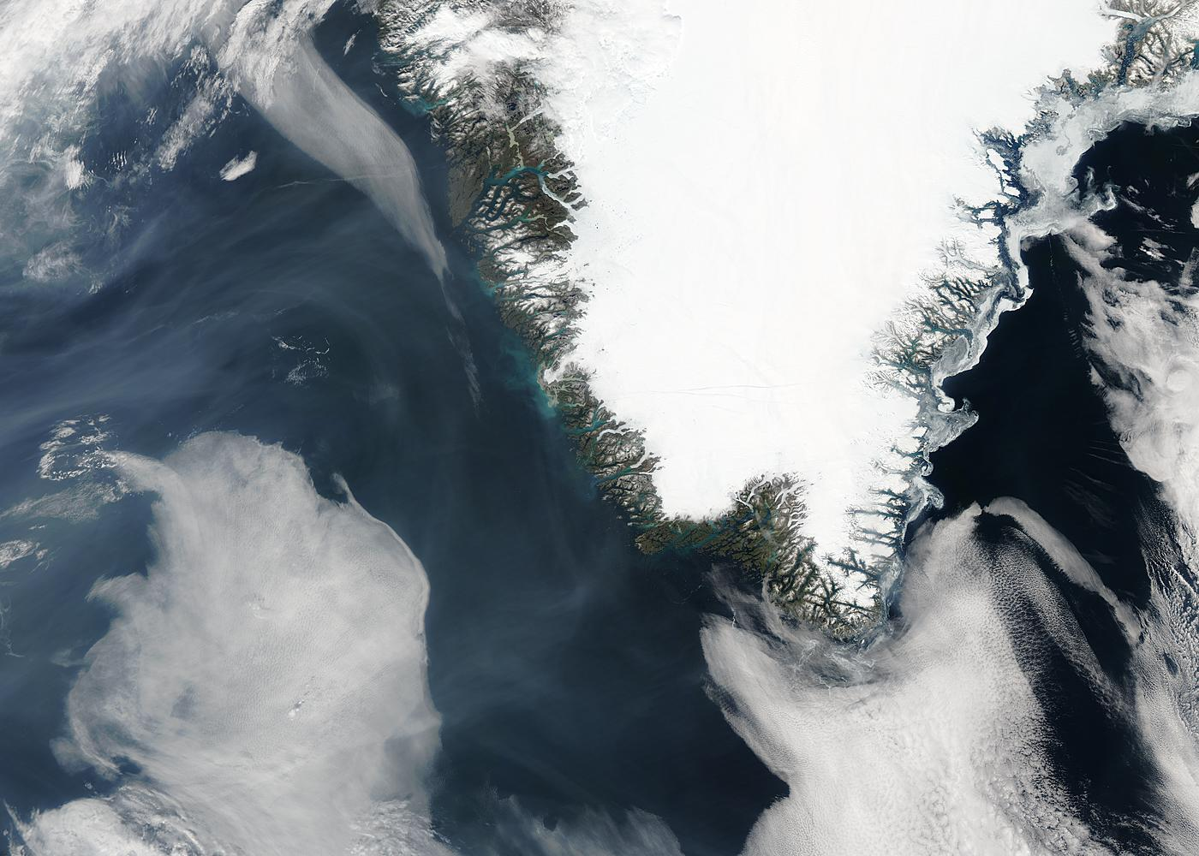
Continental Glaciers seem to be receding
Example: Greenland

Slide 13
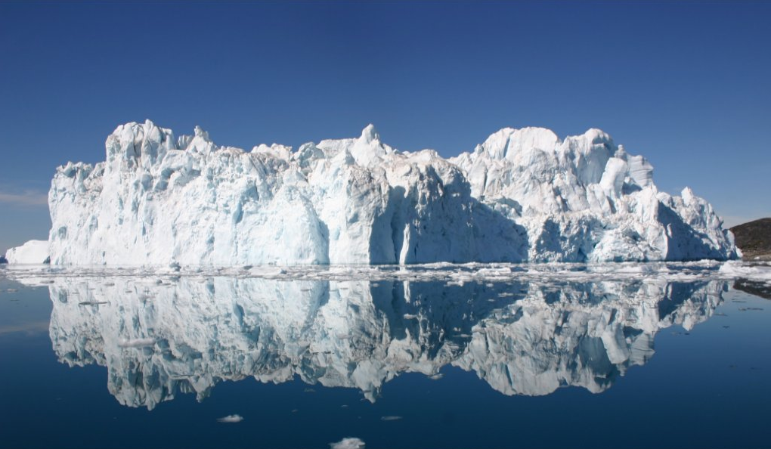
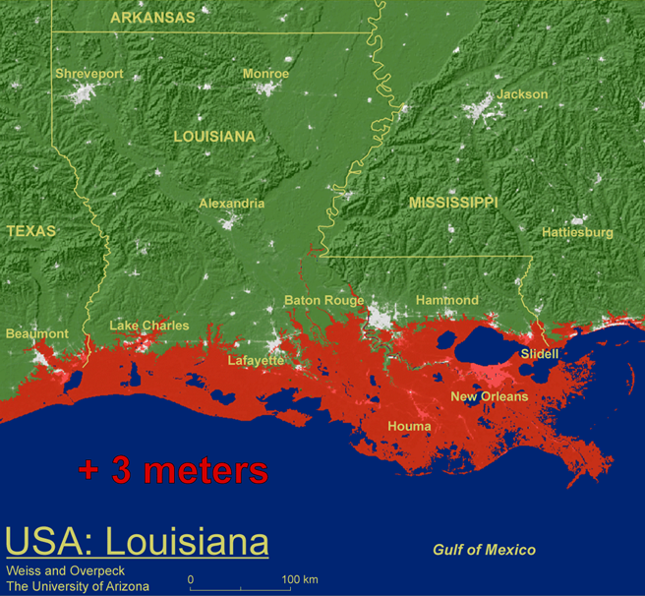
Why do we care?
What happens to water levels when an ice berg melts?
What happens when a continental glacier melts?

Slide 14
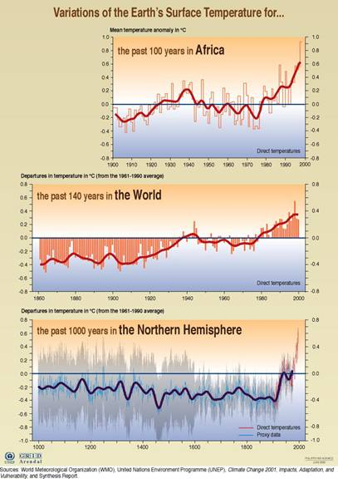
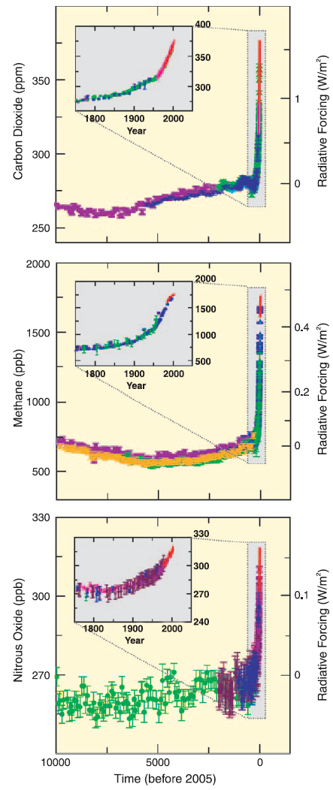
So are we causing the recent warming?
How can we tell?

Slide 15
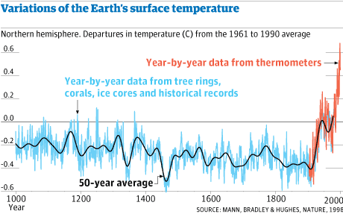
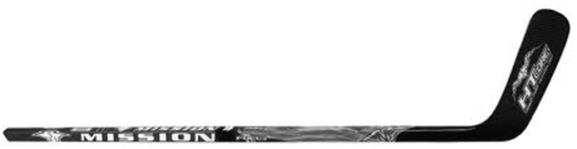
The hockey stick graph!
“The hockey stick controversy”

Slide 16
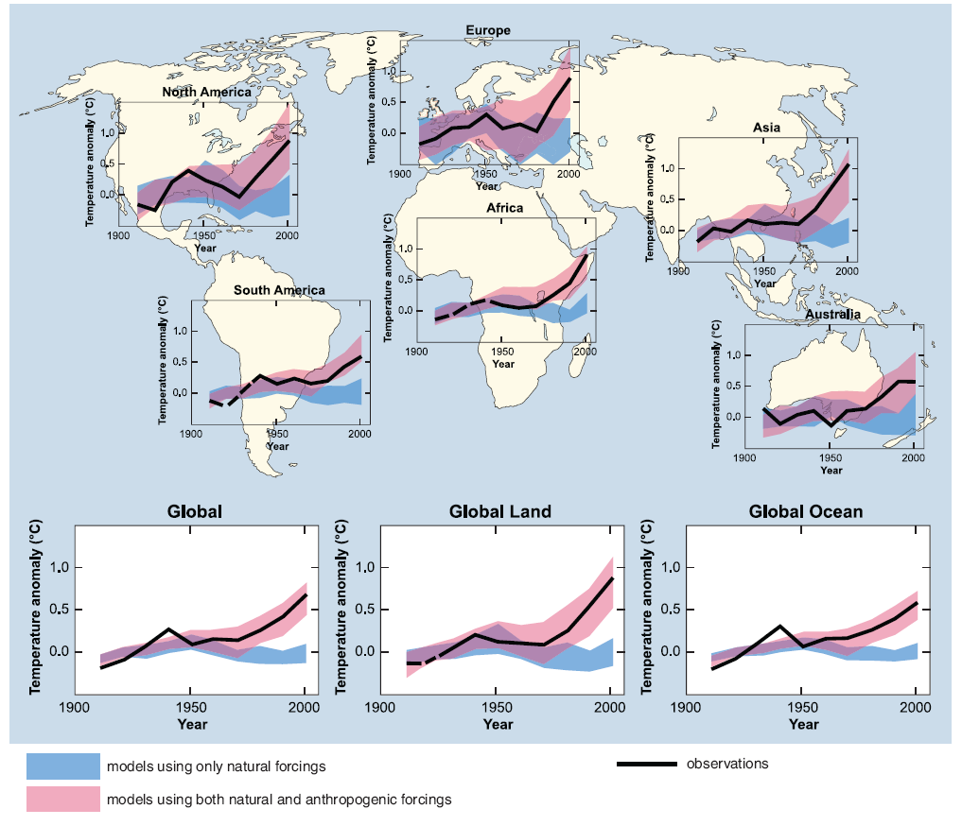
What do the current climate models tell us?

Slide 17
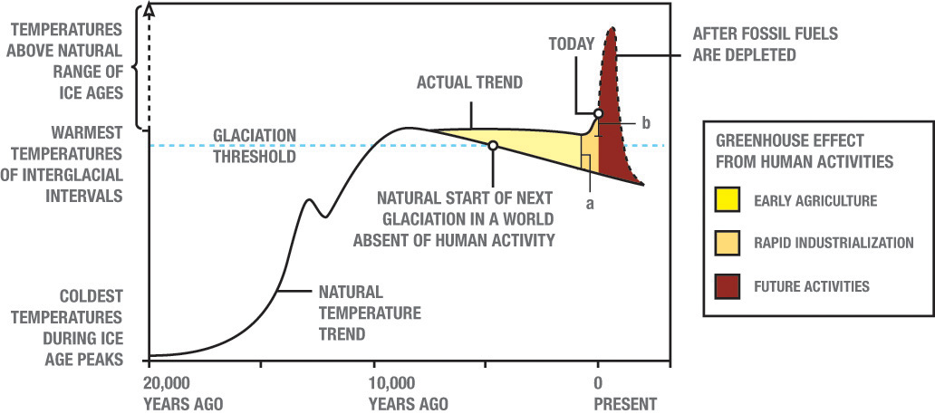
Should we do anything?

Slide 18
Risk, Cost, & Benefit
Cost of reducing greenhouse emissions will certainly be many billions of dollars (more like trillions if we avoid nuclear).
Certainty of controlling global warming is not 100%
  Current predictions depend on imperfect models
Environmental and economic consequences could be truly catastrophic
  Some say global warming could cause the end of technological civilization
As voters and consumers, these are your issues

Slide 19
Which best describes your opinion on global warming?
This is just political hype. No action is needed.
We should wait until the models are better before we do anything.
I’d like beachfront property in Utah. Do nothing and party on!
We should invest the $billions needed to find ways to reduce greenhouse gas emissions.
We are already in danger. We should immediately stop driving cars!
0

Slide 20
Which type of wave won’t travel through liquids?
compression waves
raptor waves
shear waves
circularly polarized waves

Slide 21
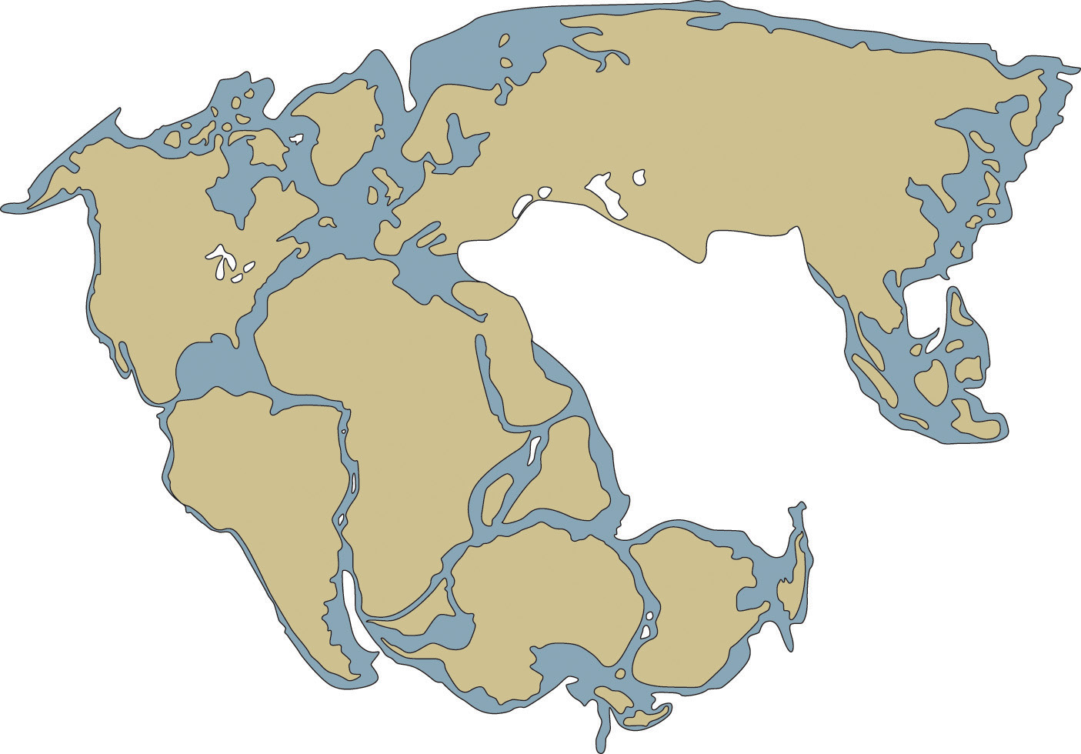
State 3 other pieces of evidence for Pangaea/plate tectonics
The puzzle piece evidence

Slide 22
The interior structure of Earth has been determined mostly from
Drilling
Exploration
X-Rays
Earthquake waves
Chemical analysis

Slide 23
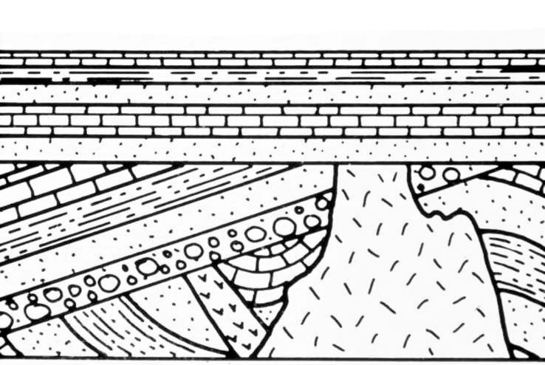
Which feature is the oldest?
A
C
B
D

Slide 24
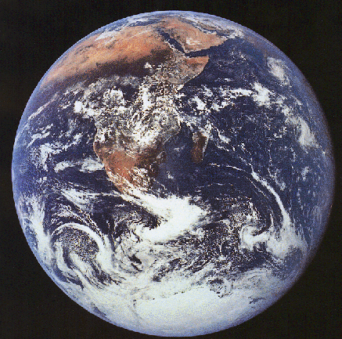
What is the estimated age earth and how do we postulate it?
13.7 billion yrs, Uranium-Lead dating
4.5 billion yrs, Various radiometric dating methods
4.5 million yrs, Carbon dating
6,000 yrs, Archbishop James Usher

Slide 25
What are these famous graphs called?

Slide 26
Natural causes(a.k.a. forcings, drivers)
Known drivers of past climate change include:
Changes in the Earth's orbit
Changes in the sun's intensity
Volcanic eruptions
  Aerosol emissions
  Carbon dioxide emissions
These climate change drivers trigger other drivers:
Changes in greenhouse gas concentrations – heat the ocean/release CO₂
Changes in ocean currents – large unexpected regional climate changes
http://epa.gov/climatechange/science/pastcc.html#ref

Slide 27
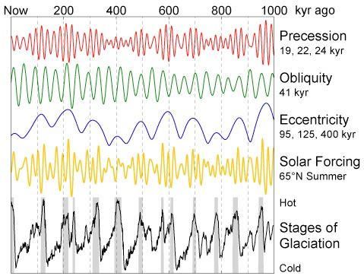
Natural driver - Changes in the Earth's orbit
Milankovitch Cycles
  Eccentricity (100,000 yr cycle) (.005 to 0.058) currently .017
  Tilt(41,000 yr cycle) (22.1 and 24.5) currently 23.44 and decreasing
  Precession(23,000 yr cycle)
http://www.eoearth.org/article/Milankovitch_cycles

Slide 28
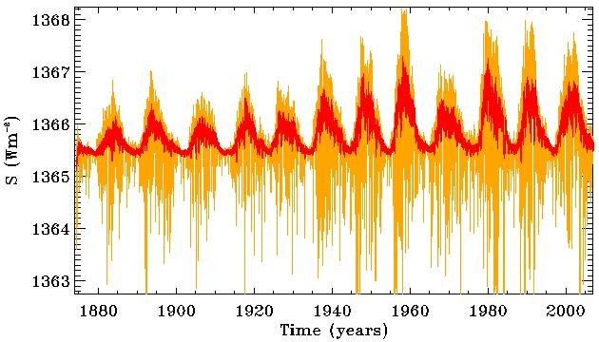
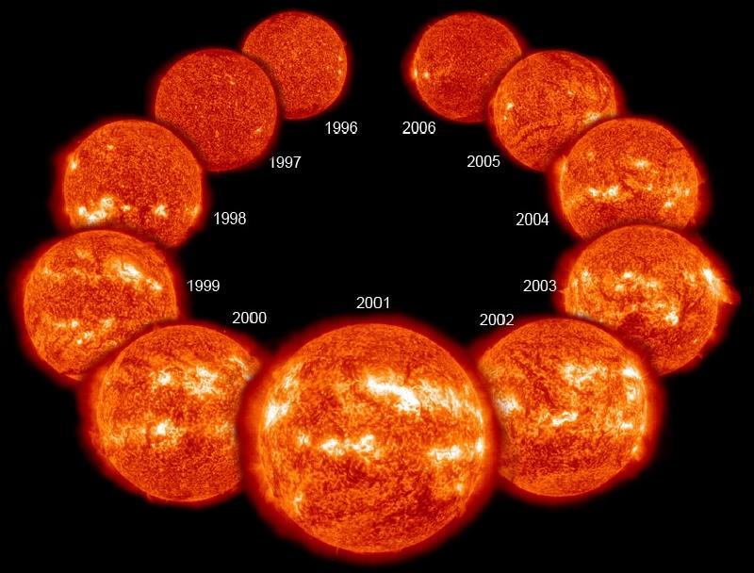
Natural driver - Changes in the sun's intensity
The intensity of the Sun varies along with the 11-year sunspot cycle.
NASA/GSFC/Steele Hill
Goddard Space Flight Center
http://glory.gsfc.nasa.gov/overview-tsi.html

Slide 29
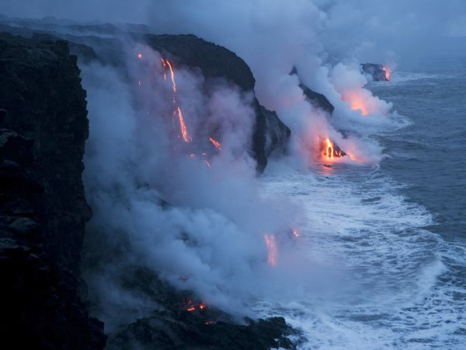
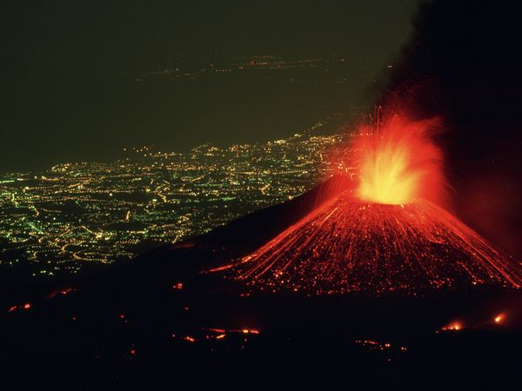
Natural driver – Aerosol and Carbon dioxide emissions
Left: Lava Flowing Into the Pacific
Photograph by Stephen Alvarez, National Geographic
With a hiss of steam, lava flows into the Pacific Ocean in Hawaii Volcanoes National Park, Hawaii. Similar flows of molten rock have built up the Hawaiian islands over the course of more than 70 million years.
Left: Mount Etna, Italy
Photograph by Carsten Peter, National Geographic
Perched above the lighted city of Catania, Italy, Mount Etna hurls a fountain of fire skyward as rivers of lava spill down its flanks. In spite of its dazzling displays, Mount Etna is a relatively safe volcano with rare, compact eruptions and slow-flowing lava that gives people a chance to escape.
http://environment.nationalgeographic.com/environment/photos/volcano-general/

Slide 30
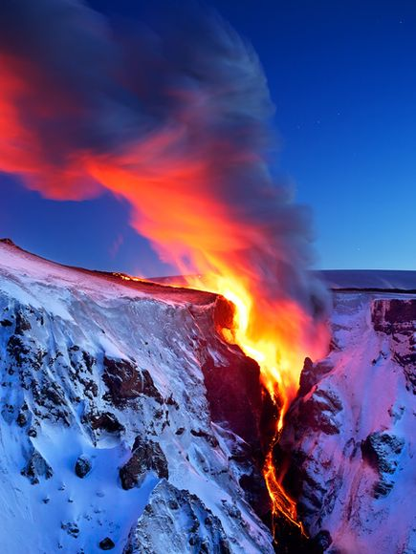
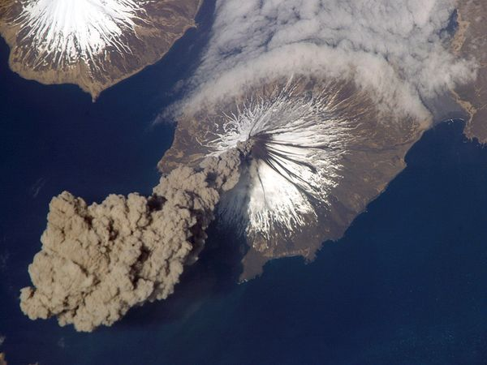
Natural driver - Aerosol and Carbon dioxide emissions
Left: Lava Falls
Photograph by Snorri Gunnarsson
Lava flows into a valley in southern Iceland near the Eyjafjallajökull volcano.
Above: Cleveland Volcano, Alaska
Photograph courtesy NASA Earth Observatory
Cleveland Volcano releases a plume of ash that rises almost 20,000 feet (6,000 meters) above the North Pacific Ocean in this aerial photograph. Cleveland Volcano, located in the Aleutian Islands southwest of Alaska, failed to produce an eruption and the plume of ash detached from the volcano two hours after it formed.
http://environment.nationalgeographic.com/environment/photos/volcano-general/

Slide 31
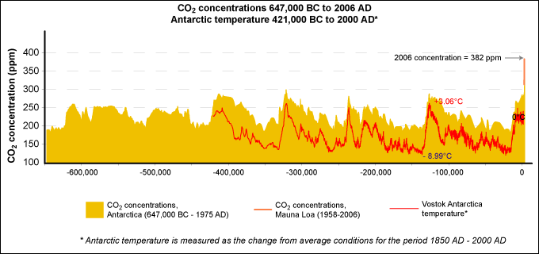
Evidence of climate change history
http://epa.gov/climatechange/science/pastcc_fig1.html
Ice cores are unique with their entrapped air inclusions enabling direct records of past changes in atmospheric trace-gas composition.
Carbon Dioxide Information Analysis Center | DOE's Oak Ridge National Laboratory | World Data Center for Atmospheric Trace Gases
http://cdiac.ornl.gov/trends/co2/siple.html
National Climatic Data Center | National Oceanic and Atmospheric Administration
ftp://ftp.ncdc.noaa.gov/pub/data/paleo/icecore/antarctica/vostok/deutnat.txt

Slide 32
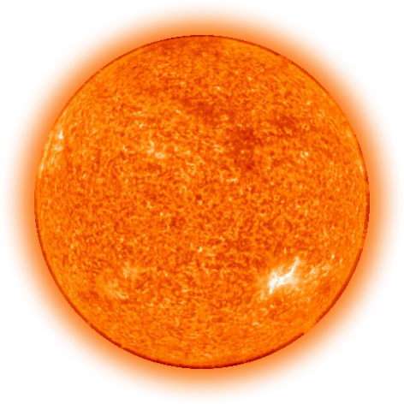
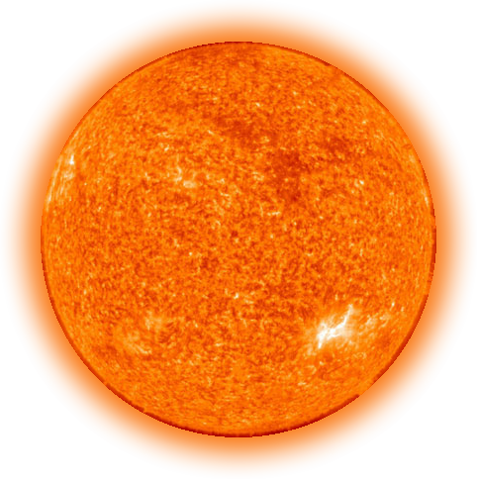
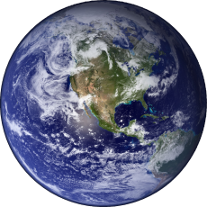
Name one natural cause of climate change

Slide 33
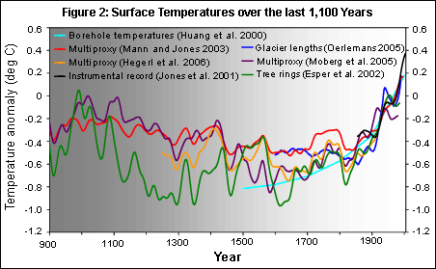

The hype
The concern is the possible anthropogenic impact
Medieval Climate Anomaly
The little ice age
Industrial era
Environmental Protection Agency | National Research Council, 2006. (Figure reprinted with permission from Surface Temperature Reconstructions© (2006) by the National Academy of Sciences, Courtesy of the National Academies Press , Washington, D.C.)
http://epa.gov/climatechange/science/pastcc.html

Slide 34
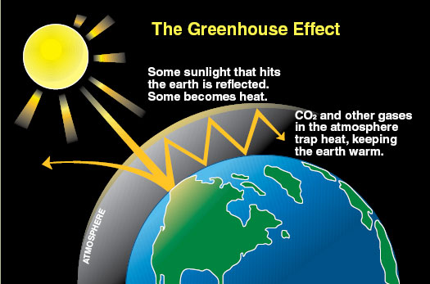
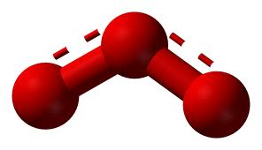
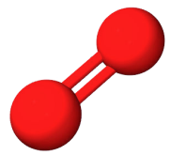
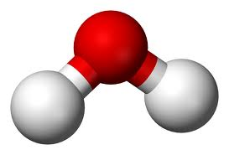
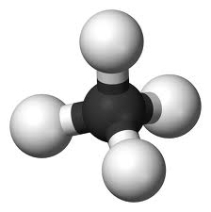
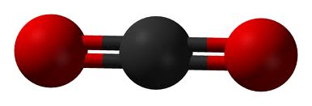
Trapping solar radiation in the atmosphere
some greenhouse gases
Carbon Dioxide
Ozone
Diatomic Oxygen
Water
Methane

Slide 35
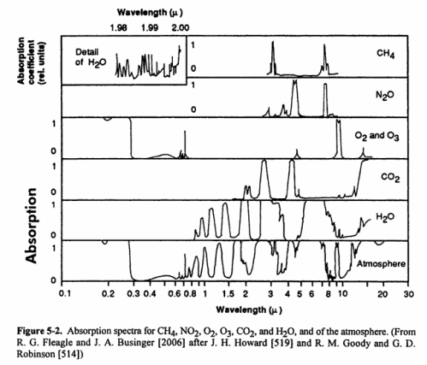

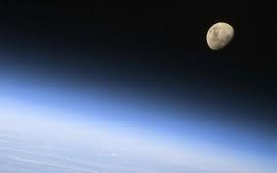
Spectral absorption data of common greenhouse gases
+
Water vapor | H₂O | 36 – 72 %
Carbon dioxide | CO₂ | 9 – 26 %
Methane | CH₄ | 4 – 9 %
Ozone | O₃ | 3 – 7 %

Slide 36





Indirect problems - Chlorofluorocarbons
CFC-11 and CFC-12
they are very stable compounds
means very low toxicity and very low flammability
gases at normal room temperatures and pressures
can be liquefied by putting them under pressures just slightly above normal pressures
CF₂Cl₂.
useful:
propellants in aerosol cans
solvents
expansion gases in the production of foams
the heat-exchanging fluid in air conditioners
the working fluid in refrigerators
CFCl₃

Slide 37





Problems when they rise up in the sky
215nm photons break the chlorine-carbon covalent bond liberating a chlorine atom
Cl
Cl
Cl+ O₃ ClO+ O₂
Depletion of ozone!

Slide 38

History of Chlorofluorocarbon concentration
Walker, S. J., R. F. Weiss & P. K. Salameh (2000) Reconstructed histories of the annual mean atmospheric mole fractions for the halocarbons CFC-11, CFC-12, CFC-113 and carbon tetrachloride. Journal of Geophysical Research 105, 14285—14296.

Slide 39




Dichlorodifluoromethane(Freon)
Global warming potential*
GWP
Carbon-dioxide
1
Methane
21
Nitrous Oxide
310
Chlorodifluoromethane
125
132
6500
Perfluorocarbons
Sulfur hexafluoride
23,900
*for 100 year time-horizon
GRID-Arendal | United Nations Environment Programme http://www.grida.no
Notes:
Perfluorocarbon derivatives can function as fluoropolymers, refrigerants, solvents, anesthetics, fluorosurfactants, and ozone depletors.

Slide 40
Let’s research one thing – the correlation between temperature and CO₂
So does temperature drive CO₂ or does CO₂ drive temperature?
Yes.
GRID-Arendal | United Nations Environment Programme
J.R. Petit, J. Jouzel. et. al. Climate and atmospheric history of the past 420 000 years from the Vostok ice core in Antarctica, Nature 399 (3June), pp 429-436, 1999
http://www.grida.no/graphicslib/detail/temperature-and-co2-concentration-in-the-atmosphere-over-the-past-400-000-years_25ae

Slide 41

What’s the main problem with Chlorofluorocarbons?
CFC-11 and CFC-12
They absorb the earth’s in the upper atmosphere
High toxicity forces waste management solutions that are costly and emit greenhouse gases
They are light molecules that emit gamma-rays that poison and mutate ocean life
They rise up into the stratosphere and break apart from high solar radiation exposure causing a depletion in the ozone layer

Slide 42

Carbon cycle
Earth System Research Laboratory | National Oceanic and Atmospheric Administration | U.S. Department of Commerce
http://www.esrl.noaa.gov/research/themes/carbon

Slide 43

Sources and Sinks
Regions or processes that predominately produce CO₂ are called sources of atmospheric CO₂, while those that absorb CO₂ are called sinks.
North American CO₂ source and sink model
Earth System Research Laboratory | National Oceanic & Atmospheric Administration | U.S. Department of Commerce
http://www.esrl.noaa.gov/research/themes/carbon

Slide 44


What do we know about the Carbon Cycle?
The amount of CO₂ in the atmosphere has been increasing globally since the onset of the industrial revolution.
Based on 50 years of direct observations of the atmosphere, it is clear that this trend continues and is accelerating.
Dr. Pieter Tans, NOAA/ESRL (www.esrl.noaa.gov/gmd/ccgg/trends/) and Dr. Ralph Keeling, Scripps Institution of Oceanography (scrippsco2.ucsd.edu/). Pieter.Tans@noaa.gov
GRID-Arendal | United Nations Environment Programme
http://www.grida.no/graphicslib/collection/vital-climate-graphics
Earth System Research Laboratory | National Oceanic and Atmospheric Administration | U.S. Department of Commerce
http://www.esrl.noaa.gov/research/themes/carbon
Notes:
Mauna Loa was originally chosen as a monitoring site because, located far from any continent, the air sampled is a good average for the central pacific. Being high, it is above the inversion layer where most of the local effects are present. There was already a rough road to the summit built by the military.

Slide 45
Pasterze Glacier, Austria
So what has been happening recently?
IPCC (Intergovernmental Panel on Climate Change) AR4 Synthesis Report
http://www.ipcc.ch/graphics/syr/spm1.jpg

Slide 46
The hockey stick graph!
“The hockey stick controversy”
Mann, M. E.; Bradley, R. S.; Hughes, M. K. (1998). Nature 392 (6678): 779–787. Bibcode 1998Natur.392..779M. doi:10.1038/33859
http://www.ipcc.ch/pdf/assessment-report/ar4/wg1/ar4-wg1-spm.pdf
United Nations Environnent Programme | World Meteorological Organization
“A report of Working Group I of the Intergovernmental Panel on Climate Change, Summary for Policymakers”, Figure SPM.1

Slide 47
What do the current climate models tell us?
www.ipcc.ch/graphics/ar4-wg1/jpg/spm4.jpg
United Nations Environment Programme | World Meteorological Organization | Intergovernmental Panel on Climate Change
Contribution of Working Group I to the Fourth Assessment Report of the Intergovernmental Panel on Climate Change
Solomon, S., D. Qin, M. Manning, Z. Chen, M. Marquis, K.B. Averyt, M. Tignor and H.L. Miller (eds.).
Cambridge University Press, Cambridge, United Kingdom and New York, NY, USA, 996 pp.

Slide 48
Should we do anything?
BYU Academic Publishing | Illustrations | Christopher Henderson
What exactly are we to do?

Slide 49

Complexity of the situation
United States Group Earth Observations
http://usgeo.gov/docs/EOCStrategic_Plan.pdf

Slide 50
What are these famous graphs called?

Slide 51
What time eras do the 3 colored regions represent?
1
2
3

