Slide 1
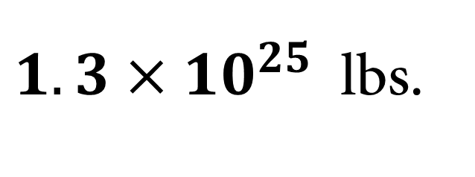
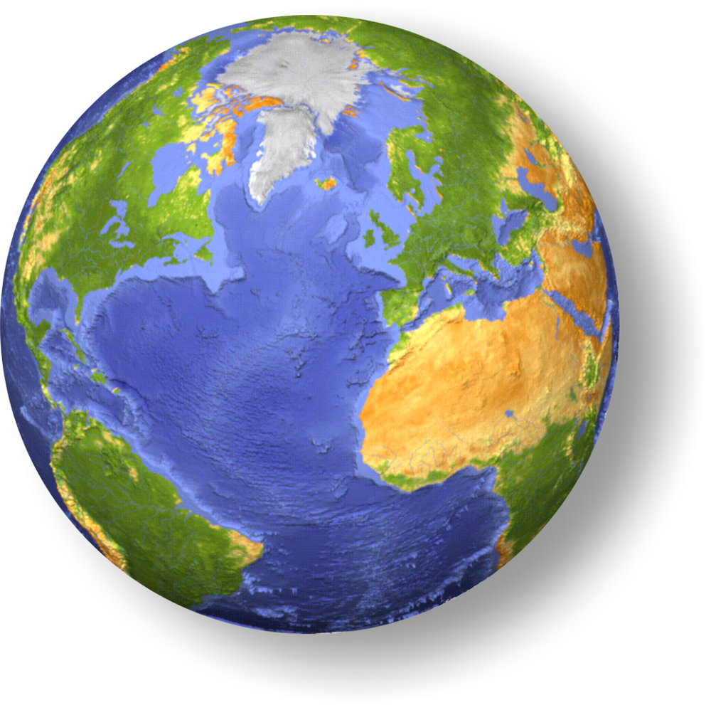
The mass
$1.3×{10}^{25}$ lbs.
Notes:
deepest hole I know about: 8 miles
weigh the earth--how mass is distributed
magnetic field: see strength and directions
earthquakes the best: waves diffract, reflect, and get absorbed

Slide 2
Earth’s increasing mass
Everyday the Earth collects ~100 tons of falling debris from space
How much more massive will the Earth be after one million years?

Slide 3
Time Dependent Mass
How much more massive will the Earth be after one million years?
4 x 10¹⁰ tons more massive
In one million years the Earth will be ~13,000,000,000,040,000,000,000 metric tons
7 orders of magnitude away from making a difference!

Slide 4
How do we know anything about the Earth’s Interior?

Slide 5
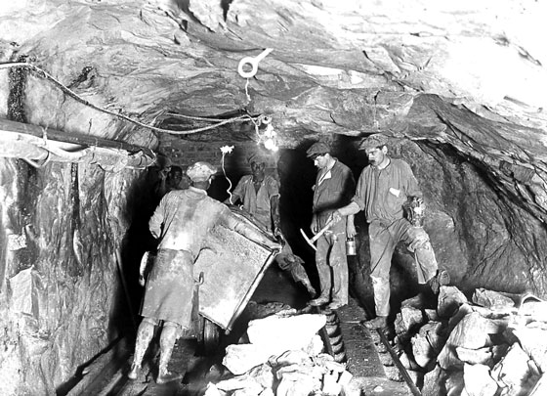
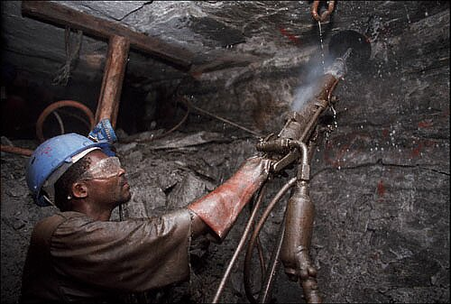
Digging a hole where people can go: a mine
World's deepest mine, 3585m (2.2 miles) below surface
1933, ½ mile
2005, ~2 miles

Slide 6
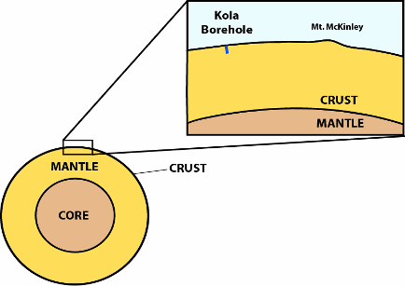
Drilling a hole
The deepest hole drilled = 12.26 km.
50km

Slide 7
Evidences from Earth’s Mass & Density
The mass of the earth is 6x10²⁴ kg
The volume of the earth is 1.1x10²¹ m³
Density of overall Earth is 5.5 g/cm³
Granite has a density of ~2.7 g/cm³
Continental Crust
Basalt has a density of ~3.0 g/cm³
Oceanic Crust
Peridotite has a density of ~3.3 g/cm³
This represents the rocks from the Upper Mantle
So, what does this tell us about the Earth’s Interior?

Slide 8
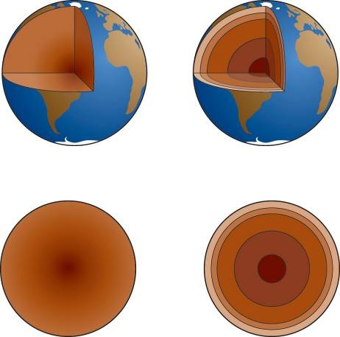
From density alone can we tell which of the models below is correct?
Gradually increasing density model
Layered density model

Slide 9
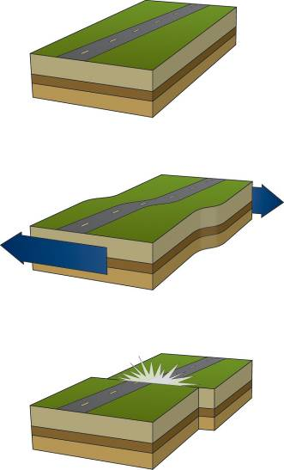
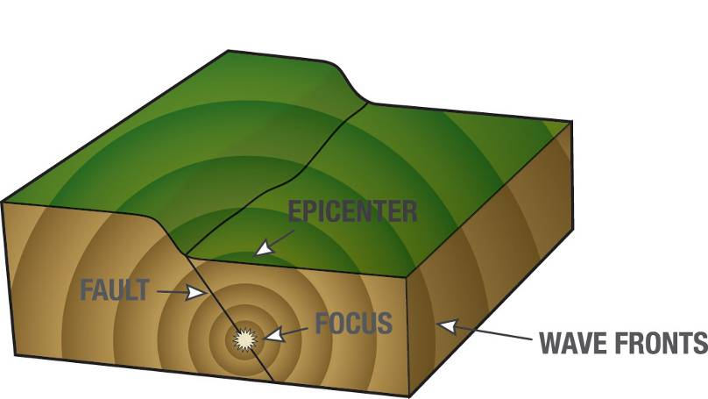
Evidences from Seismology
Elastic Rebound
Earthquakes produce waves, called seismic waves

Slide 10
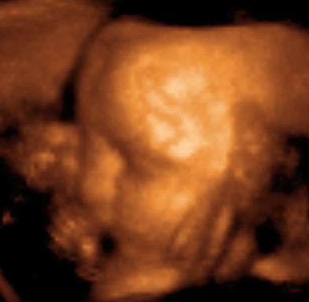

How can listening to vibrations tell us about interior of an object?

Slide 11
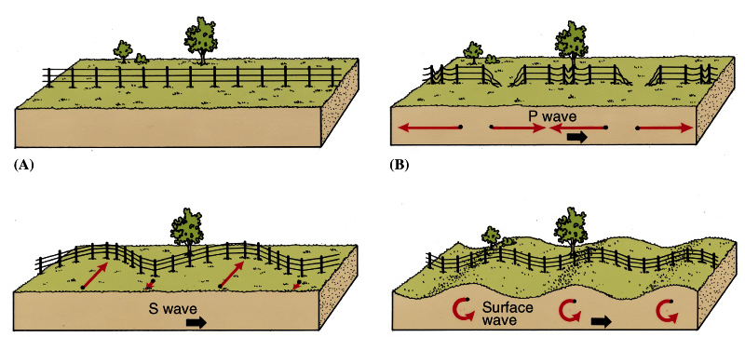
Types of Waves
Surface waves
cause most of the damage and destruction
Volume waves
compression waves
primary (P) waves, arrive first
travel through solids and liquids
shear waves
secondary (S) waves, arrive second
will not travel through liquids

Slide 12
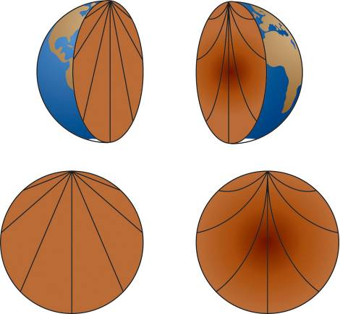
How would seismic waves travel through the different Earth density models?
Uniform density model
Gradually increasing density model

Slide 13
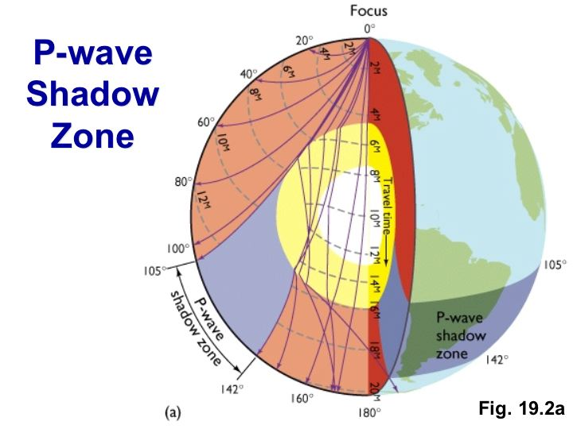
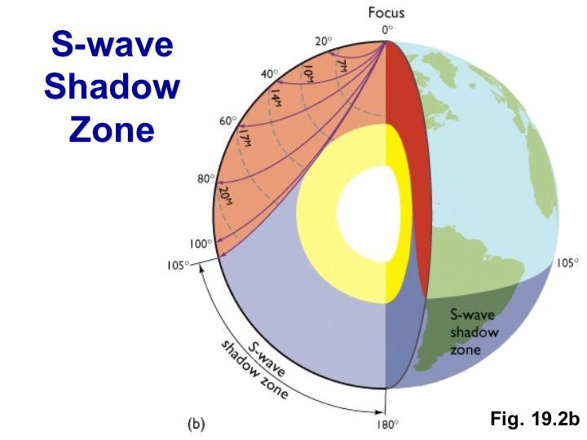
Shadow Zones
P Waves
Waves change speed abruptly when they transition from solid to liquid
This causes bending (refraction)
Refraction makes it impossible for waves to arrive in the shadow zone
Resulting shadow zone is doughnut-shaped
S Waves
S waves cannot travel through the core
Resulting shadow zone is bowl-shaped
Implies core is liquid

Slide 14
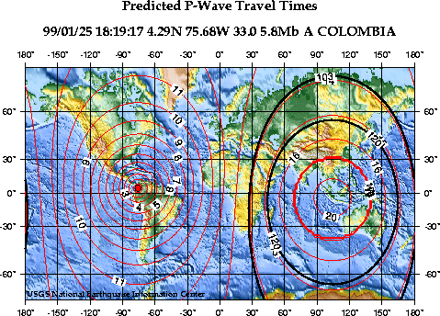
A Real Shadow Zone
Shadow zone between the dark ovals

Slide 15
Q.Q.1 - Secondary (shear) seismic waves will not propagate through the outer core. This is convincing evidence that the outer core is
Molten or liquid
Metallic
Composed primarily of oxides, silicates, and other minerals
Exactly located at the center of the earth
Very dense

Slide 16
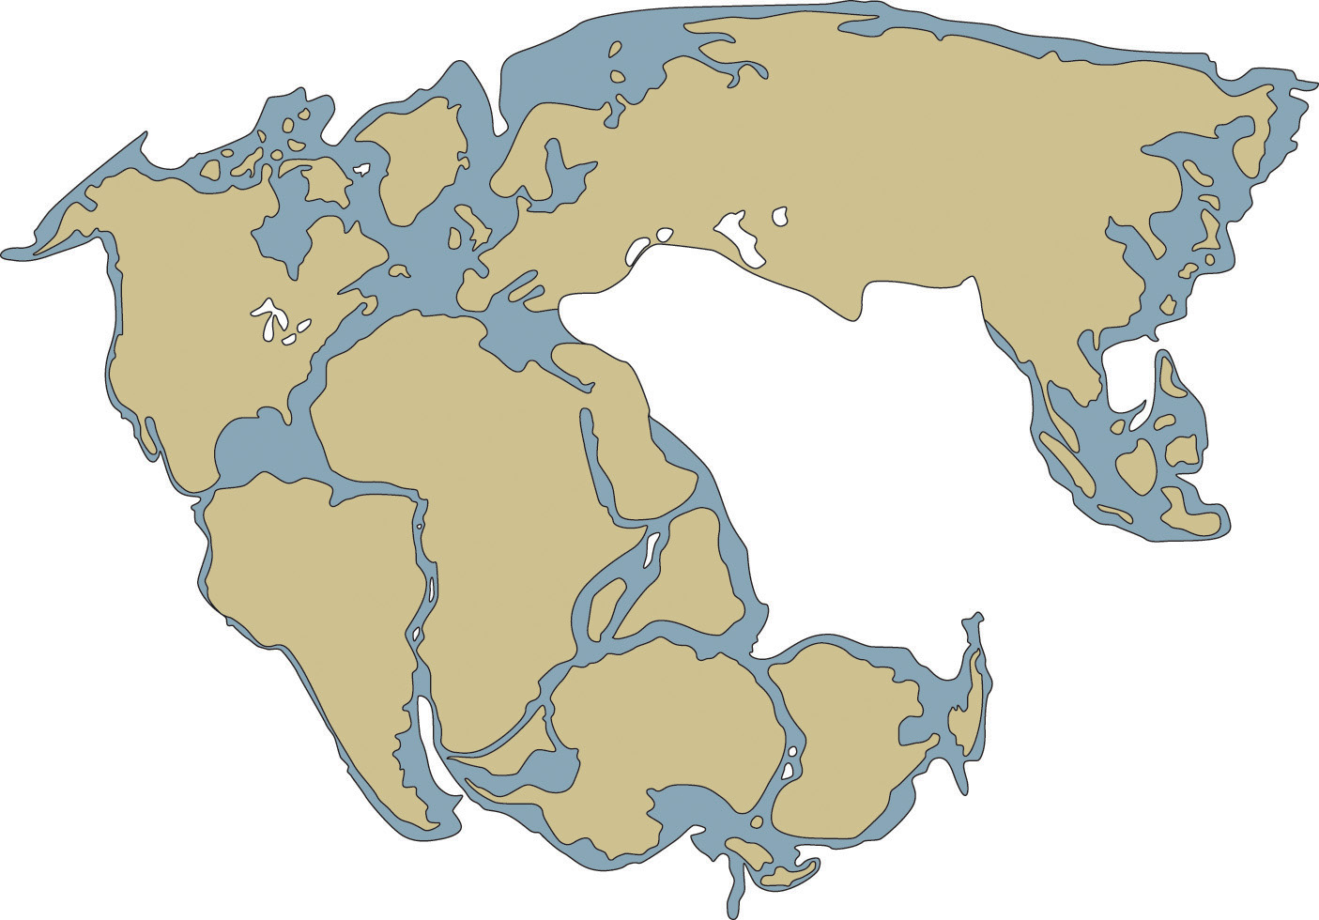
Earth surface history – Pangaea
Alfred Wegner’s ideas

Slide 17
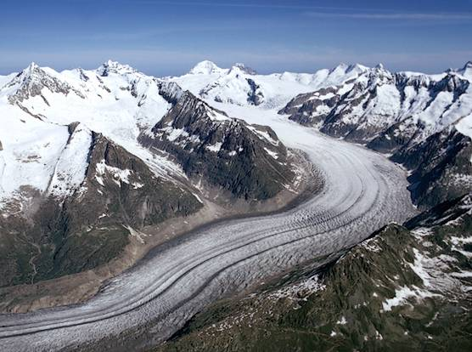
Glaciers erode the earths surface as they flow

Slide 18
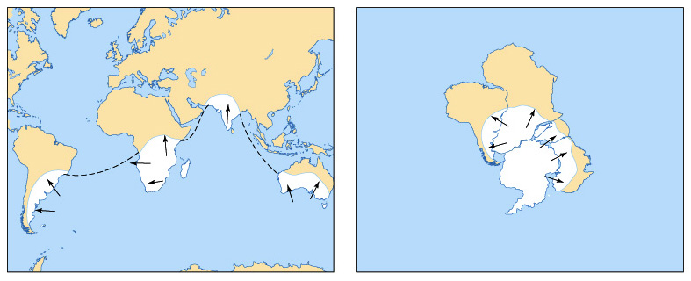
Patterns of Ancient Glaciation

Slide 19
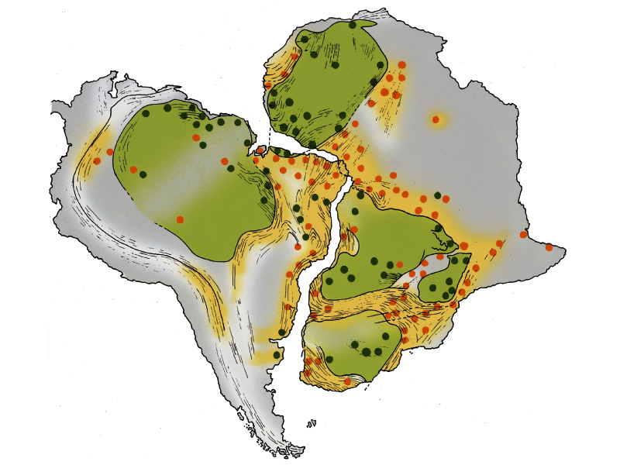
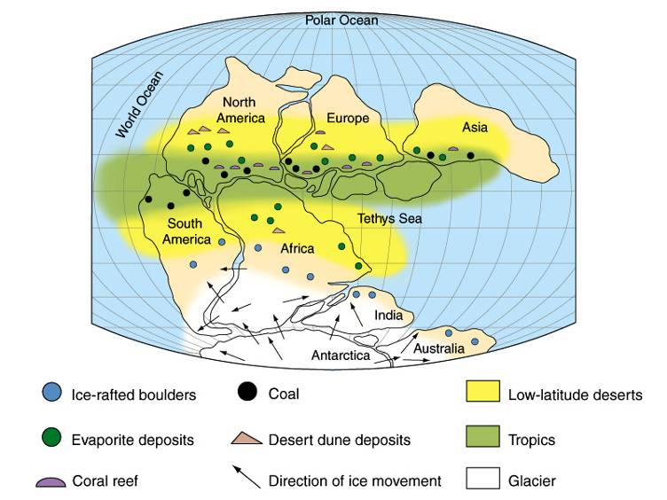
Paleoclimate Indicators and structural trends

Slide 20
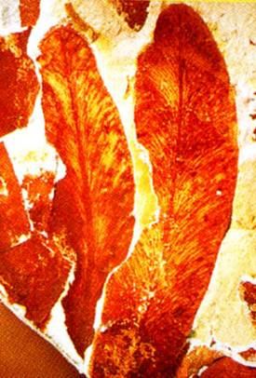
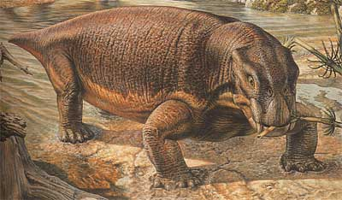
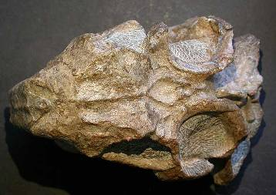
Patterns of Fossil Occurrence
Glossopteris
Lystrosaurus

Slide 21
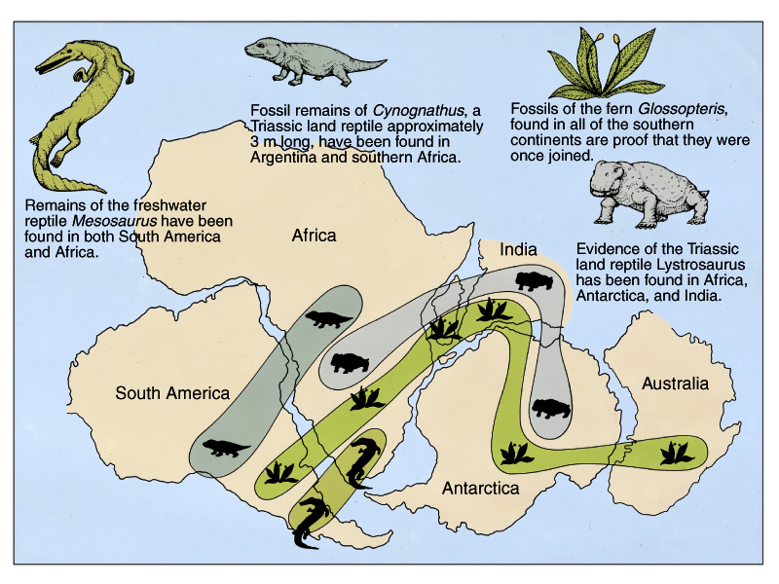
Patterns of Fossil Occurrence

Slide 22
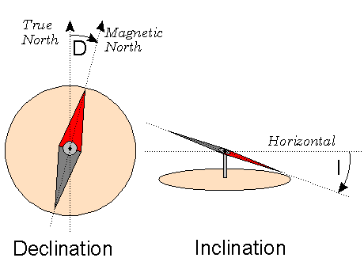
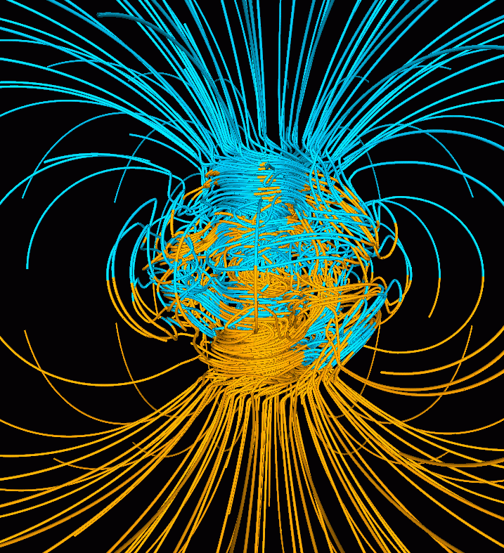
Earth’s Magnetic Field

Slide 23
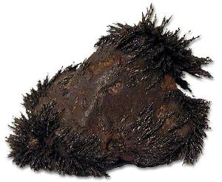
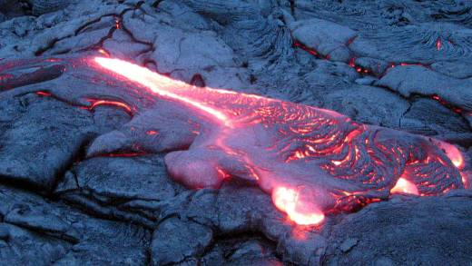
Rocks (magnetite) can record the orientation of Earth’s magnetic field

Slide 24
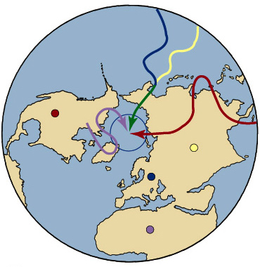
What do we actually find?

Slide 25
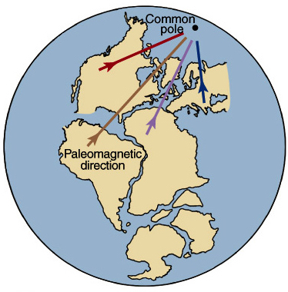
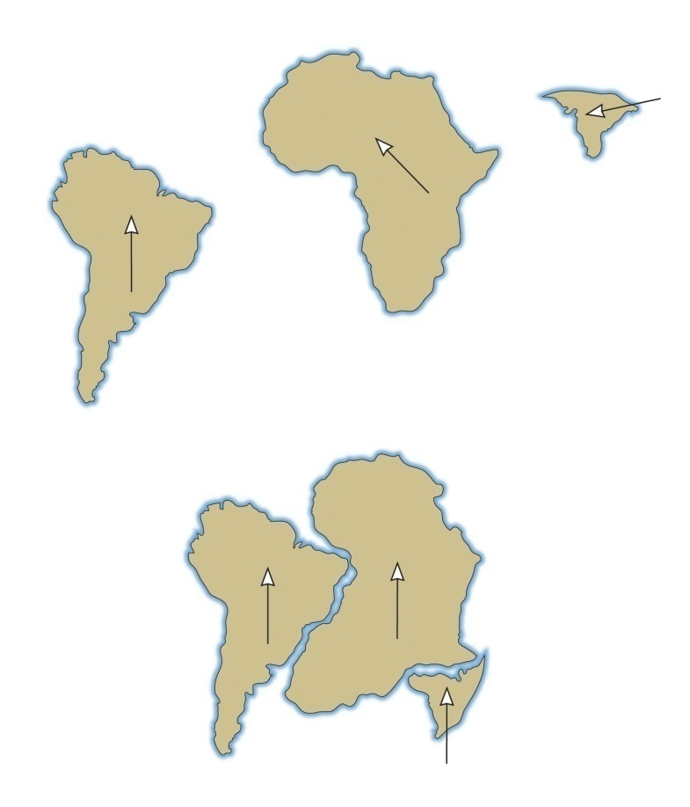
If the continents were together, then they do give a single location for the magnetic pole!

Slide 26
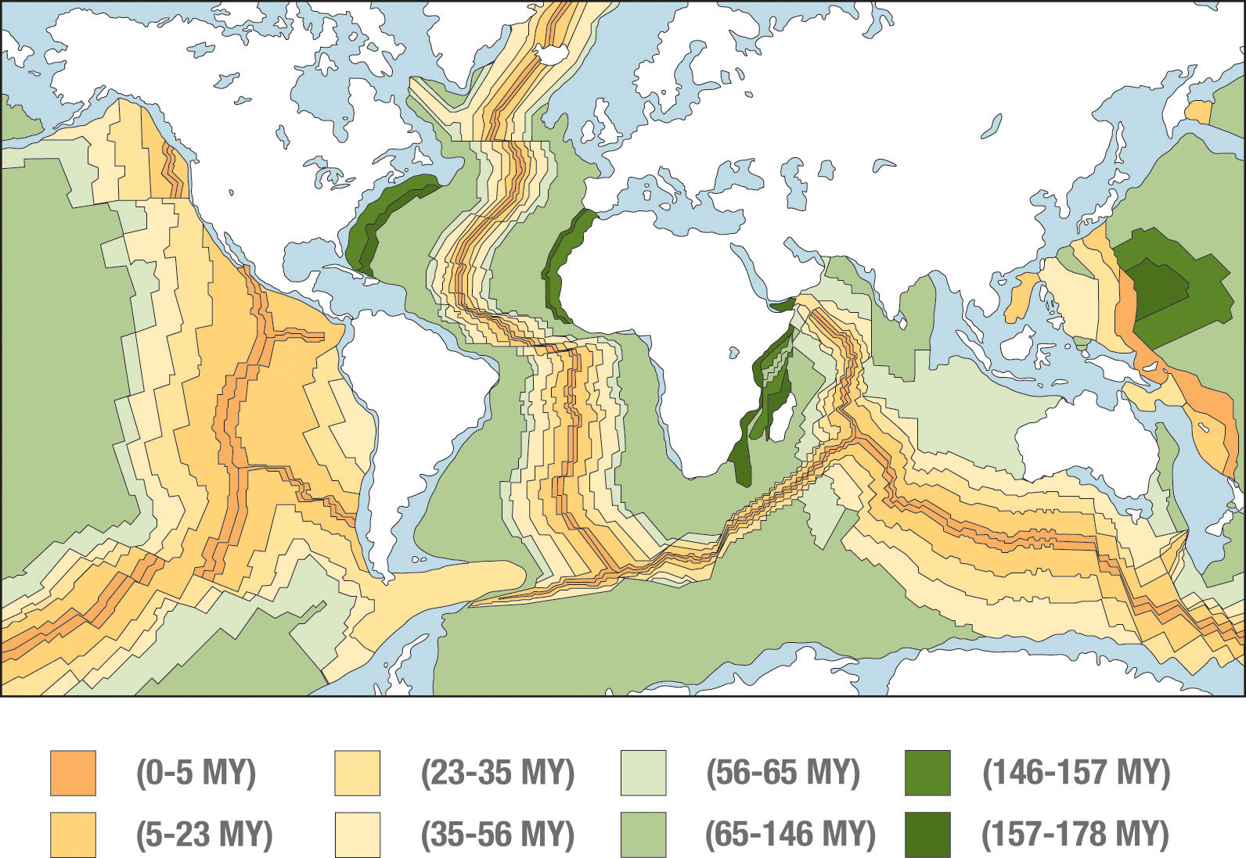
More evidence: The ocean crust is youngest near the ridges

Slide 27
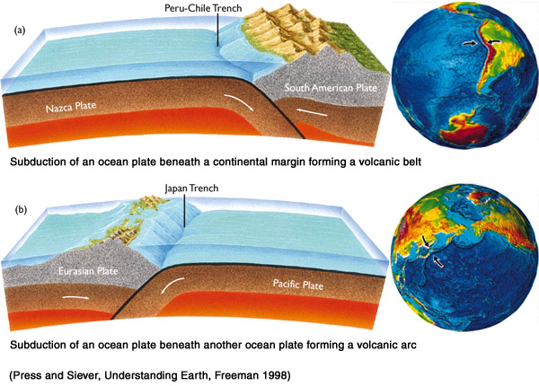
Since the surface area isn’t getting any bigger, we know that ocean crust is destroyed at trenches

Slide 28
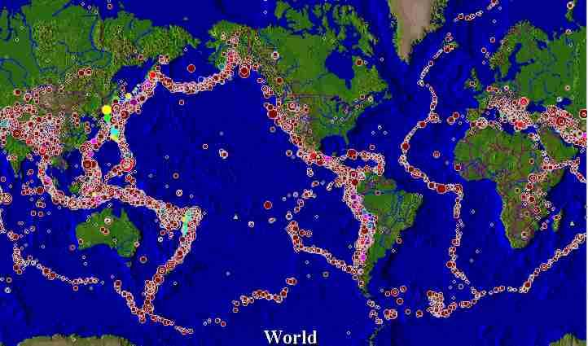
Patterns Earthquakes & Volcanoes

Slide 29
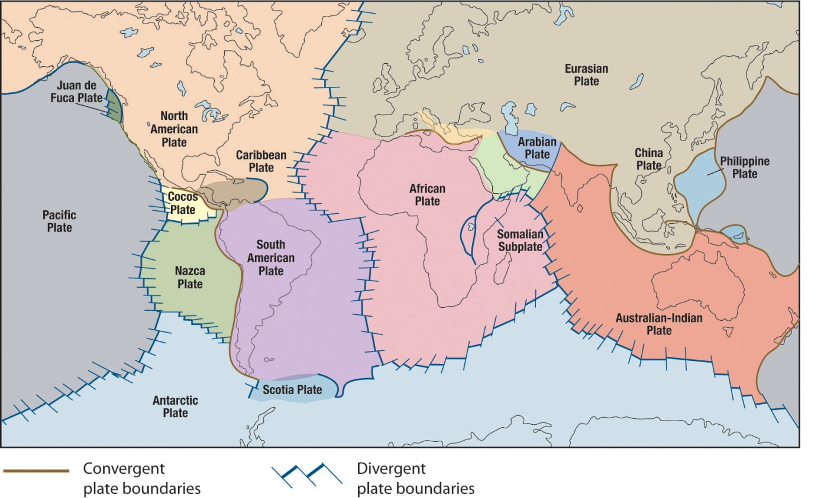
Speaking of Plate Boundaries
The action in plate tectonics is almost always at the plate boundaries.
Two plates moving towards each other form a convergent boundary
Ocean crust meets ocean crust
Ocean crust meets continental crust
Continental Crust meets continental crust
Two plates moving away from each other form a divergent boundary

Slide 30
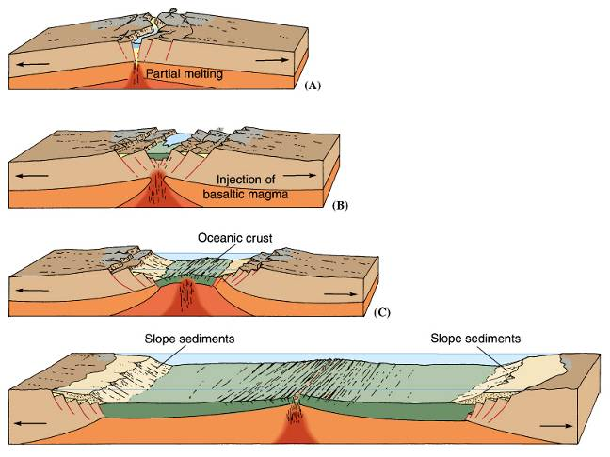
Divergent Plate Boundaries under continents
Extensional Stresses stretching
Eventually creates New Seafloor
Volcanoes
Basalt and granite (Bimodal composition)
Earthquakes
Shallow foci
Modest magnitudes -- larger than oceanic rifts.

Slide 31
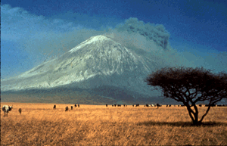
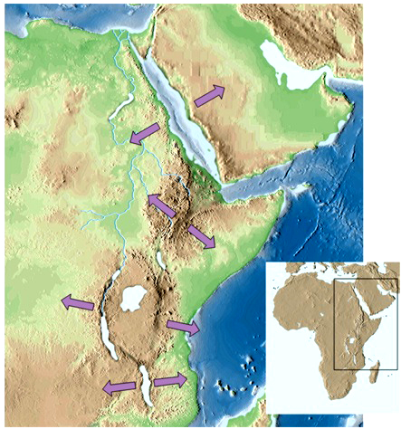
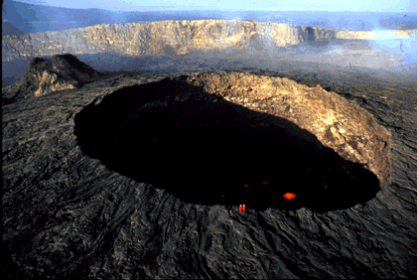
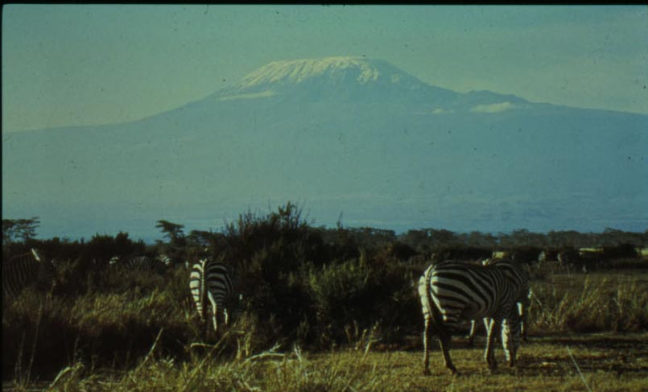
The rift valley in Africa is one of the most clear examples of continental rifting
Oldoinyo Lengai
Erta Ale
Killimanjaro

Slide 32
Convergent Plate Boundaries
Compressional Stresses
Old Seafloor Destroyed (Subduction)
Volcanoes
Explosive and Very Dangerous (lots of gas)
Earthquakes
Shallow to Deep foci
Large magnitudes
Mountain Belts/High Deformation
Accretion – Building of the Continents

Slide 33
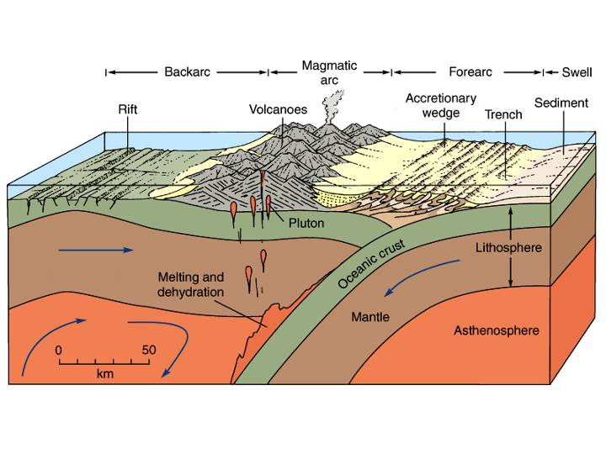
1. Ocean-Ocean Collision

Slide 34
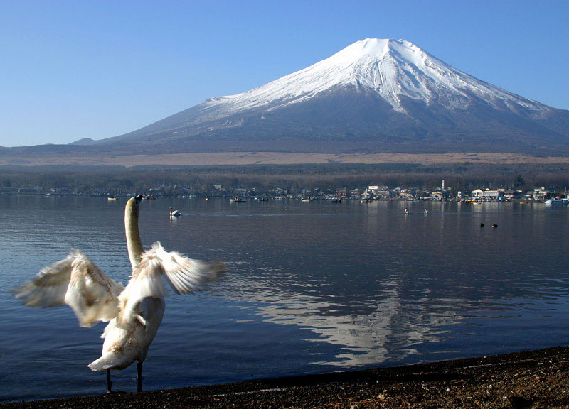
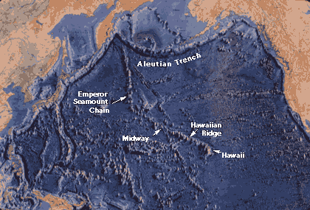
Island arcs: Indonesia, Japan, Taiwan, Philippines, Kamchatka Peninsula, Aleutian Islands.

Slide 35
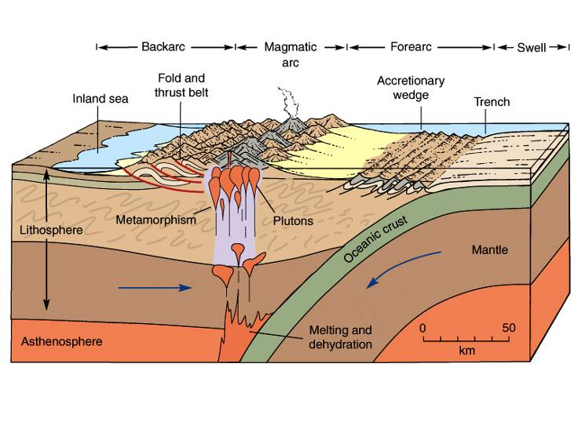
2. Ocean-Continent Collision

Slide 36
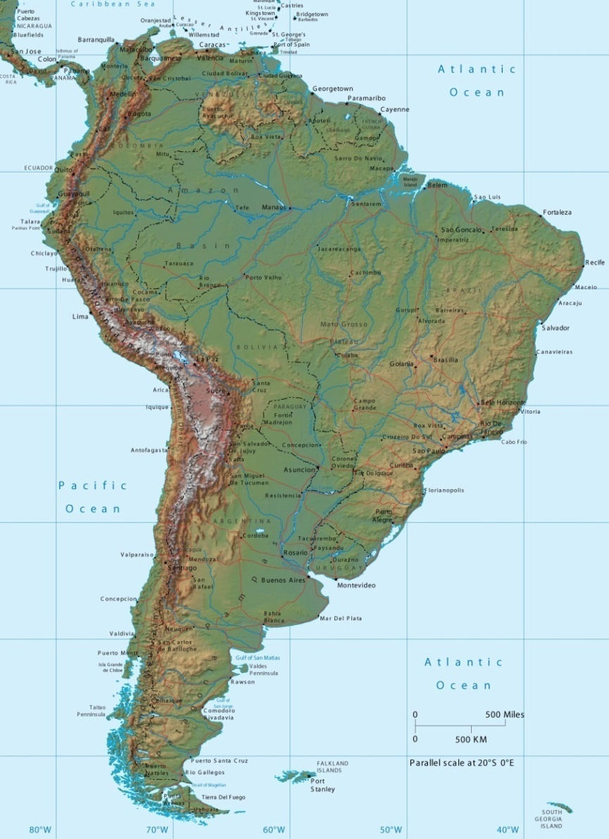
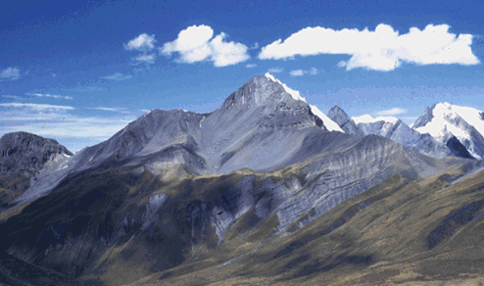
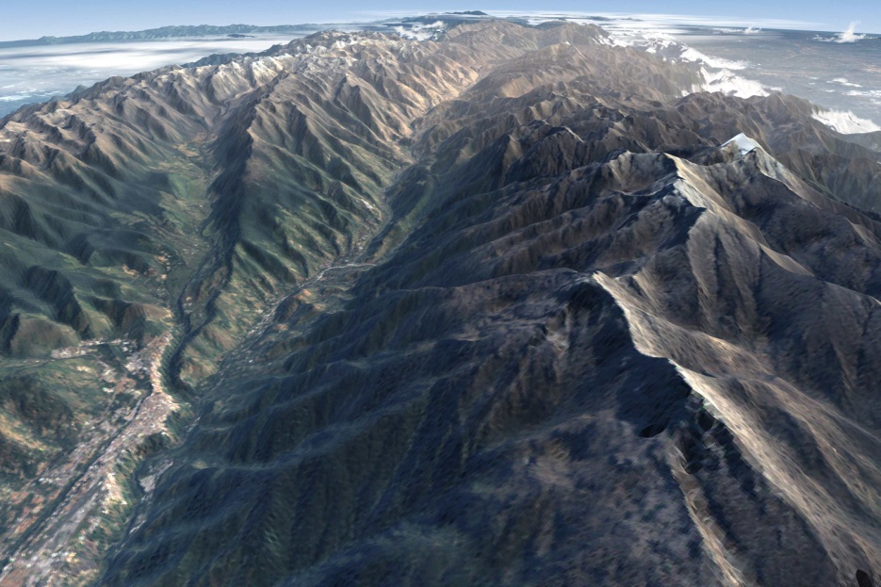
The Andes mountains are the result of a ocean-continent collision

Slide 37
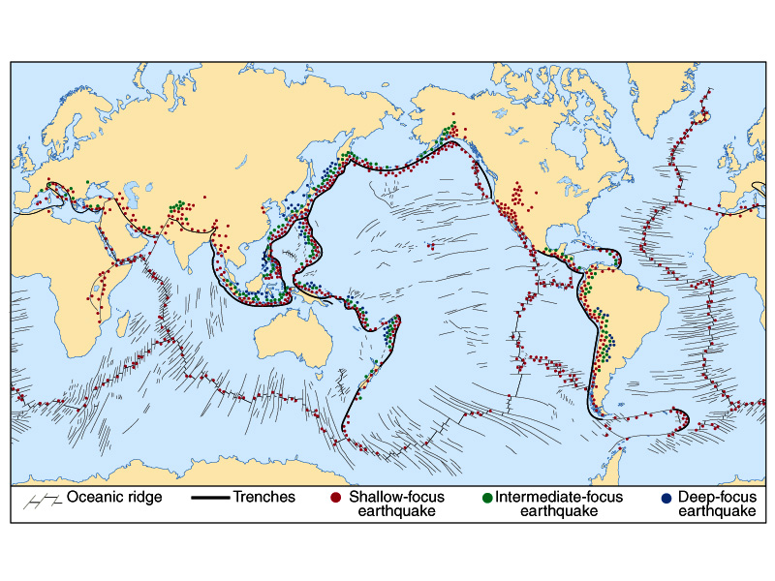
Deep, severe earthquakes and explosive volcanoes occur as oceanic crust subducts

Slide 38
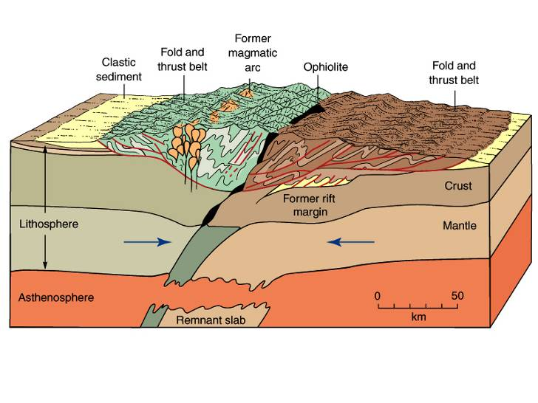
3. Continent-Continent Collision
Why are there no volcanoes when continents collide?
No plate is sinking into the mantle and melting!

Slide 39
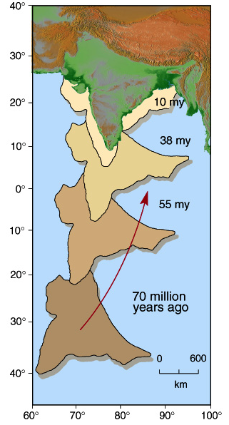
The Indian subcontinent slammed into Asia several million years ago

Slide 40
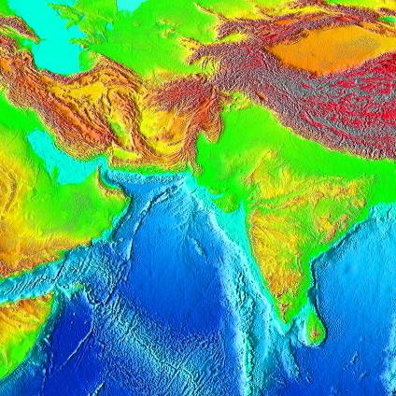

India is now a part of Asia. The Asian continent has grown.

Slide 41

Island Chains
Created by plates drifting over hot spots.

Slide 42


Major plate boundaries today

Slide 43
Q.Q.2 - The interior structure of Earth has been determined mostly from
Drilling
Exploration
X-Rays
Earthquake waves
Chemical analysis

Slide 44



The surface of Earth can been determined by black lights – Fluorescent rocks
Calcite(CaCO₃) emits a red/orange color
Willemite(Zn2SiO4) emits a green color
Fluorite(CaF₂) emits a blue color
Pure calcite crystal, phosphorescence ~ 2.5 seconds.

Slide 45


Geological laws - Original Horizontality
Horizontal
Tilted

Slide 46


Geological laws - Superposition
youngest layers are on the top
oldest layers are on the bottom.

Slide 47


Geological laws - Cross-cutting
the youngest rock is the one cutting across.
Hydrocarbon dike
cutting sandstone
Granite dikes
cutting darker rock

Slide 48


Geological laws - Inclusions
included rocks must be older than the rocks around them
Dark inclusions in granite,
Yosemite National Park.
(Lens cap & student for scale)

Slide 49

Geological laws - Faunal Succession

Slide 50

What is the Sequence of Events?
E, G, L, C deposited
fault H
erosion, unconformity
M, D, J deposited
A intruded
erosion, unconformity
N, K, B deposited
tilting, erosion, unconformity
F deposited
erosion of current surface

Slide 51

Q.Q.3 – Write out the geological features from old to young…
A
C
B
D

Slide 52

How old is the earth?

Slide 53

The relative percentage of parent to daughter isotope allows us to tell age

Slide 54
Requirements for accurate radioactive dating
A known half life
A sample of rock (igneous) representative of the geologic layer to be dated.
No end products present when the rock cooled (or corrections must be made)
No loss or gain of either the isotope or the product since the rock cooled.
Then. . . the ratio of the original isotope to the product gives the absolute date the rock formed.

Slide 55
Again… How old is the earth?
It is not infinite in age. because radioactive elements with long half-lives still exist in the crust.
It is younger than the universe--less than 20 billion years.
It is older than a few million years because radioactive elements of such “short” lifetimes have all disappeared.
It is older than the oldest dated rock--older than 3.8 billion years.
It is about the same age as the sun, moon meteorites, etc. They are about 4.6 billion years.
Best estimate: ~ 4.6 billion years

Slide 56

November
The past
Earth
BeyondEarth

Slide 57

December
Treat n’
Cosmos
Final Review
Final Exam
Grades

