Slide 1
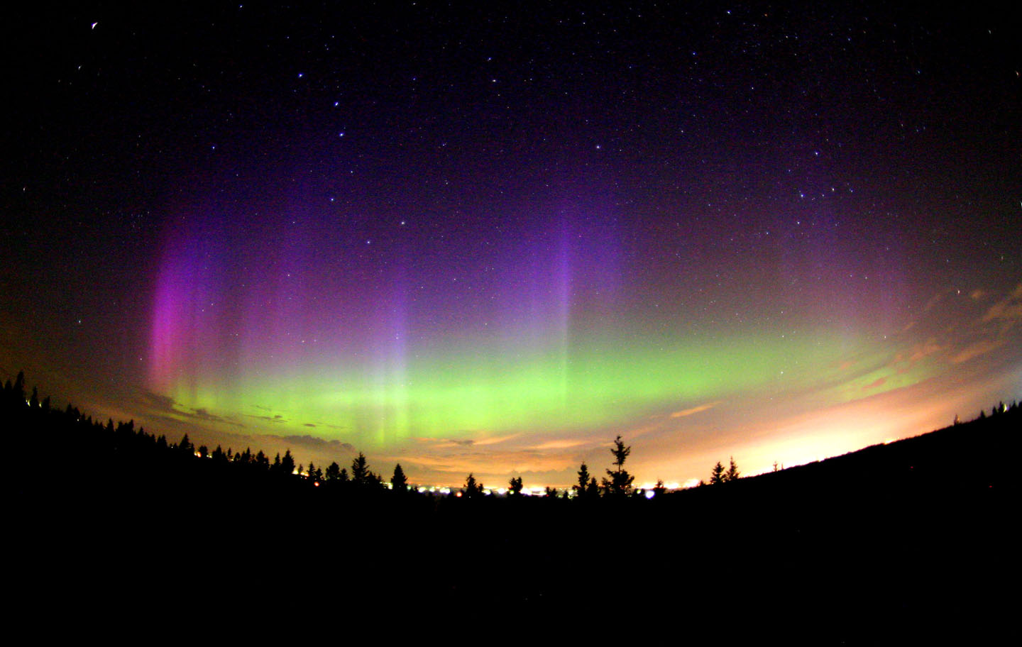
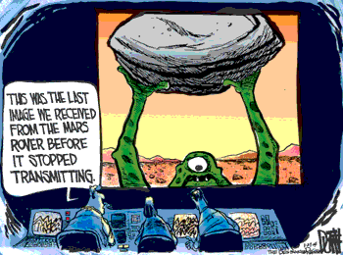
Chapters 32,33 and 34:
Beyond the earth
Notes:
Dear PS100,
We are considering throwing out the learning objectives for Ch 32 since we really test on solar system formation (the nebular hypothesis). This email message is to alert those who did not attend this morning's inservice meeting so that you can adjust your lecture appropriately. Possible test questions (to be discussed this coming Tuesday morning at 10:00 in our meeting) follow.
Regards,
Scott Bergeson
_Solar System Formation Questions:_
1. The standard model of solar system formation offers what explanation
for the different compositions of the Terrestrial and Jovian planets?
a. During condensation, the heavier elements tended to sink nearer the
Sun and, being rare, only provided enough material to build the
relatively small terrestrial planets.
b. During the collapse of the gaseous nebula, most of the material
tended to collect far from the Sun because of the large centrifugal
forces, which provided the necessary material to build the large Jovian
planets.
c. The large gravitational forces of Jupiter tended to prevent planet
formation in the inner solar system and eventually attracted most of the
material into the region of the Jovian planets.
d. The terrestrial planets were formed near the Sun where, because of
the high temperatures, only heavier elements were able to condense.
2. What was the form of the material from which the solar system formed?
a. A nebula made mostly of hydrogen and helium gas, but enriched in
heavier elements from supernova explosions.
b. A nebula made mostly of heavy elements, but enriched in hydrogen and
helium from supernova explosions.
c. A nebula made entirely of hydrogen and helium gas.
d. Debris from the explosion of a massive star.
3. What process heated the early solar nebula as it slowly contracted
toward a central protosun?
a. Rotational energy transferred to heat by friction between particles
as the nebula slowly revolved around its center.
b. Release of heat by collisions of particles as they gain kinetic
energy in falling toward the center of the nebula.
c. Release of heat as molecules formed and as gases condensed into ices.
d. Thermonuclear fusion in the protosun, followed by radiated heating
of the nebula.
4. More than any other, which physical parameter probably controlled the
early evolution of the planetary system and dictated the characteristics
of the planets that eventually formed?
a. Overall rotation of the nebula.
b. Density of hydrogen gas in the nebula.
c. Mix of chemical constituents.
d. Temperature distribution within the nebula.
5. According to modern theories, the most significant difference between
the formation of the terrestrial and Jovian planets is that
a. both formed by accretion of planetesimals, but the Jovian planets
became massive enough to attract gas onto them directly from the solar
nebula.
b. both formed by accretion of rocky and icy planetesimals, but the
terrestrial planets were close enough to the Sun that almost all of the
ices escaped back to space after the planets formed.
c. the terrestrial planets formed close to the Sun where there was lots
of rock but no ice, whereas the Jovian planets formed far from the Sun
where there was lots of hydrogen and ice but no rocky material.
d. the terrestrial planets formed by accretion of planetesimals,
whereas the Jovian planets formed from streamers of hot gas which shot
out of the protostar.
6. The atoms that make up your body were formed
a. In our Sun
b. By a star existing prior to the formation of the Sun
c. In chemical reactions in the primitive ocean and atmosphere
d. During the Big Bang
e. In a distant galaxy in a different part of the early universe
7. The force that dominates the collapse of gas and dust in the solar
nebula is the
a. Gravitational Force
b. Electromagnetic Force
c. Strong Force
d. Weak Force
e. Tidal Force
8. A curious fact about the structure of the planet Jupiter, compared to
that of Earth, is that it has
a. much greater mass but much lower average density.
b. about the same mass but much greater density.
c. much greater mass and greater average density.
d. much greater mass but about the same density.
9. The most common elements in the universe are:
a. large quantities of heavy elements, with smaller quantities of
hydrogen and helium.
b. equal amounts of hydrogen and helium with small amounts of heavier
elements.
c. equal amounts of all elements up to iron but very little of any
heavier elements.
d. hydrogen, smaller quantities of helium, and very small quantities of
heavier elements.
10. How does the Sun produce the energy that heats our planet?
a. The gases inside the Sun are on fire; they are burning like a giant
bonfire.
b. Hydrogen atoms are combined into helium atoms inside the Sun's
core. Small amounts of mass are converted into huge amounts of energy
in this process.
c. When the gas inside the Sun is compressed, it heats up. This heat
radiates outward through the star.
d. Magnetic energy gets trapped in sunspots and active regions. When
this energy is released, it explodes off the Sun as flares that give off
tremendous amounts of energy.
e. The core of the Sun has radioactive materials that give off energy
as they decay into other elements.
11. In a main sequence star, gravitational collapse is balanced by
a. convection of stellar material from the core.
b. pressure caused by photons produced during nuclear fusion.
c. Solid material at the stellar core.
d. pressure from coronal mass ejections from the core.
e. interior cooling of the star.
_Possible question for 34._
12. Why are the spiral arms of spiral galaxies blue in color?
a. They are usually moving towards us and are Doppler shifted to blue
wavelengths.
b. The gas and dust in the arms filters out all but the blue light
from stars in the arms.
c. Stars are forming in the spiral arms so there are many more high
mass, hot, blue stars present.
d. Almost all the stars of the disk are in the arms of the galaxy and
their light makes it appear blue.
_Geology tie-in questions._
13. The age of the solar system has been dated rather precisely to 4.56
billion years. What method was used to determine this number?
a. Calculating the age of the Sun from the energy it produces.
b. Calculating the age of the Earth by counting layers of geologic
deposits.
c. Determining the age of the Moon, which is older than Earth, by
measuring the density of craters.
d. Determining the age of meteorites by radioactive dating.
14. The reason that most of the terrestrial planets have dense, iron
cores is because
a. Iron solidifies at the highest temperatures, so the iron core
condensed first from the solar nebula. The rocky material then
condensed directly onto the iron core as the nebula cooled.
b. Terrestrial planets were initially molten or partially molten, and
the iron sank to the center.
c. Iron is magnetic, so there was a rapid accretion of iron dust grains
into a core, followed by a slow accretion of rocky grains.
d. Iron solidifies at the highest temperatures, so the iron core
condensed first from the solar nebula. Rocky planetesimals then formed
as the nebula cooled further, and gradually impacted onto the iron core.
15. Volcanoes on Mars have become much larger than on Earth mostly
because Mars lacks:
a. A thick atmosphere
b. Flowing water
c. Plate tectonics
d. A large moon
16. The fact that there are fewer craters on the lunar maria than on the
lunar highlands indicates that the
a. Highlands are younger than the maria
b. Craters formed as a result of volcanic eruptions
c. Maria formed more recently
d. Maria are of volcanic origin

Slide 2
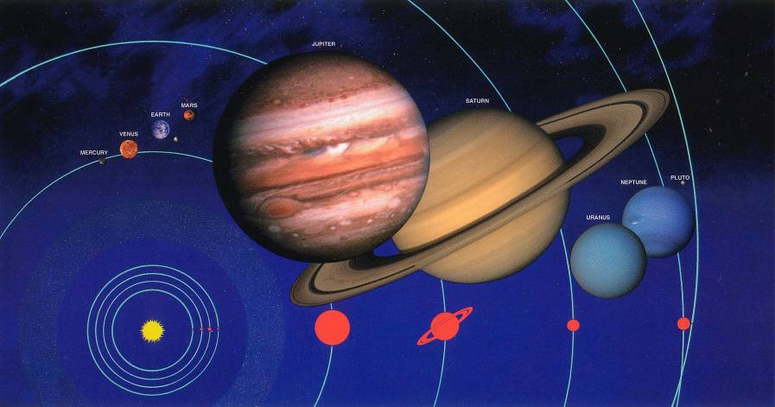
The Solar System
Sun, planets, moons, comets, asteroids, meteoroids.
  Sun at the center.
  Eight planets, thousands of asteroids, and millions of comets and meteoroids orbit the sun.
  Dozens of moons orbit the planets.

Slide 3
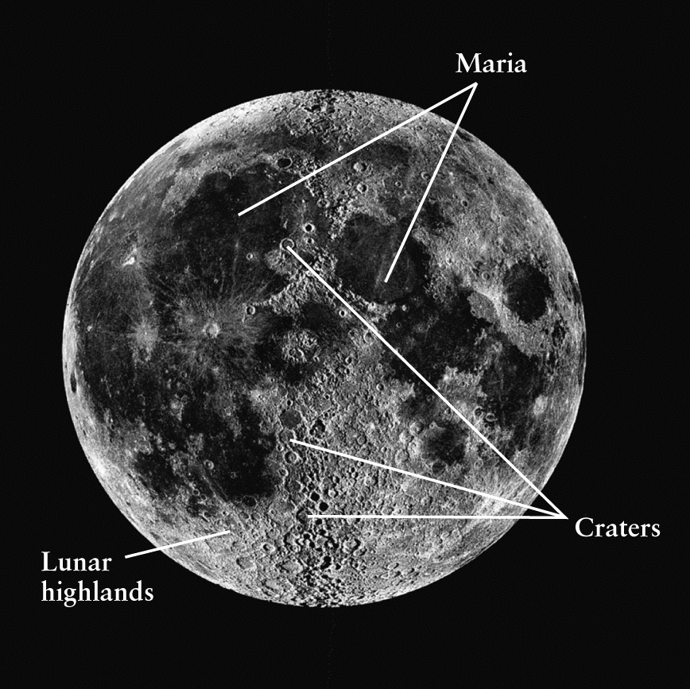
The Moon hasn’t had erosion and plate tectonics erase its history, so it is a good place to start
Three types of terrain:
  Maria
  Highlands
  Craters

Slide 4
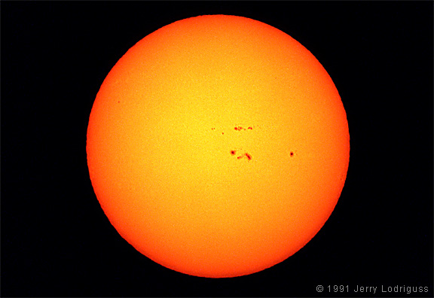
How about the rest of the solar system?
Some stats on the Sun
Time for light to reach Earth
  8.32 minutes
Mass ~ 2 x 10³⁰ kg
  ~ 333,000 more massive than the Earth
Composition by number of atoms
  92.1% Hydrogen
  7.8% Helium
  0.1% everything else
Surface temp ~ 5800 K
Interior temp ~ 15,500,000 K
The Sun contains more than 99.85% of the total mass of the solar system
If you put all the planets in the solar system, they would not fill up the volume of the Sun
110 Earths or 10 Jupiters fit across the diameter of the Sun

Slide 5
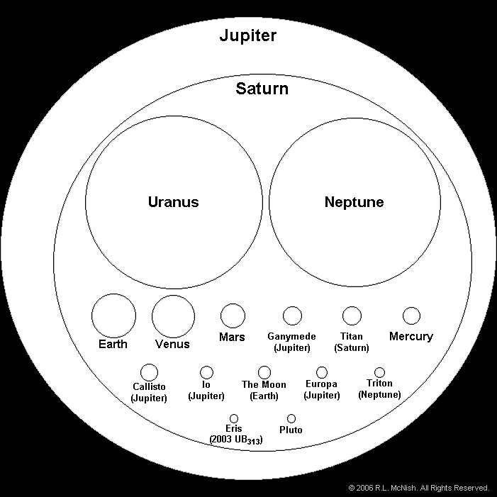
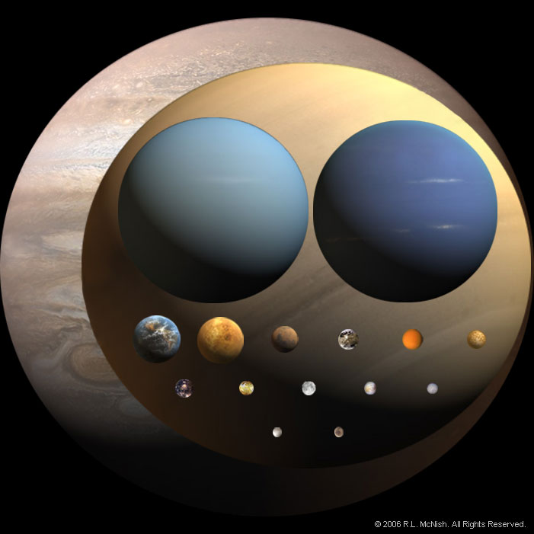
Relative Sizes
My Very Excellent Mother Just Served Us Nine Pizzas Everyday

Slide 6
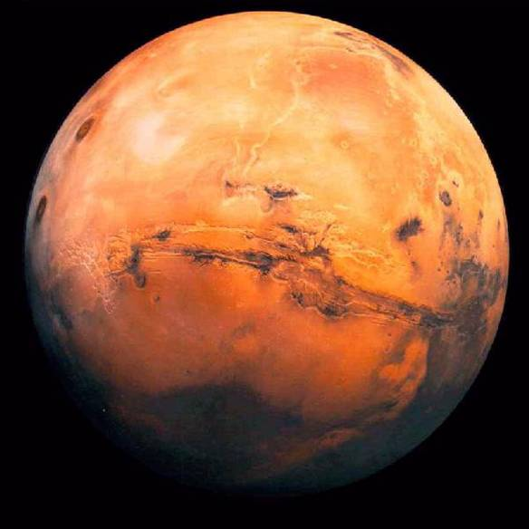
Mars Hydrologic & Atmospheric Systems
Polar Ice Caps
  H₂O and CO₂
  Substantial seasonal changes in size
Dust Storms
  May cover the entire planet at times
Thin Atmosphere
  Mostly CO₂
Evidence for periods with liquid water
  Layered sedimentary rocks
  Old river channels

Slide 7
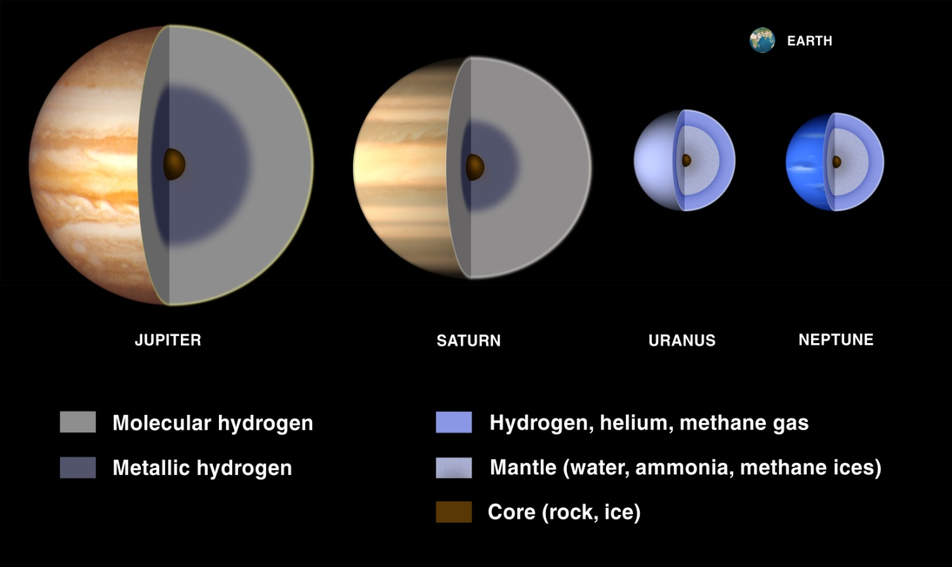
Jovian planets have extremely low densities
Possible solid core
Molecular and metallic hydrogen shells
  Jupiter and Saturn
Mantles of water and ice
  Uranus and Neptune

Slide 8
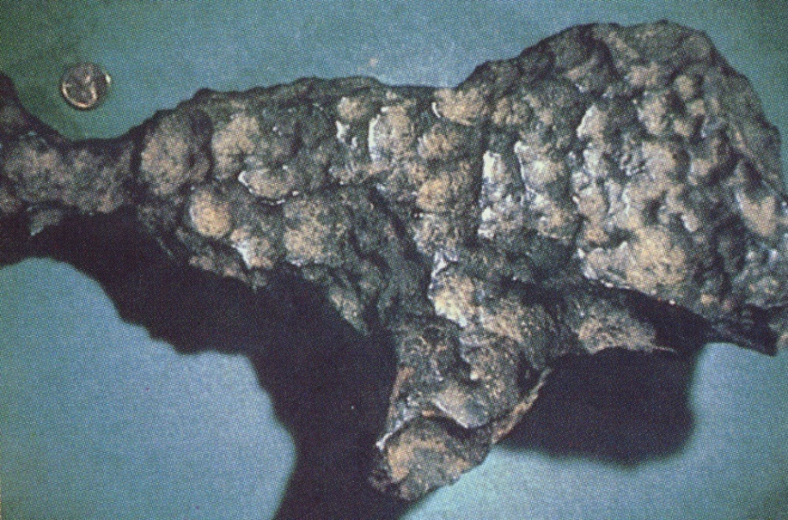
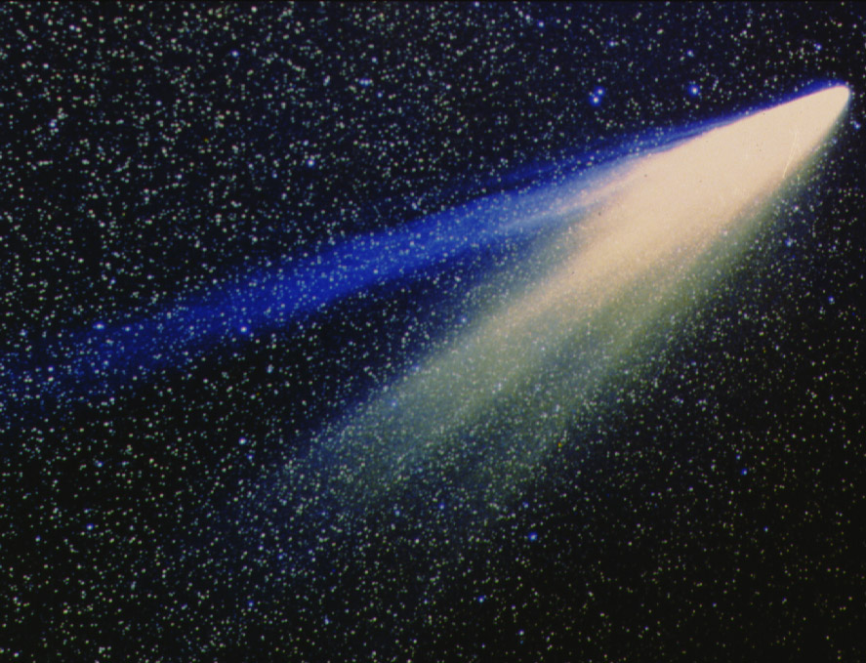
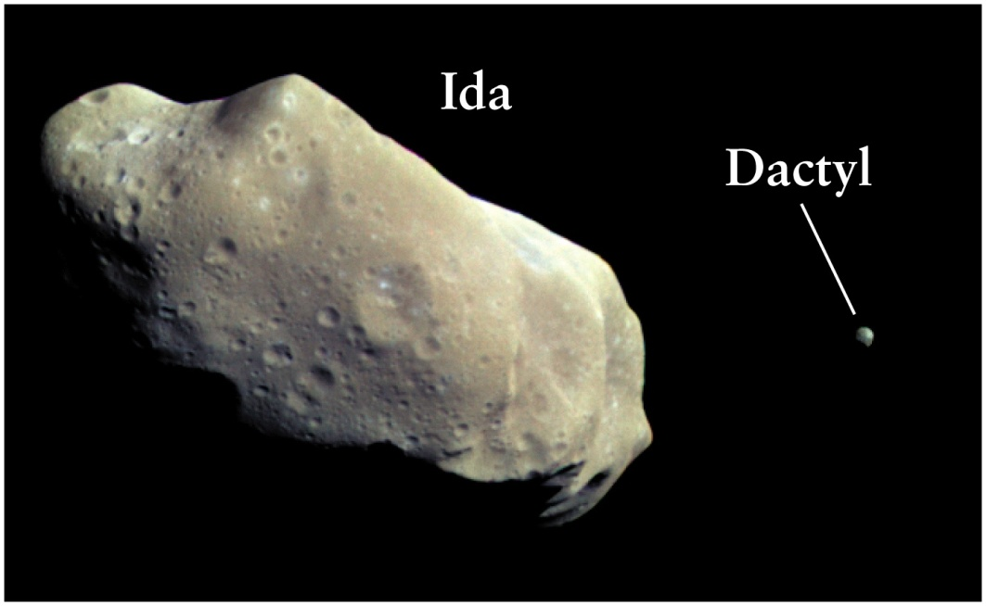
Smaller bodies in the solar system
Meteorite/Meteoroid
Comet
Asteroid
Notes:
A meteorite is a natural object originating in outer space that survives an impact with the Earth's surface. While in space it is called a meteoroid.

Slide 9
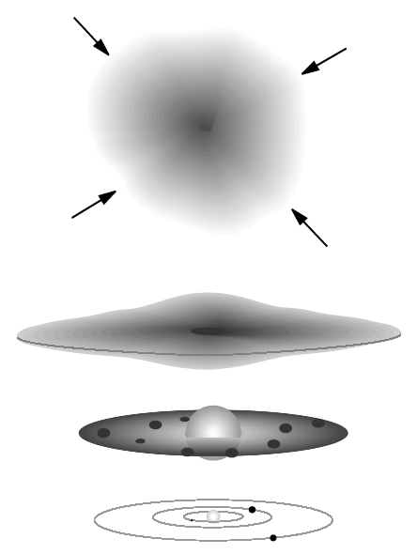
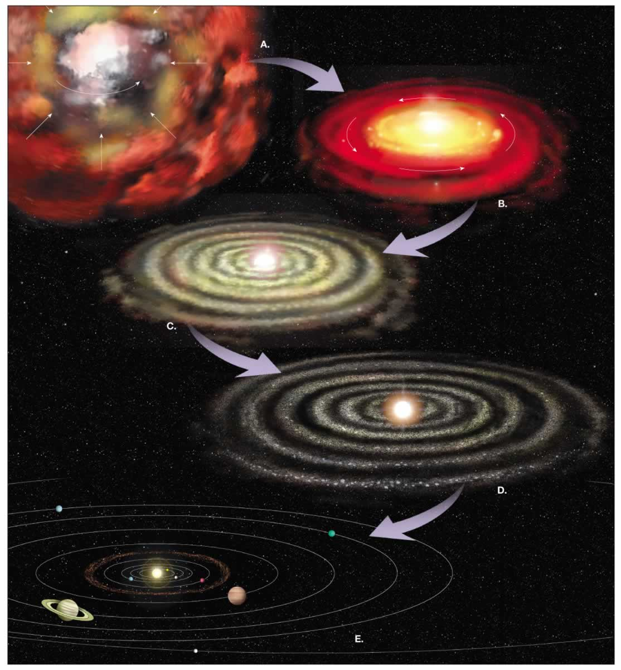
How did the solar system form?
Nebular Hypothesis
  Condensing cloud of hydrogen, helium, iron, etc.
  As cloud collapsed into protostar the rate of rotation increased and some of the gas formed a disk (like pizza dough)
  Most of the mass collapsed in the center to form the sun
  Density variations in outer part of disk caused some of the mass to collect into planetesimals (many miles in diameter)
  Protoplanets swept up most of the nearby debris. There were occasional “catastrophes” when large planetesimals collided with protoplanets.
How long ago? ~4.6 billion years

Slide 10
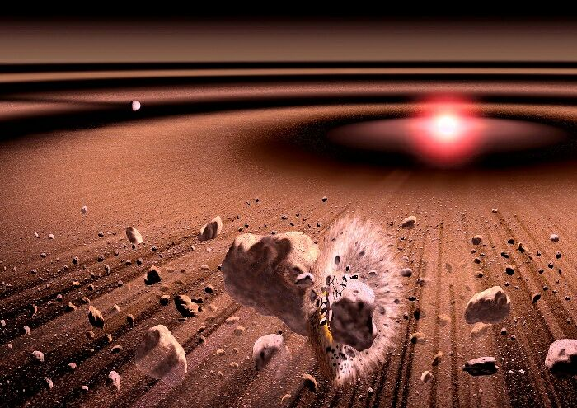
Evidence for the Nebular Hypothesis
Densest planets are nearest the sun
Planets revolve in almost the same plane
Most planets rotate in the same direction as they revolve (Venus and Uranus are exceptions)
Craters exist on most planets and moons.
Radioactive dates of earth, moon, and meteorite rocks are consistent.
The earth still collects tons of meteoric material each day.
We observe other solar systems in the process of formation, and their behavior seems to be consistent with this process.

Slide 11
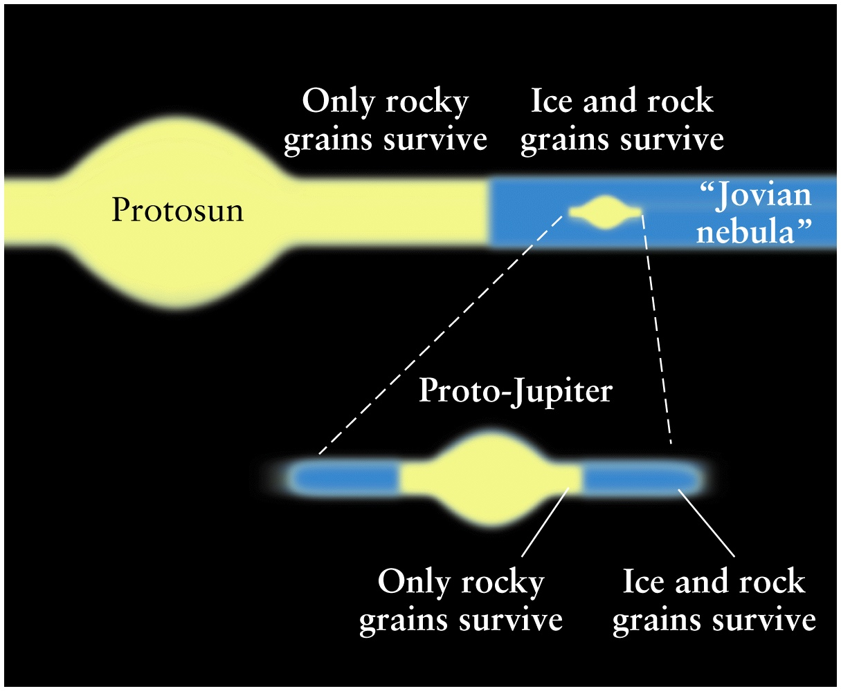
Jupiter and Saturn are “mini-solar systems”

Slide 12
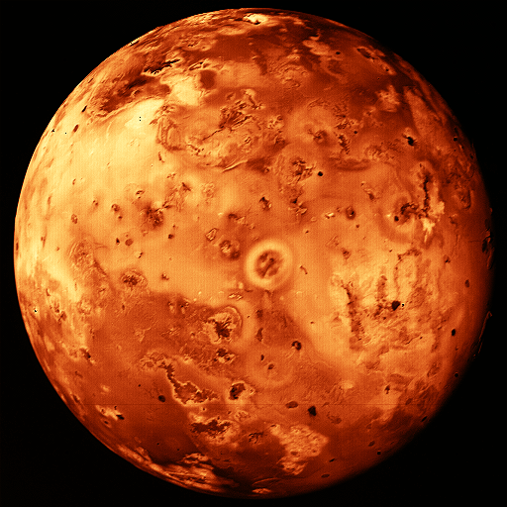
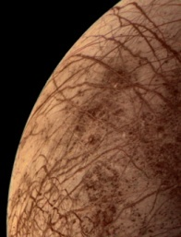
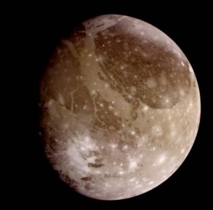
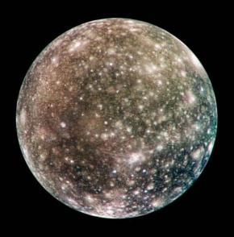
Jupiter’s Galilean Moons
Io
  Volcanically active
  High density (3.5 g/cm³)
  No craters
Europa
  Ice surface may overlie liquid water ocean
  High density (3.0 g/cm³)
  No large craters, only small ones
  Many cracks and fissures in ice surface
Ganymede
  Larger than Mercury
  Lower density (1.9 g/cm³)
  Younger surface is cracked and healed ice
  Old cratered terrain
Callisto
  Lower density (1.8 g/cm³)
  Old highly cratered ice surface

Slide 13
In a newly-formed planetary system, where will the temperatures be highest on average?
Near the central star
At intermediate distances from the star
At large distances from the star

Slide 14
In a newly-formed planetary system, where will the mass density be highest on average?
Near the central star
At intermediate distances from the star
At large distances from the star

Slide 15
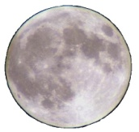
Finding Distances Precisely
Within the Solar System we can often use Radar Ranging.
  Radiation from radar travel at the speed of light
  Measure time from transmission to detection
  Distance = (speed of light) x (time delay) ÷ 2
Using communication with space probes we have found distances to all planets but Pluto to within a few meters!

Slide 16
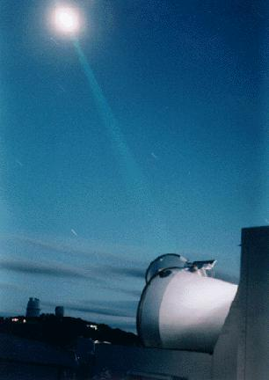
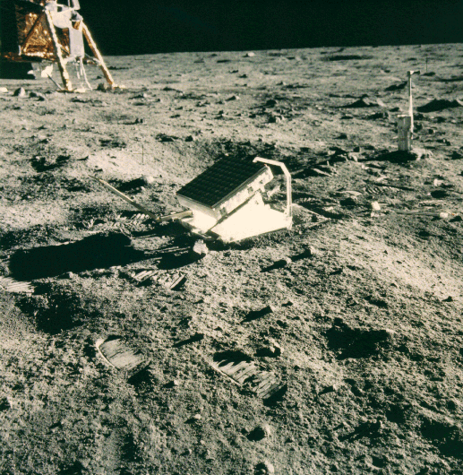
Laser Ranging to the Moon
Laser ranging allows us to measure the distance to the moon to extreme precision. However, it is not a practical method for places we haven’t visited.
Notes:
The McDonald Laser Ranging Station (MLRS) is a dedicated laser ranging station capable of measuring round trip light travel times to a constellation of artificial earth satellites and lunar retro-reflectors to a precision of about 1 centimeter and time of laser firing to about 35 picoseconds. Data from this station as well as 30-40 similar satellite-capable systems and one other regularly contributing lunar-capable system around the world are used for a variety of scientific pursuits including study of the earth's gravitational field, plate tectonics, earth's orientation in space, high precision time transfer, relativity, lunar and solar system dynamics, and providing high precision orbits for GPS and ocean top mapping missions.
MLRS History

Slide 17
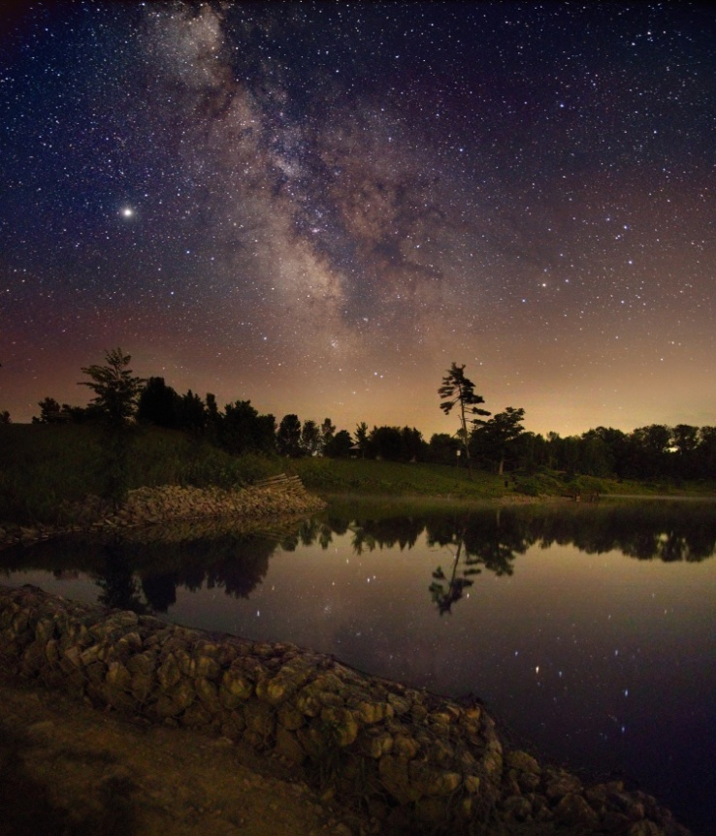
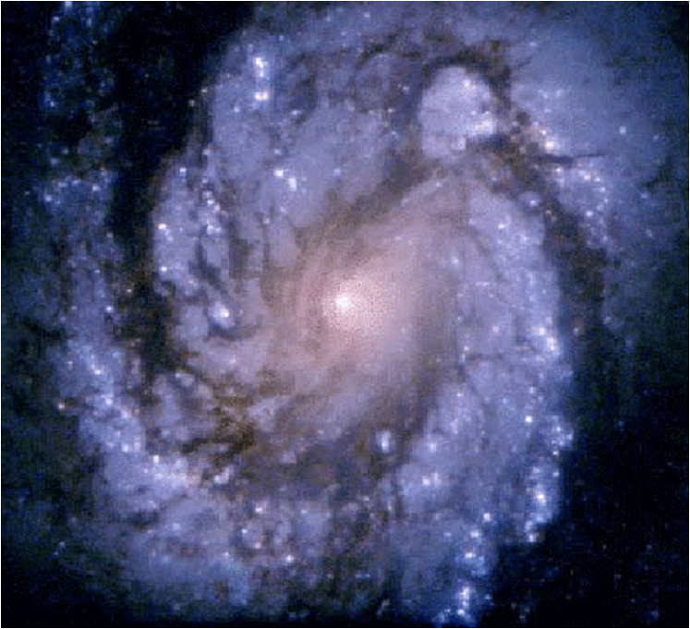
Beyond our solar system:
The milky way (our galaxy)
~400 billion stars
All objects visible at night with naked eye are in our own galaxy
Diameter = 100,000 light years
Closest Neighbor is 1,000,000 million light years
Spiral Arms
Galactic
Nucleus
Our Solar System

Slide 18
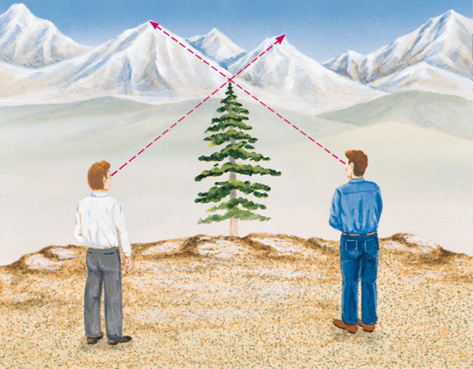
Triangulation
Used to find distances to nearest stars.
  Same techniques used in land surveys
For astronomy, it builds upon the fact that we know the orbital radius of the earth very precisely.
Earth
Star
☼
90 degrees
Sun
68 degrees
Earth

Slide 19
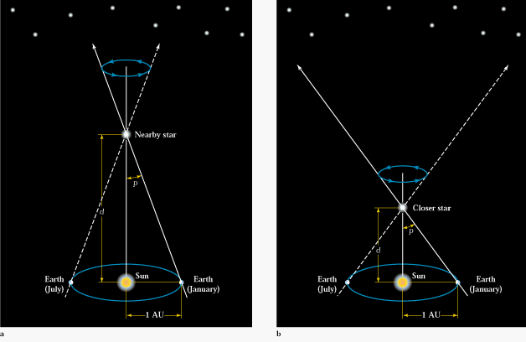
Triangulation
Can be used to find distances to the nearest ~10,000 stars.
All methods of finding greater distances build on this!

Slide 20
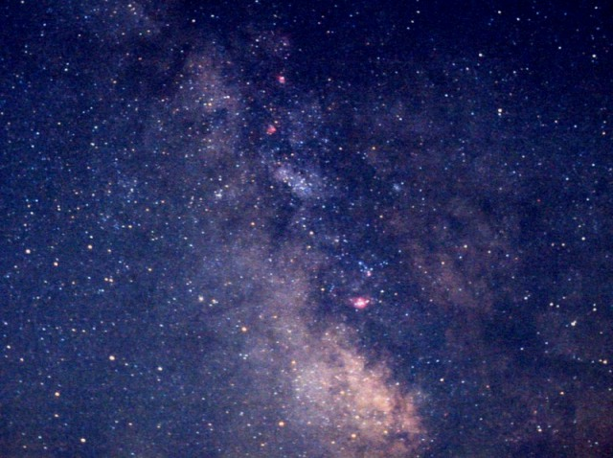
Introduction
You can see about 10,000 stars with the naked eye.

Slide 21
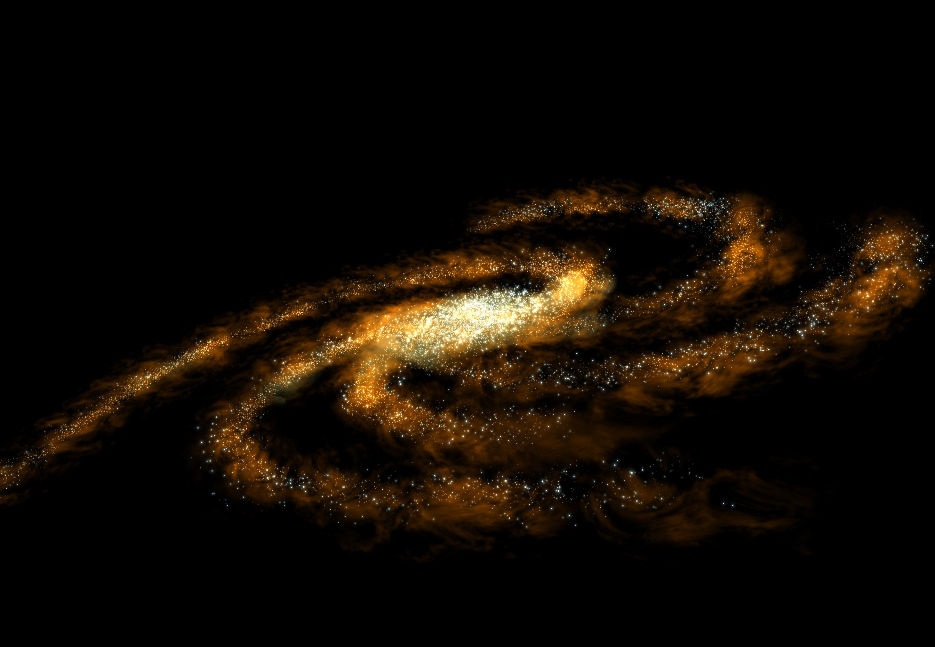
The milky way
100,000 light years across
Contains about 200-400 billion stars
We are in the Orion arm
The dust and stars in the center obscure our view with optical telescopes. To see into the center you need radio telescopes

Slide 22
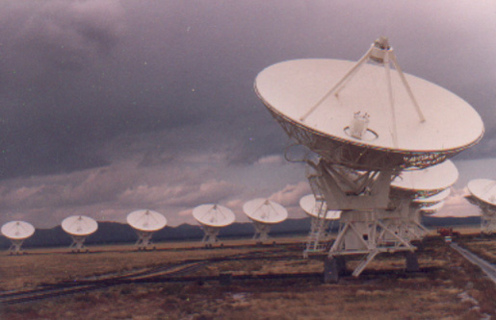
Radio telescopes allow us to look into the center of the galaxy
VLA-Very Large Array Radio Telescope

Slide 23
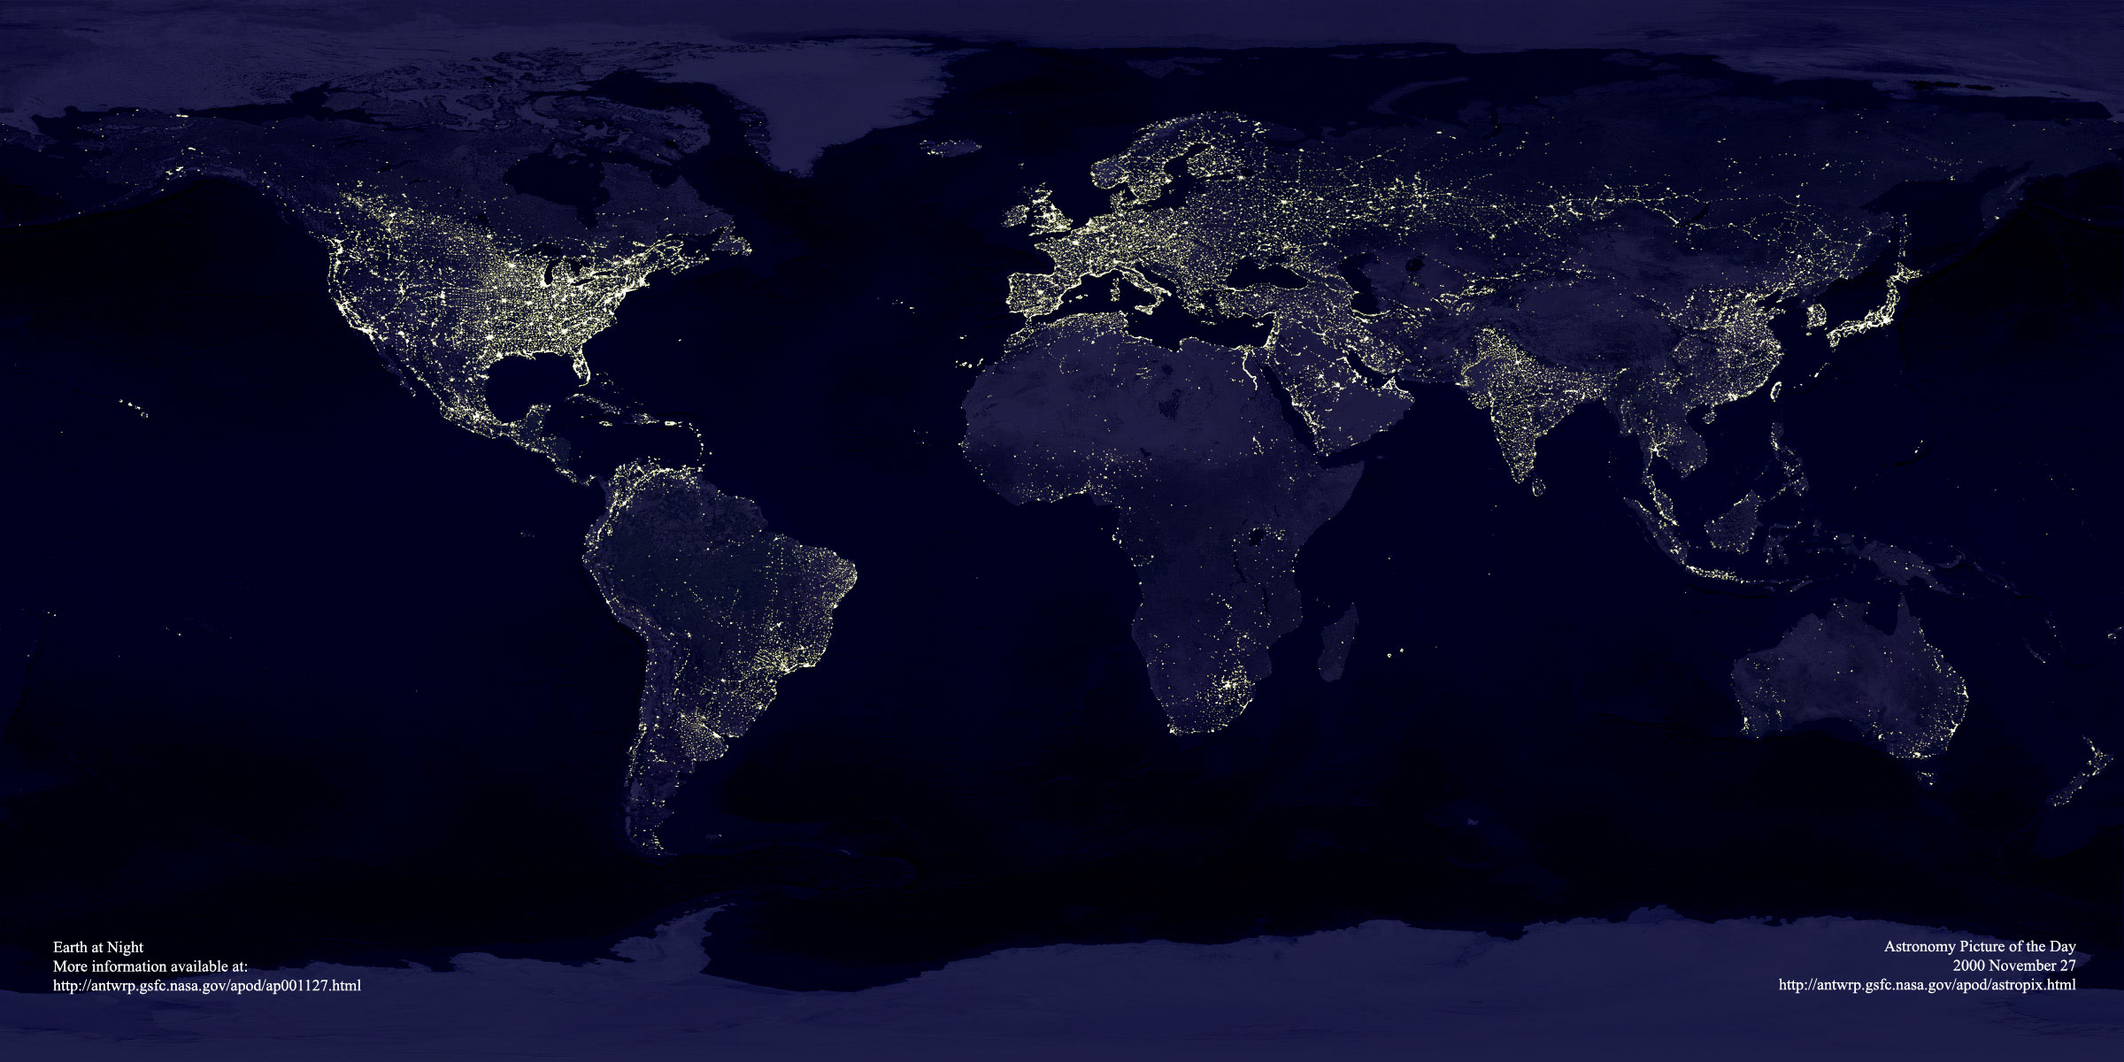
Optical Telescopes
Atmospheric distortion and light pollution limit the resolution of ground based telescopes.

Slide 24
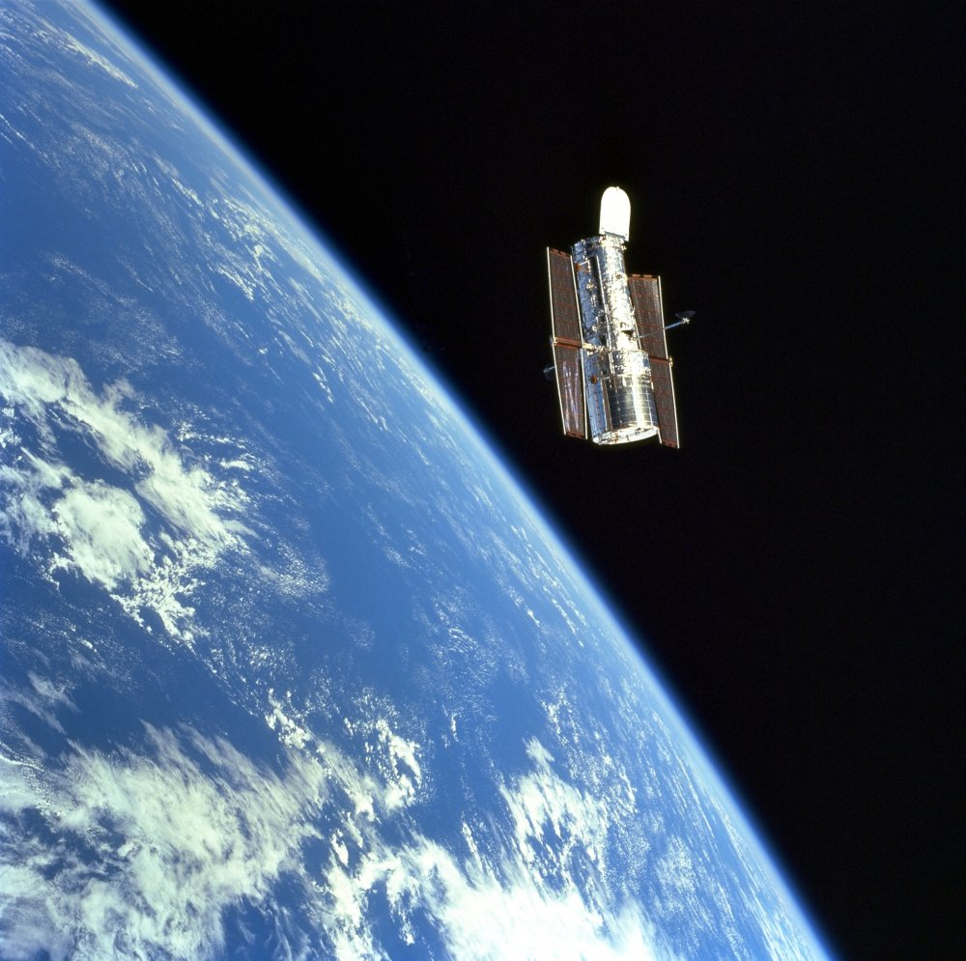
Optical Telescopes
Atmospheric distortion and light pollution limit the resolution of ground based telescopes.
With space-based telescopes we are able to gain an amazing perspective on what is going on in the universe.

Slide 25
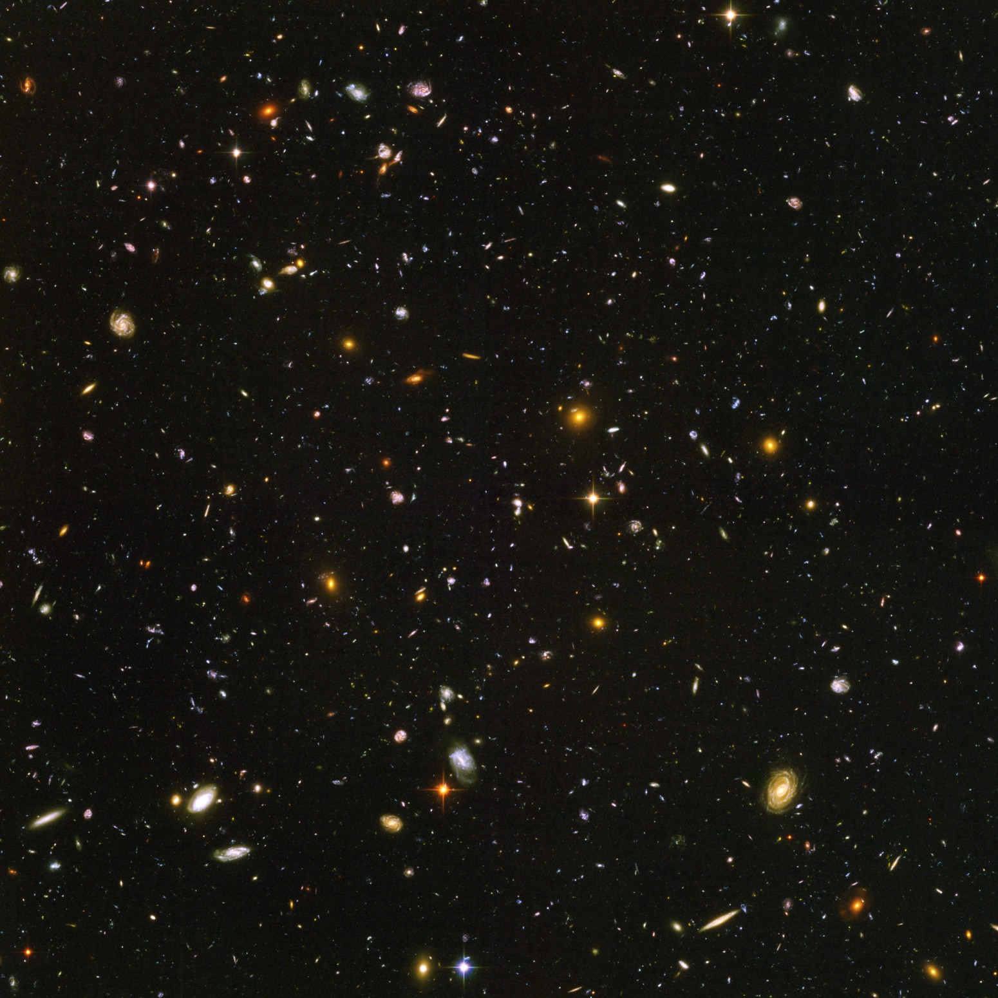
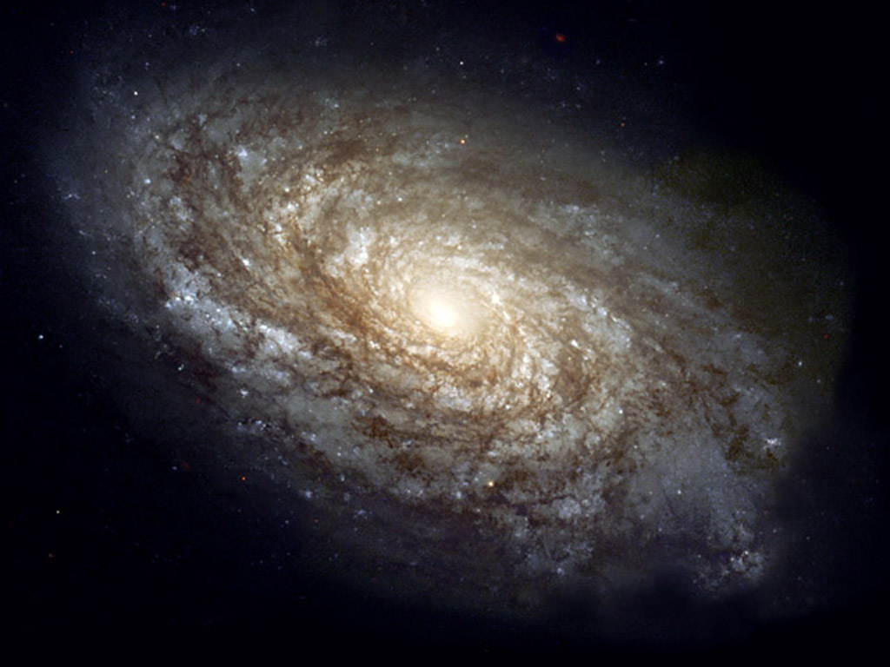
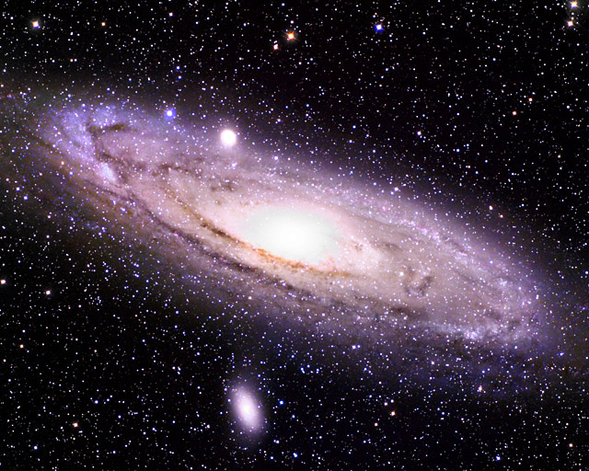
Hubble Deep space
Notes:
10,000 Galaxies from the hubble deep space scan

Slide 26
Beginnings
Space is mostly empty
  About 1 atom per cubic meter
Space in galaxies is considerably more dense
  About a million atoms per cubic meter in the interstellar regions (this is still a much better vacuum than we can achieve on earth, however)
Occasionally, a pocket of more dense gas forms. If this pocket is large enough and cool enough, a “protostar” can form.

Slide 27
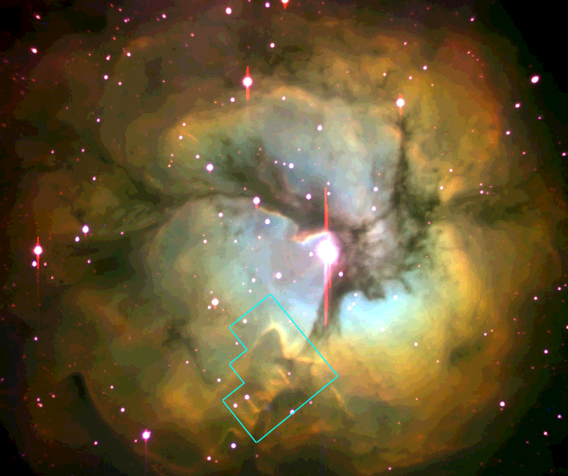
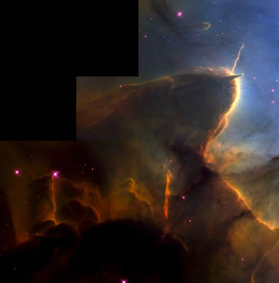
Birth to Late Adulthood
All stars start out as a gas and dust cloud which is part of the interstellar medium.
  Gravity pulls it all together.
A group or cluster of protostars form. The gas they irradiate is called an emission nebula.

Slide 28
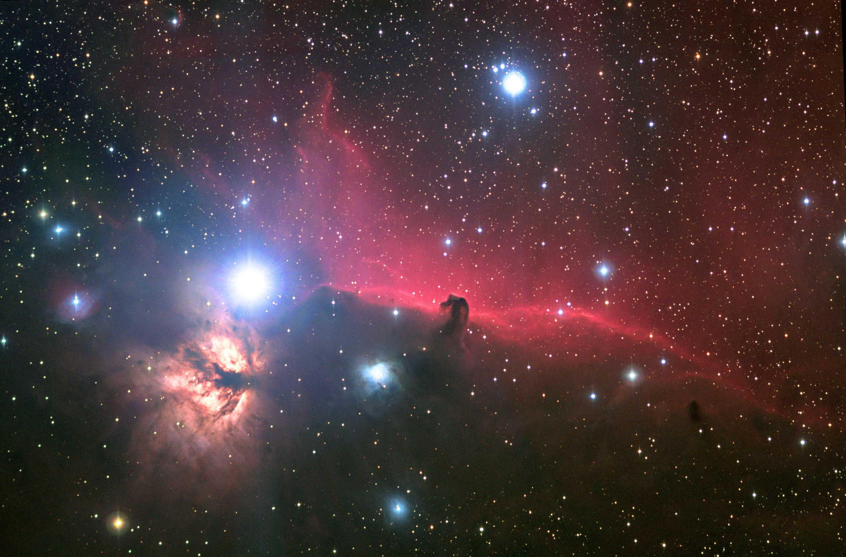
Horsehead Nebula

Slide 29
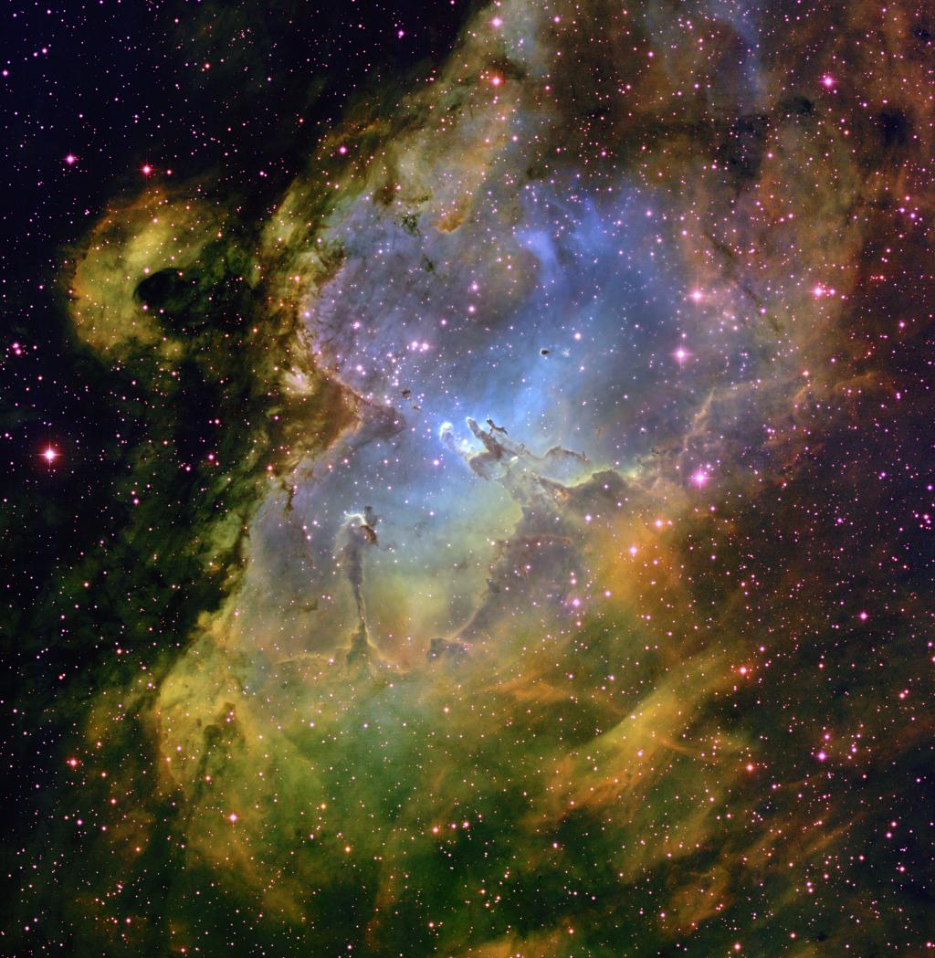
The Eagle Nebula

Slide 30
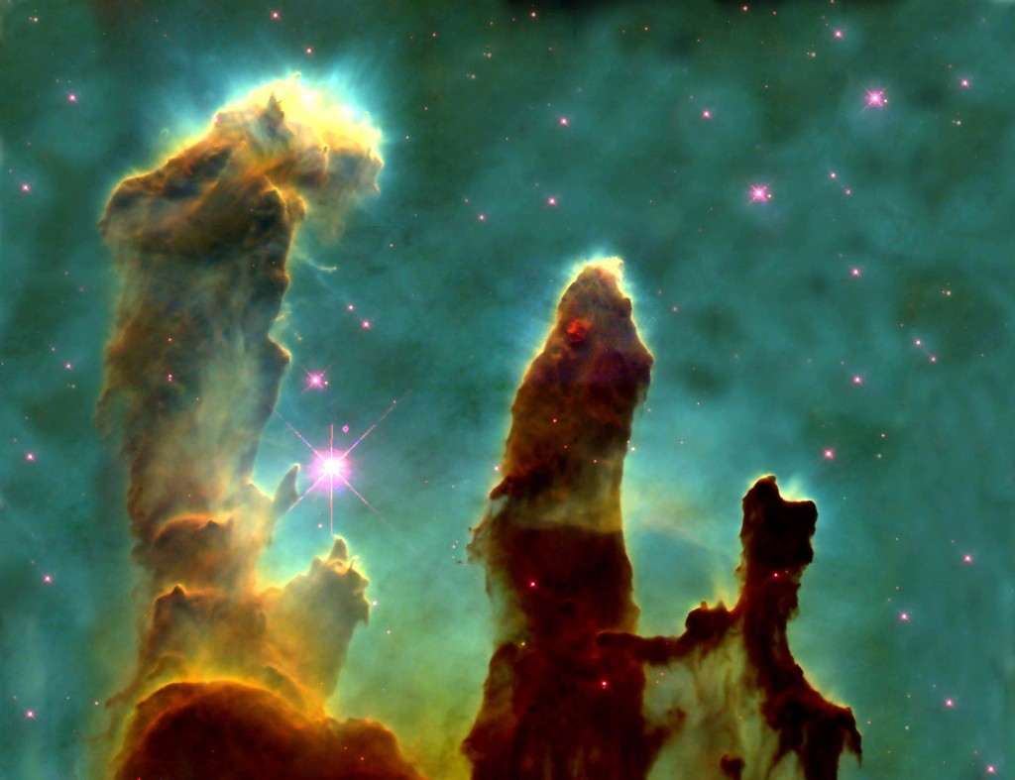
Pillars of creation

Slide 31
Stars emerging from dark eagle nebula

Slide 32
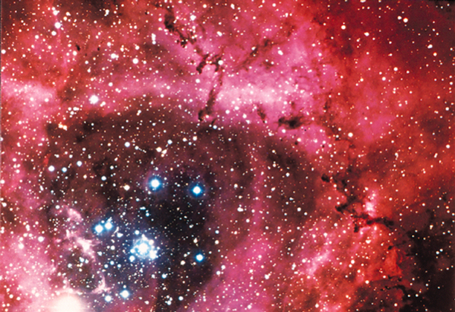
Rosette Nebula

Slide 33
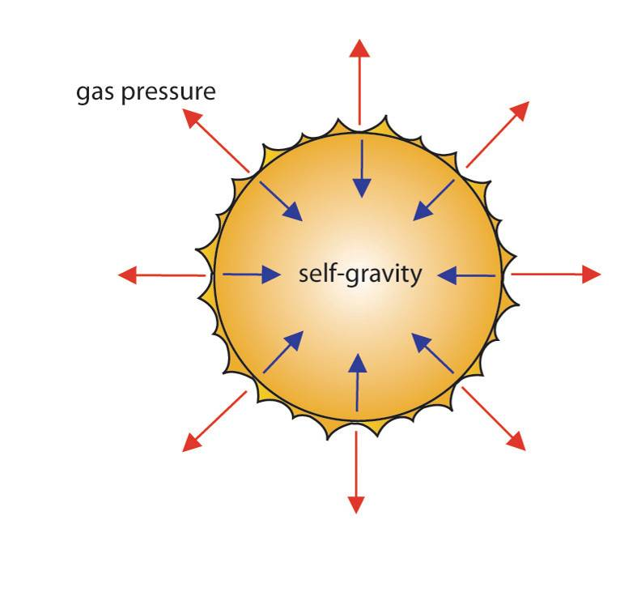
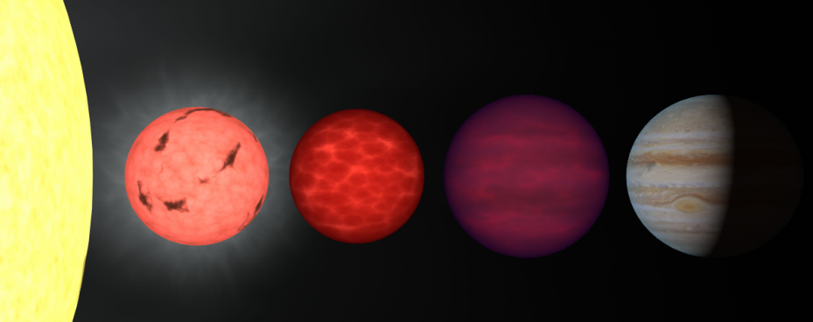
Protostars
When there is enough material “close” (within 15 trillion km) together, gravity causes atoms to start feel an attraction for the center.
As the atoms “fall” towards the center, they lose potential energy and gain kinetic energy.
A rising temperature inside each protostar causes the gas to push back against gravity. The collapse slows.
A slow collapse continues for ~10,000,000 years. The protostar shines by converting
  Gravitational potential to thermal
  Thermal to light
As the cloud gets hotter and denser, the atoms ionize (i.e. become a plasma) and the mass becomes visible
If it never starts fusion, it is called a brown dwarf (e.g. Jupiter)

Slide 34
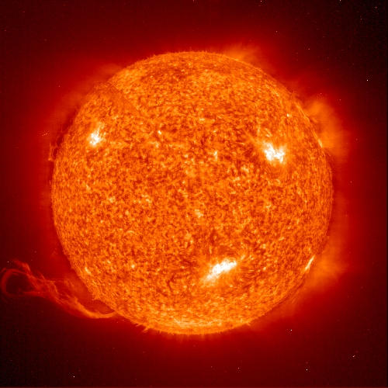
The fusion engine begins
When the core of the protostar reaches about 10 million degrees, fusion can begin
Four H nuclei fuse to form a He nucleus, two positrons, and two neutrinos.
The star contracts to about the size of our sun, the core temperature reaches ~30 million degrees, and settles into a stable equilibrium.
This phase of the star’s life will last about 10 billion years for stars with a mass about that of our sun
A star with 10x the mass of our sun will only live about 100 million years, and a star with 10x less mass would live about a trillion years

Slide 35
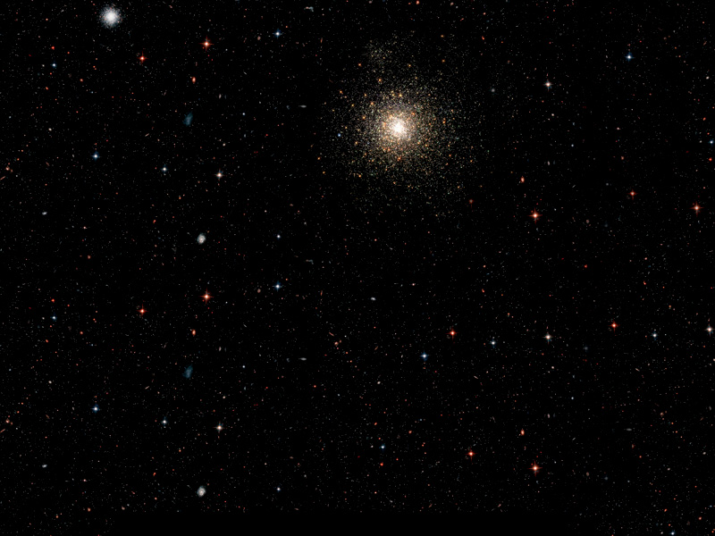
Normal, Average, Generic Stars.
Massive stars shine brighter but have shorter lives (as low as 1 million years)
Low mass stars shine fainter but have longer lives (up to a trillion years).
The sun is a low-mass star that is 5 billion years old and will continue about as-is for another 5 billion years!
All stars, when they age become red giants.

Slide 36
Red giant phase 1
As the fusion region moves away from the core, the star expands to approximately the earth’s orbital radius.
When H is spent, the star collapses.
What happens next depends on the mass of the star
Cool Outer Layer
H Fusion
Condensing
He

Slide 37
Energy is given off when
Elements lighter than iron fuse.
Elements lighter than iron fission.
Elements heavier than iron fuse.

Slide 38
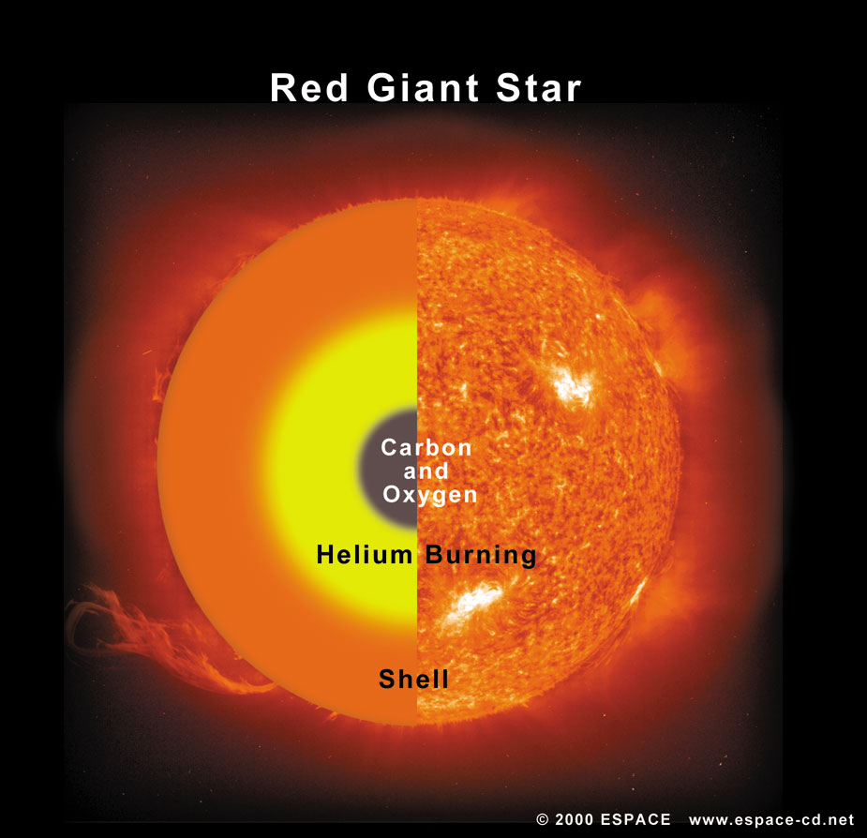
If there is enough mass, the cycle can repeat
Each successive expansion and contraction occurs in a shorter and shorter time, so that a star will burn out after only a few million years.

Slide 39
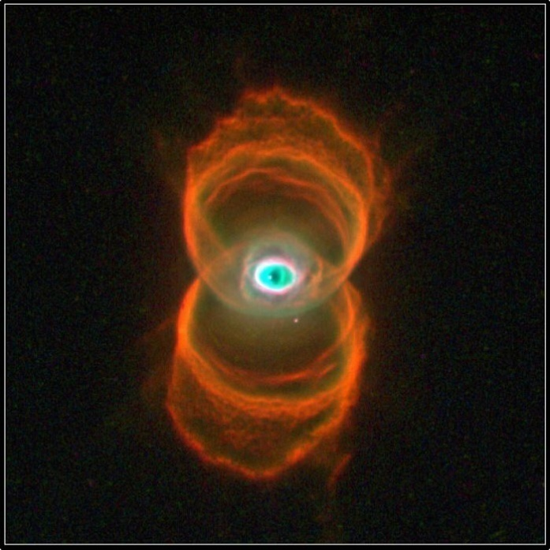
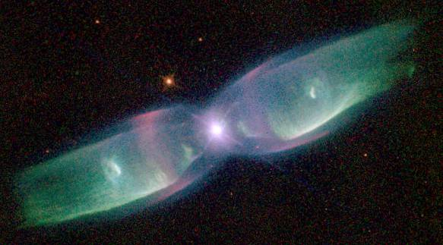
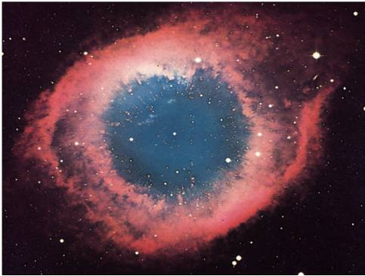
For a star the size of our sun, the cycle will not go on beyond Helium fusing into Carbon
With the last expansion, this type of red giant will turn into a planetary nebula.
White dwarf in the very center is mostly carbon, and is very hot
Eventually the white dwarf will expend its fuel, cool and become a black dwarf. This is extremely dense (1 cubic inch = 10 tons!)
Notes:
MyCn18, a young planetary nebula located about 8,000 light-years away.

Slide 40
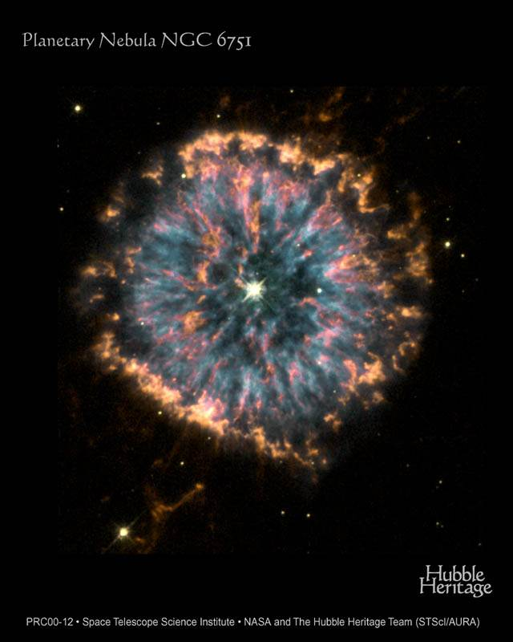

Slide 41


Slide 42

For more massive stars, you can get a different ending
If the star has enough mass, it can go on fusing right up to Fe.
Making heavier nuclei then Fe takes more energy than it supplies.
The core is almost rigid (it is made of iron). This makes the last collapse very violent.
The final explosion is known as a supernova.
Supernovae are not common, 1 per 30 years in our galaxy, and most of these are not visible
Recorded supernova occurred in 1054, 1572, 1604, and 1987.

Slide 43

1987

Slide 44

Supernova 1987A in 1997

Slide 45


Slide 46

Another Supernova occurred in 1054
Observed by Chinese and Arab astonomers.
Also thought to have been observed by Anasazi indians

Slide 47

The Crab Nebula

Slide 48

Strange goings on where supernovae have occurred
The remnant of the exploded star is incredibly dense. The gravitational attraction is so intense that electrons and protons combine to form neutrons.
In effect, the remaining star is a huge “nucleus” composed only of neutrons.
Example: In the middle of Crab nebula there is a neutron star that is about 20 miles across with more mass than the sun. (Recall that a white dwarf was about the size of the earth)

Slide 49


Neutron Stars
A neutron star spins very rapidly, and has a large magnetic field.
These neutron stars are observed to give off regular flashes of energy (LGM) and are called pulsars.

Slide 50

Heavy Element Creation
Supernova explosions have lots of energy, lots of neutrons, and lots of iron nuclei as targets for the neutrons.
All elements heavier than iron are created by lighter nuclei absorbing neutrons then undergoing beta decay.
Big Bang
Stellar Fusion
Supernova

Slide 51
Supermassive Stars
Supermassive stars evolve just like the massive ones with one exception. They have so much gravity in the core that we know of no force that can prevent their collapse to a point!(?) We call the resulting entity a black hole.
To understand this we have to take a peek back at General Relativity.

Slide 52


We have to talk a tiny bit about general relativity…
Remember space time (4 dimensional) from special relativity? Einstein went on to develop a relativistic theory of gravity.
In general relativity, massive objects cause a curvature of space-time
In the vicinity of a massive object, a “straight line” is a curve because time and space are curved!

Slide 53


We can test general relativity by observing the apparent position of a star during an eclipse

Slide 54


Black Holes
There is no known limit to the curvature; it can be infinite! When the curvature is infinite, it is a black hole.
Even light, traveling along this infinite curve, cannot find a path out!
There is a remarkably large amount of evidence supporting the reality of black holes.

Slide 55

Gravitational Lensing

Slide 56

Cygnus X-1 Binary system

Slide 57

Accretion Disk and Jets
Oddly enough, black holes should manifest themselves by ejecting material from accreting disks surrounding them.
Magnetic field

Slide 58

How do you measure distance when you can’t use triangulation? Brightness-distance

Slide 59
When light bulbs are farther away they appear
Bluer
Redder
Brighter
Dimmer

Slide 60
We could find the distance to a light bulb if we knew its
Wattage and color
Wattage and measured brightness
Color and measured brightness
Area code

Slide 61


Color-Brightness Relation
The Next Rung on the distance ladder is from the relation between brightness and color.
Star colors and brightnesses are determined by their masses.

Slide 62
Brightness-Distance (Hertzsprung-Russell Method)
Absolute brightness -- the actual brightness of things viewed from the same distance
  Read from the H-R diagram knowing the stars color
Apparent brightness -- how bright things look to us here on earth
  near stars appear brighter than far stars of the same color
By comparing the absolute and apparent brightness, we can measure distance
This is useful for distances to all the stars in the Milky way Galaxy.

Slide 63
According to the currents models of stellar evolution, our sun will eventually become a
Cloud of hydrogen gas
Protostar
Neutron star
Black hole
White dwarf

Slide 64

A Vast Universe of Galaxies
Anciently mankind thought that the universe was the solar system inside a sphere of stars.
By the 1900s we knew the sun was just one of billions of stars within the Milky Way galaxy.
  At this time the Milky Way was thought to be the entire universe.

Slide 65



William Parsons studied external Galaxies, but thought they were solar systems forming in the Milky Way
The "Leviathan of Parsonstown"
Parson's 72-inch telescope
First Sketch of a galaxy, 1845
William Parsons, 3rd Earl of Rosse
Notes:
http://en.wikipedia.org/wiki/William_Parsons,_3rd_Earl_of_Rosse
William Parsons, 3rd Earl of Rosse (June 17, 1800 – October 31, 1867) was an Irish astronomer.
He became the third Earl of Rosse when his father died in 1841. Prior to this, his title was "Lord Oxmantown".
In the 1840s, he built his "Leviathan of Parsonstown" 72-inch (183cm) telescope at Birr, Ireland (then called "Parsonstown") in County Offaly, which was for many decades the largest telescope in the world. He had to invent many of the techniques he used in constructing this telescope, both because its size was without precedent and because earlier telescope builders had guarded their secrets or had simply failed to publish their methods. It was considered a marvelous technical and architectural achievement and images of it were circulated widely within the British commonwealth.
The telescope mirror was made from speculum metal. Because it tarnished so rapidly in the damp climate, the mirror had to be repolished every six months, and so Lord Rosse had two mirrors built so that one could be used while the other was being repolished. Building of the telescope had to be suspended during the Great Potato Famine, but in 1847 it was put into service. The light-gathering ability exceeded expectations, enabling 18th magnitude stars to be observed for the first time. However, the Irish sky was not kind to astronomy, and due to weather conditions very few good nights of viewing were available per year.
William Parsons
Lord Rosse carried out pioneering astronomical studies and discovered the spiral nature of some nebulas, today known to be spiral galaxies. The first spiral galaxy he detected was M51, and his drawings of it closely resemble modern photographs (today it is known as the Whirlpool Galaxy).
He named the Crab Nebula, based on an earlier drawing made with his older 36-inch (91cm) telescope in which it resembled a crab. A few years later, when the 72-inch (183cm) telescope was in service, he produced an improved drawing of considerably different appearance, but the name stuck anyway.
A main component of Rosse's nebular research was attempting to resolve the nebular hypothesis, which posited that planets and stars were formed by gravity acting on gaseous nebulae. Rosse himself did not believe that nebula were truly gaseous, but rather were made up of such an amount of fine stars that most telescopes could not resolve them individually (that is, he considered them stellar in nature). Rosse and his technicians claimed to resolve the Orion nebula into its individual stars, which would have both political and cosmological implications, as at the time there was considerable debate over whether or not the universe was "evolved" (in a pre-Darwinian sense), a concept Rosse disagreed with strongly. Rosse's primary opponent in this was John Herschel, who used his own instruments to claim that the Orion nebula was a "true" nebula, and discounted Rosse's instruments as flawed (an insult Rosse returned about Herschel's own). In the end, neither man (or telescope) could establish sufficient scientific authority in its results to solve the question by themselves (the convincing evidence for the gaseous nature of the nebula would come later from spectroscopic evidence, though it would not resolve the philosophical issues).
In addition to his astronomical pursuits, he served as a member of Parliament from 1821 to 1834, an Irish representative peer after 1845, president of the Royal Society (1848–1854), and chancellor of the University of Dublin (beginning in 1862).
Rosse crater, on the Moon, is named after him.
He married Mary Field in 1836 and they had four children, all sons. The eldest, Lawrence Parsons, succeeded him as Earl of Rosse and continued some astronomical observations; another son, Charles Algernon Parsons, is known for his commercial development of the steam turbine. Another son, Richard Clere Parsons apparently made a name for himself building railways in South America.

Slide 66
Cosmology:
How the Universe Works
Cosmology is the study of the structure and evolution of the universe. To understand the universe we need to be able to tell
  Where things are
  How things are moving

Slide 67
Measuring Astronomical Distances
Review: Methods for mesuring distance
  Radar ranging: works in the solar system
  Triangulation: can be used up to 3,000 light years (nearest 120,000 stars)
  Brightness-distance: works for individual stars

Slide 68

The Basic Idea Behind Finding Distances to Stars:
“Real” Brightness
Farther away
Farther away still
We measure the brightness we see.
We infer the real brightness.
We calculate the distance from the difference.

Slide 69
Color-Brightness Relation
The Next Rung on the distance ladder is from the relation between brightness and color.
Star colors and brightnesses are determined by their masses.

Slide 70
Brightness-Distance (Hertzsprung-Russell Method)
Absolute brightness -- the actual brightness of things viewed from the same distance
  Read from the H-R diagram knowing the stars color
Apparent brightness -- how bright things look to us here on earth
  near stars appear brighter than far stars of the same color
By comparing the absolute and apparent brightness, we can measure distance
This is useful for distances to all the stars in the Milky way Galaxy.

Slide 71


Variable Stars as Distance Indicators
A class of very bright stars called Cepheids, have a tight relation between their real brightness and their pulsation periods.
  Pulsation period → real brightness → measured brightness → distance
The primary mission of the Hubble Space Telescope was to find distances to nearby galaxies using Cepheid variable stars.
45 days
*
*
30 days
*
15 days
10 days
Notes:
A Cepheid is usually a population I giant yellow star, pulsing regularly by expanding and contracting, resulting in a regular oscillation of its luminosity. The luminosity of cepheid stars range from 103 to 104 times that of the Sun. Because Cepheids are from population I, they are sometimes called Type I Cepheids, while the similar (but belonging to population II) W Virginis variables are known as Type II Cepheids.
The exact mass of Cepheids with given brightness or oscillations is not known to any great precision, but astronomers hope to gather data for this from the newly-discovered third star of the Polaris system [1].
The variation in luminosity is caused by a cycle of ionization of helium in the star's atmosphere, followed by expansion and deionization. While ionized, the atmosphere is more opaque to light. This cycle has a period roughly equal to the star's dynamical time scale, therefore giving information on the mean density of the body as well as its luminosity.
The oscillations of the stars have standard trvelling standing wave patterns that are described by spherical harmonics, etc. 3-d analogues to a drumhead in 2-d. The modes are driven by variable transmittance of partially ionized gasses interacting with the radiation pressure from within the star.
These are huge stars (upper right on H-R) because these are the ones that have most unstable configurations

Slide 72


External Galaxies
It wasn’t until 1923 that we fully realized the universe consisted of more than the Milky Way.
In 1923 Edwin Hubble determined that Cepheid variable stars in the Andromeda galaxy are 2.5 million light-years away.
Since the milky way is only 100,000 light-years across, it became apparent that Andromeda was a separate system of stars.
Edwin Hubble with his 200 inch telescope
Andromeda (HST)

Slide 73

We are not alone in the universe
Soon it was realized that the spiral-shaped “nebula” were galaxies of stars similar to the Milky Way.
  On average over 100 billion stars per galaxy!
  Huge! The universe itself is only 10⁵ time larger than a typical galaxy.
  At least 50 billion of them.
Sketch by William Parsons, 1845
HST photo of the “Whirlpool Galaxy”
(also known as Messier 51a, M51a, or NGC 5194)
Notes:
http://en.wikipedia.org/wiki/William_Parsons,_3rd_Earl_of_Rosse
William Parsons, 3rd Earl of Rosse (June 17, 1800 – October 31, 1867) was an Irish astronomer.
He became the third Earl of Rosse when his father died in 1841. Prior to this, his title was "Lord Oxmantown".
In the 1840s, he built his "Leviathan of Parsonstown" 72-inch (183cm) telescope at Birr, Ireland (then called "Parsonstown") in County Offaly, which was for many decades the largest telescope in the world. He had to invent many of the techniques he used in constructing this telescope, both because its size was without precedent and because earlier telescope builders had guarded their secrets or had simply failed to publish their methods. It was considered a marvelous technical and architectural achievement and images of it were circulated widely within the British commonwealth.
The telescope mirror was made from speculum metal. Because it tarnished so rapidly in the damp climate, the mirror had to be repolished every six months, and so Lord Rosse had two mirrors built so that one could be used while the other was being repolished. Building of the telescope had to be suspended during the Great Potato Famine, but in 1847 it was put into service. The light-gathering ability exceeded expectations, enabling 18th magnitude stars to be observed for the first time. However, the Irish sky was not kind to astronomy, and due to weather conditions very few good nights of viewing were available per year.
William Parsons
Lord Rosse carried out pioneering astronomical studies and discovered the spiral nature of some nebulas, today known to be spiral galaxies. The first spiral galaxy he detected was M51, and his drawings of it closely resemble modern photographs (today it is known as the Whirlpool Galaxy).
He named the Crab Nebula, based on an earlier drawing made with his older 36-inch (91cm) telescope in which it resembled a crab. A few years later, when the 72-inch (183cm) telescope was in service, he produced an improved drawing of considerably different appearance, but the name stuck anyway.
A main component of Rosse's nebular research was attempting to resolve the nebular hypothesis, which posited that planets and stars were formed by gravity acting on gaseous nebulae. Rosse himself did not believe that nebula were truly gaseous, but rather were made up of such an amount of fine stars that most telescopes could not resolve them individually (that is, he considered them stellar in nature). Rosse and his technicians claimed to resolve the Orion nebula into its individual stars, which would have both political and cosmological implications, as at the time there was considerable debate over whether or not the universe was "evolved" (in a pre-Darwinian sense), a concept Rosse disagreed with strongly. Rosse's primary opponent in this was John Herschel, who used his own instruments to claim that the Orion nebula was a "true" nebula, and discounted Rosse's instruments as flawed (an insult Rosse returned about Herschel's own). In the end, neither man (or telescope) could establish sufficient scientific authority in its results to solve the question by themselves (the convincing evidence for the gaseous nature of the nebula would come later from spectroscopic evidence, though it would not resolve the philosophical issues).
In addition to his astronomical pursuits, he served as a member of Parliament from 1821 to 1834, an Irish representative peer after 1845, president of the Royal Society (1848–1854), and chancellor of the University of Dublin (beginning in 1862).
Rosse crater, on the Moon, is named after him.
He married Mary Field in 1836 and they had four children, all sons. The eldest, Lawrence Parsons, succeeded him as Earl of Rosse and continued some astronomical observations; another son, Charles Algernon Parsons, is known for his commercial development of the steam turbine. Another son, Richard Clere Parsons apparently made a name for himself building railways in South America.

Slide 74

The Hubble Deep Field
Notes:
http://en.wikipedia.org/wiki/Hubble_Ultra_Deep_Field
The Hubble Ultra Deep Field or HUDF is an image of a small region of space composited from Hubble Space Telescope data accumulated over a period from September 3, 2003 through January 16, 2004. It is the deepest image of the universe ever taken in visible light, looking back in time more than 13 billion years. The HUDF contains an estimated 10,000 galaxies. The patch of sky in which the galaxies reside (just one-tenth the diameter of the full moon) was chosen because it had a low density of bright stars. Although most of the targets visible in the Hubble image can also be seen at infrared wavelengths by ground-based telescopes, Hubble is the only instrument which can make observations of these distant targets at visible wavelengths. Located southwest of Orion in the constellation Fornax at right ascension 3h 32m 40.0s, declination -27° 48' 00" (J2000), the image covers 3 arcminutes square, which is smaller than a grain of sand held at arm's length, and is tilted about 45° such that the upper left corner points toward north on the celestial sphere.
The million-second-long exposure reveals the first galaxies to emerge from the so-called "dark ages," the time shortly after the Big Bang when the first stars reheated the cold, dark universe. The view is actually two separate images taken by Hubble's Advanced Camera for Surveys (ACS) and the Near Infrared Camera and Multi-Object Spectrometer (NICMOS). In total, the image required 800 exposures taken over the course of 400 Hubble orbits around Earth. The total amount of exposure time was 11.3 days for the ACS and 4.5 days for the NICMOS.
The Big Bang theory suggests that the Universe has a finite age, and if this were true we might expect very distant (and hence very young) galaxies to look different from the typical older galaxies we see today. This is indeed seen in the HUDF, although some argue that the difference is partly a result of the unusual wavelength used for the HUDF (corresponding to ultraviolet light from the rest-frame of the most distant galaxies). The Hubble Ultra Deep Field also shows more evidence for galaxy formation and merging than in local studies, as expected for the early Universe.

Slide 76


Slide 77



Elliptical Galaxies

Slide 78



Spiral Galaxies

Slide 79



Barred Spirals

Slide 80



Irregular/Peculiar

Slide 81

Galaxy Clusters
Galaxies are held together in small to large groups by gravity.

Slide 82


Harlow Shapley was able to point out that we are not at the center of the galaxy
He found the position by measuring distances to the globular star clusters that orbited about the center of the Milky Way.
Globular Cluster
Harlow Shapley
Notes:
Globular cluster
From Wikipedia, the free encyclopedia
A globular cluster is a spherical collection of stars that orbits a galactic core as a satellite. Globular clusters are very tightly bound by gravity, which gives them their spherical shapes and relatively high stellar densities toward their centers. The name of this category of star cluster is derived from the Latin globulus—a small sphere. A globular cluster is sometimes known more simply as a globular.
Globular clusters, which are found in the halo of a galaxy, contain considerably more stars and are much older than the less dense galactic, or open clusters, which are found in the disk. Globular clusters are fairly common; there are about 158^{[2]} currently known globular clusters in the Milky Way, with perhaps 10–20 more undiscovered.^{[3]} Large galaxies can have more: Andromeda, for instance, may have as many as 500.^{[4]} Some giant elliptical galaxies, such as M87,^{[5]} may have as many as 10,000 globular clusters. These globular clusters orbit the galaxy out to large radii, 40 kiloparsecs (approximately 131 thousand light-years) or more.^{[6]}
Every galaxy of sufficient mass in the Local Group has an associated group of globular clusters, and almost every large galaxy surveyed has been found to possess a system of globular clusters.^{[7]} The Sagittarius Dwarf and Canis Major Dwarf galaxies appear to be in the process of donating their associated globular clusters (such as Palomar 12) to the Milky Way.^{[8]} This demonstrates how many of this galaxy's globular clusters were acquired in the past.
Although it appears that globular clusters contain some of the first stars to be produced in the galaxy, their origins and their role in galactic evolution are still unclear. It does appear clear that globular clusters are significantly different from dwarf elliptical galaxies and were formed as part of the star formation of the parent galaxy rather than as a separate galaxy.^{[citation needed]} However, recent conjectures by astronomers suggest that globular clusters and dwarf spheroidals may not be clearly separate and distinct types of objects.^{[9]}
Harlow Shapley
From Wikipedia, the free encyclopedia
Harlow Shapley (November 2, 1885 – October 20, 1972) was an American astronomer.
He studied under Henry Norris Russell at Princeton University and used the period-luminosity relation for Cepheid variable stars (discovered by Henrietta Swan Leavitt) to determine distances to globular clusters. He was the first to realize that the Milky Way Galaxy was much larger than previously believed.
He participated in the "Great Debate" with Heber D. Curtis on the nature of nebulas and galaxies and the size of the universe. The debate took place on April 26, 1920. Shapley argued against the theory that the Sun was at the center of the galaxy, and promoted the idea that globular clusters and spiral nebulae are within the Milky Way. He was incorrect about the latter point, but correct about the former.
At the time of the debate, Shapley was working at the Mount Wilson Observatory. After the debate, however, he was hired to replace the recently deceased Edward Charles Pickering as director of the Harvard College Observatory.
He served as director of the HCO from 1921 to 1952. During this time, he hired his future wife Cecilia Payne-Gaposchkin, who became the first person to earn a doctorate at Harvard University in the field of astronomy.
In the 1940's, Shapley helped found government funded scientific associations, including the National Science Foundation. He is also responsible for putting the "S" in UNESCO (United Nations Educational, Scientific and Cultural Organization).
Politically, Shapely was a liberal, and found himself one of the victims of McCarthyism.
In 1950, Shapley was instrumental in organising a campaign in academia against the controversial US bestseller book Worlds in Collision by Russian expatriate psychiatrist Immanuel Velikovsky.
Incidentally, Shapley held a life long interest in myrmecology, the study of ants.
He is also the Grandfather of best-selling author Tracey Shapley and Pulitzer Prize winning accountant Christopher Shapley

Slide 83


Position of the Sun in the Milky Way
The sun is 2/3 the way from the galaxy center to the edge.
Its position was found by measuring distances to the globular star clusters that orbited about the center of the Milky Way.
Variable stars were used to find the distances.
x
The Sun
x
Globular Clusters

Slide 84


Cosmological Redshift and The Doppler Effect
A profound discovery of the early 1900s was that all distant galaxies have their absorption and emission spectral lines shifted to the red.
The amount of the shift is related to the speed of the galaxy.
Shift can be found because spectral emission lines have a characteristic pattern
Notes:
show video clip #21 with Doppler shift of a train horn
Emphasize: higher frequency if moving towards you, lower frequency if moving away.
Other demonstration--swinging a speaker.

Slide 85

Hubble Law
The speed a galaxy moves away from us is proportional to its distance: The farther away the galaxy is, the faster it recedes.
The Hubble Law is used to find distances to the farthest galaxies
radar ranging | within solar system
triangulation | nearest 10,000 stars in galaxy
distance-brightness | within our galaxy and nearby galaxies
cosmological redshift | beyond nearby galaxies

Slide 86



The expansion of the universe makes all distant galaxies appear to be moving away from us (and hence be red-shifted).
If the universe is expanding, the farther away two galaxies are, the faster they move apart.
Also, all galaxies would appear to be moving away from all other galaxies so our view is not unique.

Slide 87
Types of Cosmologies
Early ideas of the universe held that it was:
  Infinitely old
  Infinitely large
  Unchanging in time
But this cannot be true because
  The universe is seen to be expanding and thus it is changing with time.
  An infinitely large and old universe would never know darkness. This is Olber’s paradox

Slide 88

Olbers’ Paradox
All lines of sight end on a star! The sky should be ablaze with star light!
The solution is that the universe has a beginning
  Light has not had time to reach us from the greatest distances
  Glowing stars and galaxies have not always existed.
☼
☼
☼
☼
☼
☼
☼
☼
☼
☼
☼
☼
☼
☼
☼
☼
☼
Earth

Slide 89

The observed expansion of the universe has led to the only currently viable cosmological theory: The Big Bang
The universe began as a great infusion of pure energy about 13.7 billion years ago.
Space expanded from that point in time. The energy cooled into matter.

Slide 90

As the universe expanded, it would have cooled down

Slide 91

Fred Hoyle
Fred Hoyle gave the Big Bang theory its name (in a mocking manner, but it stuck)
Worked to disprove it, because it required an act of creation.
To date, it is the best theory we have to describe the creation and evolution of the universe.

Slide 92
Experimental Evidence
cosmological red shift
  Everything is moving away from us
helium/hydrogen ratio (25%/75%)
  Fusion early after the big bang would produce that ratio of H to He
Big Bang
Stellar Fusion
Supernova
Notes:
age of stars and formation of galaxies still open to some question
Note that Dr. McNamara has made some important discoveries on this question just this year (1997).
Best current estimates: universe is about 12-18 billion years. Earth about 5 billion years (oldest crust about 4.3 billion years)

Slide 93



Evidence Supporting the Big Bang
We see a faint glow left from the original high temperatures
  Called the Cosmic Microwave Background or 3° K Background Radiation.
Arno Penzias and Robert Wilson
Notes:
age of stars and formation of galaxies still open to some question
Note that Dr. McNamara has made some important discoveries on this question just this year (1997).
Best current estimates: universe is about 12-18 billion years. Earth about 5 billion years (oldest crust about 4.3 billion years)
Like investigators at a crime scene, astronomers have been combing the Universe for physical evidence to test the big bang theory-the most widely accepted scientific theory for how the Universe evolved. The first evidence that turned up was predicted in advance but discovered by accident. Some scientists thought the big bang should still be visible as a faint glow of radio light filling the sky in all directions. In 1964 Arno Penzias and Robert Wilson discovered that light, called the cosmic background radiation.
Maybe It's the Pigeons...?
Arno Penzias and Robert Wilson were puzzled. The two scientists at Bell Labs in Holmdel, New Jersey, had ruled out everything they could think of that could create the static their satellite communications antenna was picking up. Pigeons had taken to roosting in the radio antenna's large horn. They thought that perhaps heat from pigeon droppings was the cause.
They set out a trap to catch the pigeons, but that didn't resolve the mystery either. No matter where in the sky they pointed their radio antenna, they kept picking up that faint, persistent hiss.
Their determination in 1964 that the entire sky seemed to be dimly glowing with radio light confirmed physicists' predictions and later earned Penzias and Wilson a Nobel Prize. The two scientists had, quite by accident, discovered the fading flash from the big bang.

Slide 94

The Ultimate Fate of the Universe
Gravity always pulls, never pushes, so the expansion must slow down unless there is another force pushing out.
Not enough mass
  open universe
Just right
  flat universe
Too much mass
  Closed universe (big crunch)
Another force
  Runaway universe.
  This is what we think is happening as best we can observe!

Slide 95

Looking back in time
A quasar is a supermassive black hole radiating through its accretion disk.

Slide 96

Big-Bang Theory
10⁻⁴³ sec | huge | ???
10⁻³⁵ sec | 10²⁶ deg | quarks, gluons, electrons, neutrinos, photons
.001 sec | 10¹¹ deg | protons and neutrons
3 minutes | 10⁹ deg | ³H, ³He, ⁴He nuclei
1/2 hour | 10⁸ deg | ²H nucleus
500,000 yrs | 30000 deg | atoms
universe began with an incredibly dense concentration of mass energy
in the process of rapid expansion and cooling matter was formed
  point-like particles (electrons, quarks, photons, etc.)
  nucleons (protons and neutrons)
  simple nuclei (hydrogen and helium)
  more complex nuclei, atoms, and molecules
The fate of the universe depends on its mass and energy
  Open, it keeps expanding forever
  Closed, it collapses back in on itself

