Slide 1
Review of Models
Continuous
Molecular
Thompson
Nuclear Solar System
Bohr Model
  The problems with the Bohr/solar-system model of the atom:
    Why are only certain orbits possible
    How does the atom remember what its orbits are to be like?
    Why doesn’t an atom radiate energy
Wave Model

Slide 2
An atom has only the following possible energy levels. How many discrete colors can it emit?
2
4
5
6
7 or more
E₄
E₃
E₂
E₁
How many discrete colors can it absorb?

Slide 3
Matter Models (continued…)
At least two puzzles remain at this point:
  The wave-particle duality of light.
  The physical basis for the Bohr model.
matter = electrons

Slide 4
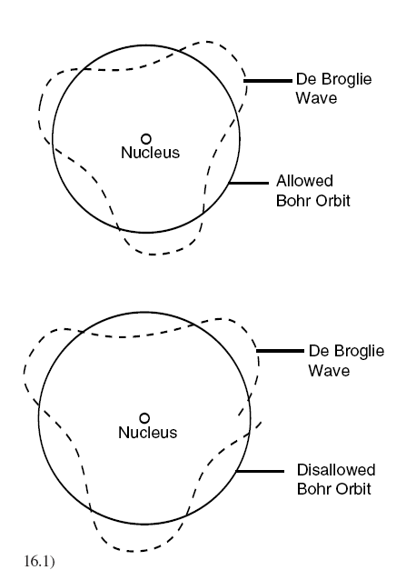

A wave turned out to describe what we observe.
De Broglie’s idea explained the Bohr orbitals
The quantized orbits of the Bohr model are predicted perfectly by requiring electrons to exactly wrap 1, 2, 3, etc waves around the nucleus.
A particle of mass should have a wavelength defined by:
Nobel Prize, 1929

Slide 5


Examples
wavelength = h / (mass×speed)
where h = Plank’s constant = 6 x 10⁻³⁴
Wavelength = 10⁻³⁸ m
(nonsense?)
Wavelength = 10⁻³⁴ m
(again nonsense?)
Wavelength = 10⁻¹⁰ m
Diameter of an atom…
60 mph
100 mph
-
2,000 mph

Slide 6
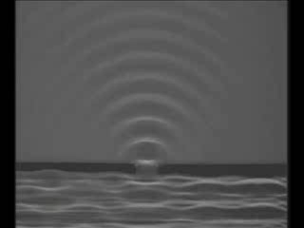
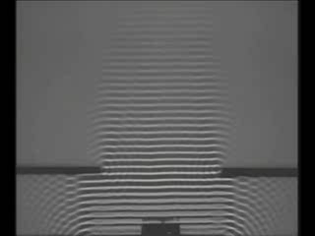
Why don’t we observe the wave nature of matter?
To observe wave effects, your “slits” need to be similar to the wavelength
wavelength = h / (mass×speed)
Example: It would take 10²⁷ years for a student to “diffract” through a doorway.
For all material objects except the very least massive (such as electrons and protons), the wavelength is so immeasurably small that it can be completely ignored.

Slide 7
QQ: An atom has only the following possible energy levels. How many discrete colors can it emit?
2
4
5
6
7 or more
E₄
E₃
E₂
E₁

Slide 8
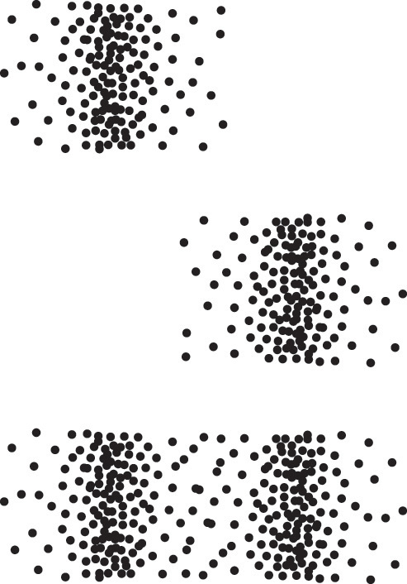
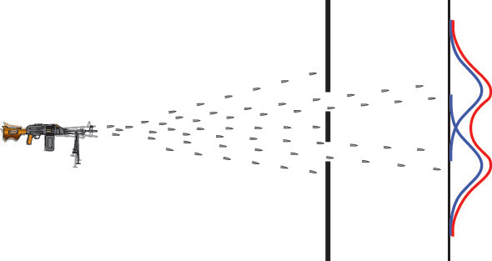
The concept of a probability distribution
Classical electrons

Slide 9
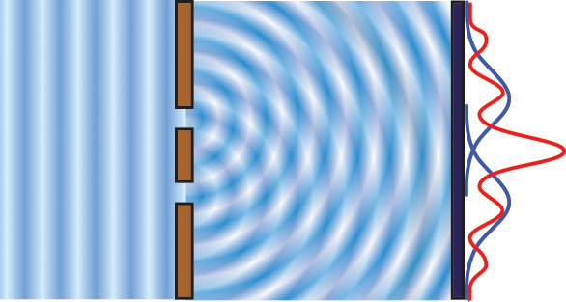
For waves, we can use the amplitude as a measure of where the wave “is”
Quantum!

Slide 10
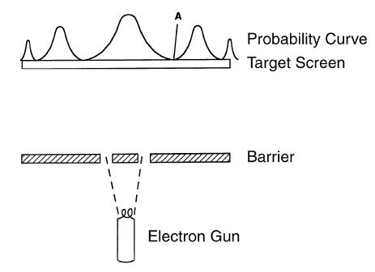
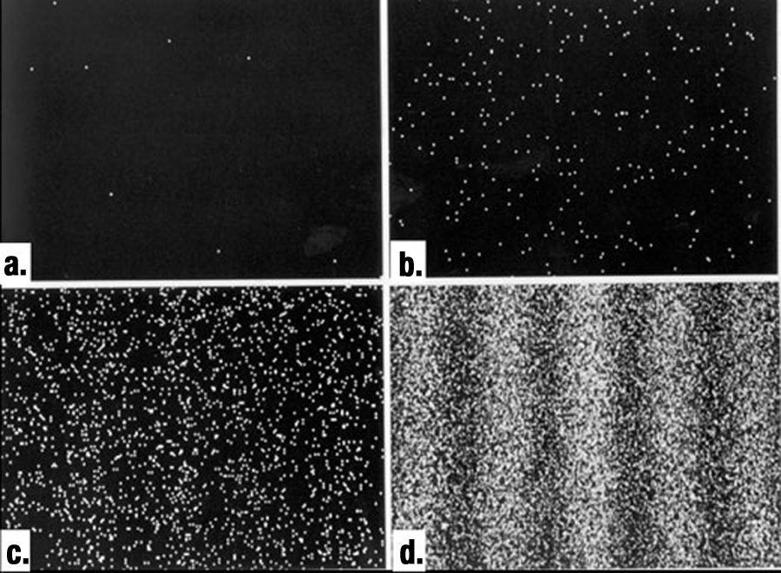
Experimental double slit experiment using electrons
Electrons are detected like particles, but the places that they are detected show interference patterns.
This is essentially the same behavior we observed with photons!

Slide 11
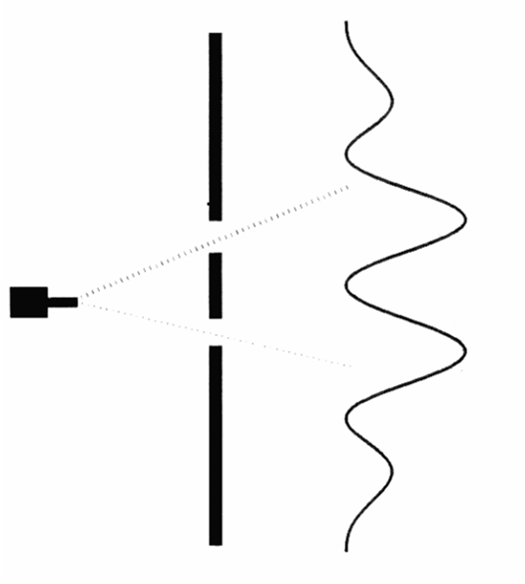

So, which slit does the electron go through?
Electron Detector

Slide 12
The results depend on how and what we measure.
Don’t measure which hole the electron goes through → wave-like behavior.
Do measure which hole the electron goes through → particle-like behavior.
How the electron behaves depends on whether it is observed.
  Deep thought: How does one study an unobserved electron.

Slide 13
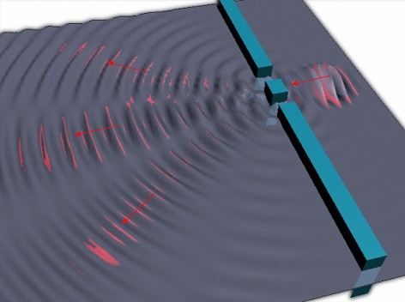
So what is waving?
The “wave” is interpreted as being the probability of locating the particle.
It propagates like a pure wave with diffraction, interference, refraction, etc.

Slide 14
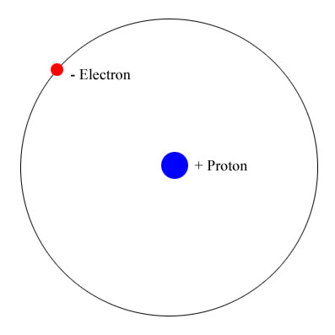
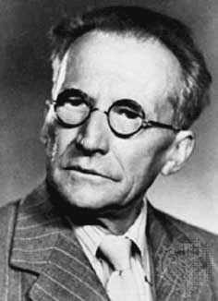
Schrodinger’s equation
In our world
The solution
In infinite dimensional complex space!

Slide 15
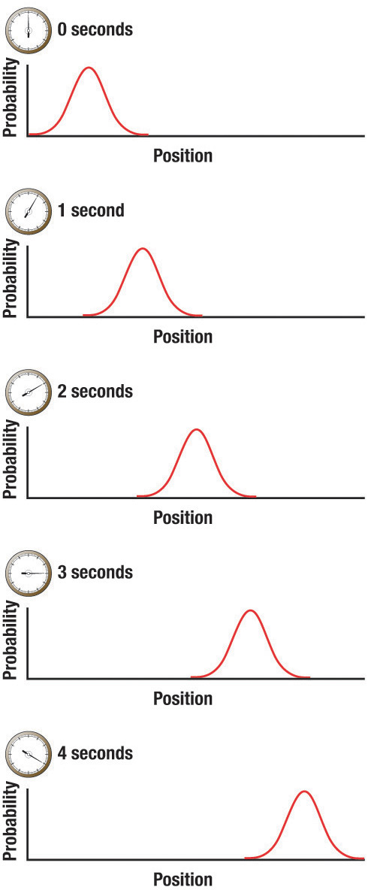
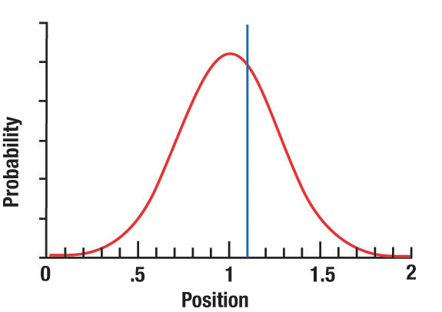
The electron position is described with a probability wave
When we measure the position, we find it at a certain position. We refer to this as the collapse of the wave function.

Slide 16
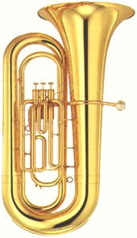
The Uncertainty Principle and waves
To find the trajectory of a particle we must know its position and velocity at the same time.
How do you locate the position of a wave/particle electron?
A well-defined momentum has a well-defined wavelength according to De Broglie.
  wavelength = h / momentum
Pure sine wave →
unclear position but clear wavelength (momentum).
Sharp pulse →
clear position but unclear wavelength (momentum).

Slide 17
Consequences
If we try to find out where an electron is, we know less about where it is going.
Measuring position more accurately makes uncertainty in momentum larger.
classical
Position
Can’t observe
Momentum

Slide 18
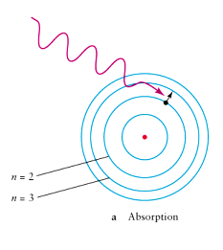
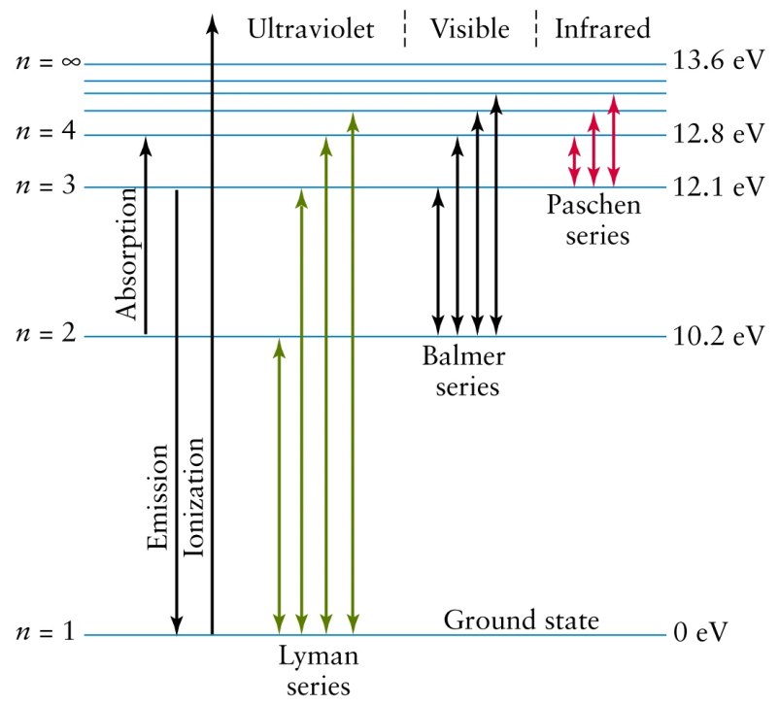
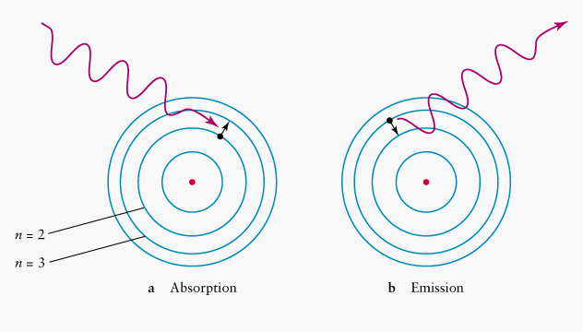
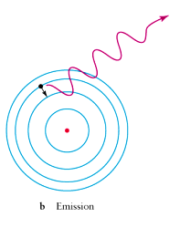
Review: How the Bohr model explains the Hydrogen Atom spectrum
Absorption
Emission
Energy Level Diagram

Slide 19
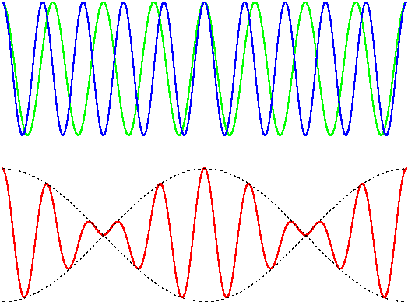
The uncertainty principal states that
We can’t know exactly where a particle is
We can’t know exactly what a particles velocity is
We can’t know exactly where a particle is and what is velocity is at the same time
Scientists are kind of unsure about what they are doing
Wavelength = h / (mass x speed)
tacoma

Slide 20
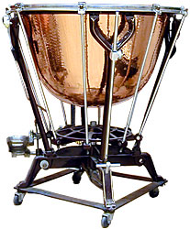
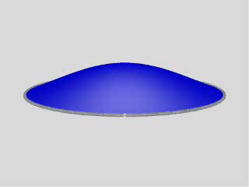
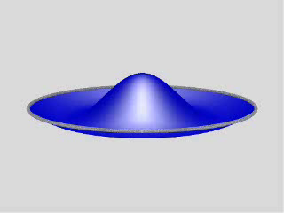
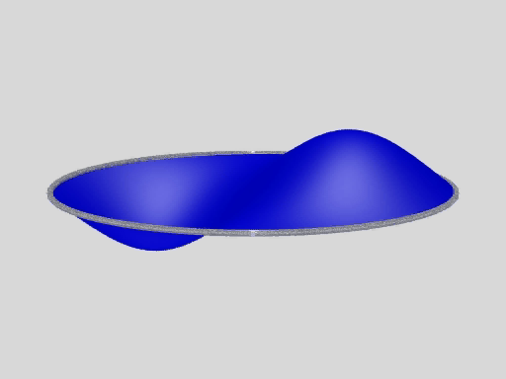
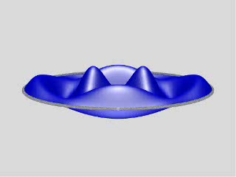
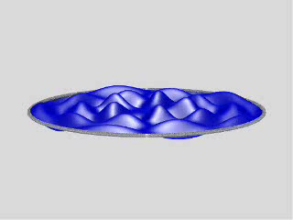
Standing wave modes in two dimensions
Notes:
http://rt210.sl.psu.edu/phys_anim/waves/indexer_waves.html

Slide 21
What is the current understanding of what “waves” when a particle acts like a wave?
The particle’s mass is extended through space and waves
The probability of finding a particle in a given place is spread out and waves
There is aluminiferous ether spread throughout space that waves

Slide 22

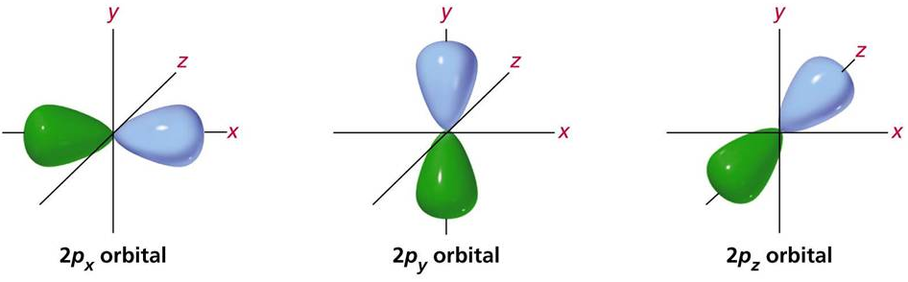
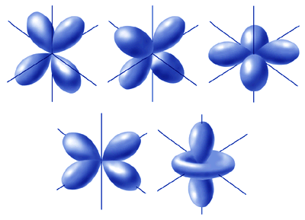
The Wave Model of the Atom
A 3-D electron standing probability wave surrounds the nucleus.
We thus call these standing-wave probability distributions orbitals to reflect the idea that we cannot trace their movement like we can in an orbit (where a particle travels along a specific path).
falstad

Slide 23
QQ: The uncertainty principal states that
We can’t know exactly where a particle is
We can’t know exactly where a particle is and what is velocity is at the same time
We can’t know exactly what a particles velocity is
Scientists are kind of unsure about what they are doing

Slide 24
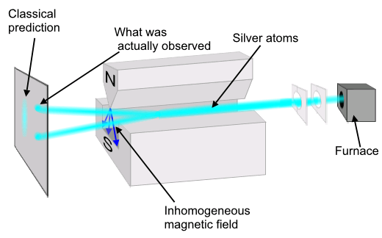
Spin: a new property of matter
When we measure spin, we can only get one of two values:
  Spin up (the electron’s magnet was aligned with our measurement)
  Spin down (the electron’s magnet was aligned opposite our measurement)
Note: The electron is not actually spinning in real space.

Slide 25
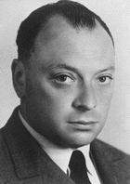
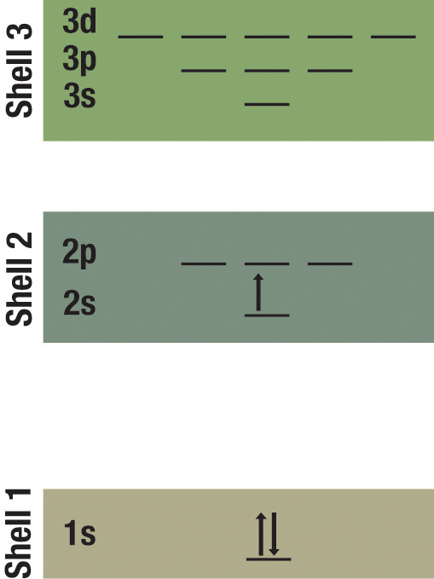
The Pauli Exclusion Principle
No more than two electrons can occupy the same orbital (in a given shell).
If two electrons are in the same orbital, they must have different spins.

Slide 26
QQ: What is the current understanding of what “waves” when a particle acts like a wave?
The particle’s charge is extended through space and waves
There is aluminiferous ether spread throughout space that waves
The particle’s mass is extended through space and waves
The probability of finding a particle in a given place is spread out and waves

