Slide 1
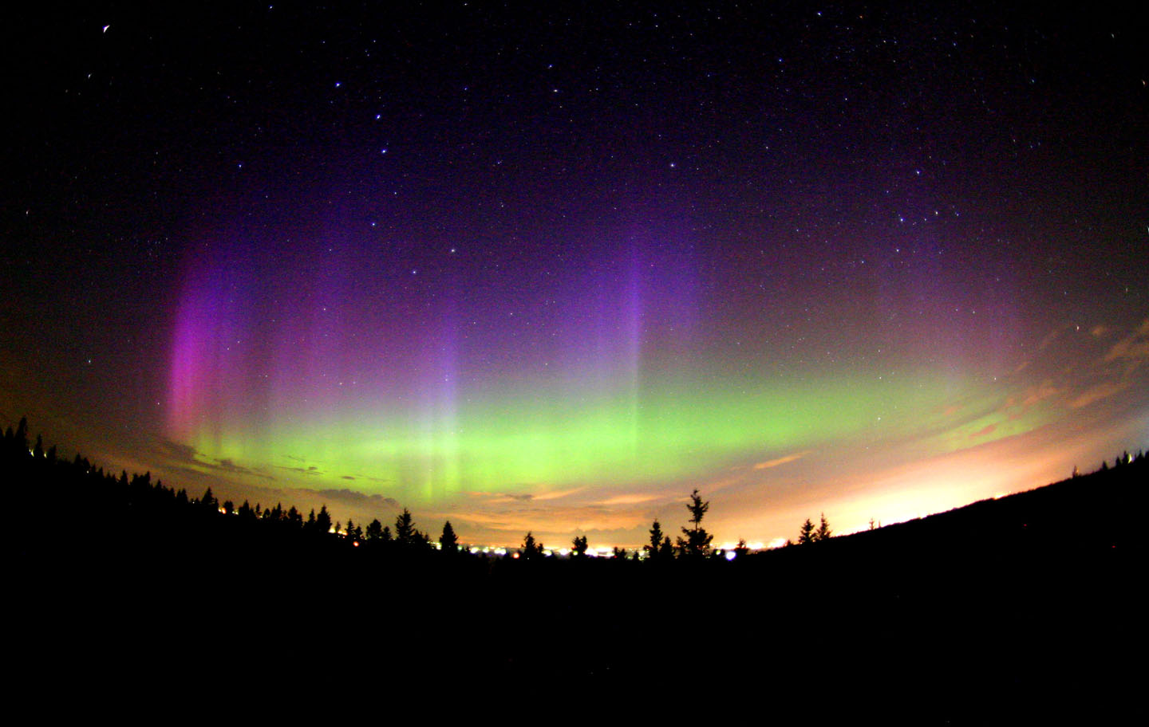
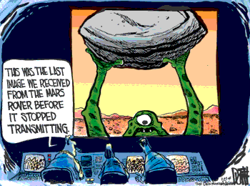
Beyond the earth
Notes:
Dear PS100,
We are considering throwing out the learning objectives for Ch 32 since we really test on solar system formation (the nebular hypothesis). This email message is to alert those who did not attend this morning's inservice meeting so that you can adjust your lecture appropriately. Possible test questions (to be discussed this coming Tuesday morning at 10:00 in our meeting) follow.
Regards,
Scott Bergeson
_Solar System Formation Questions:_
1. The standard model of solar system formation offers what explanation
for the different compositions of the Terrestrial and Jovian planets?
a. During condensation, the heavier elements tended to sink nearer the
Sun and, being rare, only provided enough material to build the
relatively small terrestrial planets.
b. During the collapse of the gaseous nebula, most of the material
tended to collect far from the Sun because of the large centrifugal
forces, which provided the necessary material to build the large Jovian
planets.
c. The large gravitational forces of Jupiter tended to prevent planet
formation in the inner solar system and eventually attracted most of the
material into the region of the Jovian planets.
d. The terrestrial planets were formed near the Sun where, because of
the high temperatures, only heavier elements were able to condense.
2. What was the form of the material from which the solar system formed?
a. A nebula made mostly of hydrogen and helium gas, but enriched in
heavier elements from supernova explosions.
b. A nebula made mostly of heavy elements, but enriched in hydrogen and
helium from supernova explosions.
c. A nebula made entirely of hydrogen and helium gas.
d. Debris from the explosion of a massive star.
3. What process heated the early solar nebula as it slowly contracted
toward a central protosun?
a. Rotational energy transferred to heat by friction between particles
as the nebula slowly revolved around its center.
b. Release of heat by collisions of particles as they gain kinetic
energy in falling toward the center of the nebula.
c. Release of heat as molecules formed and as gases condensed into ices.
d. Thermonuclear fusion in the protosun, followed by radiated heating
of the nebula.
4. More than any other, which physical parameter probably controlled the
early evolution of the planetary system and dictated the characteristics
of the planets that eventually formed?
a. Overall rotation of the nebula.
b. Density of hydrogen gas in the nebula.
c. Mix of chemical constituents.
d. Temperature distribution within the nebula.
5. According to modern theories, the most significant difference between
the formation of the terrestrial and Jovian planets is that
a. both formed by accretion of planetesimals, but the Jovian planets
became massive enough to attract gas onto them directly from the solar
nebula.
b. both formed by accretion of rocky and icy planetesimals, but the
terrestrial planets were close enough to the Sun that almost all of the
ices escaped back to space after the planets formed.
c. the terrestrial planets formed close to the Sun where there was lots
of rock but no ice, whereas the Jovian planets formed far from the Sun
where there was lots of hydrogen and ice but no rocky material.
d. the terrestrial planets formed by accretion of planetesimals,
whereas the Jovian planets formed from streamers of hot gas which shot
out of the protostar.
6. The atoms that make up your body were formed
a. In our Sun
b. By a star existing prior to the formation of the Sun
c. In chemical reactions in the primitive ocean and atmosphere
d. During the Big Bang
e. In a distant galaxy in a different part of the early universe
7. The force that dominates the collapse of gas and dust in the solar
nebula is the
a. Gravitational Force
b. Electromagnetic Force
c. Strong Force
d. Weak Force
e. Tidal Force
8. A curious fact about the structure of the planet Jupiter, compared to
that of Earth, is that it has
a. much greater mass but much lower average density.
b. about the same mass but much greater density.
c. much greater mass and greater average density.
d. much greater mass but about the same density.
9. The most common elements in the universe are:
a. large quantities of heavy elements, with smaller quantities of
hydrogen and helium.
b. equal amounts of hydrogen and helium with small amounts of heavier
elements.
c. equal amounts of all elements up to iron but very little of any
heavier elements.
d. hydrogen, smaller quantities of helium, and very small quantities of
heavier elements.
10. How does the Sun produce the energy that heats our planet?
a. The gases inside the Sun are on fire; they are burning like a giant
bonfire.
b. Hydrogen atoms are combined into helium atoms inside the Sun's
core. Small amounts of mass are converted into huge amounts of energy
in this process.
c. When the gas inside the Sun is compressed, it heats up. This heat
radiates outward through the star.
d. Magnetic energy gets trapped in sunspots and active regions. When
this energy is released, it explodes off the Sun as flares that give off
tremendous amounts of energy.
e. The core of the Sun has radioactive materials that give off energy
as they decay into other elements.
11. In a main sequence star, gravitational collapse is balanced by
a. convection of stellar material from the core.
b. pressure caused by photons produced during nuclear fusion.
c. Solid material at the stellar core.
d. pressure from coronal mass ejections from the core.
e. interior cooling of the star.
_Possible question for 34._
12. Why are the spiral arms of spiral galaxies blue in color?
a. They are usually moving towards us and are Doppler shifted to blue
wavelengths.
b. The gas and dust in the arms filters out all but the blue light
from stars in the arms.
c. Stars are forming in the spiral arms so there are many more high
mass, hot, blue stars present.
d. Almost all the stars of the disk are in the arms of the galaxy and
their light makes it appear blue.
_Geology tie-in questions._
13. The age of the solar system has been dated rather precisely to 4.56
billion years. What method was used to determine this number?
a. Calculating the age of the Sun from the energy it produces.
b. Calculating the age of the Earth by counting layers of geologic
deposits.
c. Determining the age of the Moon, which is older than Earth, by
measuring the density of craters.
d. Determining the age of meteorites by radioactive dating.
14. The reason that most of the terrestrial planets have dense, iron
cores is because
a. Iron solidifies at the highest temperatures, so the iron core
condensed first from the solar nebula. The rocky material then
condensed directly onto the iron core as the nebula cooled.
b. Terrestrial planets were initially molten or partially molten, and
the iron sank to the center.
c. Iron is magnetic, so there was a rapid accretion of iron dust grains
into a core, followed by a slow accretion of rocky grains.
d. Iron solidifies at the highest temperatures, so the iron core
condensed first from the solar nebula. Rocky planetesimals then formed
as the nebula cooled further, and gradually impacted onto the iron core.
15. Volcanoes on Mars have become much larger than on Earth mostly
because Mars lacks:
a. A thick atmosphere
b. Flowing water
c. Plate tectonics
d. A large moon
16. The fact that there are fewer craters on the lunar maria than on the
lunar highlands indicates that the
a. Highlands are younger than the maria
b. Craters formed as a result of volcanic eruptions
c. Maria formed more recently
d. Maria are of volcanic origin

Slide 2
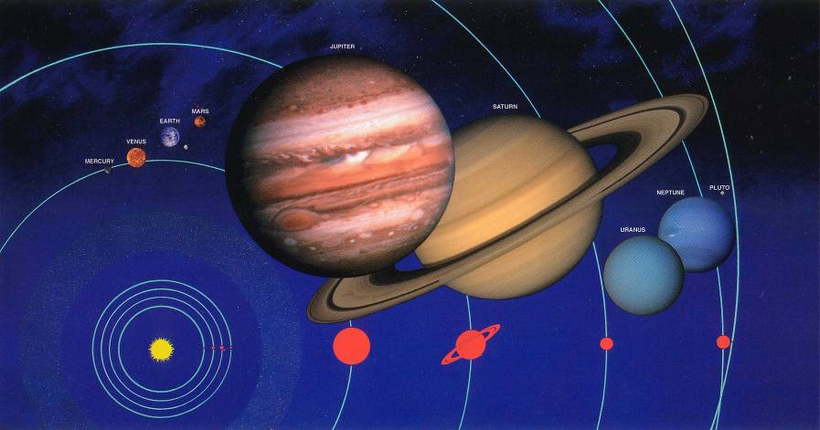
The Solar System
Sun, planets, moons, comets, asteroids, meteoroids.
Sun at the center.
Eight planets, thousands of asteroids, and millions of comets and meteoroids orbit the sun.
Dozens of moons orbit the planets.

Slide 3
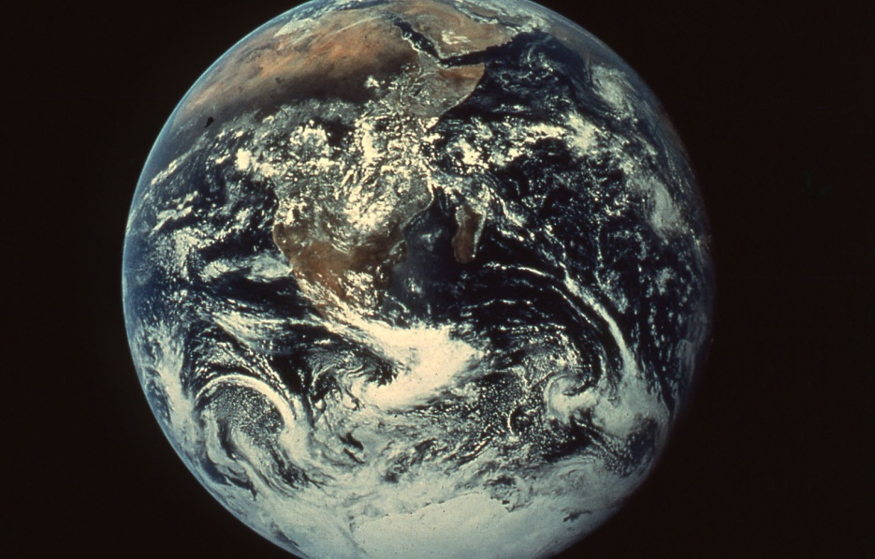
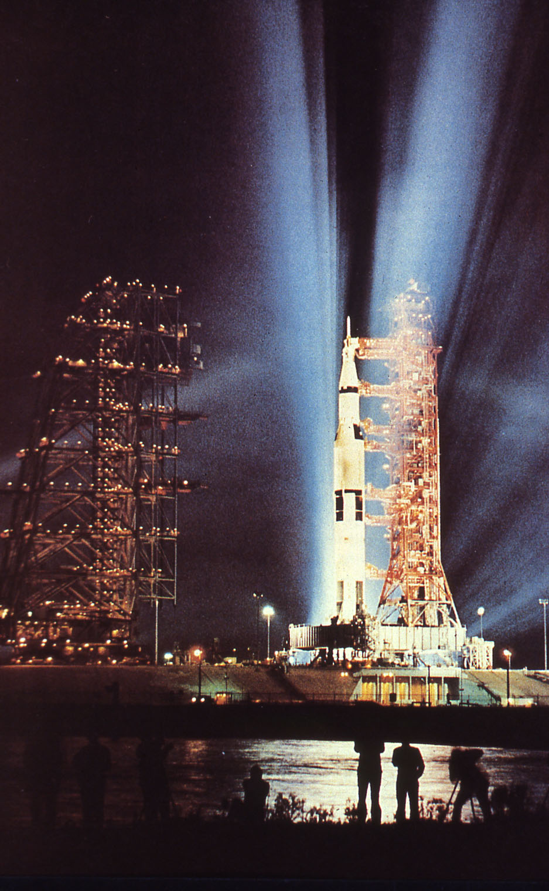
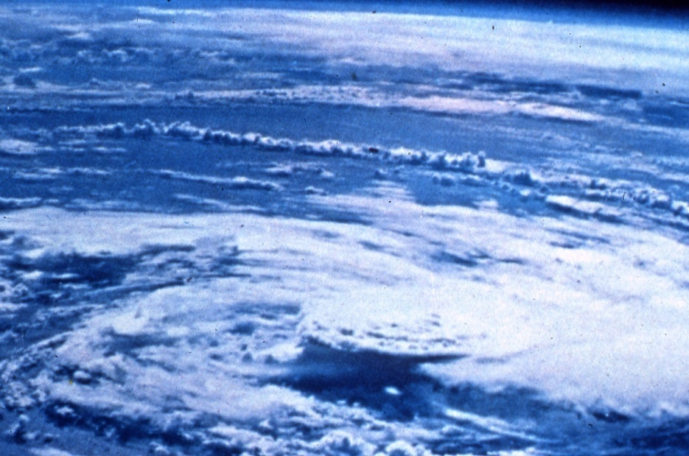
We began our study of the history of the solar system by studying the history of the earth.

Slide 4
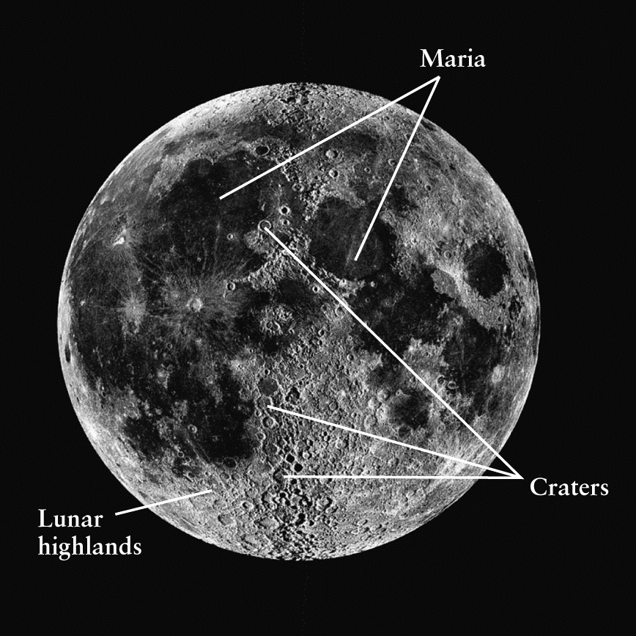
The Moon hasn’t had erosion and plate techtonics erase its history, so it is a good place to start
Three types of terrain:
Maria
Highlands
Craters

Slide 5
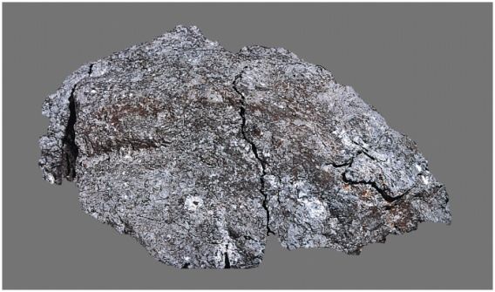
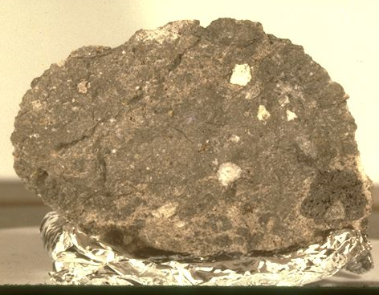
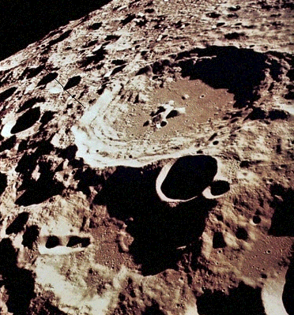
Lunar Highlands
Old, original surface
Heavily cratered.
Made of lighter, aluminim-rich minerals.
Notes:
Breccia ("BRET-cha") is a rock made of smaller rocks that are cemented together. It is like conglomerate that way. The difference between the two rock types is that breccia is made of sharp, broken clasts while conglomerate is made of smooth, eroded clasts.
This is a brecciated mudstone from a northern California beach. It started as a simple rock, but some time after it consolidated, something—probably motion along a fault—shattered it and cemented it together again. The matrix between the clasts appears to be the same substance as the clasts, although there are also a few small veins of silica from the process of brecciation.
There are many different ways to make breccia, and usually geologists add a word to signify the kind of breccia they're talking about. A sedimentary breccia arises from things like talus or landslide debris. A volcanic or igneous breccia forms during eruptive activities. A collapse breccia forms when rocks are partly dissolved, such as limestone or marble. The stone shown here is a fault breccia. And a new member of the family, first described from the Moon, is impact breccia.

Slide 6
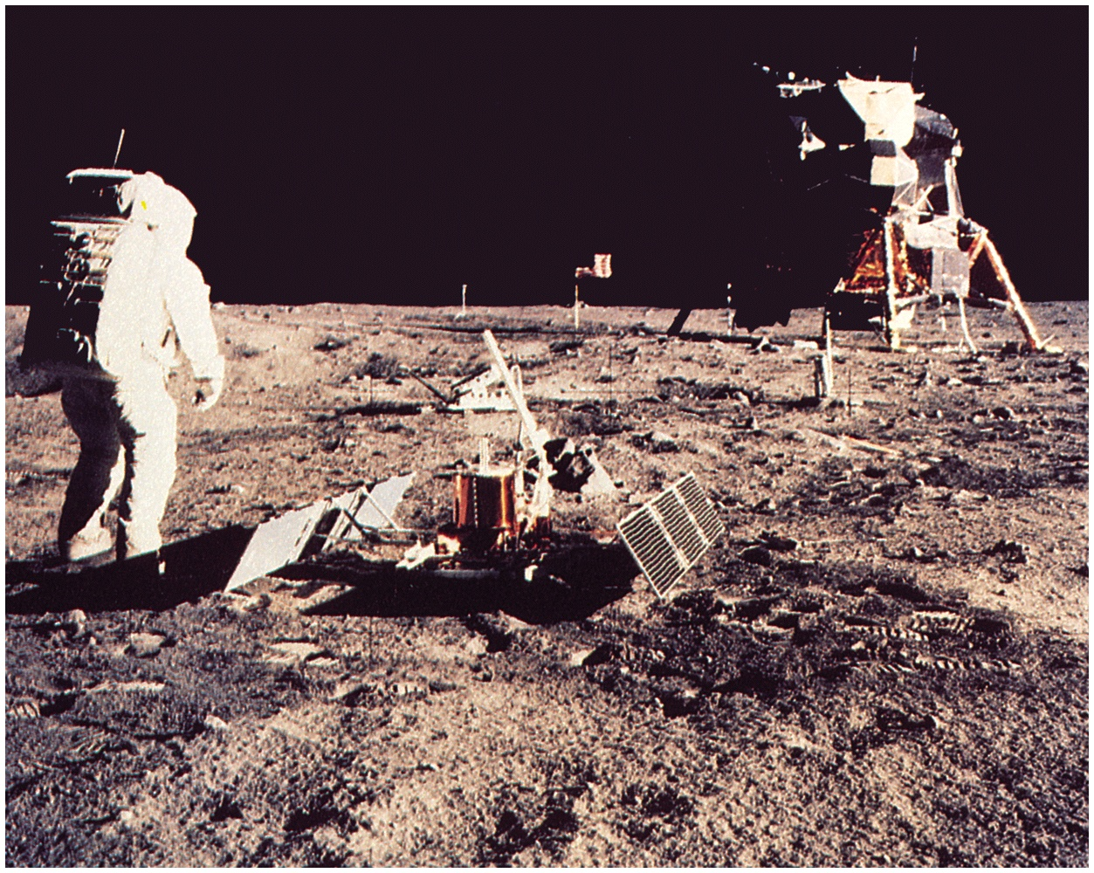
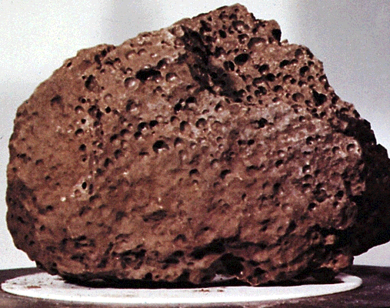
Maria
Younger terrain
Lava flows -- ancient impacts?
Made of heavier mare basalt

Slide 7
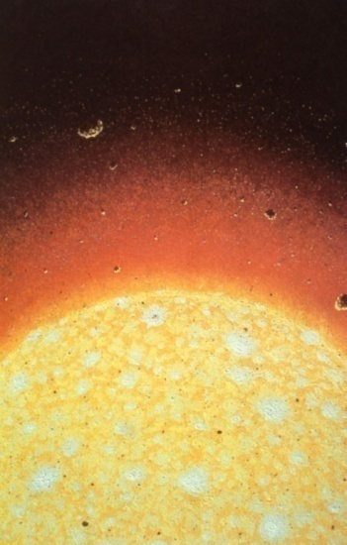
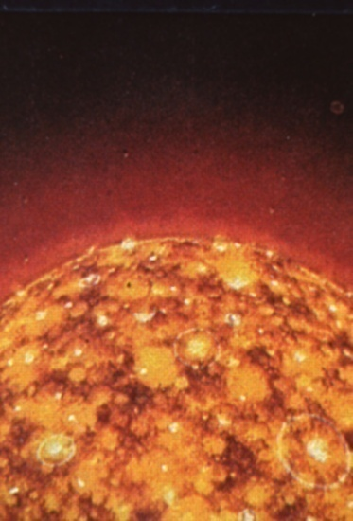
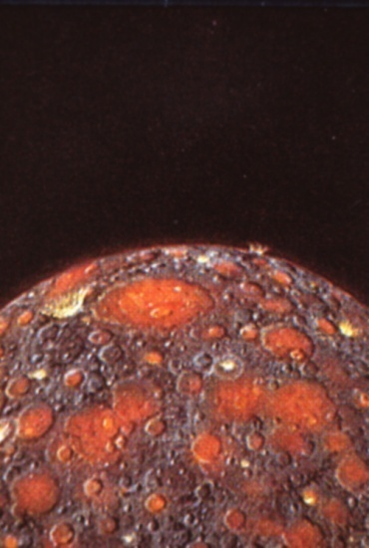
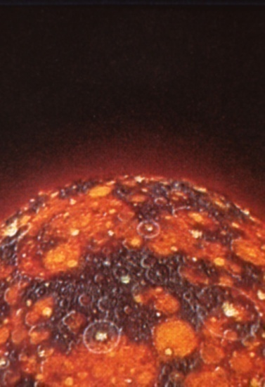
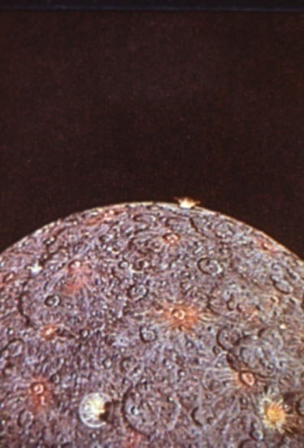
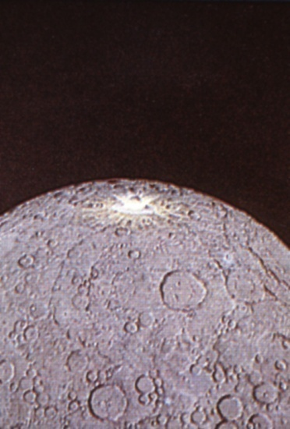
Formation of the moon
The moon absorbed the kinetic energy of objects as the struck its surface (as well as the mass)
Eventually it cooled off, but the cratering still continued.

Slide 8
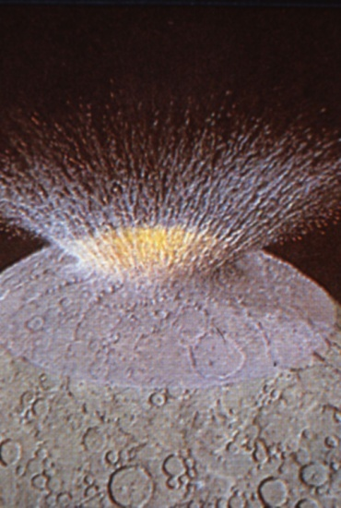
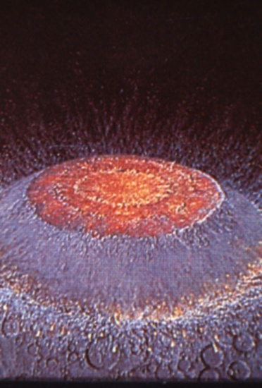
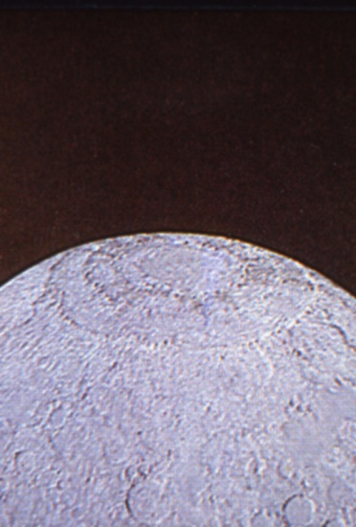
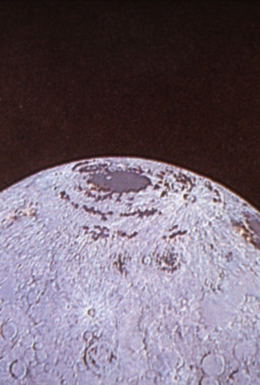
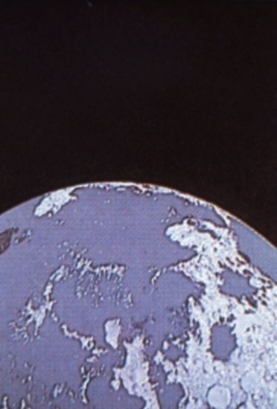
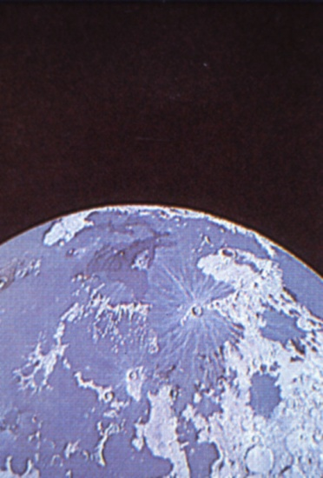
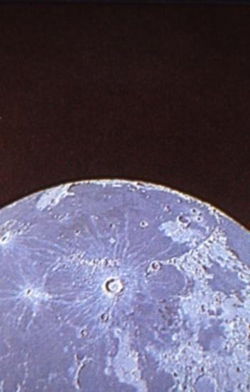
Formation of the Maria
Large impacts may have added enough energy to melt the crust and re-solidify
Later, molten rock, perhaps reheated by radioactive decay, pushed its way through the thing crust an covered the large shallow basins.
Some impact craters are visible on the Maria, but the rate has dramatically decreased.

Slide 9
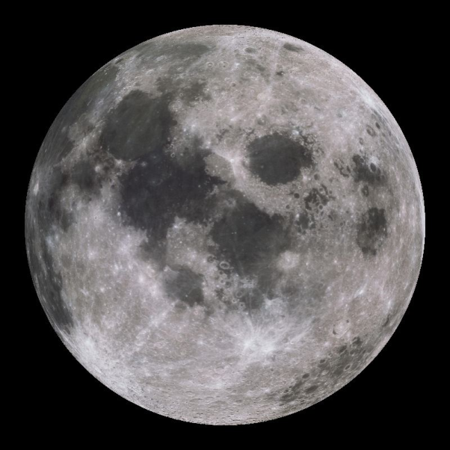
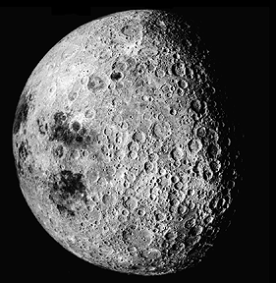
What is true about the moon?
We always see the same side
Its orbital period is the same as the Earth’s about the sun
It rotates around its own axis faster than it orbits Earth
It is not in hydrostatic equilibrium
The temperature ranges from 90 to 370 Fahrenheit.

Slide 10
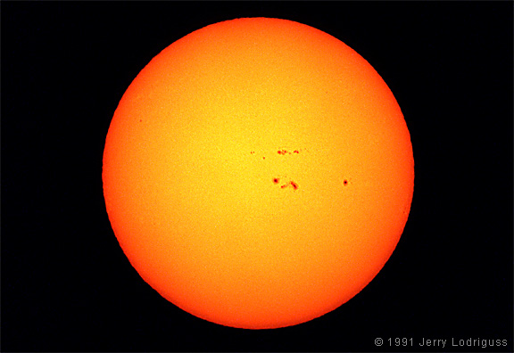
How about the rest of the solar system? Some stats on the Sun
Time for light to reach Earth
8.32 minutes
Mass ~ 2 x 10³⁰ kg
~ 333,000 more massive than the Earth
Composition by number of atoms
92.1% Hydrogen
7.8% Helium
0.1% everything else
Surface temp ~ 5800 K
Interior temp ~ 15,500,000 K
The Sun contains more than 99.85% of the total mass of the solar system
If you put all the planets in the solar system, they would not fill up the volume of the Sun
110 Earths or 10 Jupiters fit across the diameter of the Sun

Slide 11
Patterns in the Planets
The inner four planets, Mercury, Venus, Earth, and Mars are small, rocky, with hard surfaces. These are called Terrestrial.
The outer four planets, Jupiter, Saturn, Uranus, and Neptune are large, gas spheres. These are called Jovian.
Icy, Kuiper Belt objects at large distances, such as Pluto fits neither category and are essentially dirty snowballs

Slide 12
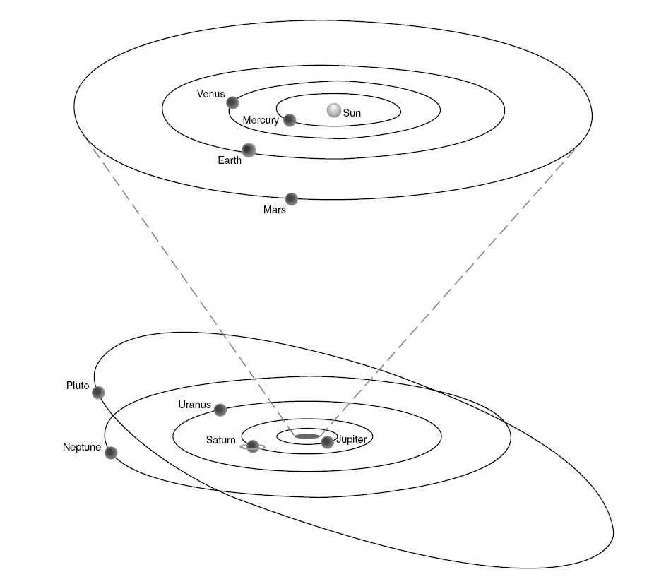
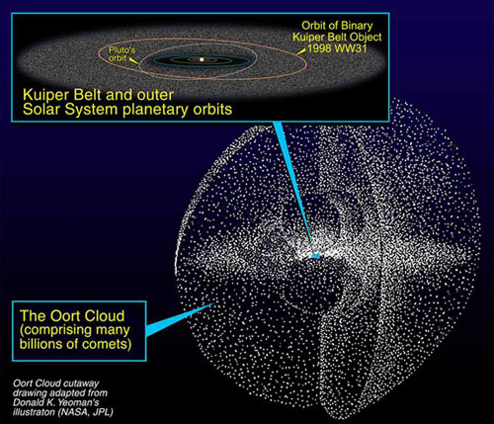
Orbital positions of the planets
Terrestrial Planets
Jovian Planets

Slide 13
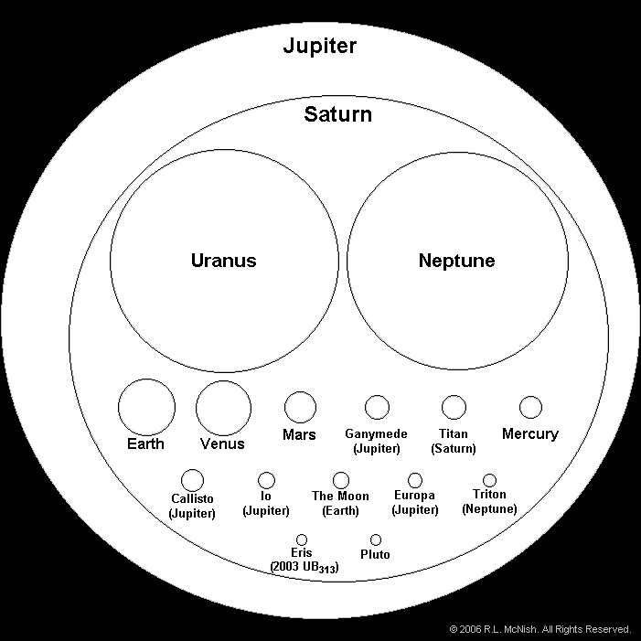
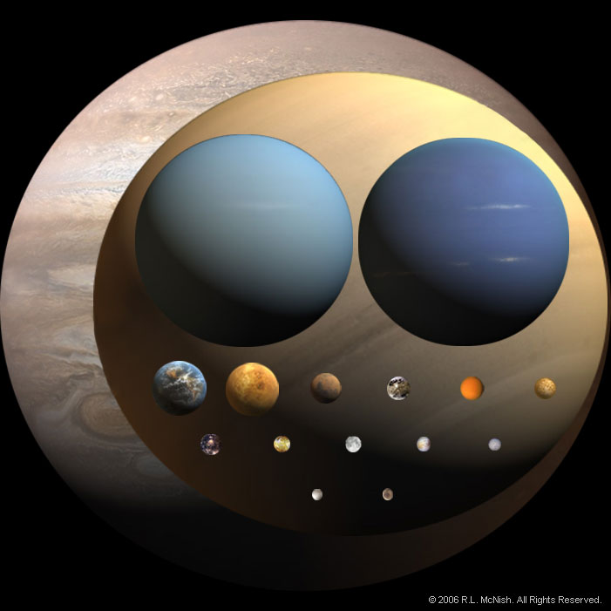
Relative Sizes

Slide 14
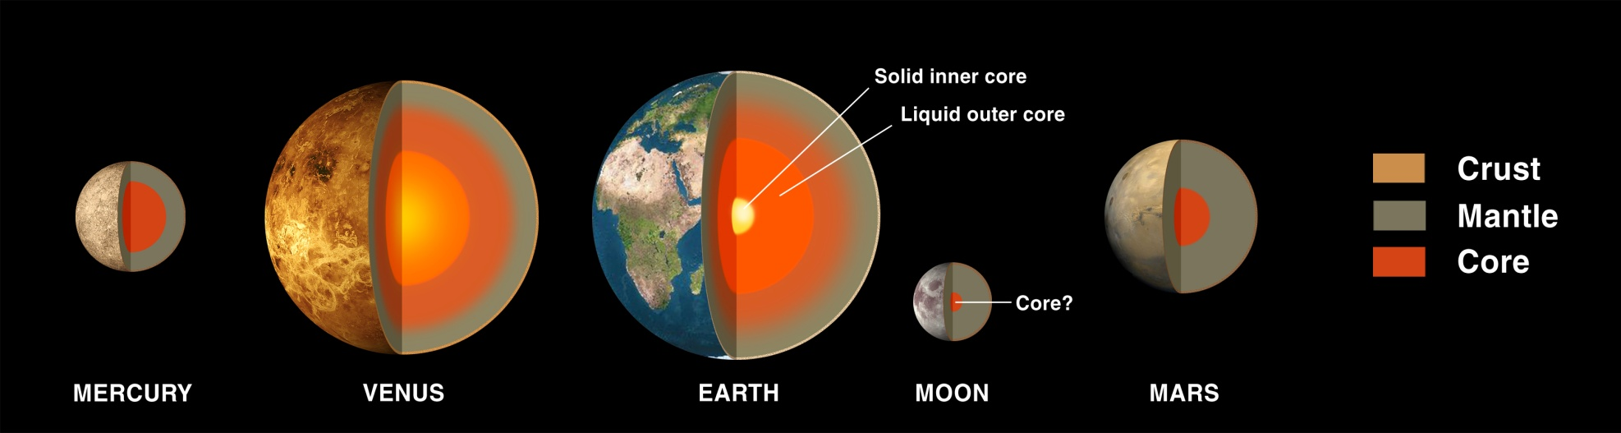
Terrestrial planets are extremely dense
Each planet has solid core.
Earth and perhaps Venus still have a liquid core

Slide 15
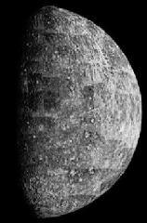
Mercury
moon-like
rocky
small
very hot on sun side
slow rotation
Mariner 10; Messenger

Slide 16
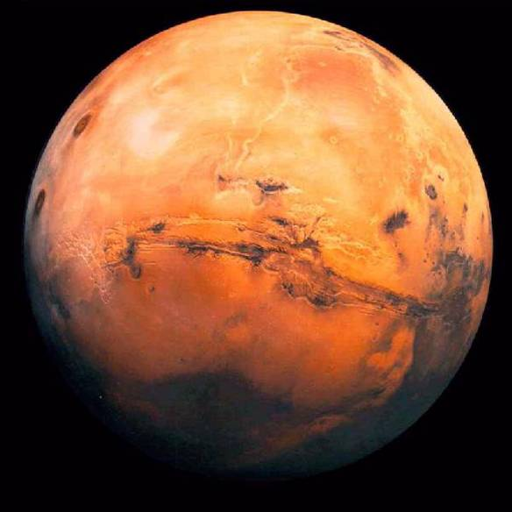
Mars Hydrologic & Atmospheric Systems
Polar Ice Caps
H₂O and CO₂
Substantial seasonal changes in size
Dust Storms
May cover the entire planet at times
Thin Atmosphere
Mostly CO₂
Evidence for periods with liquid water
Layered sedimentary rocks
“Blueberries” – concretions
Old river channels

Slide 17
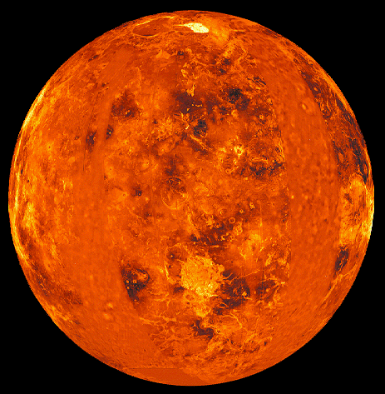
Venus
earth-like in size, density
Rocky
Structures
Faults
No Plate Tectonic System
No Hydrologic System
No Magnetic Field
retrograde rotation
very dense atmosphere
Strong greenhouse effect; very hot surface
perpetual clouds
surface visited by Soviet probes
surface mapped by radar (Magellan)
ESA’s Venus Express orbit insertion 11 April 2006

Slide 18
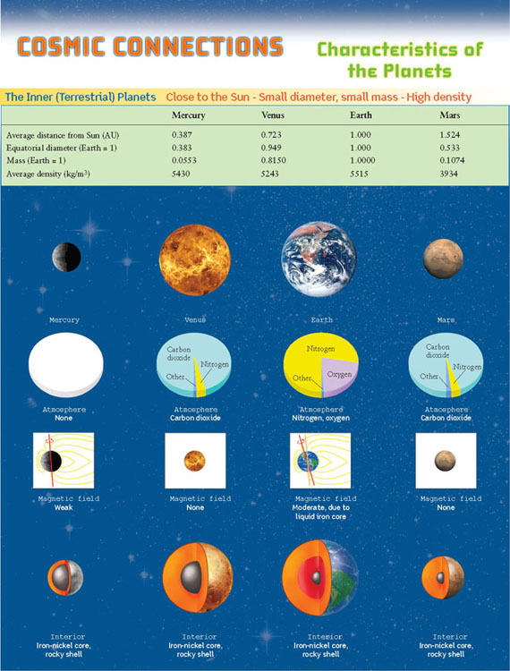
Terrestrial Planets
Atmospheres slightly different compositions
CO₂, N₂, O₂
Or None
Variable sizes for the cores of these planets
Varying densities

Slide 19
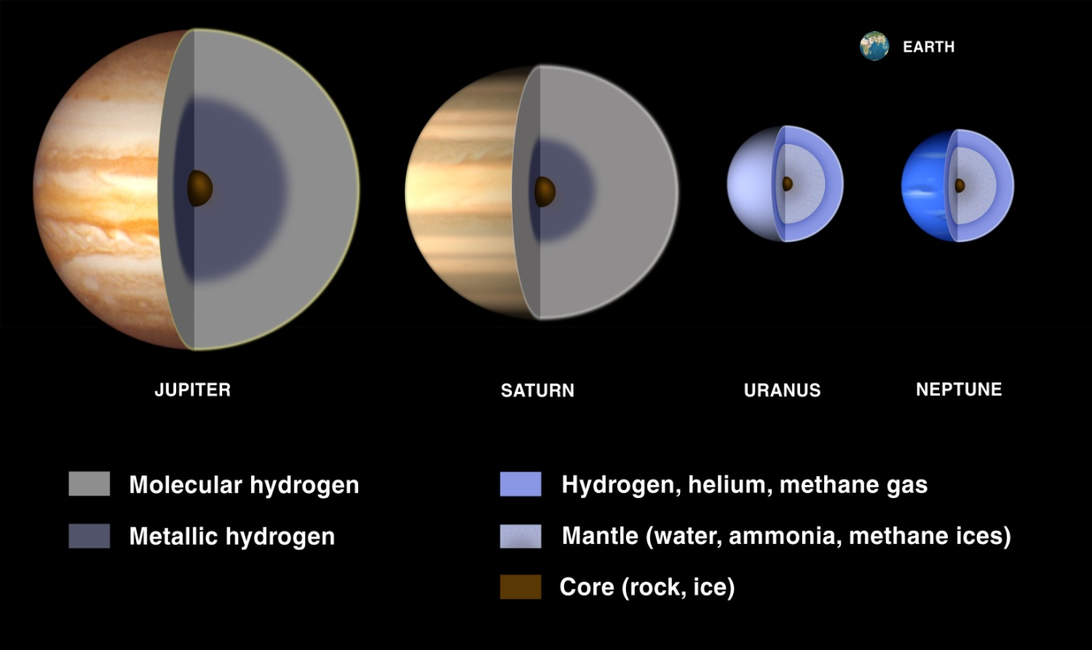
Jovian planets have extremely low densities
Possible solid core
Molecular and metallic hydrogen shells
Jupiter and Saturn
Mantles of water and ice
Uranus and Neptune

Slide 20
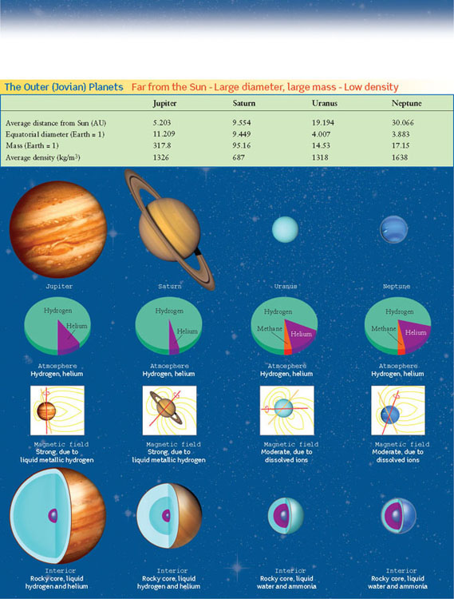
Jovian Planets
Atmospheres consist mostly of hydrogen and helium
Uranus and Neptune have a little methane as well – blue color
Varying tilts and magnetic fields
Different cores

Slide 21
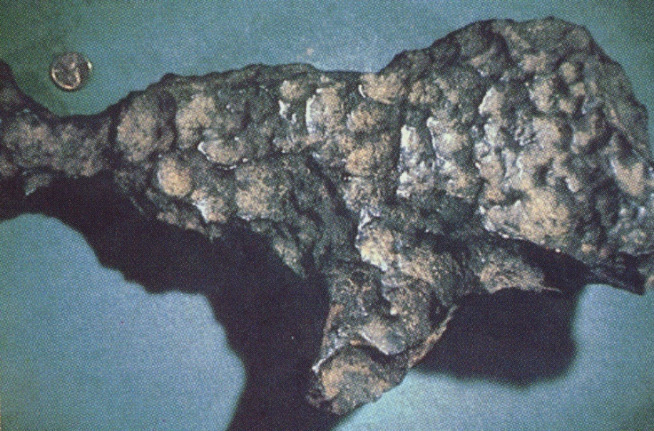
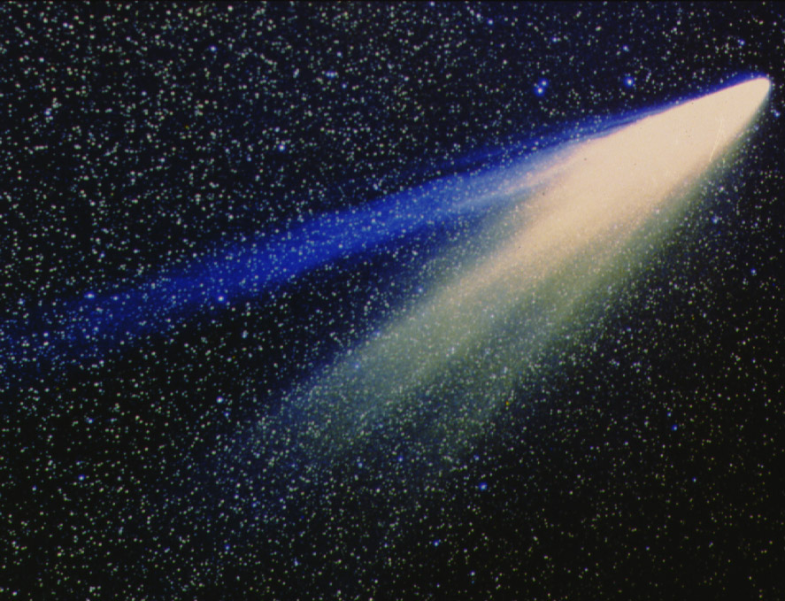
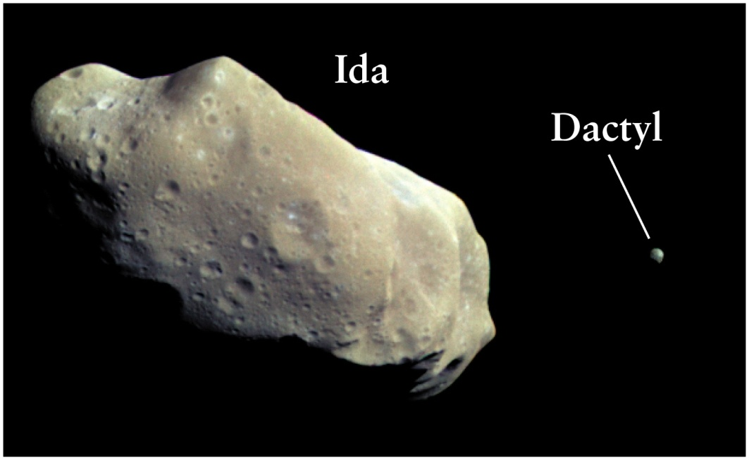
Smaller bodies in the solar system
Meteorite/Meteoroid
Comet
Asteroid
Notes:
A meteorite is a natural object originating in outer space that survives an impact with the Earth's surface. While in space it is called a meteoroid.

Slide 22
Formation of the Solar System
Any model to explain how the solar system formed must address the following points
Sun contains 99.85% of all the matter – mostly hydrogen and helium
Terrestrial planets composed primarily of rocks and metals – very little hydrogen or helium - extremely small in size
Jovian planets composed primarily of hydrogen and helium – very little rock and ice – giant in size
All the planets orbit the Sun in the same direction
All the planets orbit in nearly the same plane
The smaller terrestrial planets orbit closer to the Sun then the giant jovian planets

Slide 23
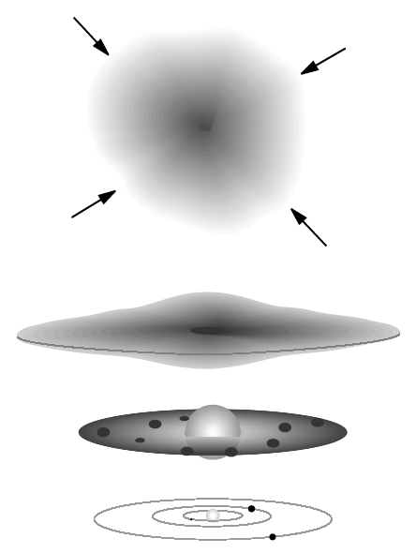
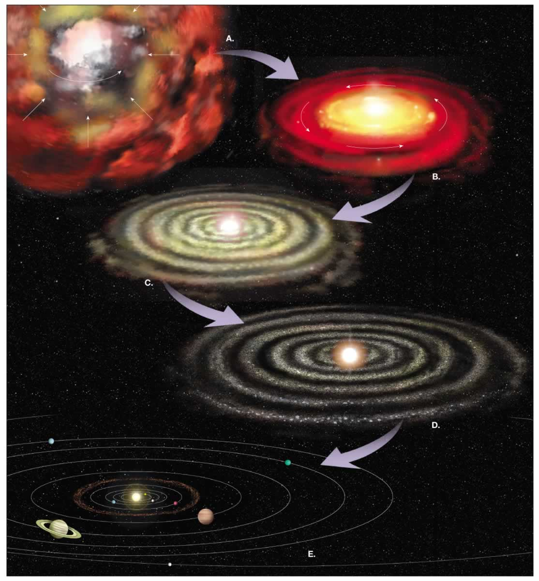
How did the solar system form?
Nebular Hypothesis
Condensing cloud of hydrogen, helium, iron, etc.
As cloud collapsed into protostar the rate of rotation increased and some of the gas formed a disk (like pizza dough)
Most of the mass collapsed in the center to form the sun
Density variations in outer part of disk caused some of the mass to collect into planetesimals (many miles in diameter)
Protoplanets swept up most of the nearby debris. There were occasional “catastrophes” when large planetesimals collided with protoplanets.
How long ago? ~4.6 billion years

Slide 24
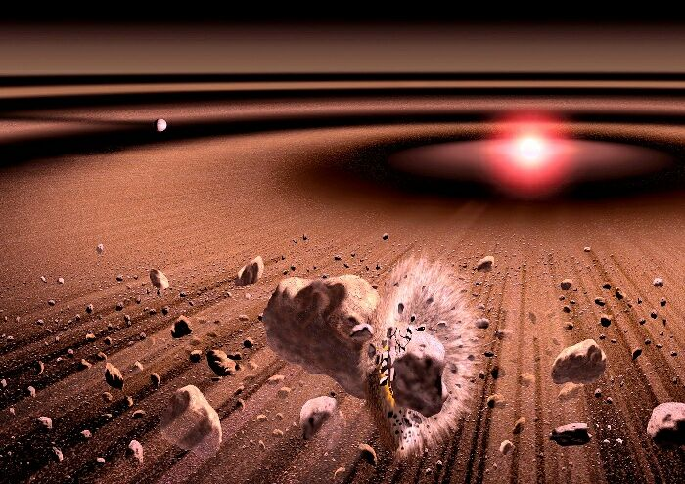
Evidence for the Nebular Hypothesis
Densest planets are nearest the sun
Planets revolve in almost the same plane
Most planets rotate in the same direction as they revolve (Venus and Uranus are exceptions)
Craters exist on most planets and moons.
Radioactive dates of earth, moon, and meteorite rocks are consistent.
The earth still collects tons of meteoric material each day.
We observe other solar systems in the process of formation, and their behavior seems to be consistent with this process.

Slide 25
Come up with your own mnemonic acronym device to memorize the planets

Slide 26
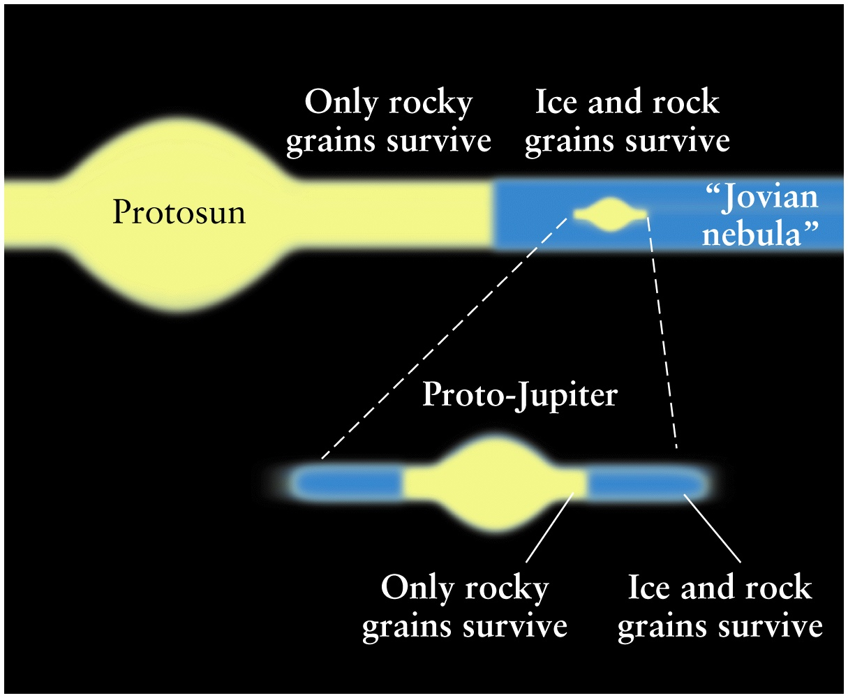
Jupiter and Saturn are “mini-solar systems”

Slide 27
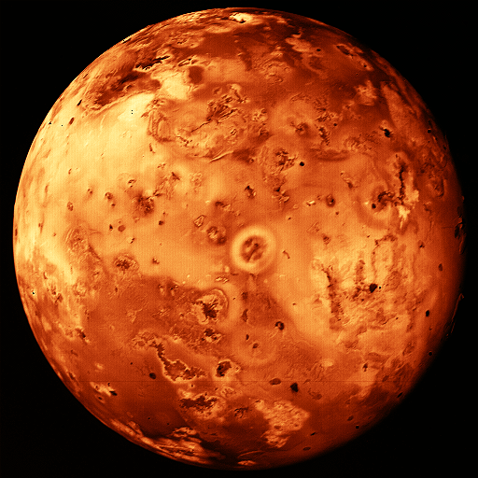
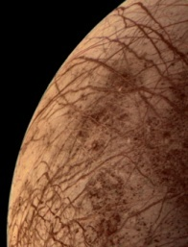
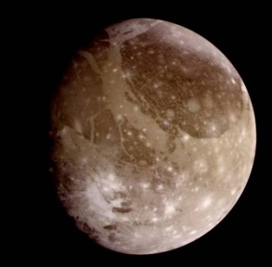
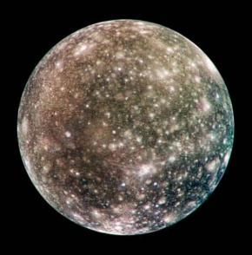
Jupiter’s Galilean Moons
Io
Volcanically active
High density (3.5 g/cm³)
No craters
Europa
Ice surface may overlie liquid water ocean
High density (3.0 g/cm³)
No large craters, only small ones
Many cracks and fissures in ice surface
Ganymede
Larger than Mercury
Lower density (1.9 g/cm³)
Younger surface is cracked and healed ice
Old cratered terrain
Callisto
Lower density (1.8 g/cm³)
Old highly cratered ice surface

Slide 28

Temperature & Density Determine what Kind of Planets Form
Near the star
Temperatures are high
Light elements like hydrogen are driven off by radiation
Leftover, heavier elements form dense, terrestrial type planets
At intermediate distances
Temperatures lower
Lots of gas (mostly H, He)
This condenses to form gas giants
At large distances
Lowest temperatures & least amount of material in largest space
Small amounts of cold material condense to form icy objects
It is believed that a large belt of these objects exist, but they are difficult to observe.

Slide 29

Finding Distances Precisely
Within the Solar System we can often use Radar Ranging.
Radiation from radar travel at the speed of light
Measure time from transmission to detection
Distance = (speed of light) x (time delay) ÷ 2
Using communication with space probes we have found distances to all planets but Pluto to within a few meters!

Slide 30


Laser Ranging to the Moon
Laser ranging allows us to measure the distance to the moon to extreme precision. However, it is not a practical method for places we haven’t visited.
Notes:
The McDonald Laser Ranging Station (MLRS) is a dedicated laser ranging station capable of measuring round trip light travel times to a constellation of artificial earth satellites and lunar retro-reflectors to a precision of about 1 centimeter and time of laser firing to about 35 picoseconds. Data from this station as well as 30-40 similar satellite-capable systems and one other regularly contributing lunar-capable system around the world are used for a variety of scientific pursuits including study of the earth's gravitational field, plate tectonics, earth's orientation in space, high precision time transfer, relativity, lunar and solar system dynamics, and providing high precision orbits for GPS and ocean top mapping missions.
MLRS History

Slide 31


Beyond our solar system: The milky way (our galaxy)
~400 billion stars
All objects visible at night with naked eye are in our own galaxy
Diameter = 100,000 light years
Closest Neighbor is 1,000,000 million light years
Spiral Arms
Galactic
Nucleus
Our Solar System

Slide 32

Triangulation
Used to find distances to nearest stars.
Same techniques used in land surveys
For astronomy, it builds upon the fact that we know the orbital radius of the earth very precisely.
Earth
Star
☼
90 degrees
Sun
68 degrees
Earth

Slide 33

Triangulation
Can be used to find distances to the nearest ~10,000 stars.
All methods of finding greater distances build on this!

Slide 34

Why do optical telescopes work better when they are in space?

Slide 35


What part of the electromagnetic spectrum allows us to look into the center of the Milky-Way?

Slide 36

Name one method used to measure astronomical distances.

Slide 37

Quiz: Three main sequence stars have different colors, but the same brightness. Which one is closest to the Earth?
The bluest one
The reddest one
The yellowest one
Impossible to tell from color

Slide 38





A very massive star (more than 10 times the size of our sun) becomes what at the very end of its life?
Black hole
Neutron star
White dwarf
Pulsar
Red giant

Slide 39


According to the currents models of stellar evolution, our sun will eventually become a
Cloud of hydrogen gas
Protostar
Neutron star
Black hole
White dwarf

Slide 40
Why does fusion stop at Iron?
10
Elements lighter than iron undergo fission.
There is an energy density limit of the fundamental forces
Elements heavier than iron do undergo fusion.
Average nucleon mass
0
of
5
Fe
Atomic mass number
Answer Now

Slide 41

Name one piece of experimental evidence in support of general relativity.

