Slide 1
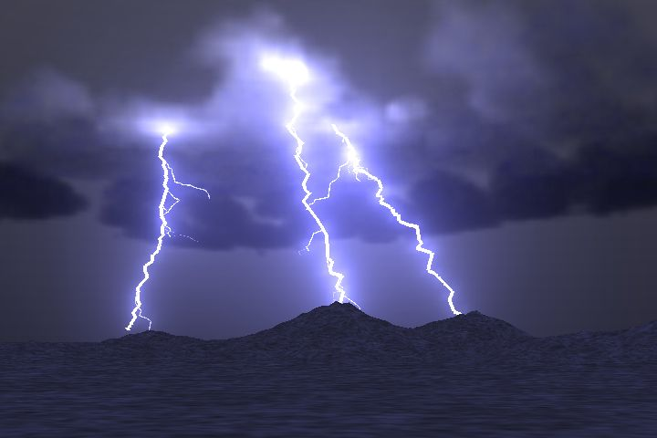
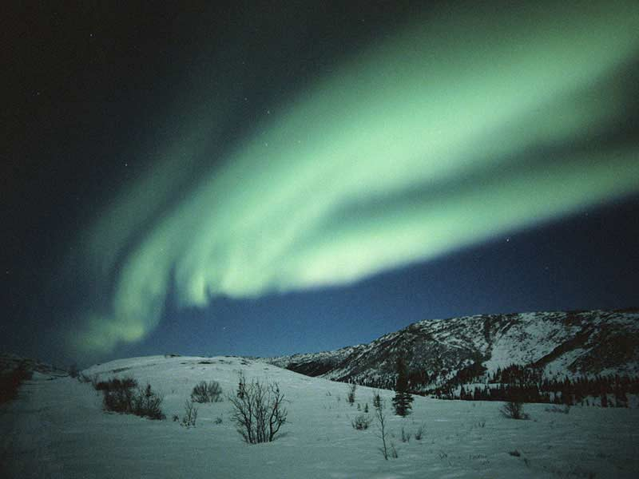
QQ3: What is this state of matter?

Slide 2
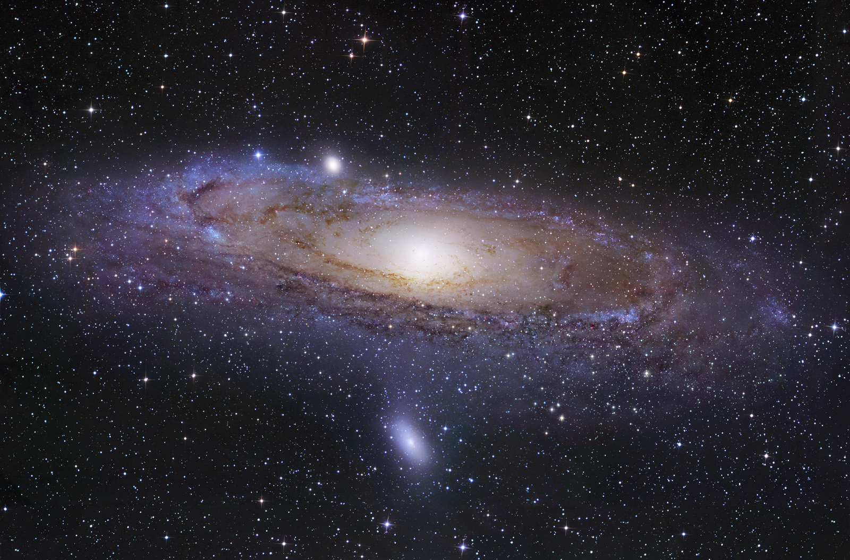
QQ4: What is the most common state of matter in the visible universe?
Solid
Liquid
Gas
Plasma
Earth

Slide 3
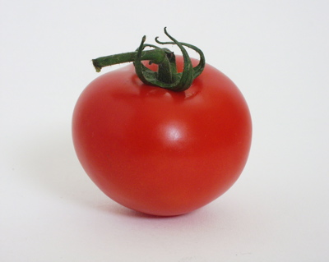

The color of an object gives information about its composition
The color of an object is determined by what wavelengths of light it reflects (or emits)
  Examples: Tomatoes reflect red light, and absorb other colors.
  Clover reflects green colors, absorbs others

Slide 4
The spectrum of light source is a measure of which wavelengths are present
continuous spectrum
discrete spectrum -- only a few specific colors
Discrete absorption spectrum – All colors but a few lines

Slide 5


Continuous model of matter

Slide 6
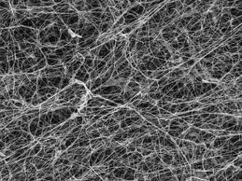
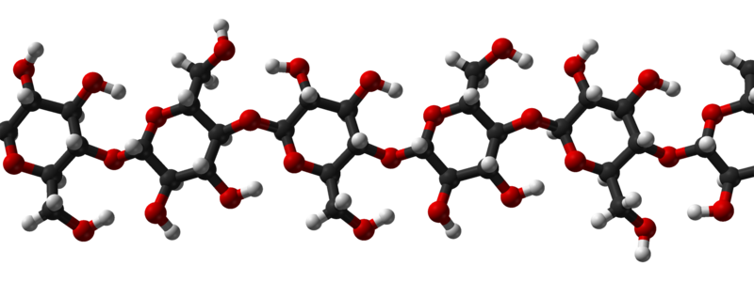
The Molecular Model of Matter

Slide 7
Continuous Model
Useful in many situations:
  Fluid dynamics
  Classical Electrodynamics
Has many limitations
  Charge and light come in distinct packets
  How do changes of state occur??!?
  Etc.

Slide 8
QQ5: Density vs. Weight
What is heavier, 3lbs. of steel or 3 lbs. of Styrofoam?
Styrofoam
Steel

Slide 9
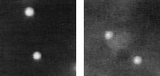
Brownian Motion
The erratic, jittery motion of a dust speck in a fluid is strong evidence supporting the molecular model.
  The speck is colliding randomly with unseen molecules.
Notes:
In both cases the fluorescent particles are 2 microns in diameter. The left picture shows particles moving in pure water; the right picture shows particles moving in a concentrated solution of DNA, a viscoelastic solution in other words. The movies are 4 seconds of data, total; you can see a slight jump in the movie when it loops around.
http://www.deas.harvard.edu/projects/weitzlab/research/brownian.html

Slide 10
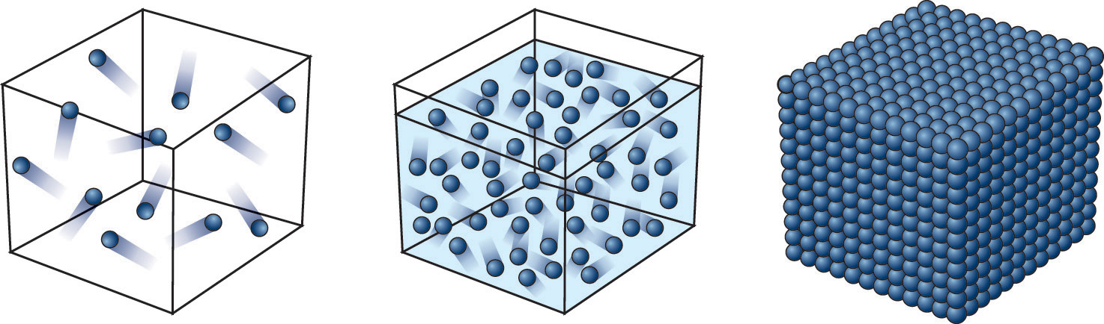
States Explained with Molecular Model
Solid: The molecules are frozen in place but still vibrate.
Liquid: The molecules move past each other but still have a weak attraction.
Gas: The molecules only interact when they collide.
Plasma: The molecules collide with enough energy to break into charged pieces.
+
-

Slide 11
Temperature Explained with Molecular Model
Temperature is a measure of the average kinetic energy of the molecules.
  Cold → slowly moving
  Hot → rapidly moving
  Absolute zero → motion ceases (-460 F, -273 C)
Notes:
Because the oven doesn't go to 700 degrees.

Slide 12
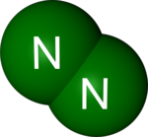
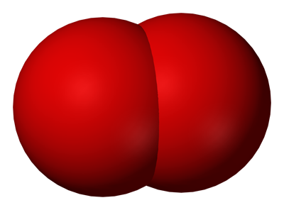
Example
At room temperature molecules are moving about 1,000 ft/s
average length of blue arrows
O
O
Notes:
Because the oven doesn't go to 700 degrees.

Slide 13
Example
At room temperature molecules are on average about .0000002 feet apart
O
O
Notes:
Because the oven doesn't go to 700 degrees.

Slide 14
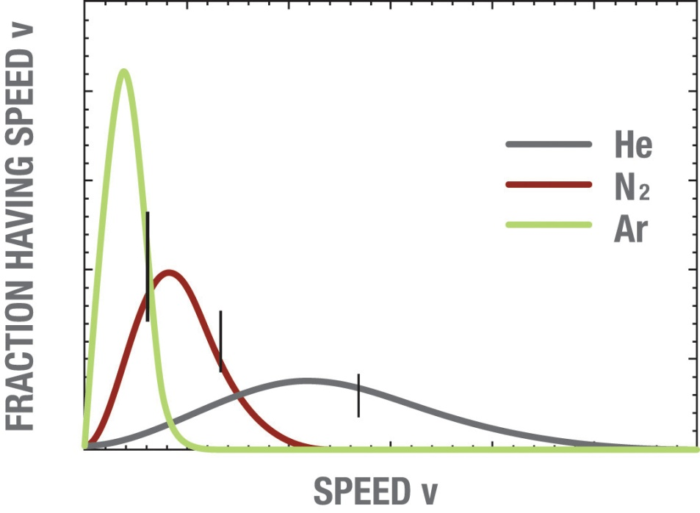
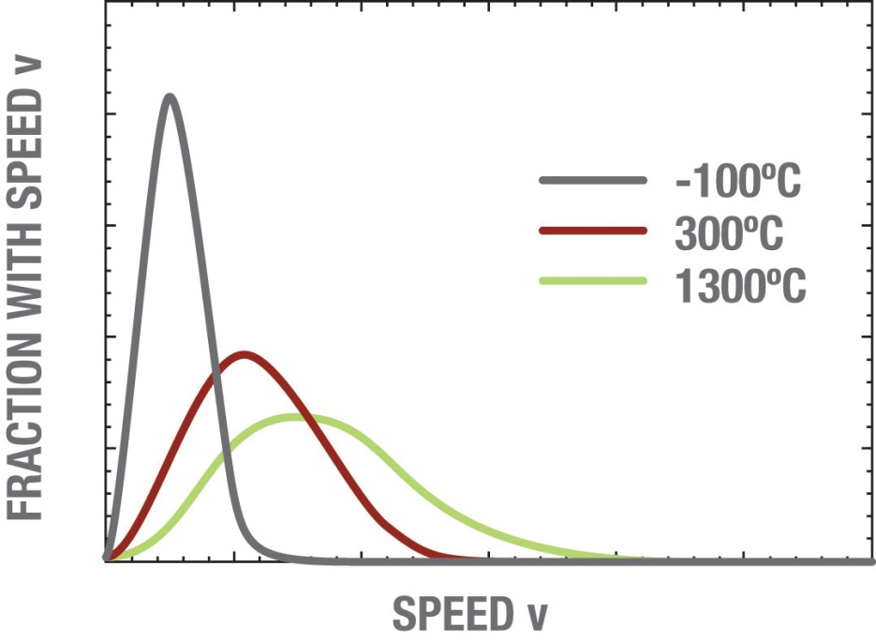
Temperature is a measure of the average kinetic energy of a collection of molecules

Slide 15
Off to the molecular races
The kinetic Energy is the same for both NH₃ and HCl
but HCl has about twice the mass

Slide 16
Which molecule has a greater avg. speed?

Slide 17
Which molecule has a greater avg. speed?

Slide 18

Off to the molecular races

Slide 19
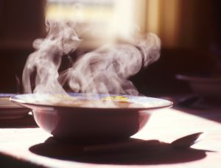
Evaporation Explained
Temperature is a measure of the average kinetic energy.
Some molecules go faster and some go slower.
The fast ones escape as a gas even when the average temperature is below boiling.
How are you able to cool soup by blowing on it?

Slide 20
QQ6: Temperature is a measure of
The number of particles in a system
The average kinetic energy of the molecules.
The rate of change of chemical reactions
Heat flow in the room
Nitrogen content
Notes:
Because the oven doesn't go to 700 degrees.

Slide 21
QQ7: Random Molecular Collision Motion
What is this erratic, jittery motion called?
Greenian Motion
Soberiety Waltz
Kinetic Theory
Brownian Motion
Anxiety Induction
Notes:
In both cases the fluorescent particles are 2 microns in diameter. The left picture shows particles moving in pure water; the right picture shows particles moving in a concentrated solution of DNA, a viscoelastic solution in other words. The movies are 4 seconds of data, total; you can see a slight jump in the movie when it loops around.
http://www.deas.harvard.edu/projects/weitzlab/research/brownian.html

Slide 22
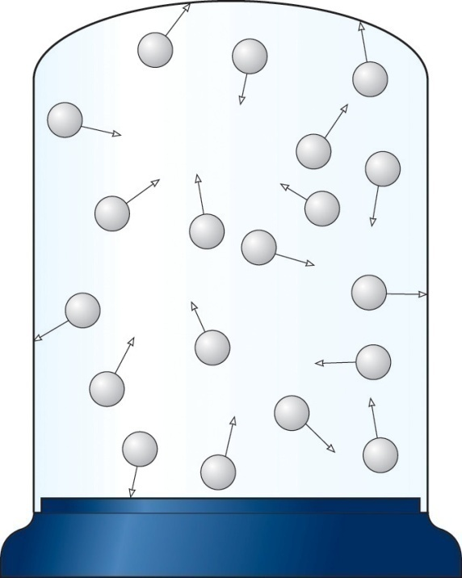
Gas Pressure Explained
Like throwing a huge number of tiny balls against a wall repeatedly.

Slide 23
Gas Pressure and Temperature
Gas pressure increases with temperature if the gas cannot expand. The hotter molecules hit the container walls harder and more often than the cold ones.
Colder
Hotter

Slide 24
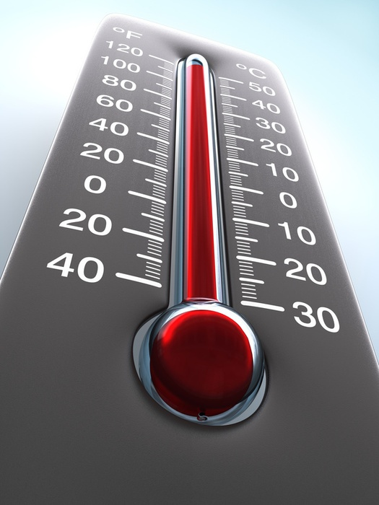
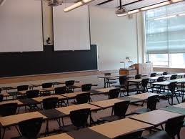
If the temperature in a closed room increases…
The pressure decreases
The pressure increases
The number of gas molecules increases

Slide 25
QQ7: If the pressure in a closed room increases…
The temperature decreases
The number of gas molecules increases
The temperature increases

Slide 26
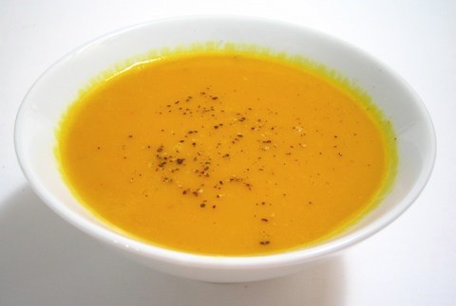
The Physical Properties of Matter
QQ8: Kinetic Theory
How are you able to cool soup by blowing on it?

Slide 27
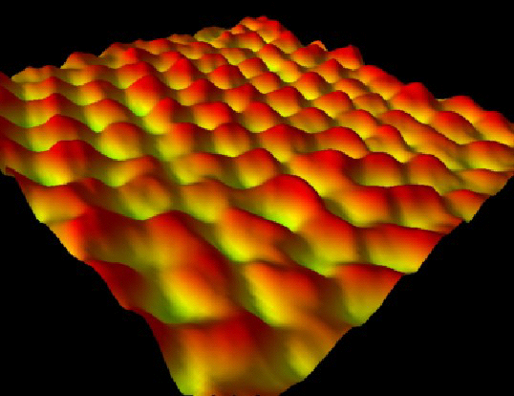

Finally, we have actually “seen” atoms using special microscopes
Graphite
Iron on Copper (Gen shi = atom)

Slide 28
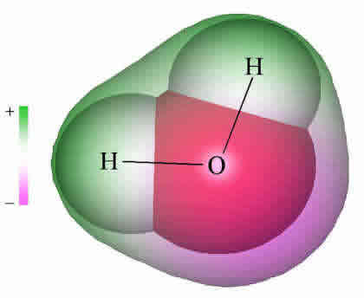

Why does water expand when it freezes?
Go to PhET
Notes:
Deflect water drops using a staticly charged rod.

Slide 29
The Physical Properties of Matter
QQ9: Shapes
A
B
C
Each curve is a Boltzmann distribution for a gas of the same molecular species. Which one is hottest A,B or C?

Slide 30
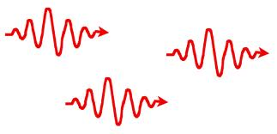
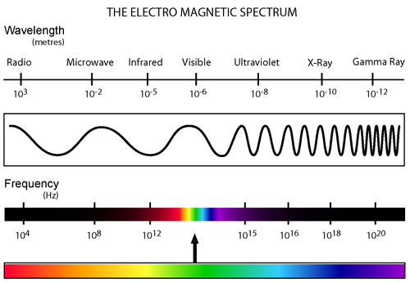
Review: Which type of electromagnetic radiation has the highest energy per photon?
Radio Waves
Infrared
Ultraviolet
Green light
Red light
Visible wavelength range 400nm to 700nm

Slide 31
QQ10: Why does water expand when it freezes?
Notes:
Deflect water drops using a staticly charged rod.

Slide 32
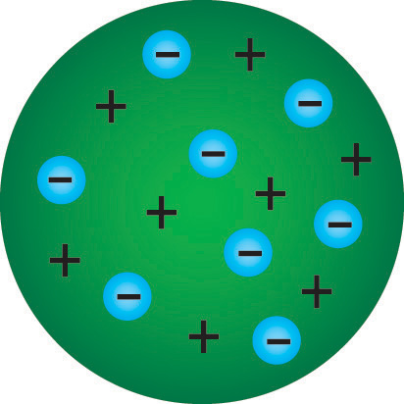
Thompson Model of the Atom (Plum Pudding)
Atom
Positive “pudding”
Negative particles

Slide 33
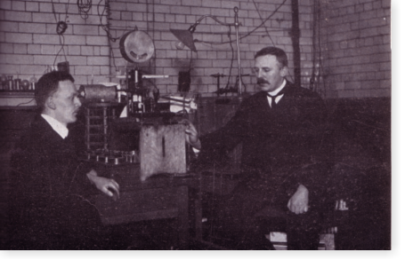
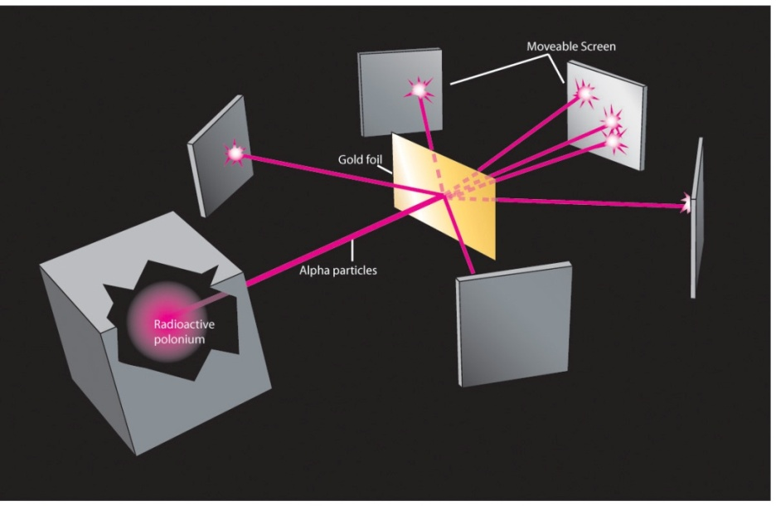

Death of Plum Pudding model
Rutherford, Geiger, and Marsden
Expectation
Result

Slide 34
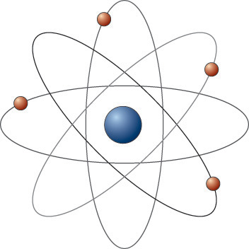
Another New Model:
The Solar System Model

Slide 35
Problems at the start!
Accelerating electrons should radiate, loose energy, and spiral into the nucleus.
The model soon died.

Slide 36
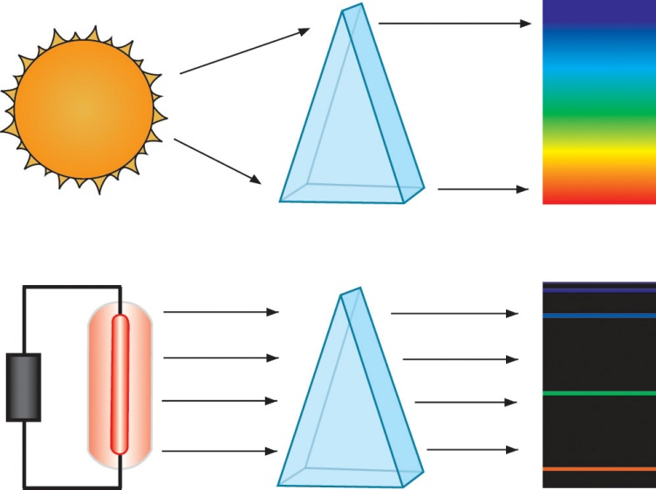
More clues from light spectra
continuous spectrum -- all colors
discrete spectrum -- only a few specific colors
Discrete absorption spectrum – All colors but a few lines
Visible wavelength range 400nm to 700nm

Slide 37
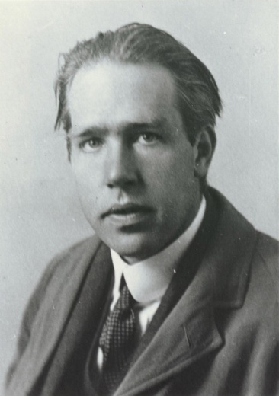
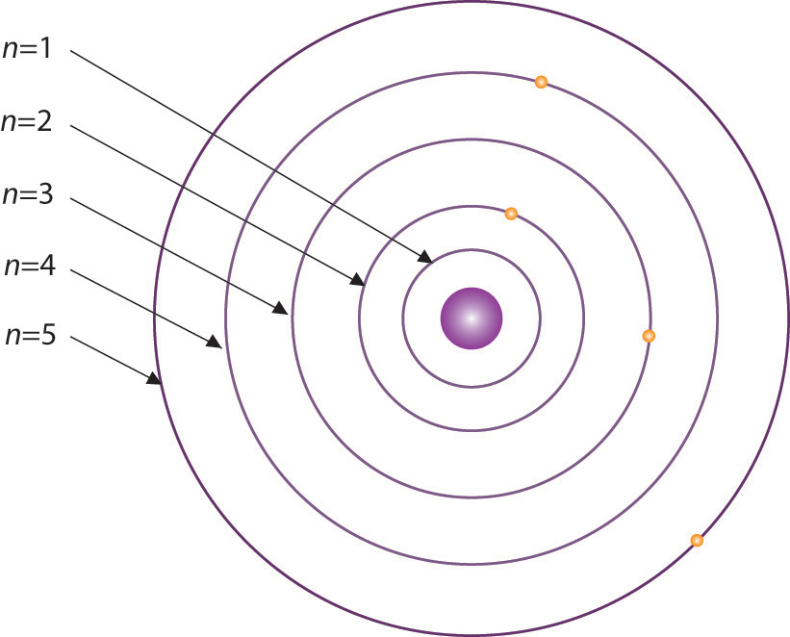
The Bohr Model: The Rutherford model plus a patch

Slide 38
QQ11: What is a problem with the Solar System model?

Slide 39
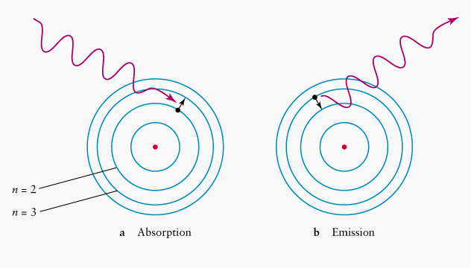
Absorption vs. Emission spectra
Visible wavelength range 400nm to 700nm
Absorption
Emission

Slide 40
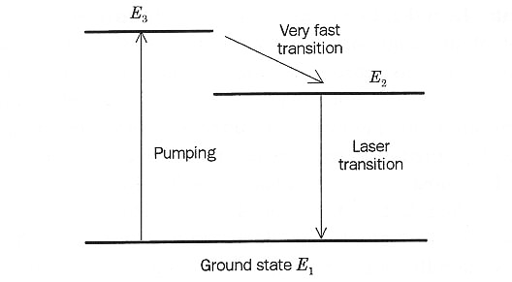

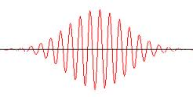
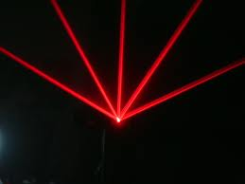

Light Amplification by Stimulated Emission of Radition
Light
Amplification by
Stimulated
Emission of Radiation
$$E_{2}→E_{1}$$
emits light
Hydrogen “energy level diagram”
~700nm

Slide 41
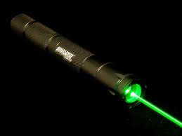









L.A.S.E.R.
$$E_{4}$$
Which transition emits green light?
-
-
-
-
$$E_{3}$$
$$E_{4}→E_{3}$$
$$E_{2}$$
$$E_{4}→E_{2}$$
$$E_{3}→E_{1}$$
$$E_{1}$$
$$E_{2}→E_{4}$$
$$E_{0}$$
Ground state
Visible wavelength range 400nm to 700nm
Not a visible transition
Nd:YAG (neodymium-doped yttrium aluminium garnet; Nd:Y₃Al₅O₁₂)

Slide 42
Problems with the “Bohr Model”
Why are only certain orbits possible (not like a solar system!)
Why doesn’t the undisturbed atom radiate? (Why don’t the electrons fall into the nucleus?)
‘Because Bohr says so’
is not a good answer.
So we continue looking!

Slide 43
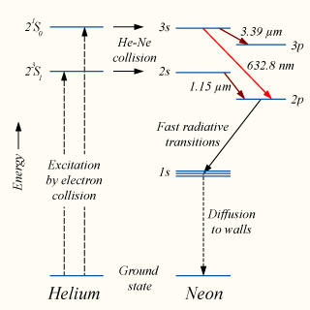
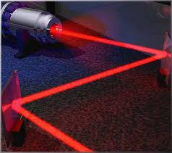
QQ11: Laser
Which transition emits red light?
3s-3p
3s-2p
2s-2p
2s-3p

Slide 44
QQ12: Problem with the “Bohr Model”
Why are only certain ______ possible?(not like a solar system!)

