Slide 1

Chapter 12
Thermal Properties of Matter

Slide 2


Reading Quiz
A sample of nitrogen gas is inside a sealed container. The container is slowly compressed, while the temperature is kept constant. This is a ________ process.
  constant-volume
  isobaric
  isothermal
  adiabatic
Slide 12-6
Notes:
Answer: C

Slide 3
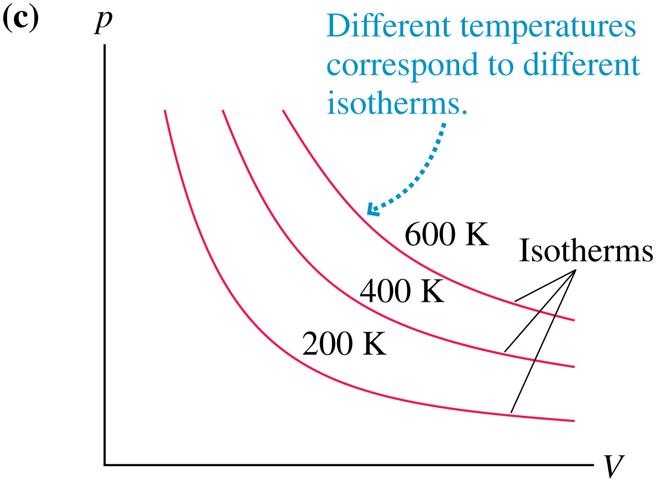
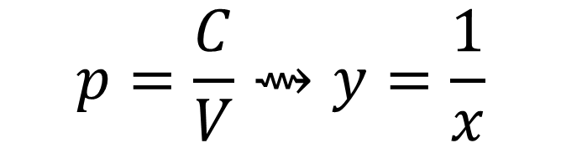


Answer
A sample of nitrogen gas is inside a sealed container. The container is slowly compressed, while the temperature is kept constant. This is a ________ process.
  constant-volume
  isobaric
  isothermal
  adiabatic
$$pV=Nk_{B}T$$
$$p=\frac{Nk_{B}T }{V}$$
constant
$$p=\frac{C}{V}⇝y=\frac{1}{x}$$
Slide 12-7
Notes:
Answer: C

Slide 4
Reading Quiz
A sample of nitrogen gas is in a sealed container with a constant volume. Heat is added to the gas. The pressure
  increases
  stays the same
  decreases
  can’t be determined with the information given
Slide 12-8
Notes:
Answer: A

Slide 5

Answer
A sample of nitrogen gas is in a sealed container with a constant volume. Heat is added to the gas. The pressure
  increases
  stays the same
  decreases
  can’t be determined with the information given
$$pV=Nk_{B}T$$
constant
Slide 12-9
Notes:
Answer: A

Slide 6
Reading Quiz
Which type of heat transfer can happen through empty space?
  conduction
  evaporation
  convection
  radiation
Slide 12-10
Notes:
Answer: D

Slide 7
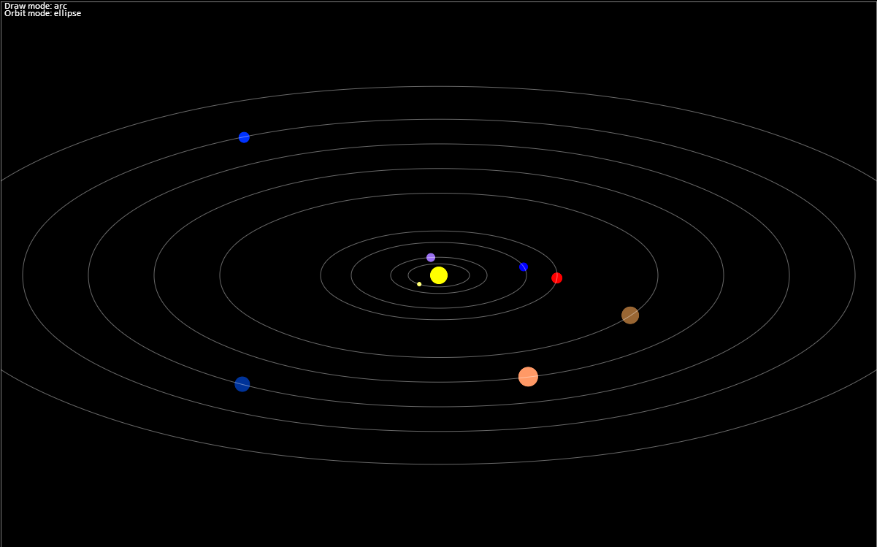
Answer
Which type of heat transfer can happen through empty space?
  conduction
  evaporation
  convection
  radiation
Slide 12-11
Notes:
Answer: D

Slide 8
Checking Understanding
What is the mass, in u, of a molecule of carbon dioxide, CO2?
  12
  24
  32
  36
  44
Slide 12-12
Notes:
Answer: E

Slide 9
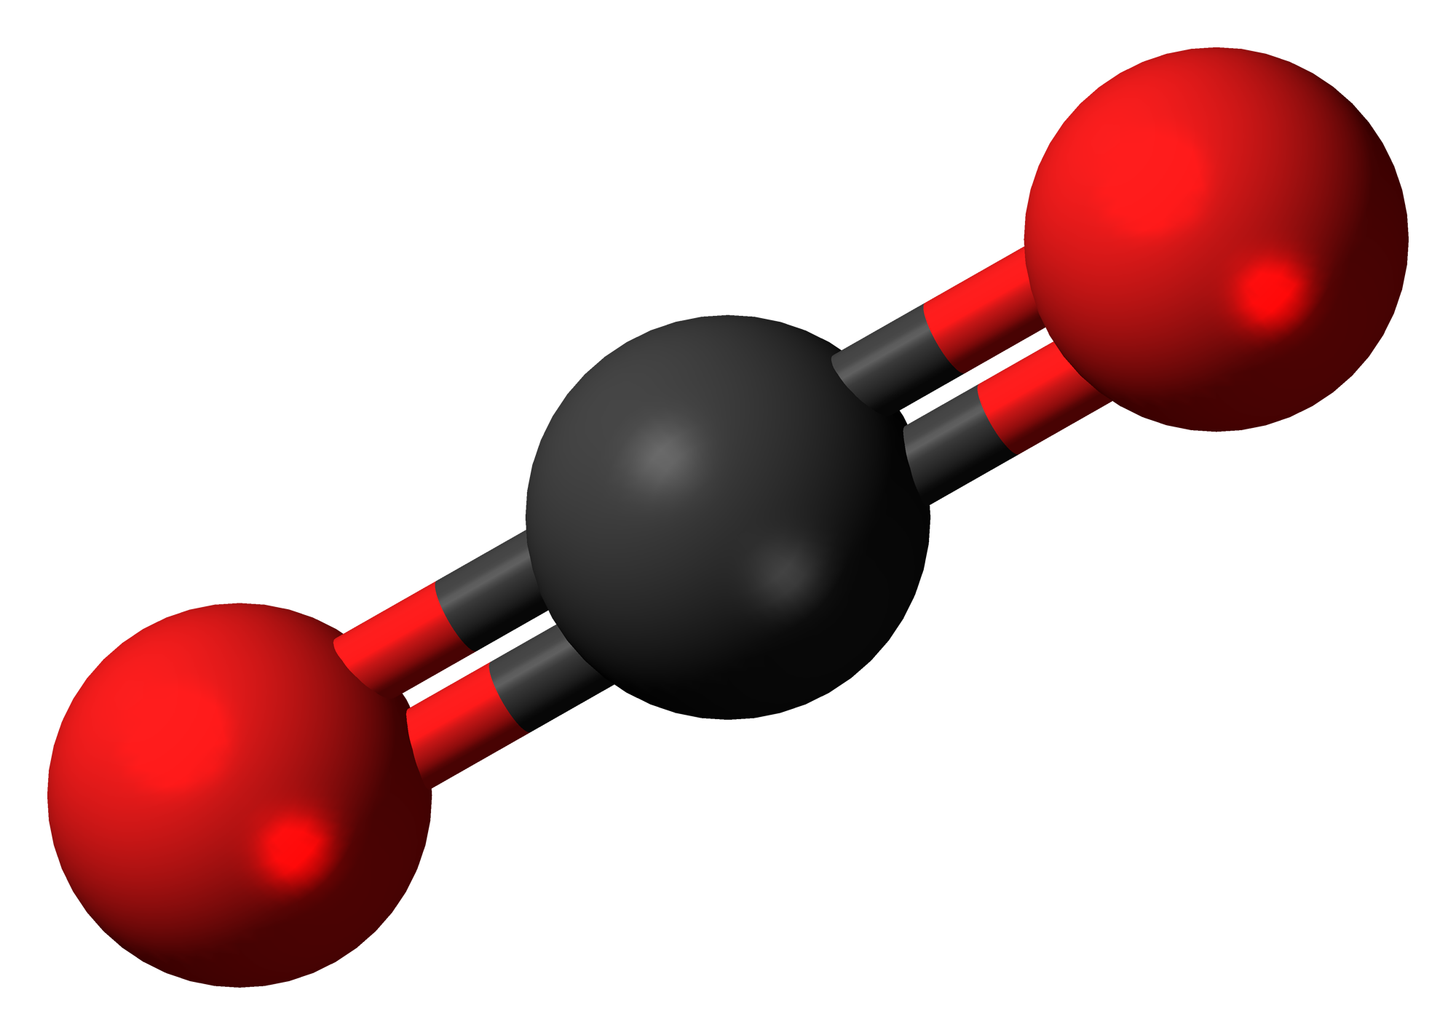
Answer
What is the mass, in u, of a molecule of carbon dioxide, CO2?
  12
  24
  32
  36
  44
16u + 12u + 16u
Slide 12-13
Notes:
Answer: E

Slide 10
Checking Understanding
Rank the following in terms of the number of moles, from greatest number of moles to least:
1. 20 g of He (A = 4)
2. 60 g of Ne (A = 20)
3. 120 g of O₂ (atomic oxygen, O, has A = 16)
4. 160 g of Ar (A = 40)
5. 200 g of Pb (A = 207)
  5 > 4 > 3 > 2 > 1
  5 > 4 > 2 > 3 > 1
  3 > 1 > 4 > 2 > 5
  1 > 4 > 3 > 2 > 5
Slide 12-14
Notes:
Answer: D

Slide 11





Answer
Rank the following in terms of the number of moles, from greatest number of moles to least:
1. 20 g of He (A = 4)
2. 60 g of Ne (A = 20)
3. 120 g of O₂ (atomic oxygen, O, has A = 16)
4. 160 g of Ar (A = 40)
200 g of Pb (A = 207)
  5 > 4 > 3 > 2 > 1
  5 > 4 > 2 > 3 > 1
  3 > 1 > 4 > 2 > 5
  1 > 4 > 3 > 2 > 5
$$20 \text{g} \frac{1 \text{mol}}{4 \text{g}}$$
$$60 \text{g} \frac{1 \text{mol}}{20 \text{g}}$$
$$120 \text{g} \frac{1 \text{mol}}{32 \text{g}}$$
$$160 \text{g} \frac{1 \text{mol}}{40 \text{g}}$$
$$200 \text{g} \frac{1 \text{mol}}{207 \text{g}}$$
Slide 12-15
Notes:
Answer:

Slide 12

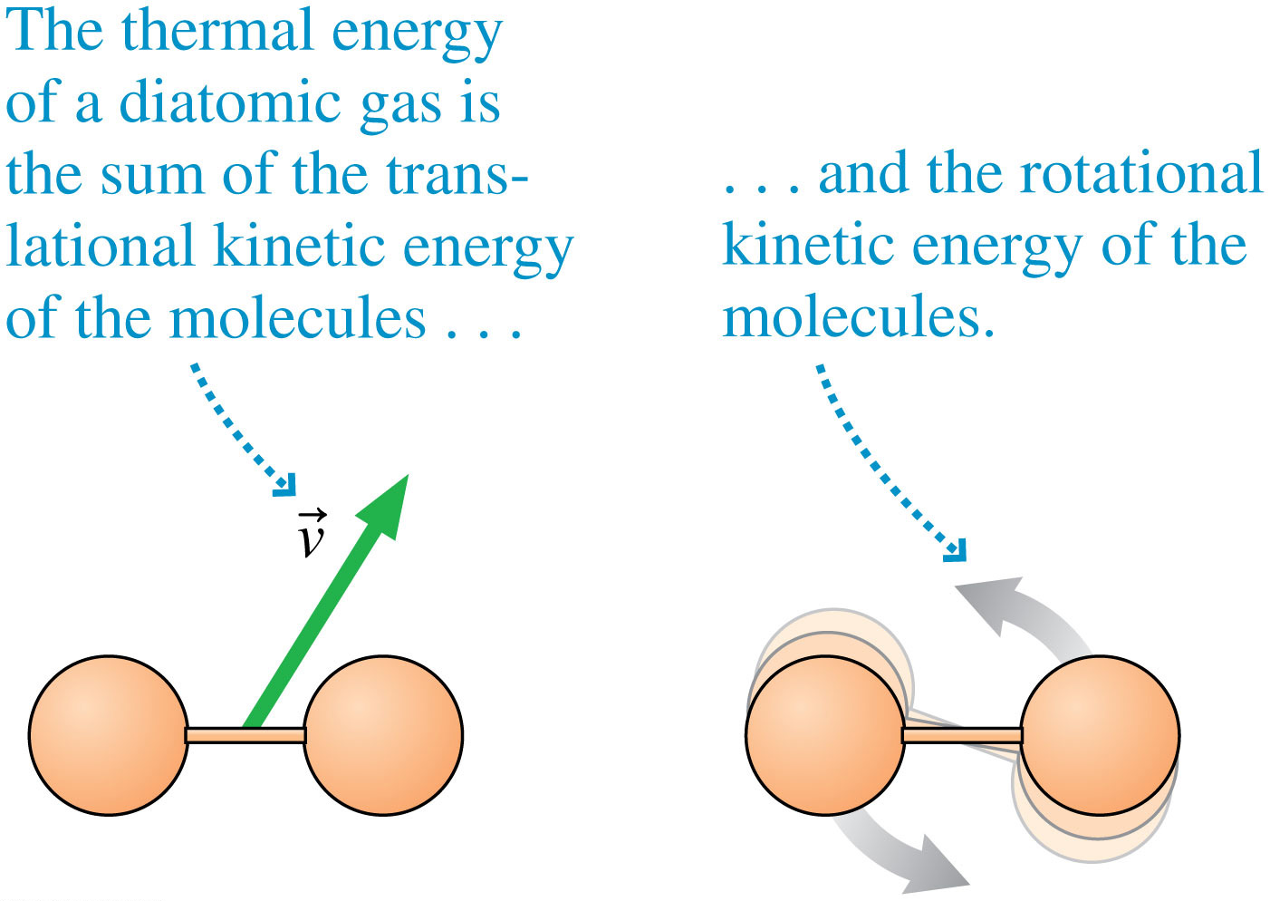
Molecular Speeds and Temperature
Ouch!

Slide 13
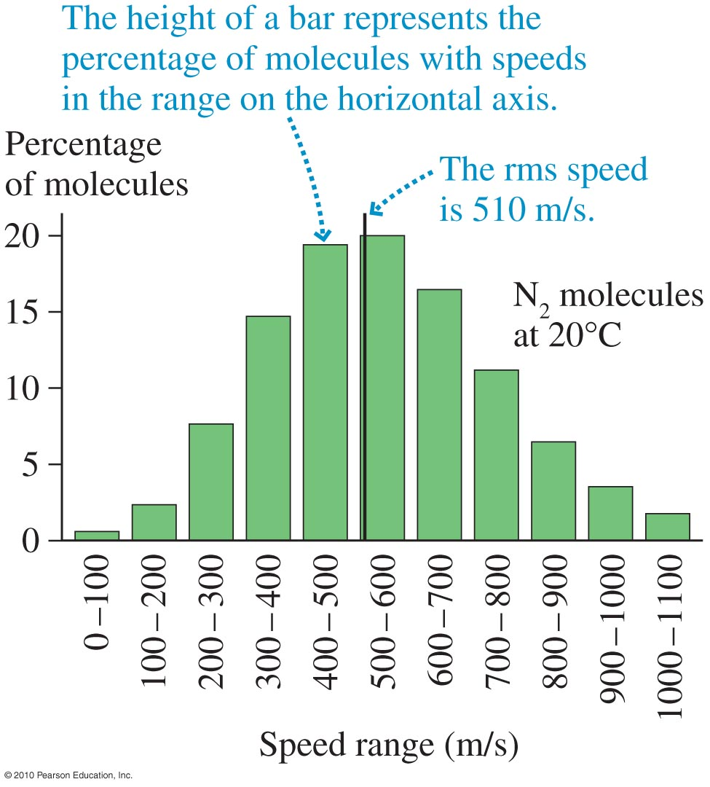
Speed and Kinetic Energy of Gas Molecules
Use Kelvin!
Slide 12-17

Slide 14
Answer this one please
What are the rms speeds of a nitrogen molecule (mass 4.5 × 10⁻²⁶ kg) at the following temperatures?
  Room temperature of 68ºF (20ºC)
  The coldest temperature ever observed on earth, −129ºF (−89ºC)
  Polar night on Mars, −133ºC
  The coldest temperature achieved in the laboratory, 0.5 nK
Slide 12-18

Slide 15

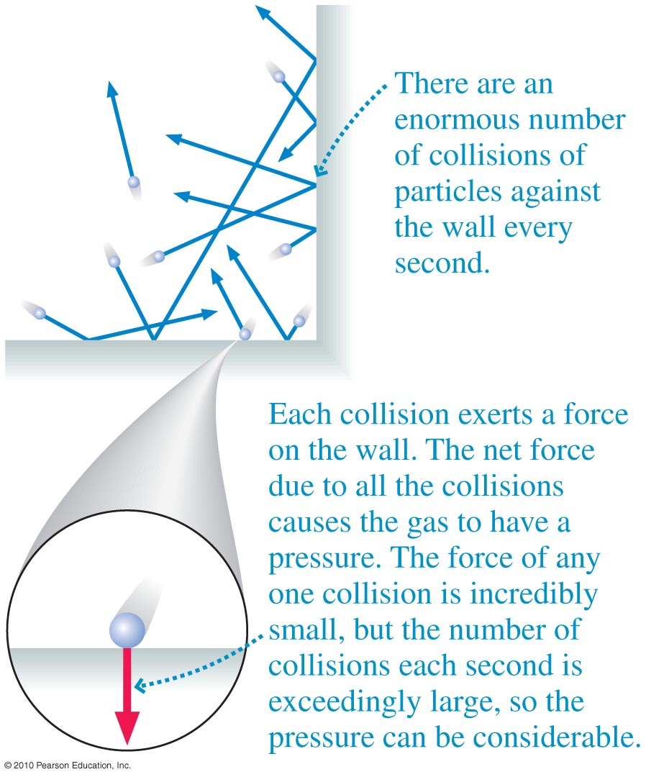
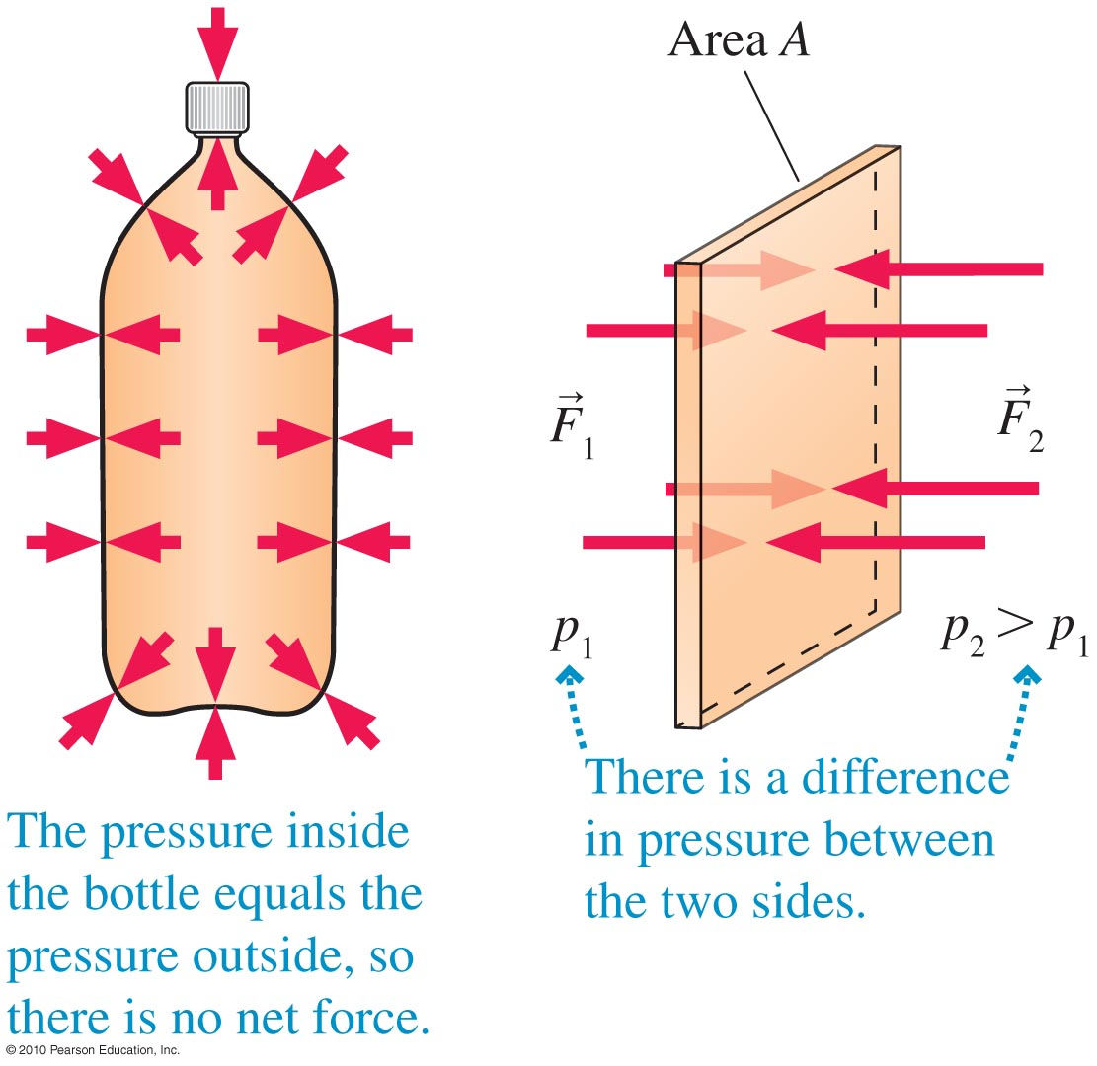
The Definition of Pressure
Slide 12-23

Slide 16
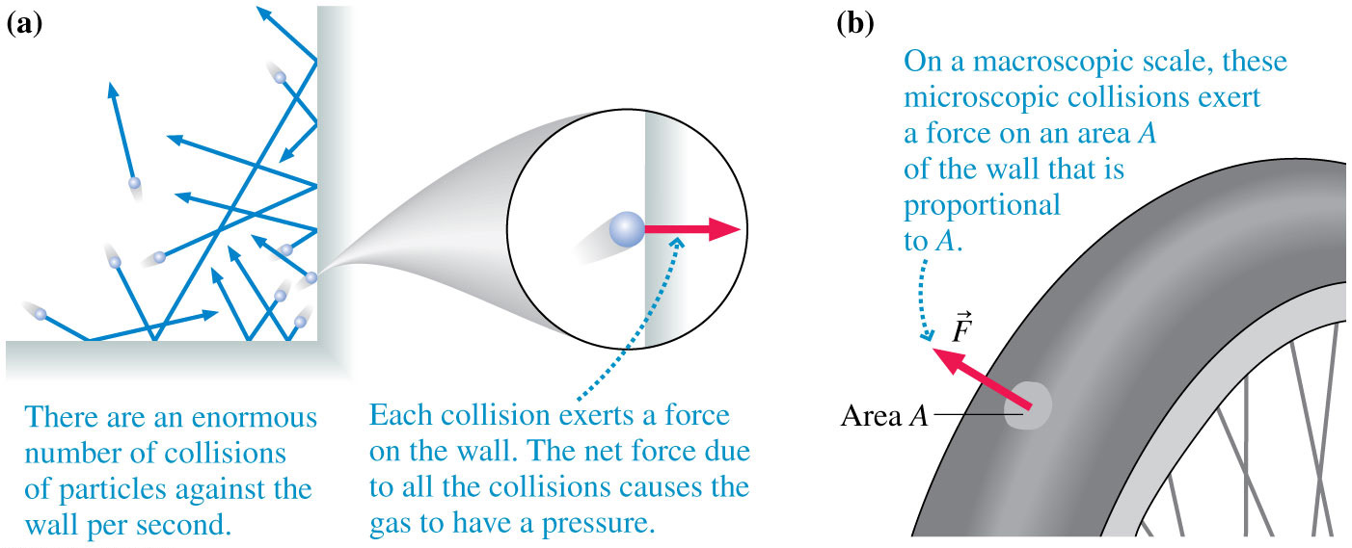
The Definition of Pressure
Notes:
FIGURE 12.5

Slide 17
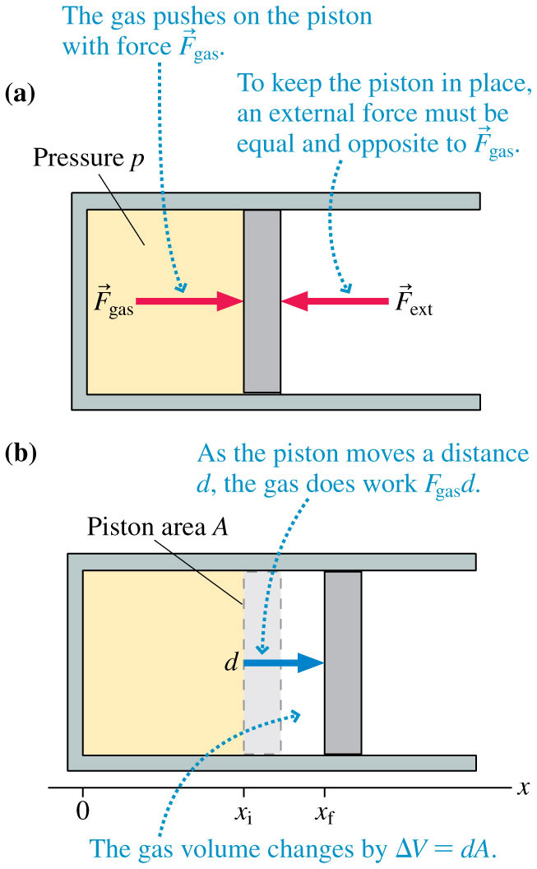
Notes:
FIGURE 12.13

Slide 18
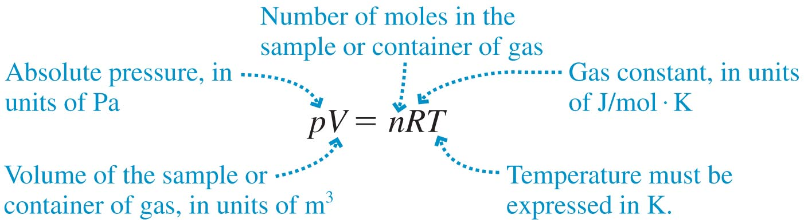
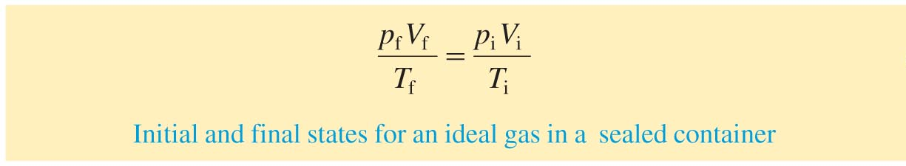
The Ideal Gas Law
Ideal Gas Law for a Fixed Amount of Gas
Slide 12-21

Slide 19
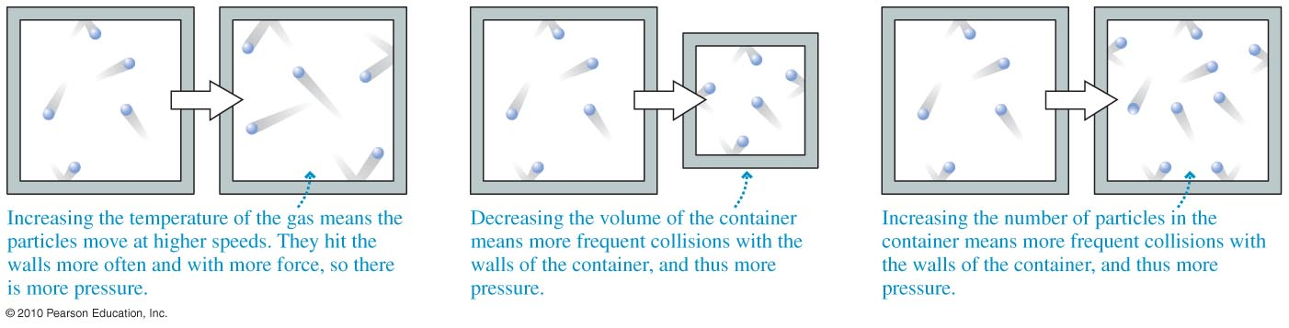
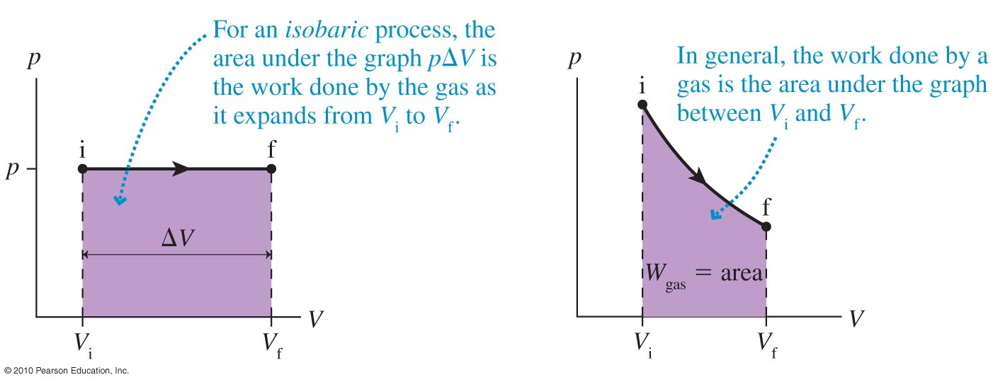
The Ideal Gas Law
Changing the temperature, volume or number of particles changes the pressure of the gas. We can understand this using our model of the ideal gas.
When a gas expands, it does work, when a gas is compressed, work is done on it.
Work
Slide 12-28

Slide 20
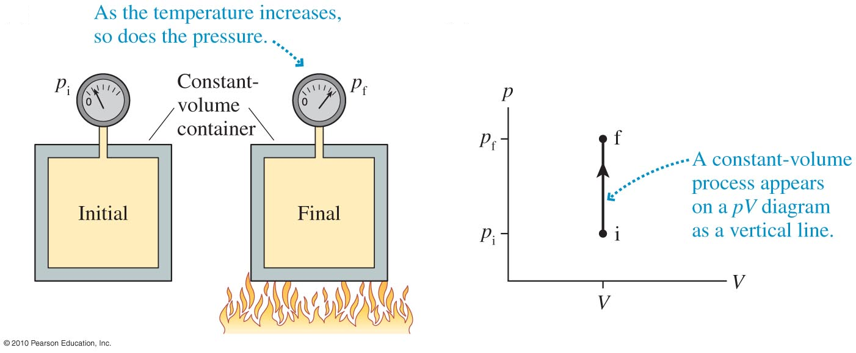
Ideal-Gas Processes
We can represent the state of a gas by a point on a pV diagram. A process can be represented by a path on this diagram.
Constant-Volume Process
Slide 12-29

Slide 21
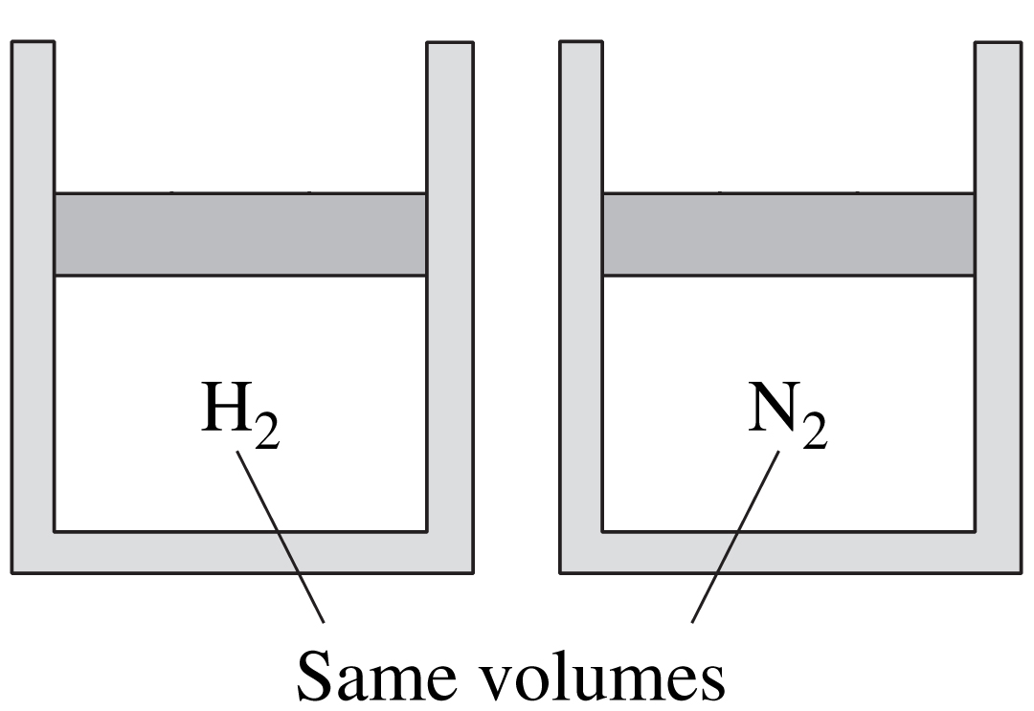
Checking Understanding: Pressure and Forces
The two identical cylinders contain samples of gas. Each cylinder has a lightweight piston on top that is free to move, so the pressure inside each cylinder is equal to atmospheric pressure. One cylinder contains hydrogen, the other nitrogen. Both gases are at the same temperature. The number of moles of hydrogen is
  greater than the number of moles of nitrogen.
  equal to the number of moles of nitrogen.
  less than the number of moles of nitrogen.
Slide 12-24
Notes:
Answer: B

Slide 22
Answer
The two identical cylinders contain samples of gas. Each cylinder has a lightweight piston on top that is free to move, so the pressure inside each cylinder is equal to atmospheric pressure. One cylinder contains hydrogen, the other nitrogen. Both gases are at the same temperature. The number of moles of hydrogen is
  greater than the number of moles of nitrogen.
  equal to the number of moles of nitrogen.
  less than the number of moles of nitrogen.
Slide 12-25
Notes:
Answer: B

Slide 23
Answer this one please
The two identical cylinders contain samples of gas. Each cylinder has a lightweight piston on top that is free to move, so the pressure inside each cylinder is equal to atmospheric pressure. One cylinder contains hydrogen, the other nitrogen. The mass of gas in each cylinder is the same. The temperature of the hydrogen gas is
  greater than the temperature of the nitrogen.
  equal to the temperature of the nitrogen.
  less than the temperature of the nitrogen.
Slide 12-26
Notes:
Answer: C

Slide 24


Answer
The two identical cylinders contain samples of gas. Each cylinder has a lightweight piston on top that is free to move, so the pressure inside each cylinder is equal to atmospheric pressure. One cylinder contains hydrogen, the other nitrogen. The mass of gas in each cylinder is the same. The temperature of the hydrogen gas is
  greater than the temperature of the nitrogen.
  equal to the temperature of the nitrogen.
  less than the temperature of the nitrogen.
$$pV=Nk_{B}T$$
$$pV=Nk_{B}T$$
Slide 12-27
Notes:
Answer: C

Slide 25
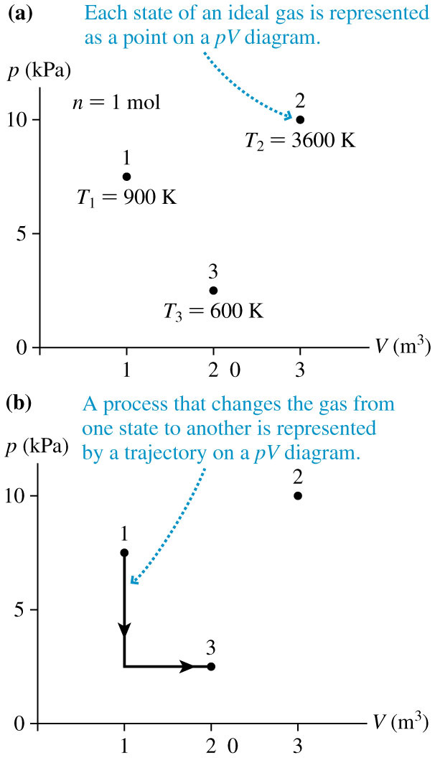
Notes:
FIGURE 12.9

Slide 26
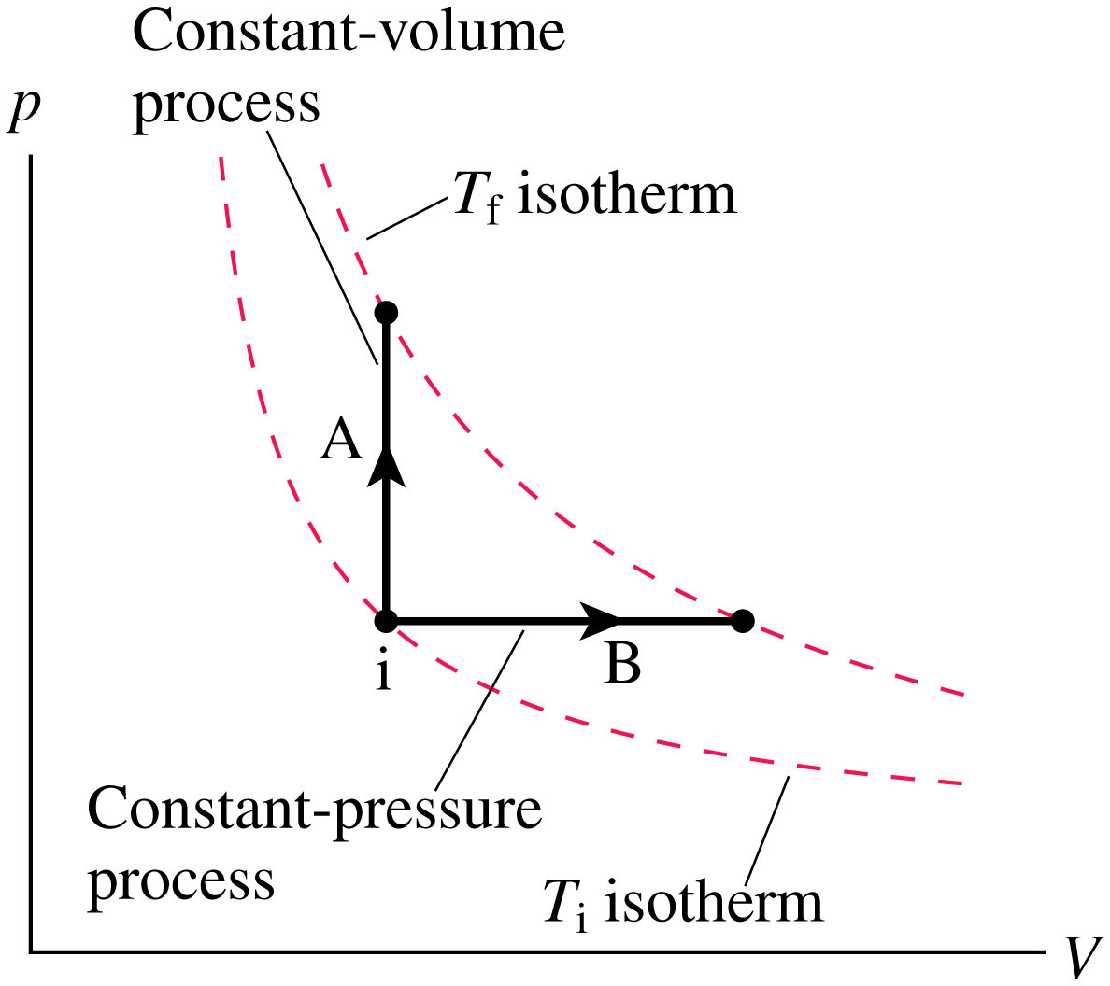
Ideal gas processes
Notes:
FIGURE 12.25

Slide 27
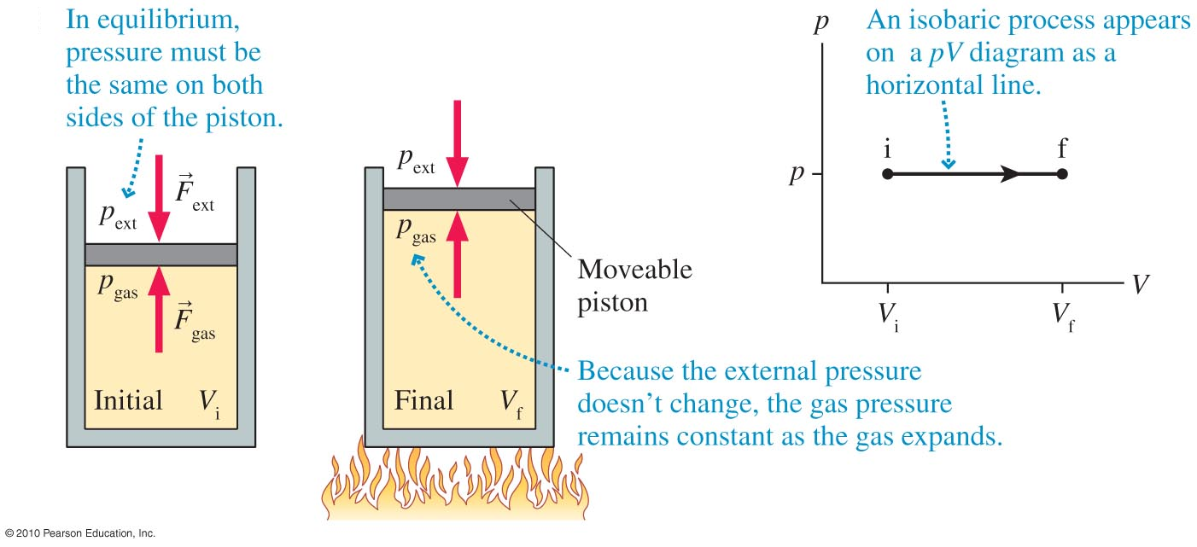
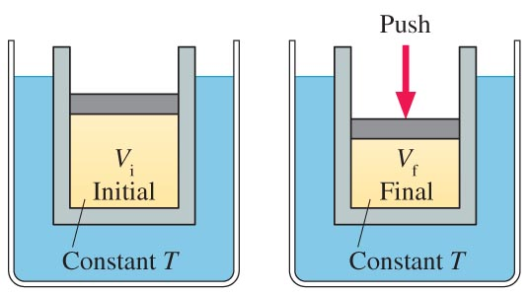
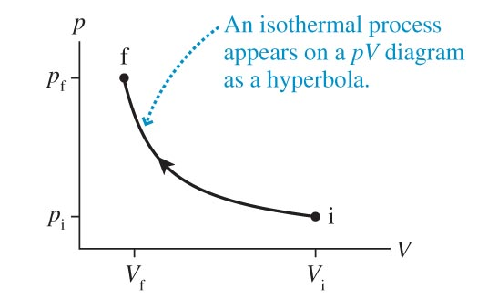
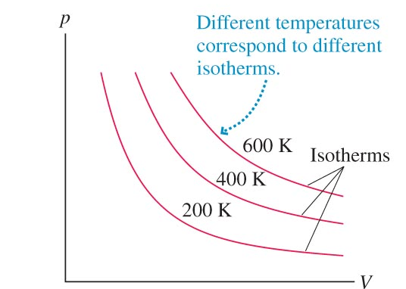
Constant-Pressure Process
Constant-Temperature Process
Slide 12-30

Slide 28
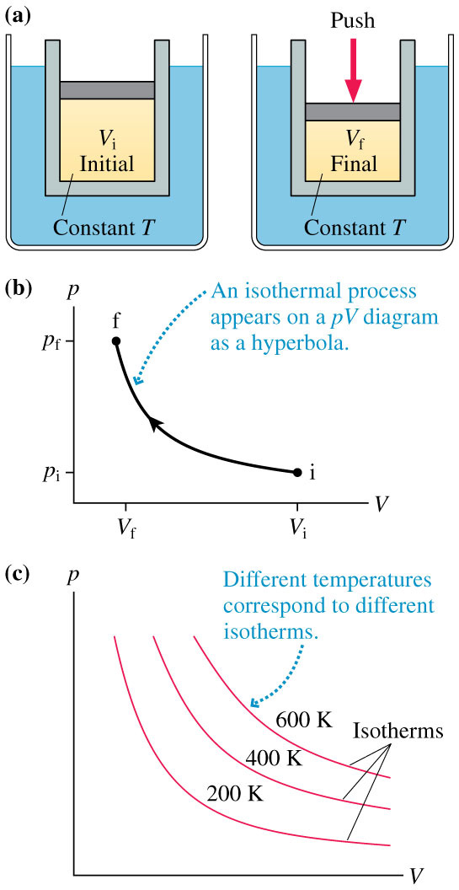
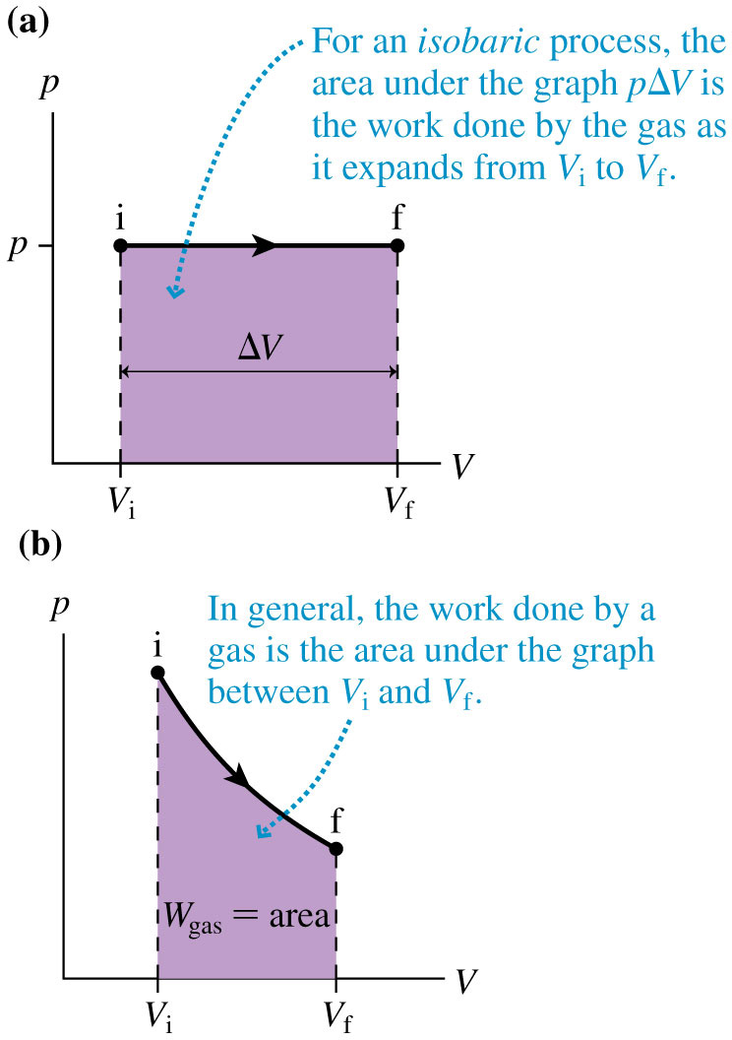
Notes:
FIGURE 12.12

Slide 29
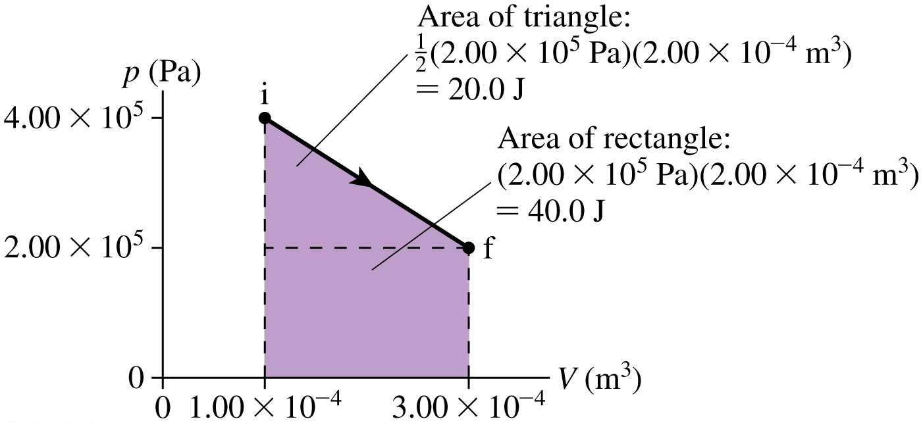
n0co451251
Notes:
FIGURE 12.16

Slide 30
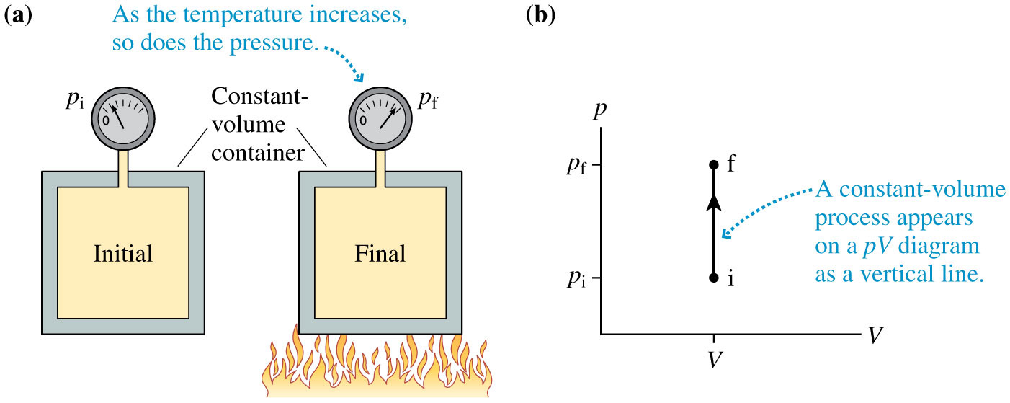
Isochoric
Notes:
FIGURE 12.10

Slide 31
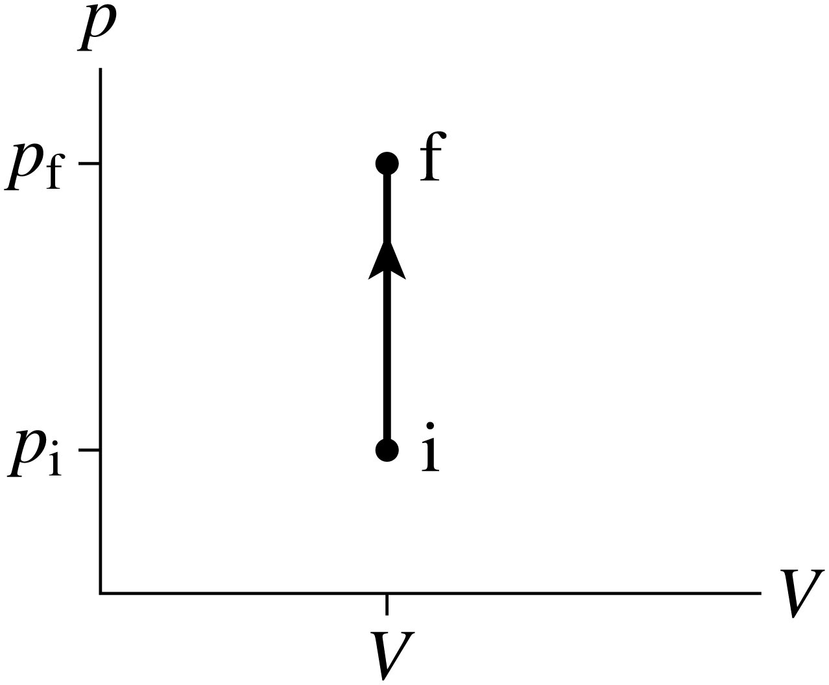
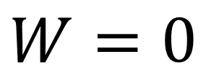
Work done is equal to area under the process curve
$$W=0$$
Isochoric
Notes:
Chapter Summary 6

Slide 32
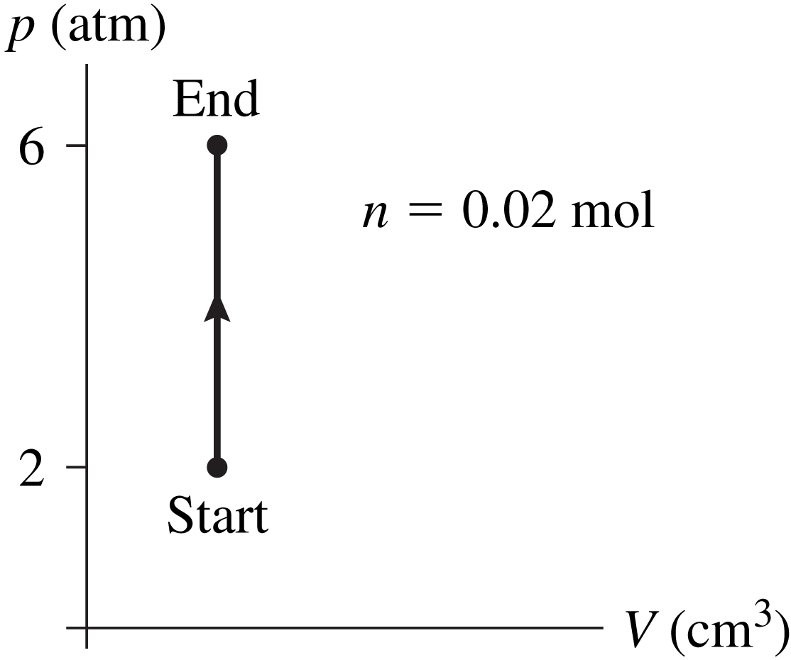
Checking Understanding: Gas-Law Processes
A sample of gas is in a cylinder with a moveable piston. The force on the piston can be varied, altering the pressure and volume. A sample of gas is taken from an initial state to a final state following a curve on a pV diagram at right. The final temperature is
  higher than the initial temperature.
  the same as the initial temperature.
  lower than the initial temperature.
Slide 12-31
Notes:
Answer: A

Slide 33
Answer
A sample of gas is in a cylinder with a moveable piston. The force on the piston can be varied, altering the pressure and volume. A sample of gas is taken from an initial state to a final state following a curve on a pV diagram at right. The final temperature is
  higher than the initial temperature.
  the same as the initial temperature.
  lower than the initial temperature.
Slide 12-32
Notes:
Answer: A

Slide 34
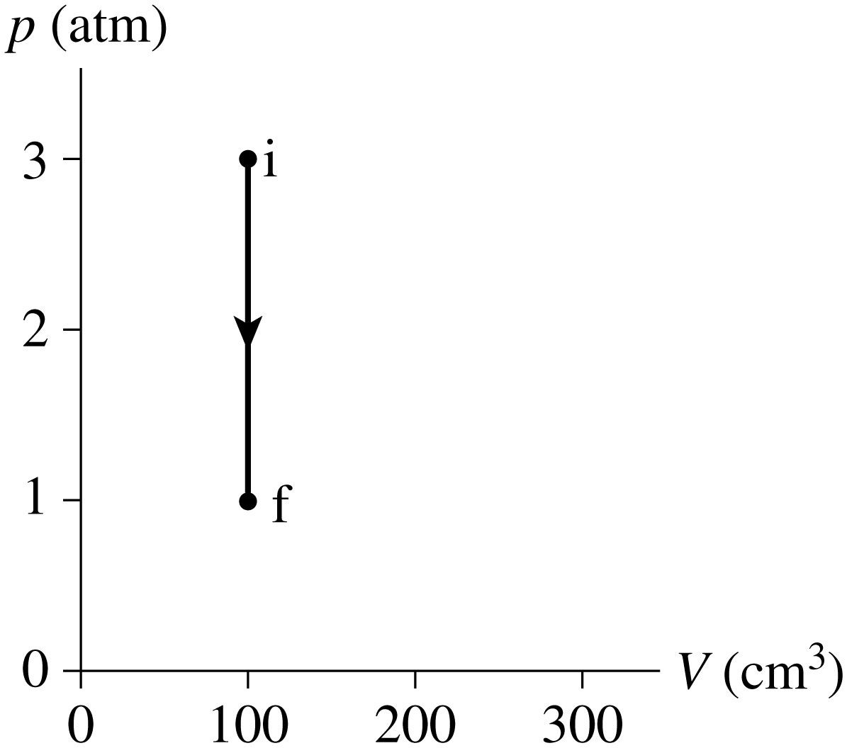
What is the work done BY the gas here?
Notes:
FIGURE P12.25

Slide 35
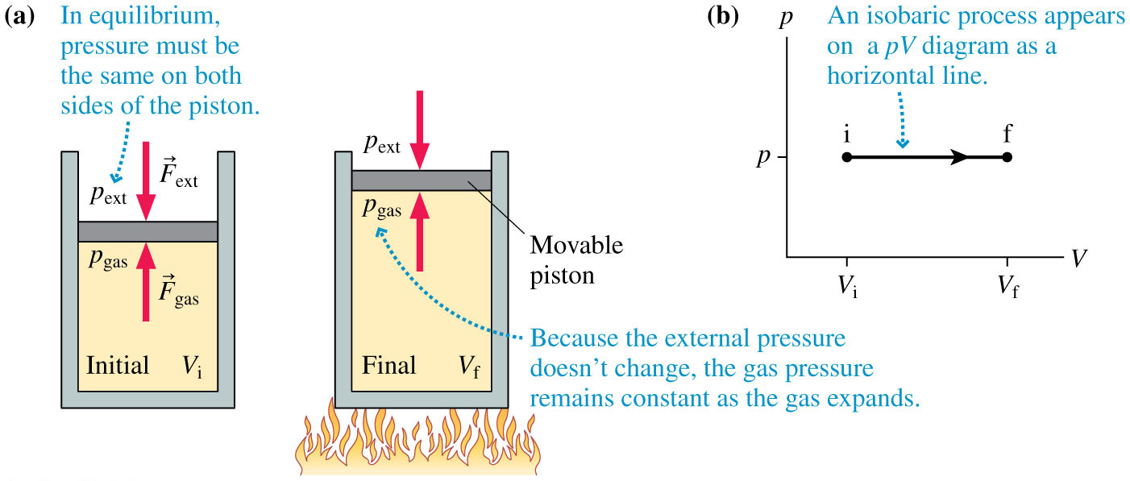
Isobaric
Notes:
FIGURE 12.11

Slide 36
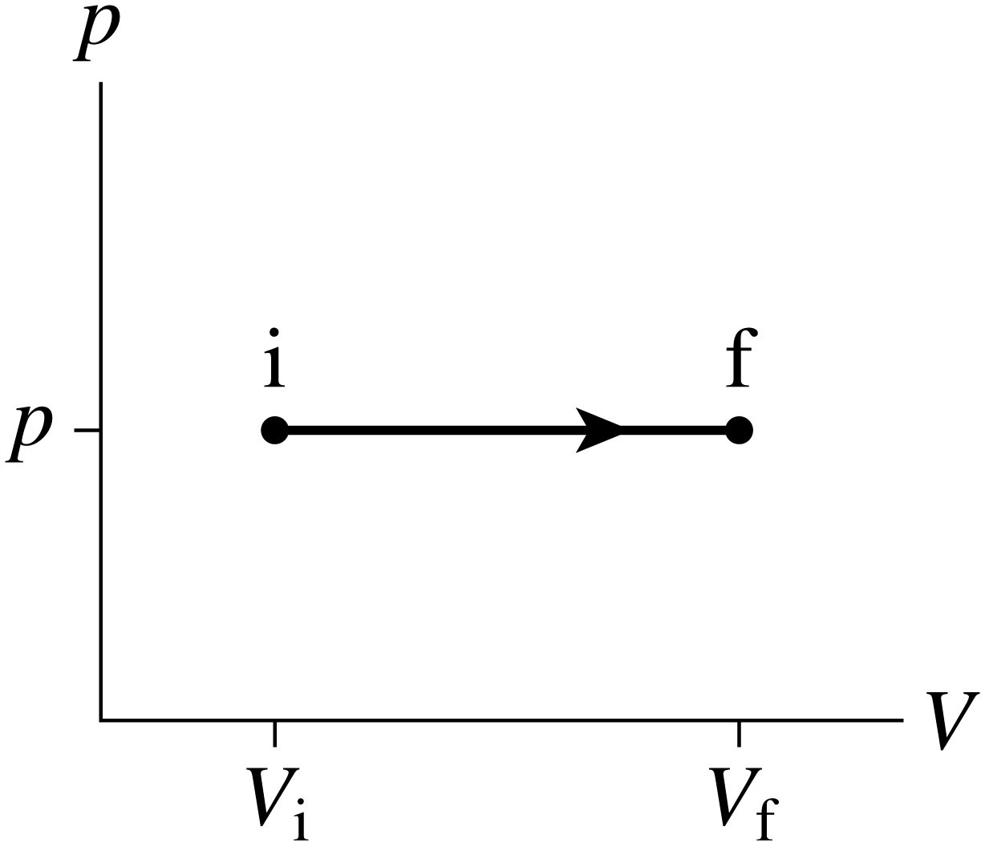
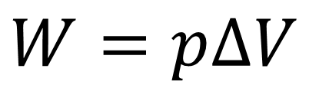
Work done is equal to area under the process curve
$$W=p∆V$$
Work done BY the gas
Isobaric
Notes:
Chapter Summary 7

Slide 37
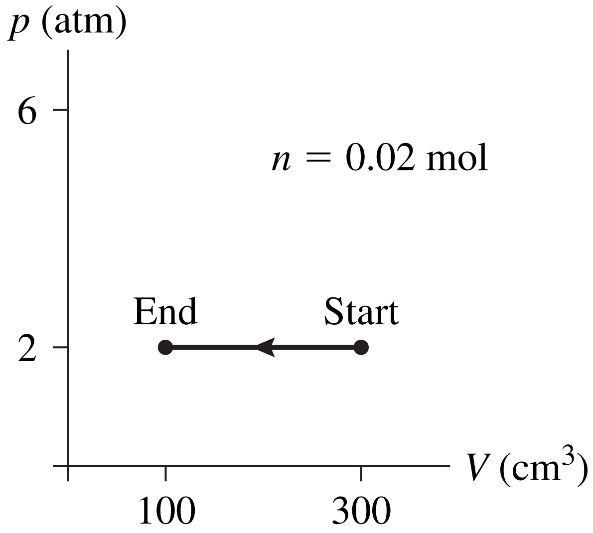
Checking Understanding: Gas-Law Processes
A sample of gas is in a cylinder with a moveable piston. The force on the piston can be varied, altering the pressure and volume. A sample of gas is taken from an initial state to a final state following a curve on a pV diagram at right. The final temperature is
  higher than the initial temperature.
  the same as the initial temperature.
  lower than the initial temperature.
Slide 12-33
Notes:
Answer: C

Slide 38
Answer
A sample of gas is in a cylinder with a moveable piston. The force on the piston can be varied, altering the pressure and volume. A sample of gas is taken from an initial state to a final state following a curve on a pV diagram at right. The final temperature is
  higher than the initial temperature.
  the same as the initial temperature.
  lower than the initial temperature.
Slide 12-34
Notes:
Answer: C

Slide 39
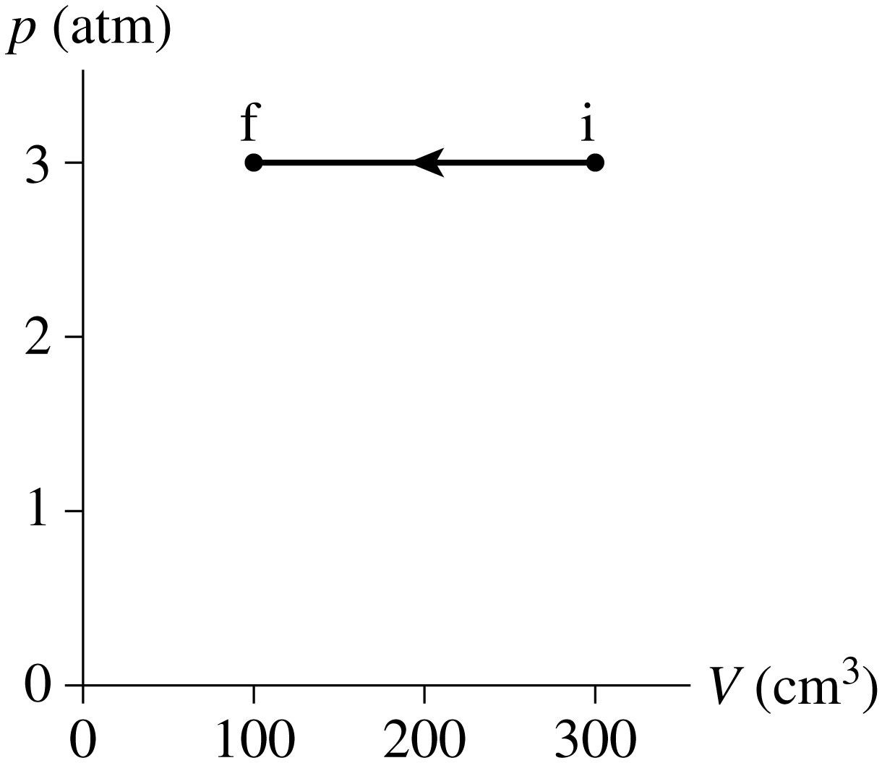
What is the work done BY the gas here?
Notes:
FIGURE P12.27

Slide 40
Additional Questions
Suppose you have a sample of gas at 10°C that you need to warm up to 20°C. Which will take more heat energy: raising the temperature while keeping the pressure constant or raising the temperature while keeping the volume constant?
  It takes more energy to raise the temperature while keeping the volume constant.
  It takes more energy to raise the temperature while keeping the pressure constant.
  The heat energy is the same in both cases.
Slide 12-54
Notes:
Answer: B

Slide 41
Answer
Suppose you have a sample of gas at 10°C that you need to warm up to 20°C. Which will take more heat energy: raising the temperature while keeping the pressure constant or raising the temperature while keeping the volume constant?
  It takes more energy to raise the temperature while keeping the volume constant.
  It takes more energy to raise the temperature while keeping the pressure constant.
  The heat energy is the same in both cases.
Slide 12-55
Notes:
Answer: B

Slide 42
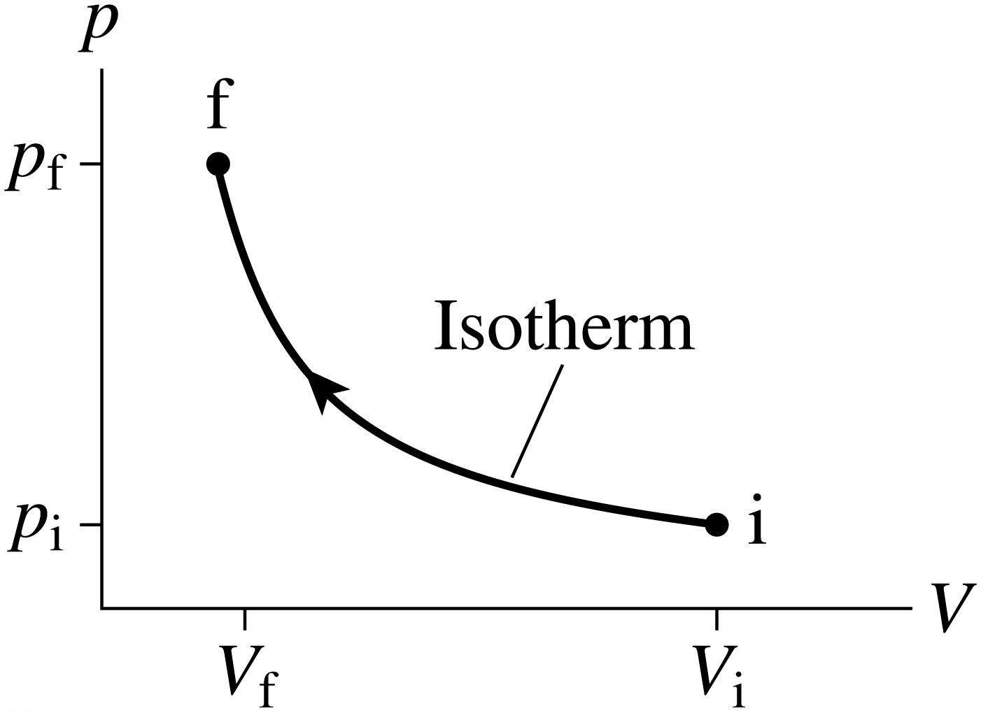
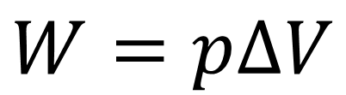
What about functions that make weird shapes?
$$W=p∆V$$
Not that simple!
Isothermic
Notes:
Chapter Summary 8

Slide 43
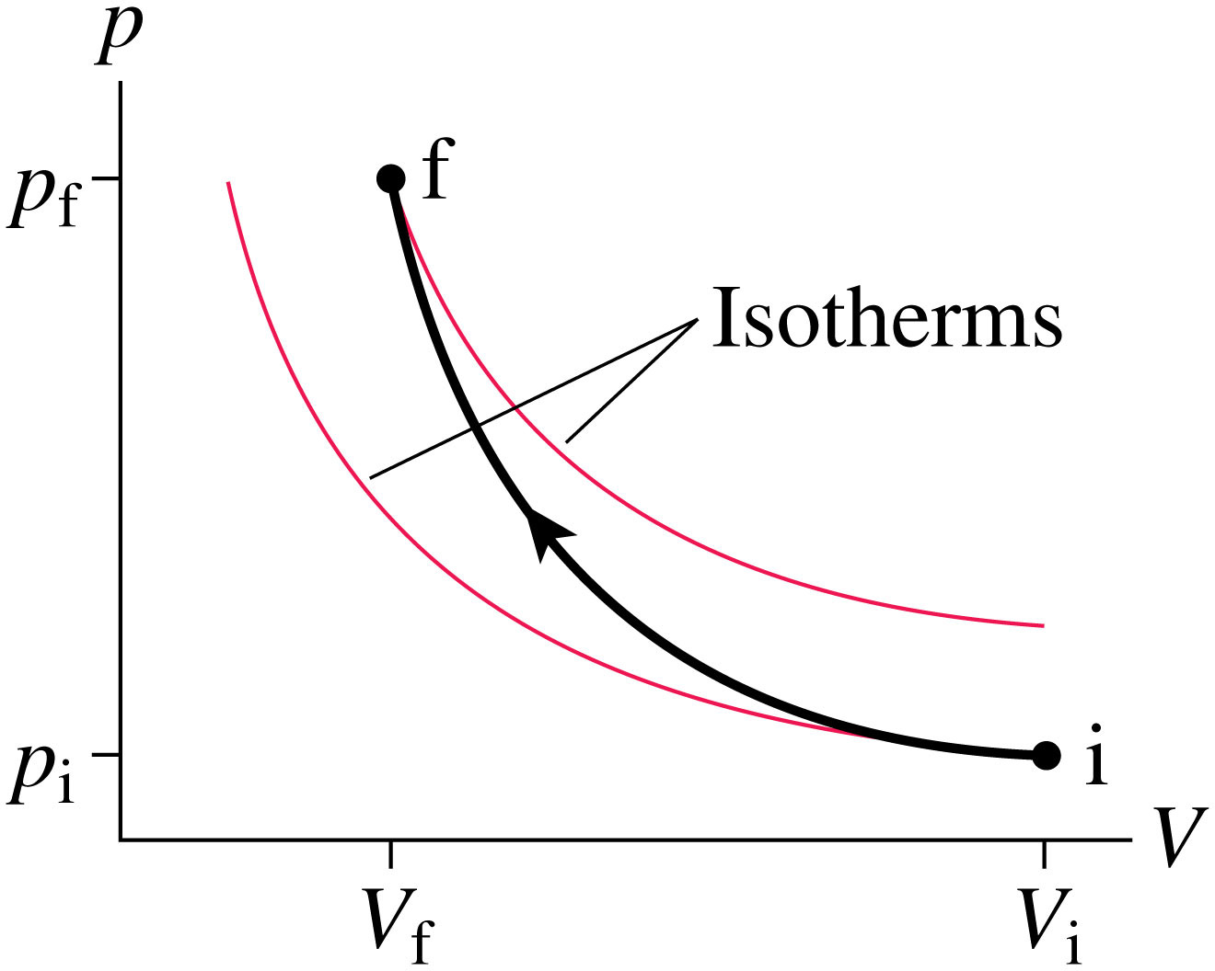
What do you call the process with no heat change?
Adiabatic
Notes:
Chapter Summary 9

Slide 44
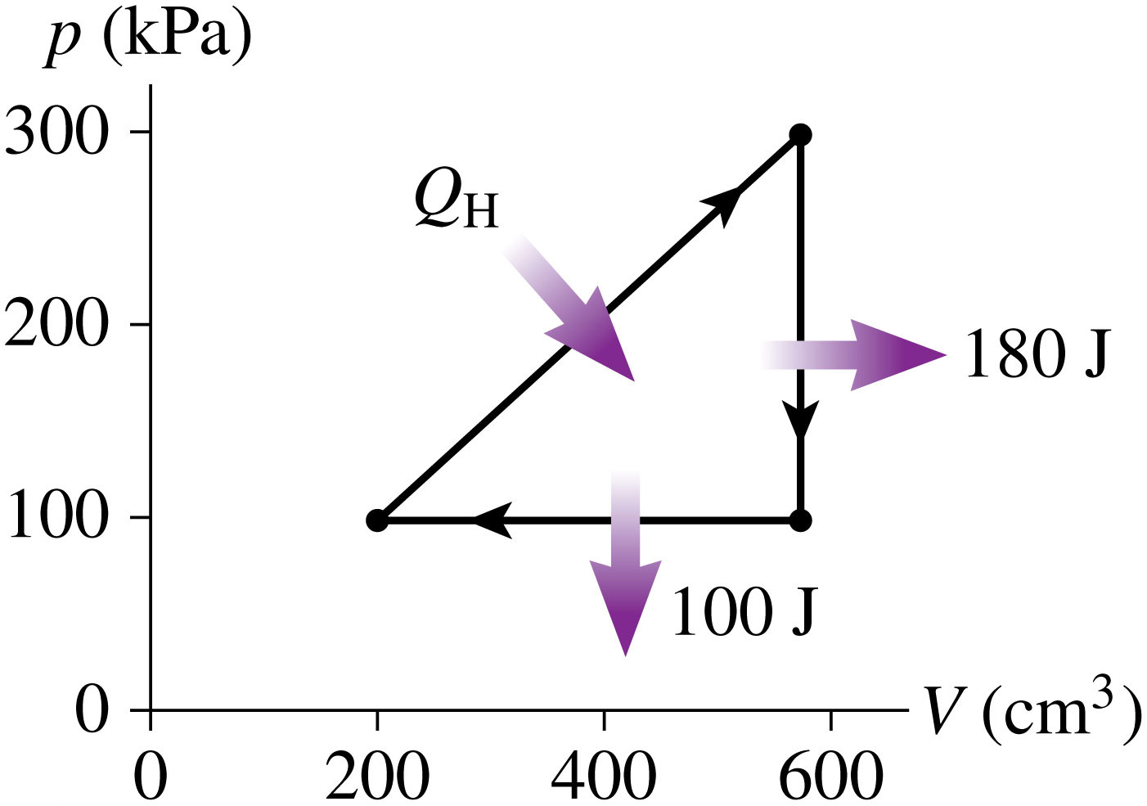
What’s going on here?
Notes:
FIGURE P12.104

Slide 45
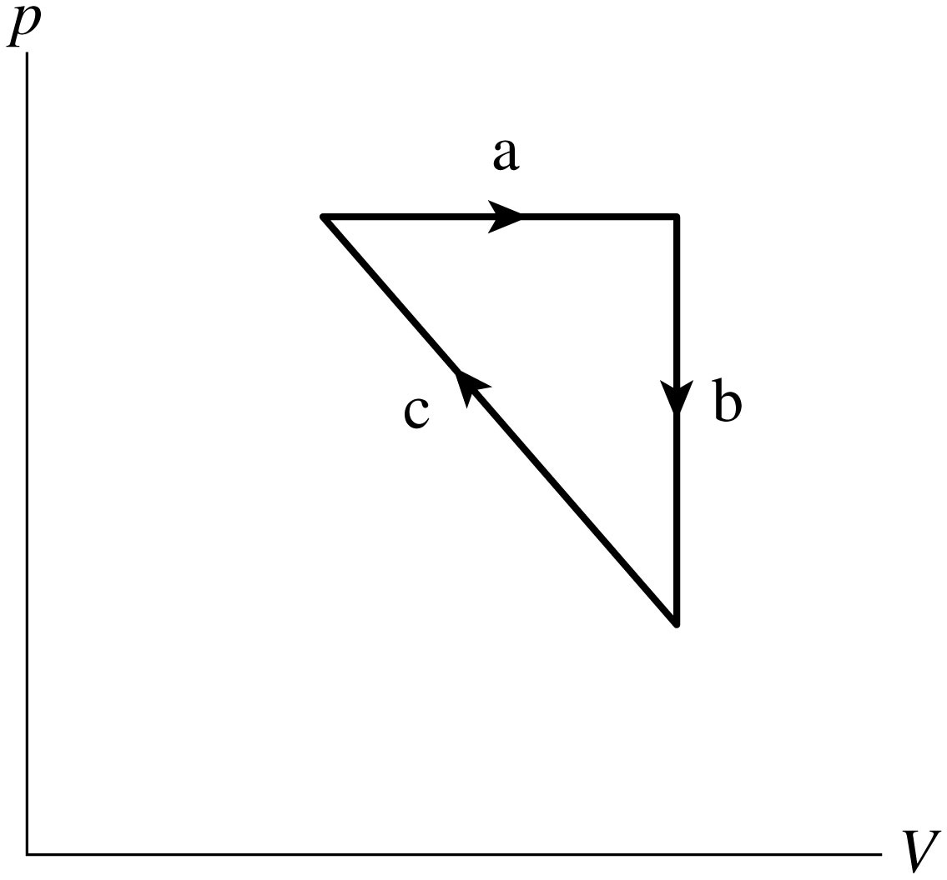

What is the work done ON the gas through this cycle?
3 Pa
$$W_{a}+W_{b}+W_{c}$$
1 Pa
2 cubic meters
4 cubic meters
Notes:
FIGURE Q12.24

Slide 46
Additional Questions
When I do work on a gas in an adiabatic process, compressing it, I add energy to the gas. Where does this energy go?
  The energy is transferred as heat to the environment.
  The energy is converted to thermal energy of the gas.
  The energy converts the phase of the gas.
Slide 12-56
Notes:
Answer: B

Slide 47
Answer
When I do work on a gas in an adiabatic process, compressing it, I add energy to the gas. Where does this energy go?
  The energy is transferred as heat to the environment.
  The energy is converted to thermal energy of the gas.
  The energy converts the phase of the gas.
Slide 12-57
Notes:
Answer: B

Slide 48
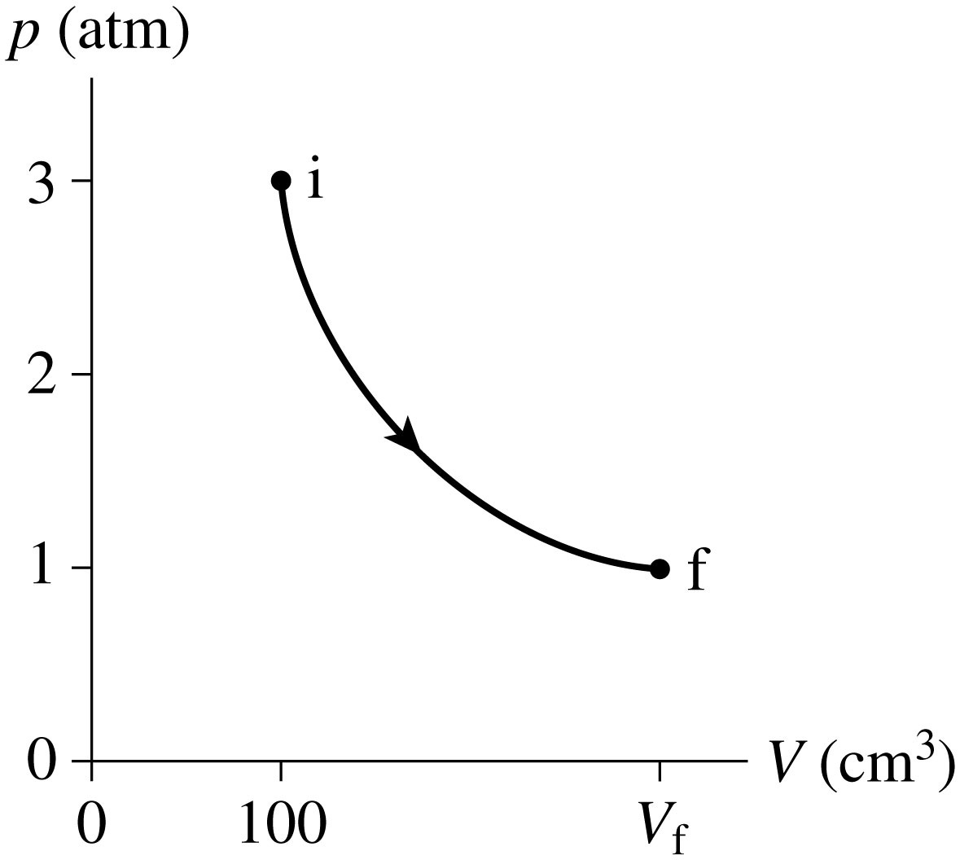
What is the work done ON the gas for this isotherm?
Notes:
FIGURE P12.26

Slide 49
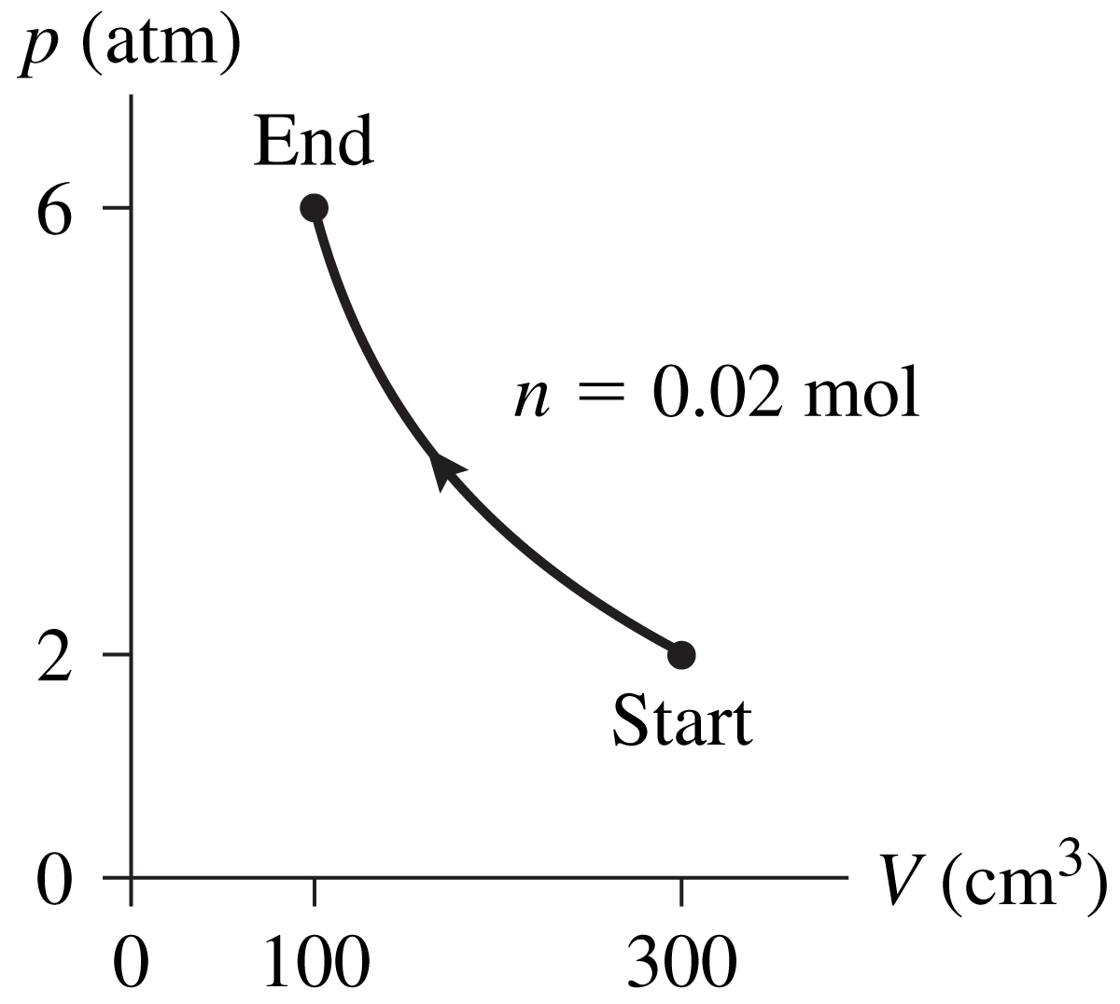
Checking Understanding: Gas-Law Processes
A sample of gas is in a cylinder with a moveable piston. The force on the piston can be varied, altering the pressure and volume. A sample of gas is taken from an initial state to a final state following a curve on a pV diagram at right. The final temperature is
  higher than the initial temperature.
  the same as the initial temperature.
  lower than the initial temperature.
Slide 12-35
Notes:
Answer: B

Slide 50
Answer
A sample of gas is in a cylinder with a moveable piston. The force on the piston can be varied, altering the pressure and volume. A sample of gas is taken from an initial state to a final state following a curve on a pV diagram at right. The final temperature is
  higher than the initial temperature.
  the same as the initial temperature.
  lower than the initial temperature.
Slide 12-36
Notes:
Answer: B

Slide 51
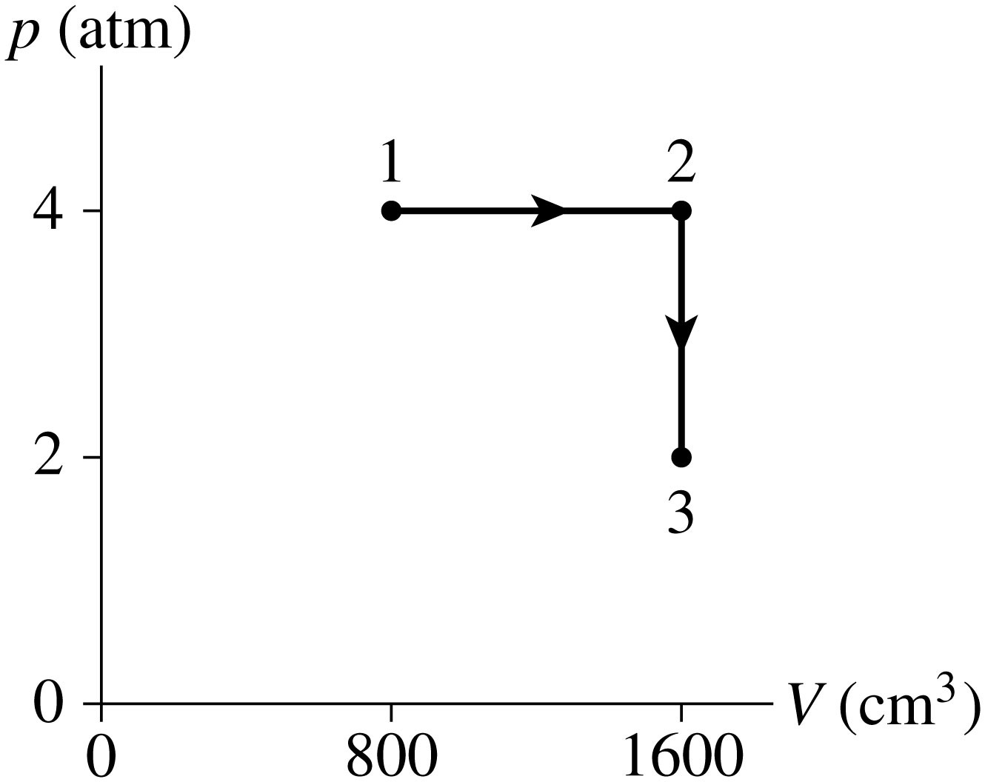
What is the work done BY the gas through 1-2-3?
Notes:
FIGURE P12.102

Slide 52
Example Problem
A child has been given a helium balloon. Ignoring repeated parental suggestions of tying it to his wrist, he lets it go so that it rapidly rises into the sky. As the balloon rises, it expands, because the pressure of the atmosphere decreases. Ignoring heat exchanges with the atmosphere (a good approximation if it rises quickly) what will happen to the temperature of the balloon? Will it increase, decrease, or stay the same? Explain.
If heat rises, why is cold on top of a mountain?
Slide 12-38

Slide 53
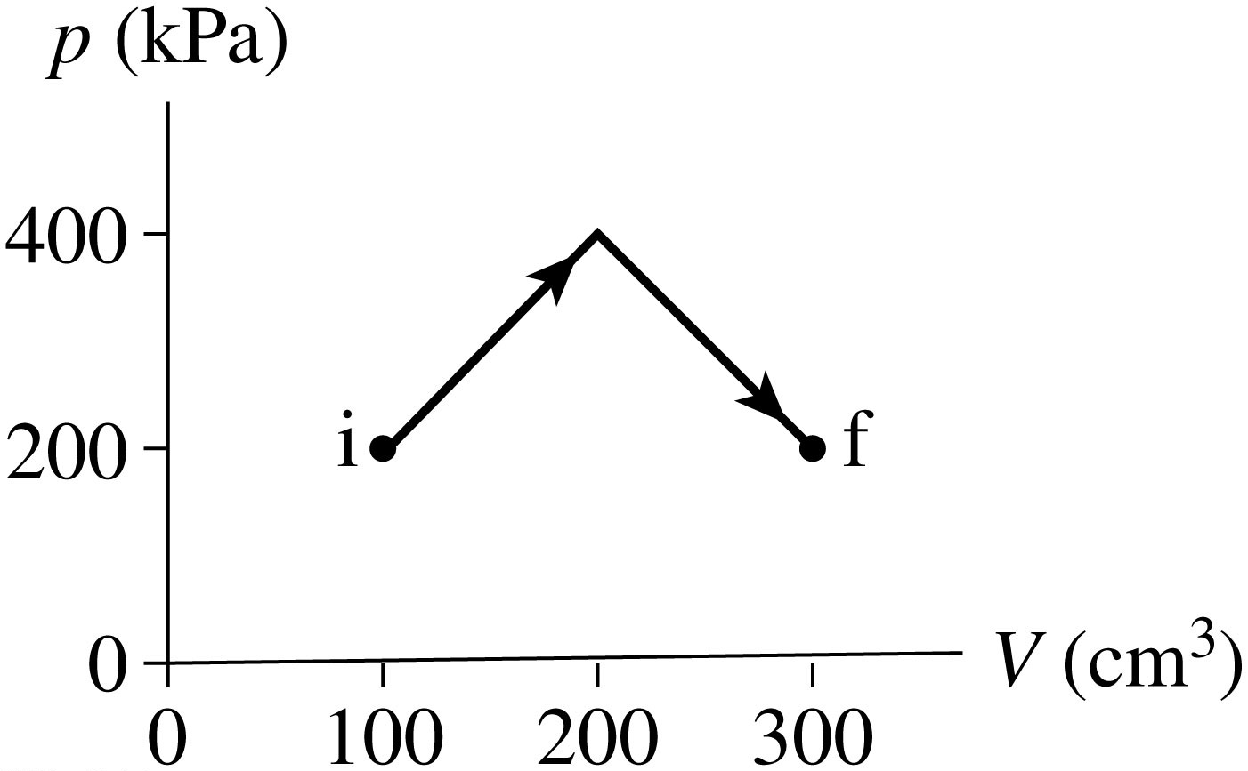
What is the work done BY the gas here?
Notes:
FIGURE P12.82

Slide 54
Example Problem
A child attending a carnival in a quaint seaside town has been given a spherical helium balloon that is 30 cm in diameter.
  How many moles of helium does the balloon contain?
  She “wants to keep the balloon fresh,” so she puts in the freezer, cooling it down from the hot 28°C outside temperature to a frosty –10°C. What will be the diameter of the balloon at this lower temperature?
Slide 12-39

Slide 55
Example Problem
Your lungs have a volume of approximately 4.0 L. While visiting the seaside on a chilly 10ºC day, you quickly take a deep breath, all your lungs can hold. The air quickly heats up to your body temperature of 37ºC. Assume that you hold the volume of your lungs constant, and that the number of molecules in your lungs stays constant as well. (For a short time, this is a good approximation. Oxygen molecules go out, carbon dioxide molecules go in, but the net flow is small.) What is the increase in pressure inside your lungs?
Slide 12-40

Slide 56
Example Problem
To blow up a rubber balloon, you need to provide a gauge pressure of about 2000 Pa. Suppose you inflate a spherical balloon from a diameter of 10 cm to a diameter of 30 cm. Assume normal atmospheric pressure at sea level.
  What is the change in volume of the balloon?
  How much work do you do in blowing up the balloon?
Slide 12-41

Slide 57
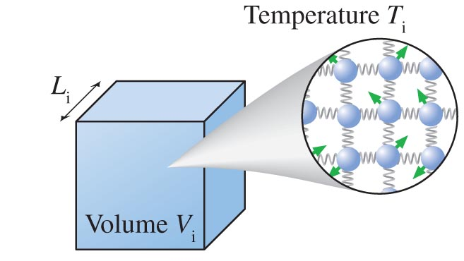
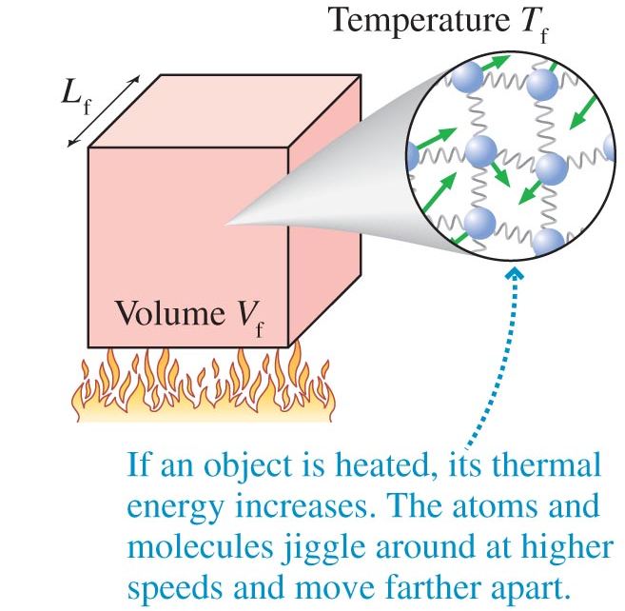
Temperature and Thermal Expansion
Slide 12-42

Slide 58
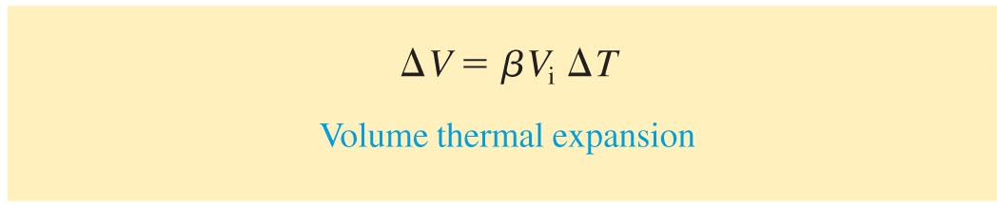
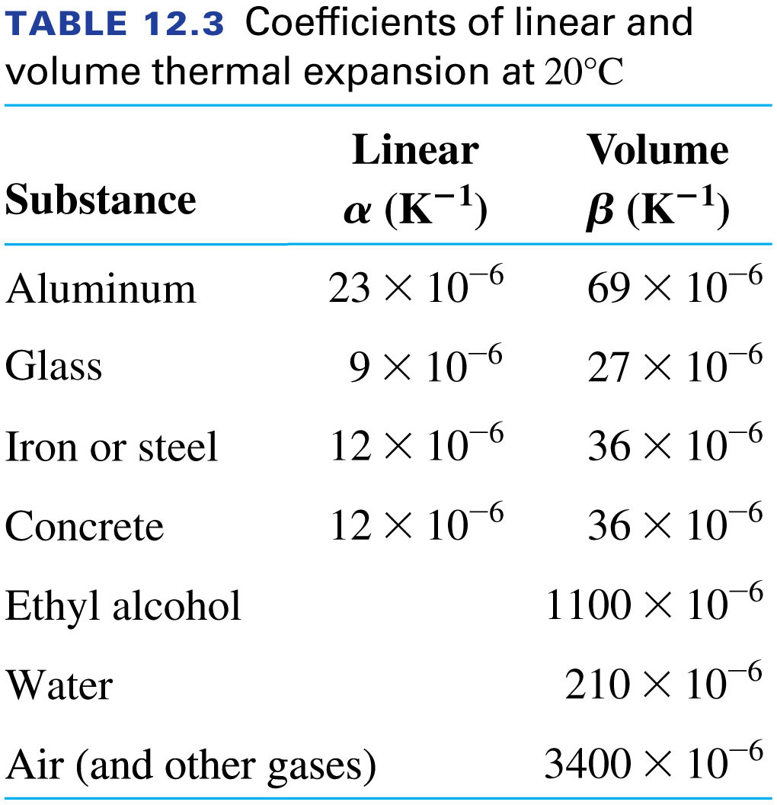

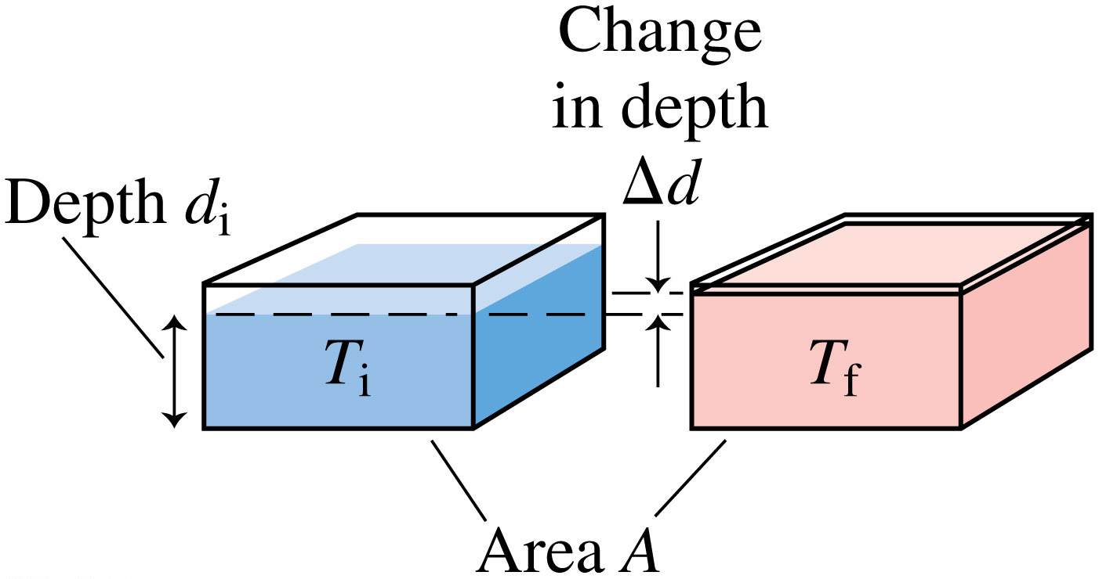
Equations
Slide 12-43

Slide 59
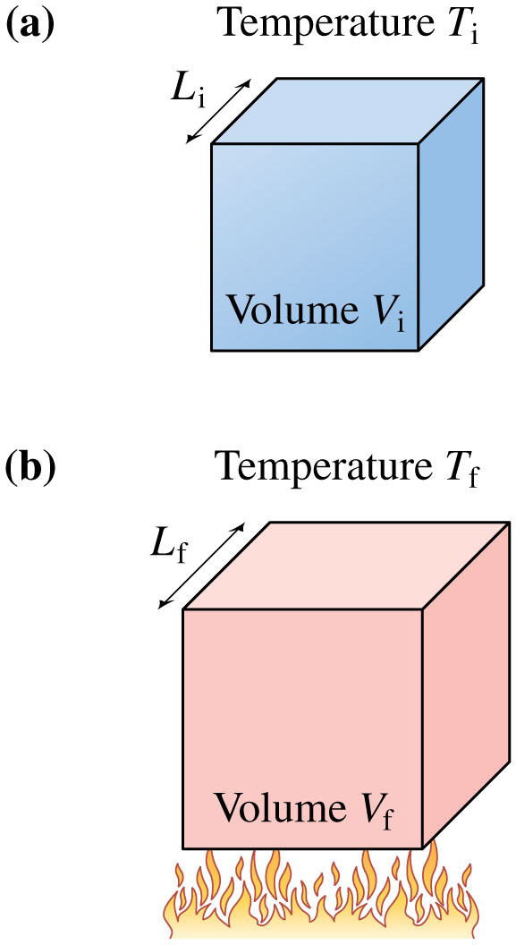

Notes:
FIGURE 12.19

Slide 60
Example Problem
In the United States, railroad cars ride on steel rails. Until the mid-1900s, most track consisted of 11.9 m lengths connected with expansion joints that allow for the rails to expand and contract with temperature. If a section of rail is exactly 11.900 m long on a hot, sunny day when it warms up to 50ºC, how long will it be on a cold −10ºC winter morning?
Slide 12-44

Slide 61



Specific Heat and Heat of Transformation
Adding heat energy will raise temperature; it may also change phase.
Slide 12-45

Slide 62

Calorimetry
Slide 12-46

Slide 63


What’s different?
Notes:
FIGURE 12.24

Slide 64
Example Problem
On a hot summer day, a cup of flavored shaved ice can be a welcome treat. Suppose you ignore the obvious “brain freeze” danger and eat an 8 oz (0.22 kg) cup of ice rather quickly. When it melts in your stomach, how much will this reduce your body temperature? How much heat is needed to melt this ice and warm it to your 37ºC body temperature?
Slide 12-47

Slide 65
Additional Questions
Which needs the most heat to bring to a final temperature of 50°C?
  100 g of iron at 0°C
  100 g of water at 0°C
  100 g of ice at 0°C
Slide 12-58
Notes:
Answer: C

Slide 66
Answer
Which needs the most heat to bring to a final temperature of 50°C?
  100 g of iron at 0°C
  100 g of water at 0°C
  100 g of ice at 0°C
Slide 12-59
Notes:
Answer: C

Slide 67
Example Problem
Jason, a 60 kg cyclist, is pedaling his bike at a good clip, using a total energy of 400 W. As he exercises, his body will start to warm up, and he will perspire to keep himself cool.
  Assuming Jason’s pedaling has a typical 25% efficiency, by how much would his body temperature rise during
  1.0 h of cycling if he had no means of exhausting excess thermal energy?
  Assume that the only means by which his body cools itself is evaporation. To keep his body temperature constant, what mass of water must be evaporated during a 1.0 h ride? What volume of water must he drink each hour to keep from becoming dehydrated? (1.0 kg of water has a volume of 1.0 L.)
Slide 12-48

Slide 68


What happens when you continually heat something up?
Notes:
FIGURE P12.95

Slide 69


What happens when you continually heat water up?
Notes:
FIGURE 12.22

Slide 70

Most materials contract when cooled, why is water an exception?
Notes:
FIGURE 12.21

Slide 71



Heat Transfer
Slide 12-49

Slide 72

Notes:
FIGURE 12.27

Slide 73

Example Problem
If you get a cup of coffee in a paper cup, you may be given a corrugated paper sleeve to put around it to make it comfortable to hold. Explain the purpose of the paper sleeve, and how it accomplishes this. Why is the paper sleeve corrugated?
AIR is a horrible conductor of heat
Slide 12-50

Slide 74
Example Problem
The temperature of the walls in a room is significant determinant of comfort; a quick calculation can show why. (The calculation is a bit artificial, but the point is clear.) A human has about 1.8 m² of skin. If a person is unclothed in dry air of 24°C, the skin will be about 33°C. Suppose this unclothed person is taking part in a study of thermal comfort. The air will be kept at 33°C, but the temperature of the room’s walls will be varied.
  Suppose the walls of the room are 24°C, the same as the air. What is the net loss of energy by radiation?
  Now suppose the walls are colder—10°C. (This would be quite cold to the touch.) What will be the net loss by radiation in this case?
Slide 12-51

Slide 75
Additional Example Problems
Suppose you are sitting, naked, on a steel bench with a temperature of 10°C. The only thing insulating the core of your body (temperature 37°C) is a layer of skin (the epidermis and dermis together are about 4 mm thick) and fat (varies from individual to individual, but a typical thickness on the buttocks and the back of the thighs might be 1.0 cm.) Estimate the rate of heat loss by conduction under this circumstance.
A typical hot tub contains about 1 m³ of water. Suppose the tub is filled with tap water at 10°C. If the tub has a 5500 W electric heater, how long must the heater run to heat the water to a final temperature of 40°C, ignoring any thermal losses? If electricity costs 10¢ per kilowatt-hour, how much will this energy cost?
Slide 12-60

