Slide 1
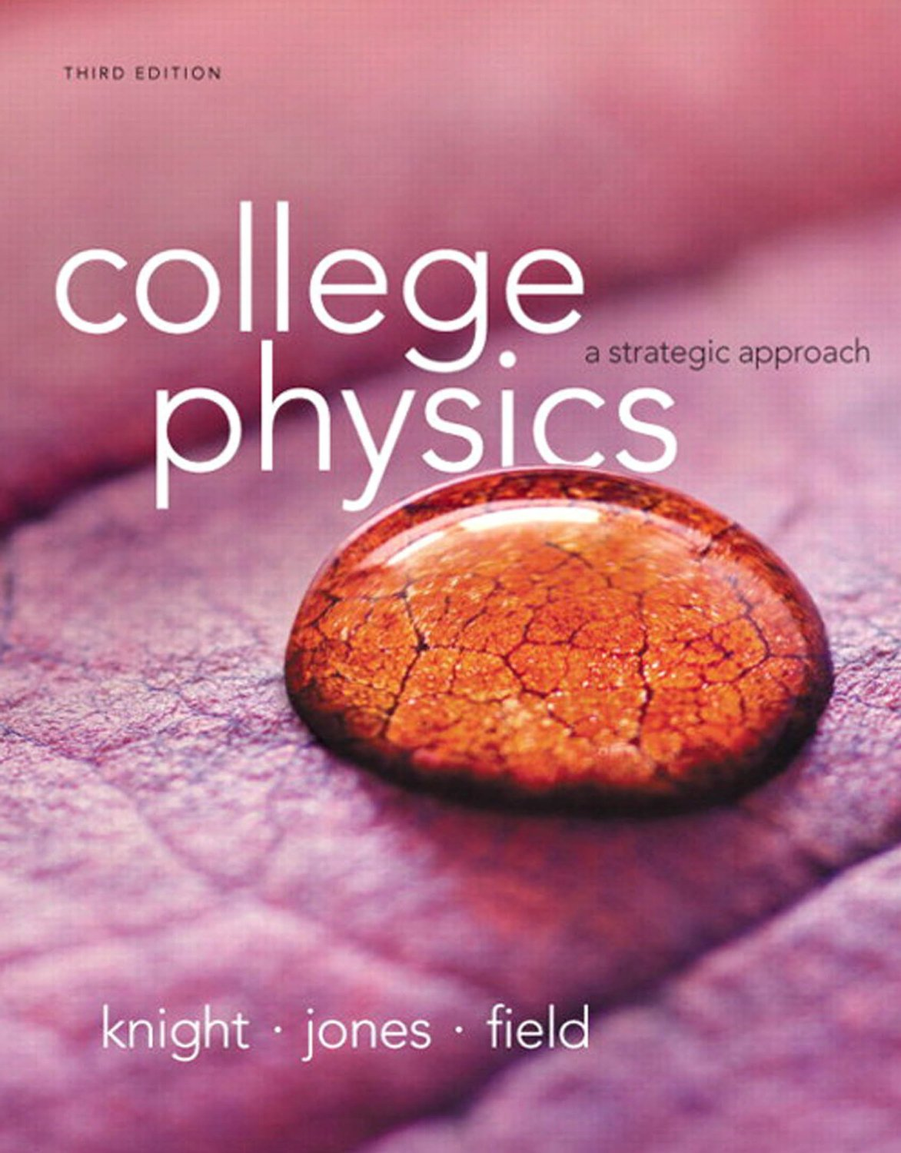
Chapter 10
Energy and Work

Slide 2
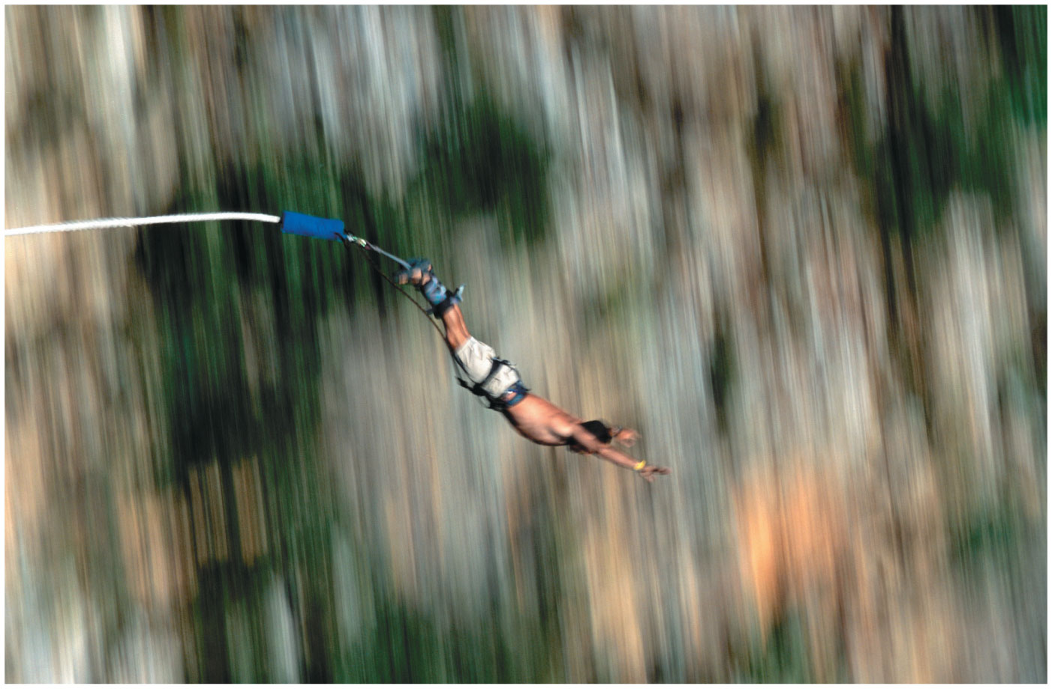
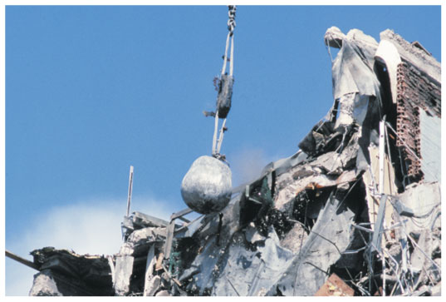
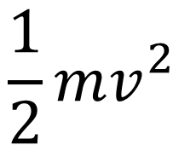
$$\frac{1}{2}mv_{}^{2}$$
As this guy falls he gains kinetic energy, the energy of motion.
Where does it come from???
Notes:
Chapter 10 Opener 1

Slide 3
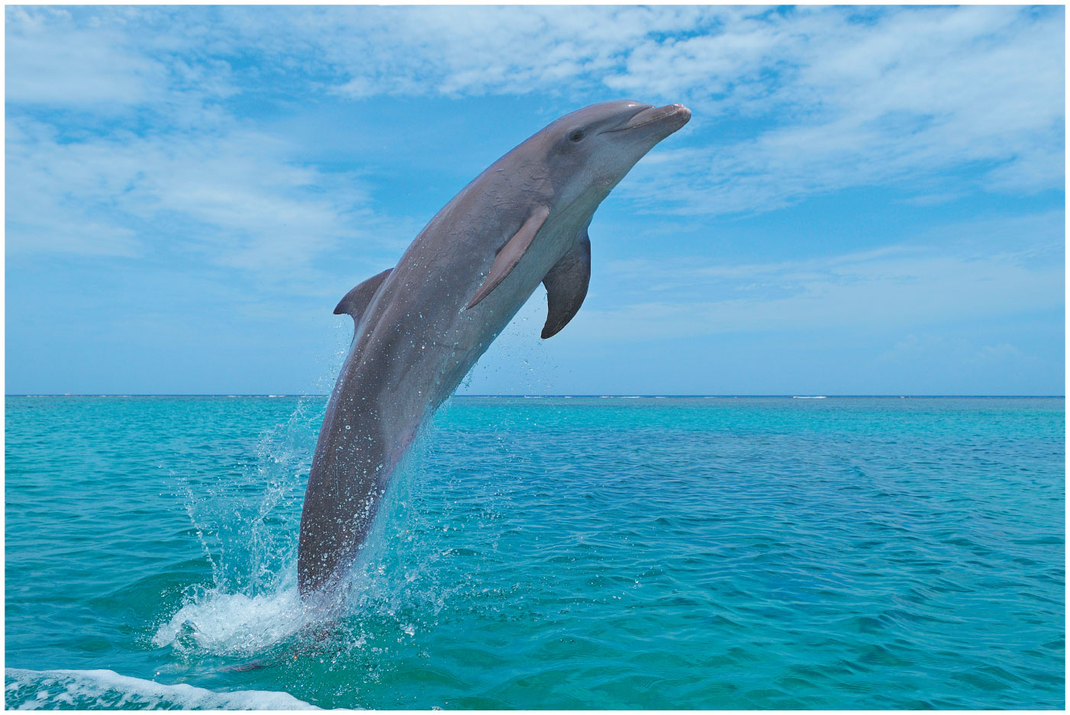
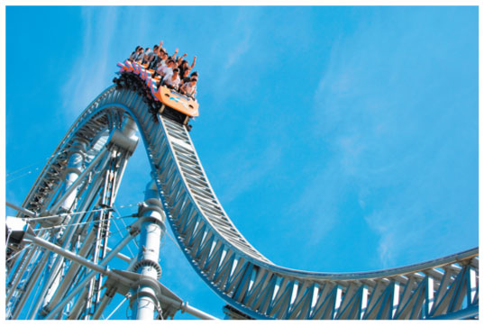

At the top of this guy’s jump out of the water he has zero kinetic energy
Where did it go???
$$mgh$$
Notes:
Chapter 10 Opener 2

Slide 4
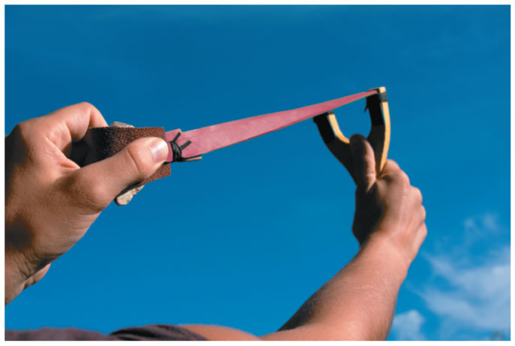
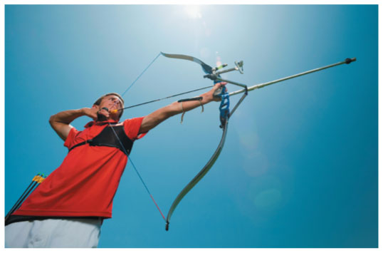

What’s doing the work here?
$$W=F∙d$$
Notes:
Chapter 10 Opener 3

Slide 5
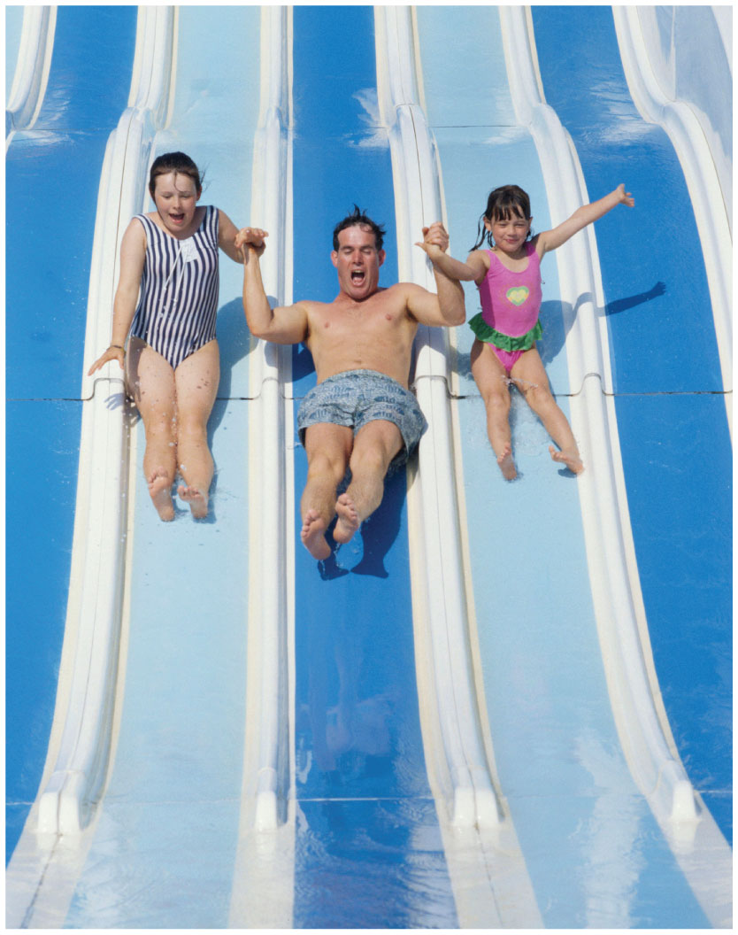
What does it mean to conserve a quantity like momentum or energy?
None is gained or lost in a process
Notes:
Chapter 10 Opener 4

Slide 6
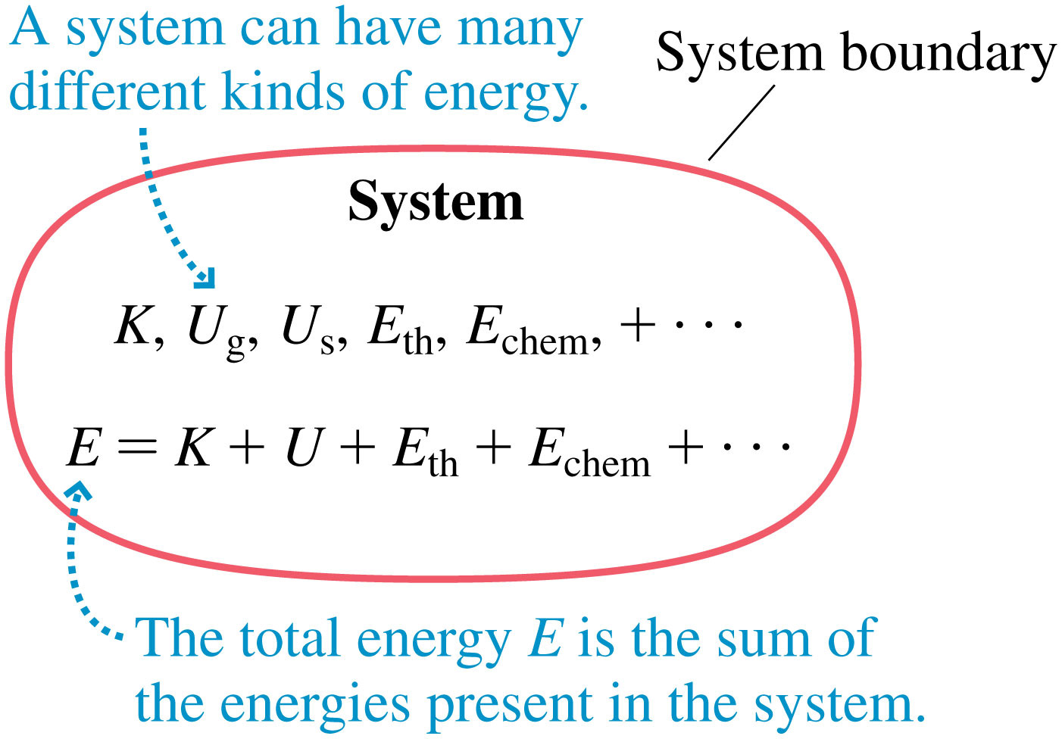
We care about “Closed Systems”
Also called “Isolated Systems”
Notes:
FIGURE 10.1

Slide 7
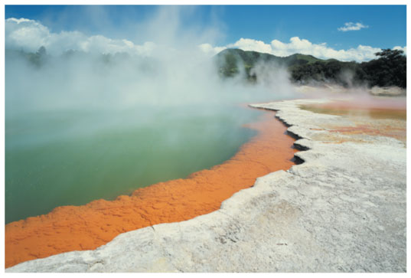
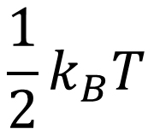
Thermal energy
$$\frac{1}{2}k_{B}T$$
Notes:
Chapter 10 Unnumbered Figure 1, Page 285

Slide 8
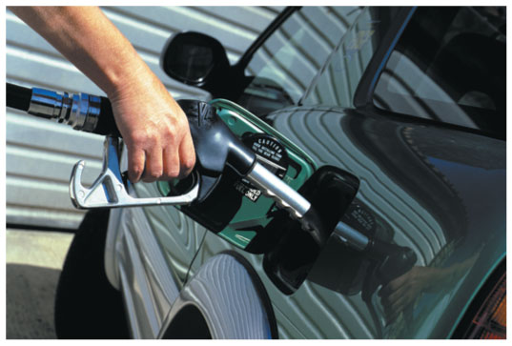

Chemical potential energy
$$H−TS$$
Notes:
Chapter 10 Unnumbered Figure 2, Page 285

Slide 9
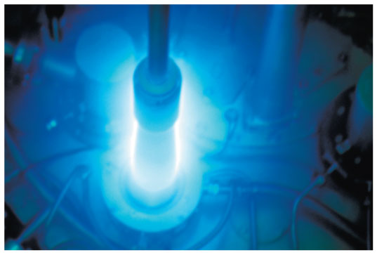
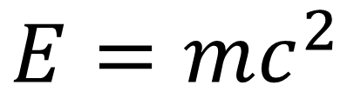
Nuclear energy
$$E=mc^{2}$$
Notes:
Chapter 10 Unnumbered Figure 3, Page 285

Slide 10
Energy can change form

Slide 11
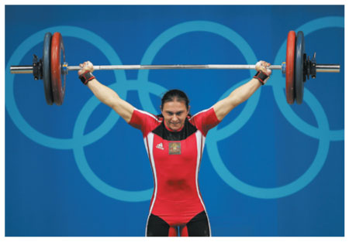

Chemical to Gravitational
$$H−TS→mgh$$
Notes:
Chapter 10 Unnumbered Figure 4, Page 285

Slide 12
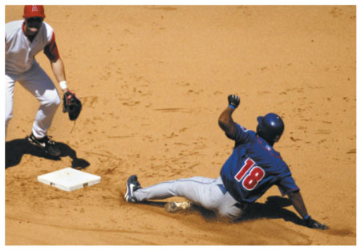
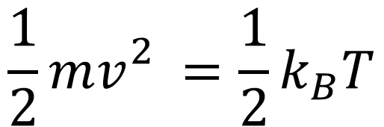
Kinetic to Thermal
$$\frac{1}{2}mv_{}^{2}=\frac{1}{2}k_{B}T$$
Notes:
Chapter 10 Unnumbered Figure 5, Page 285

Slide 13
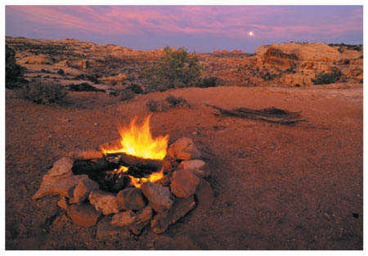
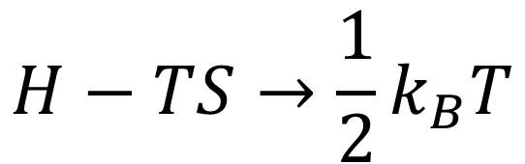
Chemical to Thermal
$$H−TS→\frac{1}{2}k_{B}T$$
Notes:
Chapter 10 Unnumbered Figure 6, Page 285

Slide 14
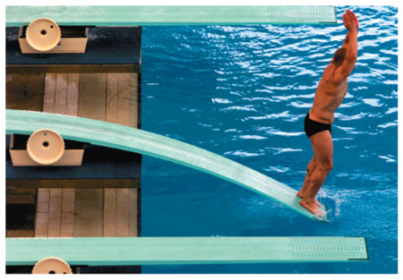
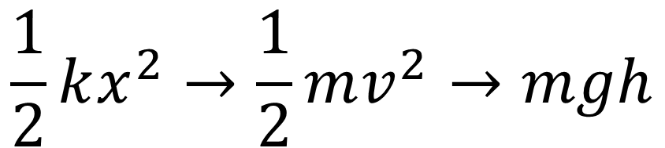
Spring – Kinetic – Gravitational
$$\frac{1}{2}kx^{2}→\frac{1}{2}mv^{2}→mgh$$
Notes:
Chapter 10 Unnumbered Figure 7, Page 285

Slide 15
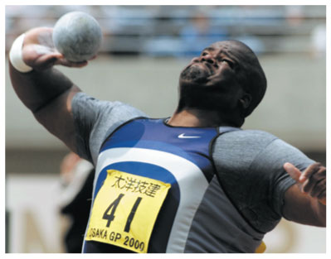

Work($F∙d$) –> Kinetic
Notes:
Chapter 10 Unnumbered Figure 1, Page 286

Slide 16
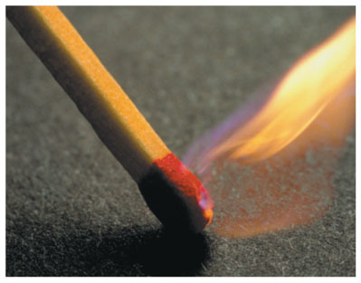

Work($F∙d$) – Thermal
Chemical?
Notes:
Chapter 10 Unnumbered Figure 2, Page 286

Slide 17
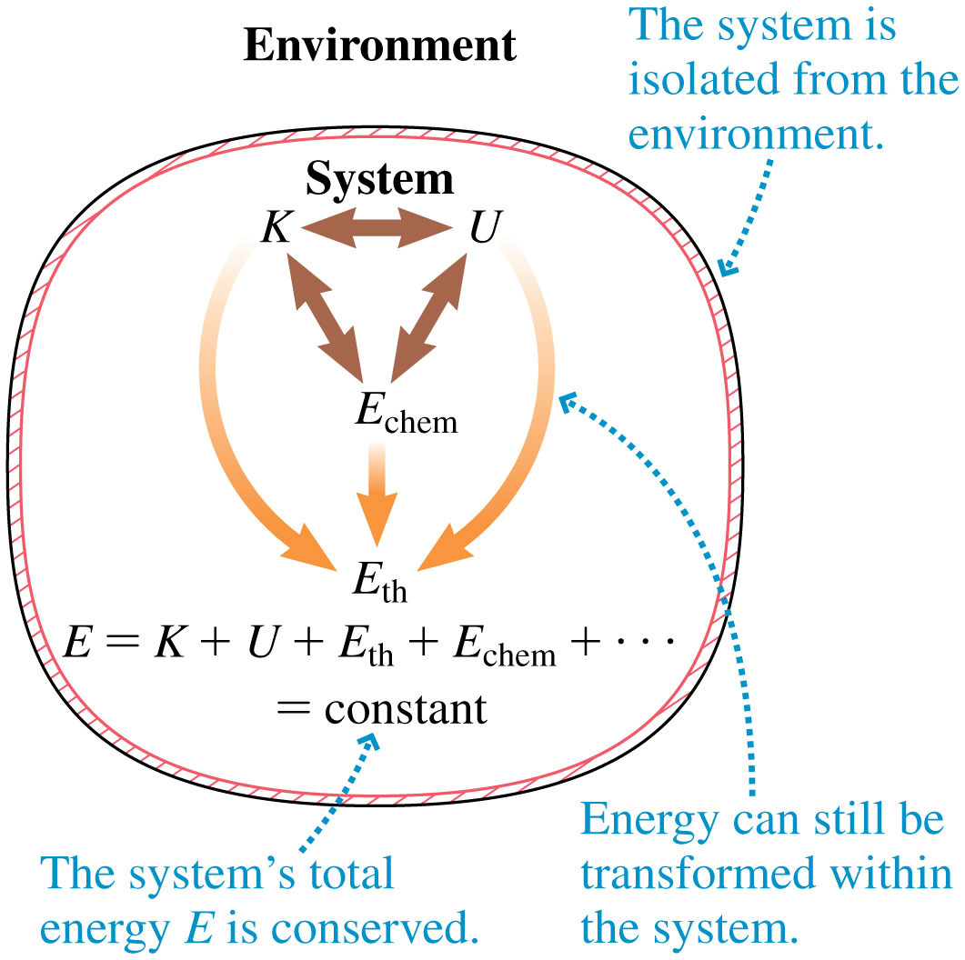
In isolated systems, energy is always conserved!
Notes:
FIGURE 10.4

Slide 18
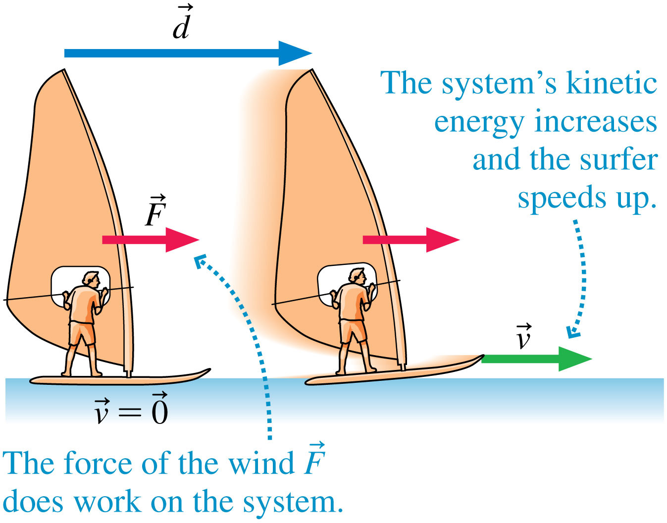
Work = Force x Distance
Notes:
FIGURE 10.5

Slide 19
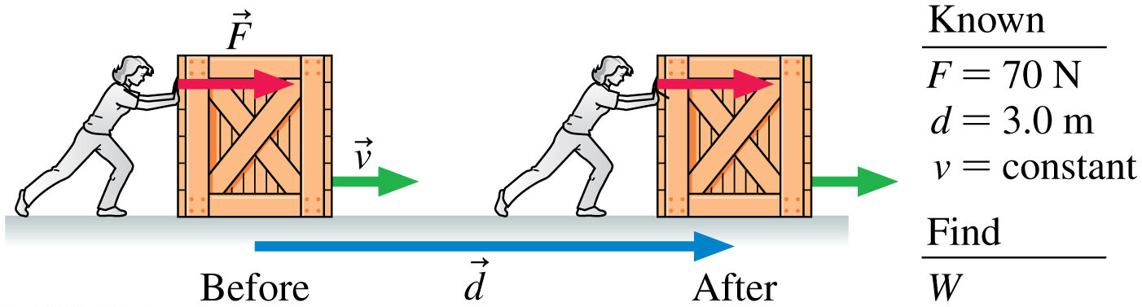
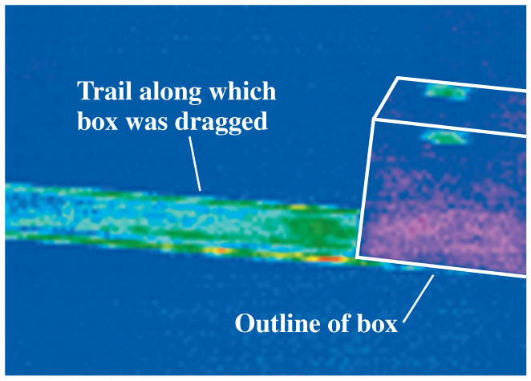
Quiz question 1
Notes:
FIGURE 10.6

Slide 20
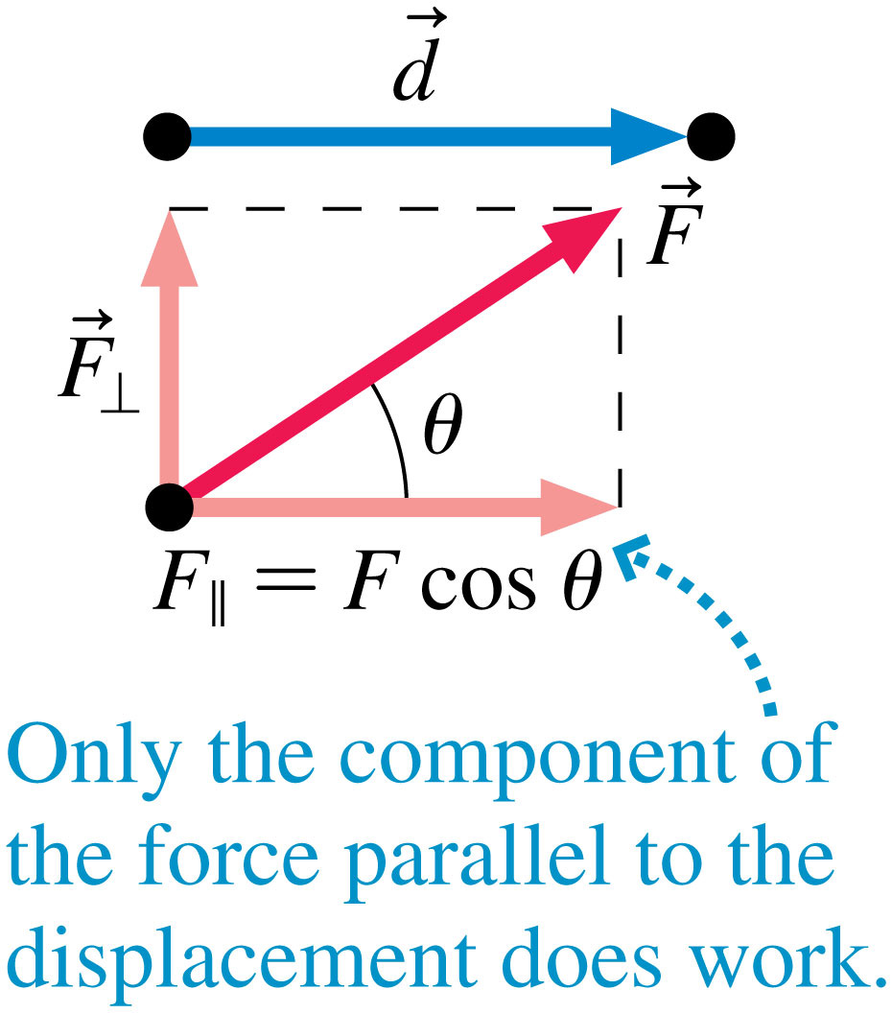
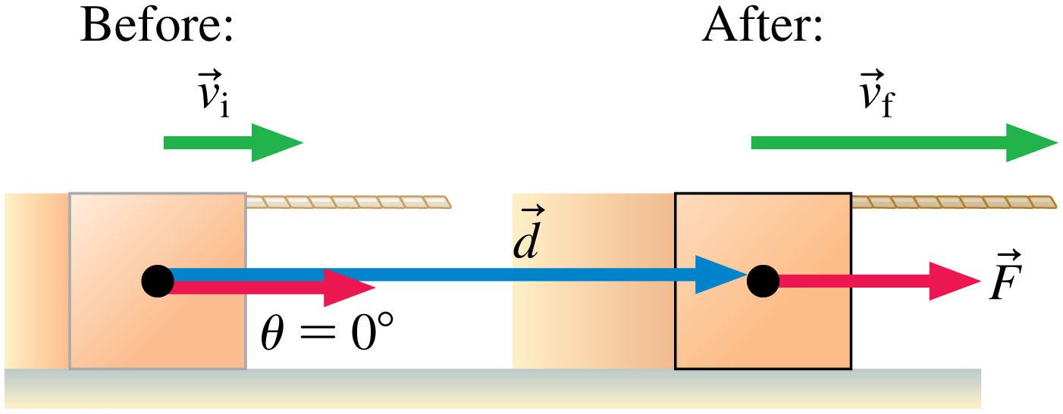
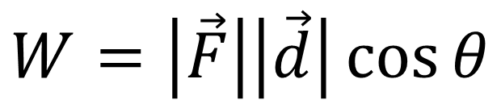
More precise definition of work:
$$W=\left|\vec{F}\right|\left|\vec{d}\right|\cos{θ}$$
Notes:
TACTICS BOX 10.1A

Slide 21
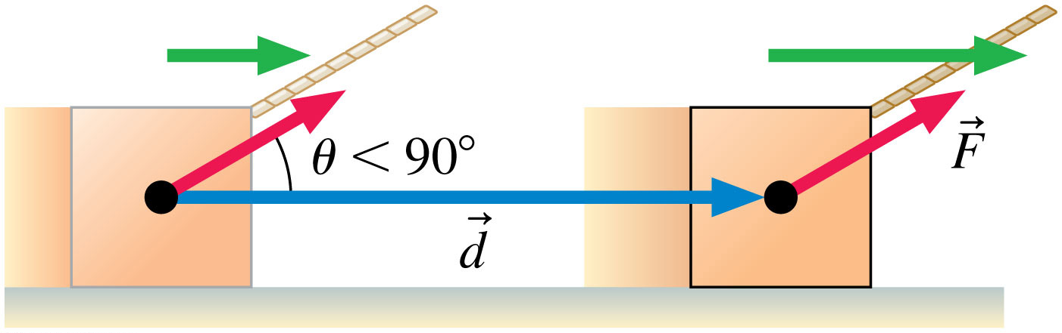
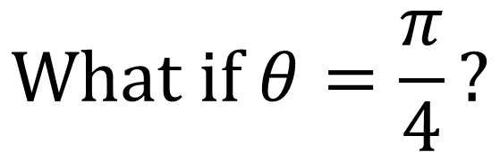
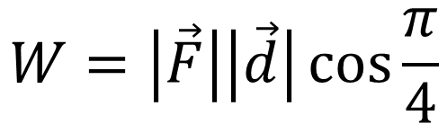
$$\text{What} \text{if} θ=\frac{π}{4}?$$
It is the opposite of torque, the cosine function essentially asks “how parallel are these two vectors?”
$$W=\left|\vec{F}\right|\left|\vec{d}\right|\cos{\frac{π}{4}}$$
Notes:
TACTICS BOX 10.1B

Slide 22
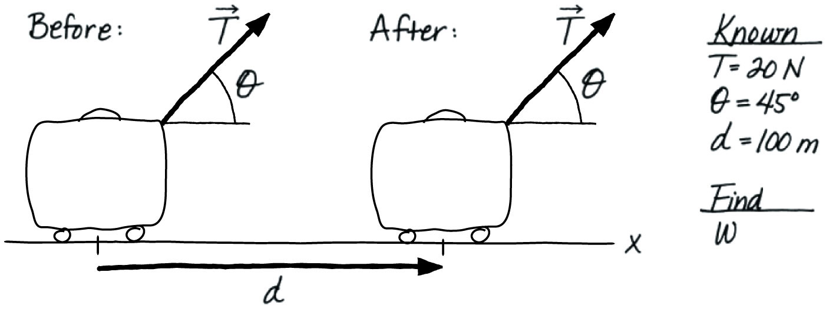
Quiz question 2
Notes:
FIGURE 10.8

Slide 23
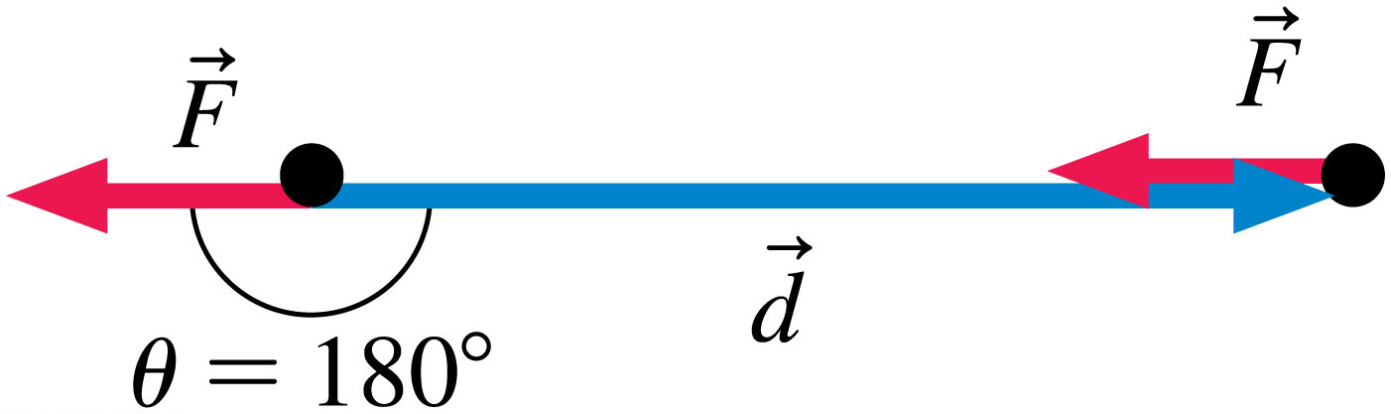
Positive work or negative work?
If the force vector is in the opposite direction of the displacement vector then the work done by that force is negative
Notes:
FIGURE 10.9

Slide 24
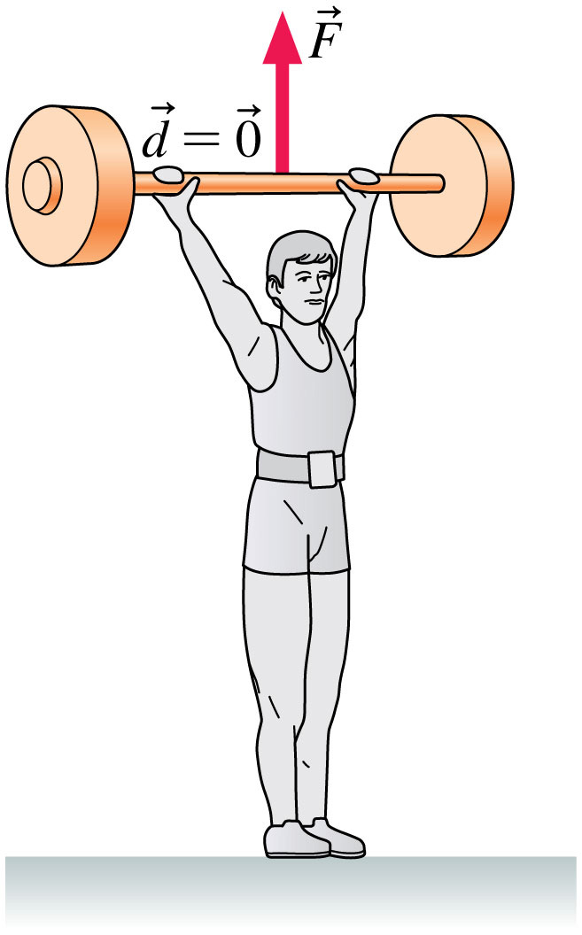
Quiz question 3
When he drops the weight, will the work gravity does on the weight as it falls be positive or negative?
Notes:
Chapter 10 Unnumbered Figure 2, Page 291

Slide 25
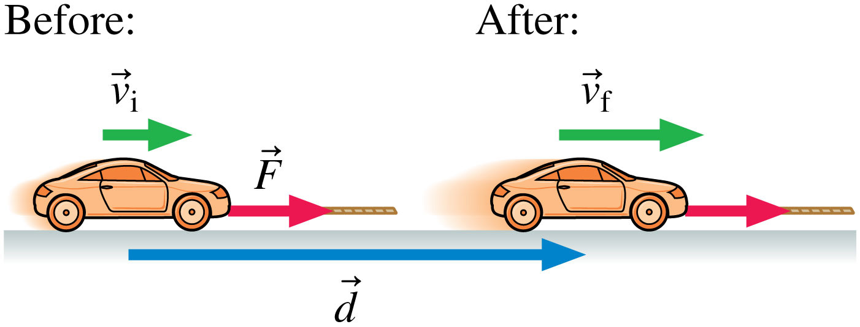
Is the work that rolling friction is doing on the car positive or negative?
negative
Notes:
FIGURE 10.10

Slide 26
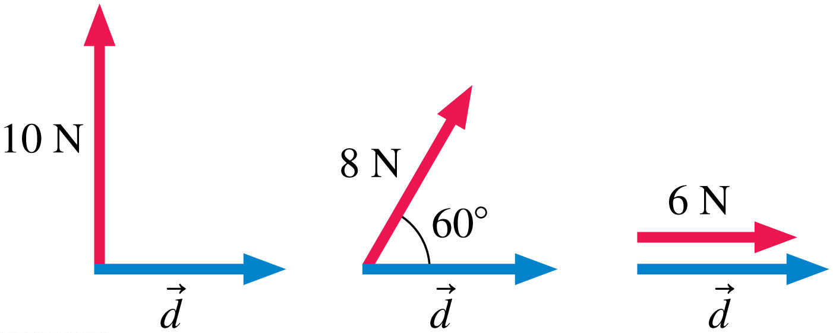
Quiz question 4
Which of the three vector combinations will produce the least amount of work?
Notes:
STOP TO THINK BOX 10.2

Slide 27
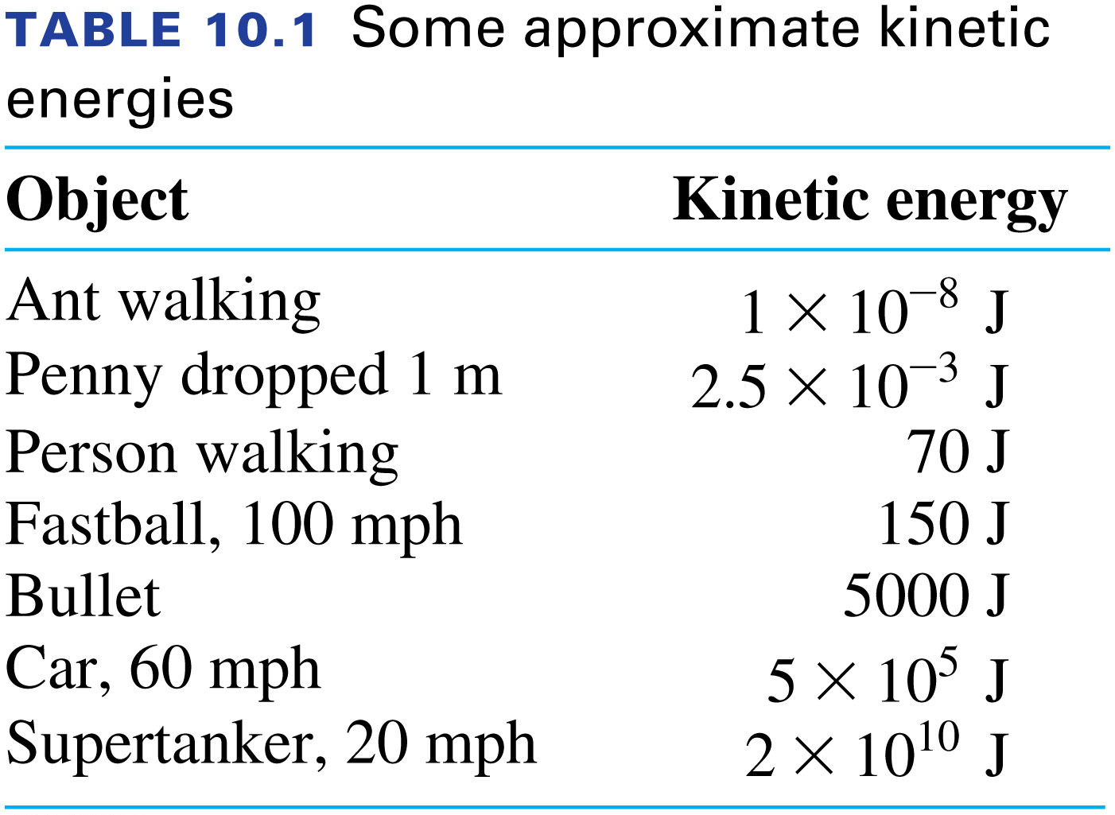
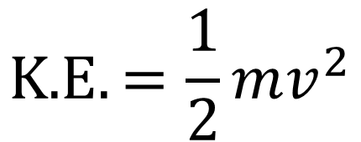
What about energy of motion?
$$\text{K}\text{.}\text{E}.=\frac{1}{2}mv^{2}$$
Notes:
TABLE 10.1

Slide 28
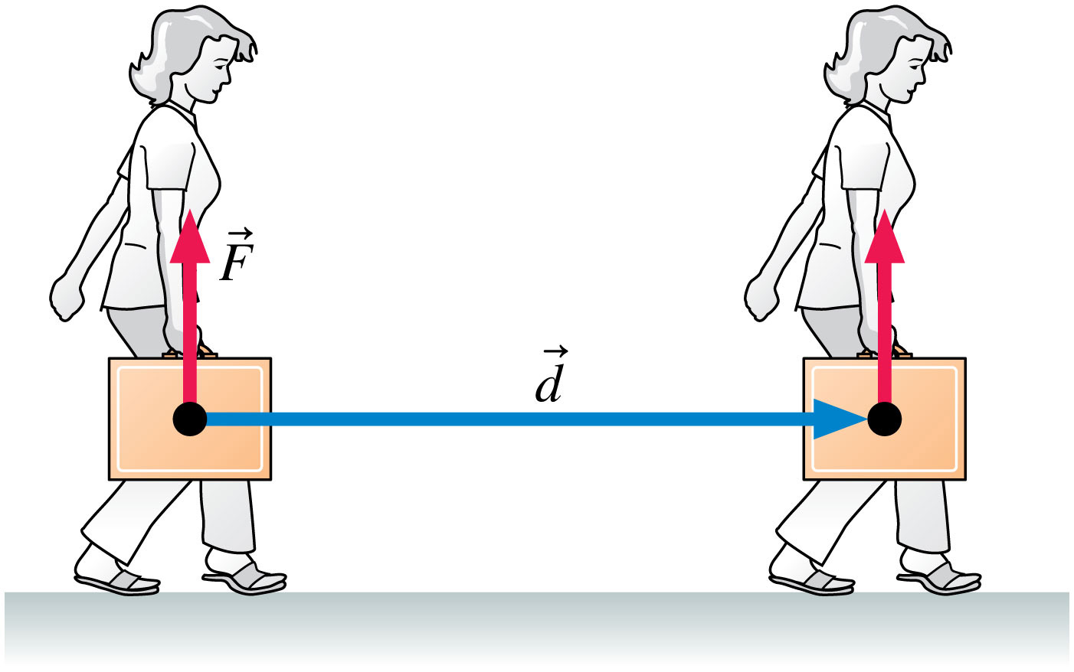
Quiz question 5
Is the work this girl is doing while carrying this box across the room positive or negative?
Notes:
Chapter 10 Unnumbered Figure 3, Page 291

Slide 29
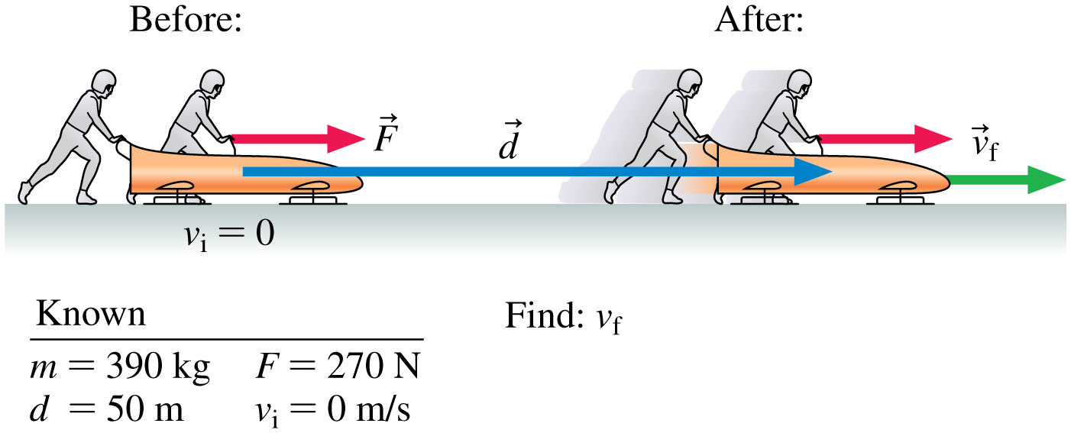
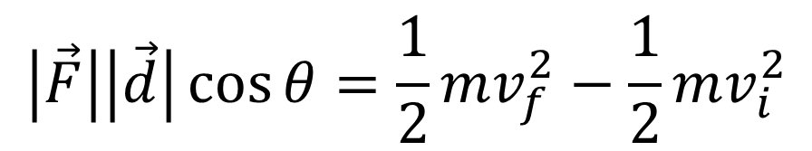

Work-Energy Theorem
$$W=∆\text{K}\text{.}\text{E}.$$
$$\left|\vec{F}\right|\left|\vec{d}\right|\cos{θ}=\frac{1}{2}mv_{f}^{2}−\frac{1}{2}mv_{i}^{2}$$
For example:
100 m
Notes:
FIGURE 10.11

Slide 30
Quiz question 6
Notes:
FIGURE 10.12

Slide 31
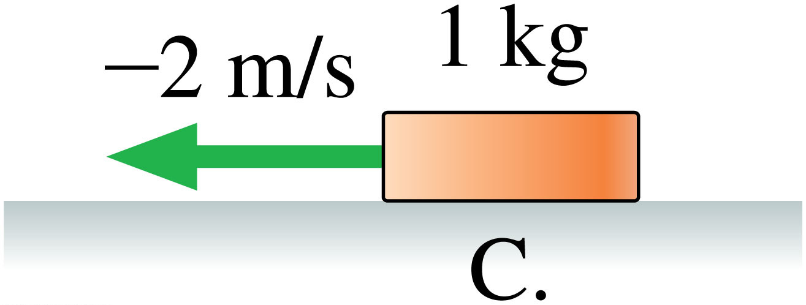
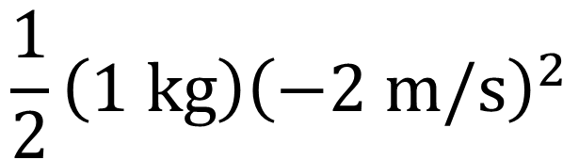
Kinetic energy is NOT A VECTOR
$$\frac{1}{2}\left(1 \text{kg}\right){\left(−2 \text{m}\text{/}\text{s}\right)}^{2}$$
It’s a scalar:
It has no direction
Notes:
STOP TO THINK BOX 10.3C

Slide 32
Quiz question 7
Which of the following pucks has the greatest kinetic energy?
Notes:
STOP TO THINK BOX 10.3

Slide 33
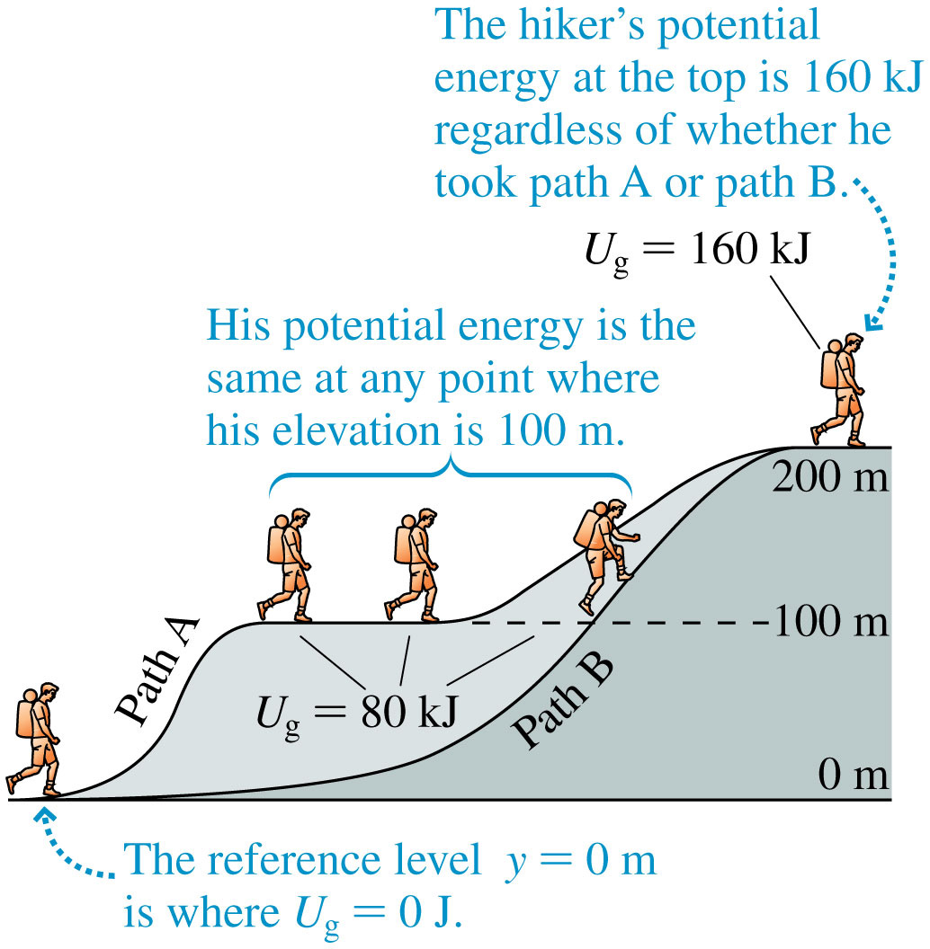
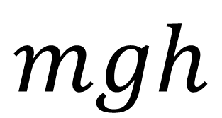
Gravitational Potential Energy
$$mgh$$
Notes:
FIGURE 10.15

Slide 34
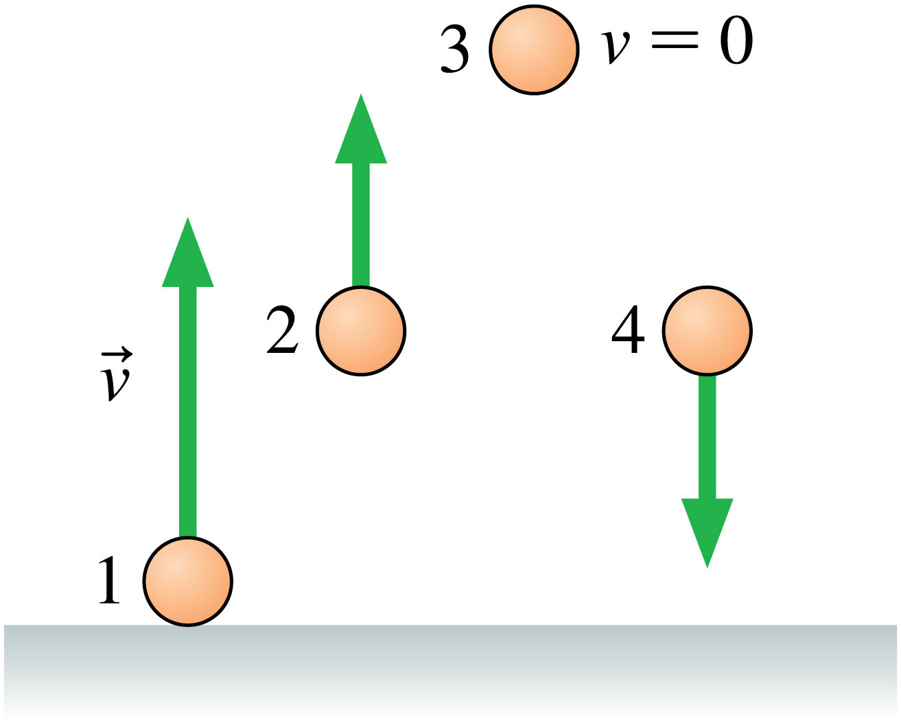
Compare the Energies of these peaches
Notes:
STOP TO THINK BOX 10.4

Slide 35
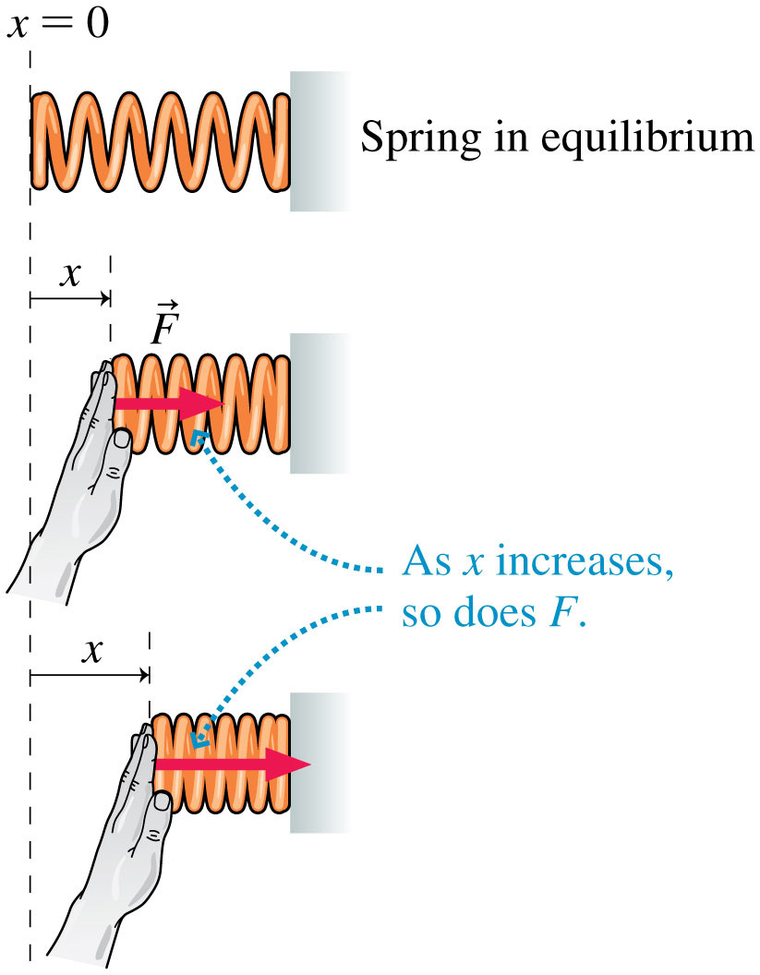

Spring Potential Energy
$$\frac{1}{2}kx^{2}$$
If this spring has a spring constant of 1000 N/m how hard would you have to push to move it 3 cm?
How many joules of energy are in the spring when it’s compressed by 3cm?
Notes:
FIGURE 10.16

Slide 36

Spring Potential Energy
What would be the spring constant of the average person’s Achilles tendon?
Notes:
Chapter 10 Unnumbered Figure, Page 297

Slide 37

Quiz question 8
Notes:
FIGURE 10.21

Slide 38

Quiz question 9
Notes:
FIGURE 10.22

Slide 39

Quiz question 10
Notes:
FIGURE 10.23

Slide 40

Quiz question 11
Notes:
FIGURE 10.25

Slide 41

Quiz question 12
Which of the following hills will give the frictionless sliding figure person the most kinetic energy at the bottom?
Notes:
STOP TO THINK BOX 10.7

Slide 42

Quiz question 13
Notes:
FIGURE 10.30

Slide 43

Notes:
Chapter 10 Unnumbered Figure, Page 309

Slide 44

Notes:
FIGURE 10.31

Slide 45

Notes:
Chapter Summary 2

Slide 46

Notes:
Chapter Summary 4

Slide 47


Power is energy per time
Notes:
Chapter Summary 5

Slide 48

Quiz question 14
Which block will reach the ground first?
Notes:
FIGURE Q10.20

Slide 49

Quiz question 15
What is this girl’s change in height?
Notes:
FIGURE P10.58

Slide 50

Quiz question 16
How far did you have to push this box to get it up the hill?
Notes:
FIGURE P10.59

Slide 51

Quiz question 17
How fast will this girl have to run to be able to make it across?
Notes:
FIGURE P10.66

Slide 52


Quiz question 18
A girl slides down a ramp with friction $μ_{k}=.25$, that is 5 m long. How far in does she compress the spring at the bottom?
frictionless
Notes:
FIGURE P10.68

